Slide 1

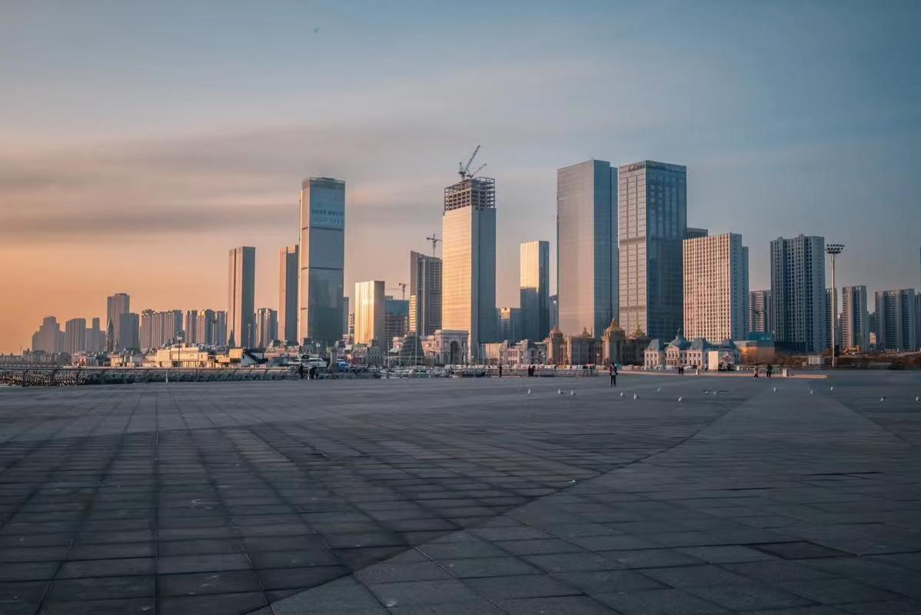
My Travel in Dalian
Made in China
Made of Sarah

Slide 2









Preparation before going.
.
Xinghai Square
Water City
Zoo

Slide 3
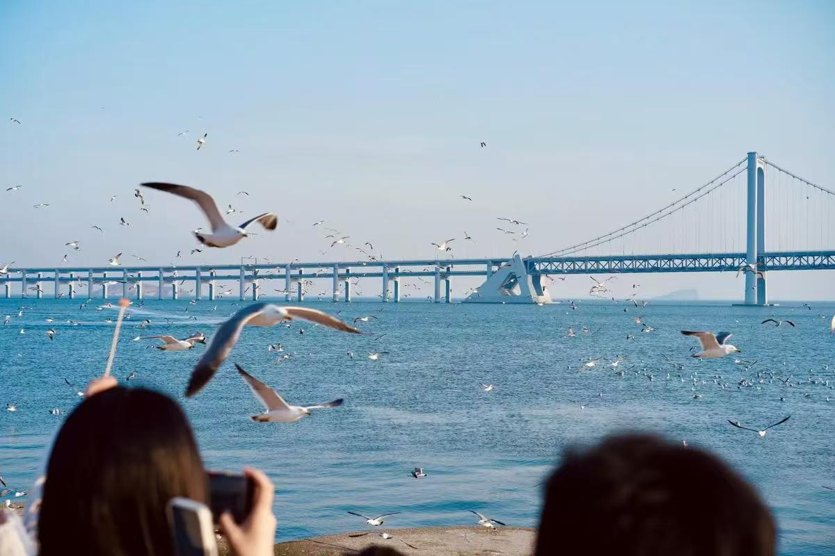
Xinghai Square
.

