Slide 1
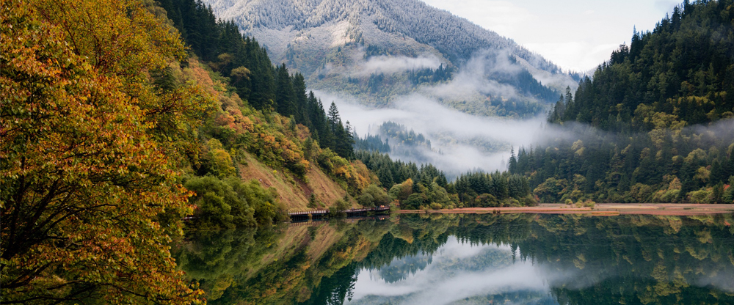
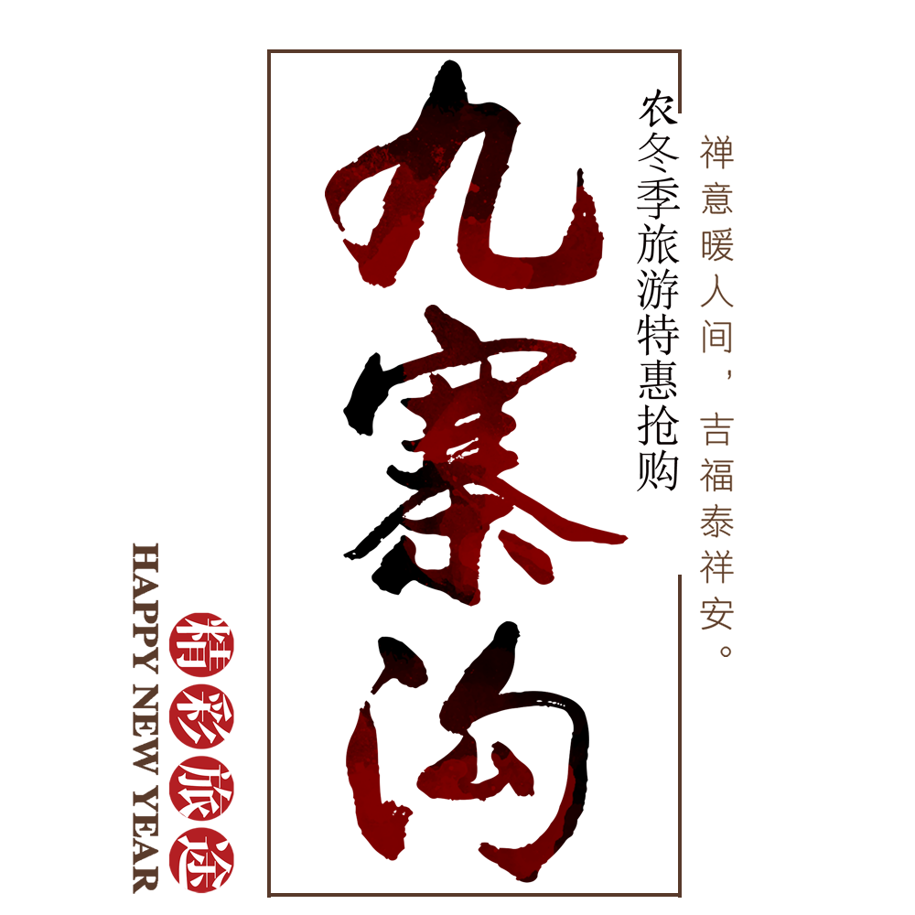
jiuzhaigou

Slide 2
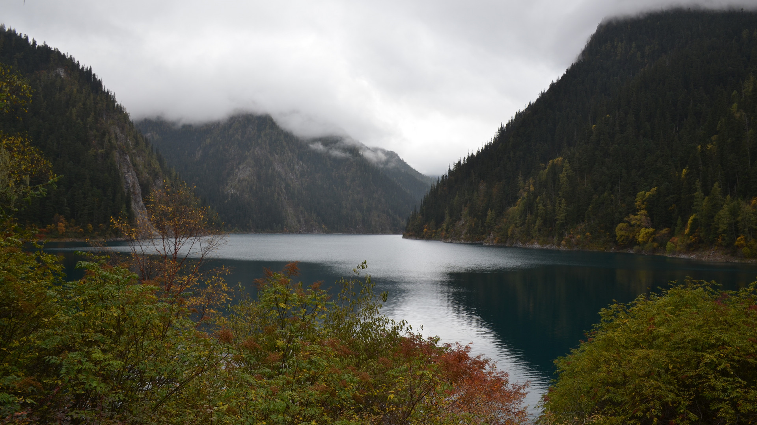
The history of Jiuzhaigou

Slide 3
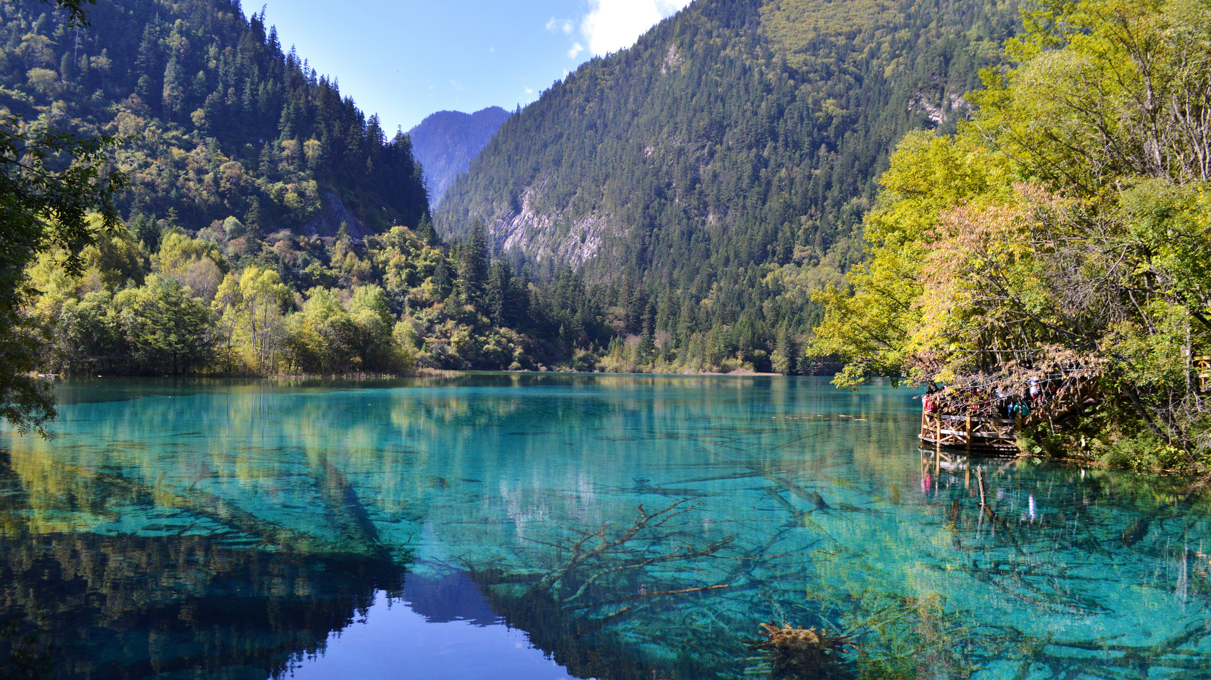
Jiuzhaigou is located in Zhangzha Town, Jiuzhaigou County, Sichuan Province. It is a branch of the Baihe River upstream of the Baigou River. It is named after the nine Tibetan villages (also known as Heyao Jiuzhai). At an altitude of more than 2000 meters, Jiuzhaigou is covered with virgin forests and 108 lakes are distributed in the valley.

Slide 4

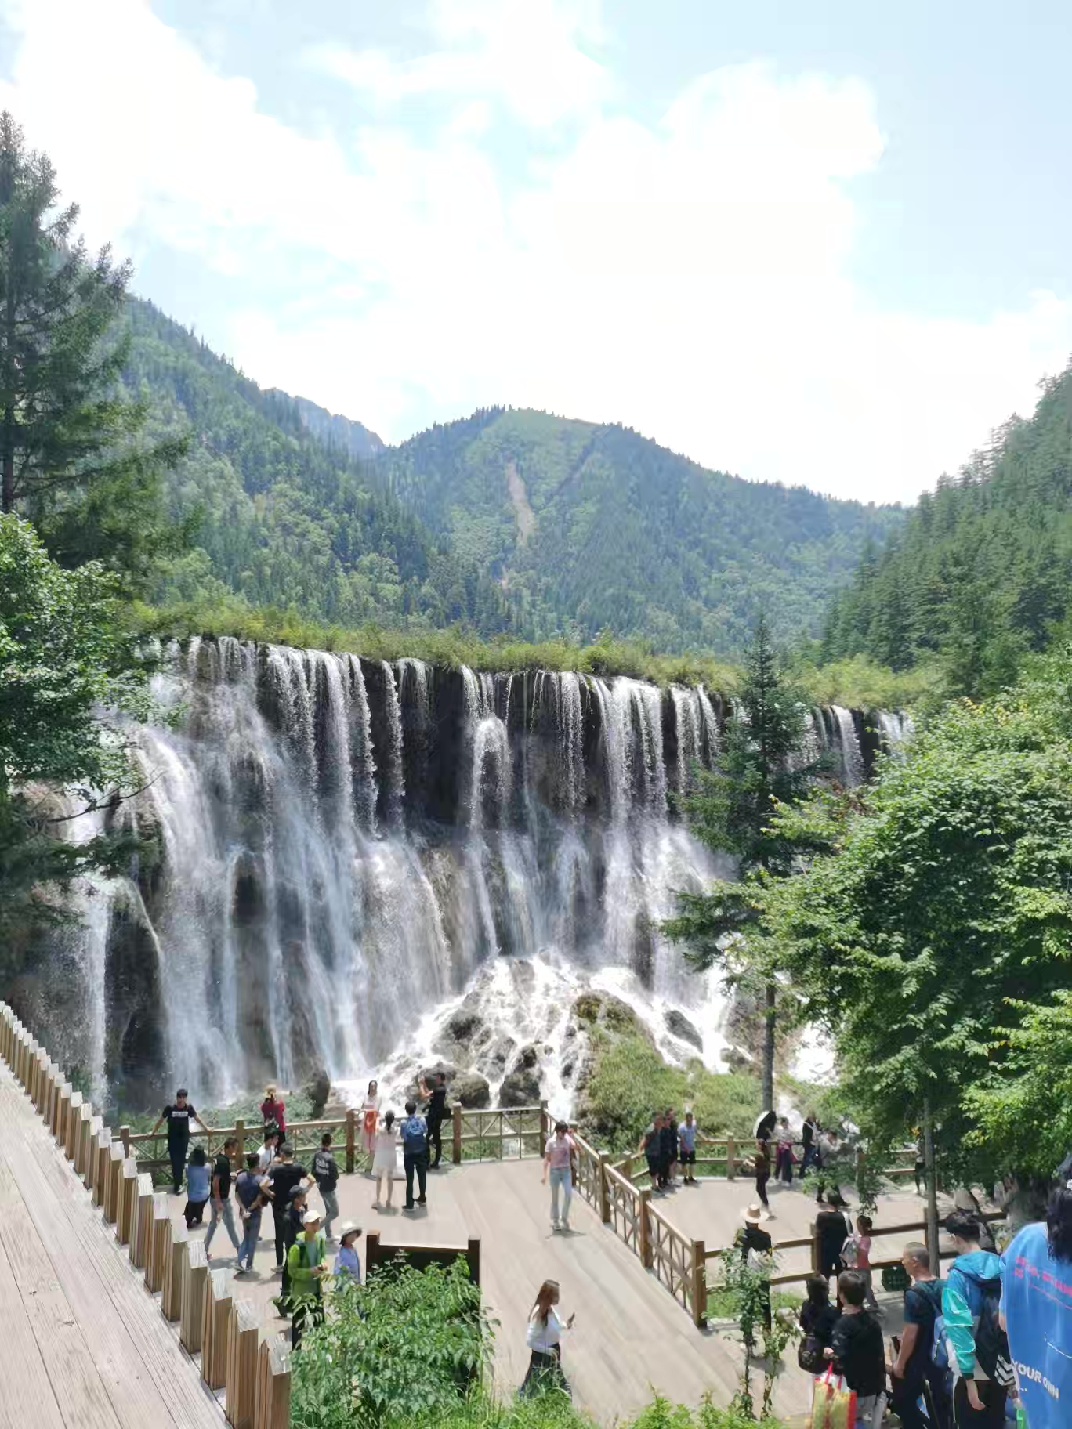
The Jiuzhaigou Valley is charming in all seasons. Rich in animal and plant resources, a wide variety of primitive forests, habitat of more than 10 kinds of rare and precious wild animals such as giant pandas. Known as the "beautiful fairy tale world"。

Slide 5
The scenery of Jiuzhaigou Valley

Slide 6


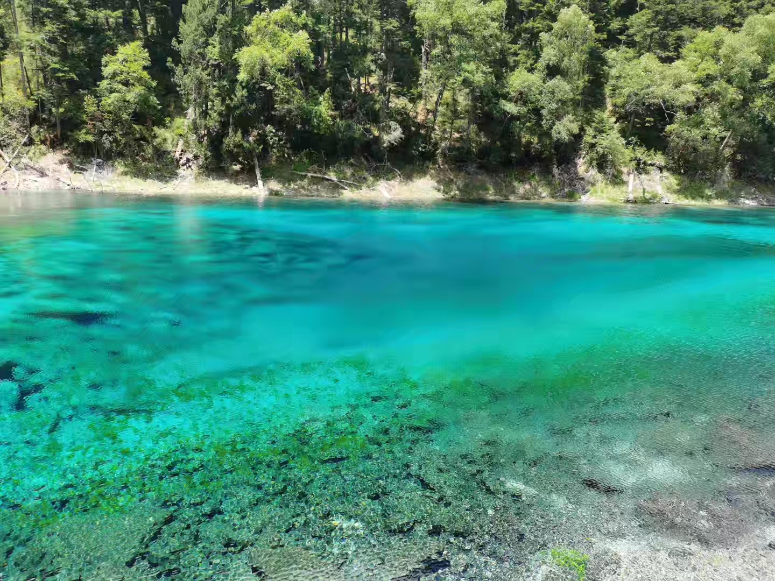
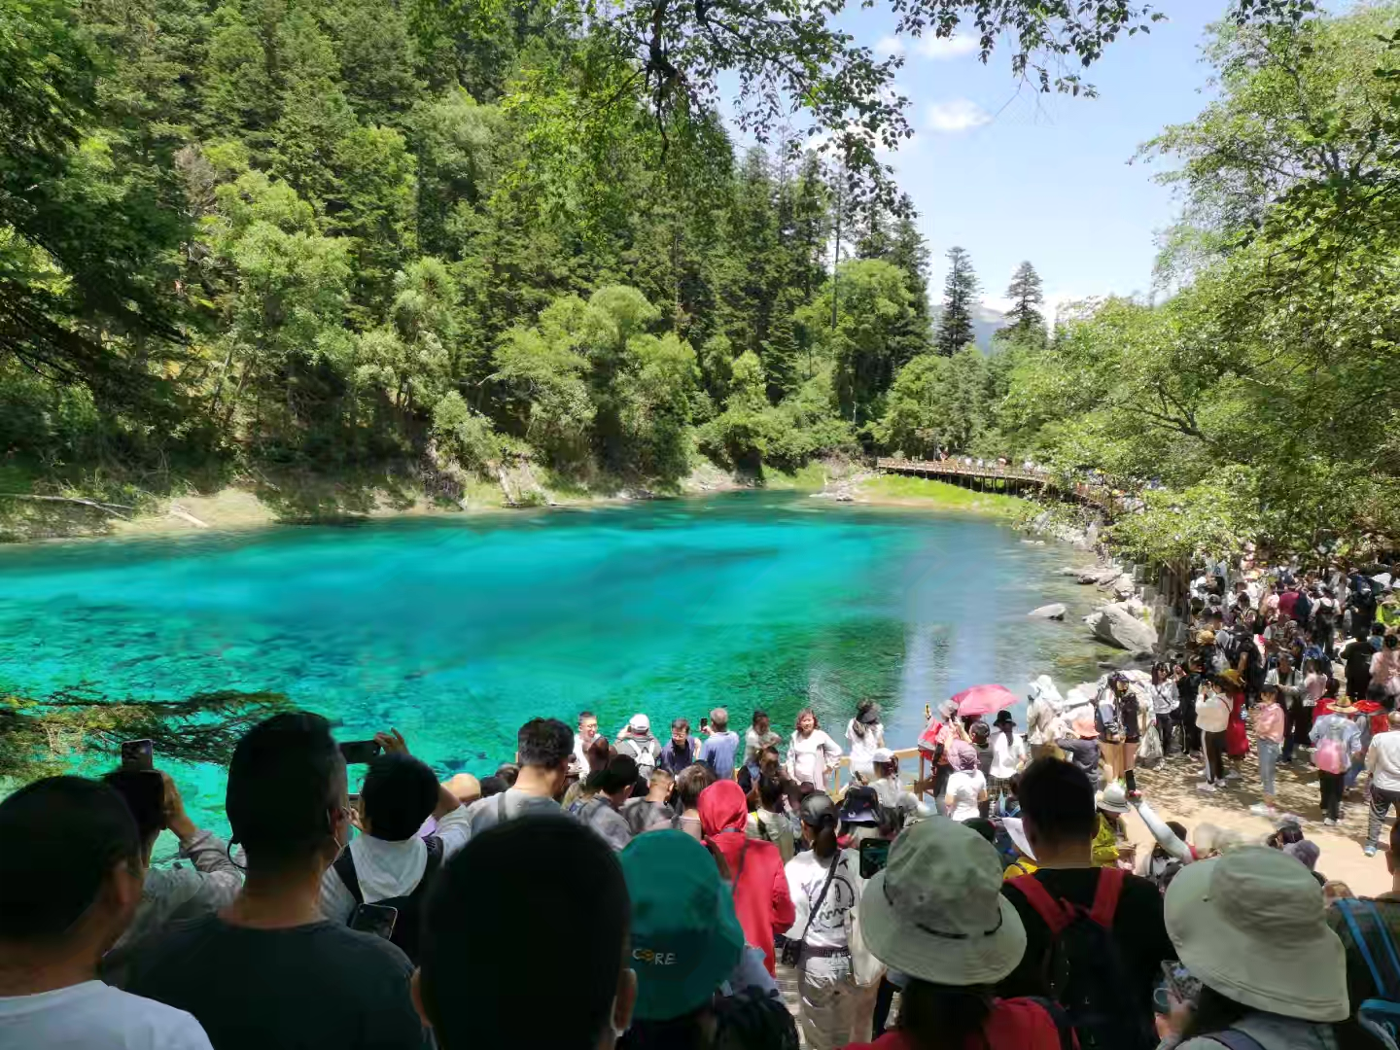

Slide 7


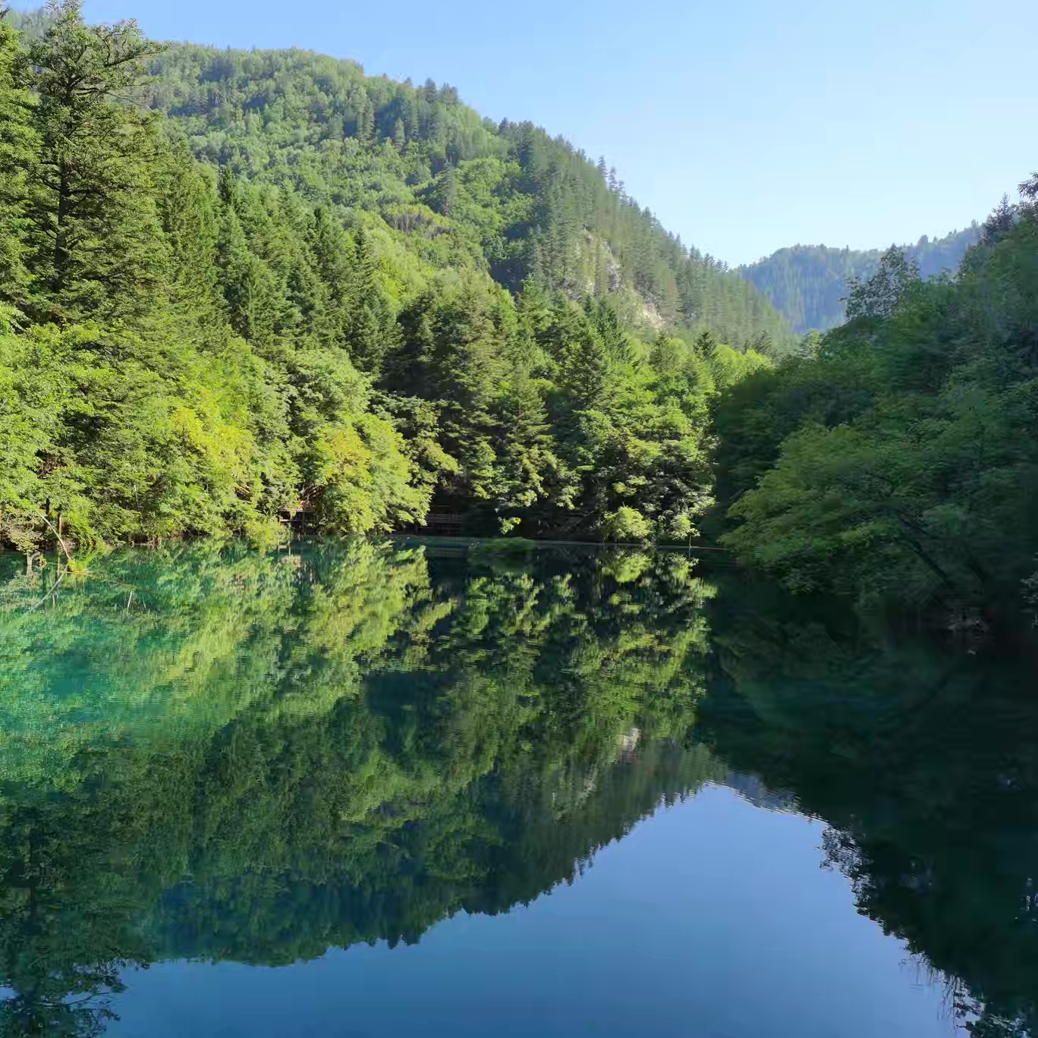
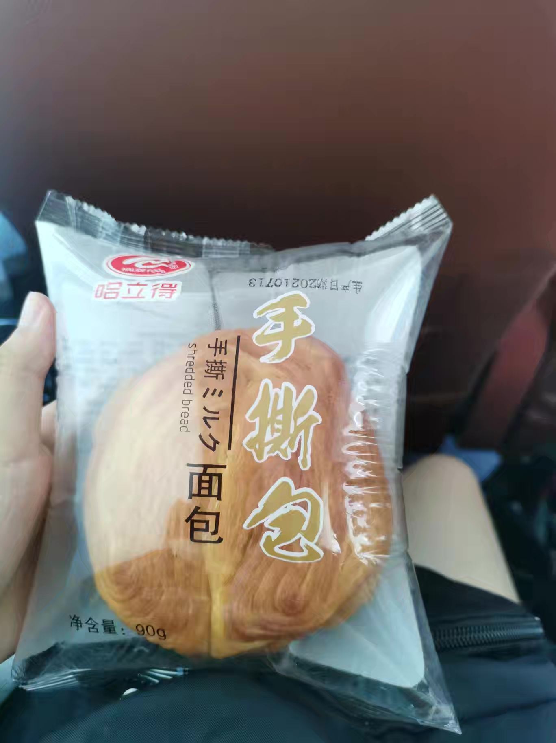

Slide 8
Jiuzhaigou Cuisine

Slide 9
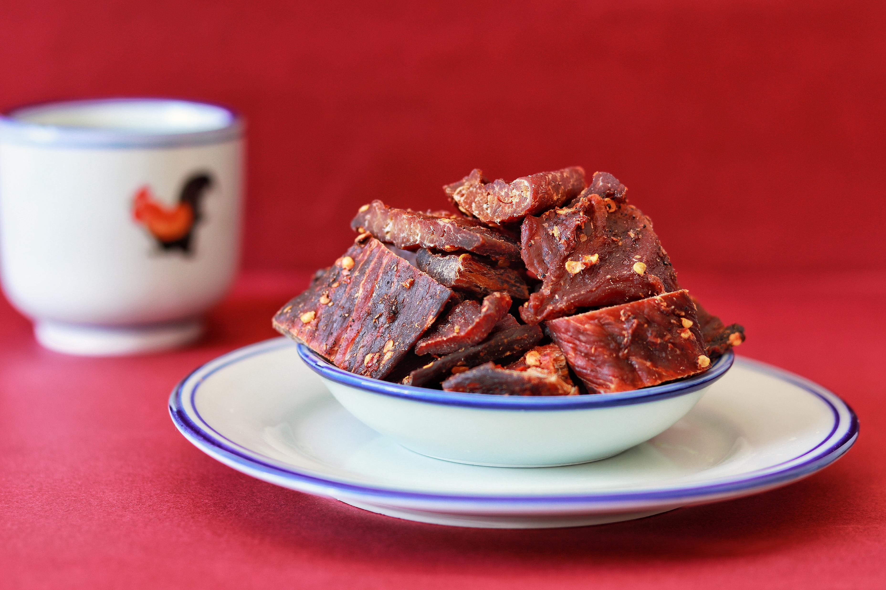

Beef devour
Highland barley cake

Slide 10
thankyou
演讲人：稻小壳
时间：贰零壹玖

