Slide 1
WE WEREN'T GOING TO TELL YOU THIS, BUT

Slide 2
VOCABULARY
bathroom - 浴室 - bɑːθru(ː)m
decide - 决定 - dɪˈsaɪd
flat - 平坦的 - flæt
honeymoon - 蜜月 - hʌnɪmuːn
island - 岛 - aɪlənd
national - 国民 - næʃənl
ocean - 海洋 - əʊʃən
overrated - 高估了 - əʊvəˈreɪtɪd
spectacular - 壮观 - spɛkˈtækjʊlə

Slide 3
1. 浴室
2. 岛
3. 海洋

Slide 4
1. 浴室 - bathroom
2. 岛 - island
3. 海洋 - ocean

Slide 5
WE WEREN'T GOING TO TELL YOU …
Cheryl: Everyone, we'd like to ask your opinion about something.
Mr. Evans: What is that?
Cheryl: We're trying to decide where to go on vacation after the wedding, for our honeymoon.
Bob: We thought you might be able to help
us decide on a location.

Slide 6
Mr. Evans: An excellent idea. Where are you thinking of going?
Cheryl: Well, Bob doesn't really like to travel, so he's agreed to go wherever I want to go,
as long as the hotel has nice bathrooms and a TV.
Mr. Evans: That sounds fair. What's your first choice?

Slide 7
Cheryl: I've heard the jungles and rain forests in Malaysia are a must-see.
Paul: They're so lush.... Of course, some people feel that the scorpions make it too dangerous to hike.
Cheryl: stay in town? For our honeymoon?
Bob: Well, I heard the rooms have really nice bathrooms and big televisions.

Slide 8

Where to go on vacation after the wedding, for our ______.
holiday
divorce
honeymoon

Slide 9
As long as the hotel has nice ______ and a TV.
bathrooms
food
toilets

Slide 10
But, of course, it's probably not ______ enough for a honeymoon.
sexy
romantic
exciting

Slide 11
Some people feel that the ______ make it too dangerous to hike.
monkeys
scorpions
grandmas

Slide 12
Cheryl, you once told me that you wanted to go to ______.
DLU
the toilet
Tahiti

Slide 13
You're ______!
joking
not serious
kidding

Slide 14
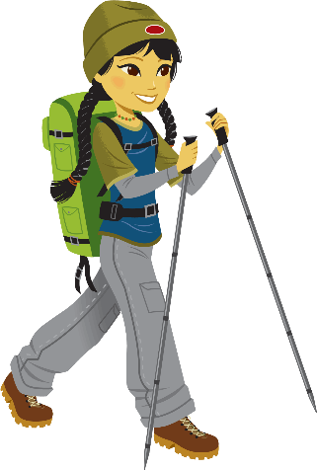
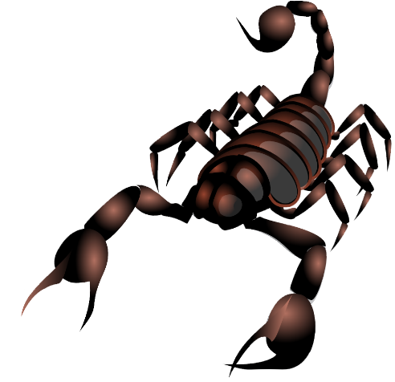
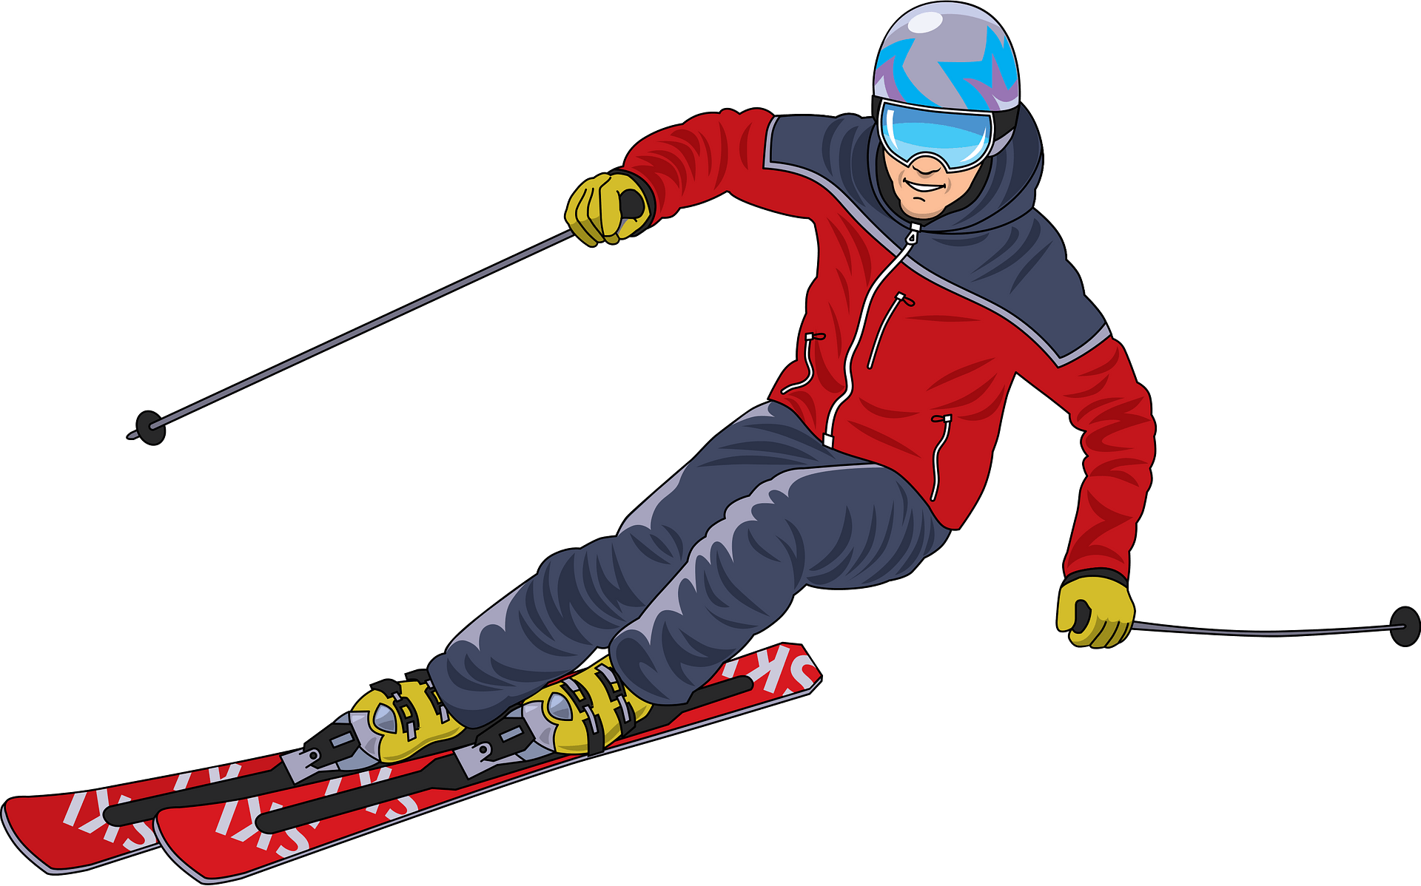
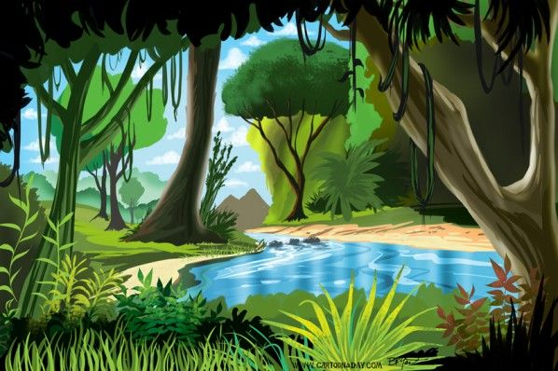
Matching Exercise
jungle | skiing | scorpion | hike

Slide 15
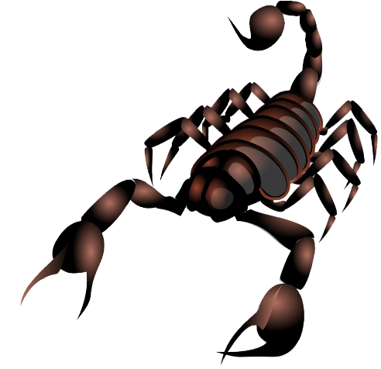
Matching Exercise
hike | scorpion | skiing | jungle

Slide 16
TRUE OR FALSE
1. Bob and Cheryl are getting married.
2. Bob likes to travel.
3. They are scorpions in Malaysia.
4. Mr. Rashid went to Tahiti.
5. Bob and Cheryl will go on honeymoon for one week.

Slide 17
TRUE OR FALSE
1. Bob and Cheryl are getting married. | TRUE
2. Bob likes to travel. | FALSE
3. They are scorpions in Malaysia. | TRUE
4. Mr. Rashid went to Tahiti. | TRUE
5. Bob and Cheryl will go on honeymoon for one week. | FALSE

