Slide 1
I WANT A LARGE WEDDING

Slide 2
VOCABULARY
ceremony - 仪式 - sɛrɪməni
contemporary - 当代的 - kənˈtɛmpərəri
indoors - 在室内 - ɪnˈdɔːz
invite - 邀请 - ɪnˈvaɪt
location - 地点 - ləʊˈkeɪʃən
plan - 计划 - plæn
reception - 接待 - rɪˈsɛpʃən
relatives - 亲戚们 - rɛlətɪvz
traditional - 传统的 - trəˈdɪʃənl

Slide 3
1. 地点
2. 计划
3. 亲戚们

Slide 4
1. 地点 - location
2. 计划 - plan
3. 亲戚们 - relatives

Slide 5
I WANT A LARGE WEDDING
Cheryl: Marie, could you give us your opinion on a few things?
Marie: I'd love to!
Cheryl: First, how many people should we invite? Bob wants a small wedding.
Bob: Twenty guests would be nice.
Cheryl: I want a large wedding. About 300 people.

Slide 6
Bob: I want a short ceremony, and a huge celebration afterwards.
Cheryl: I want a white cake.
Bob: And I want ...
Marie: A chocolate cake, I know.
Bob: How are we ever going to agree on this?
Marie: Plan a wedding that's big enough to include all of Cheryl's family.

Slide 7
Bob: You're amazing! We couldn't have done it without you.
Mr. Evans: How about National On-Time Day?
Bob: What happens on National ON-Time Day?
Mr. Evans: You remind one another to come back to work on time.
Paul: Happy holiday.

Slide 8

First, how many people should we invite? Bob wants a small ______.
event
party
wedding

Slide 9
I want a large wedding. About ______ people.
300
2
3000

Slide 10
I always thought I would get married in a ______ or at the beach.
church
park
toilet

Slide 11
I want a white ______.
dress
cake
hat

Slide 12
Planning a wedding is hard work.
I need a ______.
vacation
break
holiday

Slide 13
What about a Red Day? Everybody wears ______ clothes …
red
old
no

Slide 14

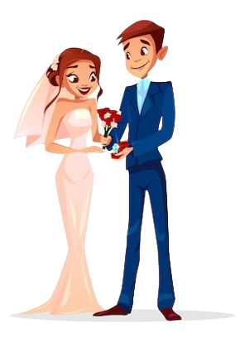
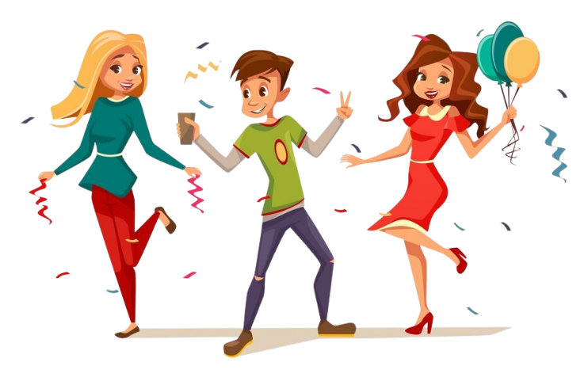

Matching Exercise
wedding | romantic | beach | celebration

Slide 15
Matching Exercise
romantic | wedding | celebration | beach

Slide 16
TRUE OR FALSE
1. Bob wants a big wedding.
2. Cheryl wants about 300 people at the wedding.
3. Bob wants to have the wedding indoors.
4. Cheryl wants KFC at the wedding.
5. Marie suggests two cakes, one white and one chocolate.

Slide 17
TRUE OR FALSE
1. Bob wants a big wedding. | FALSE
2. Cheryl wants about 300 people at the wedding. | TRUE
3. Bob wants to have the wedding indoors. | FALSE
4. Cheryl wants KFC at the wedding. | FALSE
5. Marie suggests two cakes, one white and one chocolate. | TRUE

