Slide 1
I COULD HAVE BEEN A GREAT DANCER

Slide 2
VOCABULARY
culture - 文化 - kʌlʧə
custom - 风俗 - kʌstəm
diet - 饮食 - daɪət
engaged - 已订婚的 - ɪnˈgeɪʤd
etiquette - 礼仪 - ɛtɪkɛt
international - 国际的 - ɪntə(ː)ˈnæʃənl
polite - 有礼貌的 - pəˈlaɪt
program - 程序 - prəʊgræm
state - 状态 - steɪt

Slide 3
1. 饮食
2. 已订婚的
3. 有礼貌的

Slide 4
1. 饮食 - diet
2. 已订婚的 - engaged
3. 有礼貌的 - polite

Slide 5
I COULD HAVE BEEN A GREAT DANCER
Marie: Another wonderful dinner, Cheryl. Thank you.
Cheryl: You're welcome. I really enjoy cooking. Actually, when I was young,
I thought I was going to be a chef.
Paul: You could be a chef. These cookies are fantastic.
Marie: Why didn't you become a chef?

Slide 6
Mr. Evans: Your mother must have been very happy when you and Bob got engaged.
Cheryl: She was. Hey, you'll never guess what Bob was going to be.
Bob: Cheryl ...
Marie: A rock musician?
Paul: A basketball player?
Cheryl: No, Bob was going to be a dancer.

Slide 7
Cheryl: He was actually in the state ballet when he was young.
Marie: No kidding!
Paul: You never told me this!
Bob: I could have been a great dancer.
Paul: What made you change your mind?
Bob: The diet was too hard. I had to stop eating everything - chocolate cake, fried chicken, potato chips. I tried.

Slide 8

You could be a chef. These ______ are fantastic.
cakes
sandwiches
cookies

Slide 9
Your mother must have been very happy when you and Bob got ______.
engaged
a baby
married

Slide 10
No, Bob was going to be a ______.
musician
dancer
pimp

Slide 11
The ______ was too hard.
training
diet
pants

Slide 12
What did you think you were going
to be when you were ______?
older
a woman
younger

Slide 13
I always thought I would have my own television ______.
program
station
channel

Slide 14
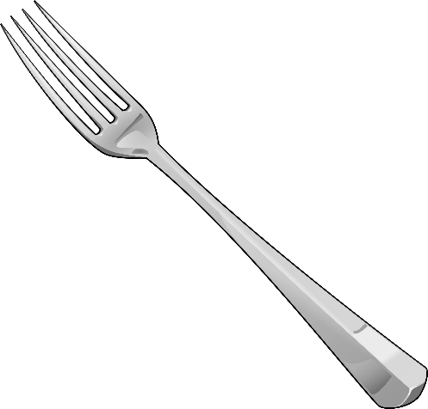



Matching Exercise
ballet | fork | fast food | chef

Slide 15
Matching Exercise
fork | fast food | chef | ballet

Slide 16
TRUE OR FALSE
1. Marie thought she was going to be a chef.
2. Cheryl's mother thought she wouldn't get married if she worked at night.
3. Bob was a ballet dancer when he was young.
4. Bob didn't become a dancer because of the diet.
5. Mr. Evans wanted to be a movie star.

Slide 17
TRUE OR FALSE
1. Marie thought she was going to be a chef. | FALSE
2. Cheryl's mother thought she wouldn't get married if she worked at night. | TRUE
3. Bob was a ballet dancer when he was young. | TRUE
4. Bob didn't become a dancer because of the diet. | TRUE
5. Mr. Evans wanted to be a movie star. | FALSE

