Slide 1
I NEED TO GET A PACKAGE …

Slide 2
VOCABULARY
choice - 选择 - ʧɔɪs
copies - 副本 - kɒpiz
fix - 使固定 - fɪks
flew - 飞了 - fluː
guide - 指南 - gaɪd
hurry - 匆忙 - hʌri
reliable - 可靠的 - rɪˈlaɪəbl
reprint - 重印 - riːˈprɪnt
tailor - 裁缝 - teɪlə

Slide 3
1. 飞了
2. 匆忙
3. 重印

Slide 4
1. 飞了 - flew
2. 匆忙 - hurry
3. 重印 - reprint

Slide 5
I NEED TO GET A PACKAGE …
Cheryl: Mr. Evans, we gave you the package of travel documents to give to Mr. Wells the other night at dinner, before he flew home to Sydney.
Mr. Evans: A white envelope about this big?
Cheryl: Yes.
Mr. Evans: I gave it to Mr. Rashid before he left for Lebanon.

Slide 6
Cheryl: Oh, Mr. Wells needs those documents the day after tomorrow! His group is flying in on Thursday.
Marie: I'll call the courier. If they can pick up a package by 5:00 P.M., we should be OK.
Paul: That gives us an hour. I'll reprint the tour information, but what about the travel guides? I can't print twenty-five copies that fast.

Slide 7
Marie: The Green Room is a nice restaurant.
Cheryl: Great! That's my favourite, too. Now, Bob, about the food ...
Bob: I was thinking steak and potatoes and ...
Cheryl: Well, the client asked for fish or chicken. So I had the restaurant put together a menu with each. Which do you like better?
Bob: I like chicken more than fish, I guess.

Slide 8
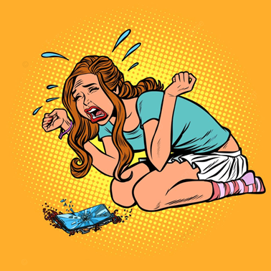
Now, about the travel documents
for the ______ group.
Spanish
French
Australian

Slide 9
Oh, ______ needs those documents the day after tomorrow!
Mr. Wells
Mr. Mehdi
Mr. Simpson

Slide 10
Call ______ instead. They're faster and much more reliable.
Jasper's
Harper's
Barber's

Slide 11
These ______ are too long, and they're driving me crazy.
arms
sleeves
pants

Slide 12
I was thinking ______ and potatoes and ...
chicken
fish
steak

Slide 13
Let me guess. You have a list of ______ choices.
music
song
KTV

Slide 14




Matching Exercise
documents | envelope | sleeve | package

Slide 15
Matching Exercise
package | documents | envelope | sleeve

Slide 16
TRUE OR FALSE
1. Mr. Wells needs documents the day after tomorrow.
2. They need 25 copies of the travel guides.
3. Copies To Go will print the travel guides.
4. Mr. Wells group will have a party next Friday.
5. Bob suggests KFC for the menu.

Slide 17
TRUE OR FALSE
1. Mr. Wells needs documents the day after tomorrow. | TRUE
2. They need 25 copies of the travel guides. | TRUE
3. Copies To Go will print the travel guides. | FALSE
4. Mr. Wells group will have a party next Friday. | TRUE
5. Bob suggests KFC for the menu. | FALSE

