Slide 1
ARE YOU OK?

Slide 2
VOCABULARY
acupuncture - 针刺 - ækjʊˌpʌŋ(k)ʧə
bother - 打扰 - bɒðə
chiropractic - 整脊疗法 - kʌɪrə(ʊ)ˈpraktɪk
herbal - 草本 - ˈhɜːbəl
hip - 时髦的 - hɪp
horrible - 可怕 - hɒrəbl
medical - 医疗的 - mɛdɪkəl
pain - 痛 - peɪn
remedy - 补救 - rɛmɪdi

Slide 3
1. 时髦的
2. 医疗的
3. 痛

Slide 4
1. 时髦的 - hip
2. 医疗的 - medical
3. 痛 - pain

Slide 5
ARE YOU OK?
Marie: Paul, are you OK?
Paul: No. I feel awful.
Cheryl: What's wrong?
Paul: I've got this horrible cold. I'm sneezing, and my back is killing me. I've got this pain in my hip. My neck has been bothering me all day. And I have a stomach-ache.
Marie: You may have to go see a doctor.

Slide 6
Paul: No! I hate doctors.
Cheryl: I wonder what could be wrong.
Bob: Maybe he's allergic to work.
Paul: I'm not kidding here. I'm in pain.
Bob: I used to want to be a doctor, you know. Say "Ahhh."
Paul: Ahhh-choo!
Bob: Now I remember why I didn't become a doctor.

Slide 7
Cheryl: Paul, you really must get some medical help.
Bob: A little acupuncture might help you feel better.
Paul: Stay away from me.
Cheryl: Dr. Anderson is meeting Mr. Evans downstairs in the café. Should we ask her to come up? She may be able to help.
Marie: Great idea. I'll go get her.

Slide 8
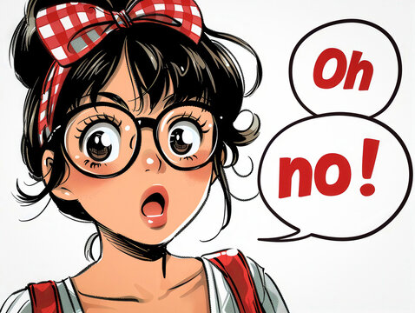
I've got this horrible ______.
cough
virus
cold

Slide 9
No! I hate ______.
doctors
DLU
foreigners

Slide 10
Maybe he's allergic to ______.
cheese
work
food

Slide 11
______ is the best medicine, you know.
A woman
Laughter
Chocolate

Slide 12
That's too much ______ in one day.
running
work
medicine

Slide 13
We lifted ______ last night for about an hour and ran five miles.
weights
boxes
furniture

Slide 14
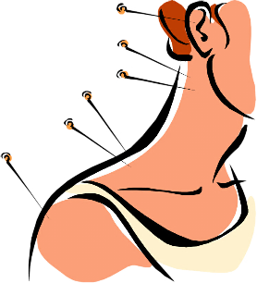
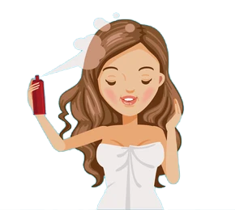


Matching Exercise
tablets | spray | weights | acupuncture

Slide 15
Matching Exercise
acupuncture | tablets | spray | weights

Slide 16
TRUE OR FALSE
1. Paul loves doctors.
2. Dr. Anderson is meeting Mr. Evans.
3. Paul has a cold.
4. Paul exercised with his friend Don.
5. Paul ran 10 miles.

Slide 17
TRUE OR FALSE
1. Paul loves doctors. | FALSE
2. Dr. Anderson is meeting Mr. Evans. | TRUE
3. Paul has a cold. | TRUE
4. Paul exercised with his friend Don. | TRUE
5. Paul ran 10 miles. | FALSE

Slide 18
IELTS Speaking Exam. Health & Fitness.
Part 2
Describe a fitness goal you have achieved. You should say:
What the goal was
How you achieved it
How you felt afterwards.

