Slide 1
I'M A LITTLE EARLY, AREN'T I?

Slide 2
VOCABULARY
accent - 口音 - æksənt
gesture - 手势 - ʤɛsʧə
impolite - 不礼貌 - ɪmpəˈlaɪt
insult - 侮辱 - ɪnsʌlt
keeping - 保持 - kiːpɪŋ
point - 观点 - pɔɪnt
pronounce - 发音 - prəˈnaʊns
shortly - 不久 - ʃɔːtli

Slide 3
1. 口音
2. 侮辱
3. 观点

Slide 4
1. 口音 - accent
2. 侮辱 - insult
3. 观点 - point

Slide 5
I'M A LITTLE EARLY, AREN'T I?
Cheryl: Marie, can I have that information for Mr. Rashid's group? He'll be here in a few minutes.
Marie: I'm working as fast as I can. Mr. Evans will be with you very soon.
Mrs. Beatty: That's fine. I'm a little early, aren't I?
Marie: Just a few minutes.

Slide 6
Mrs. Beatty: Do you mind if I call you
Ms. LePage? I love the way it sounds.
Marie: That's fine.
Mrs. Beatty: I'm keeping you from your work, aren't I?
Marie: I'm sorry. I'd love to talk, but I really have to get this done right away.
Mrs. Beatty: I understand. You're not from here, are you?

Slide 7
Marie: Excuse me?
Mrs. Beatty: Your accent. You come from France, don't you?
Marie: Yes. Paris, actually.
Mrs. Beatty: That's nice. It sure is a beautiful day, isn't it?
Marie: Mmm-hmm.
Cheryl: Can I have that information?
Marie: I'm not quite done.

Slide 8
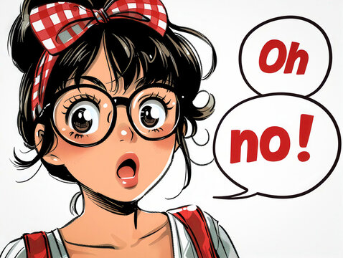
Marie, can I have that ______ for
Mr. Rashid's group?
bus
ticket
information

Slide 9
Do you mind if I call you Ms. LePage? I love the way it ______.
sounds
feels
looks

Slide 10
Your ______. You come from France, don't you?
parents
accent
face

Slide 11
Mrs. Beatty, I can take you to
Mr. Evans's ______.
toilet
office
bedroom

Slide 12
Paul, why don't you greet me as if
I were ______ tourist?
a Nigerian
An American
An Indian

Slide 13
Pointing with your ______ is considered impolite.
fingers
banana
feet

Slide 14
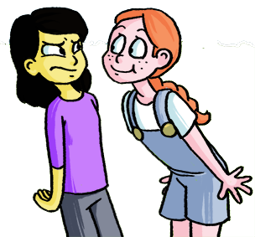
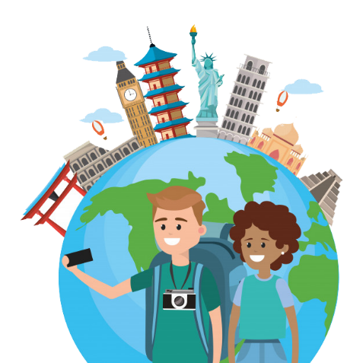
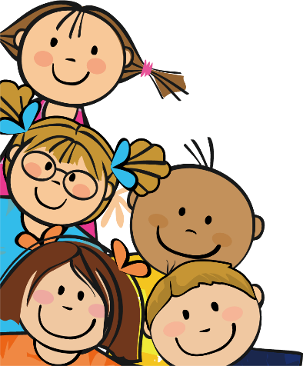
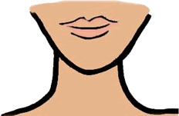
Matching Exercise
chin | tourists | group | close

Slide 15
Matching Exercise
close | chin | tourists | group

Slide 16
TRUE OR FALSE
1. Mrs. Beatty is late.
2. Marie is from Paris.
3. Mr. Rashid has been to India many times.
4. Cheryl takes Mrs. Beatty to Mr. Evans' office.
5. Men and women always shake hands in India.

Slide 17
TRUE OR FALSE
1. Mrs. Beatty is late. | FALSE
2. Marie is from Paris. | TRUE
3. Mr. Rashid has been to India many times. | TRUE
4. Cheryl takes Mrs. Beatty to Mr. Evans' office. | TRUE
5. Men and women always shake hands in India. | FALSE

Slide 18
IELTS Speaking Exam. Health & Fitness.
Part 1
Do you think you have a healthy lifestyle?
Do you enjoy exercising?
Is there any sport or activity you used to do but don't anymore?

