Slide 1
THAT'S DAVID DOOLITTLE

Slide 2
VOCABULARY
actor - 演员 - æktə
bag - 包 - bæg
gloves - 手套 - glʌvz
hat - 帽子 - hæt
pocket - 口袋 - pɒkɪt
romantic - 浪漫的 - rəʊˈmæntɪk
steal - 偷 - stiːl
table - 桌子 - teɪbl
wrong - 错误的 - rɒŋ

Slide 3
1. 演员
2. 帽子
3. 浪漫的

Slide 4
1. 演员 - actor
2. 帽子 - hat
3. 浪漫的 - romantic

Slide 5
THAT'S DAVID DOOLITTLE
Cheryl: That man just left something at his table.
Marie: That's David Doolittle . . . the actor! He left his hat. And his gloves. And his
cell phone. And his keys. Hold these.
Cheryl: What are you doing?
Marie: I'm giving him back his hat.

Slide 6
Marie: Sir! Excuse me, sir! Is this hat yours?
Doolittle: That's mine, yes, thank you.
Did I leave it here?
Marie: I saw it under your table.
Doolittle: Thanks again.
Marie: You're welcome.
Cheryl: If you don't give him back the rest of his things, I will.

Slide 7
Marie: I didn't steal it. He left it, and I'm waiting to return it until tonight.
Cheryl: What are you going to do now?
Marie: I'm going to call him tonight, tell him
I found his phone, and ask him to meet me for dinner.
Cheryl: You're going to ask him to dinner?
Marie: Sure. Why not?

Slide 8
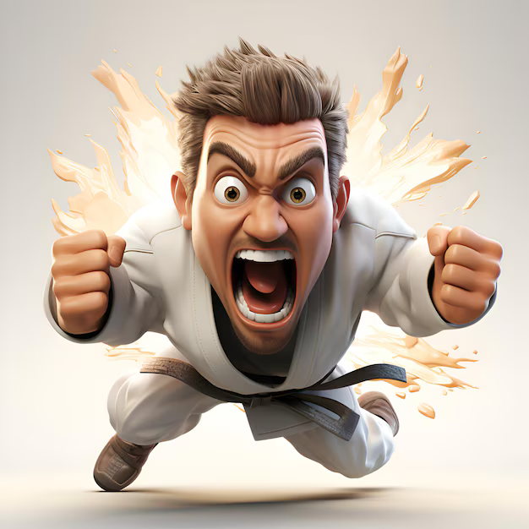
That's David Doolittle . . . the ______!
pig
gay
actor

Slide 9
Doolittle: Did I leave it here?
Marie: I saw it under your ______.
table
chair
hair

Slide 10
If you don't give him back the rest of his ______, I will.
money
things
food

Slide 11
You know, I'm missing my ______. Have you seen it?
watch
mobile
underpants

Slide 12
I'm going to call him tonight, and ask him to meet me for ______.
hot pot
sexy time
dinner

Slide 13
I thought you were the most ______ woman I had ever met.
amazing
smelly
cheap

Slide 14
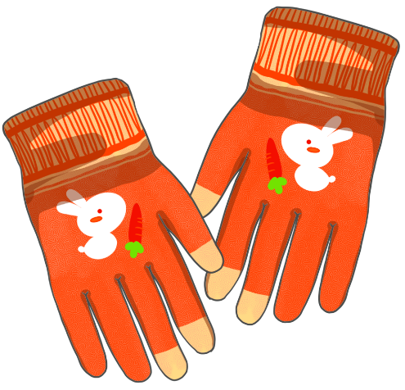

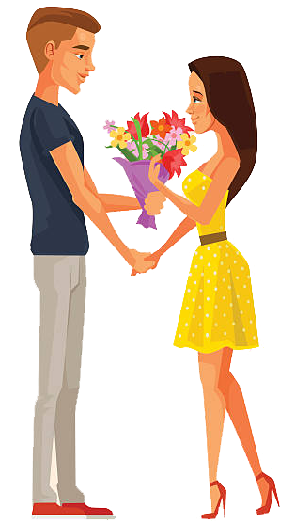
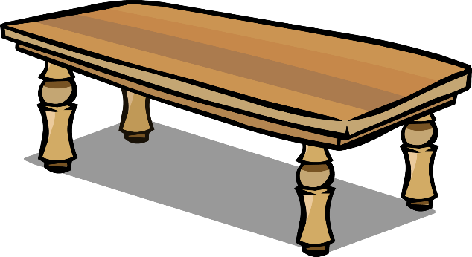
Matching Exercise
table | bag | romantic | gloves

Slide 15
Matching Exercise
gloves | table | bag | romantic

Slide 16
TRUE OR FALSE
1. The girls were eating cake.
2. The first thing Marie gives David Doolittle is his phone.
3. Cheryl wants to meet David Doolittle for dinner.
4. Bob and Cheryl first met at the park.
5. Marie lost her clothes in the park.

Slide 17
TRUE OR FALSE
1. The girls were eating cake. | TRUE
2. The first thing Marie gives David Doolittle is his phone. | FALSE
3. Cheryl wants to meet David Doolittle for dinner. | FALSE
4. Bob and Cheryl first met at the park. | TRUE
5. Marie lost her clothes in the park. | FALSE

Slide 18
IELTS Speaking Exam. People & Relationships. Part 2
Describe a person who made a positive impact on you. You should say:
who they were
what you learned from them
and explain how they influenced you.

