Slide 1
CAN YOU HELP ME WITH SOMETHING?

Slide 2
VOCABULARY
attachment - 附件 - əˈtæʧmənt
button - 按钮 - bʌtn
file - 文件 - faɪl
push - 推 - pʊʃ
restart - 重新开始 - riːˈstɑːt
scanner - 扫描器 - skænə
toolbar - 工具栏 - tuːlbɑː
unless - 除非 - ənˈlɛs
virus - 电脑病毒 - vaɪərəs

Slide 3
1. 按钮
2. 推
3. 电脑病毒

Slide 4
1. 按钮 - button
2. 推 - push
3. 电脑病毒 - virus

Slide 5
CAN YOU HELP ME WITH SOMETHING?
Marie: Bob, can you help me with something?
Bob: Sure.
Marie: I'm trying to print a file, but the printer won't work.
Bob: Push the green button on the printer.
Marie: Why?
Bob: To turn it on. It won't print unless it's on.

Slide 6
Paul: Hey, Bob. My laptop crashed, and
I can't get it to do anything. I type on the
keyboard and nothing happens.
Bob: Stick this here.
Paul: Why?
Bob: To restart the computer.
Paul: You sure? OK. Thanks.
Cheryl: Bob, I could use a hand with something.

Slide 7
Bob: What is it?
Cheryl: Somebody sent me an e-mail,
but I think it has a virus in it.
Bob: Don't open the attachment. Click on the No-Virus icon on the toolbar.
Cheryl: Why?
Bob: To clean the computer and stop the virus.
Cheryl: Thanks!

Slide 8

I'm trying to ______ a file, but the printer won't work.
save
delete
print

Slide 9
Hey, Bob. My ______ crashed, and
I can't get it to do anything.
laptop
grandma
pig

Slide 10
Somebody sent me ______,
but I think it has a virus in it.
a letter
an e-mail
a fax

Slide 11
I'm sorry, but I can't get any work done with all these ______!
demands
questions
problems

Slide 12
Well, sir, I think I need some new ______.
hardware
staff
technology

Slide 13
It's not a digital ______, sir. It won't take pictures as easily as this one.
camera
girl
pen

Slide 14


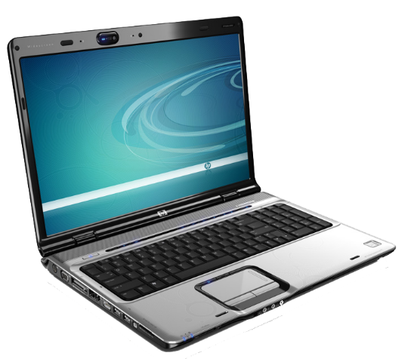

Matching Exercise
button | restart | virus | laptop

Slide 15
Matching Exercise
restart | virus | laptop | button

Slide 16
TRUE OR FALSE
1. Marie didn't turn the printer on.
2. Paul's laptop crashed.
3. Bob is busy playing games.
4. The new joystick would give better photos.
5. Mr. Evans buys everything Bob asks for.

Slide 17
TRUE OR FALSE
1. Marie didn't turn the printer on. | TRUE
2. Paul's laptop crashed. | TRUE
3. Bob is busy playing games. | TRUE
4. The new joystick would give better photos. | FALSE
5. Mr. Evans buys everything Bob asks for. | FALSE

Slide 18
IELTS Speaking Exam. People & Relationships. Part 1
What qualities do you value most in a friend?
How has your relationship with your family changed over the years?
In what ways are you similar to or different from your best friend?

