Slide 1
WHAT DO YOU THINK?

Slide 2
VOCABULARY
decorate - 装饰 - dɛkəreɪt
fascinated - 着迷 - fæsɪneɪtɪd
gallery - 画廊 - gæləri
gold - 金子 - gəʊld
inspired - 启发 - ɪnˈspaɪəd
sculpture - 雕塑 - skʌlpʧə
sculptor - 雕塑家 - skʌlptə
traditions - 传统 - trəˈdɪʃənz
wood - 木头 - wʊd

Slide 3
1. 金子
2. 传统
3. 木头

Slide 4
1. 金子 - gold
2. 传统 - traditions
3. 木头 - wood

Slide 5
WHAT DO YOU THINK?
Mr. Evans: Ms. Novak has just opened an art gallery here. I've asked her to find some pieces to decorate our office. She's brought some things for us to look at today.
Ms. Novak: Here's the painting. This was painted by a Russian artist that I really like. It's called Sun on the Water. The artist was inspired by looking at the sea.

Slide 6
Paul: I think I can do that.
Cheryl: It's . . . fantastic.
Marie: How . . . interesting!
Bob: It's very . . . blue.
Ms. Novak: Yes.
Mr. Evans: It's gorgeous!
Ms. Novak: Oh, good. Here's the sculpture.
It was made by a British sculptor. It's called
City of Gold.

Slide 7
Paul: Is it really gold?
Ms. Novak: No. It's made of wood. It was painted gold. What do you think?
Cheryl: It's . . . cool.
Bob: Mr. Evans, I think it would look good in your office.
Marie: I think I prefer the painting.
Mr. Evans: I'm fascinated by it!

Slide 8

Ms. Novak has just opened an art ______ here.
museum
shop
gallery

Slide 9
The artist was inspired by looking at ______.
the sea
the moon
the stars

Slide 10
It was made by a British sculptor.
It's called ______ of Gold.
Sea
City
Walls

Slide 11
It's called ______. It was photographed in Paris.
Spring
Winter
Autumn

Slide 12
I was ______ by looking at the walls of the office.
bored
angered
inspired

Slide 13
You have ______.
I do?
a talent
Covid-19
brain damage

Slide 14
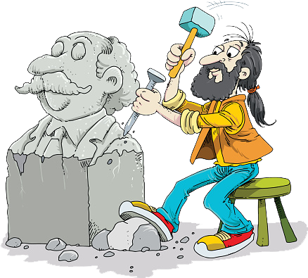
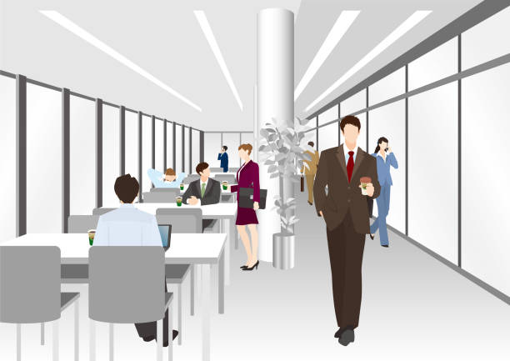
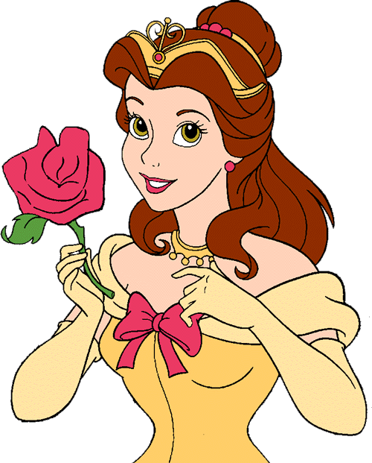
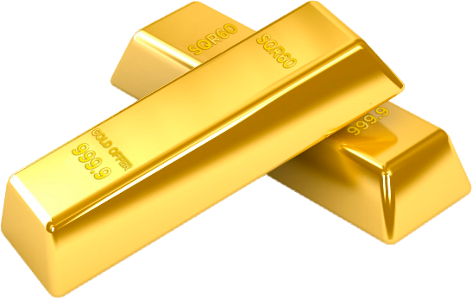
Matching Exercise
gold | sculptor | gorgeous | office

Slide 15
Matching Exercise
sculptor | office | gold | gorgeous

Slide 16
TRUE OR FALSE
1. Mr. Evans has opened an art gallery.
2. A Russian artist painted Sun on the Water.
3. The sculpture 'City of Gold' is made of gold.
4. Paul takes a lot of pictures.
5. Ms. Novak thinks she can sell Paul's work.

Slide 17
TRUE OR FALSE
1. Mr. Evans has opened an art gallery. | FALSE
2. A Russian artist painted Sun on the Water. | TRUE
3. The sculpture 'City of Gold' is made of gold. | FALSE
4. Paul takes a lot of pictures. | TRUE
5. Ms. Novak thinks she can sell Paul's work. | TRUE

Slide 18
IELTS Speaking Exam. Shopping. Part 2
Describe your favourite bricks and mortar shop. You should say:
What kind of store it is
Where it is
And why you like shopping there.

