Slide 1
HELP YOURSELF

Slide 2
VOCABULARY
allergic - 过敏 - əˈlɜːʤɪk
diet - 饮食 - daɪət
garlic - 大蒜 - gɑːlɪk
passion - 热情 - pæʃən
skinny - 瘦骨嶙峋的 - skɪni
smell - 闻 - smɛl
snacking - 吃零食 - snækɪŋ
terrific - 了不起 - təˈrɪfɪk

Slide 3
1. 饮食
2. 大蒜
3. 瘦骨嶙峋的

Slide 4
1. 饮食 - diet
2. 大蒜 - garlic
3. 瘦骨嶙峋的 - skinny

Slide 5
HELP YOURSELF
Marie: This smells so wonderful! What are we having to eat?
Cheryl: There's roast chicken, baked potatoes, salad, broccoli with garlic, red cabbage, and rice. Help yourself, everyone.
Paul: Wow! That's a lot of vegetables.
Cheryl: Vegetables are very healthy for you.
Mr. Evans, would you like some chicken?

Slide 6
Mr. Evans: Just a little, thank you. I'm not a big chicken eater.
Cheryl: How about some potatoes?
Mr. Evans: I'm sorry. I'm avoiding potatoes.
Cheryl: Some broccoli?
Mr. Evans: I'll pass. I'm afraid it doesn't agree with me.
Cheryl: Cabbage?

Slide 7
Paul: Cheryl, that was fantastic.
Mr. Evans: The rice was terrific.
Cheryl: Cookies, anyone?
Marie: Yes, one please!
Paul: I'll take two, thanks. Or three. Or four.
Cheryl: Do you eat sweets, Mr. Evans?
Mr. Evans: I used to. But I can't anymore.
Marie: No dessert for you, Bob?
Cheryl: Not on his diet.

Slide 8

This ______ so wonderful! What are we having to eat?
tastes
is
smells

Slide 9
Vegetables are very ______ for you.
healthy
good
beneficial

Slide 10
I'm crazy about ______.
girls
rice
boys

Slide 11
Why are you on a diet? You're so ______.
tall
skinny
thin

Slide 12
What about that ______ you ate yesterday?
pig
hot pot
ice cream

Slide 13
I'm crazy about ______ cake!
chocolate
banana
strawberry

Slide 14
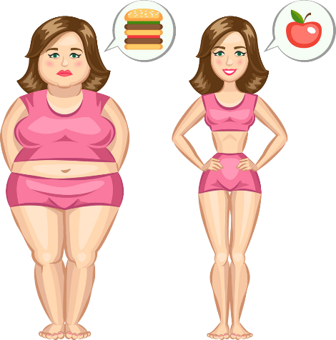
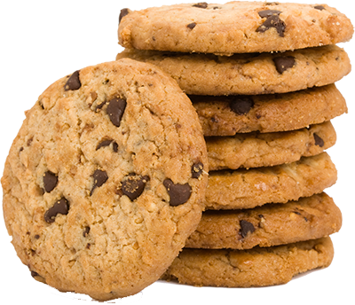
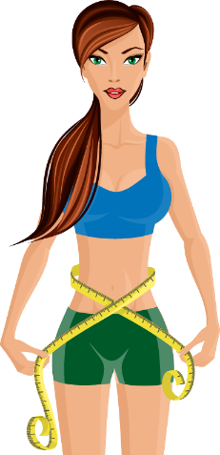
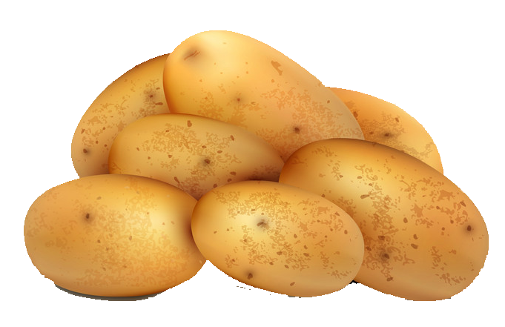
Matching Exercise
cookies | skinny | potatoes | diet

Slide 15
Matching Exercise
diet | cookies | skinny | potatoes

Slide 16
TRUE OR FALSE
1. Mr. Evans is not a big chicken eater.
2. Cheryl is allergic to cabbage.
3. Bob is trying to gain weight.
4. Paul is trying to lose weight.
5. Marie has a cookie.

Slide 17
TRUE OR FALSE
1. Mr. Evans is not a big chicken eater. | TRUE
2. Cheryl is allergic to cabbage. | FALSE
3. Bob is trying to gain weight. | FALSE
4. Paul is trying to lose weight. | FALSE
5. Marie has a cookie. | TRUE

Slide 18
IELTS Speaking Exam. The Natural World.
Part 2
Describe a wild animal you like.
You should say:
What the animal is
Where it lives
What it looks like
and explain why you like this animal.

