Slide 1
HAVE WE MET BEFORE?

Slide 2
VOCABULARY
coincidence - 巧合 - kəʊˈɪnsɪdəns
corner - 角落 - kɔːnə
familiar - 熟悉的 - fəˈmɪliə
institute - 研究所 - ɪnstɪtjuːt
met - 遇见 - mɛt
pilot - 飞行员 - paɪlət
reserve - 预订 - rɪˈzɜːv
sightseeing - 观光 - saɪtˌsiːɪŋ
taxi - 出租车 - tæksi

Slide 3
1. 角落
2. 飞行员
3. 出租车

Slide 4
1. 角落 - corner
2. 飞行员 - pilot
3. 出租车 - taxi

Slide 5
HOW MUCH IS IT?
Mr. Evans: Marie, this is Ms. Novak. She's from Chicago. Marie is our receptionist.
Marie: It's nice to meet you.
Ms. Novak: It's nice to meet you, too.
Mr. Evans: I'll get your tickets.
Ms. Novak: You look very familiar to me, Marie. Have we met before?
Marie: I don't think so. No.

Slide 6
Ms. Novak: Well, I never forget a face.
I'm sure I know you from somewhere.
I don't look familiar to you?
Marie: I'm sorry. No.
Ms. Novak: I know. We met in Chicago.
You were a waitress in a restaurant near the Art Institute.
Marie: I've never been to Chicago.

Slide 7
Ms. Novak: Have you ever driven a taxi in Egypt?
Marie: No.
Ms. Novak: Oh, you were the pilot on a small airplane in China. You flew me over the Great Wall.
Marie: No.
Ms. Novak: Driven a bus in Peru?

Slide 8

You look very familiar to me, ______. Have we met before?
Cheryl
Bob
Marie

Slide 9
Have you ever driven a ______ in Egypt?
taxi
truck
ambulance

Slide 10
Paris? My ______, Katerina, lived there for a year.
mother
sister
grandma

Slide 11
Ever been to ______ Beach?
Old
Cold
Hot

Slide 12
Have you ever visited the Museum of ______?
cheese
pizza
chocolate

Slide 13
It's a wonderful little cheese ______ They have every kind of cheese.
sandwich
cake
shop

Slide 14
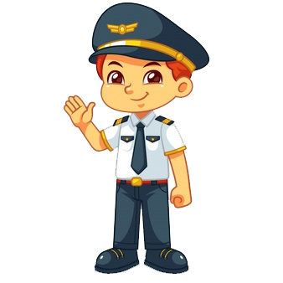
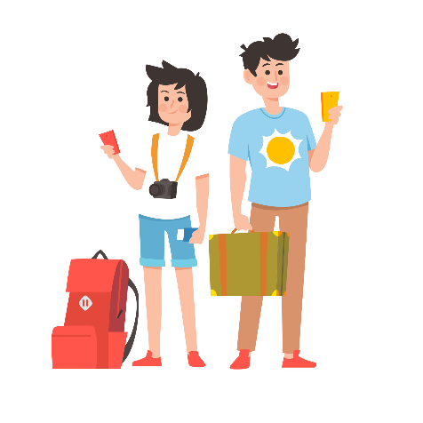
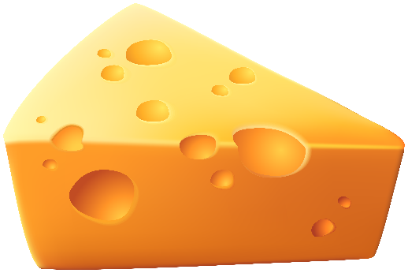
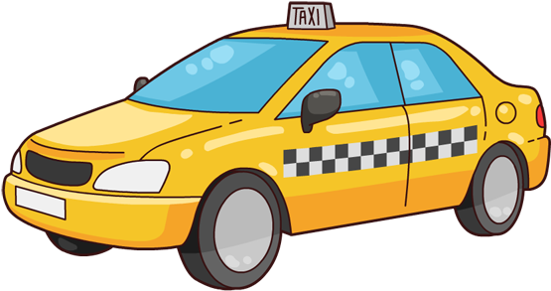
Matching Exercise
taxi | cheese | pilot | sightseeing

Slide 15
Matching Exercise
cheese | pilot | sightseeing | taxi

Slide 16
TRUE OR FALSE
1. Ms. Novak is from Chicago.
2. Marie was a taxi driver in Egypt.
3. Marie's sister lived with Ms. Novak is Paris.
4. Ms. Novak hasn't been to the Olson Building.
5. Ms. Novak and Mr. Evans will go to the 'Museum of Cheese'.

Slide 17
TRUE OR FALSE
1. Ms. Novak is from Chicago. | FALSE
2. Marie was a taxi driver in Egypt. | FALSE
3. Marie's sister lived with Ms. Novak is Paris. | FALSE
4. Ms. Novak hasn't been to the Olson Building. | FALSE
5. Ms. Novak and Mr. Evans will go to the 'Museum of Cheese'. | TRUE

Slide 18
mobile phones
1
books
2
fashion
3
food
4
AI
5
taking
photos
6
Dalian
7
music
8
weather
9
animals
10
jobs
11
sport
12
travel
13
cartoons
14
Douyin
15

