Slide 1
HOW MUCH DO YOU WANT FOR IT?

Slide 2
VOCABULARY
ATM - 自动柜员机 - eɪ-tiː-ɛm
bargain - 讨价还价 - bɑːgɪn
camera - 相机 - kæmərə
credit card - 信用卡 - krɛdɪt kɑːd
service - 服务 - sɜːvɪs
tip - 给服务员小费 - tɪp

Slide 3
1. 自动柜员机
2. 相机
3. 信用卡

Slide 4
1. 自动柜员机 - ATM
2. 相机 - camera
3. 信用卡 - credit card

Slide 5
HOW MUCH IS IT?
Marie: Hey, here comes Bob.
Paul: He wants to sell me his digital camera.
Bob: The best digital camera money can buy.
Marie: Paul, that's the same camera you looked at…
Paul: Why are you selling it?
Bob: I have two. Cheryl gave me another one for my birthday.

Slide 6
Paul: How much do you want?
Bob: Two hundred and fifty dollars.
Marie: Wow! That's a great . . .
Paul: That's more than I want to pay.
Marie: But that's less than . . .
Paul: I can give you $200 for it.
Bob: No. I need at least $245 (two four five).
Paul: Sorry, all I have is $210 (two ten).
Marie: There's an ATM right . . .

Slide 7
Marie: You could buy that camera for two hundred and thirty dollars, but now it's gone!
Bob: All right. You can have it for $225.
Paul: $220 (two two zero).
Bob: $224 (two two four).
Paul: $221 (two two one).
Bob: $223 (two two three).
Paul: $222 (two two two). Not a dollar more.

Slide 8

Yeah. He wants to sell me his digital ______!
laptop
watch
camera

Slide 9
I have two. Cheryl gave me another one for my ______.
birthday
wedding
funeral

Slide 10
You don't know how to ______, do you?
barter
bargain
buy

Slide 11
Here! Here's one ______! Now you both get what you want.
pound
dollar
euro

Slide 12
My pleasure. I saved a lot of money on the ______.
food
woman
camera

Slide 13
Five dollars? The bill was ______ dollars. That's only 5%!
fifty
fifteen
five

Slide 14
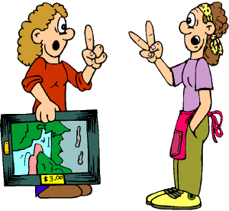
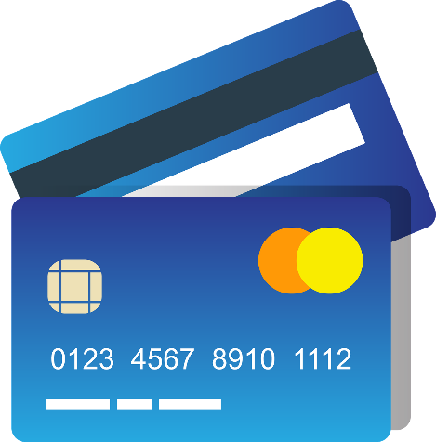

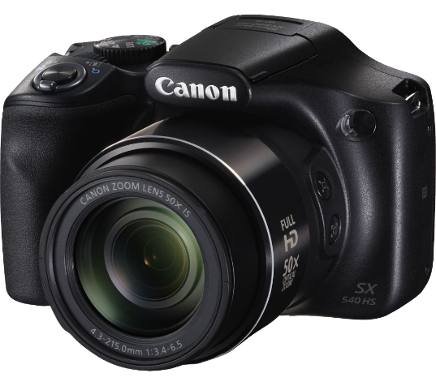
Matching Exercise
camera | tip | credit card | bargain

Slide 15
Matching Exercise
bargain | credit card | tip | camera

Slide 16
TRUE OR FALSE
1. Bob was given a camera for his birthday.
2. Paul's first offer is $200.
3. The final price is $223.
4. Marie pays for dinner.
5. Marie tells Paul he should tip 55%.

Slide 17
TRUE OR FALSE
1. Bob was given a camera for his birthday. | TRUE
2. Paul's first offer is $200. | TRUE
3. The final price is $223. | TRUE
4. Marie pays for dinner. | FALSE
5. Marie tells Paul he should tip 55%. | FALSE

