Slide 1
IS THAT AN EXPRESS DONKEY?

Slide 2
VOCABULARY
accident - 意外 - æksɪdənt
Africa - 非洲 - æfrɪkə
aisle - 走道 - aɪl
donkey - 驴 - dɒŋki
express - 表示 - ɪksˈprɛs
limo - 豪华轿车 - lɪməʊ
mechanical - 机械的 - mɪˈkænɪkəl
safari - 苹果浏览器 - səˈfɑːri
window - 窗户 - wɪndəʊ

Slide 3
1. 意外
2. 驴
3. 窗户

Slide 4
1. 意外 - accident
2. 驴 - donkey
3. 窗户 - window

Slide 5
IS THAT AN EXPRESS DONKEY?
Cheryl: So, Mrs. Beatty, we should talk about your safari trip.
Mrs. Beatty: I'm so excited! My first time in Africa!
Cheryl: You're going to be flying into South Africa. Would you like a window or an aisle?
Mrs. Beatty: A window. I want to see everything!

Slide 6
Cheryl: You should take a taxi or a limo to your hotel. The next day you could
fly or you could take a train.
Mrs. Beatty: Is it an express train?
Cheryl: Yes.
Mrs. Beatty: I'll take the train. I'd like to see the country.
Cheryl: Great. Then you can take a small plane or a bus.

Slide 7
Mrs. Beatty: How small is the airplane?
Cheryl: It's pretty small.
Mrs. Beatty: I'll take the bus. Is it an express bus?
Cheryl: I think so. You're going to be taking a boat to your hotel.
Mrs. Beatty: A boat?
Cheryl: The hotel is on an island.

Slide 8
I'm so excited! My first time in ______!
Asia
the toilet
Africa

Slide 9
You can take a small ______ or a bus.
plane
aeroplane
helicopter

Slide 10
The hotel is on ______.
an Iceland
an island
a donkey

Slide 11
I think it's probably a local ______.
monkey
donkey
grandma

Slide 12
Oh, it was. On the way there the plane had ______ problems.
mechanical
GPS
computer

Slide 13
How much is a ticket to ______?
Beijing
London
Paris

Slide 14

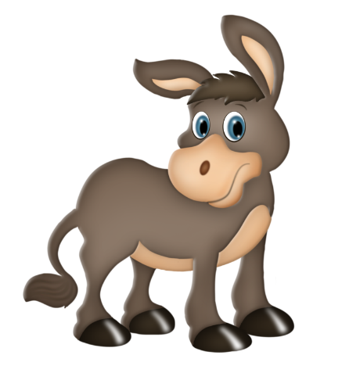
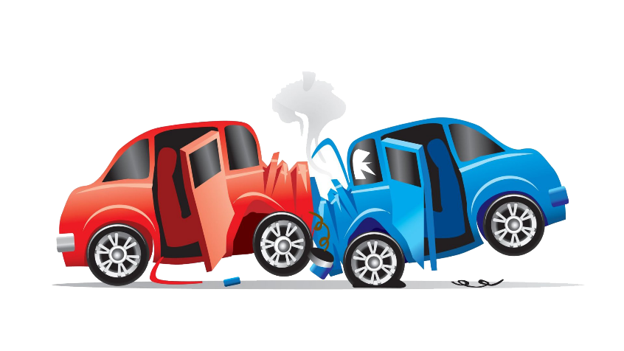

Matching Exercise
donkey | accident | limo | Africa

Slide 15
Matching Exercise
accident | limo | Africa | donkey

Slide 16
TRUE OR FALSE
1. Mrs. Beatty has never been to Africa before.
2. The hotel is on an island.
3. A donkey takes luggage to the hotel.
4. Donkeys always have mechanical problems.
5. Bob had a holiday in Africa.

Slide 17
TRUE OR FALSE
1. Mrs. Beatty has never been to Africa before. | TRUE
2. The hotel is on an island. | TRUE
3. A donkey takes luggage to the hotel. | TRUE
4. Donkeys always have mechanical problems. | FALSE
5. Bob had a holiday in Africa. | FALSE

