Slide 1
WHICH DRESS DO YOU LIKE BETTER?

Slide 2
VOCABULARY
blouse - 衬衫 - blaʊz
cheap - 便宜的 - ʧiːp
conservative - 保守 - kənˈsɜːvətɪv
cute - 可爱的 - kjuːt
expensive - 昂贵的 - ɪksˈpɛnsɪv
flattering - 讨人喜欢 - flætərɪŋ
prefer - 更喜欢 - priˈfɜː
purple - 紫色的 - pɜːpl
wear - 穿 - weə

Slide 3
1. 便宜的
2. 可爱的
3. 昂贵的
4. 紫色的

Slide 4
1. 便宜的 - cheap
2. 可爱的 - cute
3. 昂贵的 - expensive
4. 紫色的 - purple

Slide 5
WHICH DRESS DO YOU LIKE BETTER?
Cheryl: It's Mr. Evans's birthday. Remember?
Bob: Oh, right. Am I going?
Cheryl: Yes, you are.
Bob: OK.
Cheryl: So tell us what you think of our new clothes.
Bob: All those clothes are for one party?

Slide 6
Cheryl: No. We have to decide what to wear. What do you think of these blouses?
Bob: They're very flattering.
Marie: Which one do you like more?
Bob: What do you mean?
Cheryl: Which one do you prefer?
Bob: I like them both the same.
Marie: No, you don't. You're just saying that. You need to have an opinion.

Slide 7
Bob: No, no, no. I'm not doing that.
Cheryl: Bob, please. Help us decide what to wear.
Bob: OK.
Marie: Which skirt do you like?
Bob: The red one.
Cheryl: Great. That's not so hard, is it? Which shoes look better?
Bob: Those.

Slide 8
Marie: Which sweater do you prefer?
Bob: I like the purple one.
Cheryl: Bob, you like Marie's clothes more than mine.
Bob: No, I don't. That's not true!
Cheryl: Then which dress do you prefer?
Bob: That one!
Cheryl: This is Marie's dress, too! What's wrong with my clothes?

Slide 9
It's Mr. Evans's ______. Remember?.
wedding
graduation
birthday

Slide 10
No. We have to decide what to wear. What do you think of these ______?
blouses
dresses
pants

Slide 11
Which one do you ______?
like
prefer
want

Slide 12
Which ______ do you prefer?
coat
sweater
jumper

Slide 13
A ______ and jeans.
T-shirt
dress
underpants

Slide 14
That looks a little ______. Do you have anything more expensive?
rubbish
poor
cheap

Slide 15

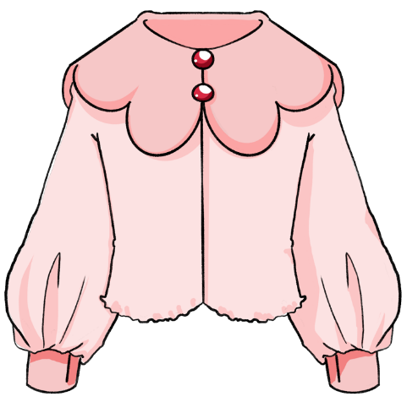
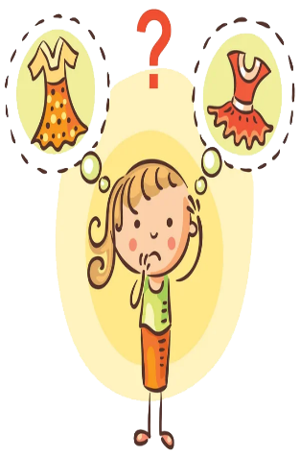
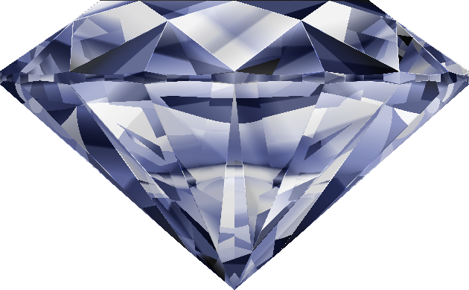
Matching Exercise
blouse | cheap | expensive | prefer

Slide 16
Matching Exercise
cheap | blouse | prefer | expensive

Slide 17
TRUE OR FALSE
1. It's Bob's birthday tomorrow.
2. Bob likes the red skirt.
3. Bob likes the purple sweater.
4. Bob says the green pants look cold.
5. Bob will wear a dress to the party.

Slide 18
TRUE OR FALSE
1. It's Bob's birthday tomorrow. | FALSE
2. Bob likes the red skirt. | TRUE
3. Bob likes the purple sweater. | TRUE
4. Bob says the green pants look cold. | FALSE
5. Bob will wear a dress to the party. | FALSE

Slide 19
IELTS Speaking Exam. Travel. Part 1
How do you plan your vacations?
When you visit new places, what do you like to do?
How do you find your way around new places?

