Slide 1
WHERE ARE THE TICKETS?

Slide 2
VOCABULARY
blow - 吹 - bləʊ
brand - 品牌 - brænd
gentle - 温和的 - ˈʤɛntl
inexpensive - 便宜 - ɪnɪksˈpɛnsɪv
junk - 垃圾 - ʤʌŋk
print - 打印 - prɪnt
tap - 轻打 - tæp
ticket - 票 - tɪkɪt

Slide 3
1. 吹
2. 打印
3. 轻打
4. 票

Slide 4
1. 吹 - blow
2. 打印 - print
3. 轻打 - tap
4. 票 - ticket

Slide 5
TNTV 4 - WHERE ARE THE TICKETS?
Bob: Where are the tickets?
Marie: They're printing. OK?
Bob: Mr. Evans needs them right now! The client is coming in five minutes!
Marie: This printer is driving me crazy. It's so slow.
Bob: Try blowing on it.
Marie: What? Really?

Slide 6
Bob: Try it. Now tap the sides. Just try it. Now rub this side gently.
Marie: Does this really work?
Cheryl: Where are the tickets?
Bob: They're printing. OK?
Cheryl: Mr. Evans needs them now! The client is coming in four minutes!
Bob: Easy there, Jackie Chan.

Slide 7
Marie: We need a new printer. Aren't we getting a new printer?
Cheryl: You're buying the new printer, aren't you?
Bob: This is the new printer.
Cheryl: This piece of junk is new?
Bob: Well ... It's new ... to us.
Cheryl: This is an old printer?
Bob: Just a little old.

Slide 8
Where are the ______?
documents
letters
tickets

Slide 9
This ______ is driving me crazy. It's so slow.
printer
computer
iPhone

Slide 10
______ needs them now! The client
is coming in four minutes!
Bob
Mr. Evans
Paul

Slide 11
We need a new ______ Aren't we getting a new ______?
toilet
printer
office

Slide 12
This piece of ______ is new?
junk
crap
rubbish

Slide 13
Cheryl: Is your cell phone working?
Paul: No, it's a ______.
melon
banana
lemon

Slide 14


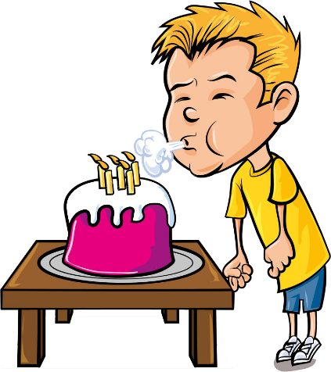

Matching Exercise
blow | tickets | junk | inexpensive

Slide 15
Matching Exercise
tickets | junk | inexpensive | blow

Slide 16
TRUE OR FALSE
1. The printer is slow.
2. Mr. Evans needs the tickets.
3. Bob blows on the printer.
4. Paul's laptop is a lemon.
5. Paul has an iphone 14.

Slide 17
TRUE OR FALSE
1. The printer is slow. | TRUE
2. Mr. Evans needs the tickets. | TRUE
3. Bob blows on the printer. | TRUE
4. Paul's laptop is a lemon. | FALSE
5. Paul has an iphone 14. | FALSE

