Slide 1
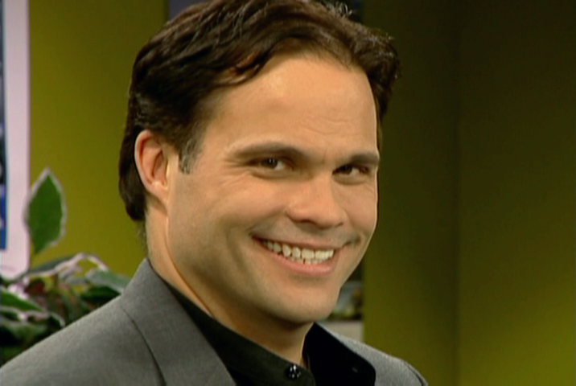
INTRODUCE ME

Slide 2
VOCABULARY
agency 机构 - eɪʤᵊnsi
client - 客户 - klaɪᵊnt
introduce - 介绍 - ɪntrəˈdjuːs
Italy - 意大利 - ɪtəli
manager - 经理 - mænɪʤə
occupation - 职业 - ɒkjəˈpeɪʃᵊn
office - 办公室 - ɒfɪs
receptionist - 接待员 - rɪˈsɛpʃᵊnɪst
sensation - 感觉 - sɛnˈseɪʃᵊn

Slide 3
1. 意大利
2. ɒfɪs
3. rɪˈsɛpʃᵊnɪst

Slide 4
1. 意大利 - Italy
2. ɒfɪs - office
3. rɪˈsɛpʃᵊnɪst - receptionist

Slide 5
TNTV 1 - INTRODUCE ME
Mr. Evans: Marie, I'd like you to meet ...
Marie: Giorgio Moretti!
Mr. Evans: Oh, you know him.
Mr. Moretti: It's very nice to meet you. What's your name?
Marie: My name? UM ... uh ... Marie! Yes! I'm Marie.
Mr. Moretti: Very nice to meet you, Marie.

Slide 6
Mr. Evans: Marie is our receptionist. She's from Paris. Mr. Moretti is a new client. He's from Italy.
Cheryl: Giorgio Moretti! Giorgio Moretti! That's Giorgio Moretti!
Mr. Evans: Yes, I know. He's a new client. He's from Italy.
Cheryl: Introduce me! Introduce me!
Marie: Oh, yes. This is ...

Slide 7
Cheryl: Cheryl!
Marie: Cheryl! Yes. Cheryl. She's our ...
Cheryl: Office manager. Hello, Mr. Giorgio ... I mean, Mr. Moretti!
Mr. Moretti: Please. Call me Giorgio.
Cheryl: Call him Giorgio! It's so meet to nice ... I mean, nice to meet you.
Mr. Moretti: It's nice to meet you, too..

Slide 8
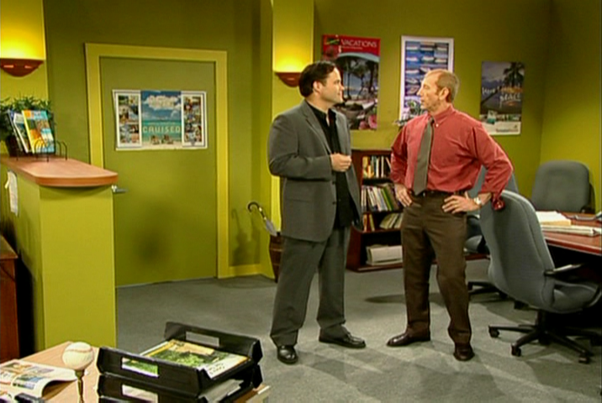
And you're traveling to ______?
Paris
London
Tokyo

Slide 9
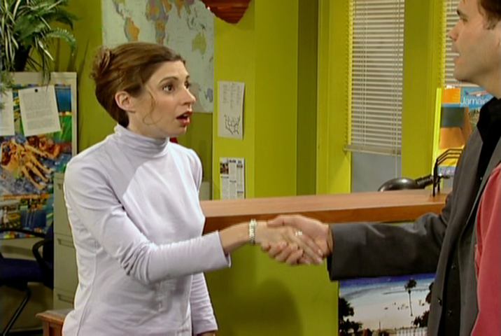
Marie is our ______.
receptionist
grandma
manager

Slide 10
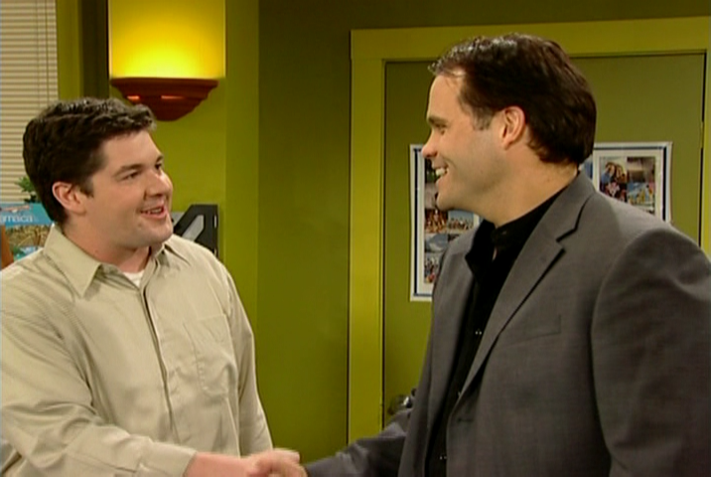
I'm ______, but everyone calls me Roberto.
Rob
Bob
Bill

Slide 11
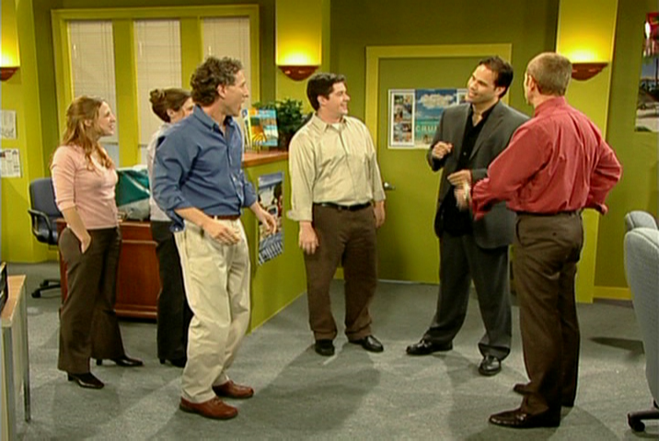
Paul is a ______.
tour guide
travel agent
tourist

Slide 12
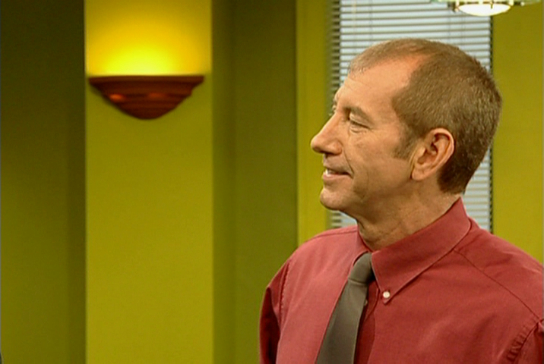
So, Mr. Moretti, what is your ______?
job
career
occupation

Slide 13
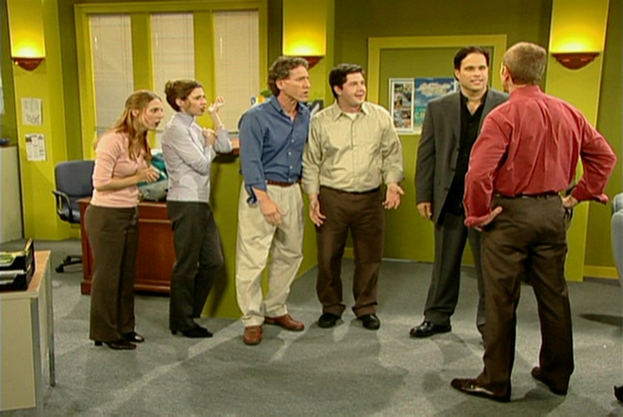
He's ______.
an actor
singer
pig

Slide 14
TRUE OR FALSE
1. Marie is from Paris.
2. Giorgio Moretti is from Italy.
3. Cheryl is a receptionist.
4. Bob is a tour guide.
5. Mr. Evans doesn't know Giorgio Moretti's occupation.

Slide 15
TRUE OR FALSE
1. Marie is from Paris. | TRUE
2. Giorgio Moretti is from Italy. | TRUE
3. Cheryl is a receptionist. | FALSE
4. Bob is a tour guide. | FALSE
5. Mr. Evans doesn't know Giorgio Moretti's occupation. | TRUE

