Slide 1
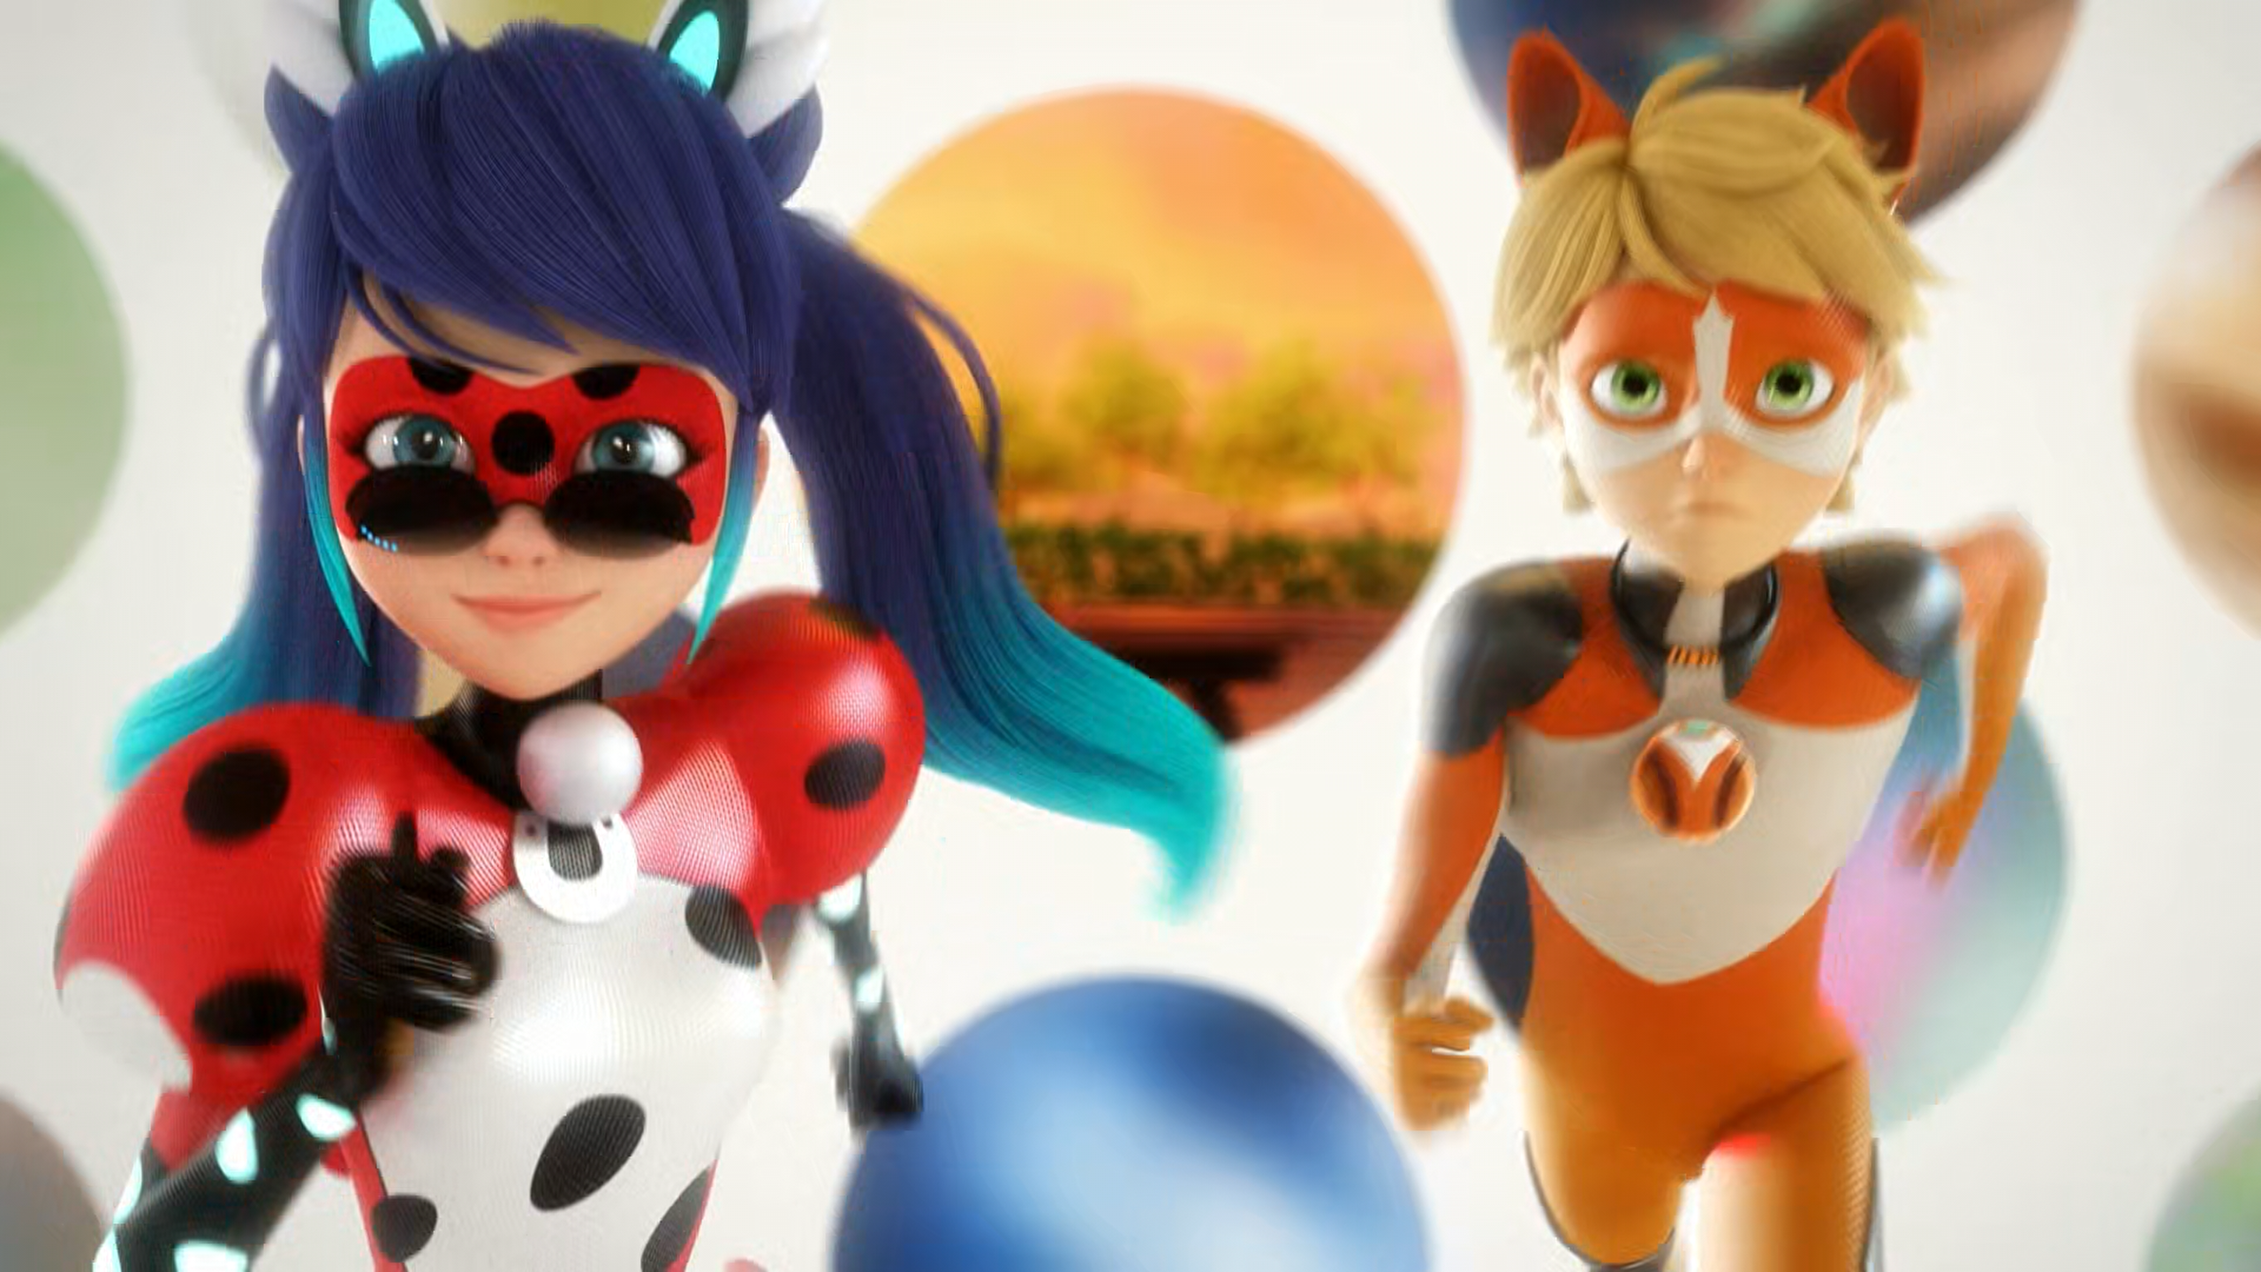
MIRACULOUS LADYBUG: RISK 2. PART 2

Slide 2
VOCABULARY
access - 通道 - æksɛs
courage - 勇气 - kʌrɪʤ
direct - 直接的 - daɪˈrɛkt
divide - 分 - dɪˈvaɪd
doubt - 怀疑 - daʊt
loyal - 忠诚的 - lɔɪəl
object - 对象 - ɒbʤɪkt
portal - 门户网站 - pɔːtᵊl
renounce - 宣布放弃 - rɪˈnaʊns

Slide 3
1. 勇气
2. daʊt
3. 忠诚的

Slide 4
1. 勇气 - courage
2. daʊt - doubt
3. 忠诚的 - loyal

Slide 5
RISK 2. PART 2
Pennybug: Thanks to your superpower, you can locate any object that you've touched before.
Flairmidable: Oh! Uh... Like this?
Pennybug: No! With the ball. A light touch will be enough.
Flairmidable: Okay, I get it. What about the object I'm supposed to find? Where is it?

Slide 6
Ladybug: Spots off!
Flairmidable: Lay down!
Marinette: Thanks again, Adrien. I'll take you back to the train.
Félix: I don't wanna get back on that train.
I wanna stay and fight with you.
Marinette: What about your trip? Are you going to stand up to your father?
Félix: Yes. You've given me the courage I need.

Slide 7
Rena Furtive: Let's rest.
Alya: (sadly) I'm sorry. I couldn't lie to Nino, we share everything, you know?
Ladybug: I get it. I share everything with my best friend, and I wasn't able to lie to her either.
Alya: You shouldn't ever trust me with it again. It's too risky, now that Shadow Moth knows.

Slide 8
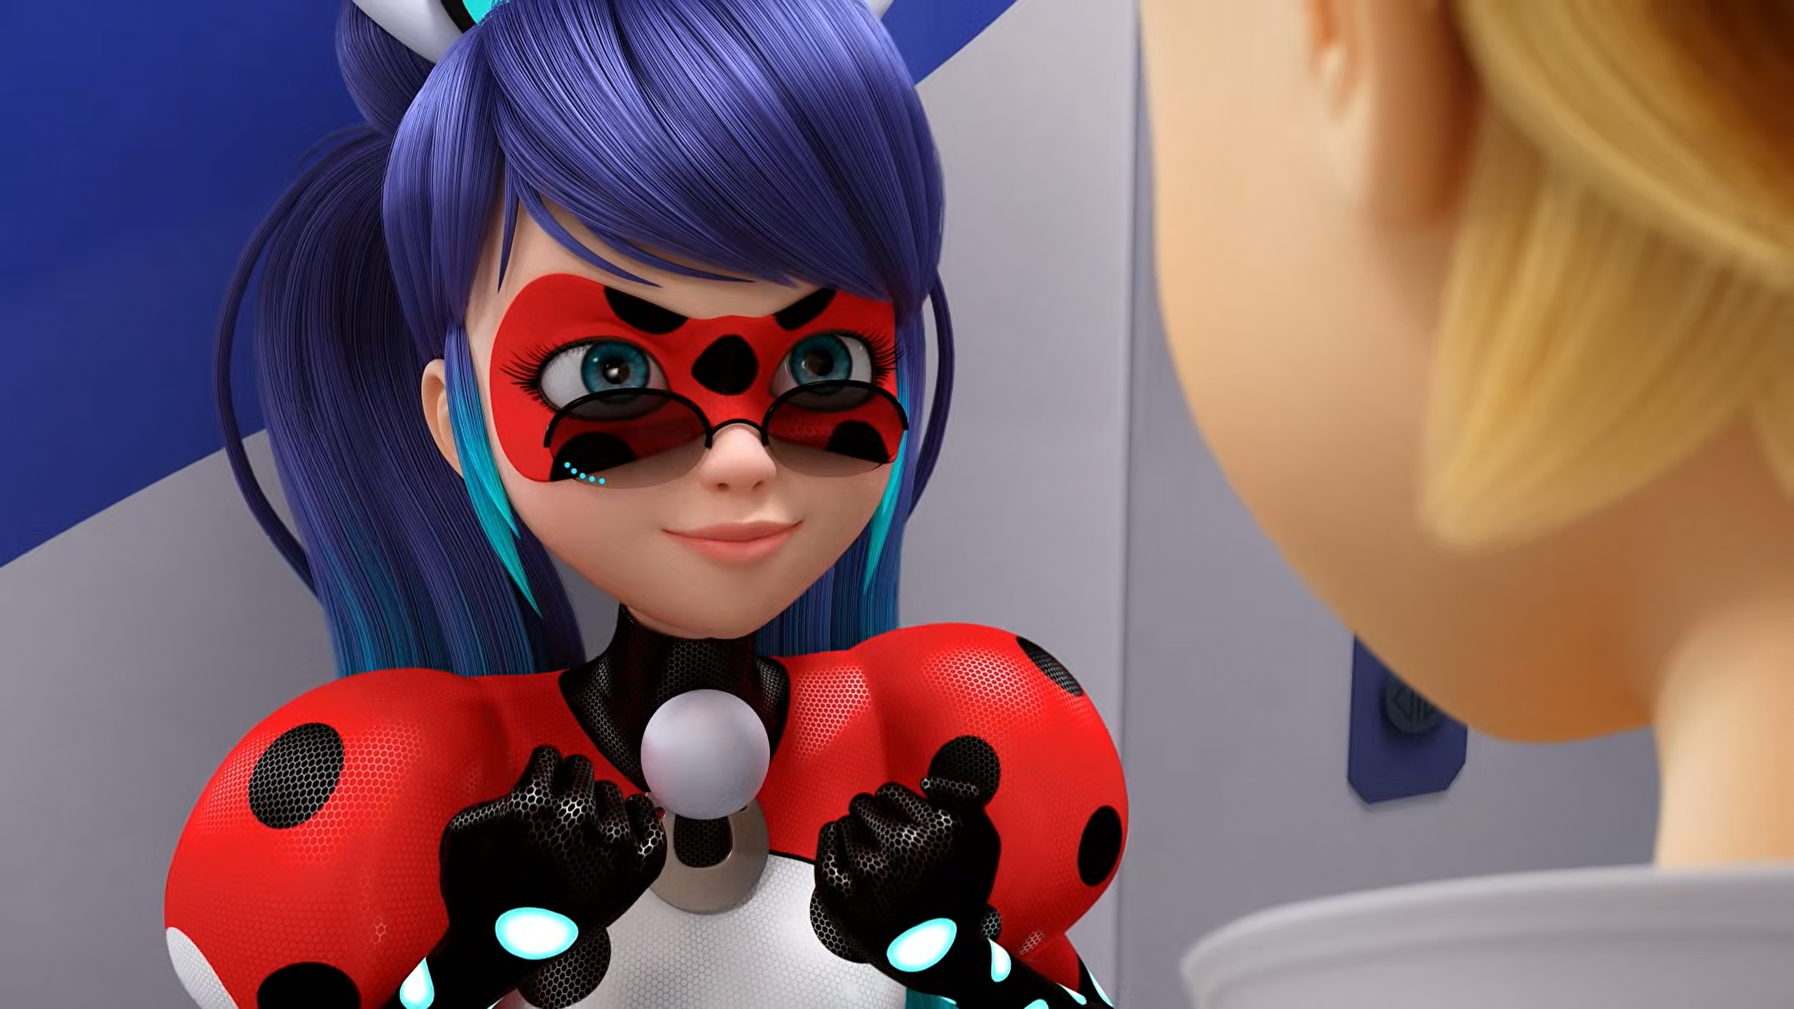

Ladybug with a few extra powers. ______!
Multibug
Timebug
Pennybug

Slide 9
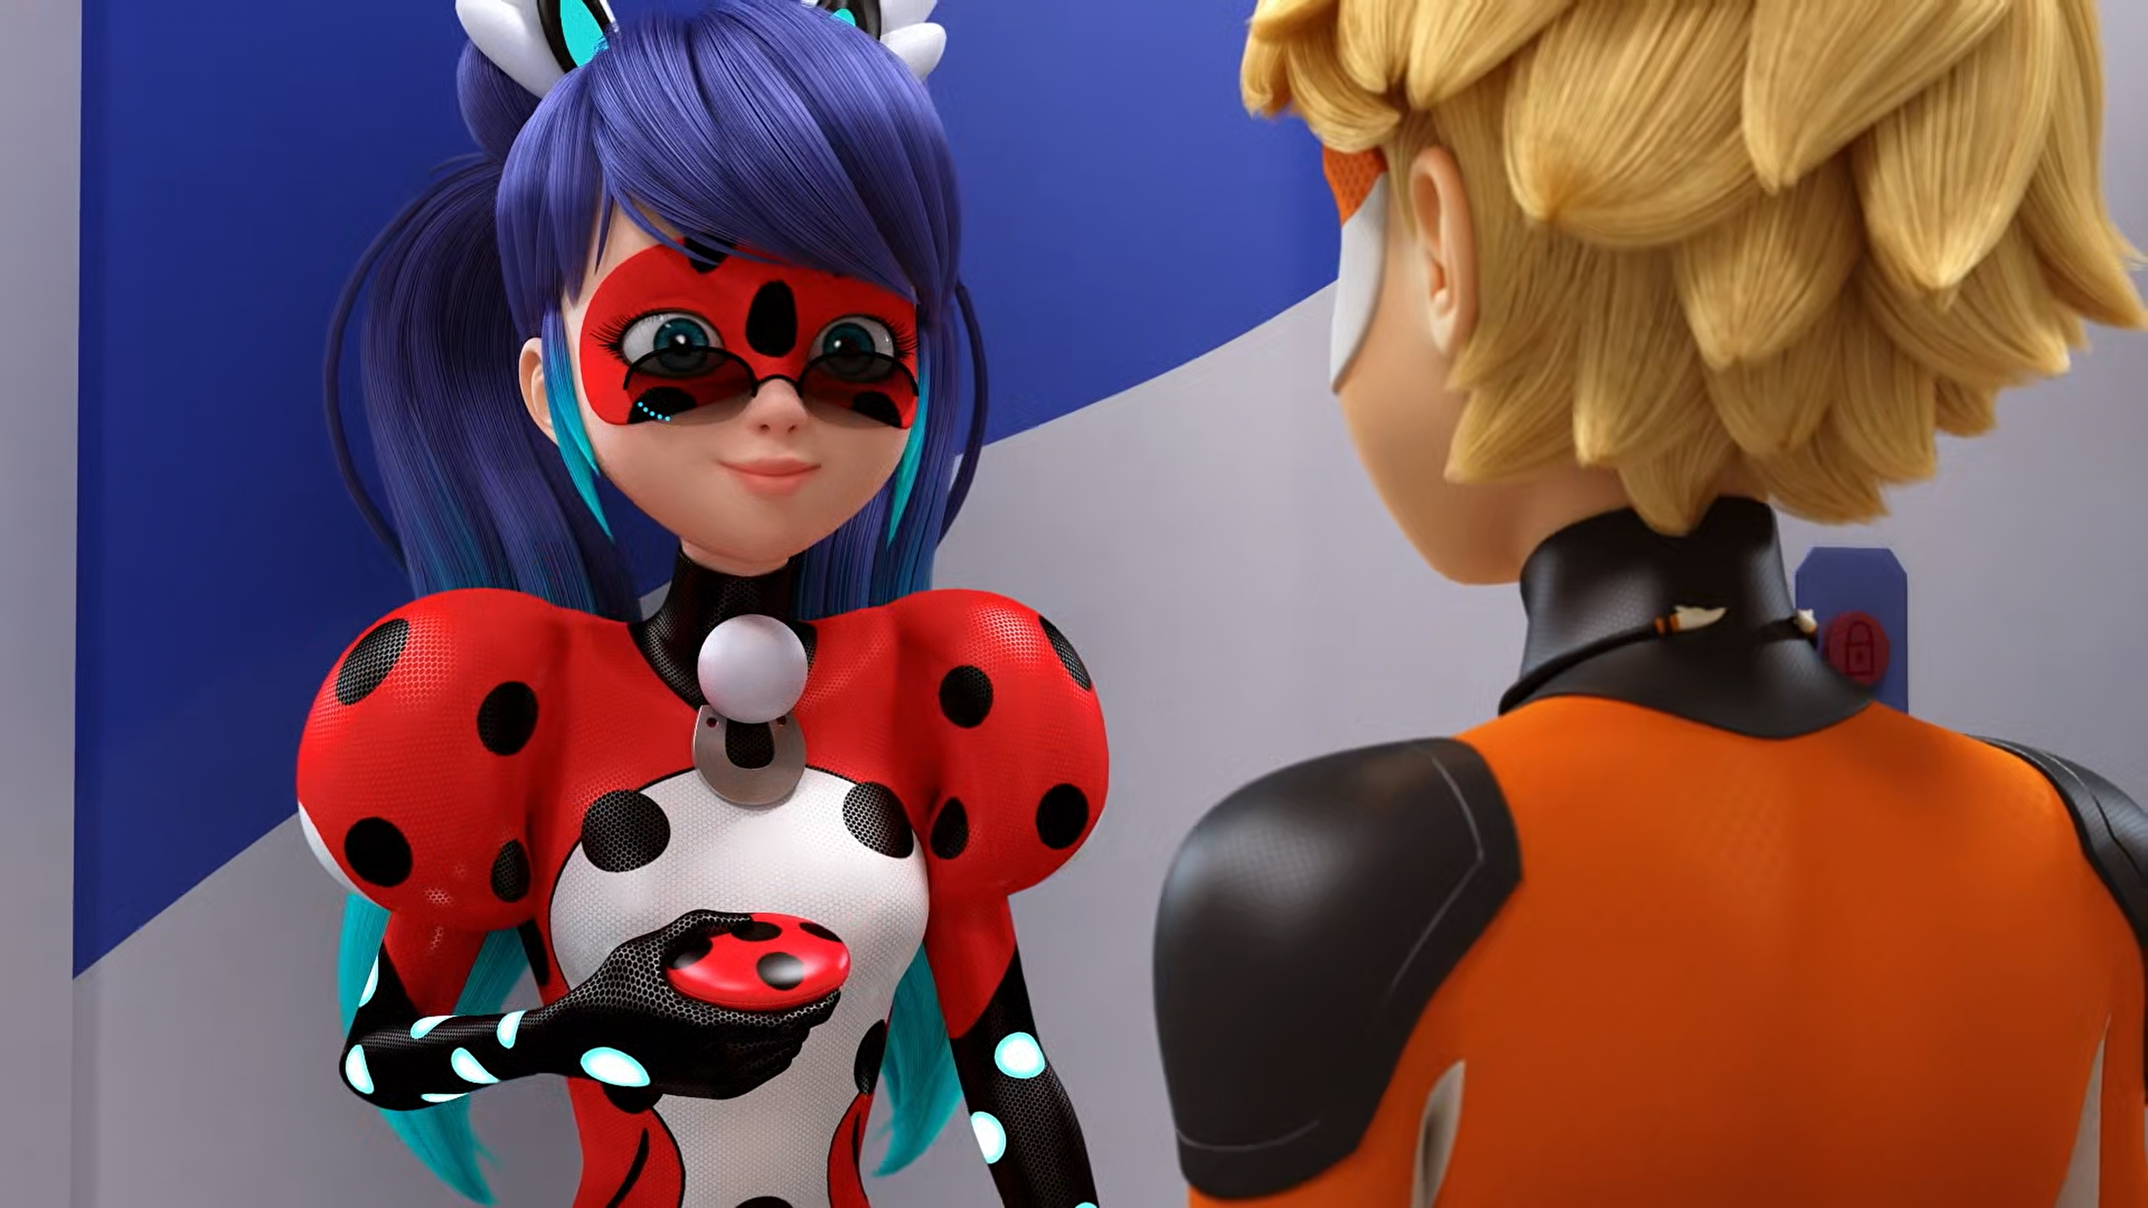
Thanks to your superpower, you can locate any object that you've ______.
touched
captured
smelled

Slide 10

We have to find the little ______ before he was akumatized.
girl
boy
pig

Slide 11
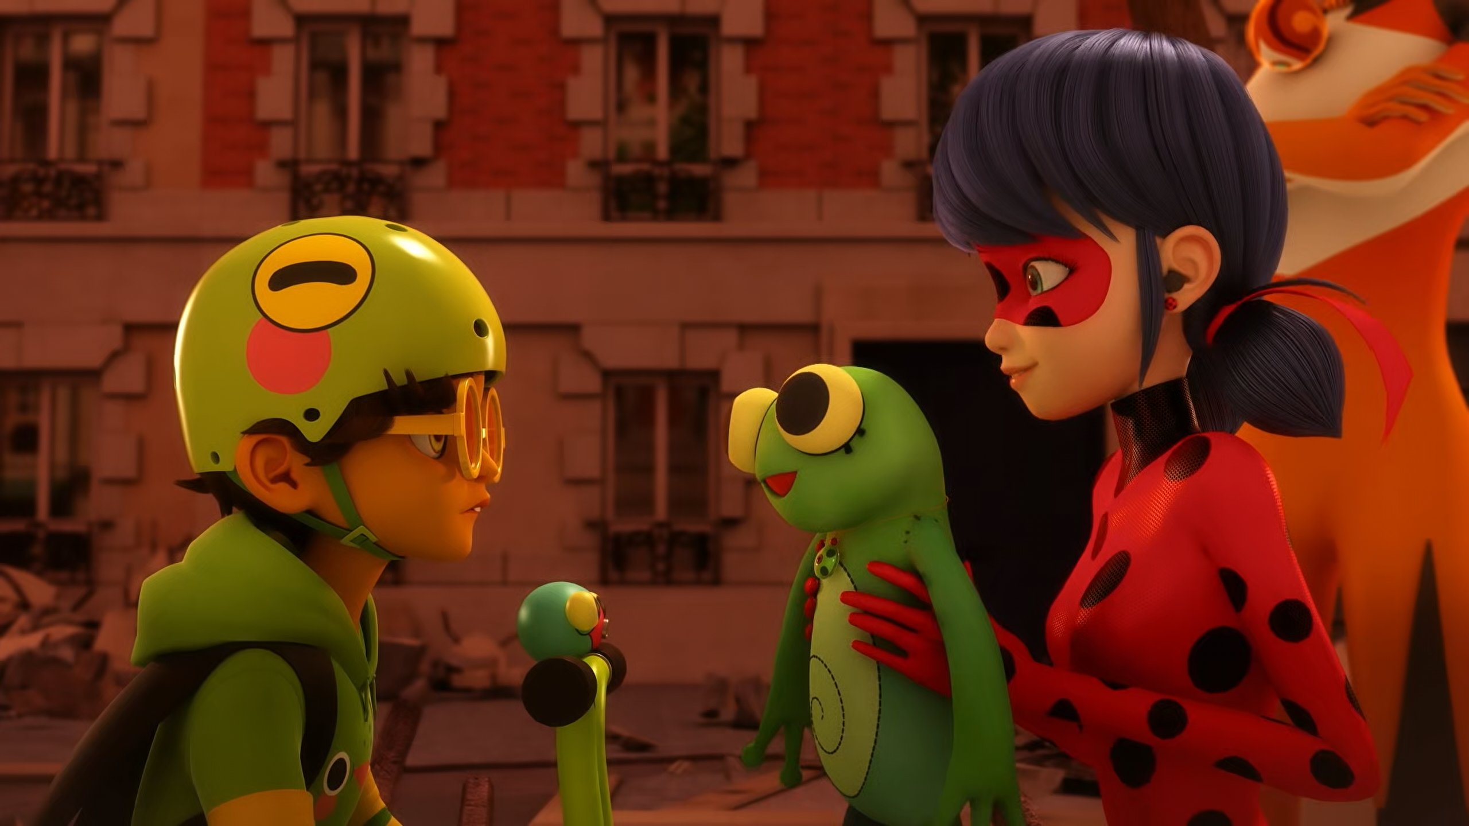
Here you go, little ______!
bitch
buddy
boy

Slide 12
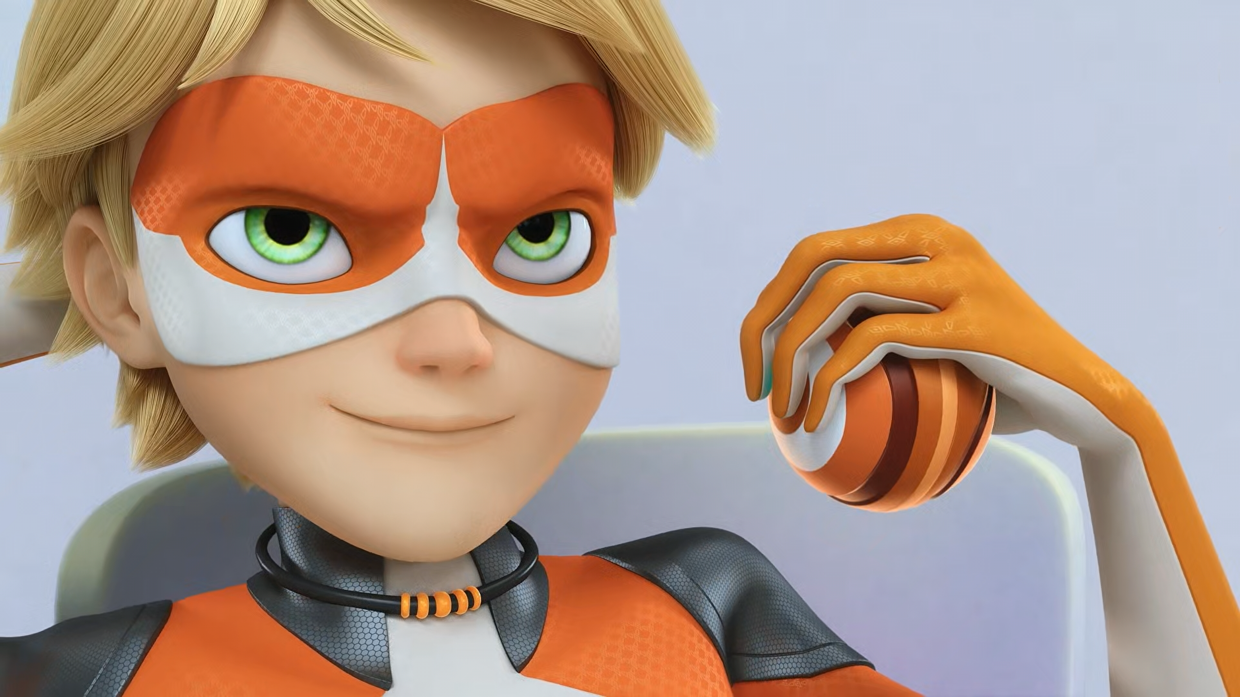
I want the real ______ Miraculous. And you’re going to give it to me.
Dog
Monkey
Peacock

Slide 13
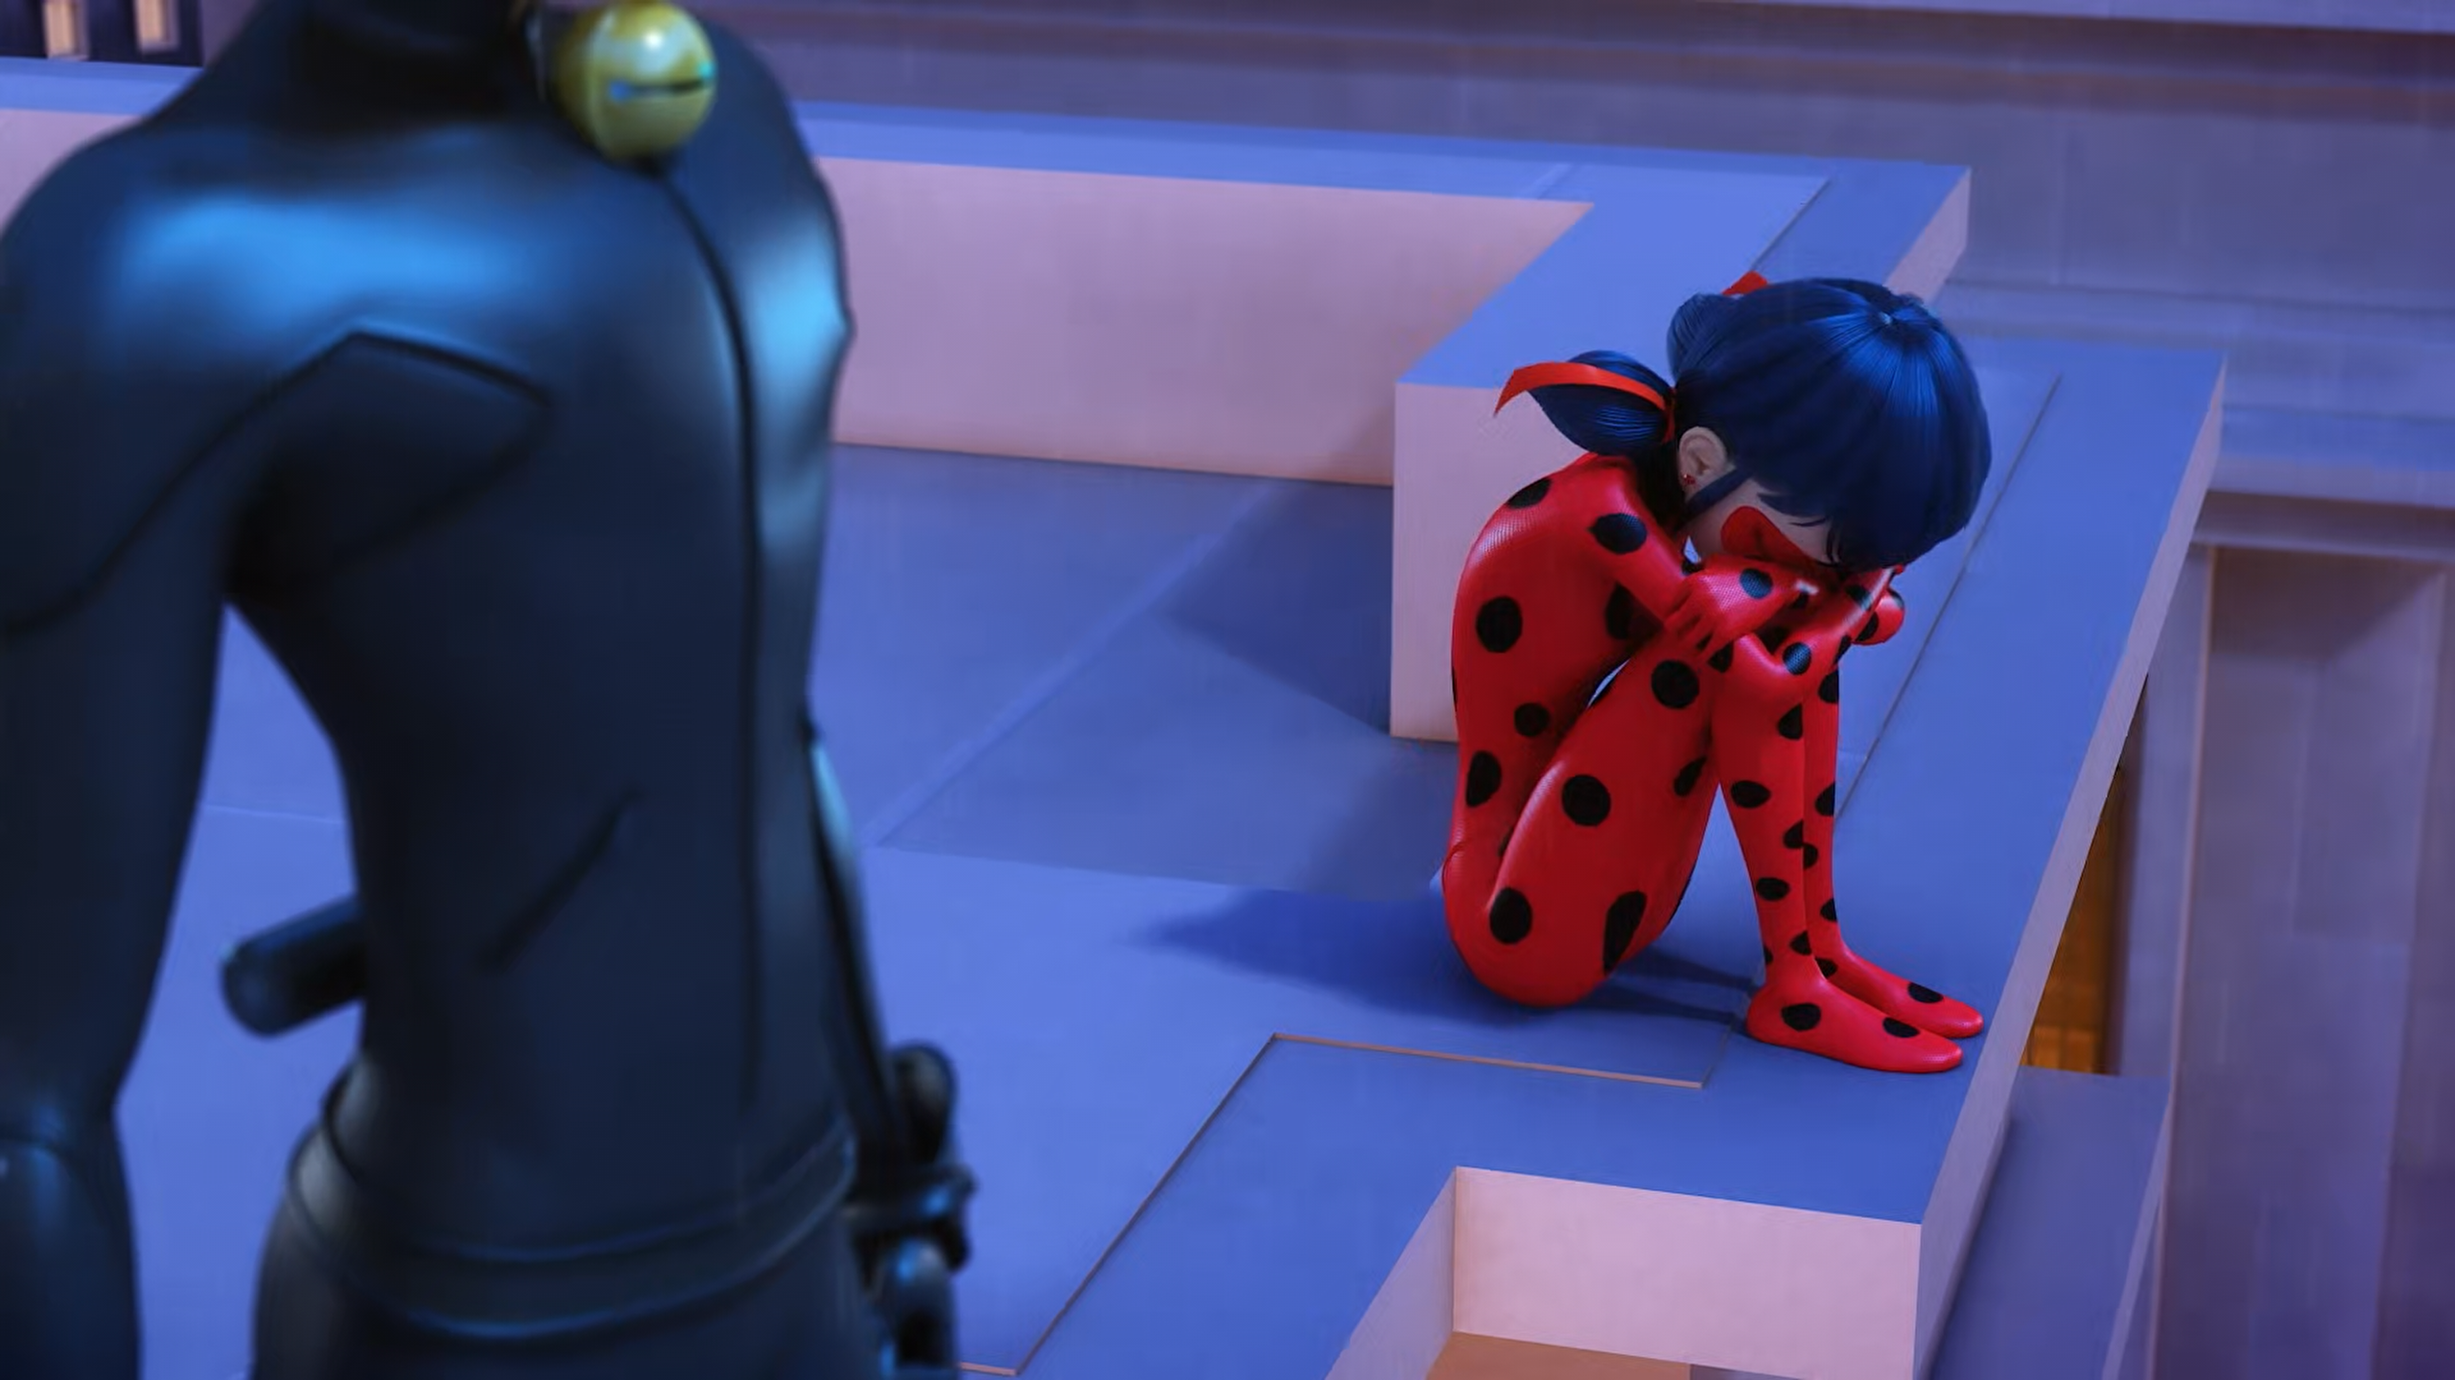
I've lost all the Miraculous! I'm the worst ______ ever!
Guardian
Ladybug
Girlfriend

Slide 14
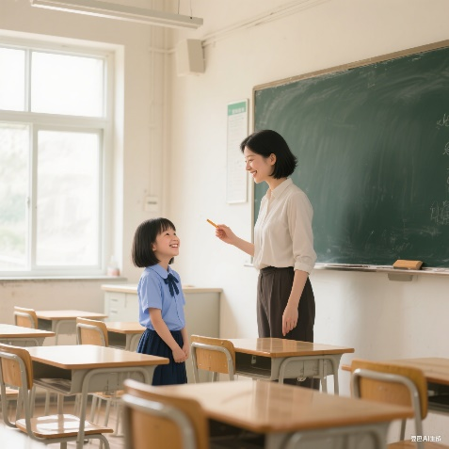
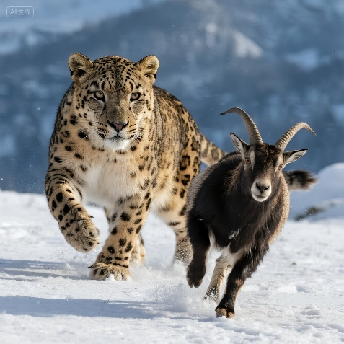
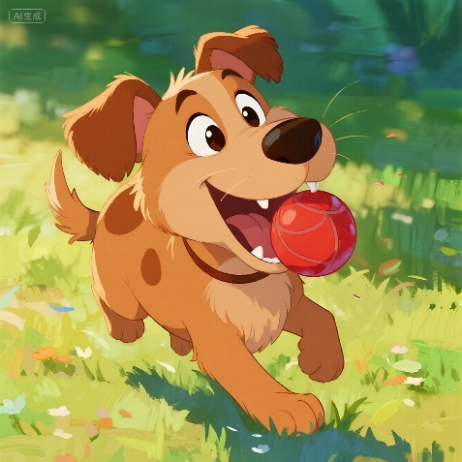
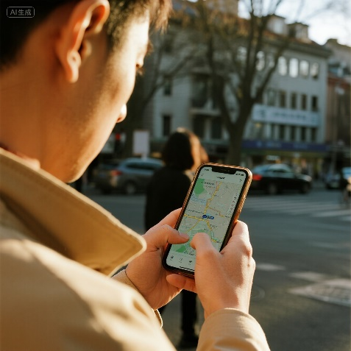
Matching Exercise
locate | fetch | hunt | adoration

Slide 15
Matching Exercise
adoration | hunt | fetch | locate

Slide 16
TRUE OR FALSE
1. Adrien is on the train to London.
2. Pennybug & Felix travel to the future.
3. Marinette gives the kwamis macaroons.
4. Gabriel gives Felix the Peacock Miraculous.
5. Felix steals the yoyo.

Slide 17
TRUE OR FALSE
1. Adrien is on the train to London. | FALSE
2. Pennybug & Felix travel to the future. | FALSE
3. Marinette gives the kwamis macaroons. | TRUE
4. Gabriel gives Felix the Peacock Miraculous. | TRUE
5. Felix steals the yoyo. | TRUE

