Slide 1
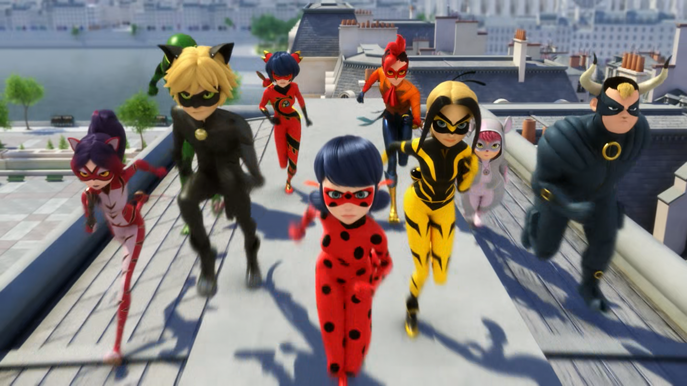
MIRACULOUS LADYBUG: RISK 2. PART 1

Slide 2
VOCABULARY
countless - 无数的 - ˈkaʊntləs
ensure - 确保 - ɪnˈʃɔː
limit - 限制 - lɪmɪt
multitude - 群众 - ˈmʌltɪtjuːd
opportunity - 机会 - ˌɒpəˈʧuːnəti
reinforcement - 巩固 - ˌriːɪnˈfɔːsmənt
seize - 抓住 - siːz
teleport - 远距离传送 - tɛləˈpɔrt
wrap - 包 - ræp

Slide 3
1. 限制
2. ɒpəˈʧuːnəti
3. tɛləˈpɔrt

Slide 4
1. 限制 - limit
2. ɒpəˈʧuːnəti - opportunity
3. tɛləˈpɔrt - teleport

Slide 5
RISK 2. PART 1
Ladybug: What's wrong with you? It's dangerous to stay here, shoo!
Cat Noir: Hey, little buddy old pal! Over here!
Ladybug: Don't stay here, otherwise you risk getting hit by the bad guy!
Risk: I'm Froggy, here I come. I'm not afraid of anyone.
Cat Noir: Come on, no time to waste!

Slide 6
André: Finally! Something more exciting than power or money - the magic of cinema!
Cat Noir: This is no time for a film shoot,
Mr. Mayor! It's pretty risky, okay?
Person on the helicopter: Head straight for him! If he attacks us, that'll make for some great footage!
Cat Noir: Do you think this villain is the reason why people are acting unusual?

Slide 7
Rena Furtive: Ladybug, everyone's got a mark in a shape of a frog's foot on their necks.
Ladybug: What?
Rena Furtive: You, Cat Noir, the others, all the people of Paris... we've all got that mark!
Cat Noir: Blind! We were blind. We're not just dealing with a sentimonster. There's also an akumatized villain!
Ladybug: That's why we're being so careless

Slide 8
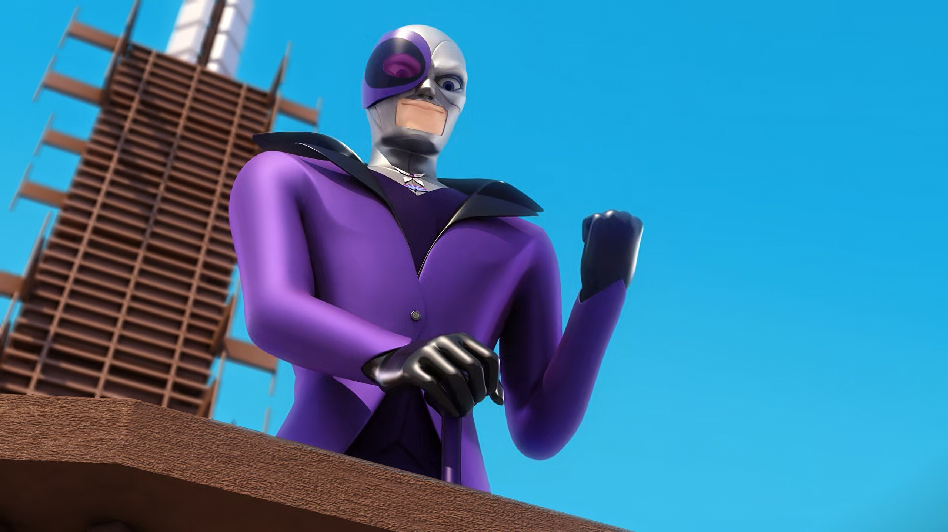

We must ensure that Ladybug and Cat Noir will take countless ______.
chances
gambles
risks

Slide 9
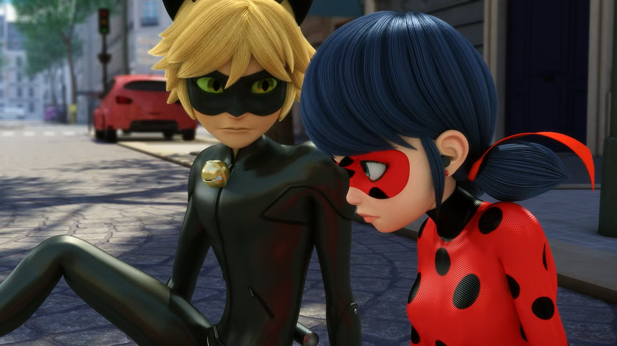
So why do you know the ______ of the other holders? So why not me?
identities
secrets
names

Slide 10
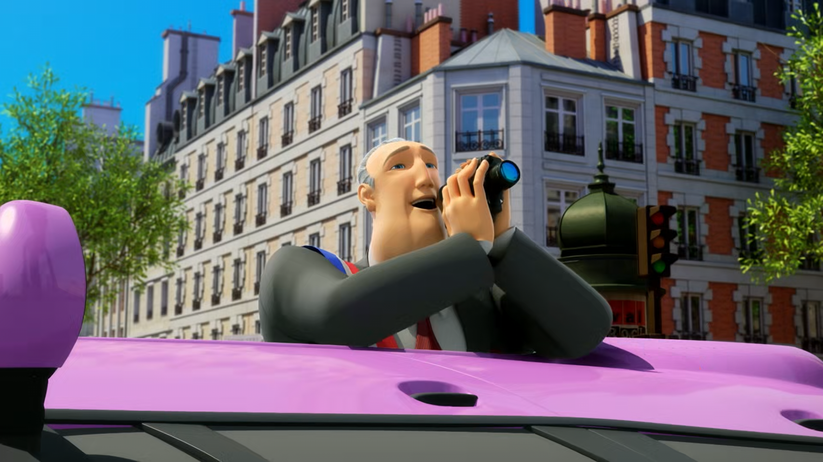
Finally! Something more exciting than power or ______.
KFC
money
Douyin

Slide 11
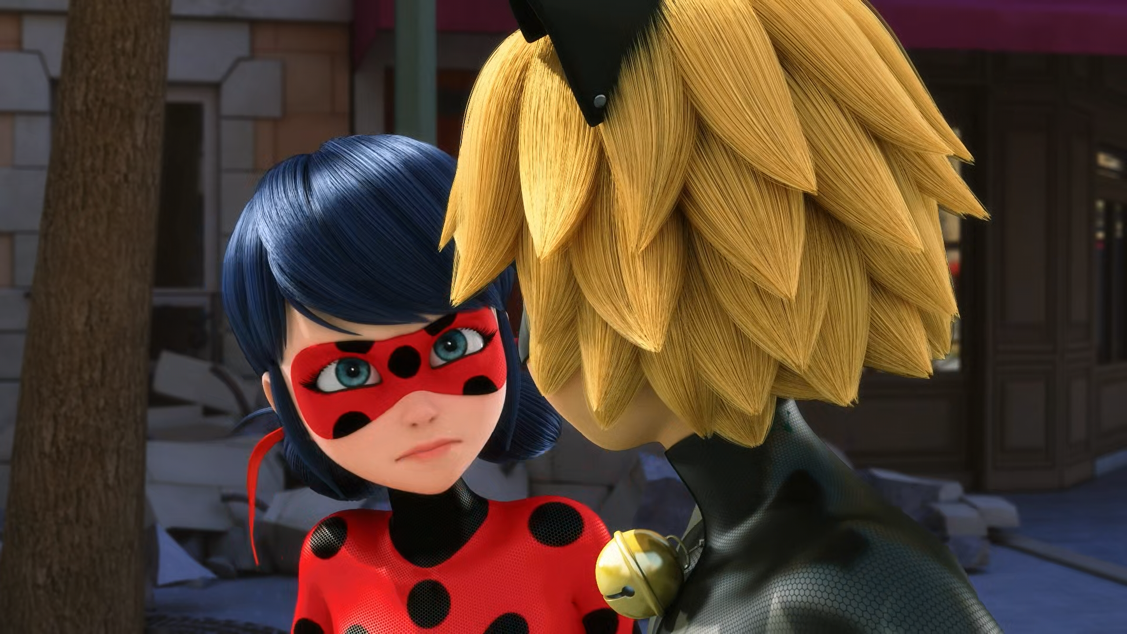
We won't be able to defeat him if we keep having to ______ people.
rescue
save
eat

Slide 12
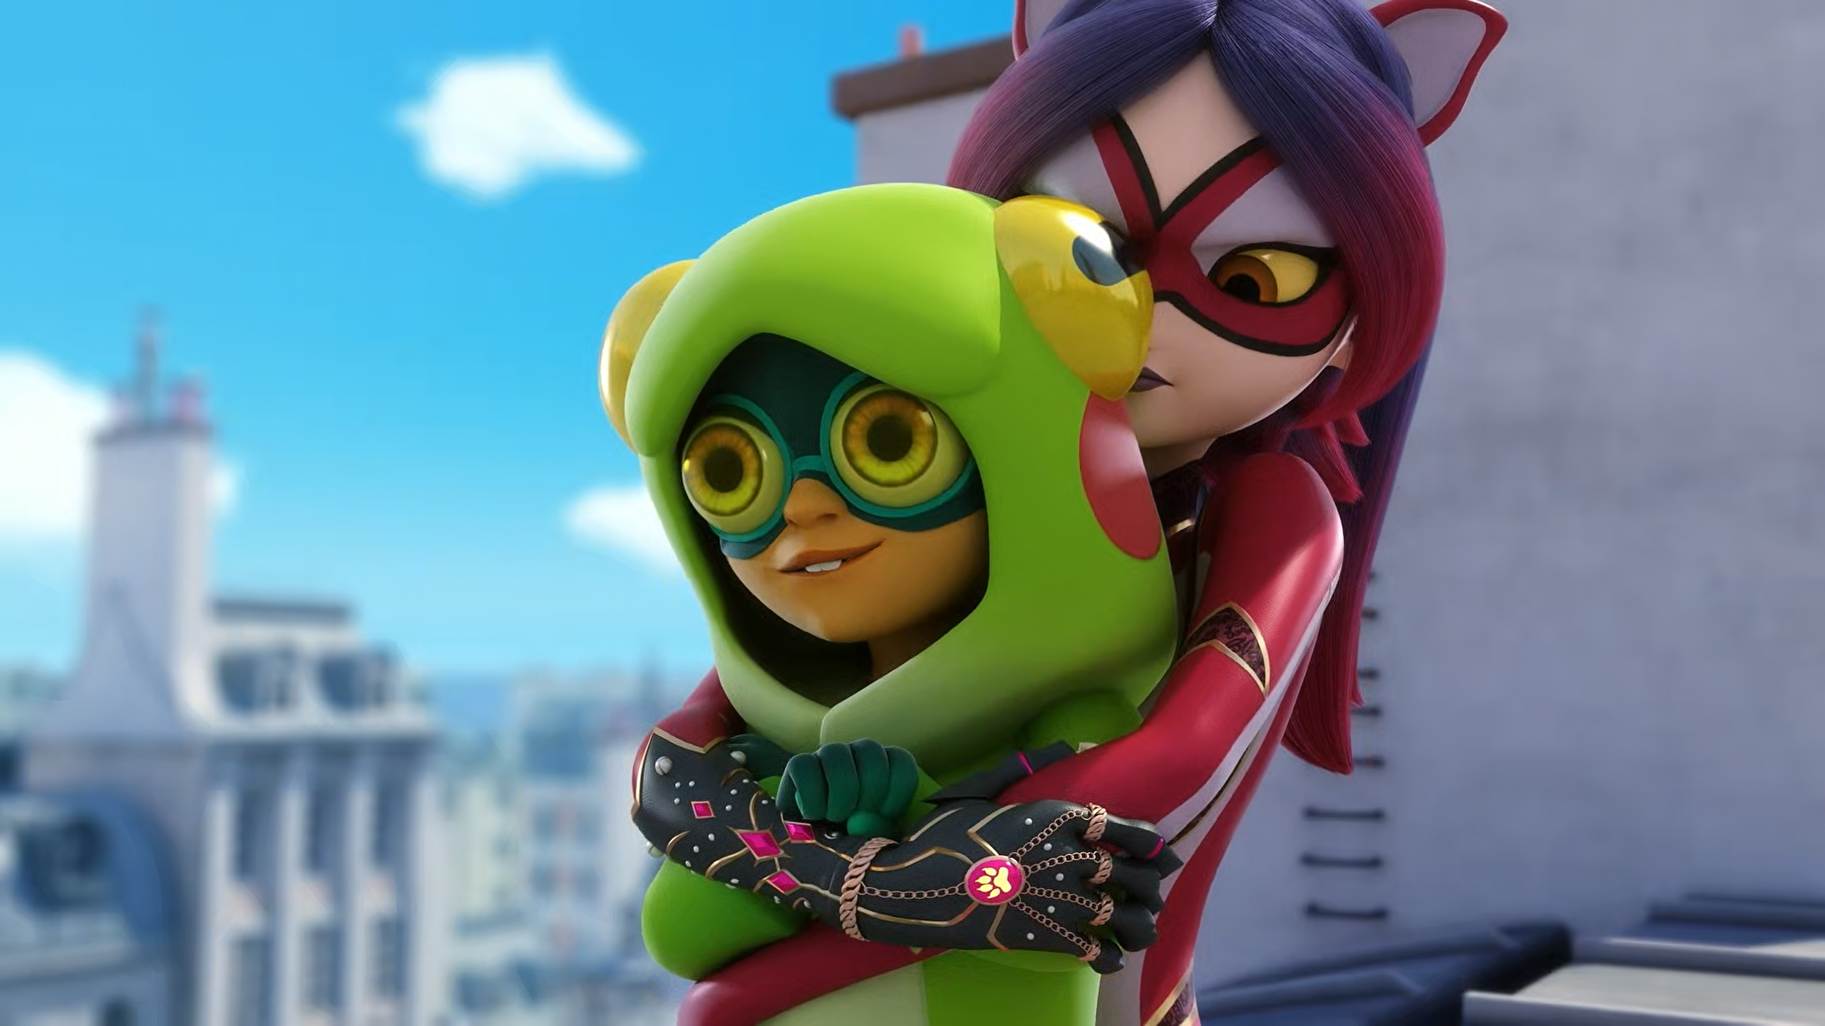
You'll never find my ______ 'cause my object's hidden from you!
WeChat
identity
akuma

Slide 13
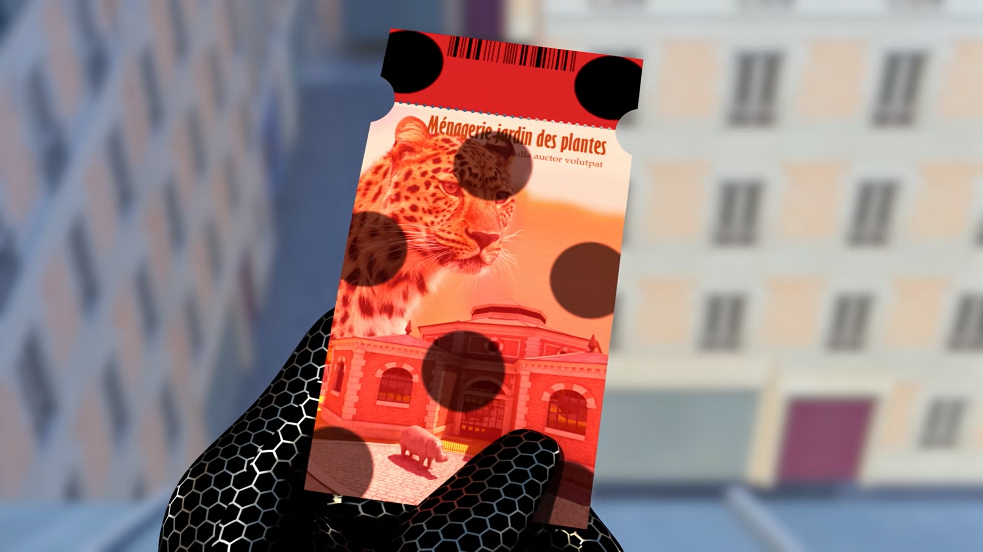
A ______ for the Jardin des Plantes? It's from yesterday.
ticket
poster
brochure

Slide 14
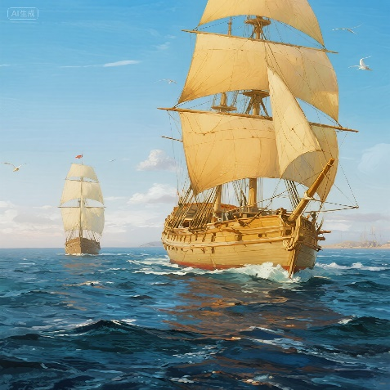
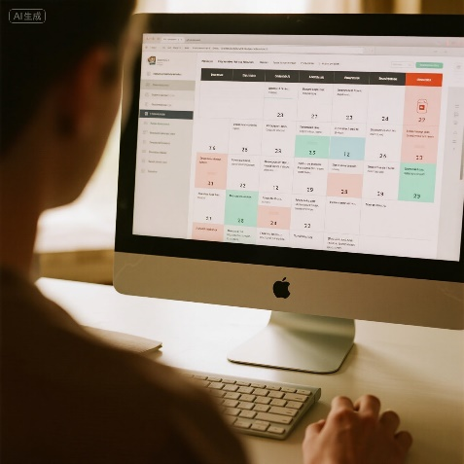
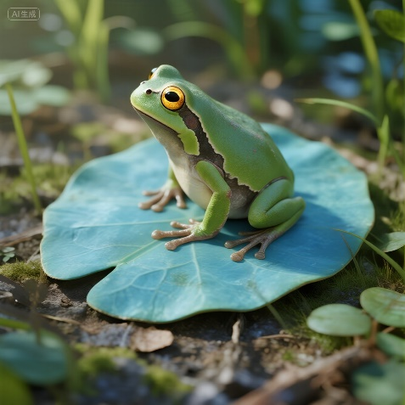
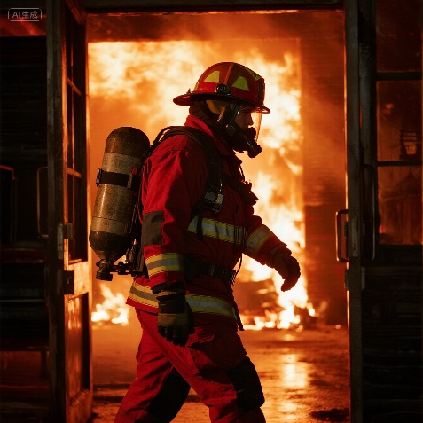
Matching Exercise
schedule | frog | risky | voyage

Slide 15
Matching Exercise
voyage | schedule | frog | risky

Slide 16
TRUE OR FALSE
1. Felix is on the train to London.
2. Ladybug tells Cat Noir where Rena Rouge is hidden.
3. Ladybug has the mark of a frog's foot on her neck.
4. Froggy has the akuma.
5. Marinette has a ticket from yesterday.

Slide 17
TRUE OR FALSE
1. Felix is on the train to London. | TRUE
2. Ladybug tells Cat Noir where Rena Rouge is hidden. | FALSE
3. Ladybug has the mark of a frog's foot on her neck. | TRUE
4. Froggy has the akuma. | FALSE
5. Marinette has a ticket from yesterday. | TRUE

