Slide 1
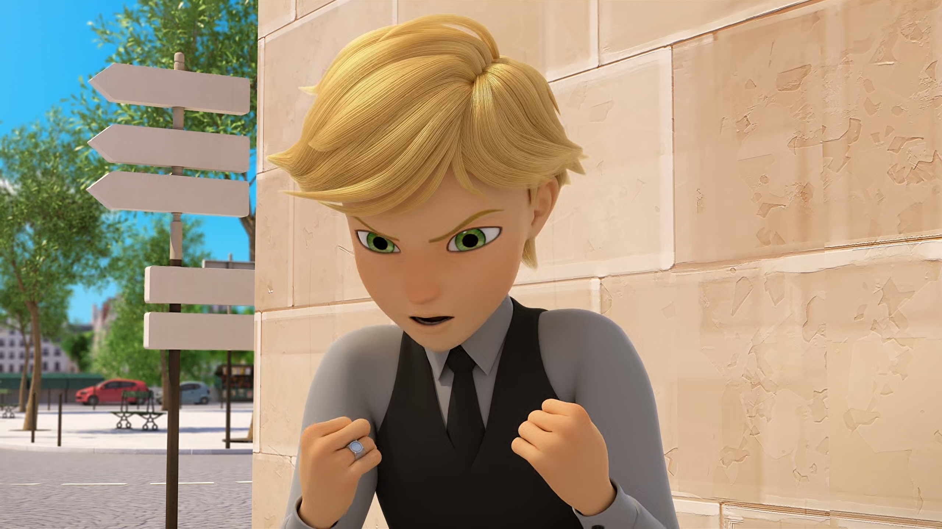
MIRACULOUS LADYBUG: RISK 1. PART 2

Slide 2
VOCABULARY
disobey - 不服从 - dɪsəˈbeɪ
frustrate - 使沮丧 - frʌsˈtreɪt
invisible - 看不见的 - ɪnˈvɪzəbᵊl
liberate - 解放 - lɪbəreɪt
meantime - 同时 - miːntaɪm
mock - 嘲弄 - mɒk
model - 模型 - mɒdᵊl
parameter - 参数 - pəˈræmɪtə
voyage - 航行 - vɔɪɪʤ

Slide 3
1. ɪnˈvɪzəbᵊl
2. 模型
3. 航行

Slide 4
1. ɪnˈvɪzəbᵊl - invisible
2. 模型 - model
3. 航行 - voyage

Slide 5
RISK 1. PART 2
Nino: You better send me some local music from your trip!
Kim: The photos of all the beaches where you swim!
Rose: And of the pretty sunsets!
Mr. D'Argencourt: You so richly deserve to finally see the beauty of this world!

Slide 6
Nino: Hang on! You wanna stop Adrien from travelling around the world? Adrien who's never allowed outside his house? Adrien who's never seen anything his whole life?
Alya: It's 'cause Lila's going with him, isn't it?
Rose: If you love him, you gotta let him go and live his dream!
Marinette: But it's not his dream! Adrien hates the film shoots!

Slide 7
Marinette: It's all over, Tikki.
Tikki: He'll be back, Marinette. He's just going on a voyage!
Marinette: Of course, Voyage! Ladybug may have failed, but Pegabug will bring him back! And together we'll go talk to his father!
Tikki: You wanna use the Miraculous of the Horse and teleport yourself, just for that?
Marinette: I'm ready to risk everything.

Slide 8
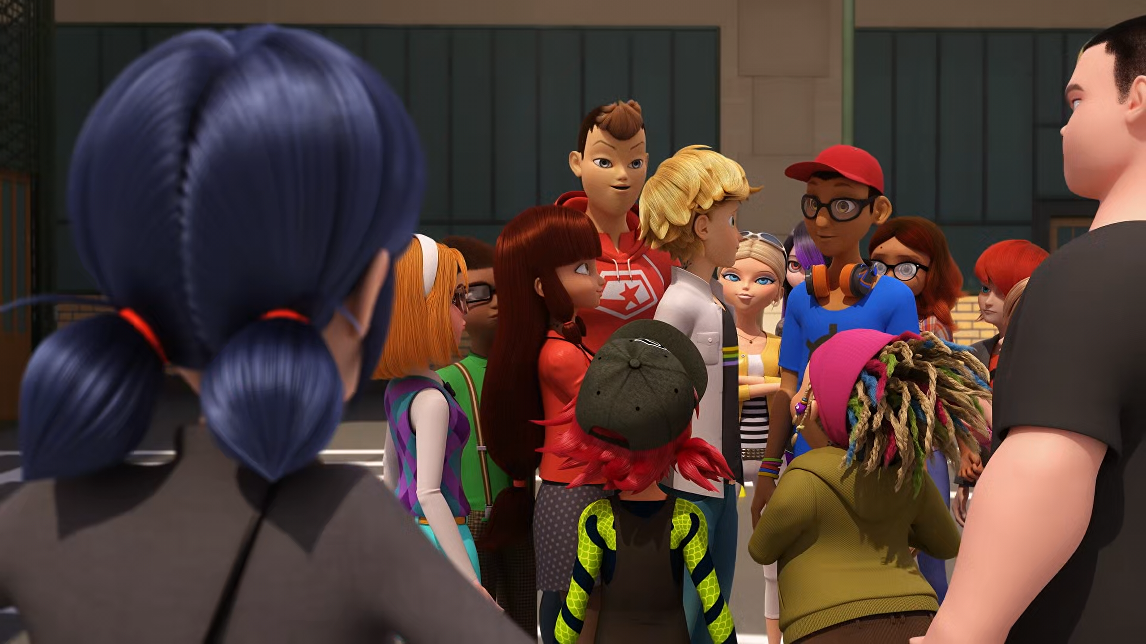

You better send me some local ______ from your trip!
girls
food
music

Slide 9
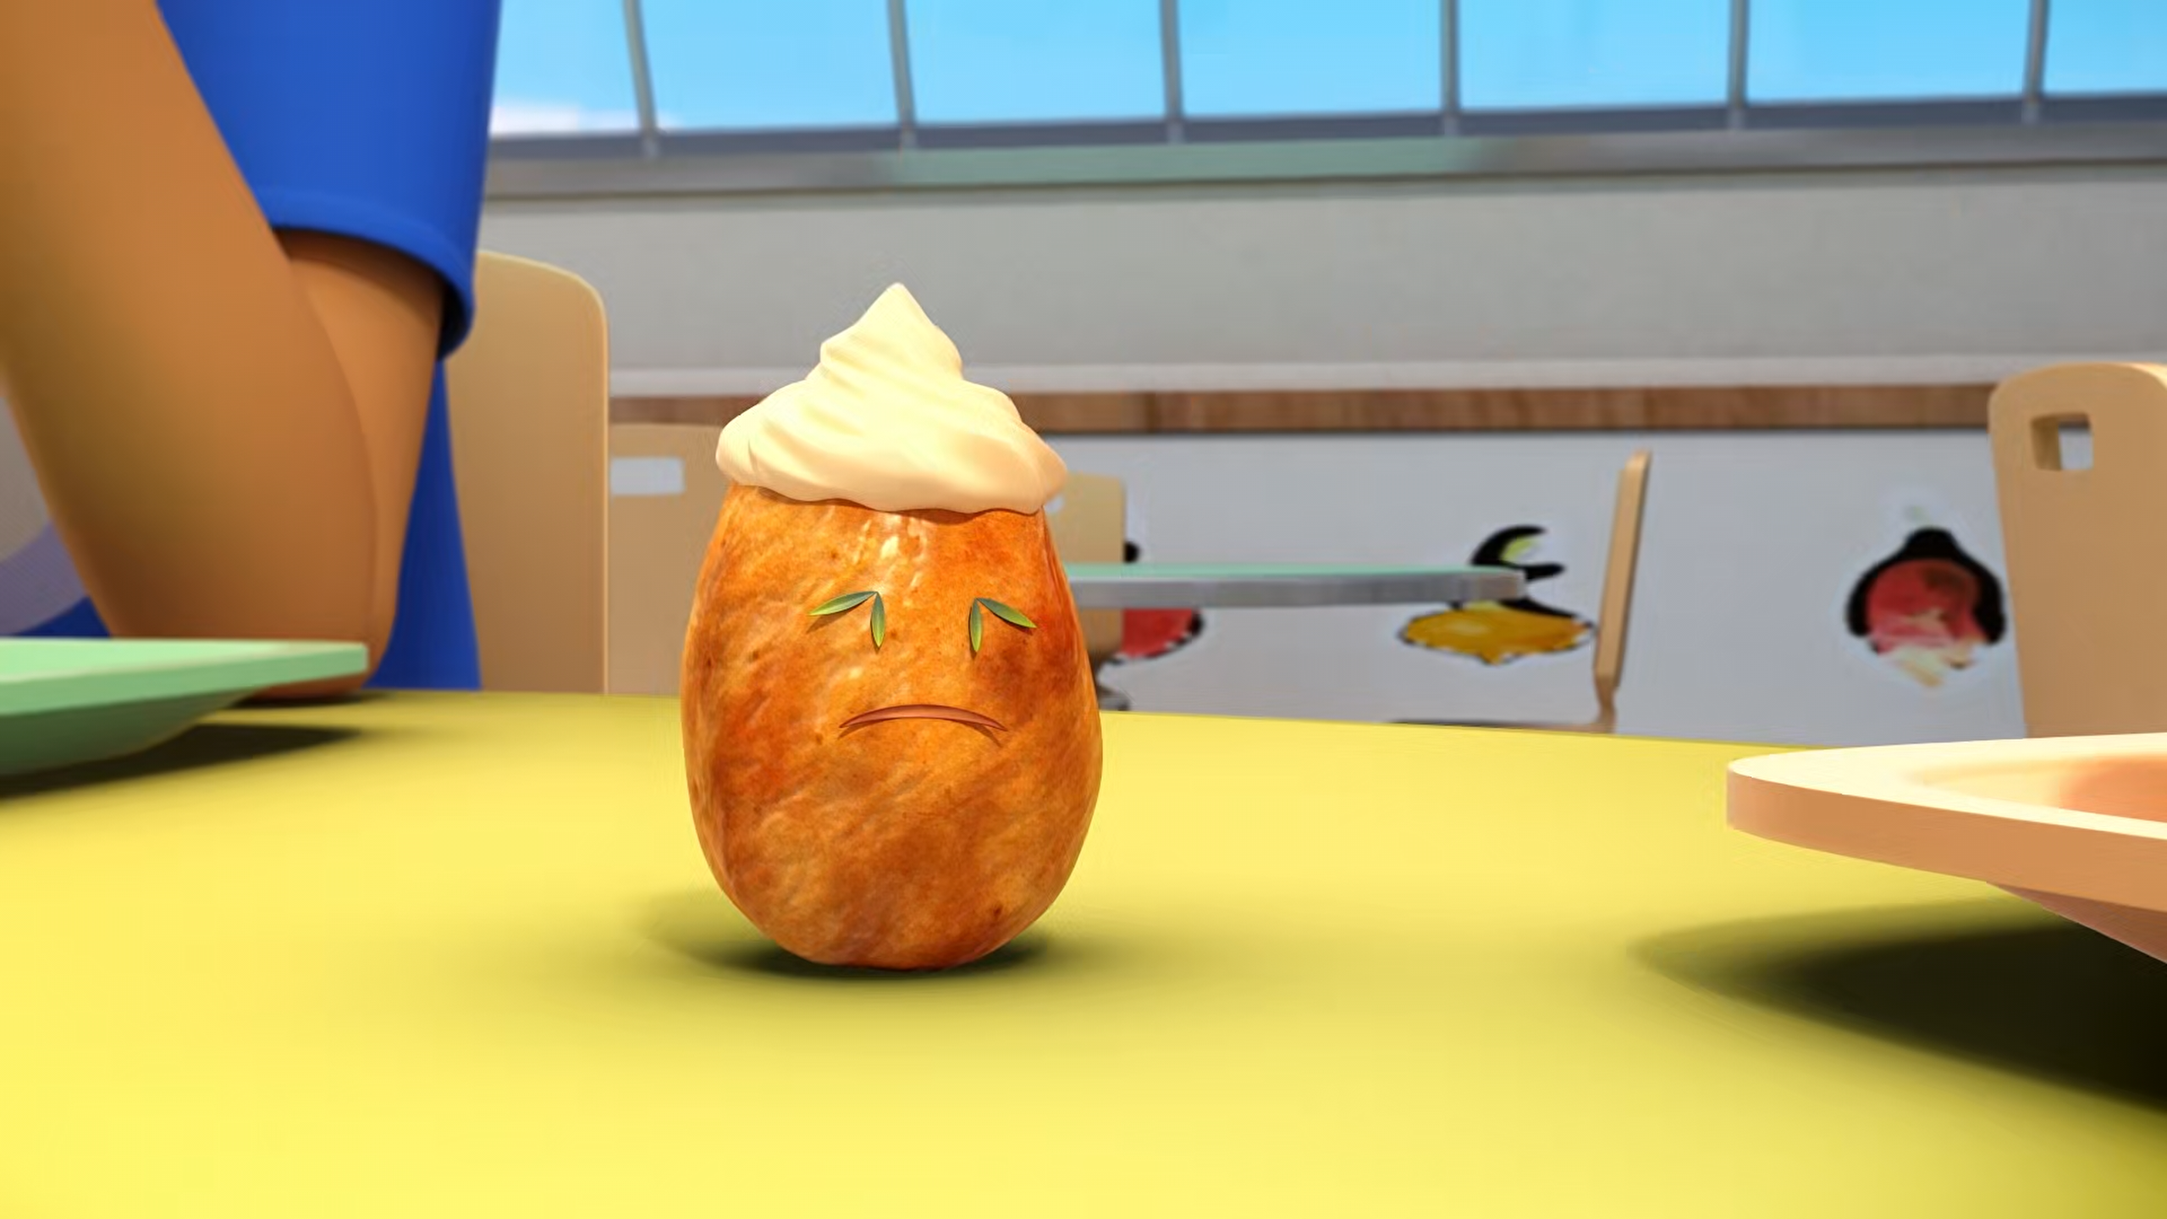
The ______ is Adrien. Alya, you'll be the juice box.
potato
turnip
mango

Slide 10
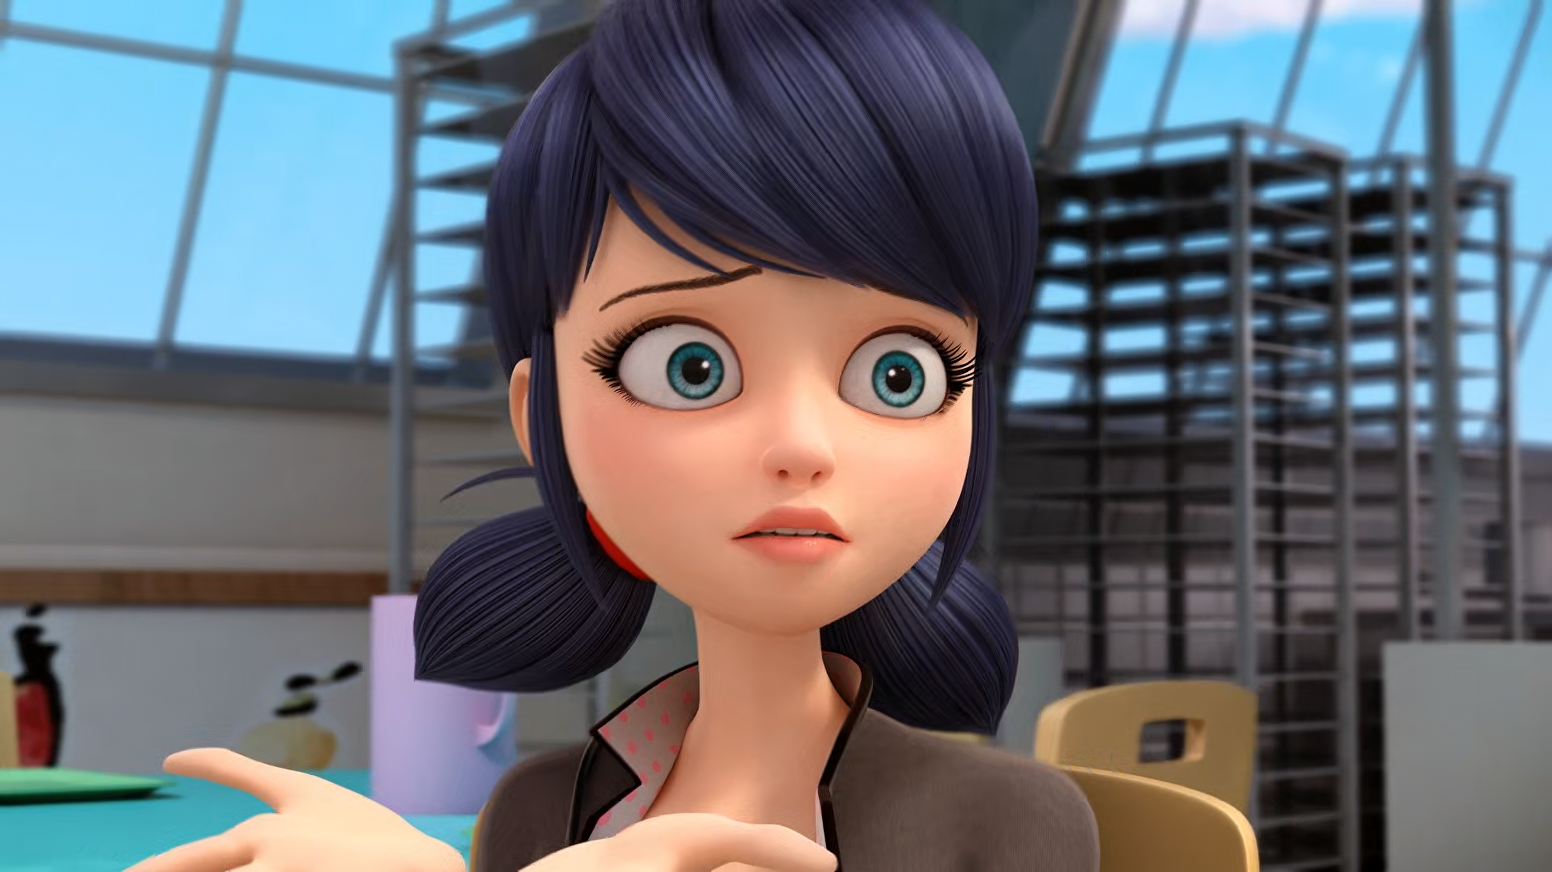
I'm not trying to save him from Lila, but from his ______!
grandma
father
fans

Slide 11
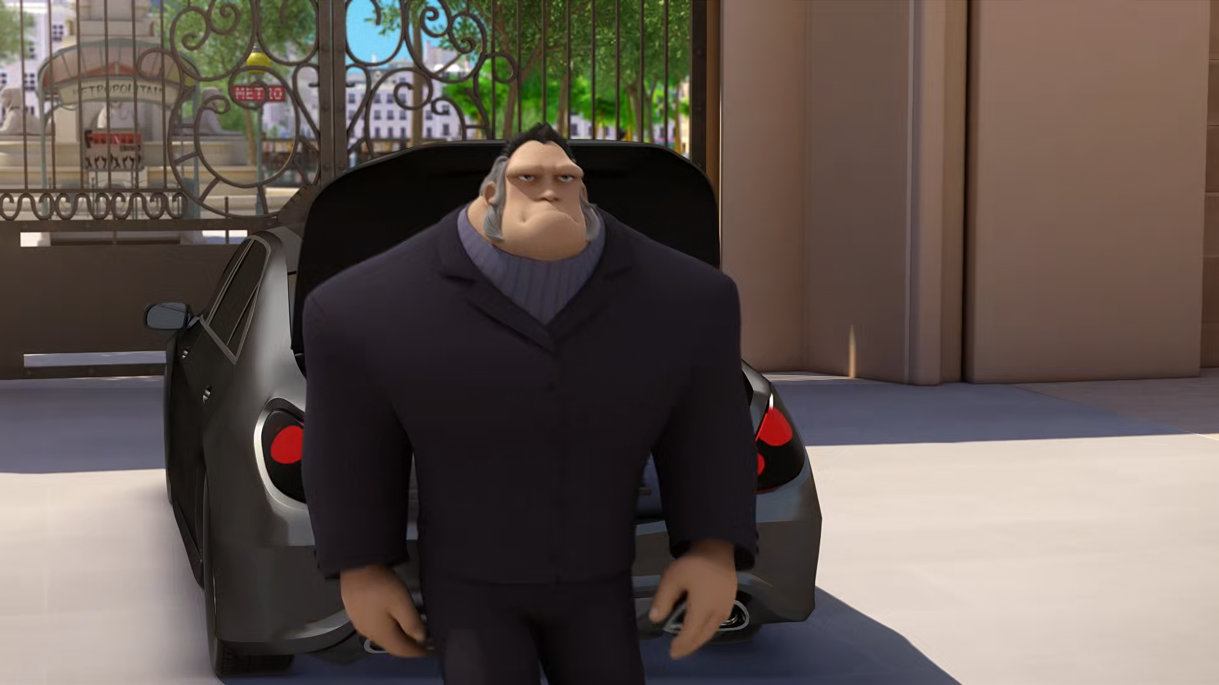
Excuse me! Could you give me a hand with my ______?
pants
suitcases
Miraculous

Slide 12
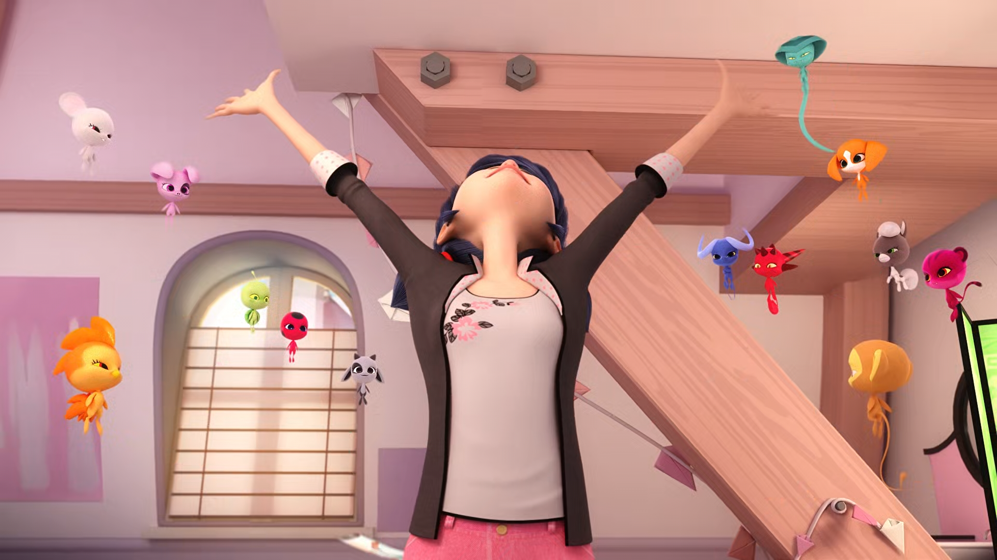
And to save a prince from a dragon, you need a ______!
night
lucky charm
knight

Slide 13
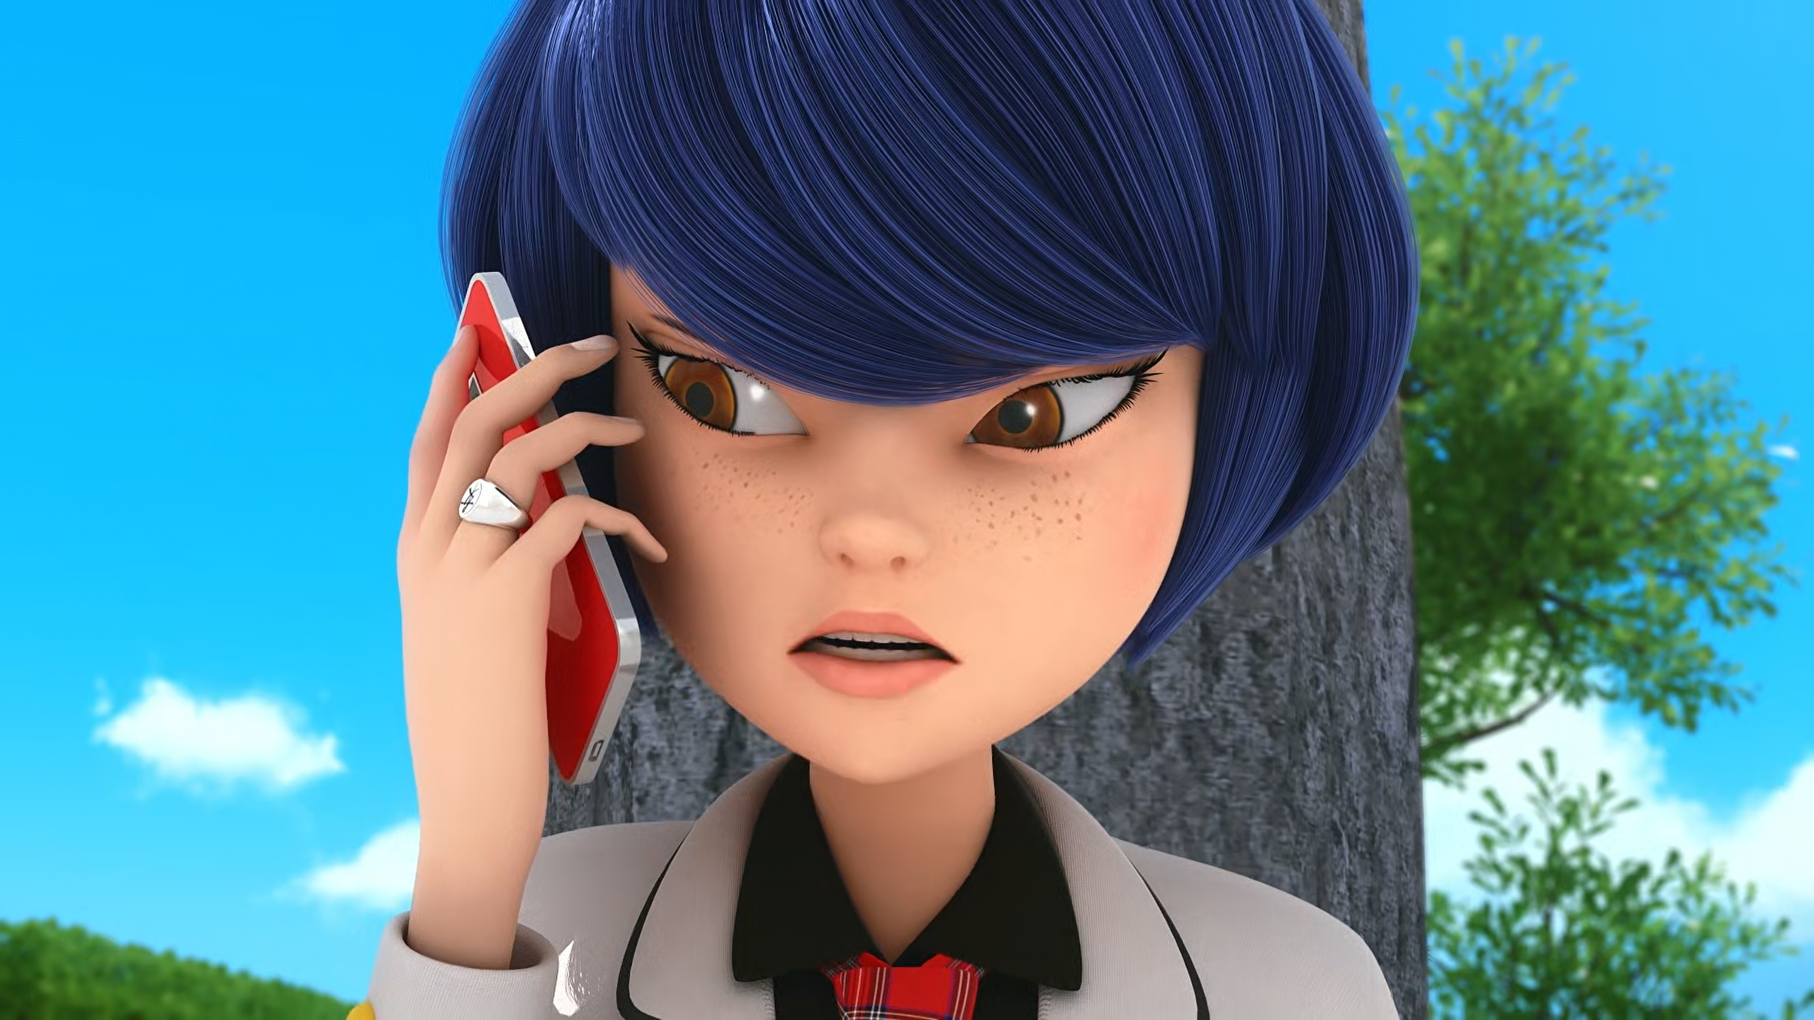
How long are you going to remain his ______, Adrien?
puppet
bitch
slave

Slide 14
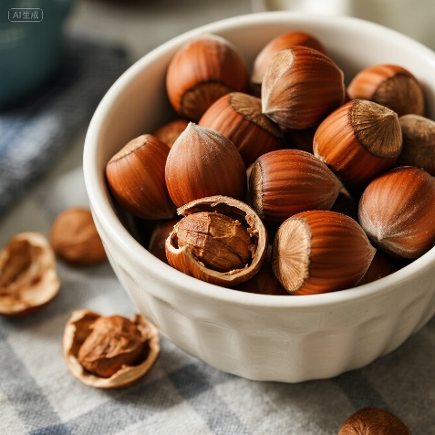
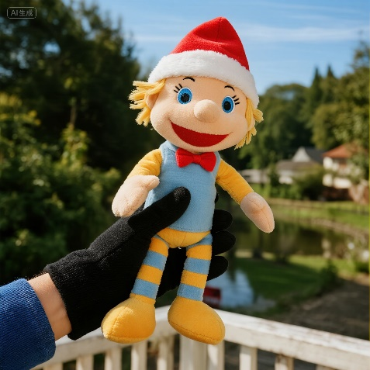

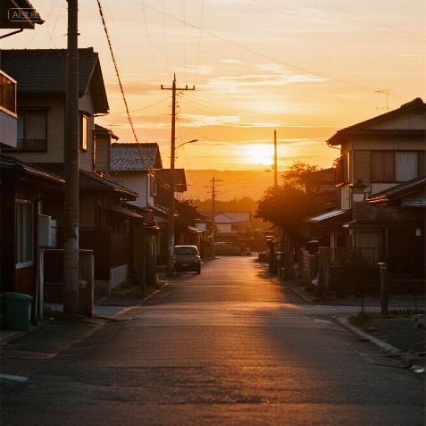
Matching Exercise
sunset | knight | puppet | hazelnuts

Slide 15
Matching Exercise
hazelnuts | puppet | knight | sunset

Slide 16
TRUE OR FALSE
1. Chloé's mum has a private jet.
2. Marinette's plan is to turn Adrien into a potato.
3. Felix is Adrien's cousin.
4. Kagami scolds Adrien.
5. Adrien gets on the train to Berlin.

Slide 17
TRUE OR FALSE
1. Chloé's mum has a private jet. | TRUE
2. Marinette's plan is to turn Adrien into a potato. | FALSE
3. Felix is Adrien's cousin. | TRUE
4. Kagami scolds Adrien. | TRUE
5. Adrien gets on the train to Berlin. | FALSE

