Slide 1
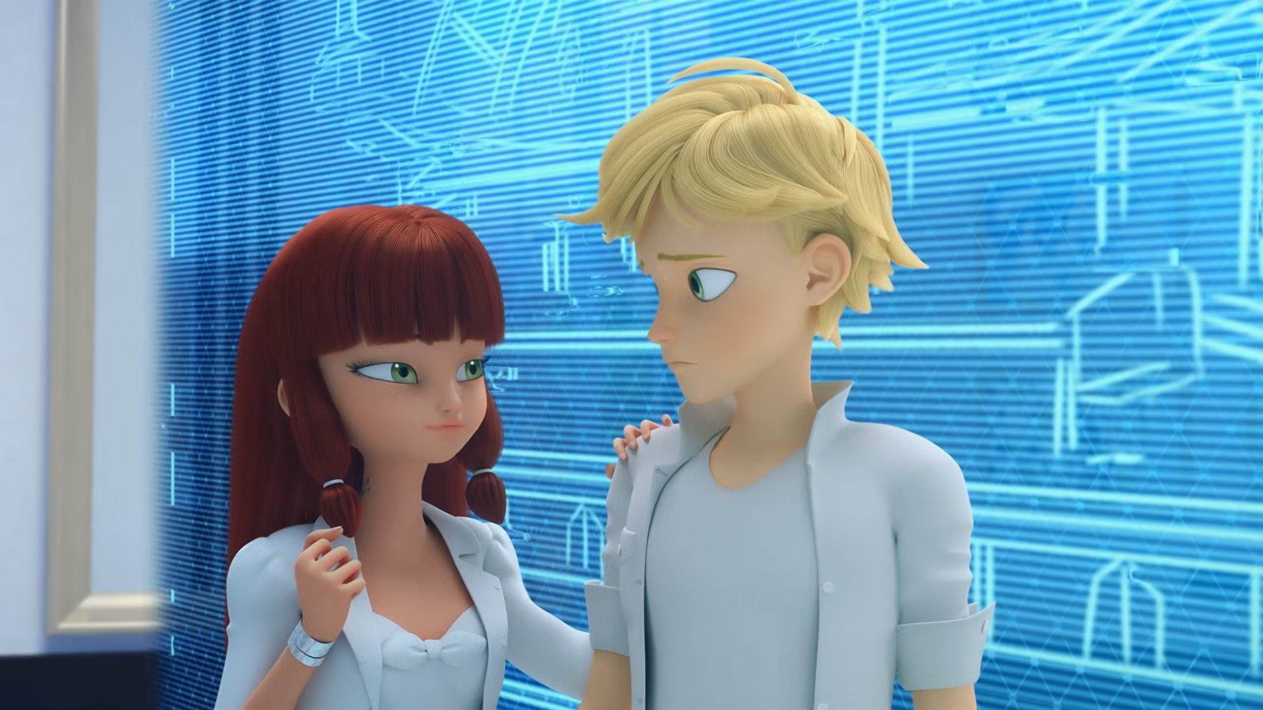
MIRACULOUS LADYBUG: RISK 1. PART 1

Slide 2
VOCABULARY
ambitious - 雄心勃勃的 - æmˈbɪʃəs
brand - 品牌 - brænd
campaign - 运动 - kæmˈpeɪn
combined - 联合的 - kəmˈbaɪnd
discrete - 离散的 - dɪˈskriːt
homage - 致敬 - hɒmɪʤ
reckless - 鲁莽的 - rɛkləs
secure - 保护 - sɪˈkjʊə
spikes - 尖刺 - spaɪks

Slide 3
1. 品牌
2. kəmˈbaɪnd
3. spaɪks

Slide 4
1. 品牌 - brand
2. kəmˈbaɪnd - combined
3. spaɪks - spikes

Slide 5
RISK 1. PART 1
Nathalie: It wasn't a mistake. I was the one who decided to use the Peacock Miraculous despite it being damaged. I was fully aware of the risk that I was taking.
Gabriel: A risk... of course! She never makes mistakes, because she never takes any risks!
I need a villain who will force Ladybug to take risks.

Slide 6
Marinette: Adrien doesn't look happy, and
I feel like I'm the only one who sees it!
Tikki: You can see it 'cause you love him, Marinette!
Marinette: I've got to tell him before he leaves, but I'm just gonna mess it all up as usual!
Risk: I'm Froggy, here I come, I'm not afraid of anyone.

Slide 7
Marinette: Are you really leaving for several months?
Adrien: That's what my father's decided.
If only you knew how sick I am of all of it, the photos, the film shoots, all these people fawning over me who don't even know me! These ads that don't make any sense? And now I'm expected to just leave my friends and travel to the end of the world.

Slide 8
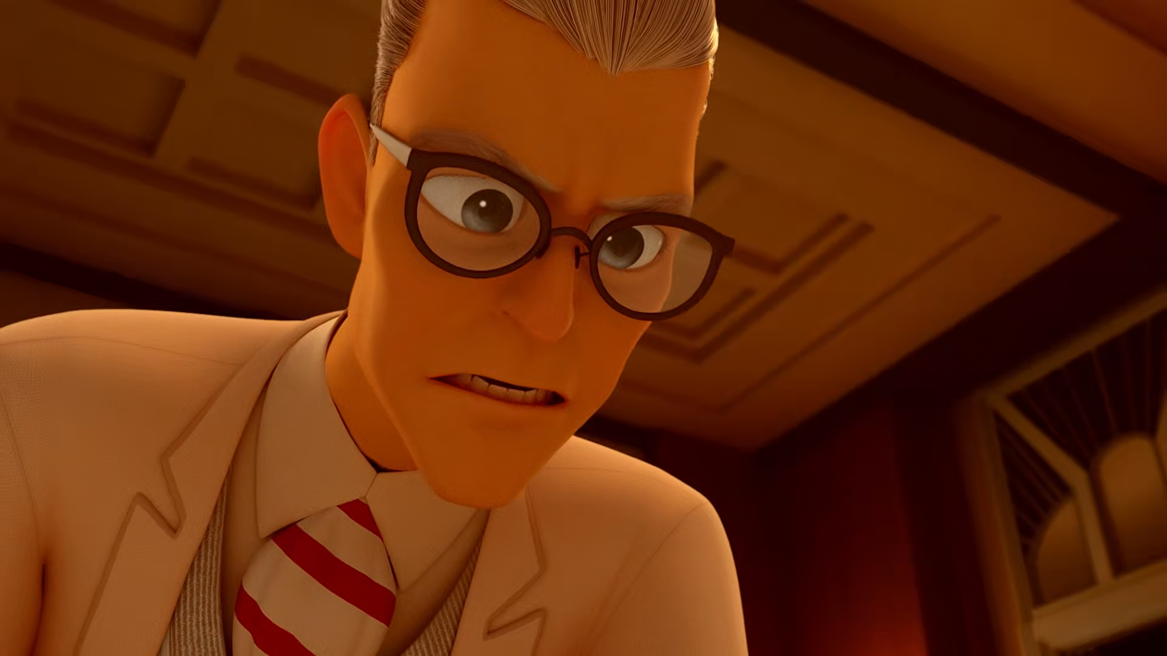
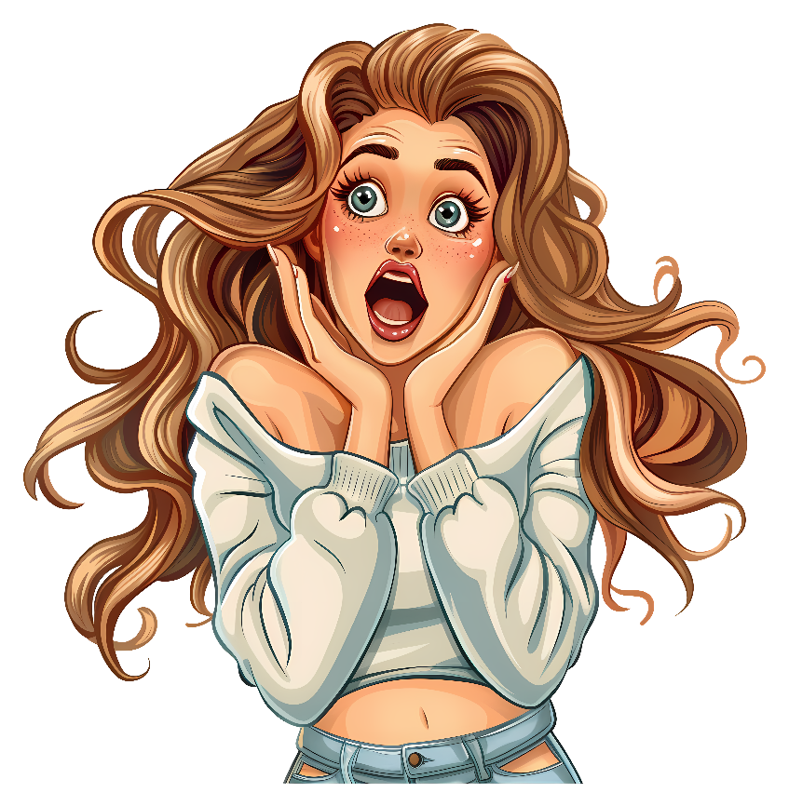
Ladybug never makes a ______!
hot pot
cup of tea
mistake

Slide 9
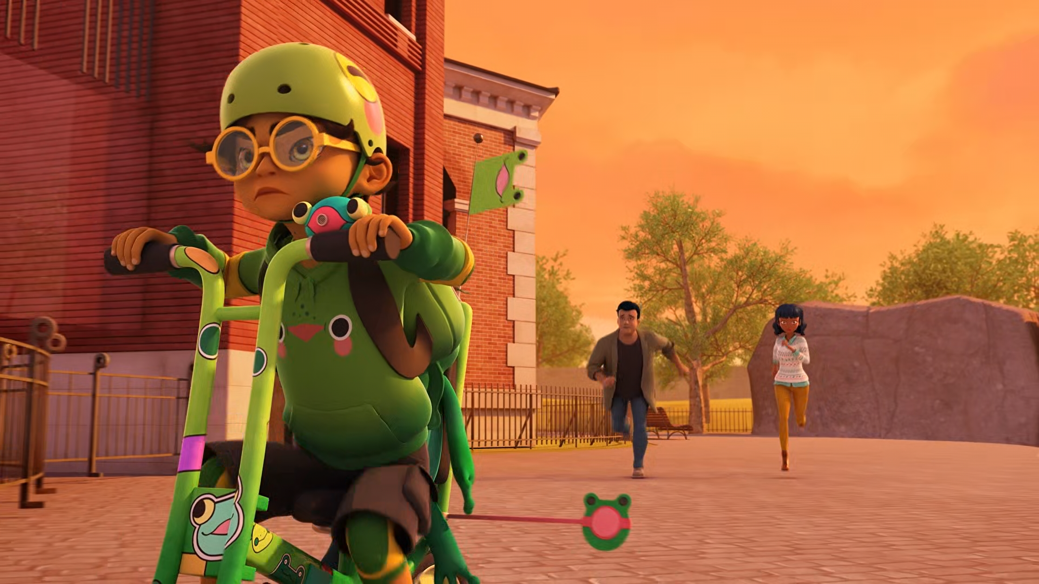
______, come back! It's time to
go home!
Froggy
Moggy
Foggy

Slide 10
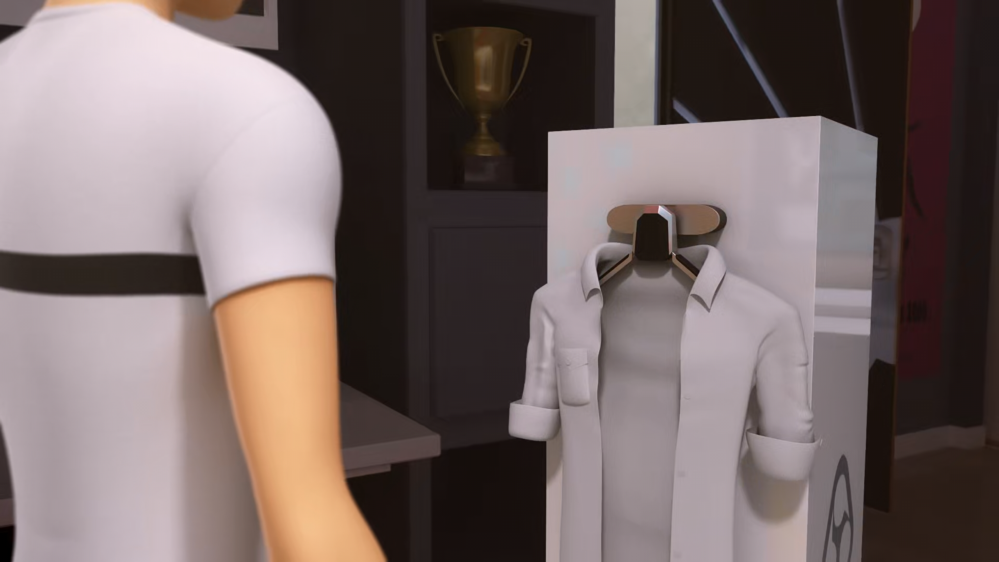
Last night, your father had an idea for a new ad ______.
poster
campaign
film

Slide 11
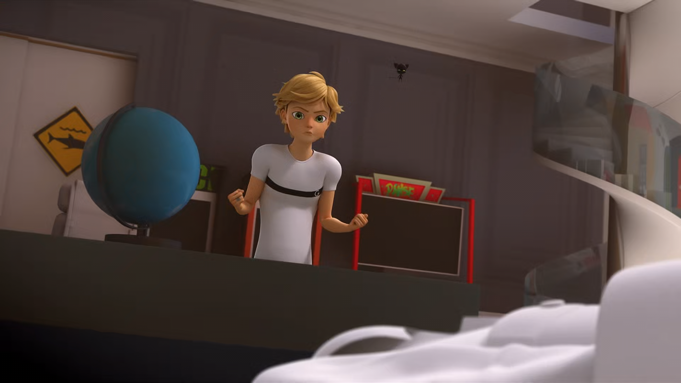
I don't want to be a ______ anymore.
boy
model
superhero

Slide 12
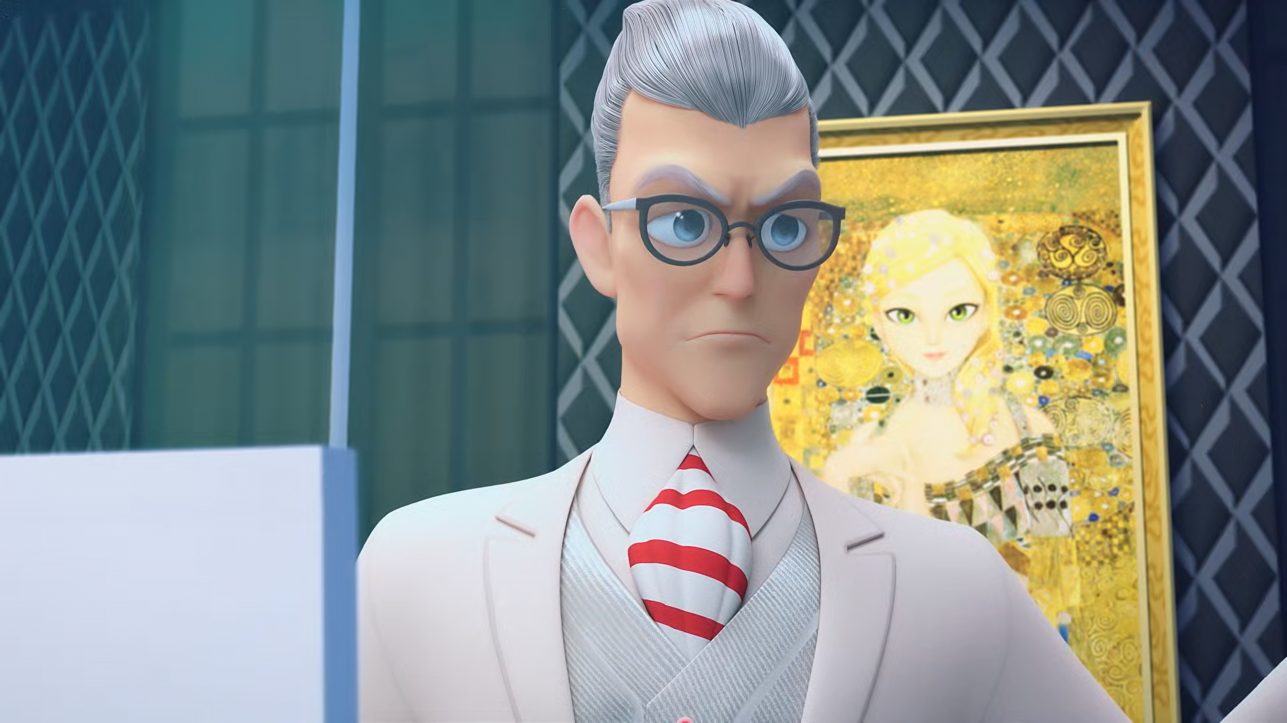
This ______ will last several months all over the world.
film
campaign
shoot

Slide 13
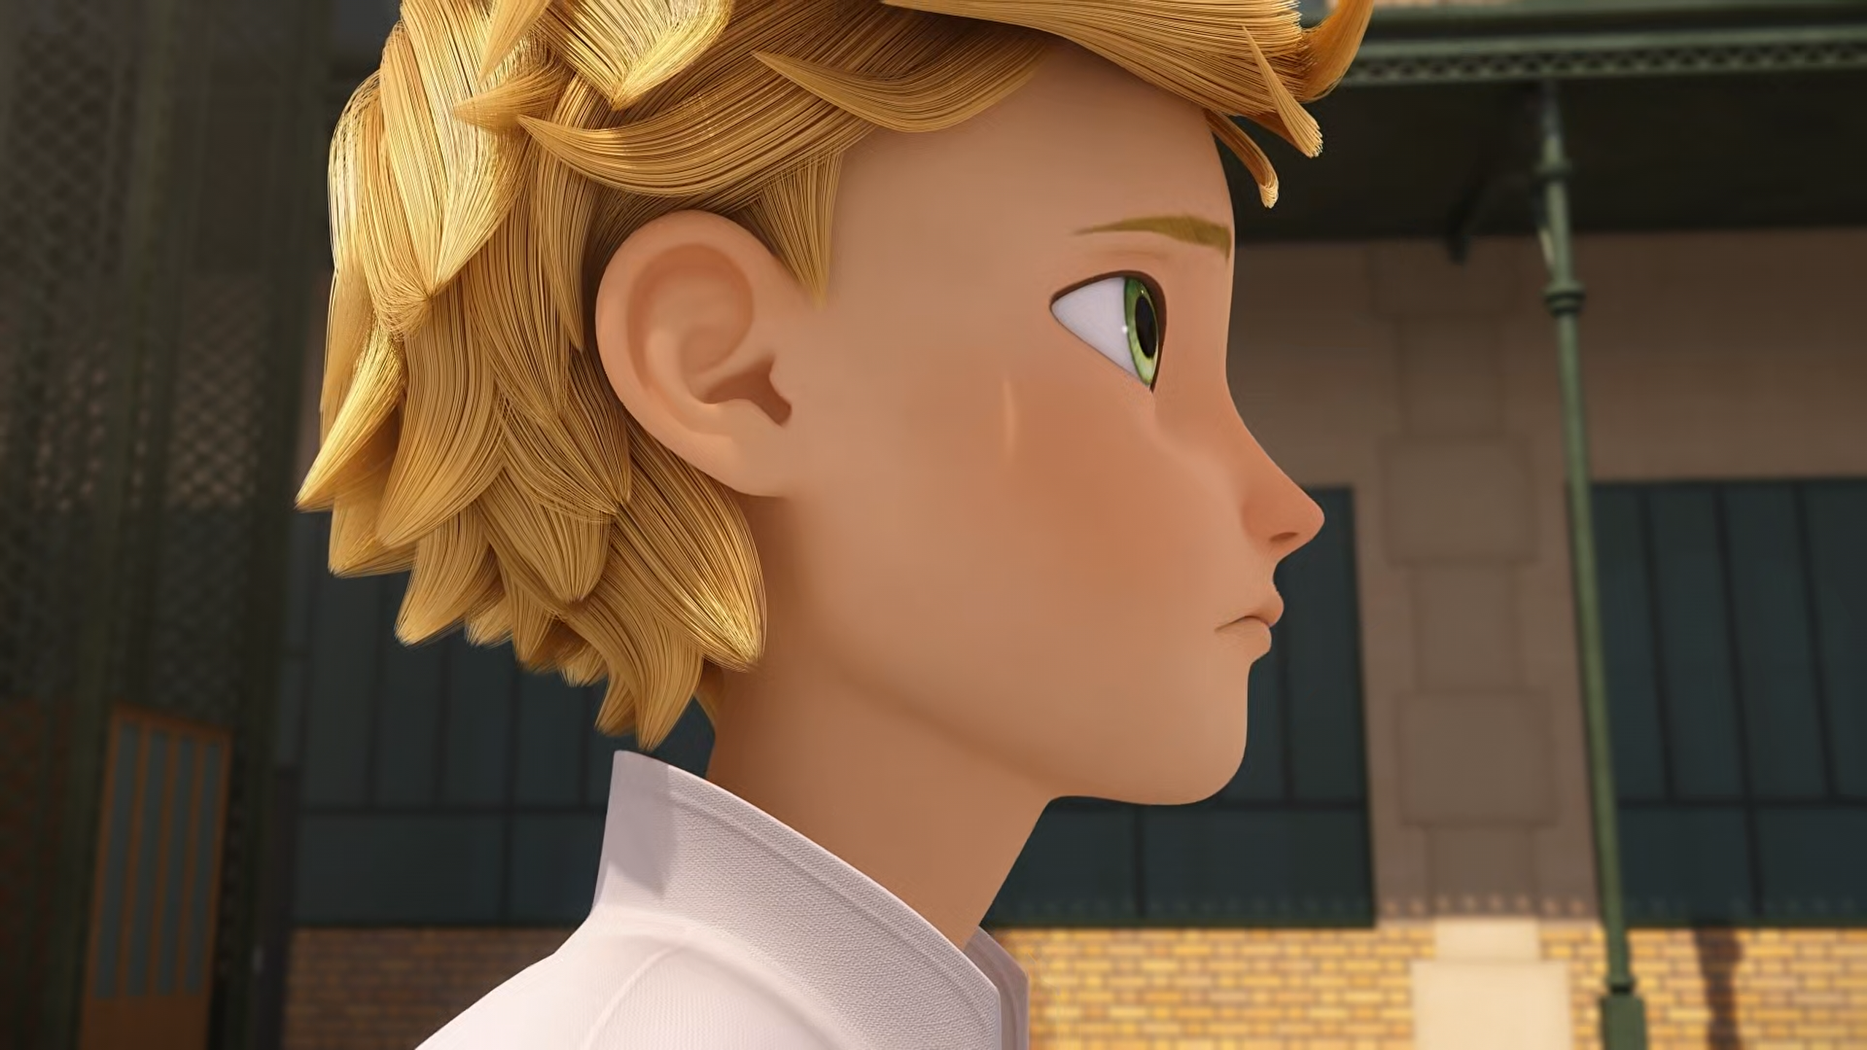
No one would understand my ______.
complaining
father
love

Slide 14
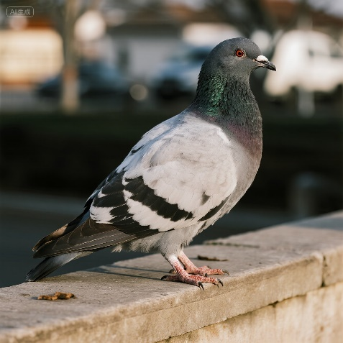
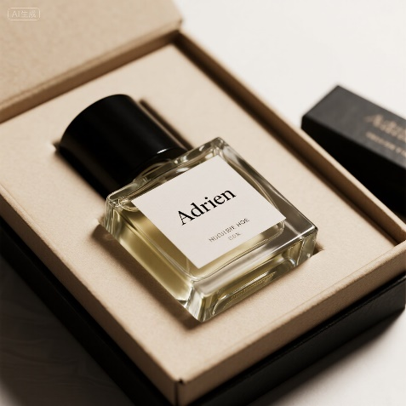
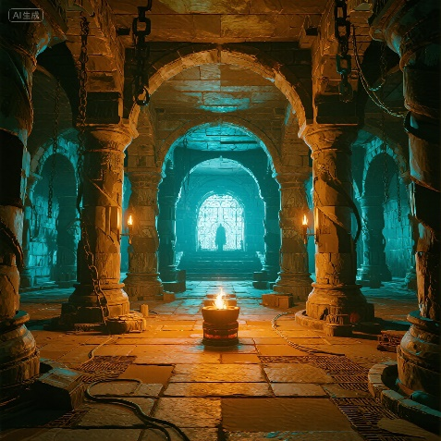
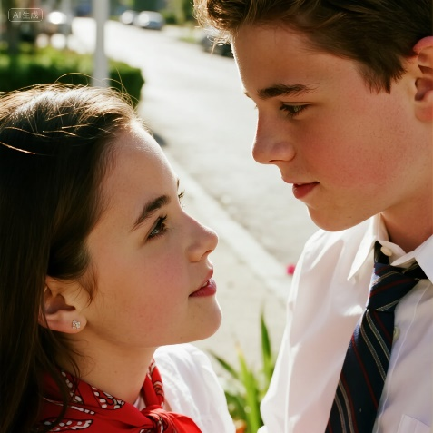
Matching Exercise
perfume | dungeon | fawning | pigeon

Slide 15
Matching Exercise
pigeon | perfume | dungeon | fawning

Slide 16
TRUE OR FALSE
1. The Peacock Miraculous is damaged.
2. Adrien has Spanish classes.
3. Adrien has to travel the world with Lila.
4. Marinette is late for school.
5. Adrien loves film shoots.

Slide 17
TRUE OR FALSE
1. The Peacock Miraculous is damaged. | TRUE
2. Adrien has Spanish classes. | FALSE
3. Adrien has to travel the world with Lila. | TRUE
4. Marinette is late for school. | TRUE
5. Adrien loves film shoots. | FALSE

