Slide 1
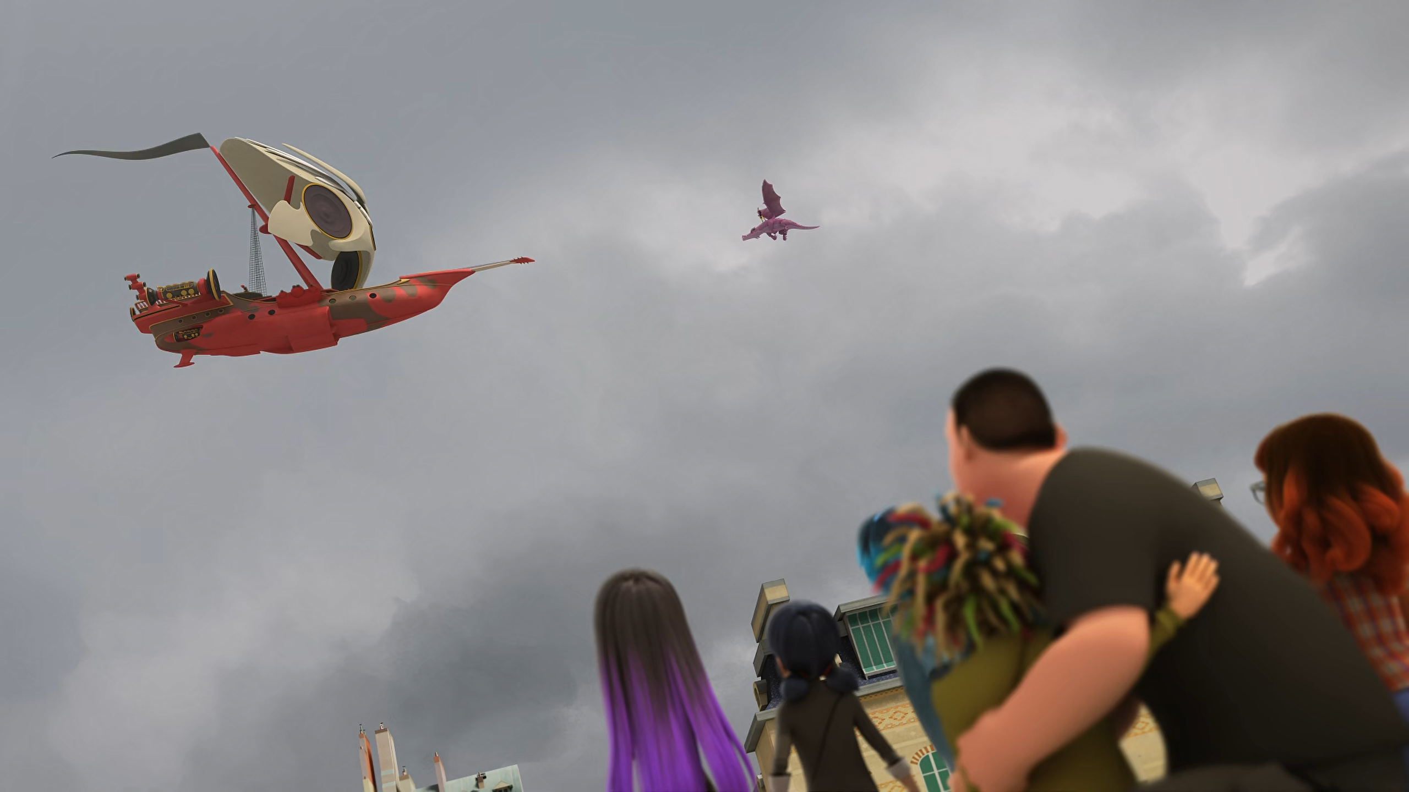
MIRACULOUS LADYBUG: CROCODUEL. PART 2

Slide 2
VOCABULARY
clout - 影响力 - klaʊt
cruise - 巡航 - kruːz
duel - 决斗 - djuːəl
hesitate -犹豫 - hɛzɪteɪt
shipwreck - 沉船 - ʃɪprɛk
sprain - 扭伤 - spreɪn
steer - 驾驶 - stɪə
torn - 犹豫的 - tɔːn
venture - 企业 - vɛnʧə

Slide 3
1. djuːəl
2. 犹豫
3. 犹豫的

Slide 4
1. djuːəl - duel
2. 犹豫 - hesitate
3. 犹豫的 - torn

Slide 5
CROCODUEL. PART 2
Cat Noir: Bugaboo, promise me that we won't be like them when we're an old couple.
Ladybug: For that to happen, we'd have to be a couple first, Kitty Cat!
Guitar Villain: Hey! Where do you think you're going?
Captain Hardrock: Don't tell me you're gonna let those two house pets beat us?!

Slide 6
Ladybug: To think that they were in love once...
Luka: Looks like those feelings are long gone.
Ladybug: Still, it's no reason to stop talking to each other. Lucky Charm!
Cat Noir: Not sure if that's gonna be strong enough to patch things up between them, m'lady.
Ladybug: We need someone to listen to!

Slide 7
Juleka: Stop! Now you are going to apologize and make up by talking. Not yelling!
Anarka: But he was the one who...
Jagged Stone: It was her...
Juleka: No one cares! The past is the past.
Jagged Stone: I'm sorry, Nanarky. I was wrong.
Anarka: No, you old pirate. It was me.
Jagged Stone: No, it's my fault.
Marinette: Juleka, you rock!

Slide 8
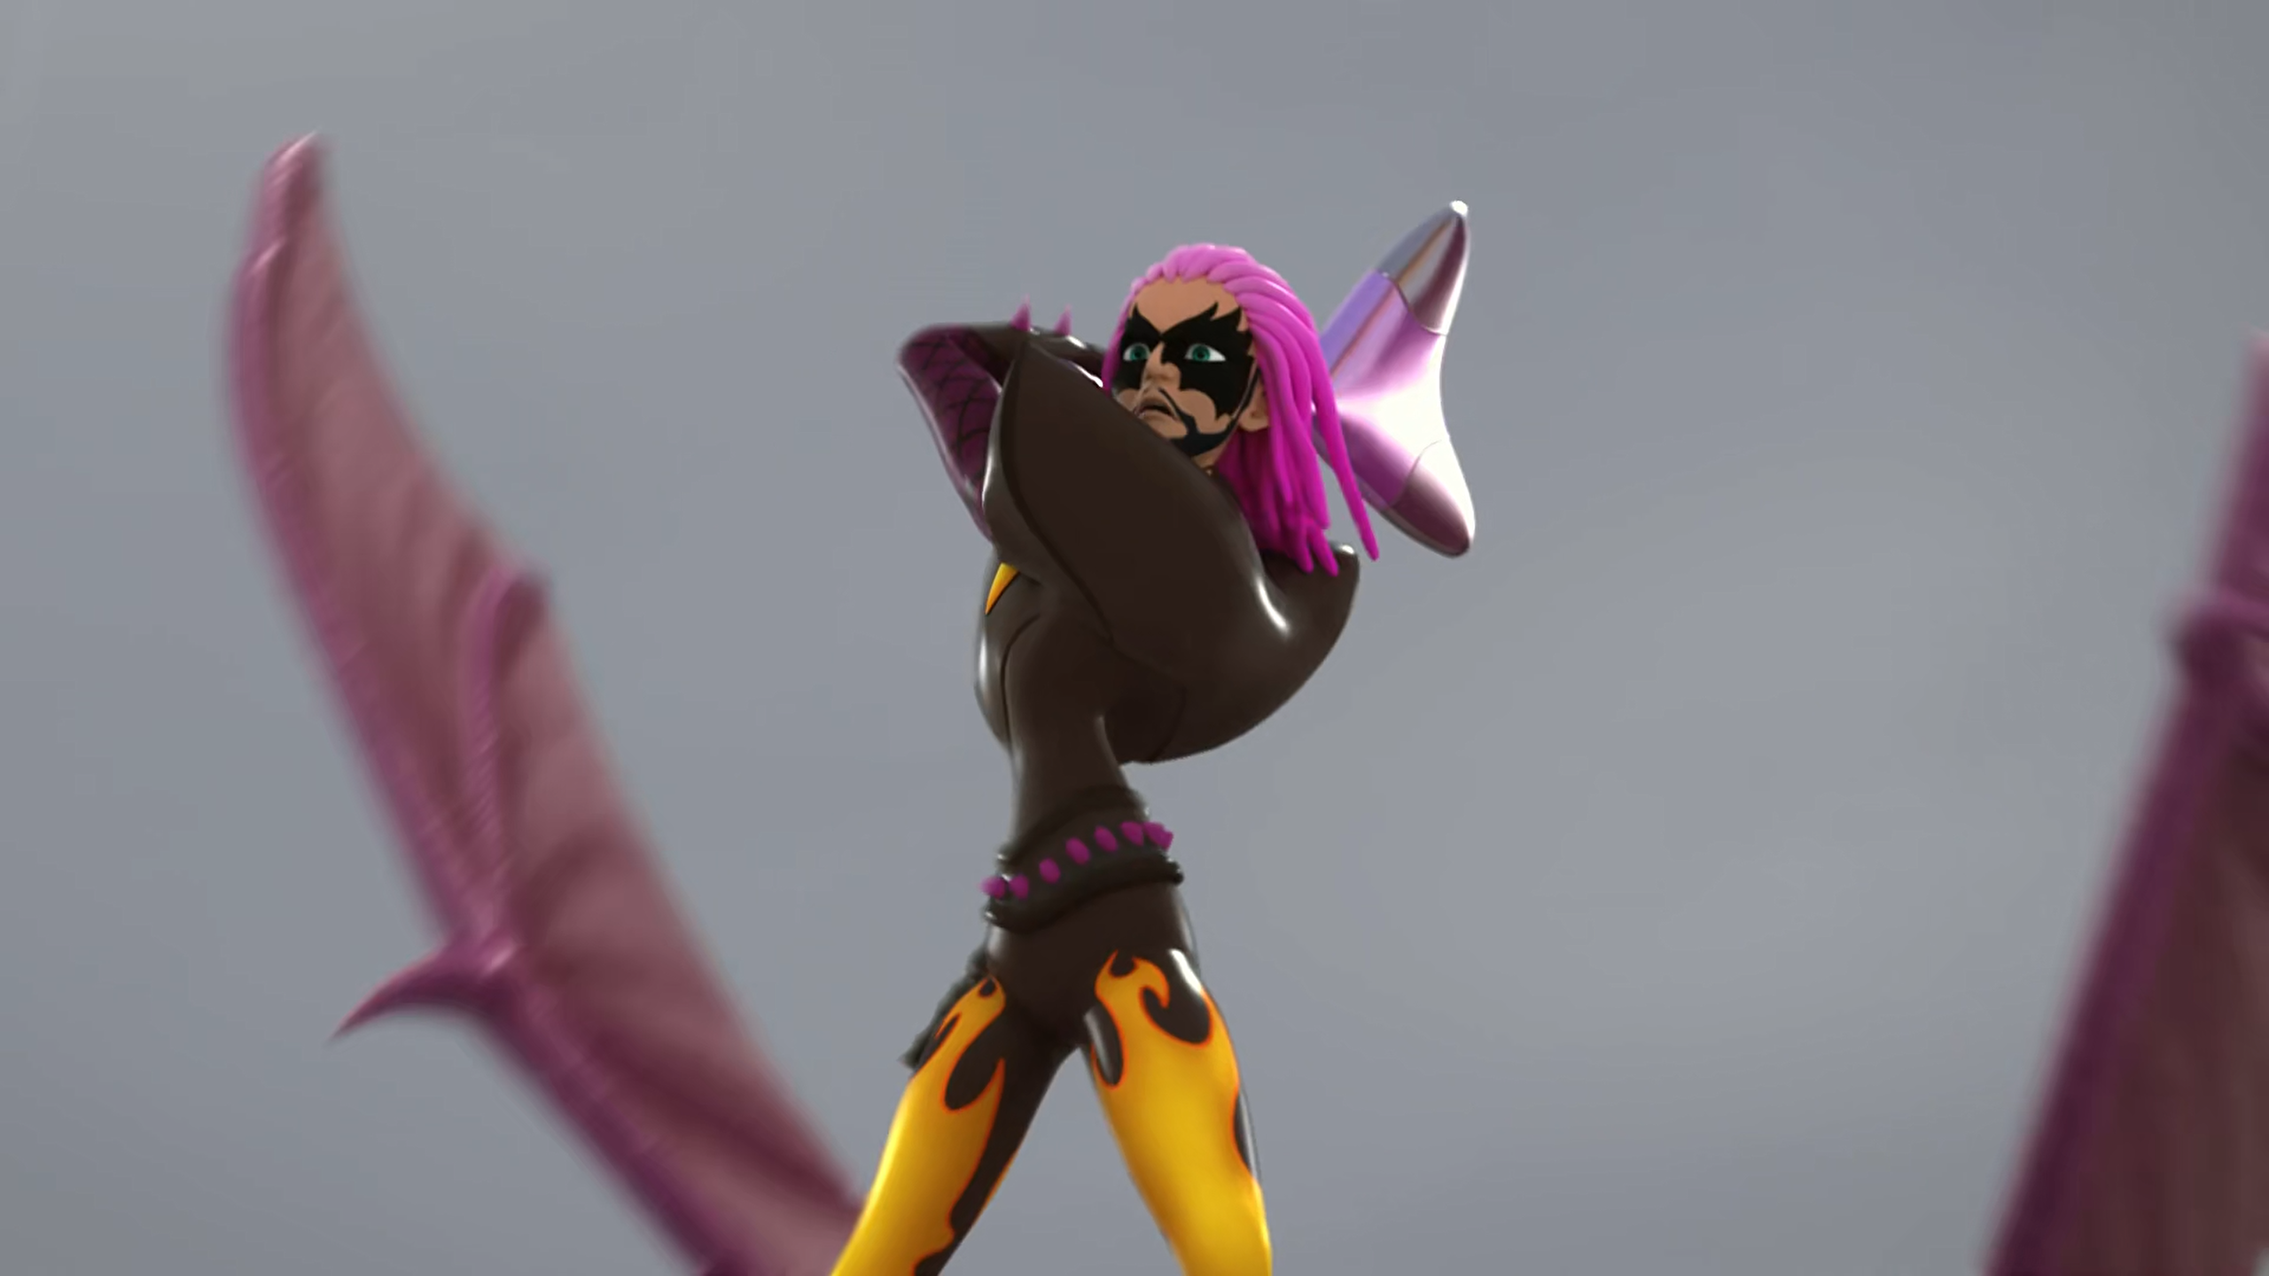

I'm the only one who gets to ______ you, Captain Hardrock!
crush
destroy
shipwreck

Slide 9
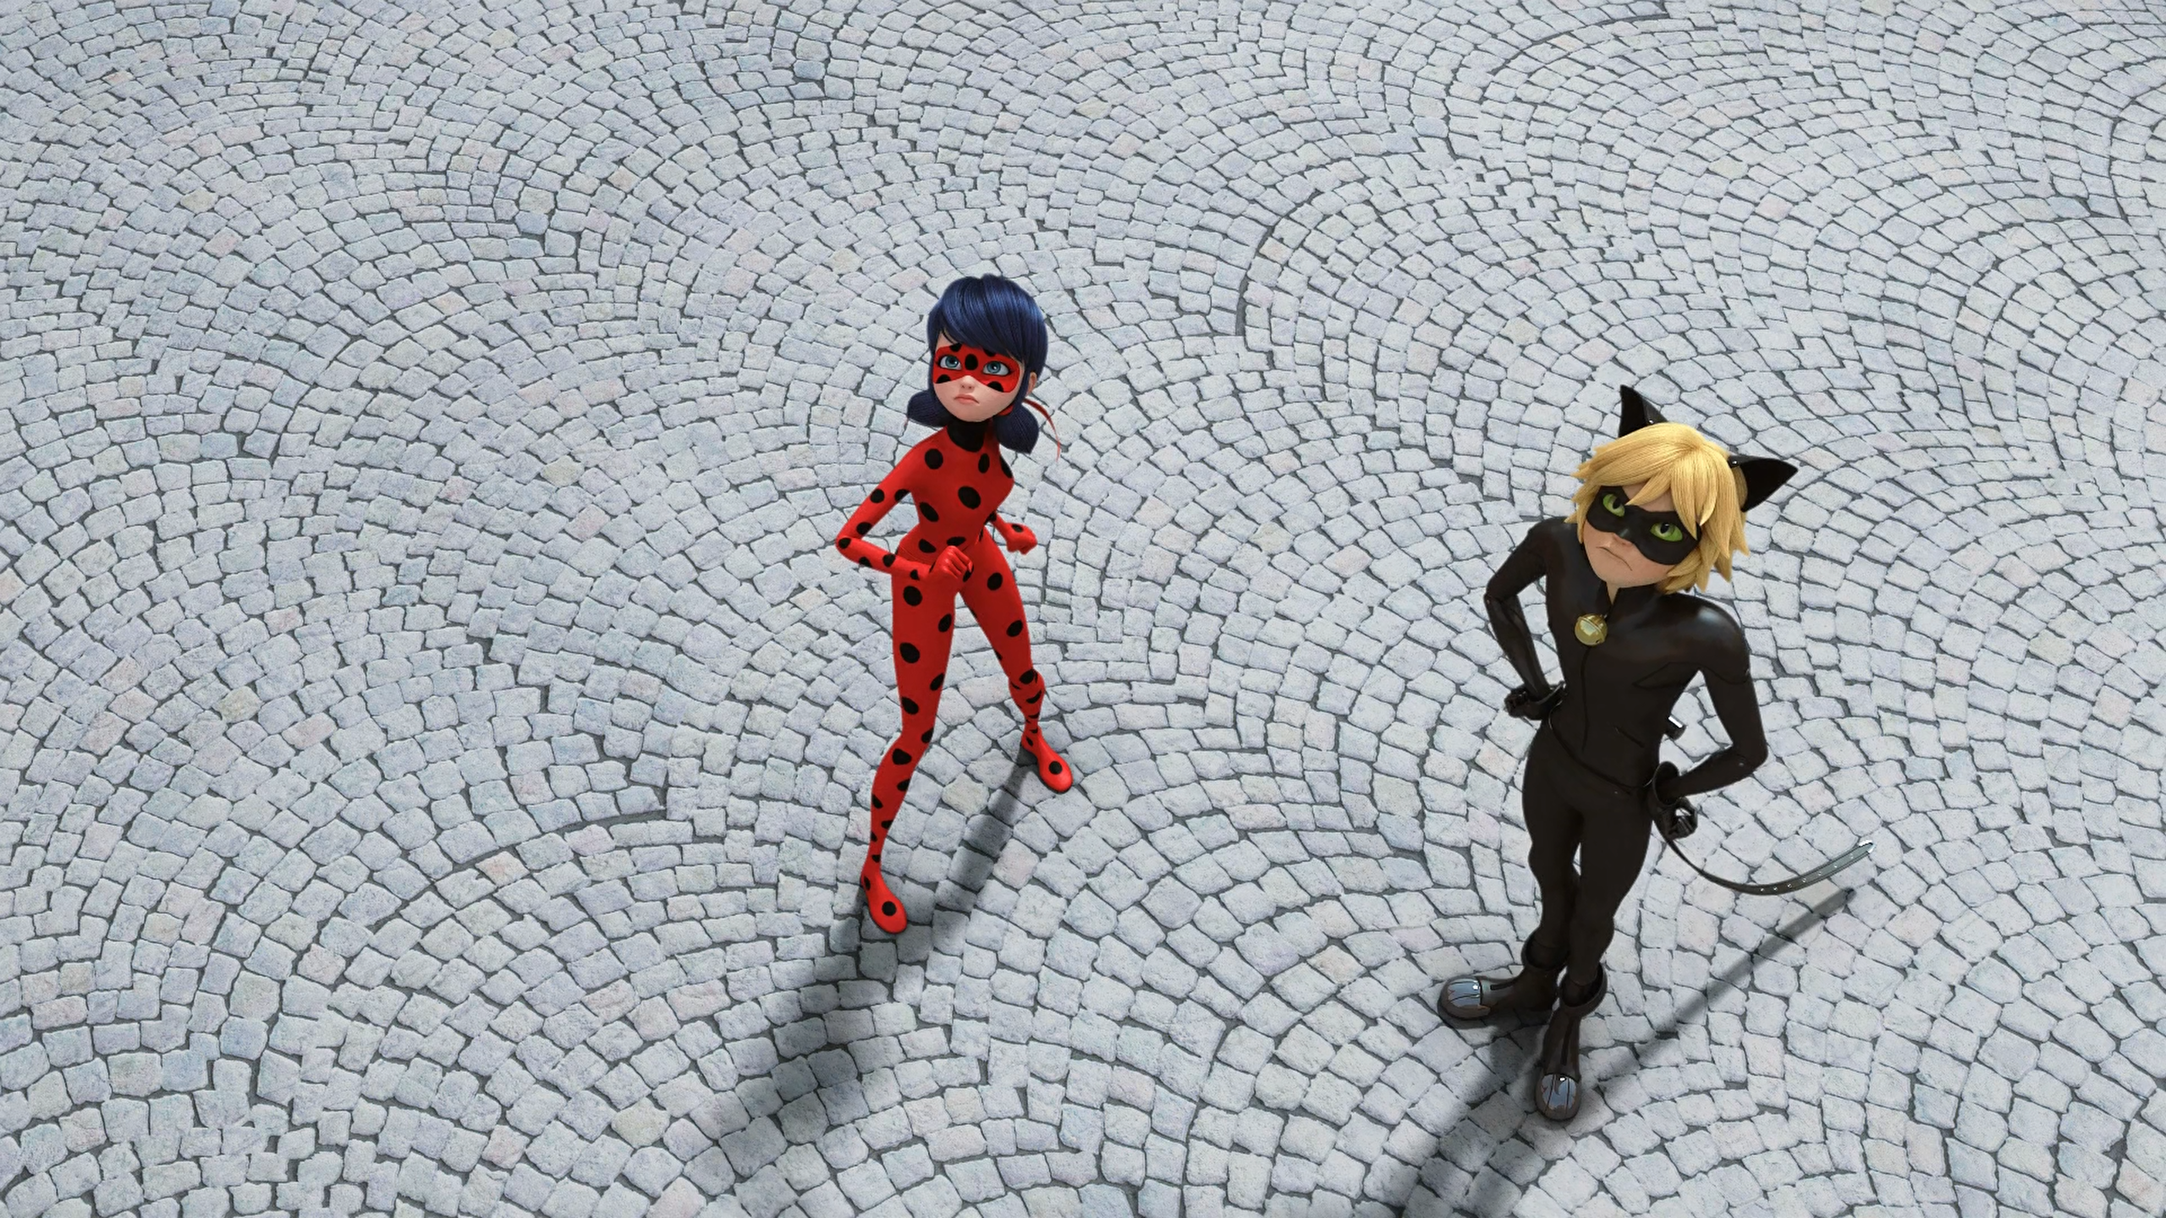
Hey, no fair! We don't have any ______ or a flying pirate ship!
wings
dragons
cannonballs

Slide 10
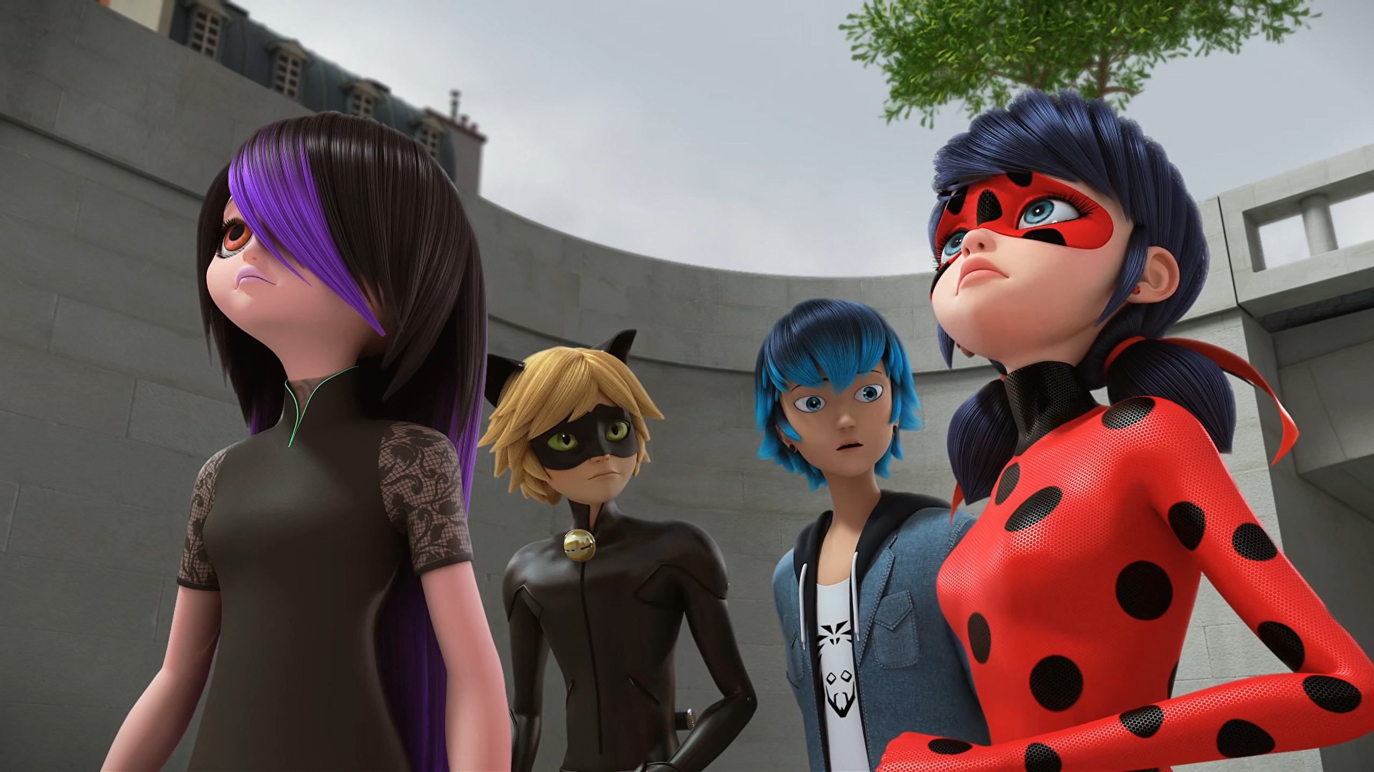
To think that they were ______ once...
married
in love
sweethearts

Slide 11
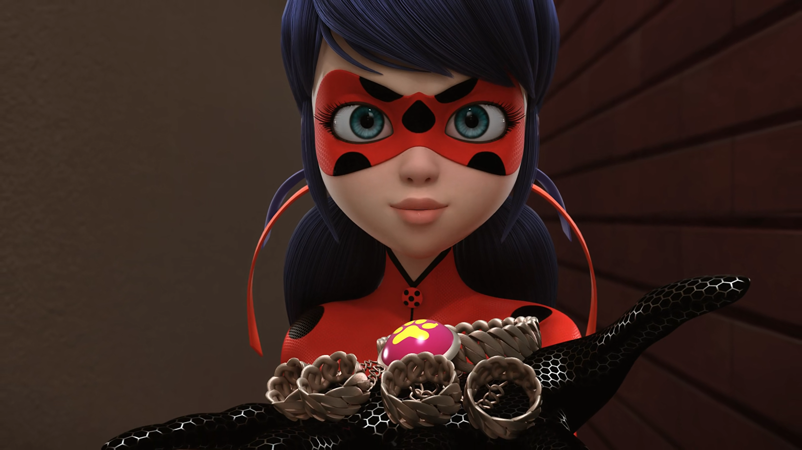
Juleka Couffaine, here is the Miraculous of the ______.
lion
tiger
puma

Slide 12
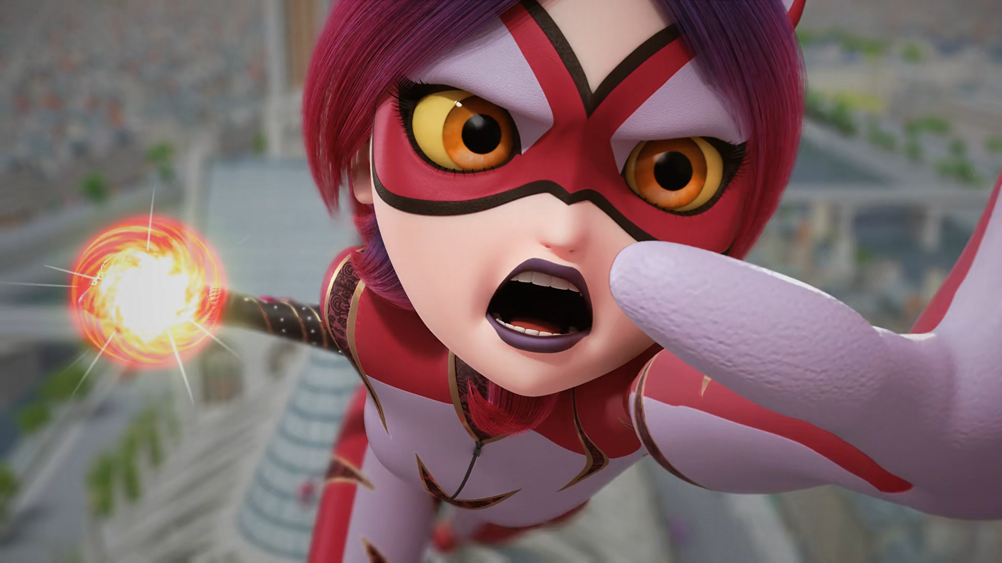
Mom, Dad, I'm sorry, but talk it over instead of ______!
fighting
shouting
arguing

Slide 13
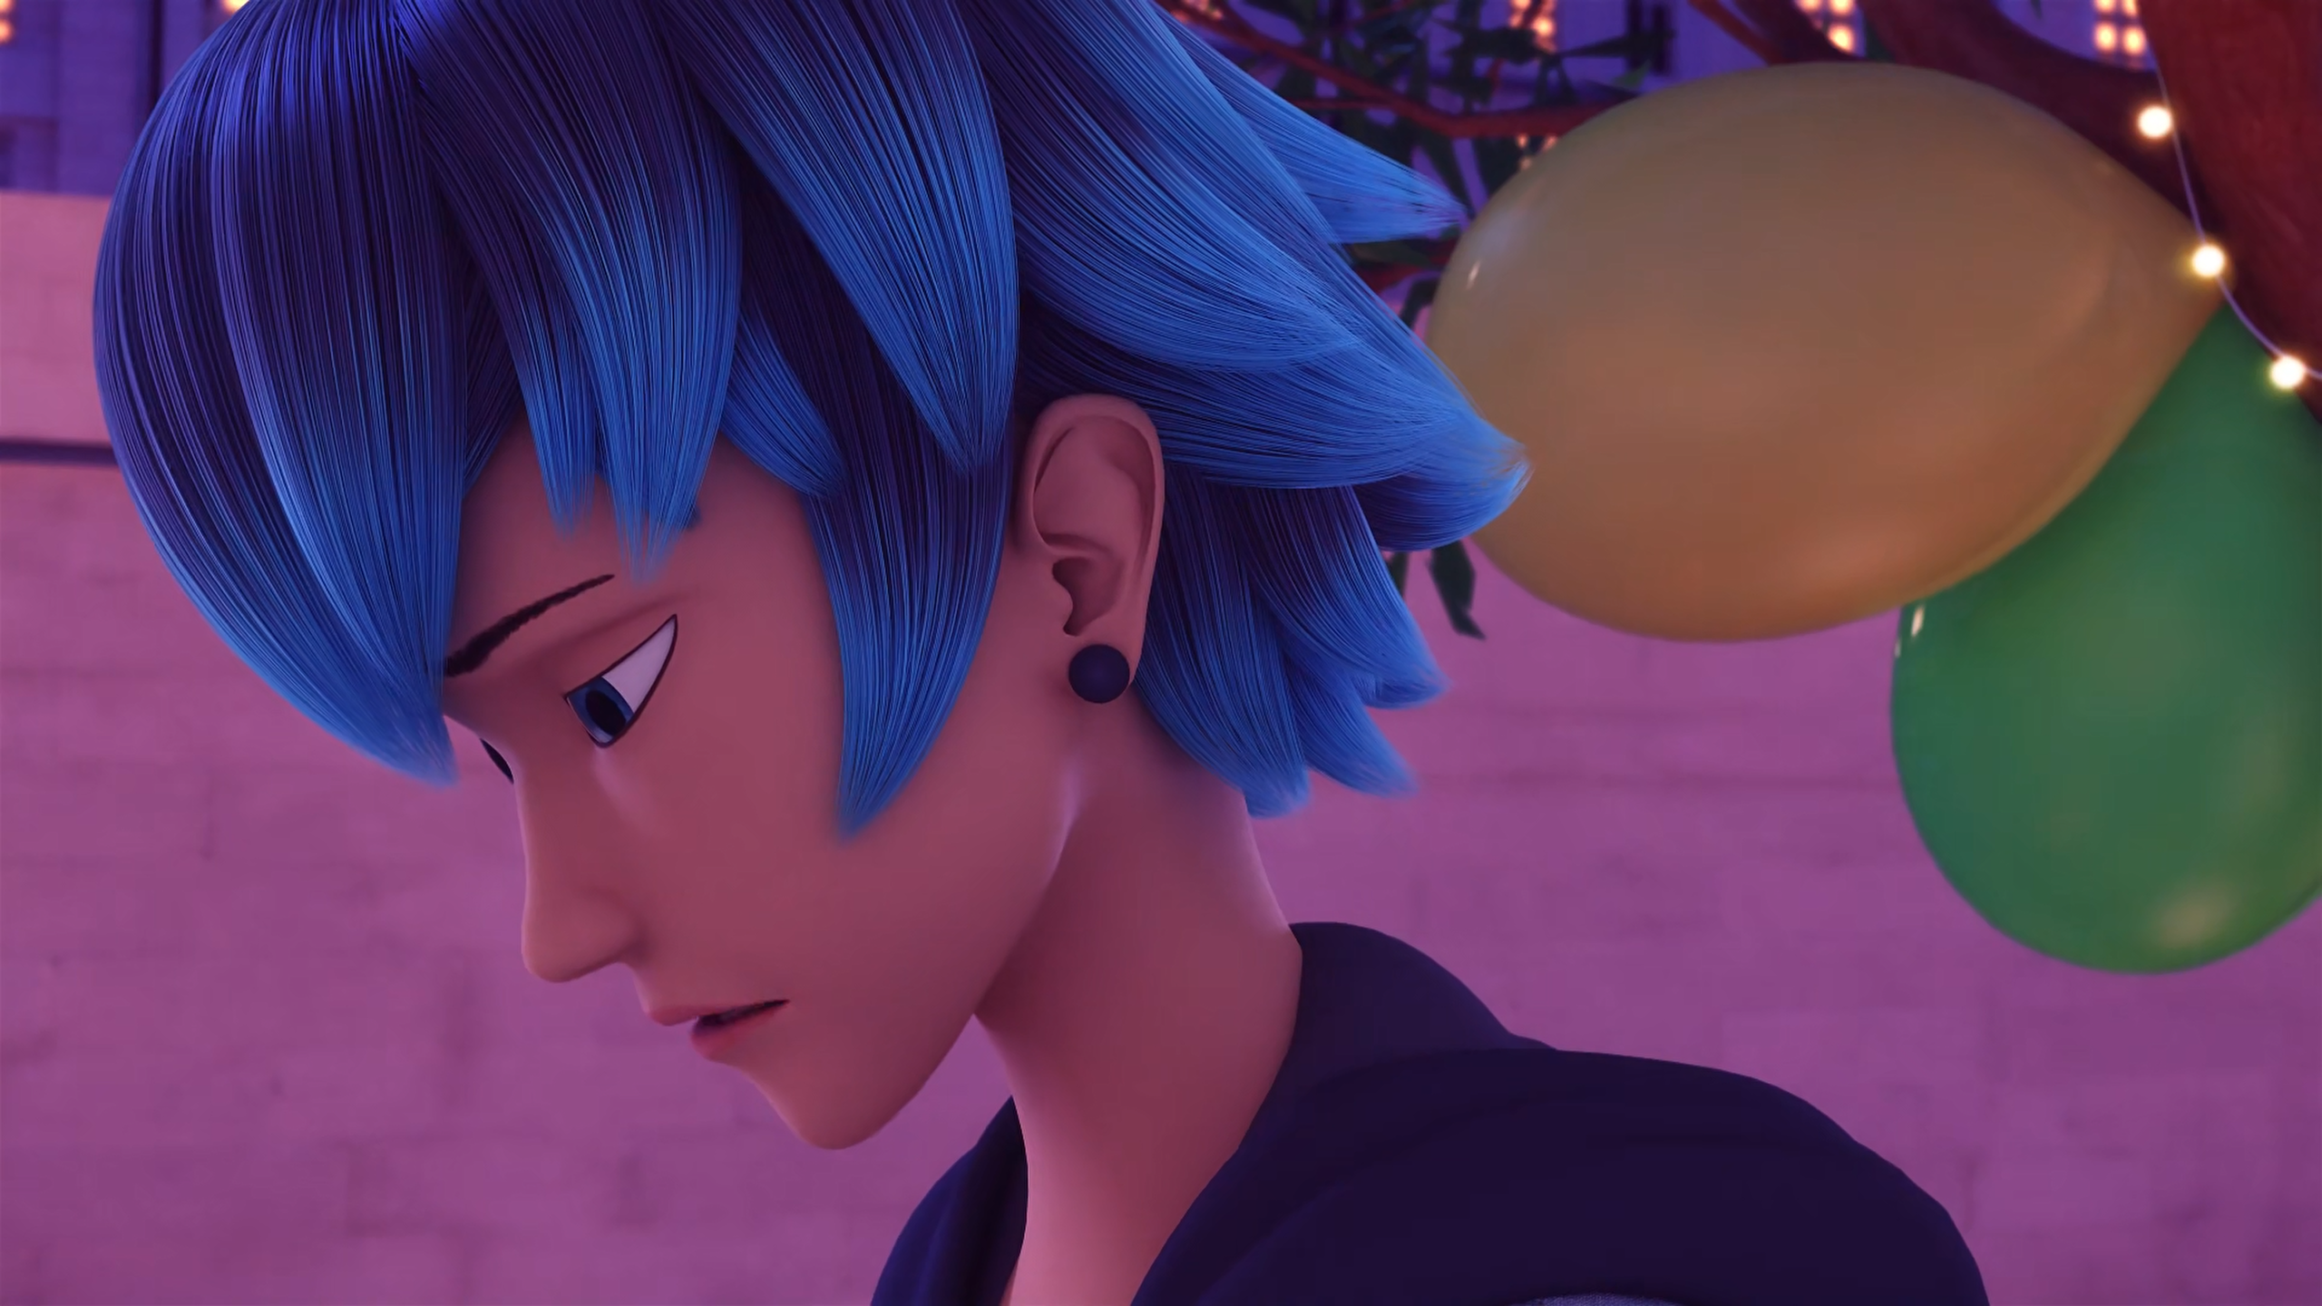
You know, it hurts more not ______ you than ______ you, Marinette.
seeing
meeting
loving

Slide 14
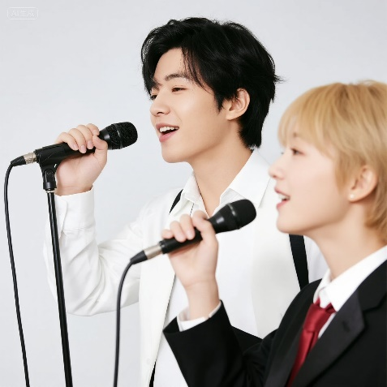
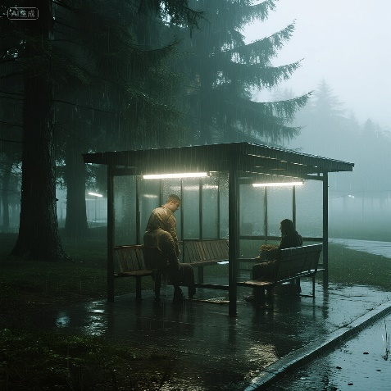
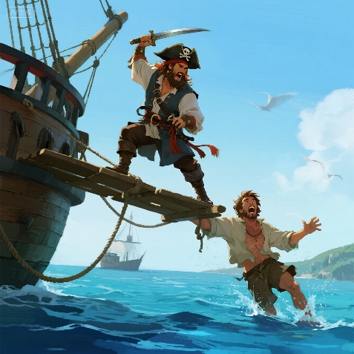
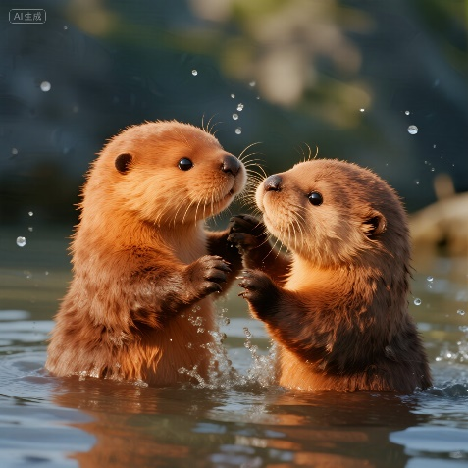
Matching Exercise
buddy | harmony | shelter | walk the plank

Slide 15
Matching Exercise
harmony | shelter | walk the plank | buddy

Slide 16
TRUE OR FALSE
1. Captain Hardrock fires a cannonball at Ladybug.
2. Cat Noir knocks Guitar Villain off his dragon.
3. Juleka is given the dog Miraculous.
4. Purple Tigress has the power of clout.
5. Marinetta and Luka get back together.

Slide 17
TRUE OR FALSE
1. Captain Hardrock fires a cannonball at Ladybug. | TRUE
2. Cat Noir knocks Guitar Villain off his dragon. | TRUE
3. Juleka is given the dog Miraculous. | FALSE
4. Purple Tigress has the power of clout. | TRUE
5. Marinetta and Luka get back together. | FALSE

