Slide 1
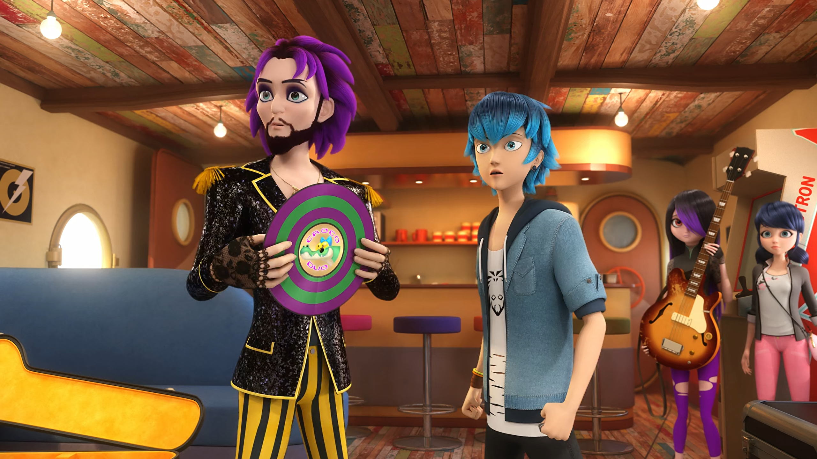
MIRACULOUS LADYBUG: CROCODUEL. PART 1

Slide 2
VOCABULARY
avoid - 避免 - əˈvɔɪd
awkward - 令人尴尬的 - ɔːkwəd
buddies - 伙伴 - bʌdiz
discretion - 自由裁量权 - dɪˈskrɛʃᵊn
misunderstanding - 误解 - mɪsʌndəˈstændɪŋ
rehearsal - 排练 - rəˈhɜːsᵊl
resentment - 怨恨 - rɪˈzɛntmənt
sensitive - 敏感的 - sɛnsɪtɪv
urgent - 紧急的 - ɜːʤᵊnt

Slide 3
1. ɔːkwəd
2. 伙伴
3. sɛnsɪtɪv

Slide 4
1. ɔːkwəd - awkward
2. 伙伴 - buddies
3. sɛnsɪtɪv - sensitive

Slide 5
CROCODUEL. PART 1
Nino: Wait a sec, Adrien can't come this Saturday! He's got a fashion show.
Alya: Perfect! If Adrien shows up, Marinette wouldn't be able to take her eyes off him.
Alix: And she might act... well, you know?
Zoé: I'll help set up!
Nino: I'm on music!
Alya: And I'll take care of Marinette!

Slide 6
Jagged Stone: Sorry I'm tardy to the party, son. You have any wrapping paper I could borrow?
Alya: Hang on. Jagged Stone...
Nino: Is the father of...
Rose: Luka and Juleka?
Ivan: That's... so... awesome!!
Juleka: Oh, yeah. He's my dad.

Slide 7
Anarka: Jagged Stone, you really are a shipwrecker. How dare you come here and give my son the album that caused our
break-up!
Jagged Stone: Caused our break-up? You mean the album to help me get my life back after you left me!
Anarka: You got a lot of nerve, pirate! You were the one who left me!

Slide 8
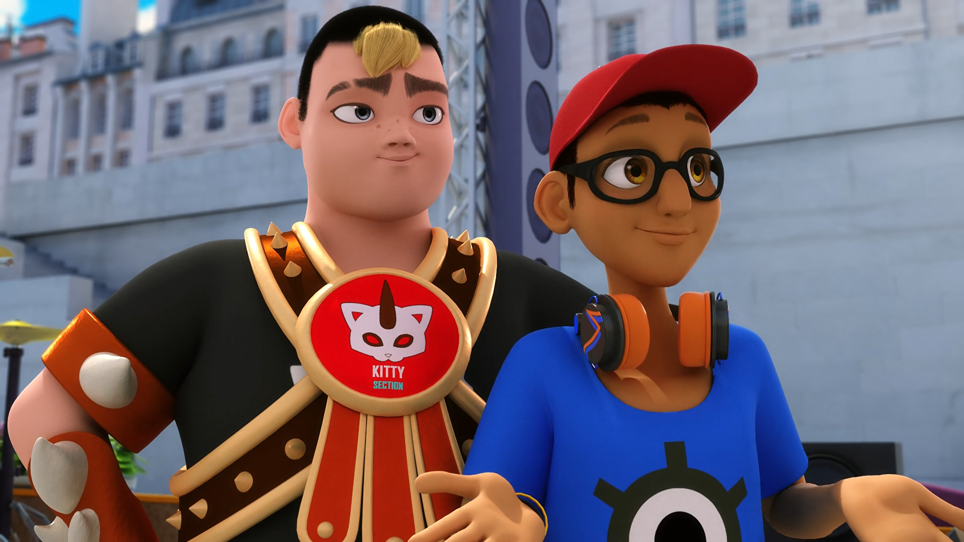
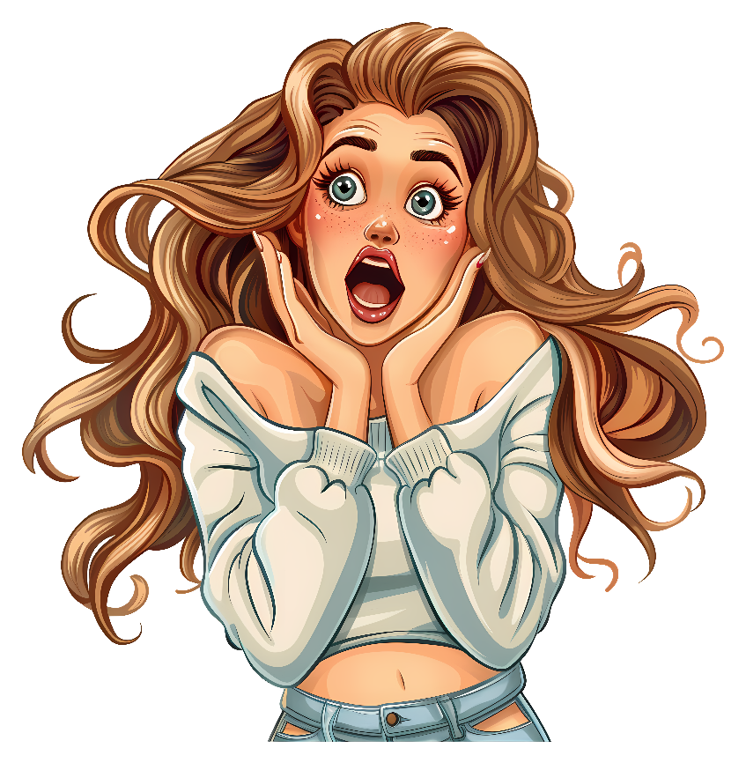
Wait a sec, Adrien can't come this ______! He's got a fashion show.
Sunday
Monday
Saturday

Slide 9
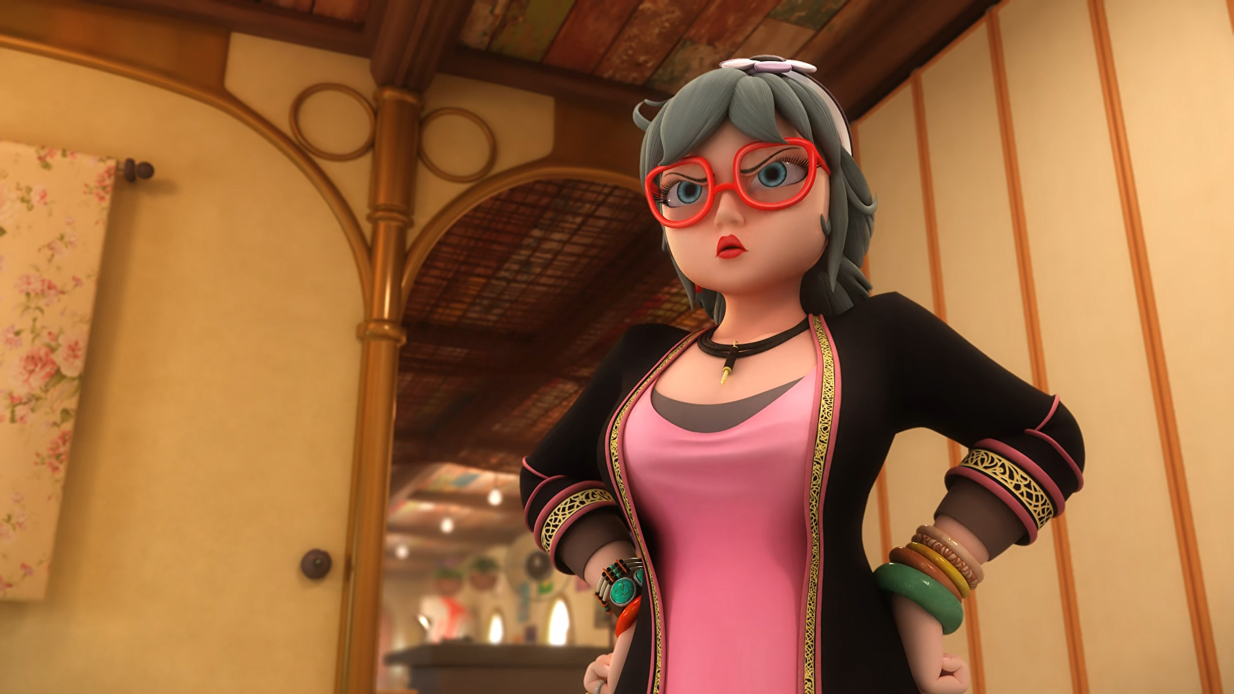
Jagged Stone, you ______! No stowaways on my ship!
scallywag
deadbeat
scumbag

Slide 10
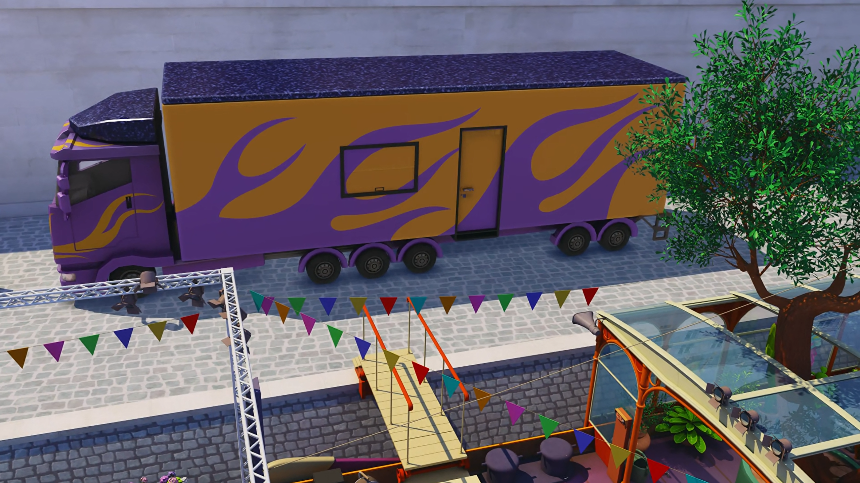
Sneaky? Your ______ is parked on the dock, you one-hit wonder!
boat
tour bus
horse

Slide 11
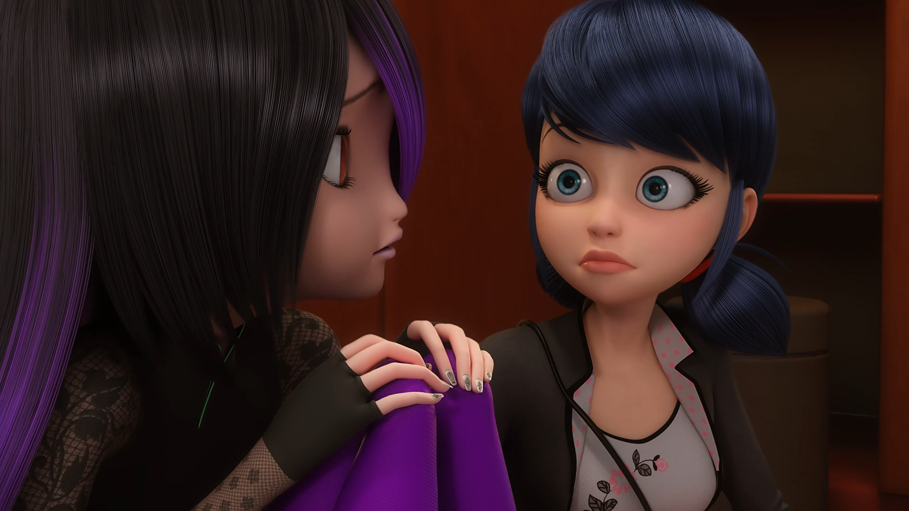
What? Jagged Stone is your ______?
mother
father
grandma

Slide 12
How dare you come here and give my son the ______.
record
song
album

Slide 13
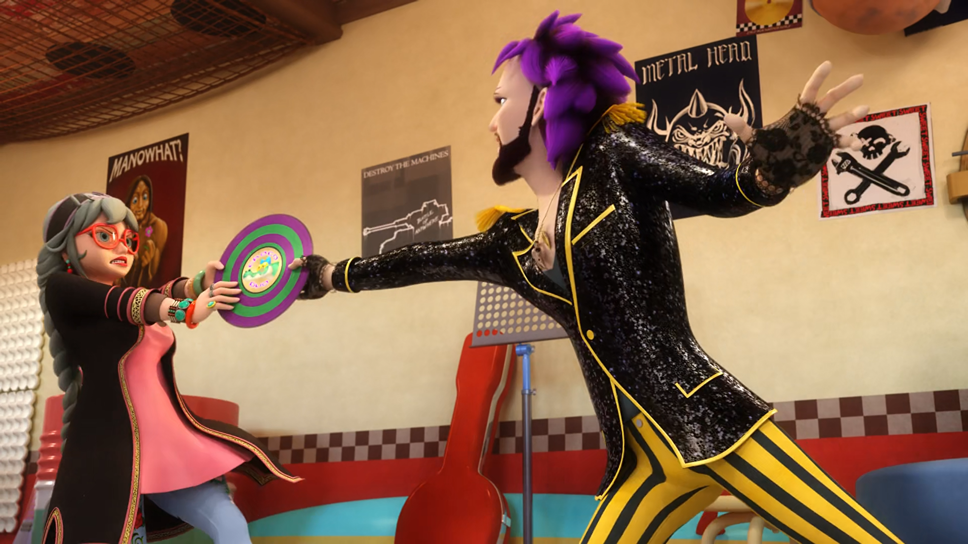
You got a lot of ______, pirate! You were the one who left me!
nerve
gall
audacity

Slide 14
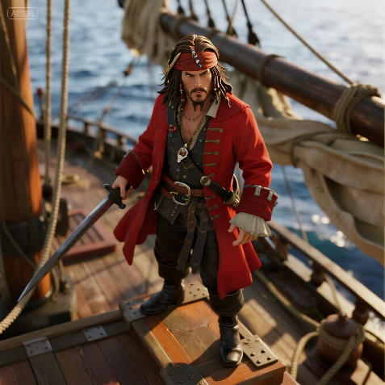
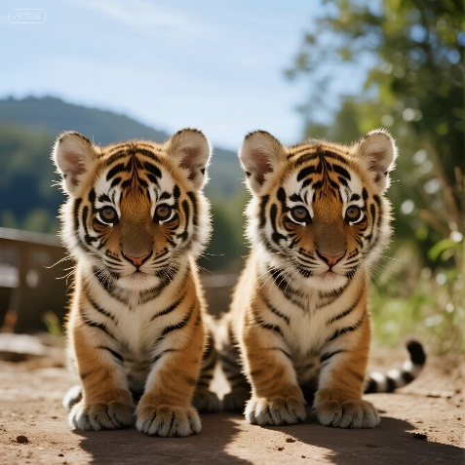
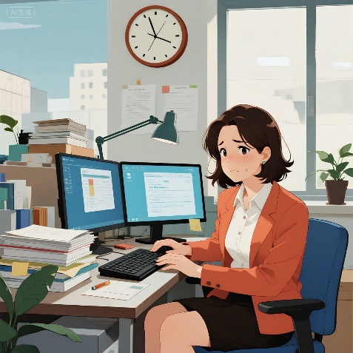
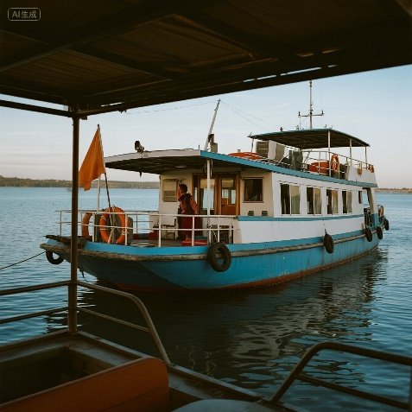
Matching Exercise
houseboat | pirate | twins | urgent

Slide 15
Matching Exercise
pirate | twins | urgent | houseboat

Slide 16
TRUE OR FALSE
1. Marinette misses rehearsals because she doesn't want to see Luka.
2. Luka and Juleka are cousins.
3. The birthday party will be on Saturday.
4. Jagged Stone gives Juleka a guitar.
5. Anarka breaks the record.

Slide 17
TRUE OR FALSE
1. Marinette misses rehearsals because she doesn't want to see Luka. | TRUE
2. Luka and Juleka are cousins. | FALSE
3. The birthday party will be on Saturday. | TRUE
4. Jagged Stone gives Juleka a guitar. | TRUE
5. Anarka breaks the record. | FALSE

