Slide 1

MIRACULOUS LADYBUG: QUEEN BANANA. PART 2

Slide 2
VOCABULARY
acquaintance - 熟人 - əˈkweɪntᵊns
capable - 有能力 - keɪpəbᵊl
destructive - 破坏性的 - dɪˈstrʌktɪv
exchange - 交换 - ɪksˈʧeɪnʤ
flop - 落下 - flɒp
immobilize - 使不动 - ɪˈməʊbɪlaɪz
mainly - 主要地 - meɪnli
refuse - 拒绝 - rɪˈfjuːz
transatlantic - 跨大西洋的 - trænzətˈlæntɪk

Slide 3
1. keɪpəbᵊl
2. 破坏性的
3. ɪksˈʧeɪnʤ

Slide 4
1. keɪpəbᵊl - capable
2. 破坏性的 - destructive
3. ɪksˈʧeɪnʤ - exchange

Slide 5
QUEEN BANANA. PART 2
Cat Noir: Hey there, banana queen!
So what's your superpower? Making people slip on banana peels?
Queen Banana: You're about to find out,
you ridiculous alley cat!
Ladybug: Careful! Shadow Moth has been very generous to Chloé.
Cat Noir: I'm a little jealous of her gear.

Slide 6
Ladybug: Zoé Lee, here is the Bee Miraculous, which grants you the power to immobilize your opponent. You will use it for the greater good.
Pollen: At your service, my queen.
Zoé: But Chloé's gonna be furious, she used to be Queen Bee!
Ladybug: Chloé will never know it's you.

Slide 7
Ladybug: This Lucky Charm glue is really good. And so is Vesperia, don't you think, Cat Noir?
Cat Noir: You counted your bananas before they were peeled, Queen Banana.
Queen Banana: No, not again!
Chloé: I hate you, Ladybug! And you, Vesperia. You're only a fake version of Queen Bee.
Ladybug: You need to learn to control your anger, Chloé.

Slide 8
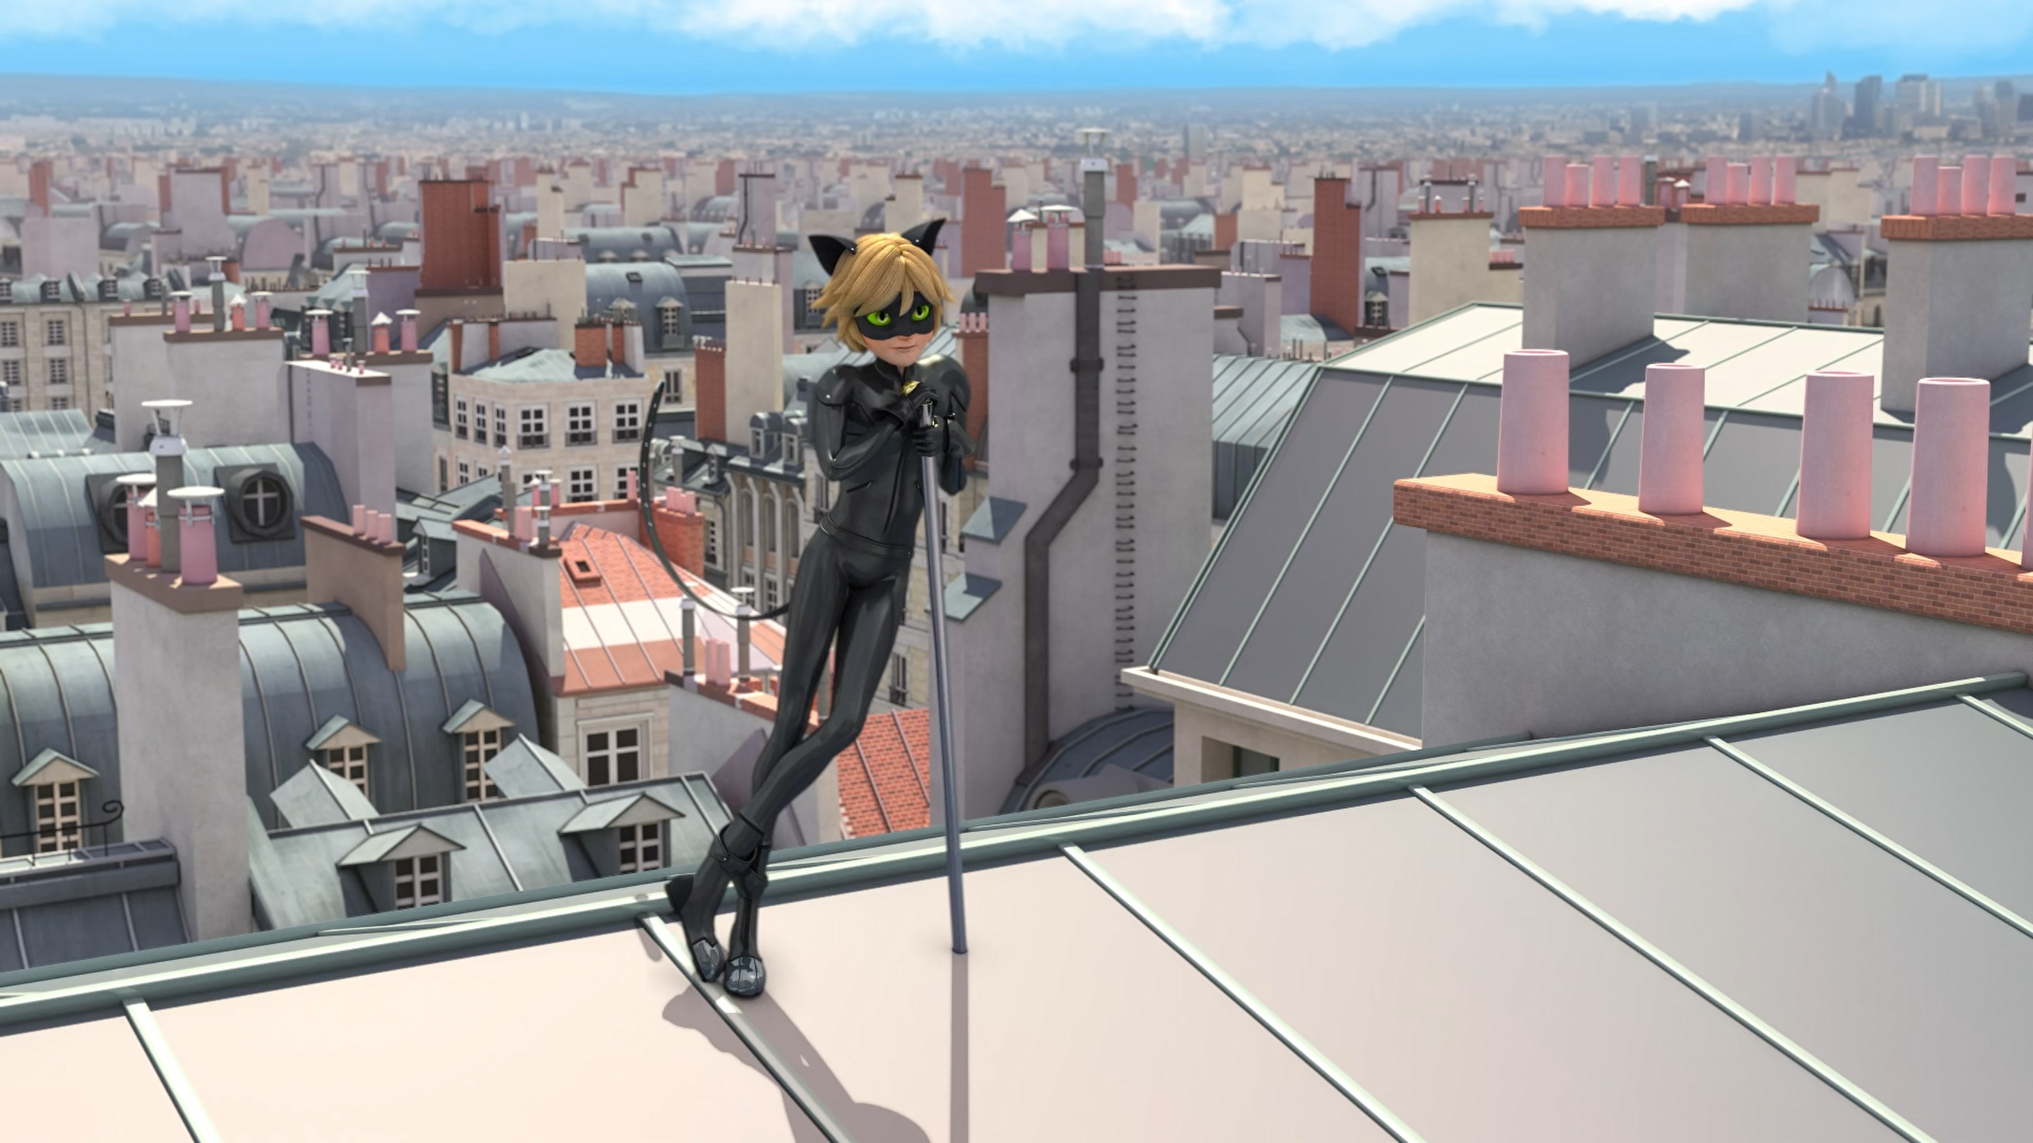

So what's your superpower? Making people ______ on banana peels?
trip
fall
slip

Slide 9
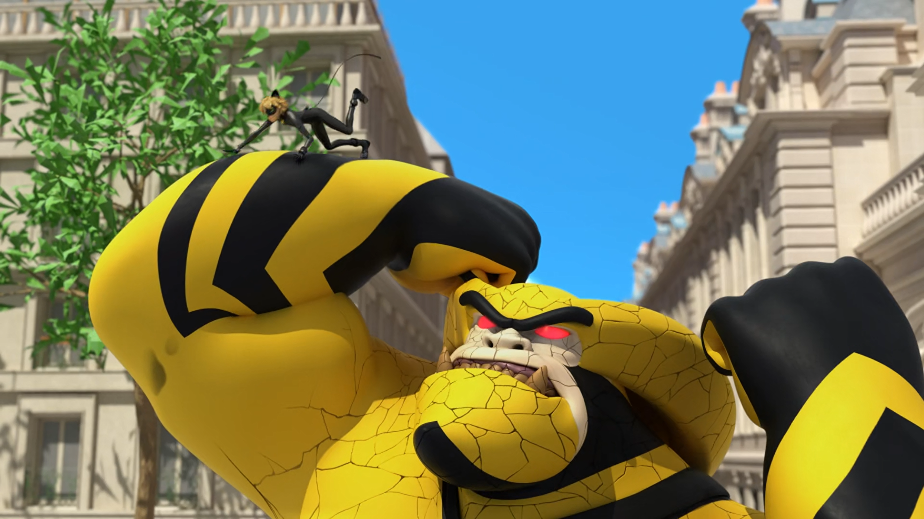
Banana Boom-Boom is even more ______!
destructive
deadly
dangerous

Slide 10
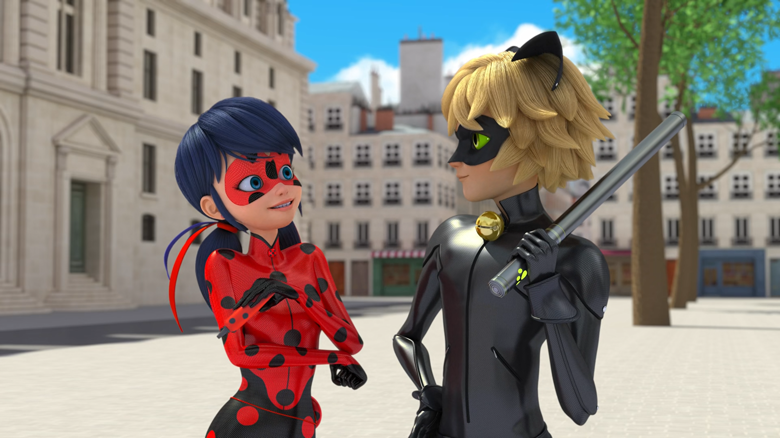
This Lucky Charm ______ is really good. And so is Vesperia.
paste
glue
liquid

Slide 11
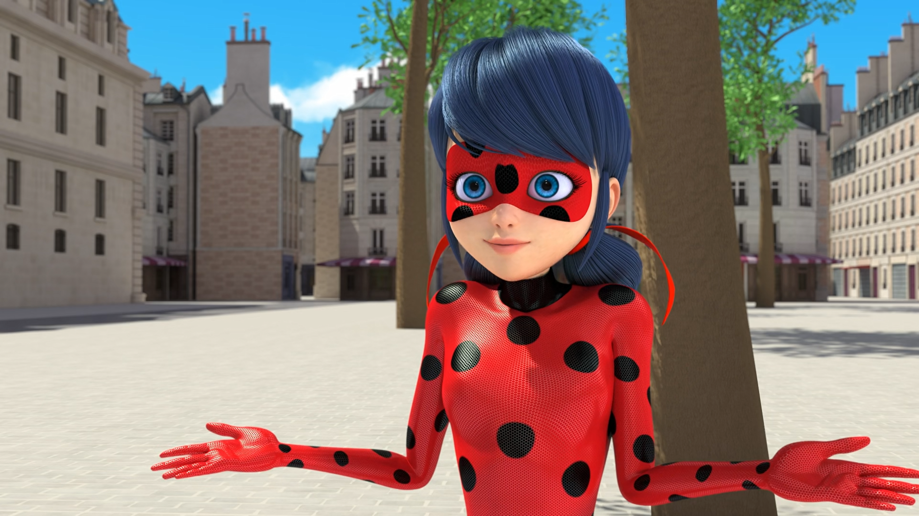
You need to learn to control your ______, Chloé.
temper
anger
mood

Slide 12
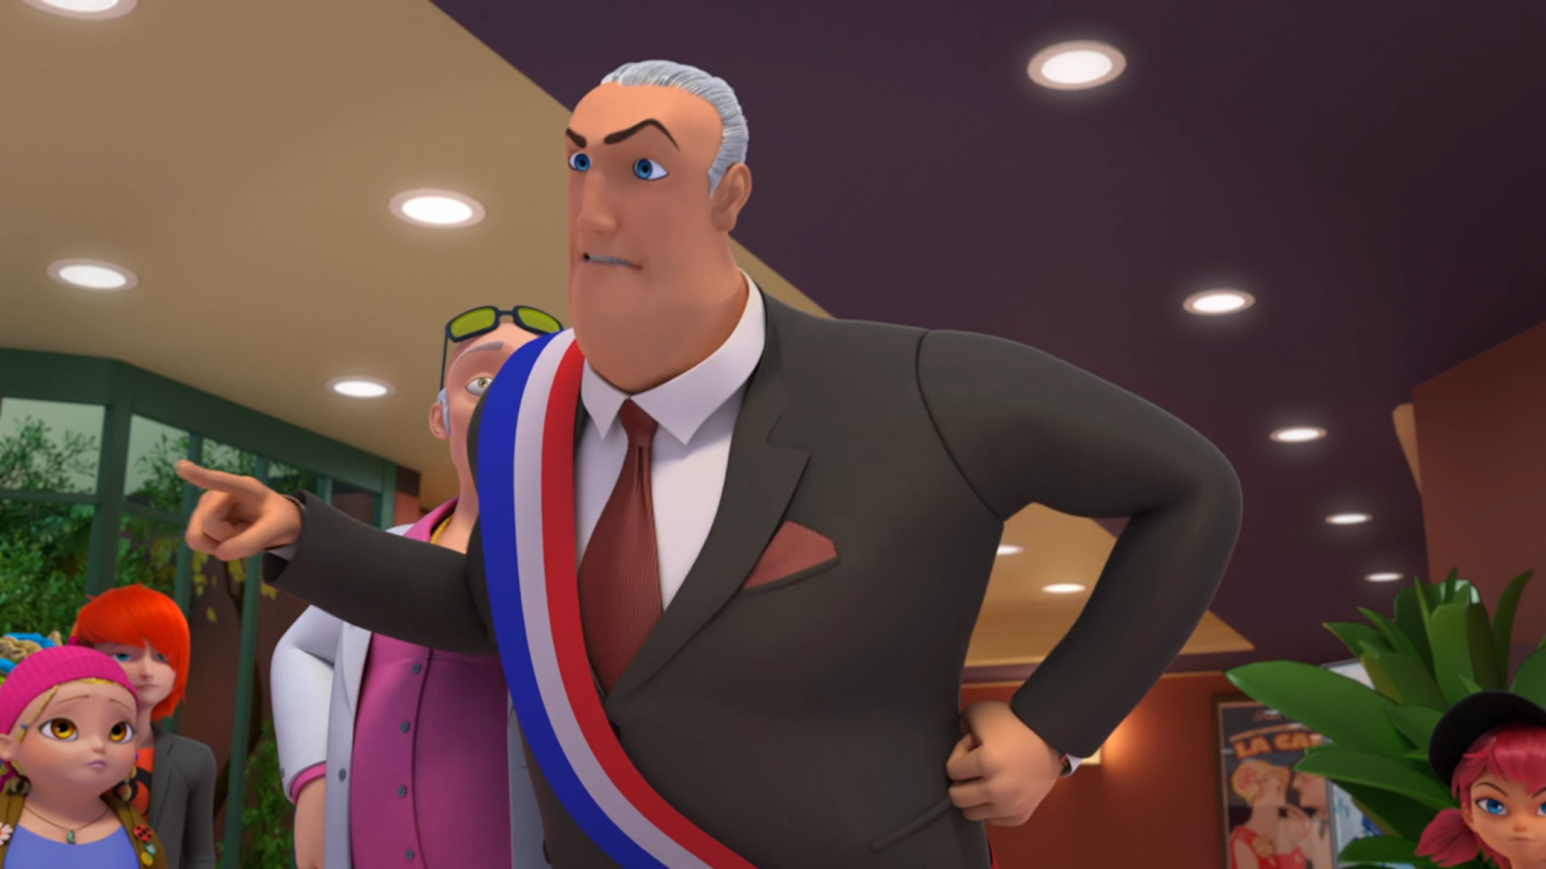
You can ask me for a new cellphone or to paint the ______ pink.
car
house
limousine

Slide 13
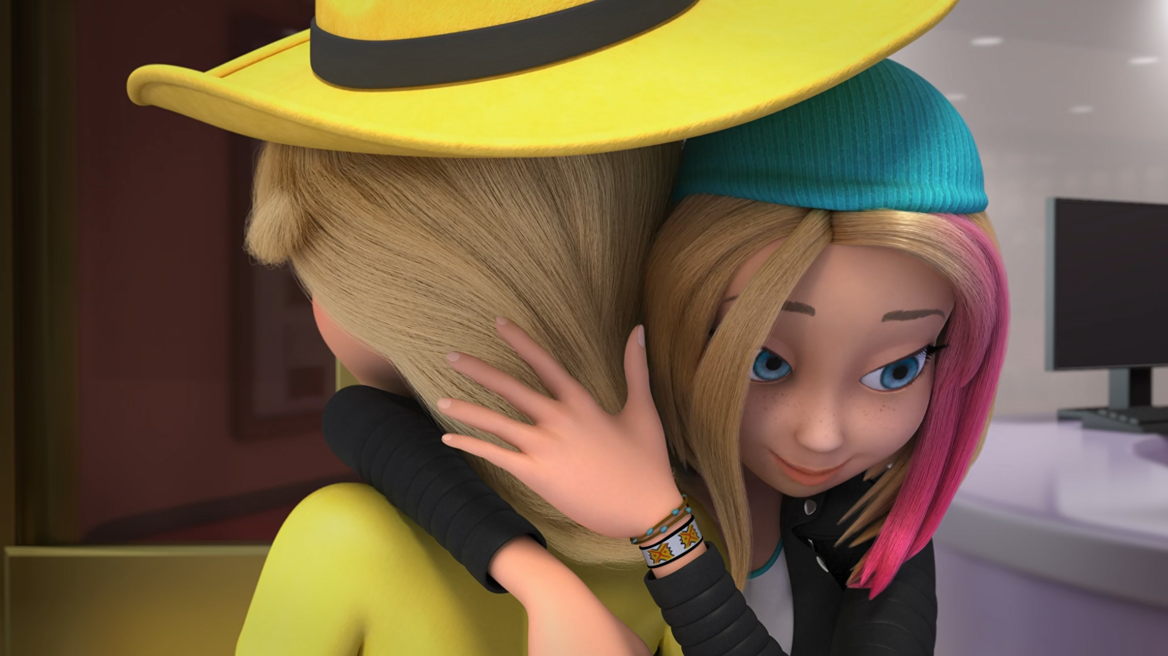
Remember? We have the same ______!
mother
dog
father

Slide 14
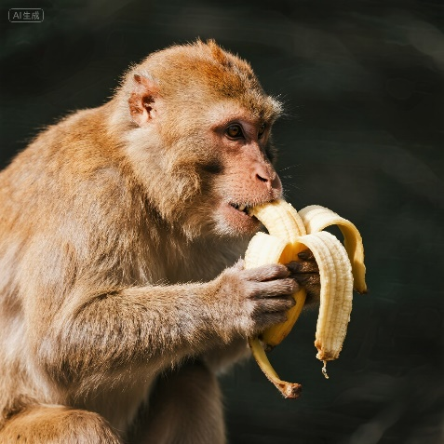
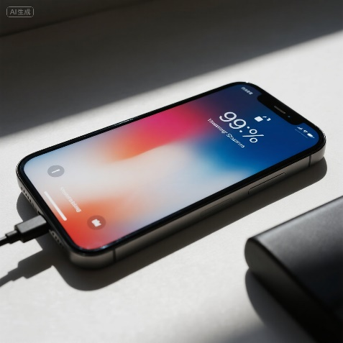
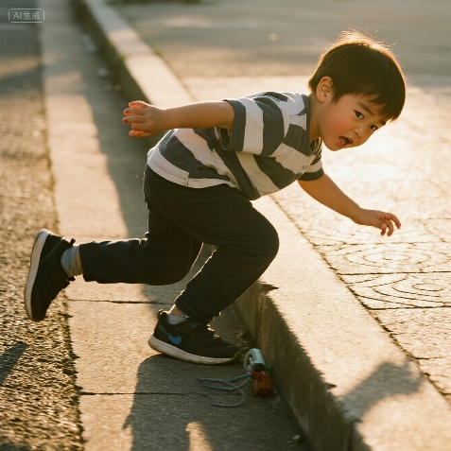
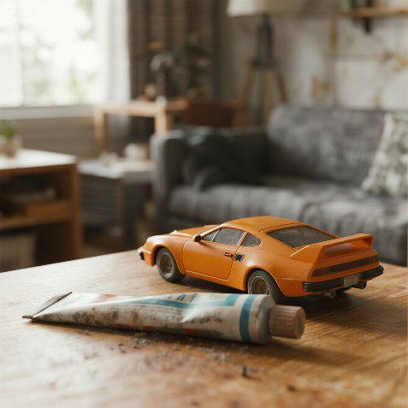
Matching Exercise
recharge | peeling | glue | slip

Slide 15
Matching Exercise
peeling | recharge | slip | glue

Slide 16
TRUE OR FALSE
1. Cat Noir has a car.
2. Chloé's gorilla is called Banana Boom-Boom.
3. Chloé escapes in her flying car.
4. Zoé becomes Queen Bee.
5. Chloé and Zoé have the same boyfriend.

Slide 17
TRUE OR FALSE
1. Cat Noir has a car. | FALSE
2. Chloé's gorilla is called Banana Boom-Boom. | TRUE
3. Chloé escapes in her flying car. | TRUE
4. Zoé becomes Queen Bee. | FALSE
5. Chloé and Zoé have the same boyfriend. | FALSE

