Slide 1

MIRACULOUS LADYBUG: QUEEN BANANA. PART 1

Slide 2
VOCABULARY
authorise - 授权 - ɔːθᵊraɪz
cape - 海角 - keɪp
compromise - 妥协 - kɒmprəmaɪz
costume - 服装 - kɒstjuːm
exploding - 爆炸 - ɪkˈspləʊdɪŋ
initiative - 倡议 - ɪˈnɪʃətɪv
participate - 参加 - pɑːˈtɪsɪpeɪt
prepped - 预备 - prɛpt

Slide 3
1. kɒmprəmaɪz
2. 服装
3. pɑːˈtɪsɪpeɪt

Slide 4
1. kɒmprəmaɪz - compromise
2. 服装 - costume
3. pɑːˈtɪsɪpeɪt - participate

Slide 5
QUEEN BANANA. PART 1
Chloé: Surprise!
Marinette: Chloé, what are you doing here?!
Bob: My old friend André told me you'd be okay making a few small changes in the script so that his daughter could be part of the film.
Marinette: But it's impossible, we've prepped and gotten everything set!
Bob: Moviemaking, kid.

Slide 6
Chloé: The next plane for New York leaves in 30 minutes.
Zoé: Marinette, no big deal if I don't play the main role. There is lots of other positions of the non-act crew.
Chloé: Perfect, as long as she's not on-screen, it's fine with me.
Bob: Then it's a deal! See you all tomorrow morning on set.

Slide 7
Chloé: Adrikins, it's sweet of you to want to console me, but I'm fine. I'm going to get my revenge and send Zoé back to New York.
Adrien: Actually, I came to suggest that you apologize to everyone.
Chloé: Are you ill?! They've ruined my film!
Adrien: It was never your film, Chloé. It belonged to the group. You promised me you'd make an effort to stop being mean.

Slide 8
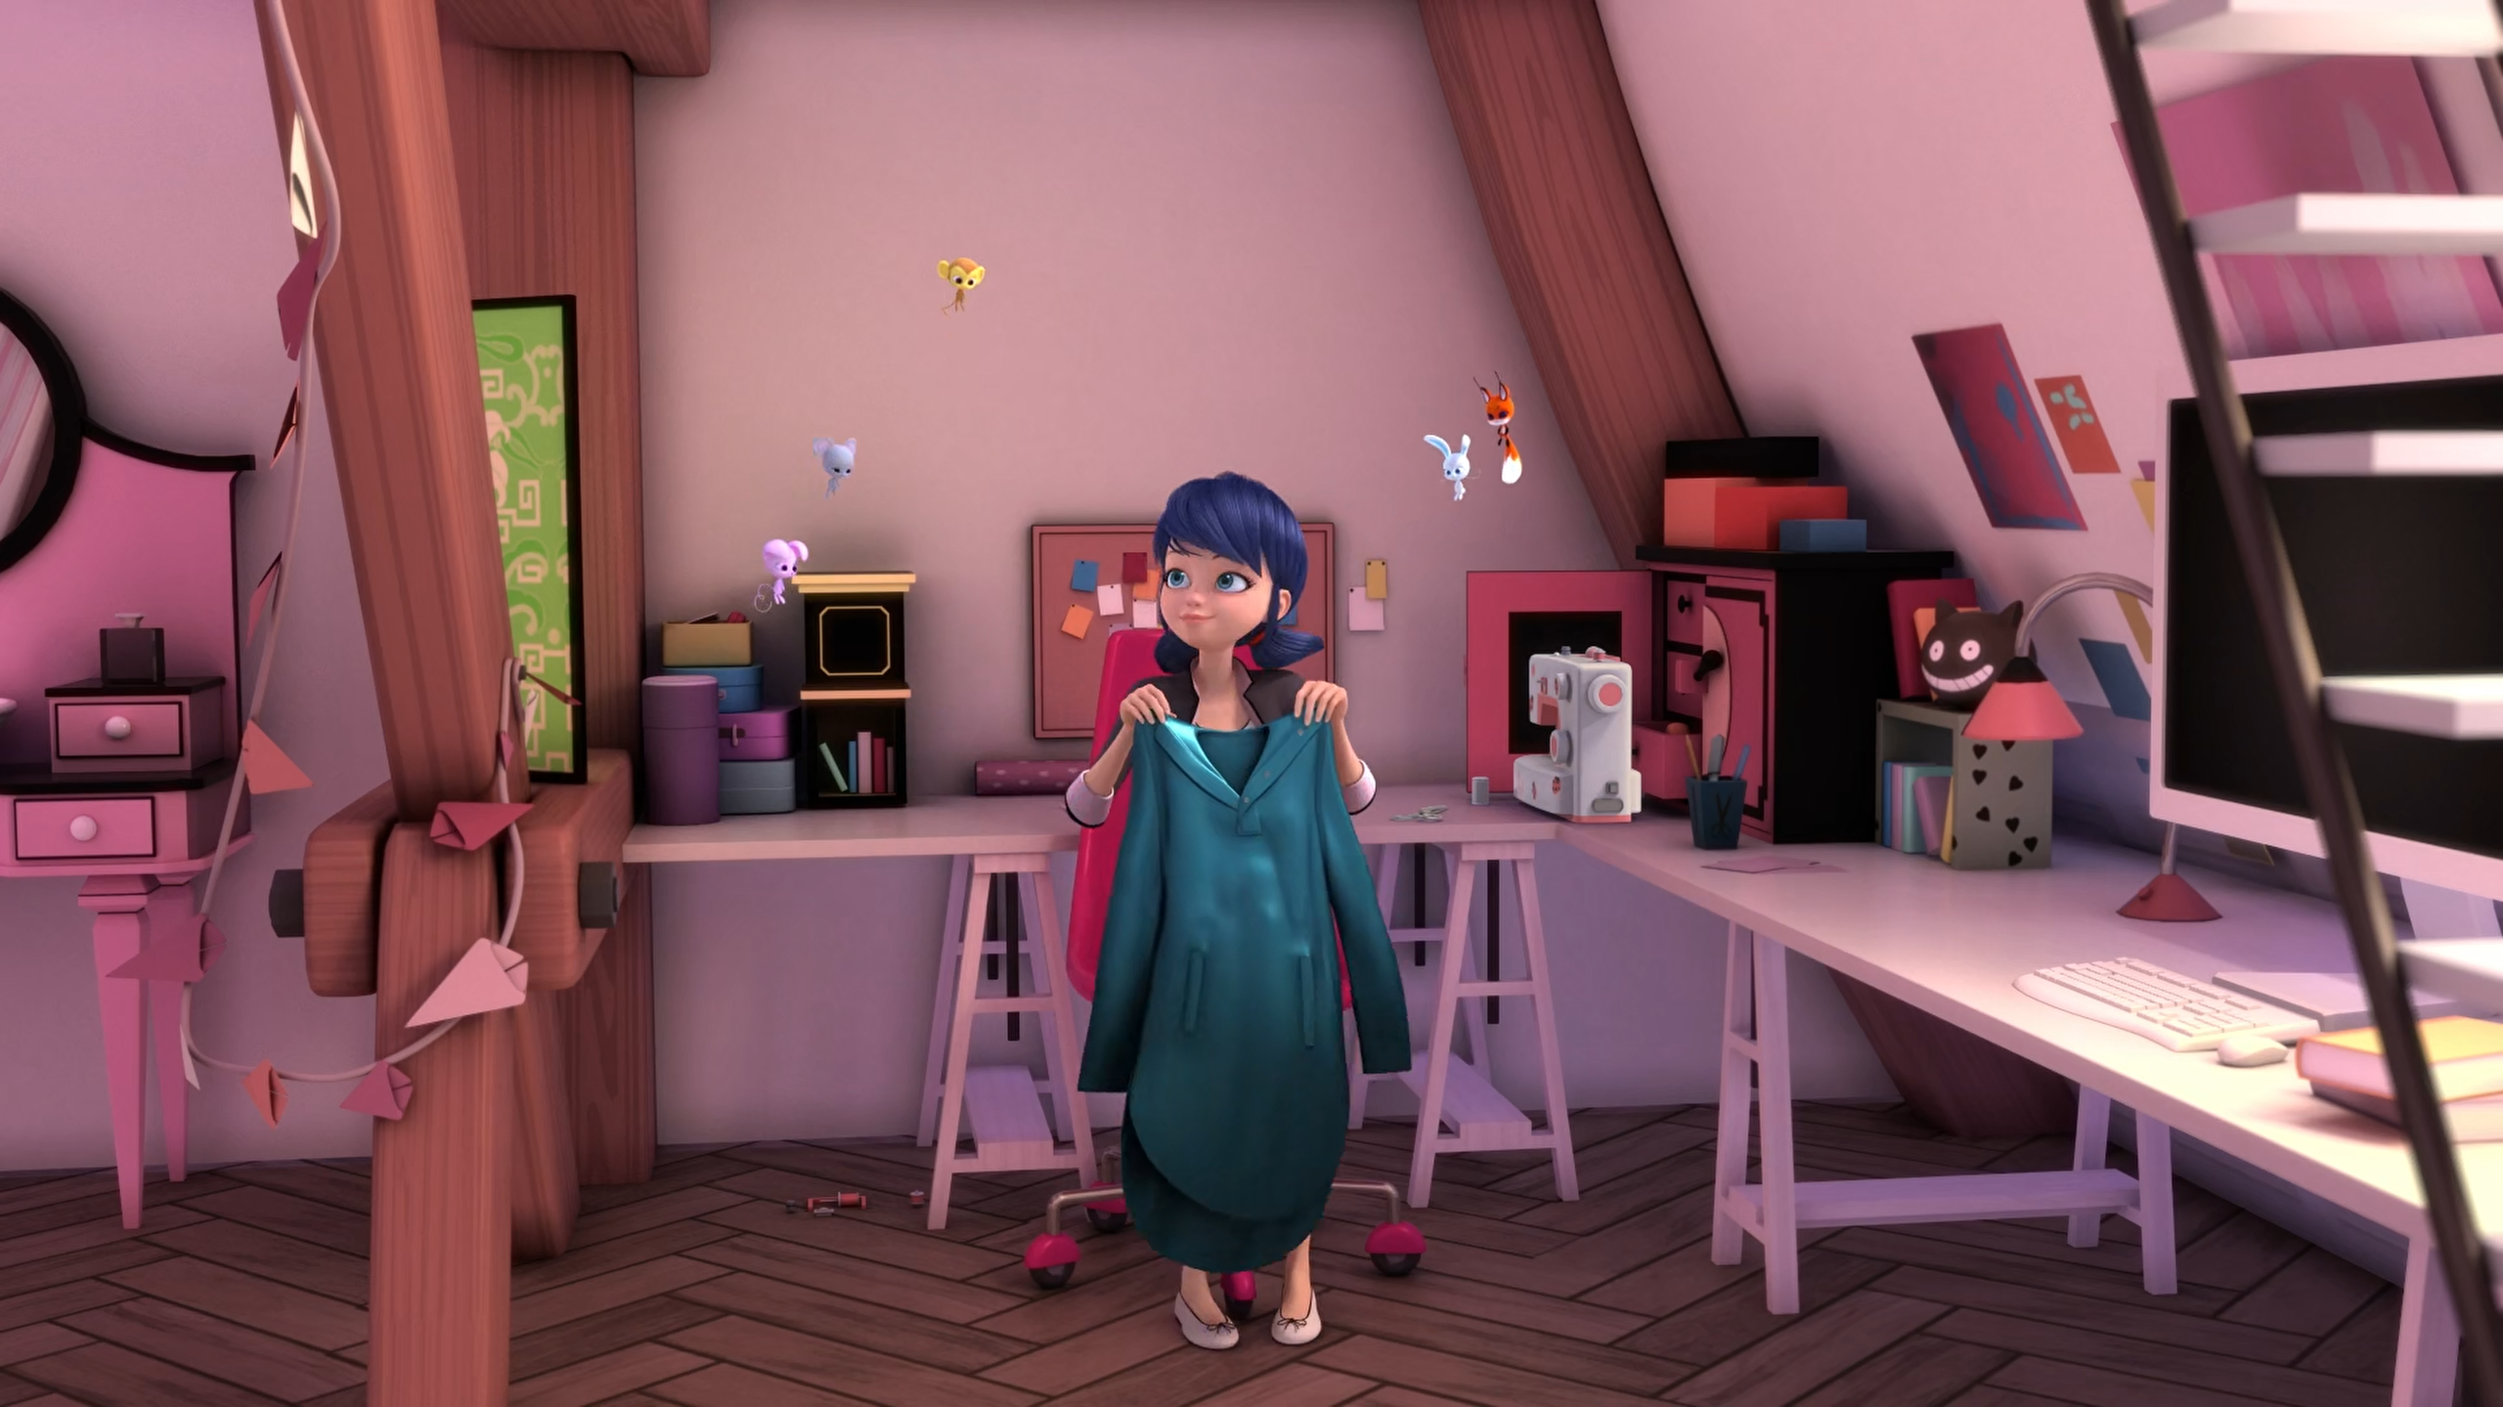

It's a ______. This one's for the superhero of creation.
cloak
tablecloth
cape

Slide 9
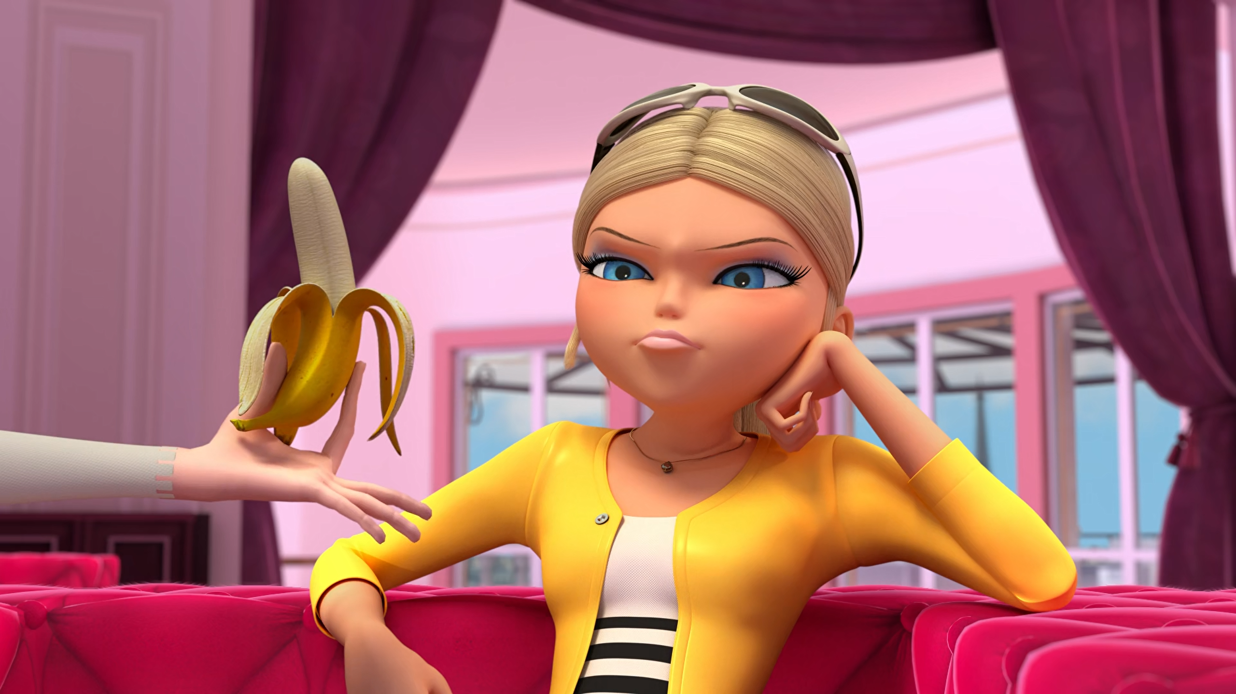
Do you want another ______, Chloé?
banana
apple
monkey

Slide 10
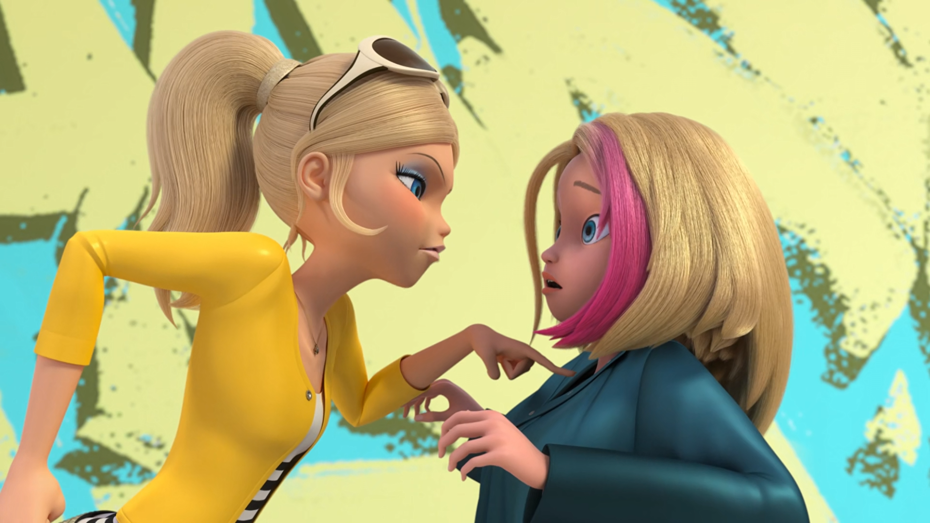
I told you that you'd be sent back to ______.
Dalian
New York
Paris

Slide 11
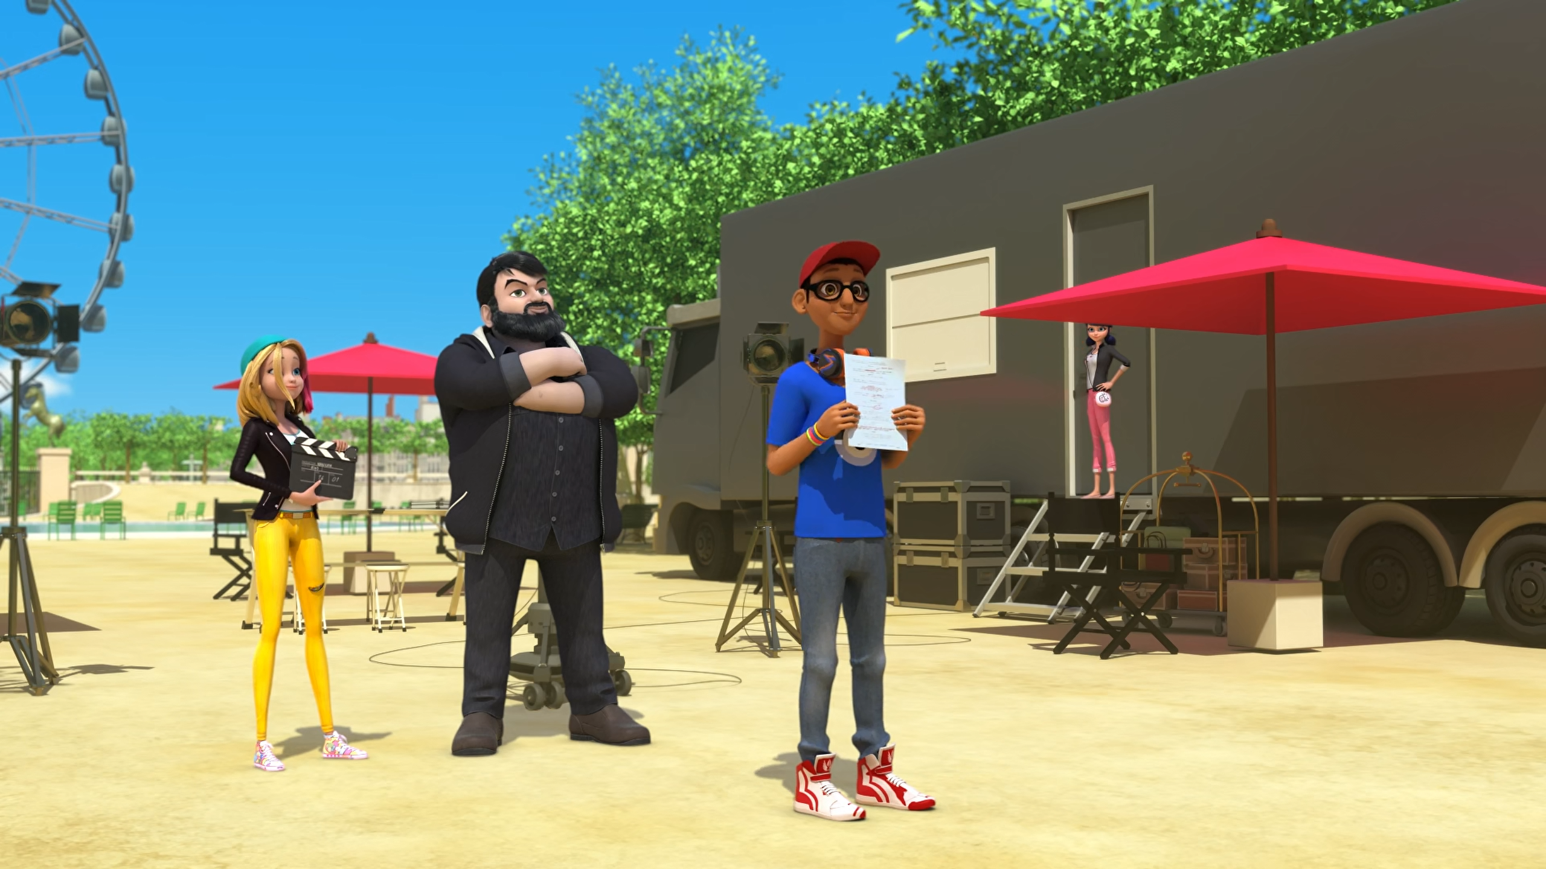
The entire ______ has been put into an enchanted sleep.
people
population
populous

Slide 12
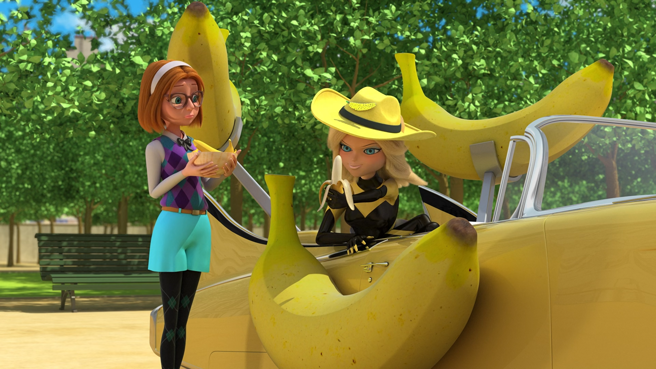
I want a giant yellow ______ that throws exploding bananas.
ape
monkey
gorilla

Slide 13
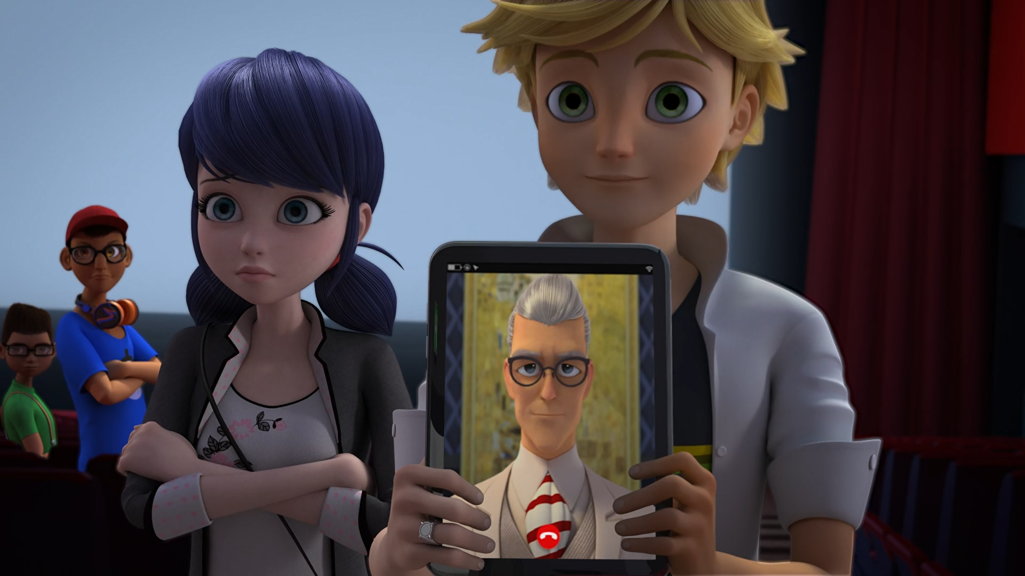
I've therefore decided to privately ______ the movie.
finance
buy
fund

Slide 14
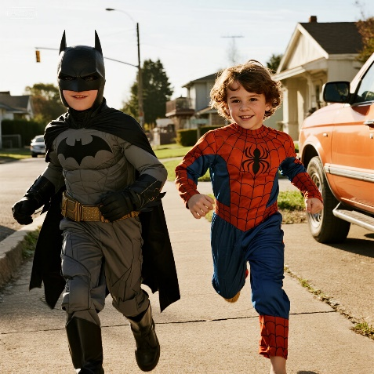
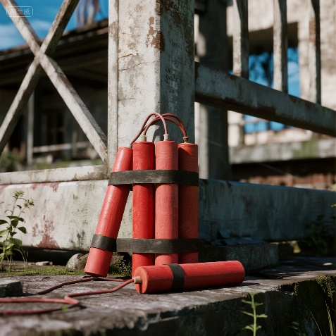
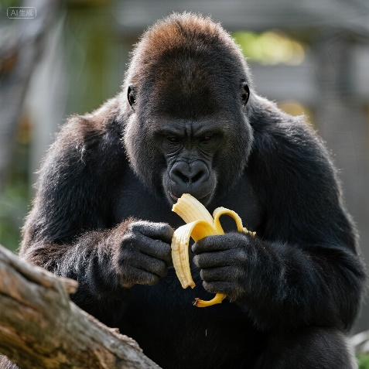
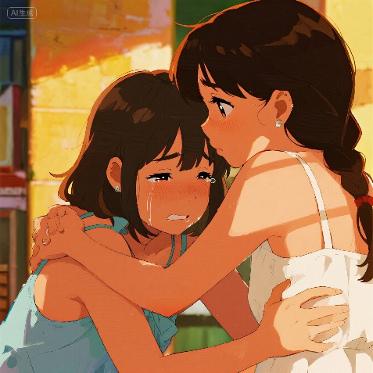
Matching Exercise
gorilla | console | costumes | dynamite

Slide 15
Matching Exercise
costumes | dynamite | gorilla | console

Slide 16
TRUE OR FALSE
1. Marinette is going to star in the movie.
2. Sabrina keeps giving Chloé bananas.
3. The city are funding the movie.
4. Chloé wants a car.
5. The zoo give Chloé an ape.

Slide 17
TRUE OR FALSE
1. Marinette is going to star in the movie. | FALSE
2. Sabrina keeps giving Chloé bananas. | TRUE
3. The city are funding the movie. | TRUE
4. Chloé wants a car. | TRUE
5. The zoo give Chloé an ape. | FALSE

