Slide 1
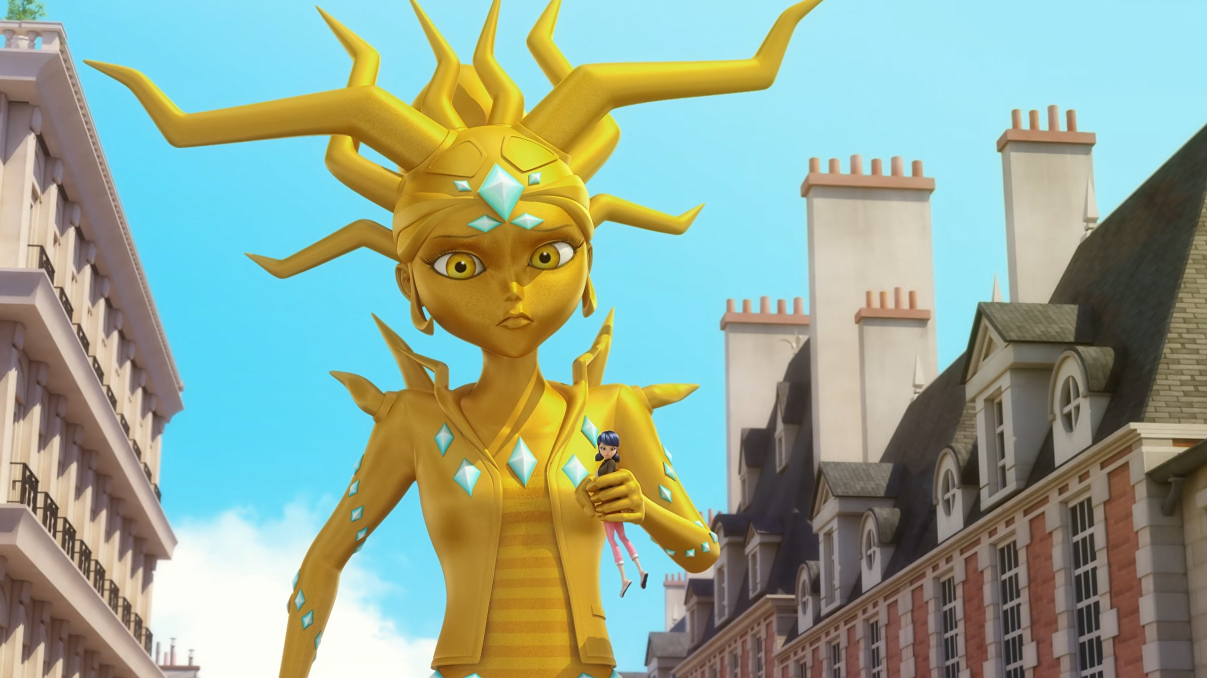
MIRACULOUS LADYBUG: SOLE CRUSHER. PART 2

Slide 2
VOCABULARY
directly - 直接地 - daɪˈrɛktli
image - 形象 - ˈɪmɪʤ
infect - 传染 - ɪnˈfɛkt
magical charm - 魔法魅力 - ˈmæʤɪkᵊl ʧɑːm
rejected - 拒收 - rɪˈʤɛktɪd
spectacular - 壮观的 - spɛkˈtækjələ
unique - 独特的 - juːˈniːk
weakening - 削弱 - ˈwiːkᵊnɪŋ
witnessed - 见证 - ˈwɪtnəst

Slide 3
directly - 直接地 - daɪˈrɛktli
image - 形象 - ˈɪmɪʤ
infect - 传染 - ɪnˈfɛkt
magical charm - 魔法魅力 - ˈmæʤɪkᵊl ʧɑːm
rejected - 拒收 - rɪˈʤɛktɪd
spectacular - 壮观的 - spɛkˈtækjələ
unique - 独特的 - juːˈniːk
weakening - 削弱 - ˈwiːkᵊnɪŋ
witnessed - 见证 - ˈwɪtnəst

Slide 4
1. 形象
2. spɛkˈtækjələ
3. 削弱

Slide 5
1. 形象 - image
2. spɛkˈtækjələ - spectacular
3. 削弱 - weakling

Slide 6
SOLE CRUSHER. PART 2
André: When I was young, I wanted to make movies, tell stories. Ah, that was the real me. What about you? What are your dreams?
Zoé: At first, I wanted to be an actress. I'm good at acting. Then I found myself acting all the time, playing these different roles trying to please everyone, until I couldn't do it anymore.

Slide 7
Chloé: Hey! How come you're using my image without my authorization?!
Sole Crusher: The student has become the master, Chloé, and now, I'm going to crush you!
Chloé: Zoé?!
Civillian: Hey! That's our cab!
Chloé: Not anymore!
Civillian: Hey!

Slide 8
Chloé: And see to it that we never cross paths again!
André: She'll take the service elevator with the staff.
Zoé: Thank you. Promise me that you won't leave your dreams too long down in that cellar.
André: I promise. Come on. You're going to love your new room.

Slide 9


When I was young, I wanted to make ______, tell stories.
music
muffins
movies

Slide 10
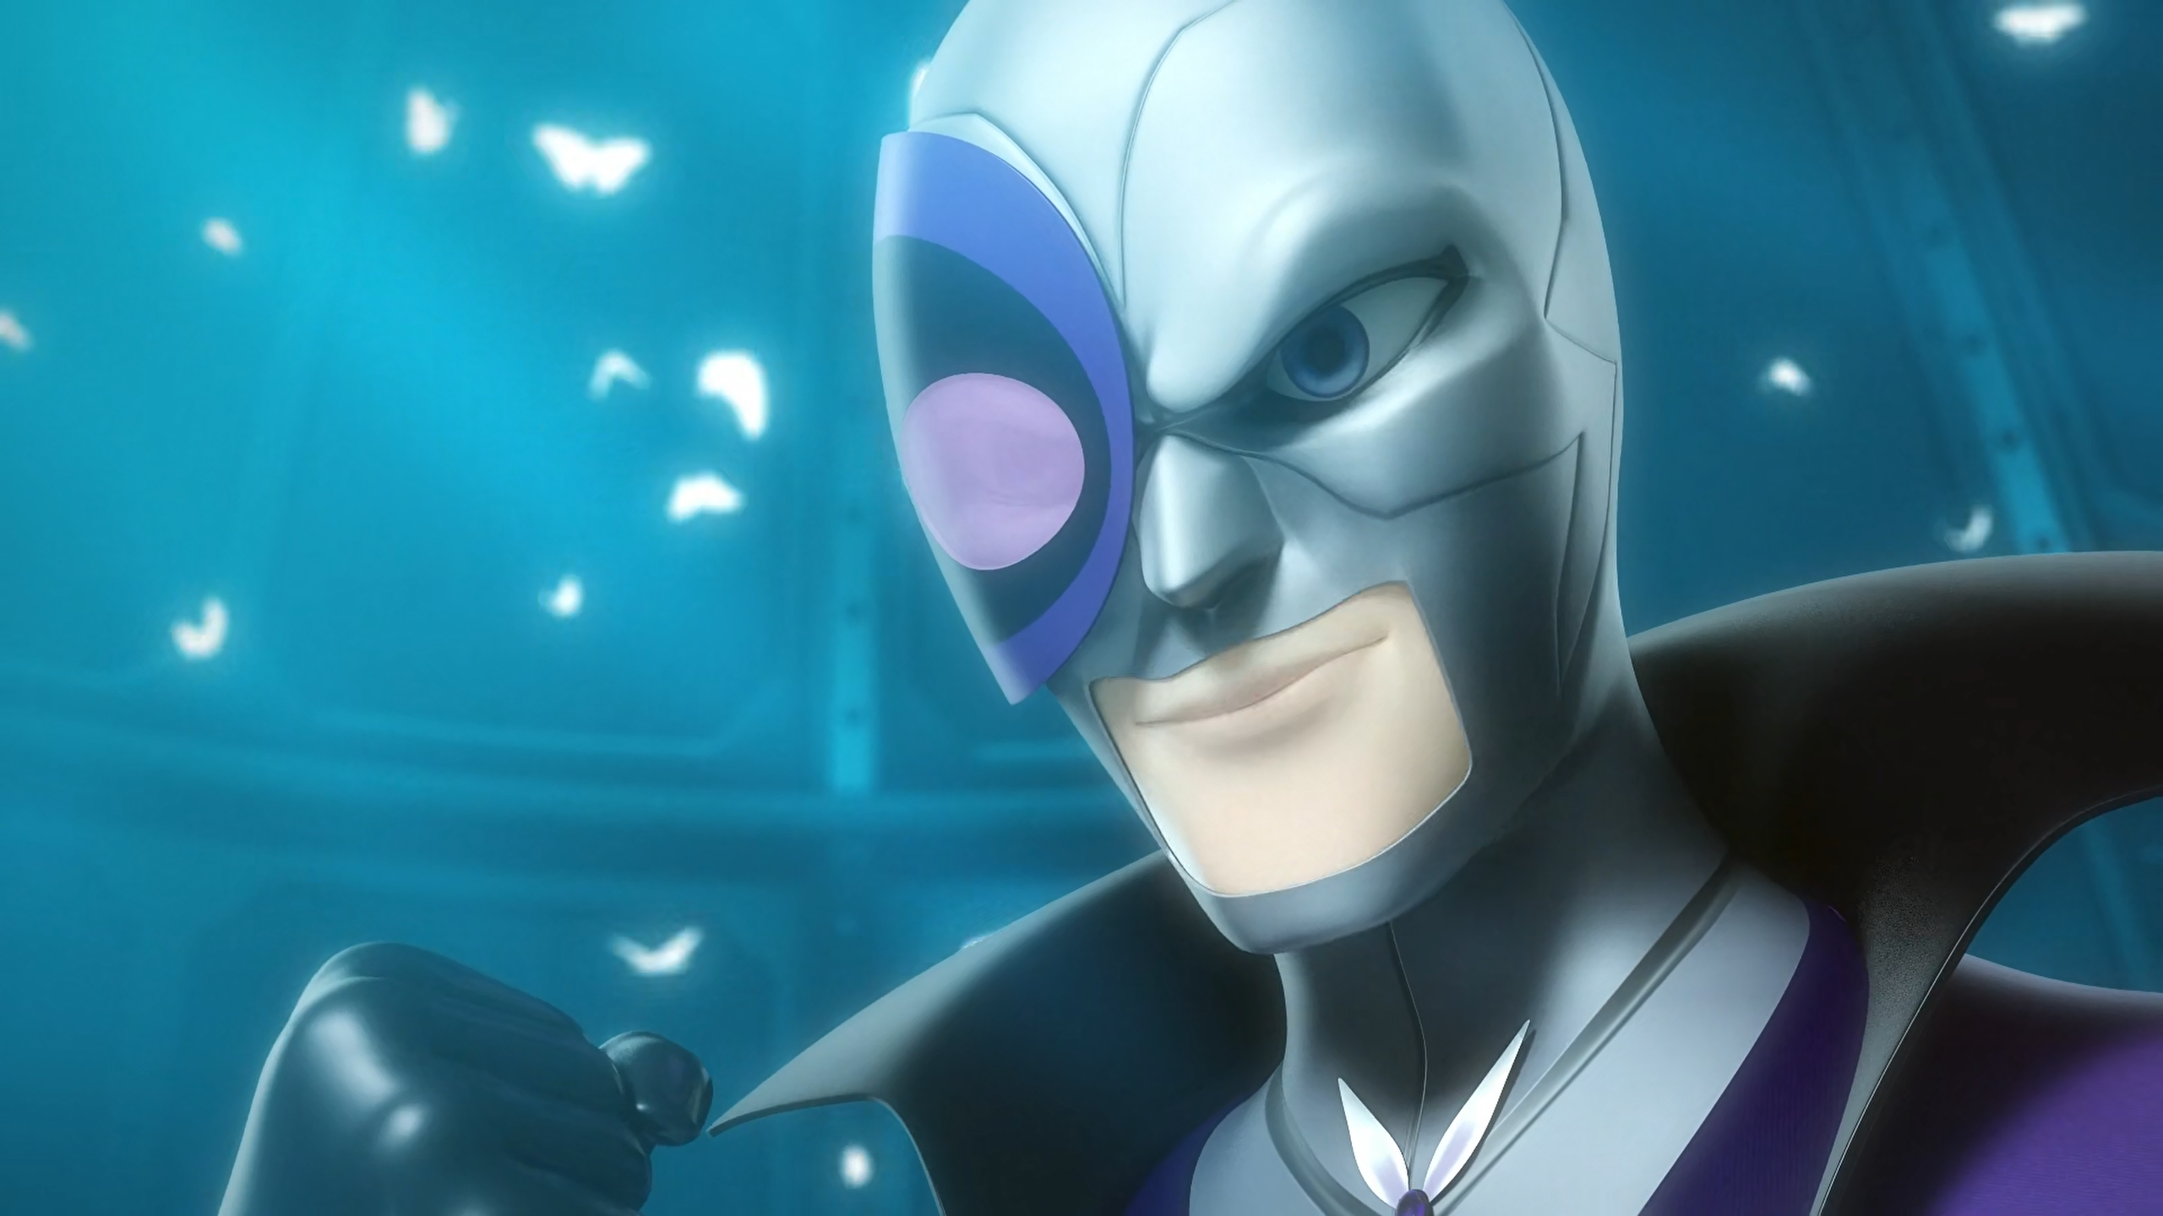
Travelling across the ______ only to be rejected once again!
ocean
sea
world

Slide 11
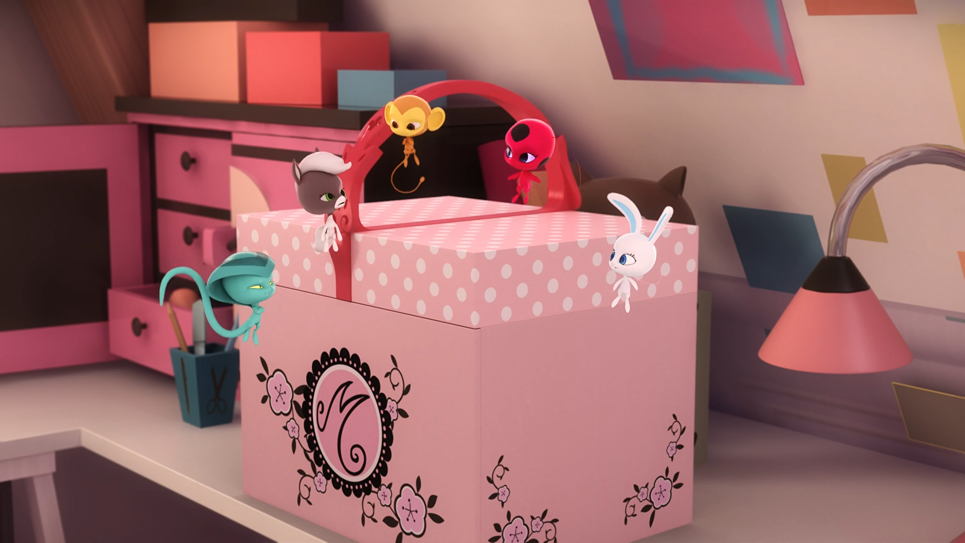
Kaalki, teleport to ______. We're going to need Cat Noir's help.
Adrien
Plagg
Cat Noir

Slide 12
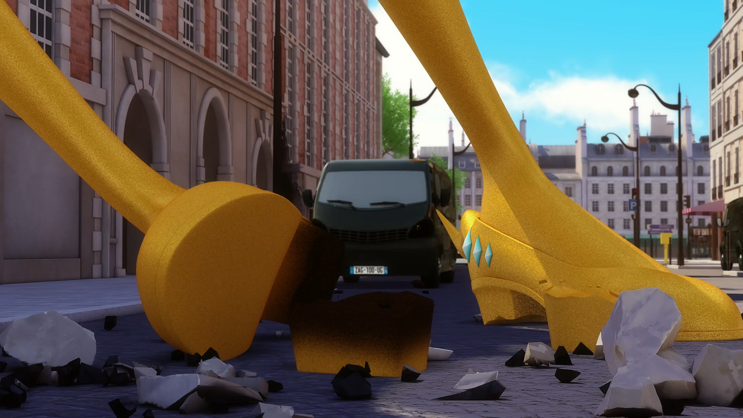
Just look at how you're treating my ______ shoes!
costly
priceless
expensive

Slide 13
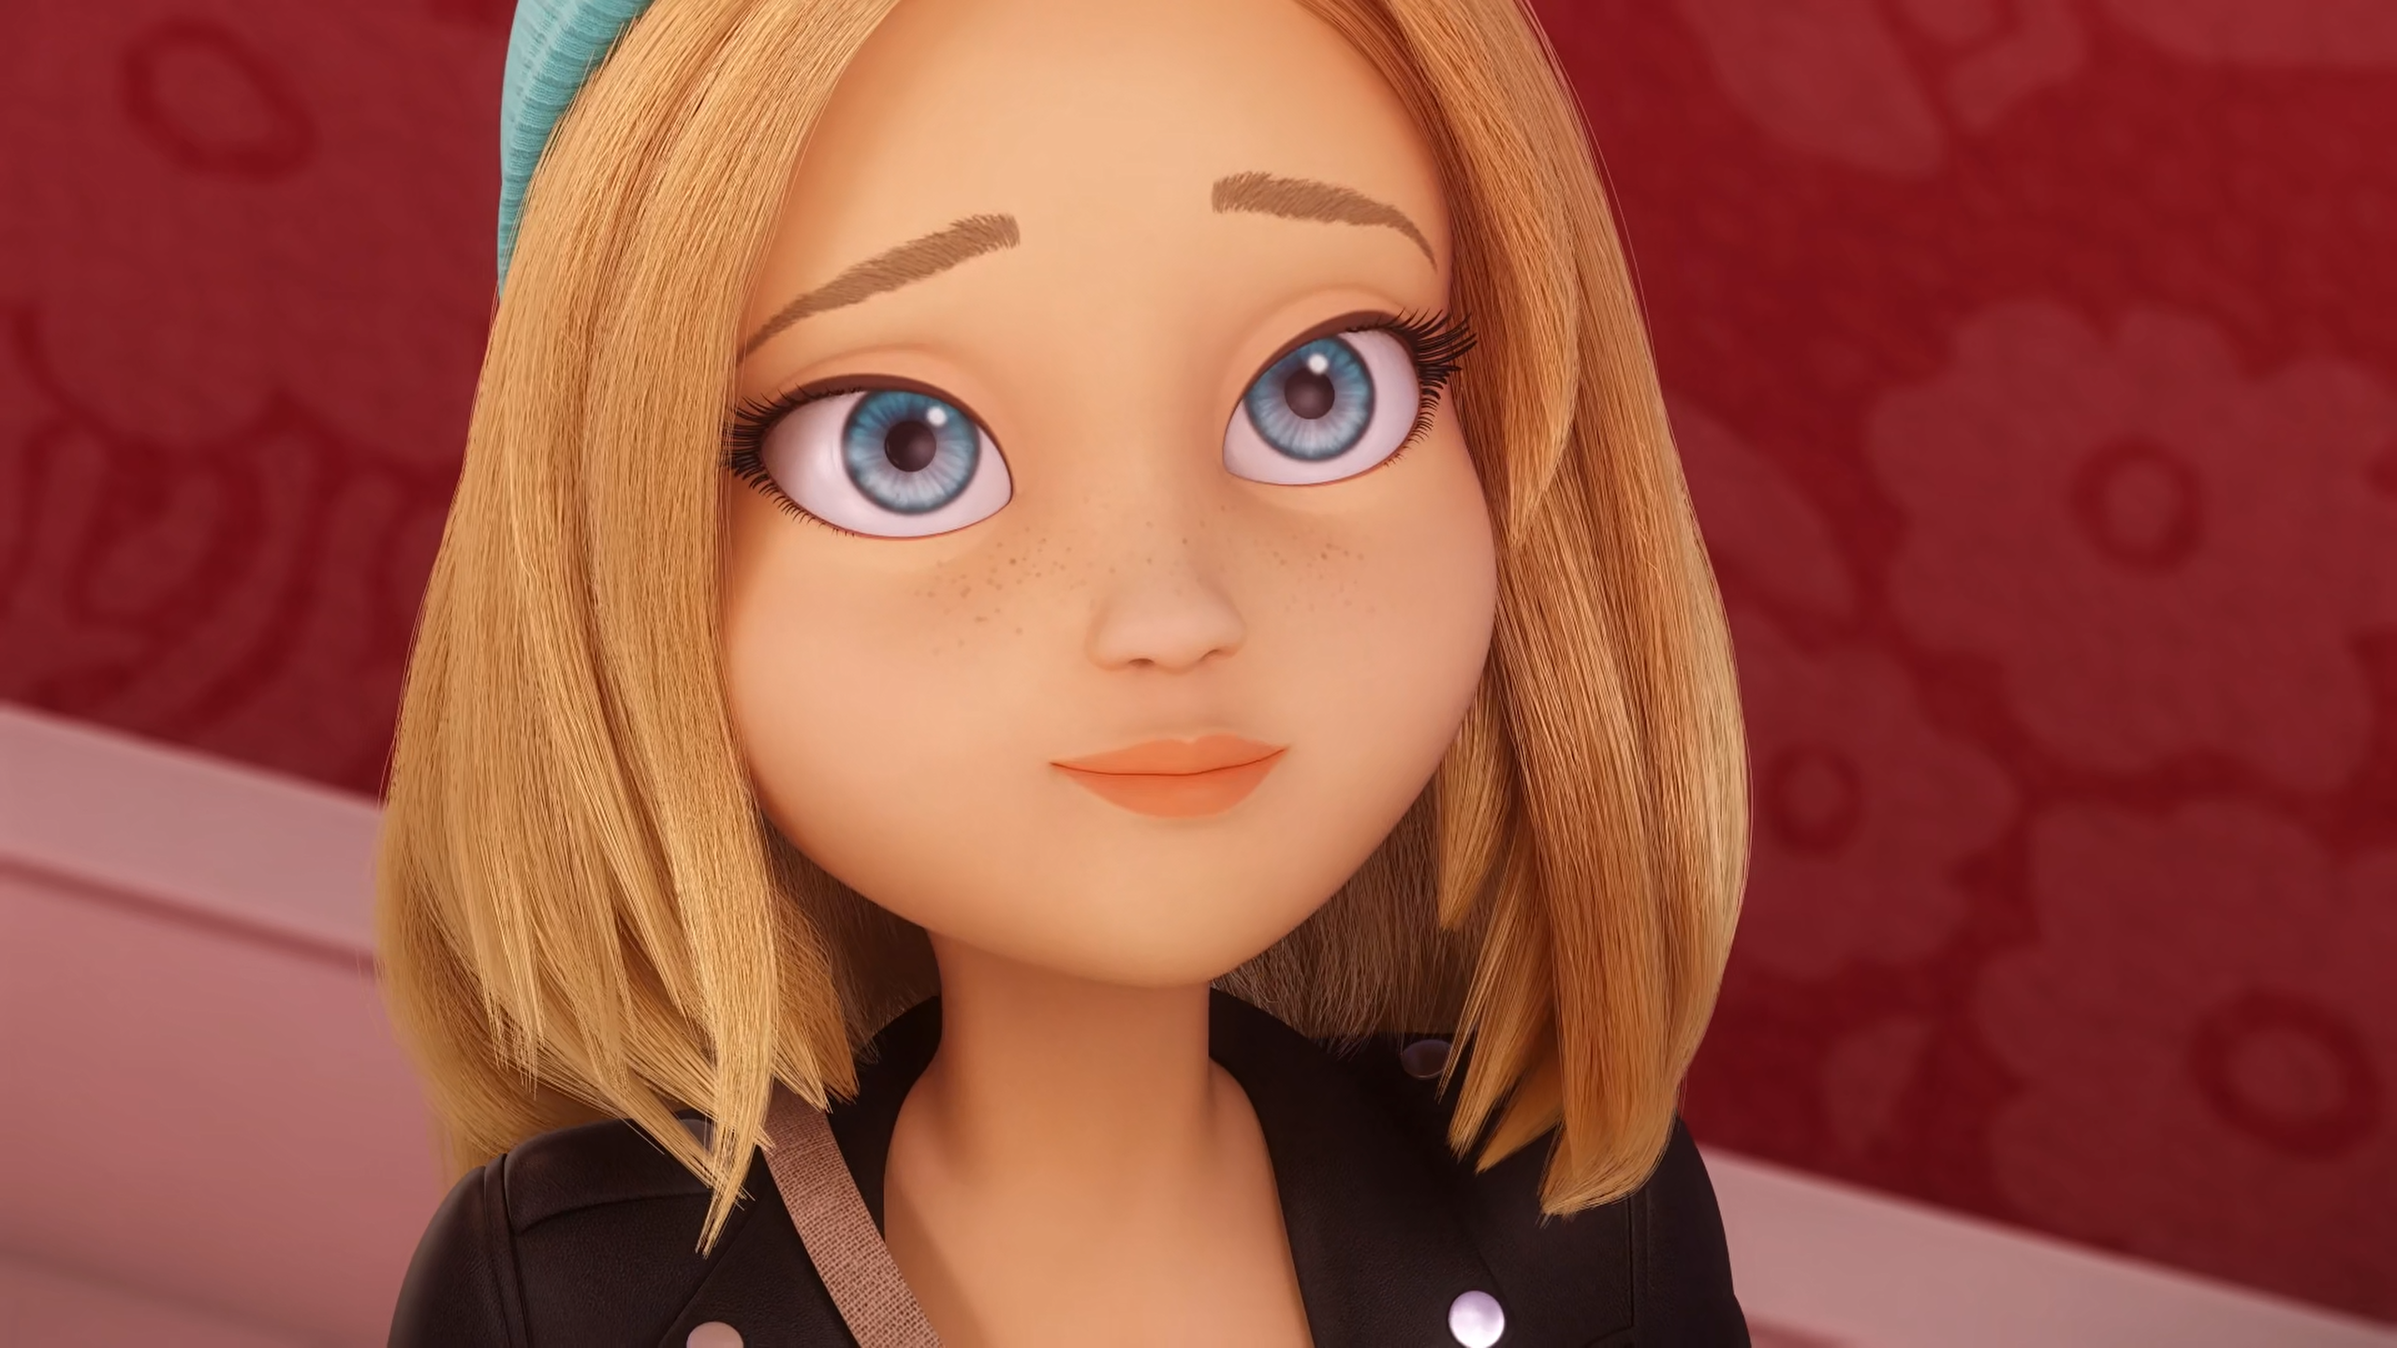
Promise me that you won't leave your dreams too long down in that ______.
cellar
hotel
room

Slide 14
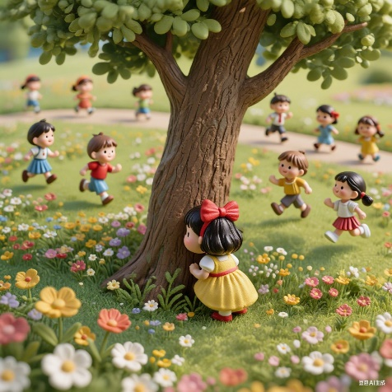
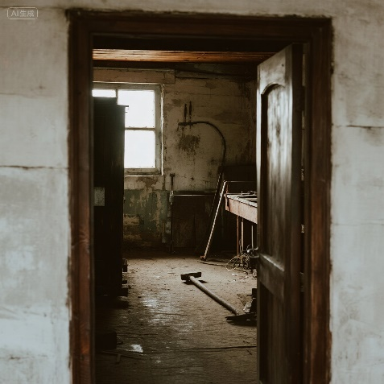
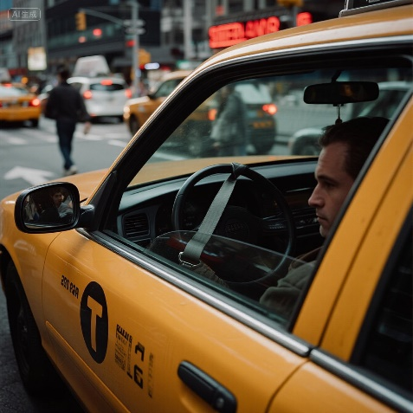
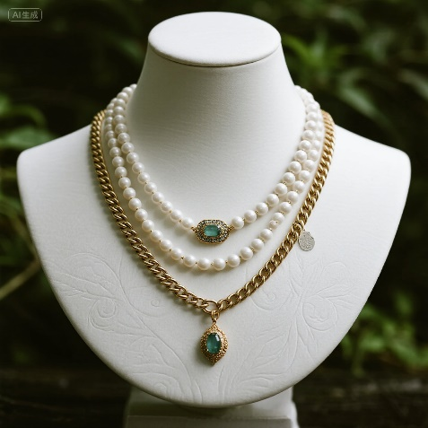
Matching Exercise
cab | priceless | hide | cellar

Slide 15
Matching Exercise
hide | cellar | cab | priceless

Slide 16
TRUE OR FALSE
1. Zoé's father wanted to be a chef.
2. Zoé puts her sneakers in the cellar.
3. Gorillas are playing on Adrien's fussball table.
4. André is afraid of his wife.
5. Zoé goes back to New York.

Slide 17
TRUE OR FALSE
1. Zoé's father wanted to be a chef. | FALSE
2. Zoé puts her sneakers in the cellar. | TRUE
3. Gorillas are playing on Adrien's fussball table. | TRUE
4. André is afraid of his wife. | TRUE
5. Zoé goes back to New York. | FALSE

