Slide 1
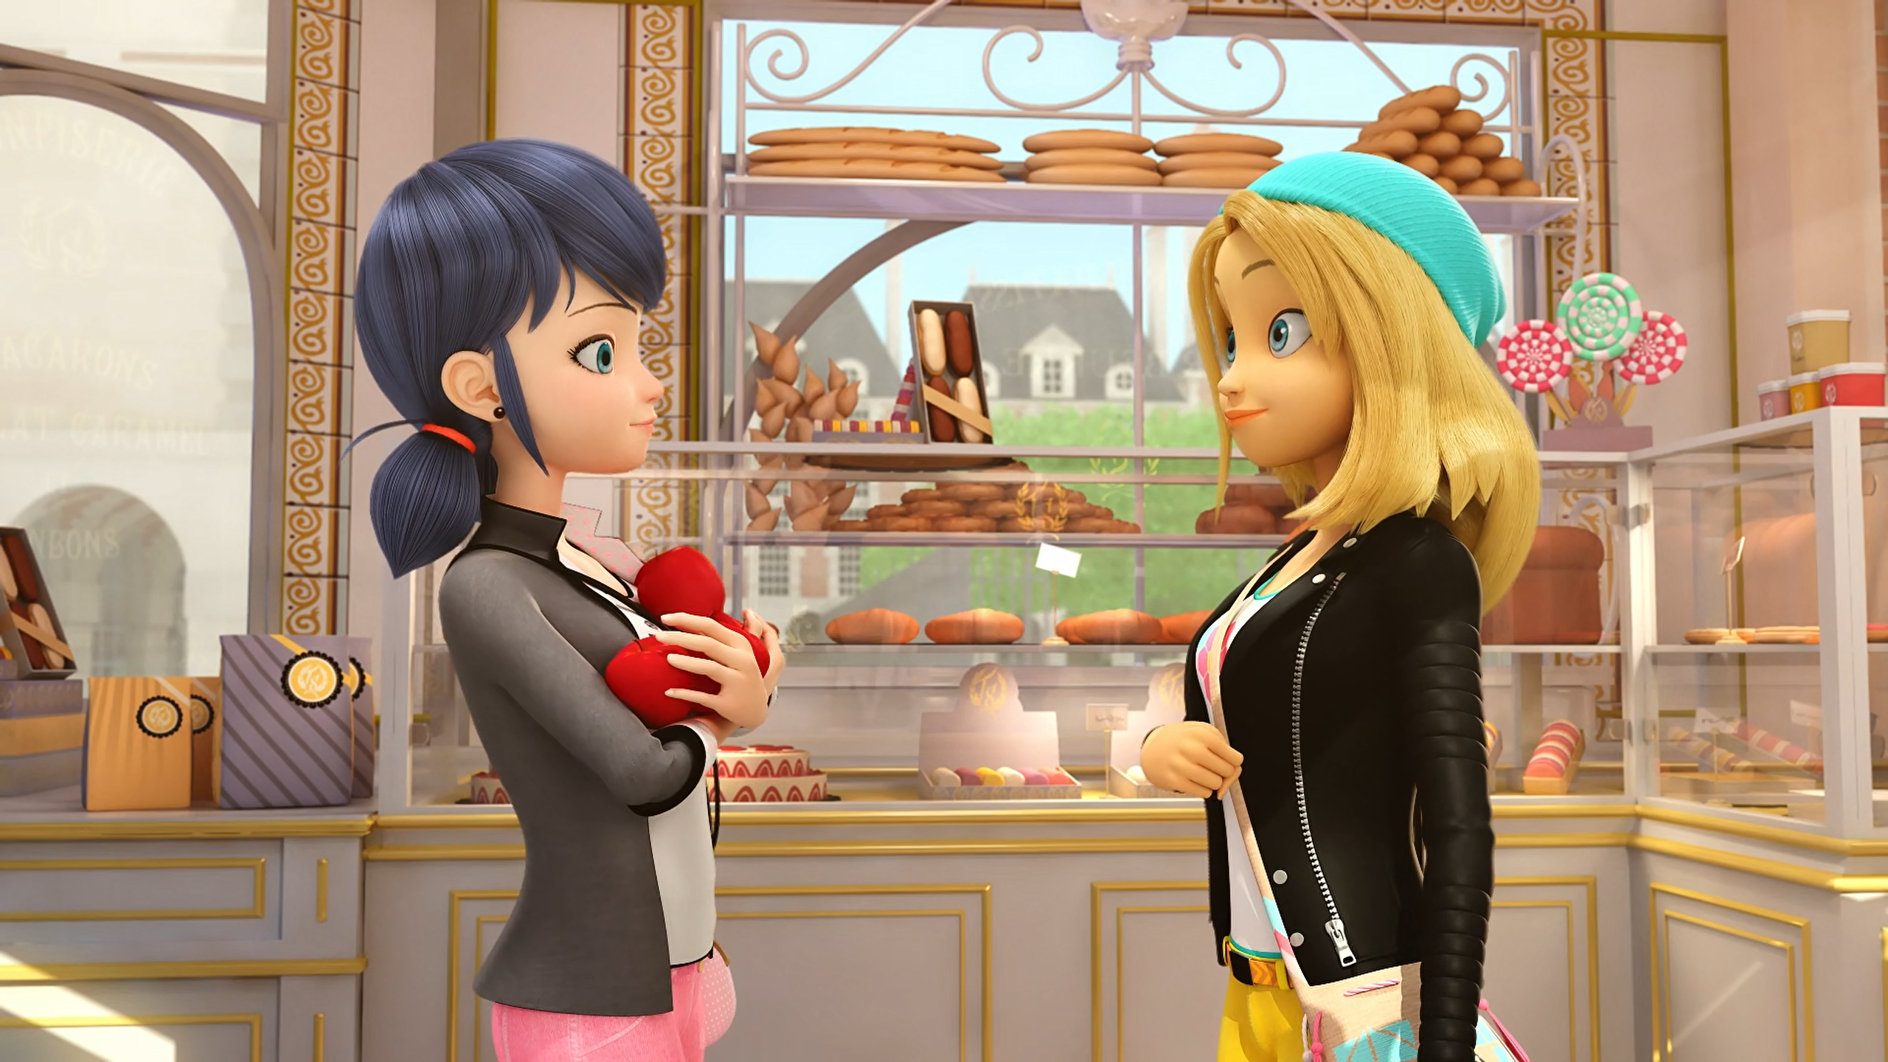
MIRACULOUS LADYBUG: SOLE CRUSHER. PART 1

Slide 2
VOCABULARY
accent - 口音 - æksᵊnt
acceptable - 可接受的 - əkˈsɛptəbᵊl
adore - 崇拜 - əˈdɔː
discover - 发现 - dɪˈskʌvə
huge - 巨大的 - hjuːʤ
influence - 影响 - ɪnfluəns
minion - 奴才 - mɪnjən
toxic - 有毒的 - tɒksɪk

Slide 3
1. æksᵊnt
2. 巨大的
3. 影响

Slide 4
1. æksᵊnt - accent
2. 巨大的 - huge
3. 影响 - influence

Slide 5
SOLE CRUSHER. PART 1
Sabine: You're lucky they're fresh out of the oven.
Marinette: Sorry I got held up here!
Sabine: Is everyone all right?
Marinette: Sorry, sorry, sorry!
Zoé: It's totally okay, but maybe I should be asking if you're okay. That was quite a fall!

Slide 6
Marinette: Wow, your sneakers are awesome! Did you decorate them yourself?
Zoé: Yeah, I've written every nice thing that anyone's ever said to me, to keep them with me all the time.
Marinette: But there's only one message!
Zoé: I only had one friend.
Marinette: Oh...

Slide 7
Marinette: Why did she become so nasty when she was so nice before?
Daizzi: Maybe she was…hungry?
Marinette: I'm sure the real Zoé is the one
I met the first time. I hope I can get to the bottom of this.
Tikki: As long as you're acting with kindness, Marinette, you can't go wrong.
Mullo: Mm-hmm.

Slide 8

Where's your ______ from? It's really pretty!
dialect
beret
accent

Slide 9
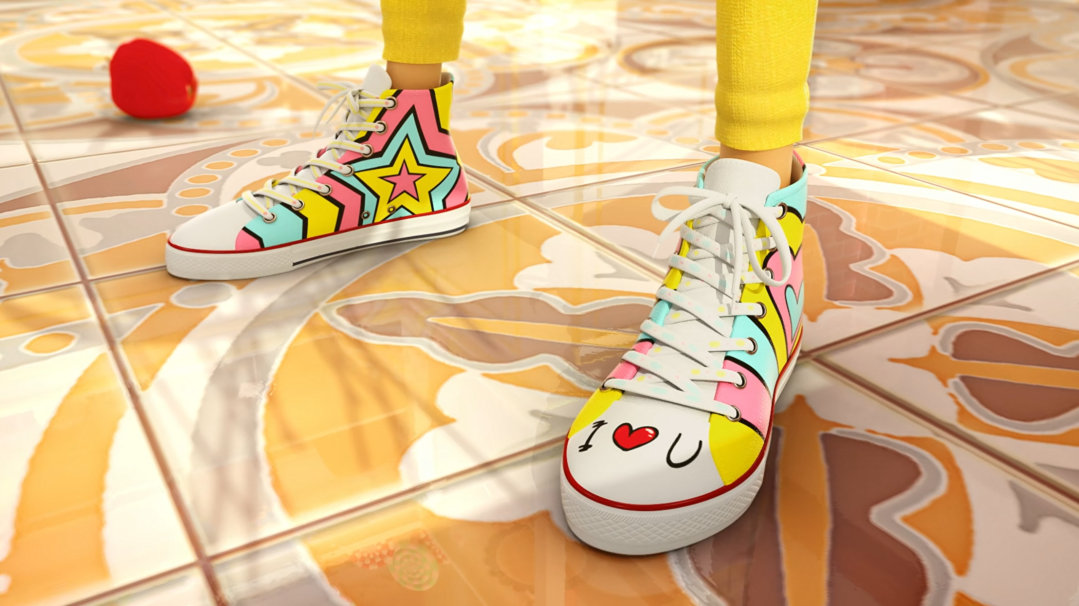
Wow, your sneakers are awesome! Did you ______ them yourself?
decorate
buy
make

Slide 10
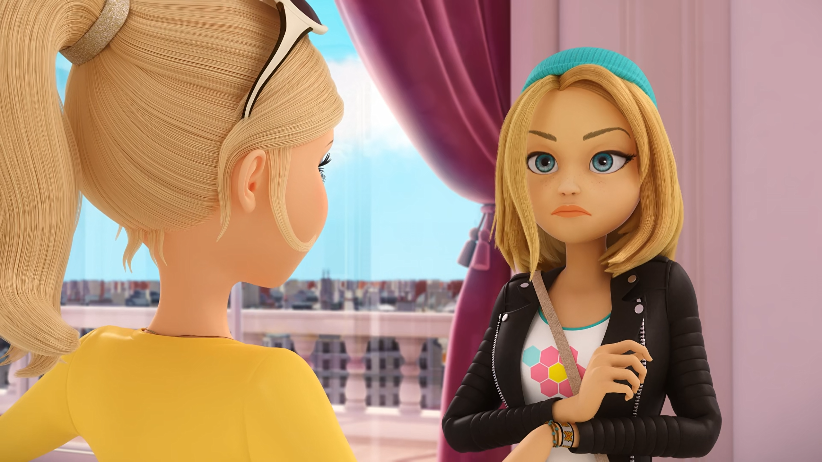
Rule number two. You need a ______. Where's yours?
friend
minion
butler

Slide 11
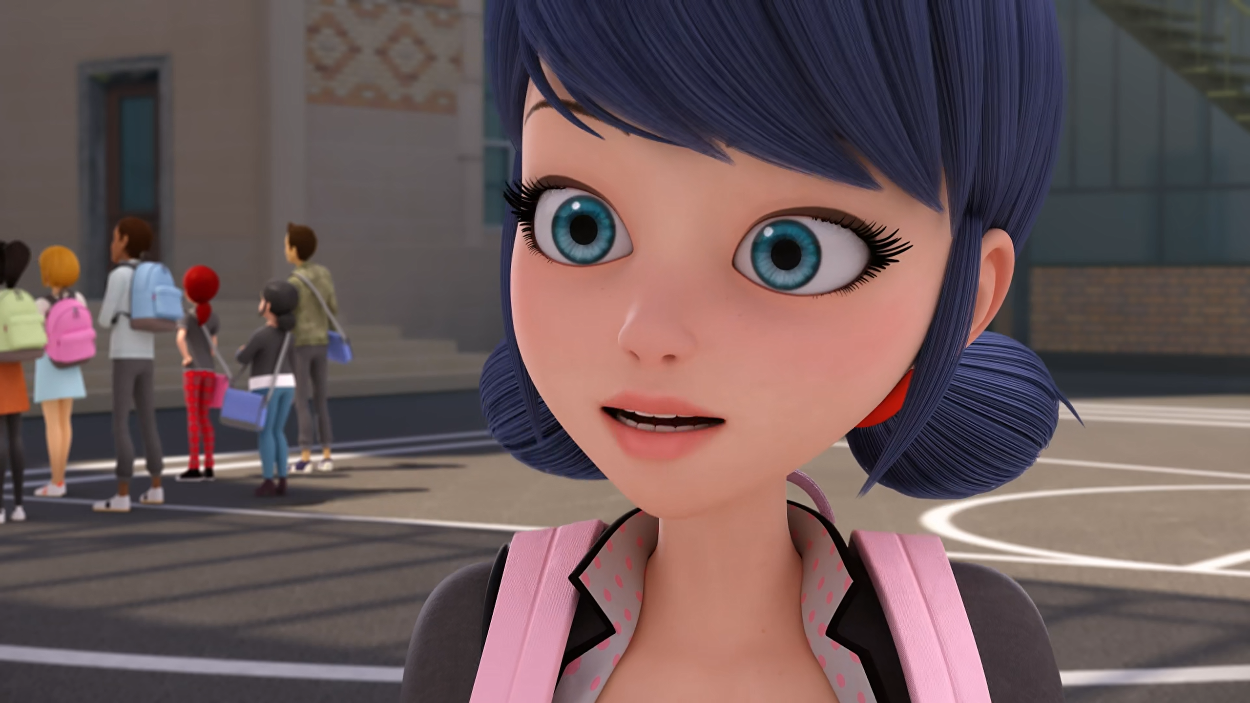
Relax girls! I met her at the ______ earlier.
café
bakery
mall

Slide 12
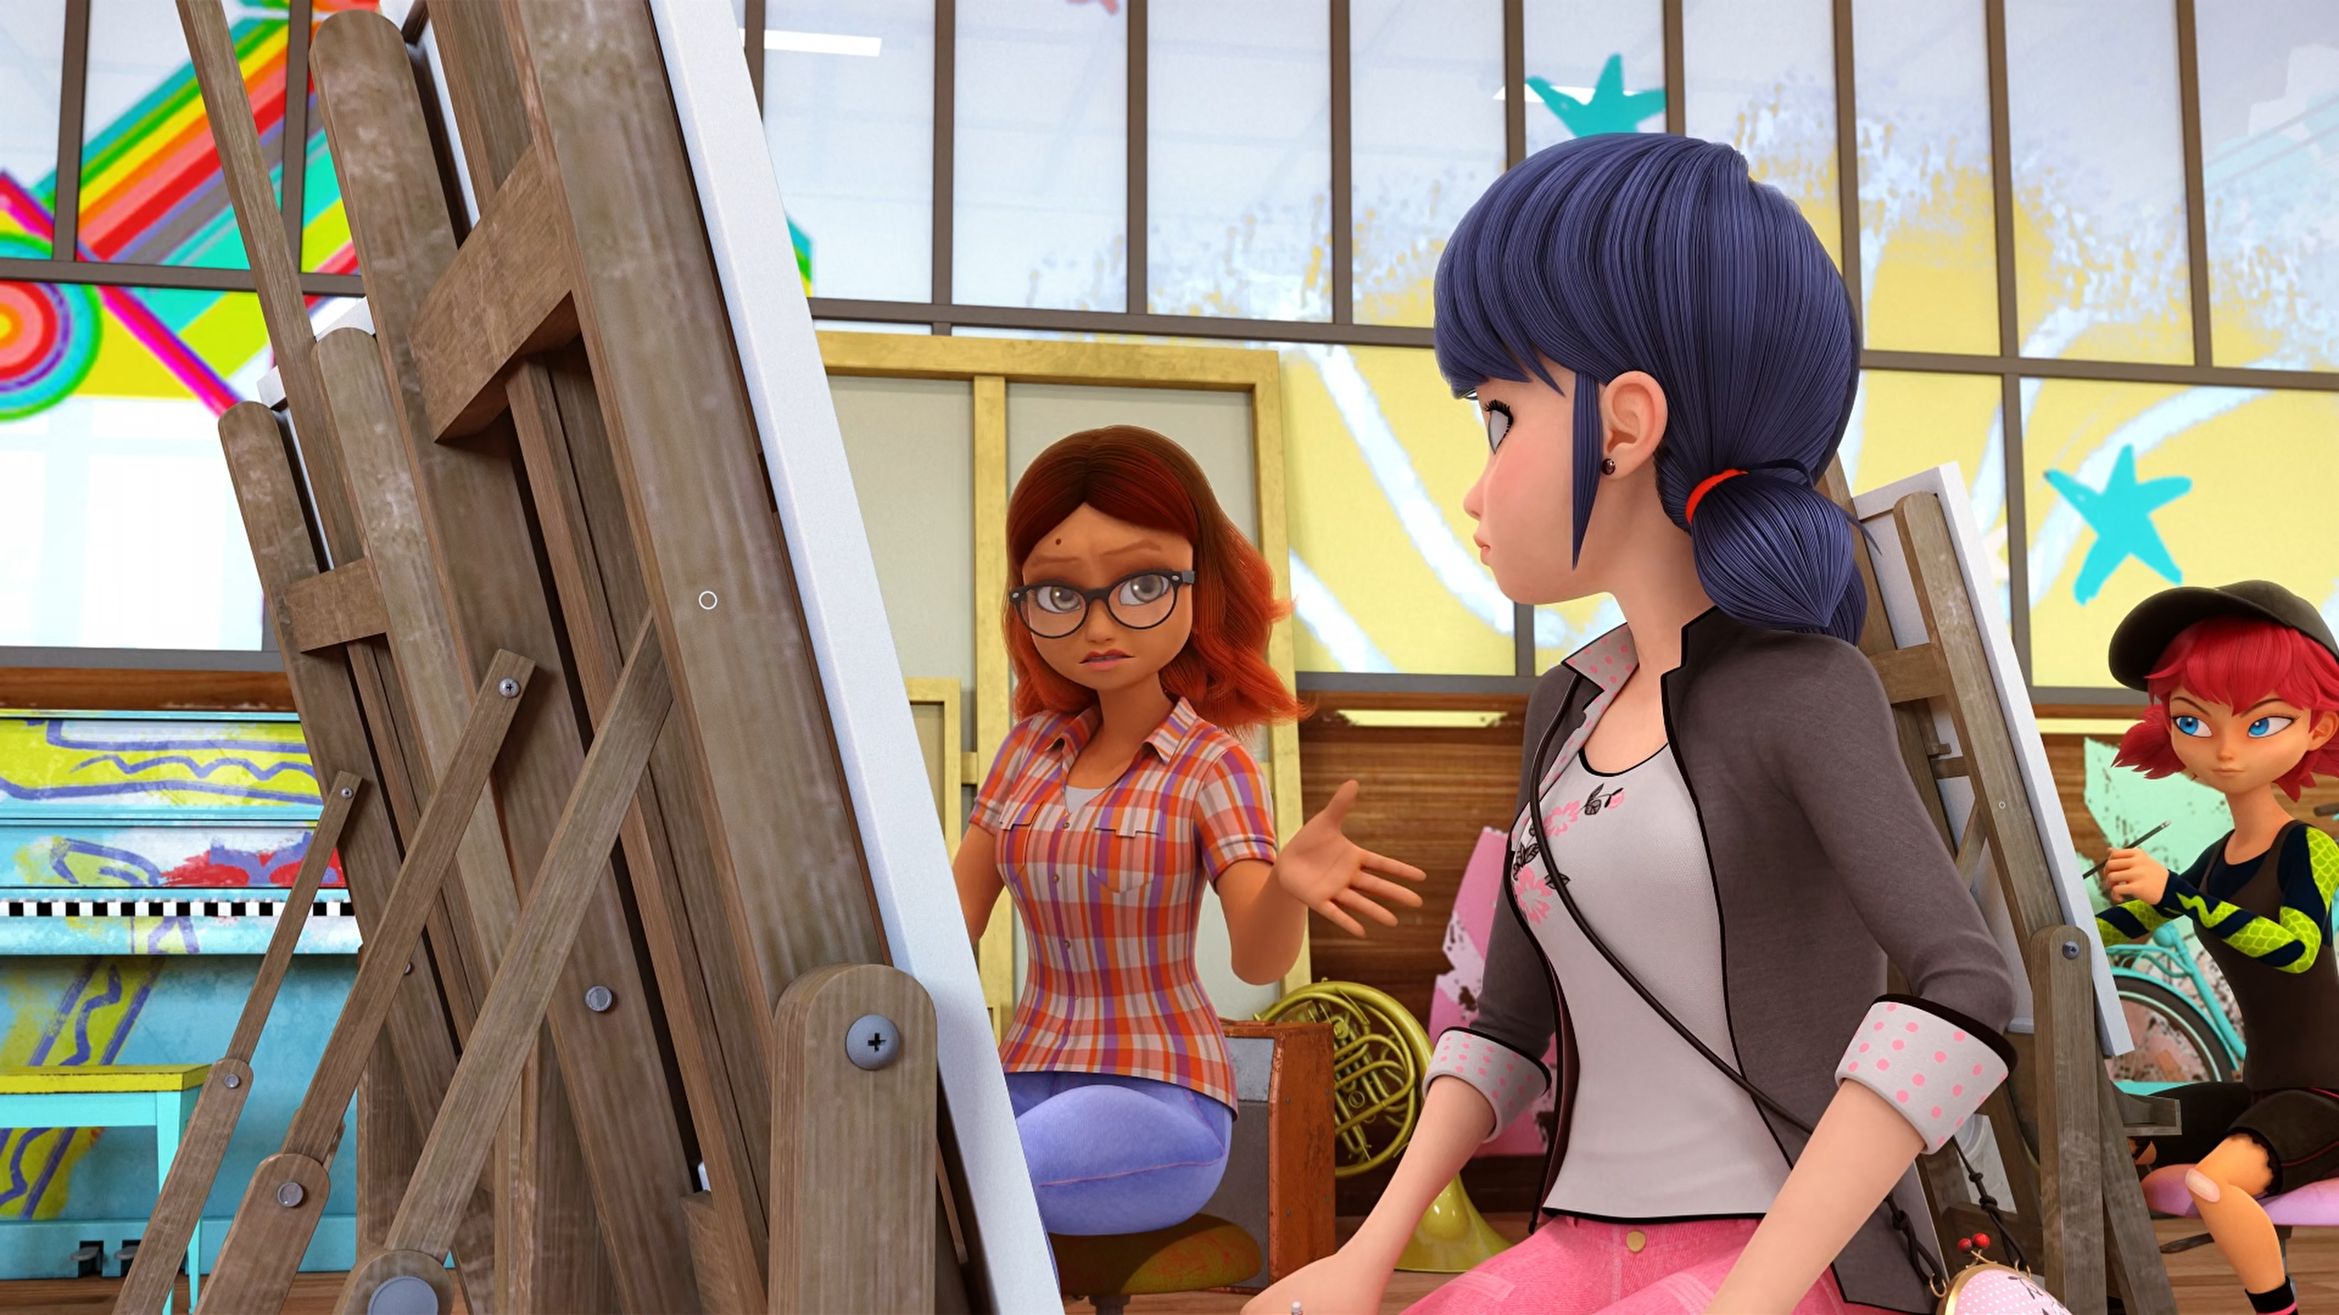
Chloe's influence is so ______ that she's managed to corrupt her sister.
dangerous
contagious
toxic

Slide 13
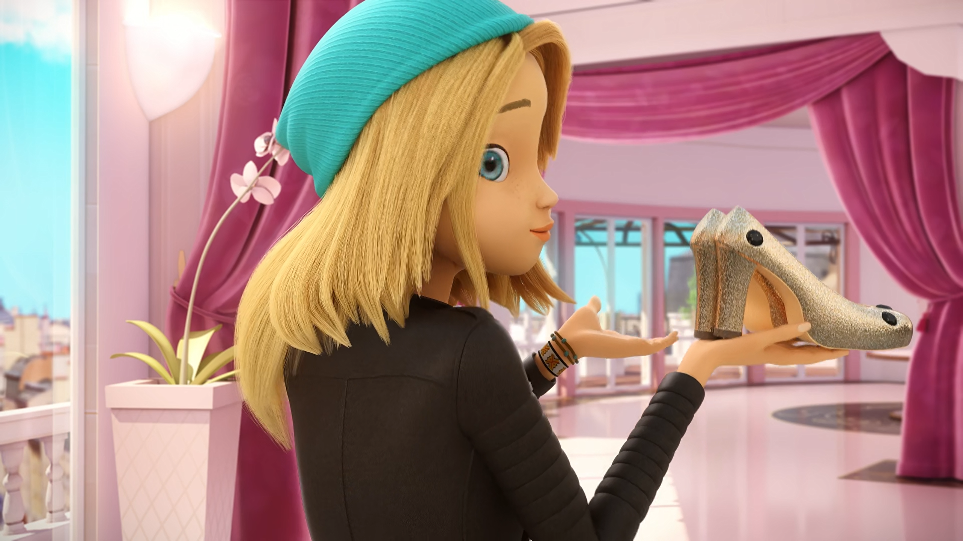
I want to see the ______ sparkle in the sunlight.
diamonds
jewels
shoes

Slide 14
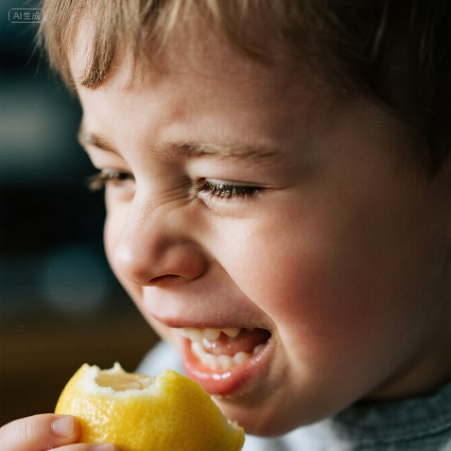
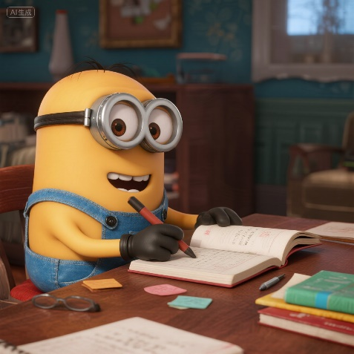
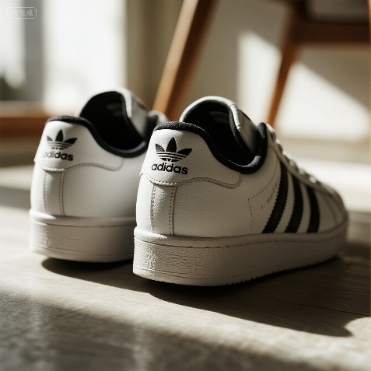

Matching Exercise
clumsy | sneakers | sour | minion

Slide 15
Matching Exercise
Sour | minion | sneakers | clumsy

Slide 16
TRUE OR FALSE
1. It would take 100 days to see everything in the louvre.
2. Marinette is carrying a box of oranges.
3. Zoé is from Chicago.
4. Zoé's mum says she looks terrible.
5. Chloé has silver shoes.

Slide 17
TRUE OR FALSE
1. It would take 100 days to see everything in the louvre. | TRUE
2. Marinette is carrying a box of oranges. | FALSE
3. Zoé is from Chicago. | FALSE
4. Zoé's mum says she looks terrible. | TRUE
5. Chloé has silver shoes. | FALSE

