Slide 1
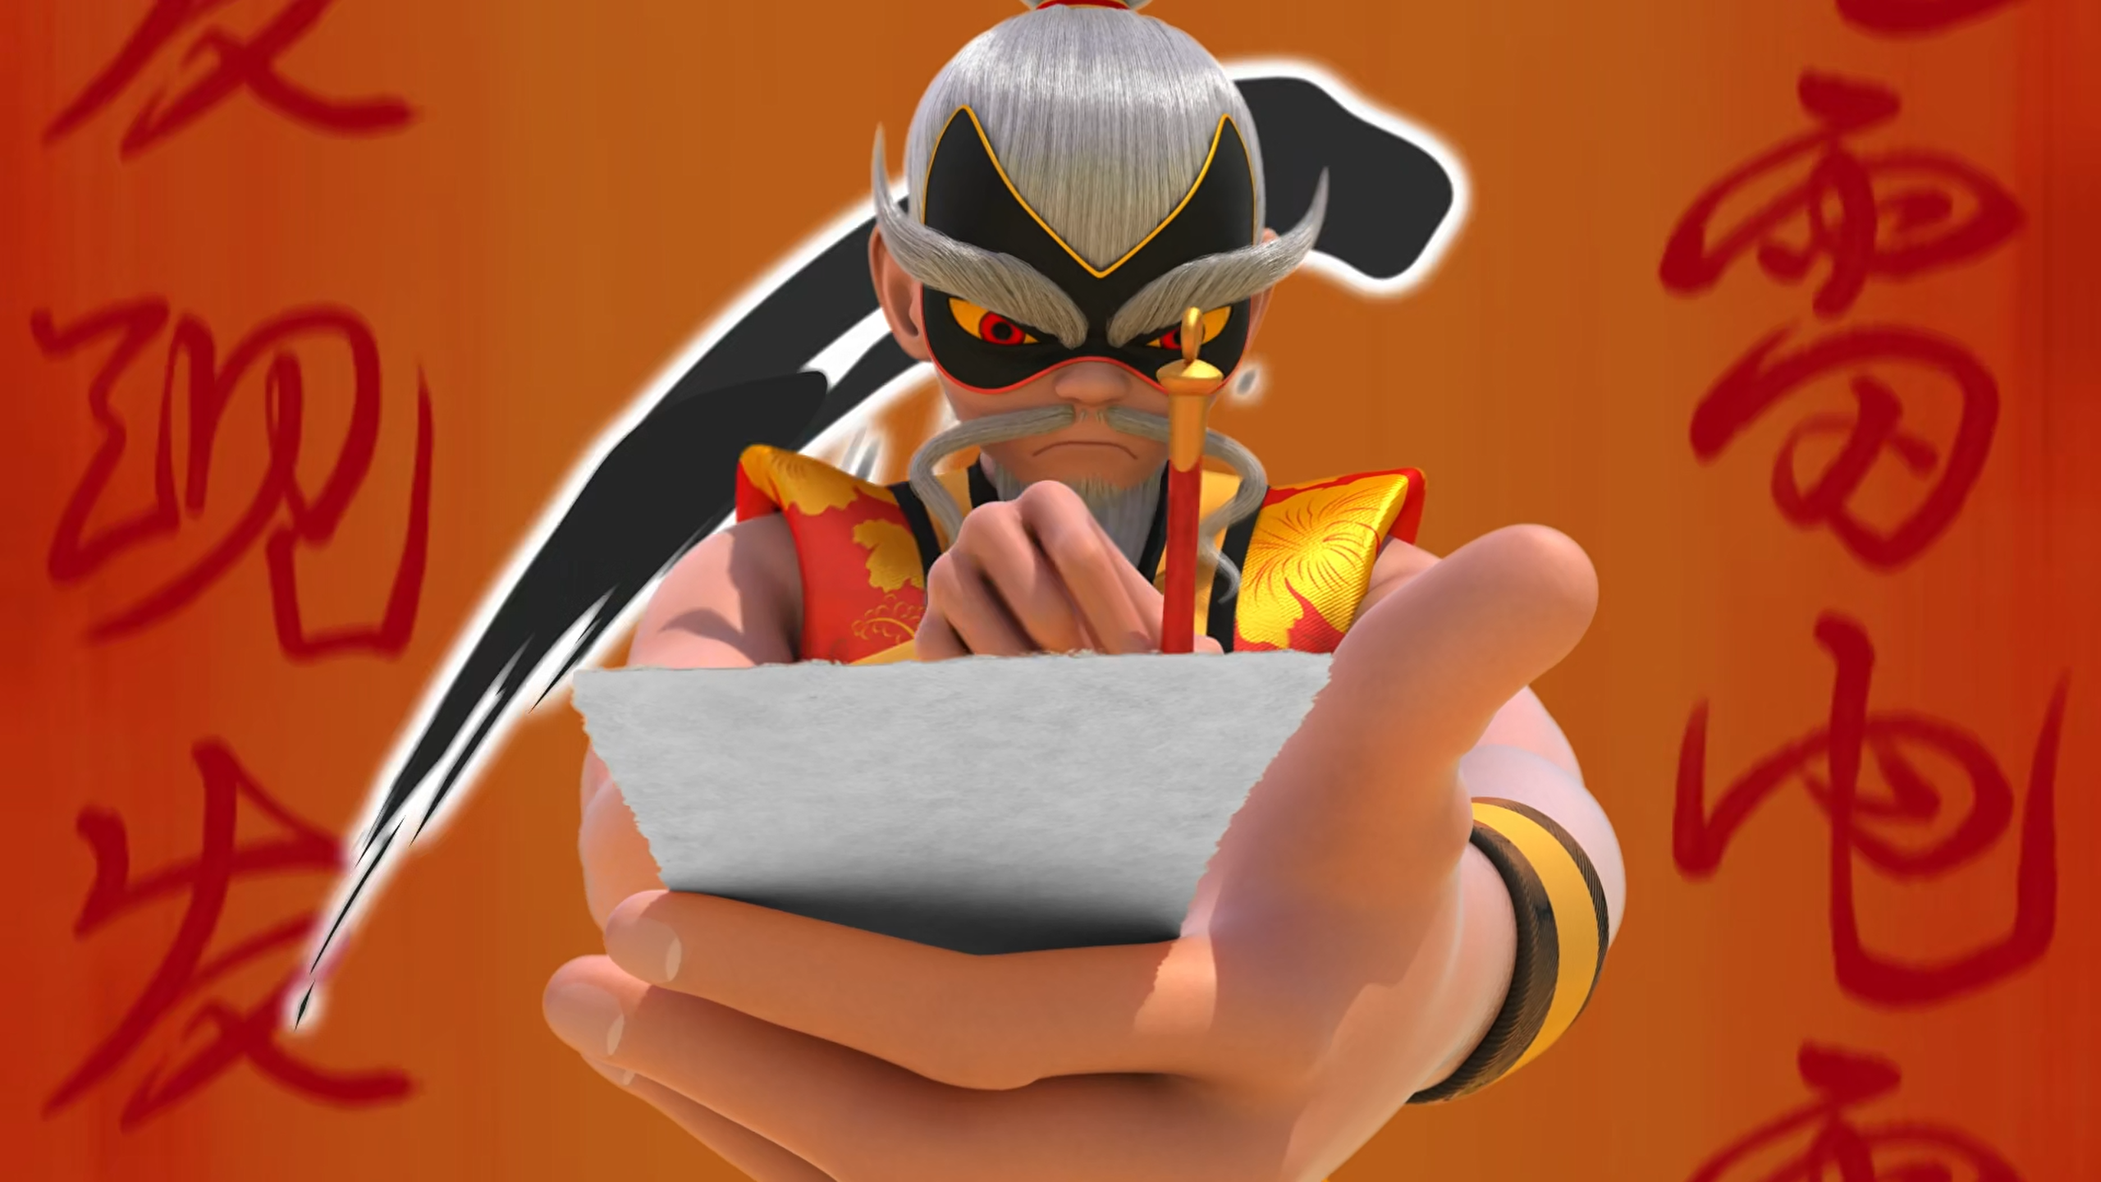
MIRACULOUS LADYBUG: FURIOUS FU. PART 2

Slide 2
VOCABULARY
audacity - 鲁莽 - ɔːˈdæsəti
clouds - 云 - klaʊdz
gone rogue - 耍流氓 - ɡɒn rəʊɡ
insolent - 无礼的 - ɪnsᵊlənt
instincts - 本能 - ɪnstɪŋkts
murder - 谋杀 - mɜːdə
reckless - 鲁莽的 - rɛkləs
scorn - 轻蔑 - skɔːn

Slide 3
1. 云
2. 谋杀
3. skɔːn

Slide 4
1. 云 - clouds
2. 谋杀 - murder
3. skɔːn - scorn

Slide 5
FURIOUS FU. PART 2
Cat Noir: Master Fu was much nicer.
Su-Han: And his Mira-Kung Fu was much worse.
Ladybug: Grand Master! The last I heard, I was the Guardian! And I say that Cat Noir keeps his Miraculous and I keep mine!
Ladybug: I don't know how he's doing it but he's guessing our every move in advance!

Slide 6
Furious Fu: I want my cane and an apology! Thunderbolt!
Su-Han: Give it!
Ladybug: Never!
Shadow Moth: Furious Fu, bring me that box!
Cat Noir: Gooaal!! Hey!
Furious Fu: Teleportation!
Shadow Moth: One-zero, Ladybug.

Slide 7
Ladybug: Here, carry this with you at all times. It will protect you from future attacks.
Wang Fu: And it will remind me of you everyday. Thank you, Lady Beetle and Mister Bat.
Su-Han: I'm terribly sorry. Forgive me, Whiny... Uh! Sir. I... I mistook you for someone who has been long gone.

Slide 8
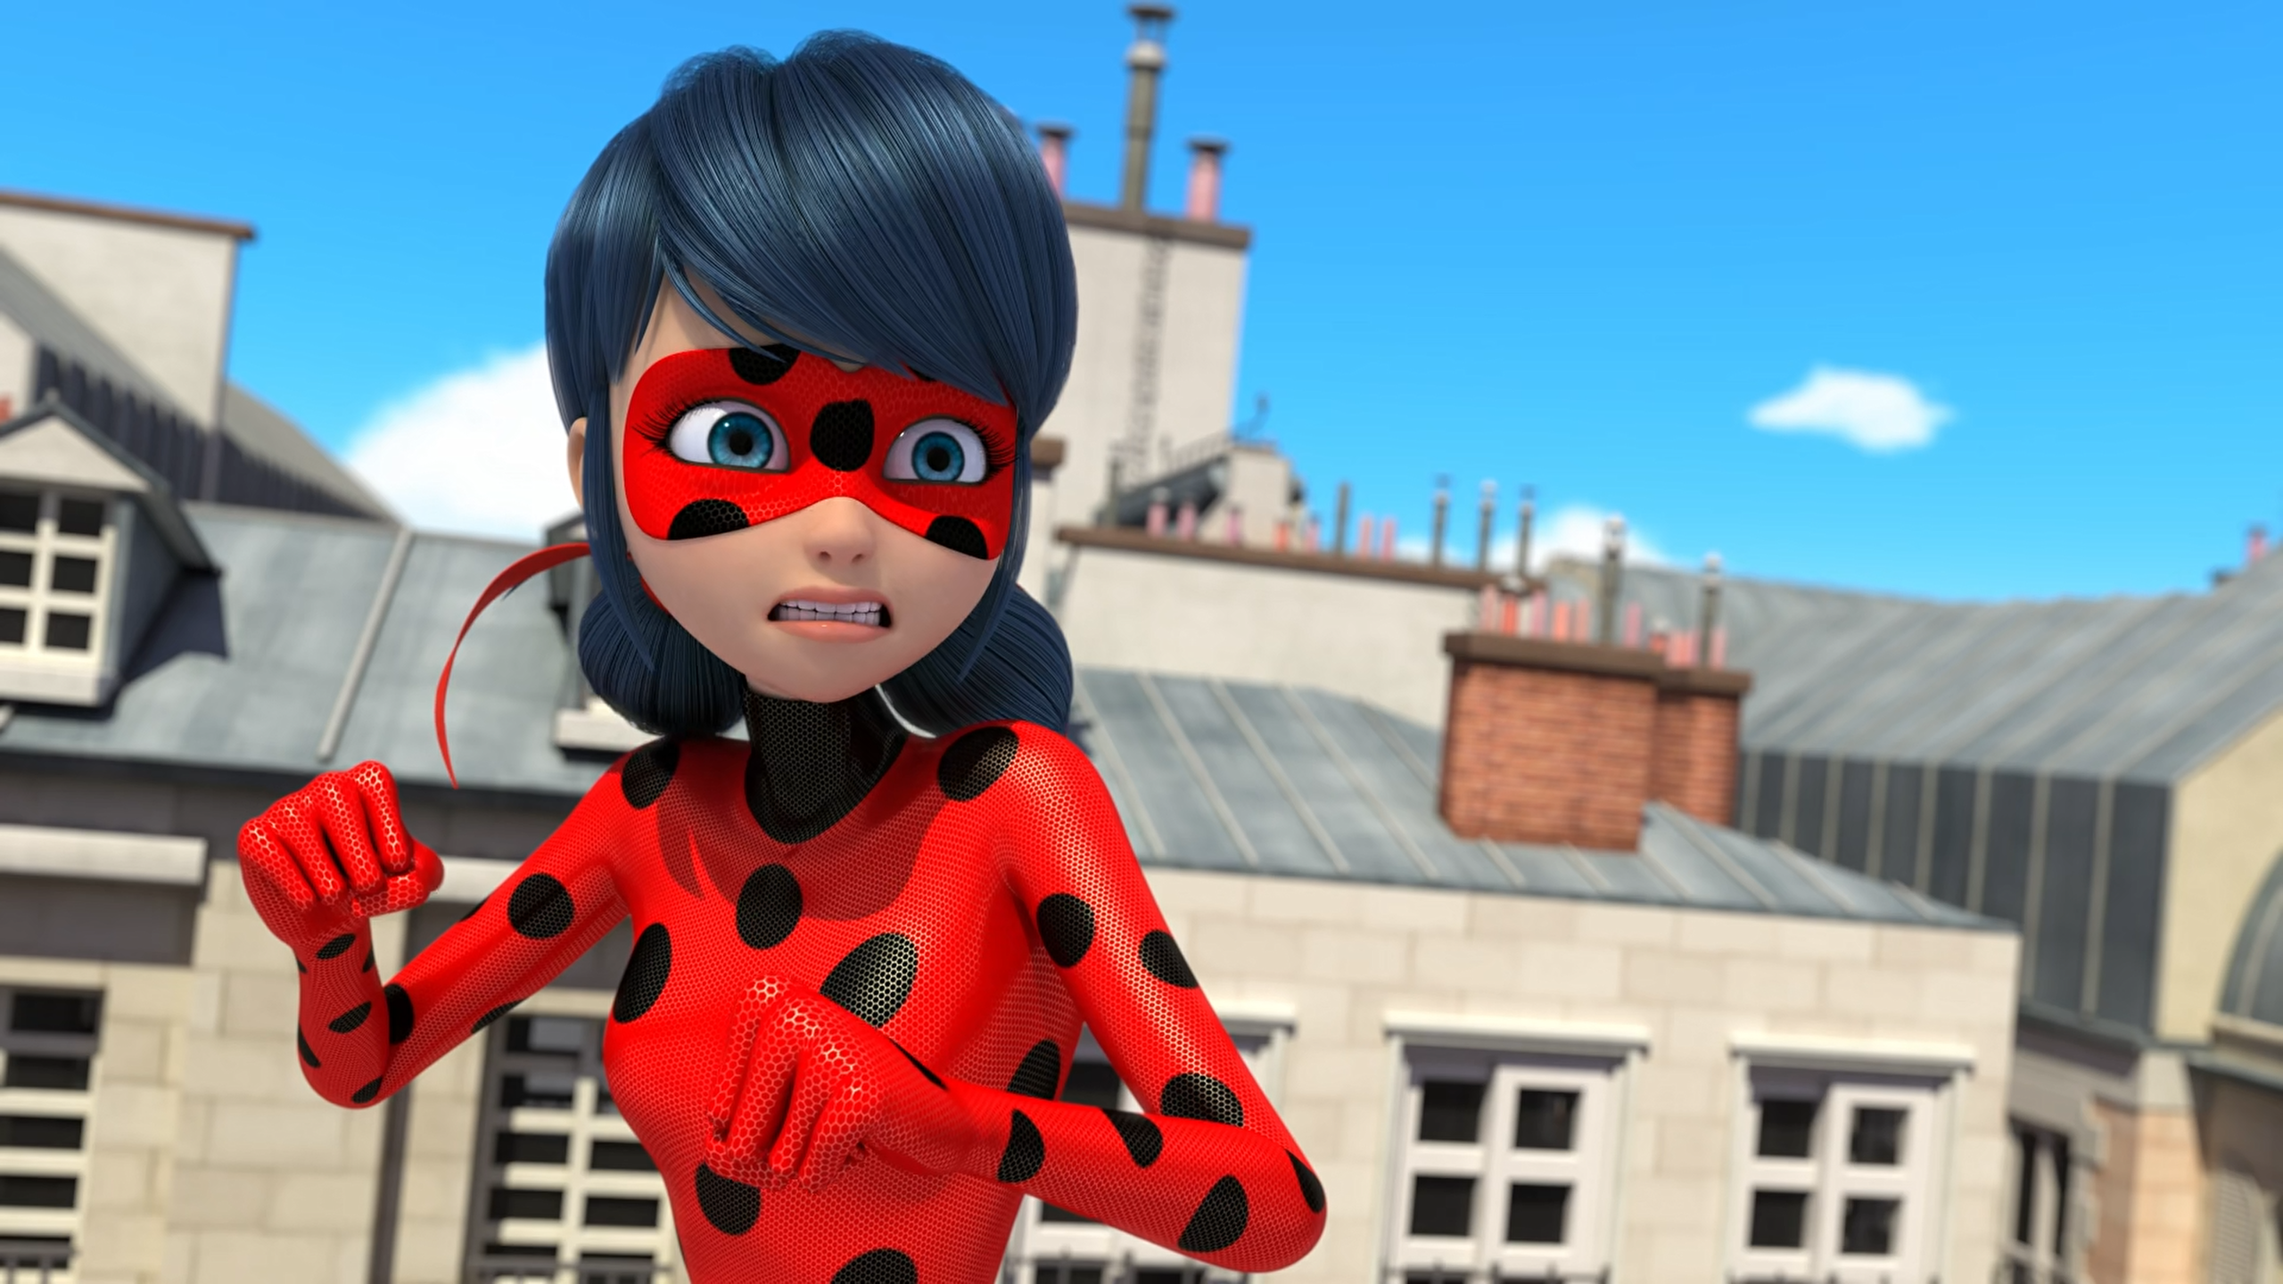

He's guessing our every ______ in advance!
attack
blow
move

Slide 9
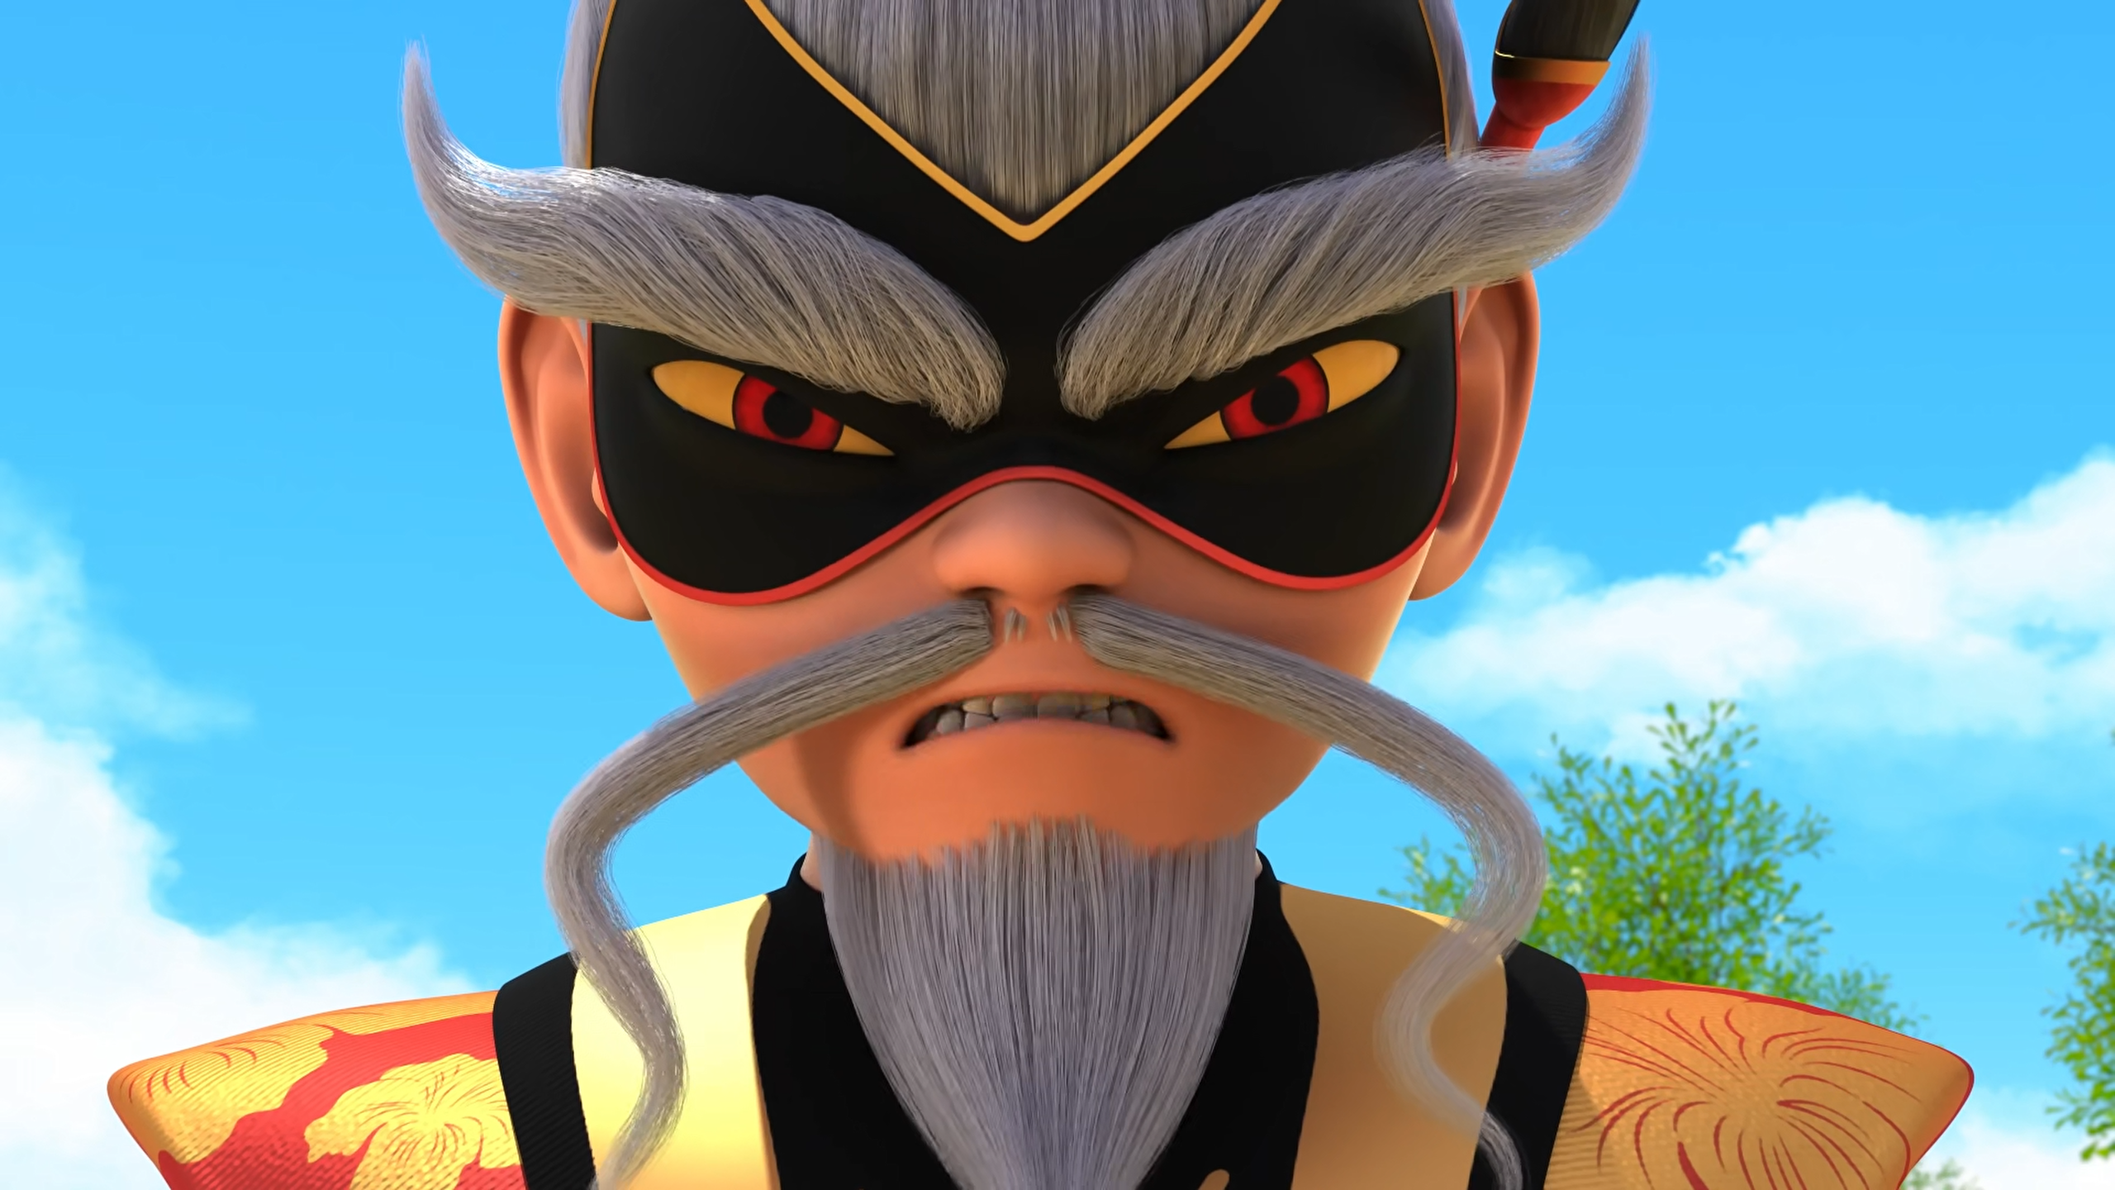
That reckless ______ will not spit in the dragon's face.
toad
fool
pig

Slide 10
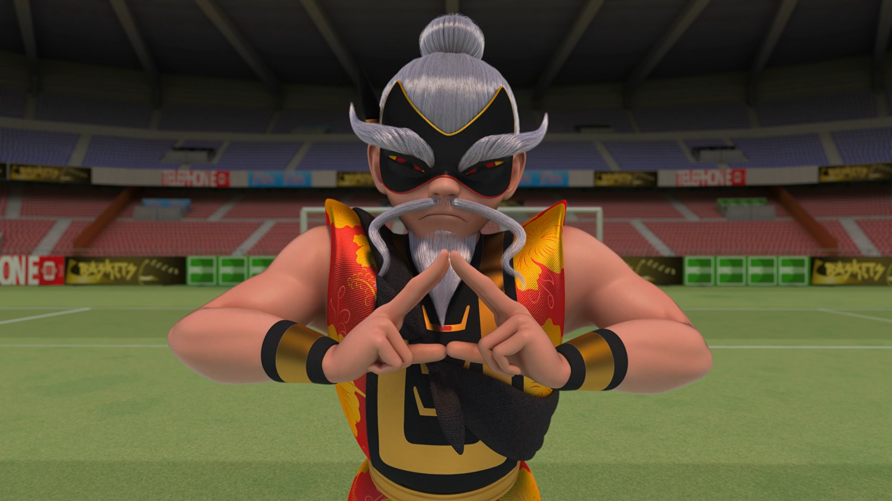
The wise man moves ______without touching them!
boxes
mountains
people

Slide 11
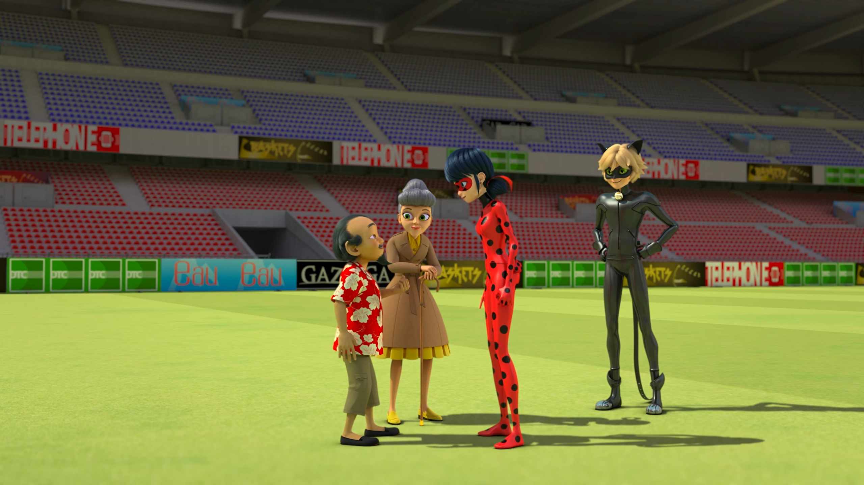
Thank you, ______ and Mister Bat.
Ladybug
Lady Beetle
Ladyboy

Slide 12
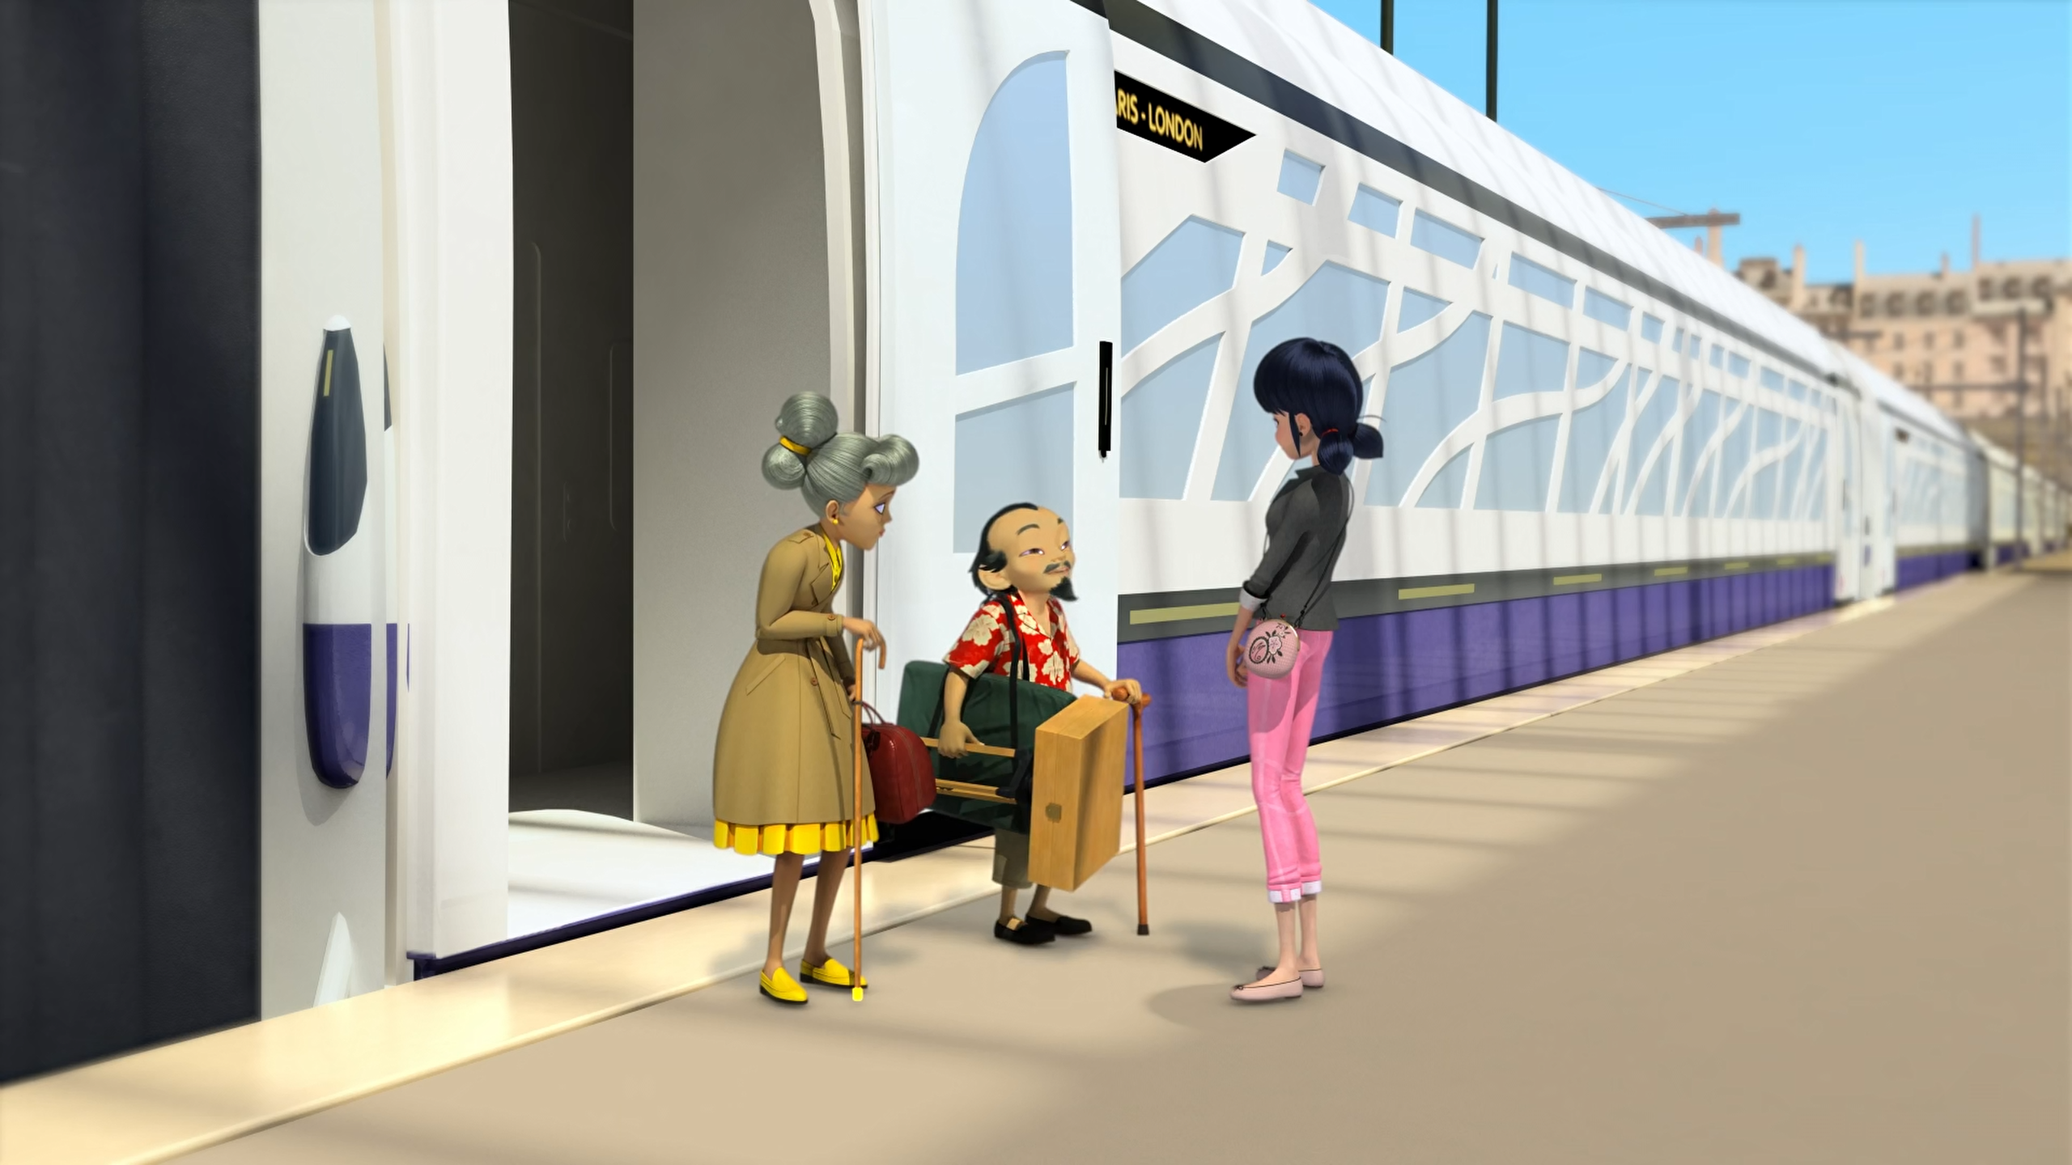
______ is always filled with good people.
Dalian
New York
Paris

Slide 13
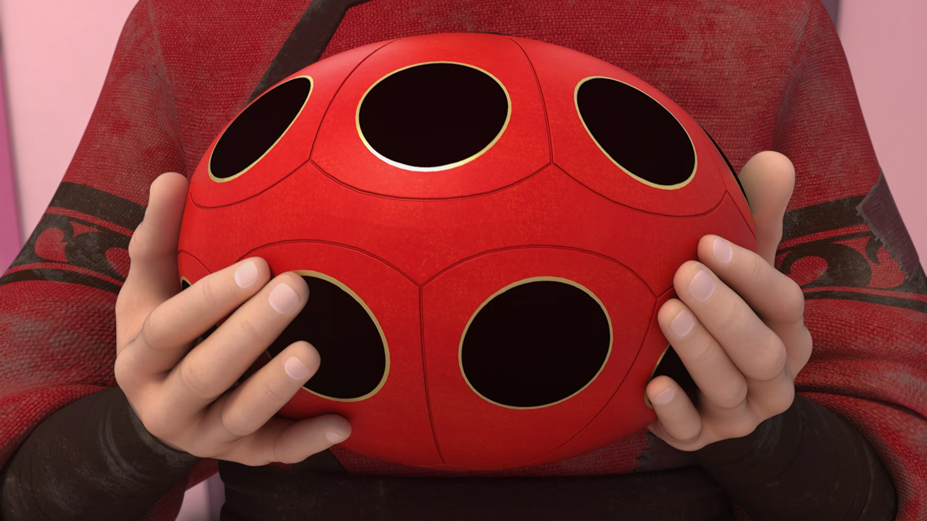
The ______ is the mother of all boxes.
Miracle Box
Miraculous
Mother box

Slide 14
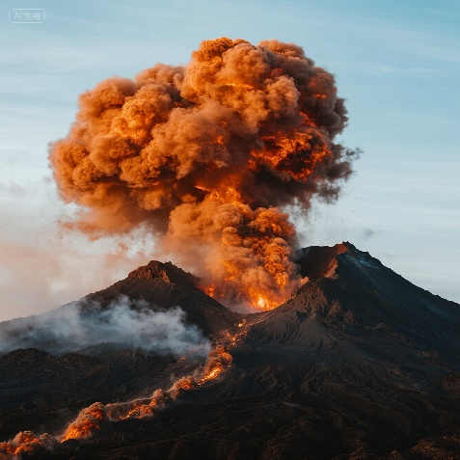
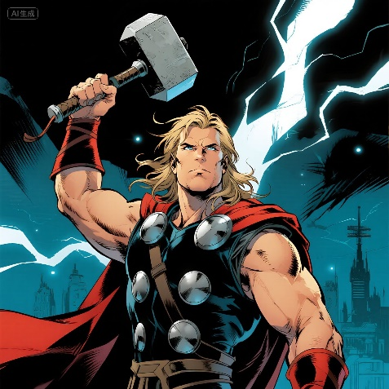
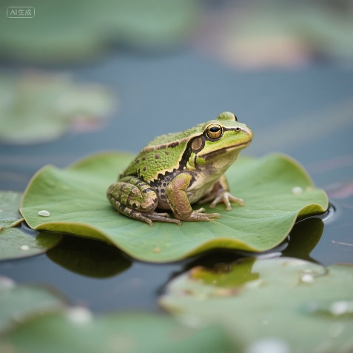

Matching Exercise
toad | road | volcano | thunder

Slide 15
Matching Exercise
volcano | thunder | toad | road

Slide 16
TRUE OR FALSE
1. Ladybug drops a chimney on Su-Han.
2. Master Fu is taller when he's akumatized.
3. Cat Noir takes Master Fu's cane.
4. Marianne breaks the Akuma.
5. Master Fu and Marianne go back to New York by train.

Slide 17
TRUE OR FALSE
1. Ladybug drops a chimney on Su-Han. | TRUE
2. Master Fu is taller when he's akumatized. | TRUE
3. Cat Noir takes Master Fu's cane. | FALSE
4. Marianne breaks the Akuma. | TRUE
5. Master Fu and Marianne go back to New York by train. | FALSE

