Slide 1
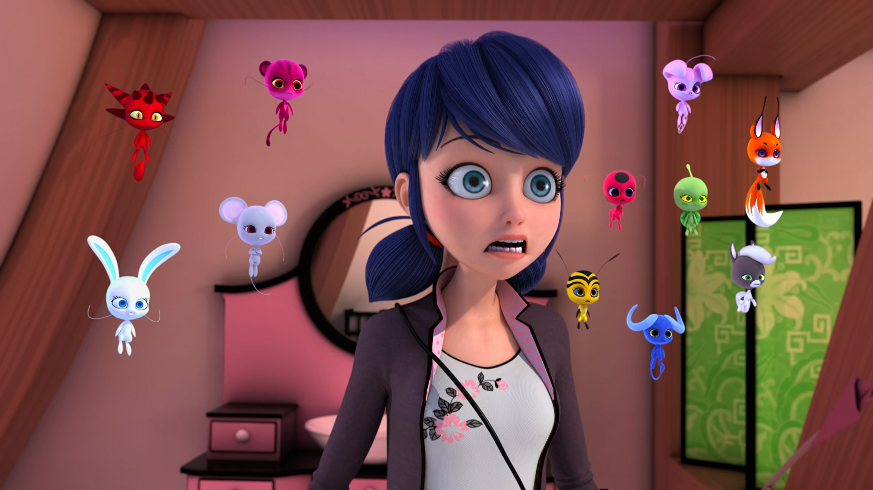
MIRACULOUS LADYBUG: FURIOUS FU. PART 1

Slide 2
VOCABULARY
absolute - 绝对的 - æbsəluːt
ancient - 古代的 - eɪnʃᵊnt
disciple - 门徒 - dɪˈsaɪpᵊl
guarded - 谨慎的 - ɡɑːdɪd
incompetent - 无能的 - ɪnˈkɒmpɪtᵊnt
not fair - 不公平 - nɒt feə
soulmate - 知己 - səʊlmeɪt
volunteer - 志愿者 - vɒlənˈtɪə

Slide 3
1. 古代的
2. dɪˈsaɪpᵊl
3. 志愿者

Slide 4
1. 古代的 - ancient
2. dɪˈsaɪpᵊl - disciple
3. 志愿者 - volunteer

Slide 5
FURIOUS FU. PART 1
Come on, Tikki! Let's go.
Kwamis: It's not fair!
Ziggy: Why does Tikki get to go and not us?
Tikki: I'm sorry, friends. But you know I can't leave Marinette in case she needs to transform.
Trixx: But what if we hide, too? Then he'd never see us! That'd be okay, right?

Slide 6
Marinette: I'm so glad to see you again, Master... I mean, Mister Fu.
Master Fu: My dear child, you reunited me with my beloved Marianne. I can never thank you enough.
Wang Fu: Yes, life in London has been quite wonderful.
Marianne: Would you believe it? Wang discovered a passion for painting.

Slide 7
Su-Han: How come you are in possession of the Mother Box, young lady?
Marinette: Uh... Who are you?
Tikki: That's Grand Master Su-Han. The Celestial Guardian of the Miracle Box.
Marinette: But I'm the Guardian of the box.
Tikki: Celestial Guardian was in charge of it before that incident caused by Master Fu.

Slide 8
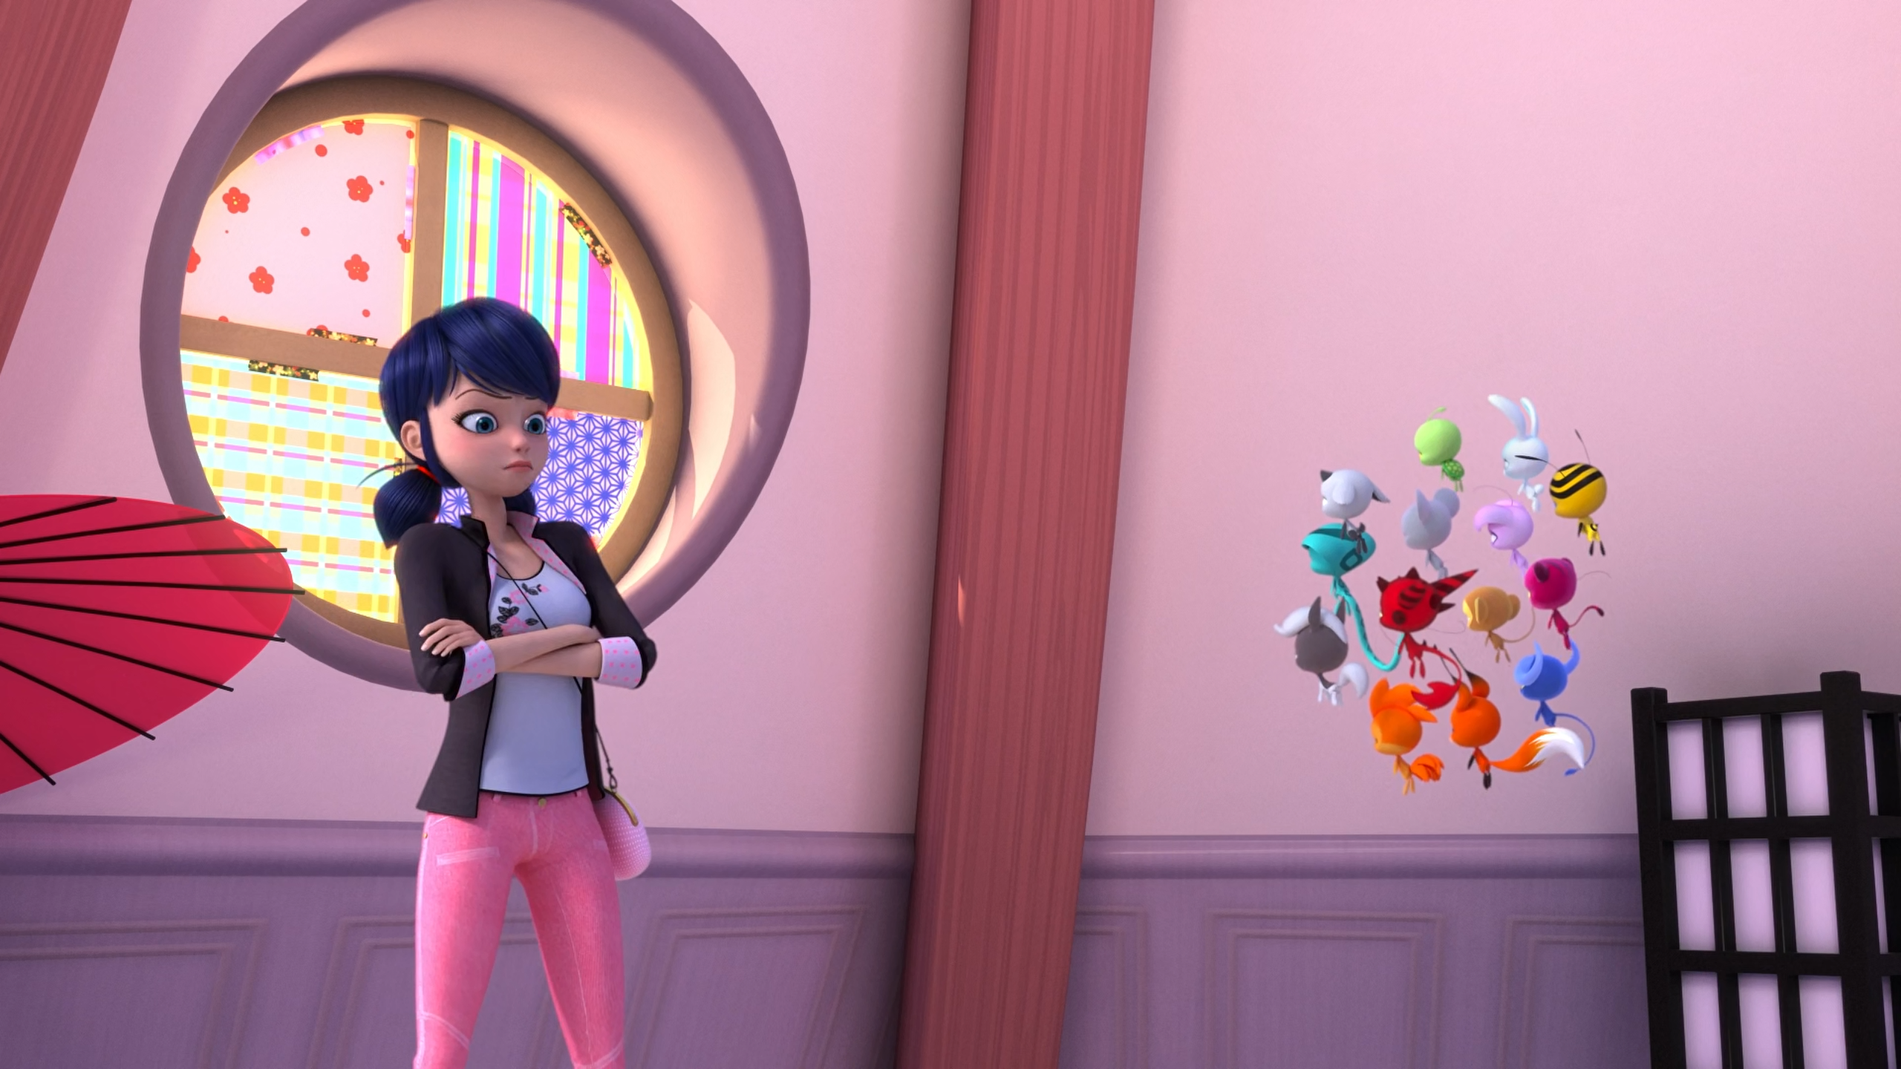

Oh, no, you don't! That's cheating! Besides, I'm the ______!
Master
Boss
Guardian

Slide 9
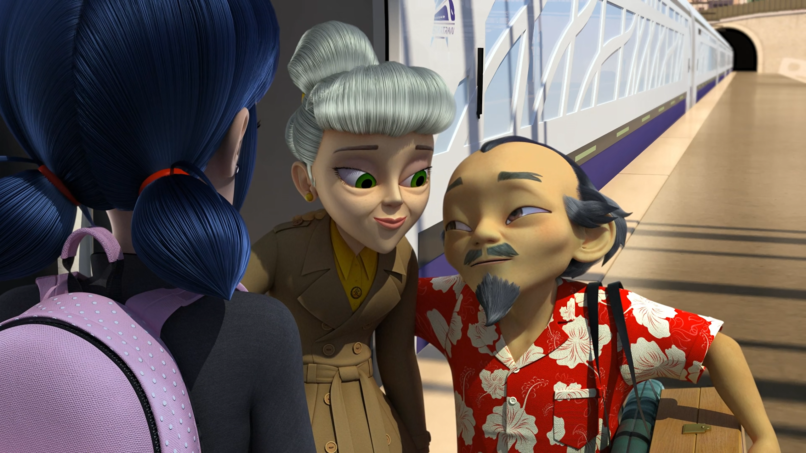
My dear child, you reunited me with my beloved ______.
Marianne
Marinette
Maria

Slide 10
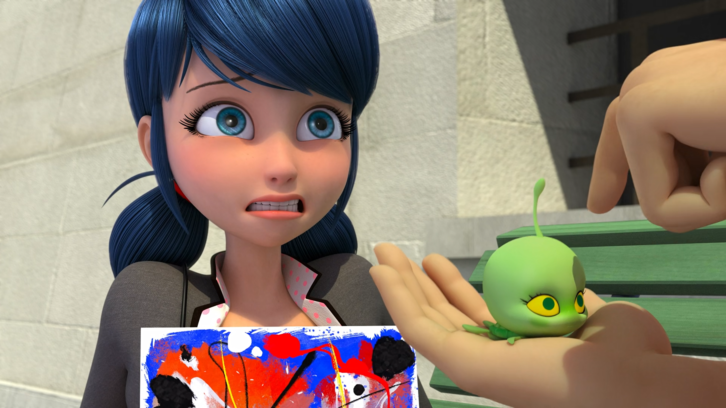
That's such a cute little ______. Is it yours?
kwami
doll
puppet

Slide 11
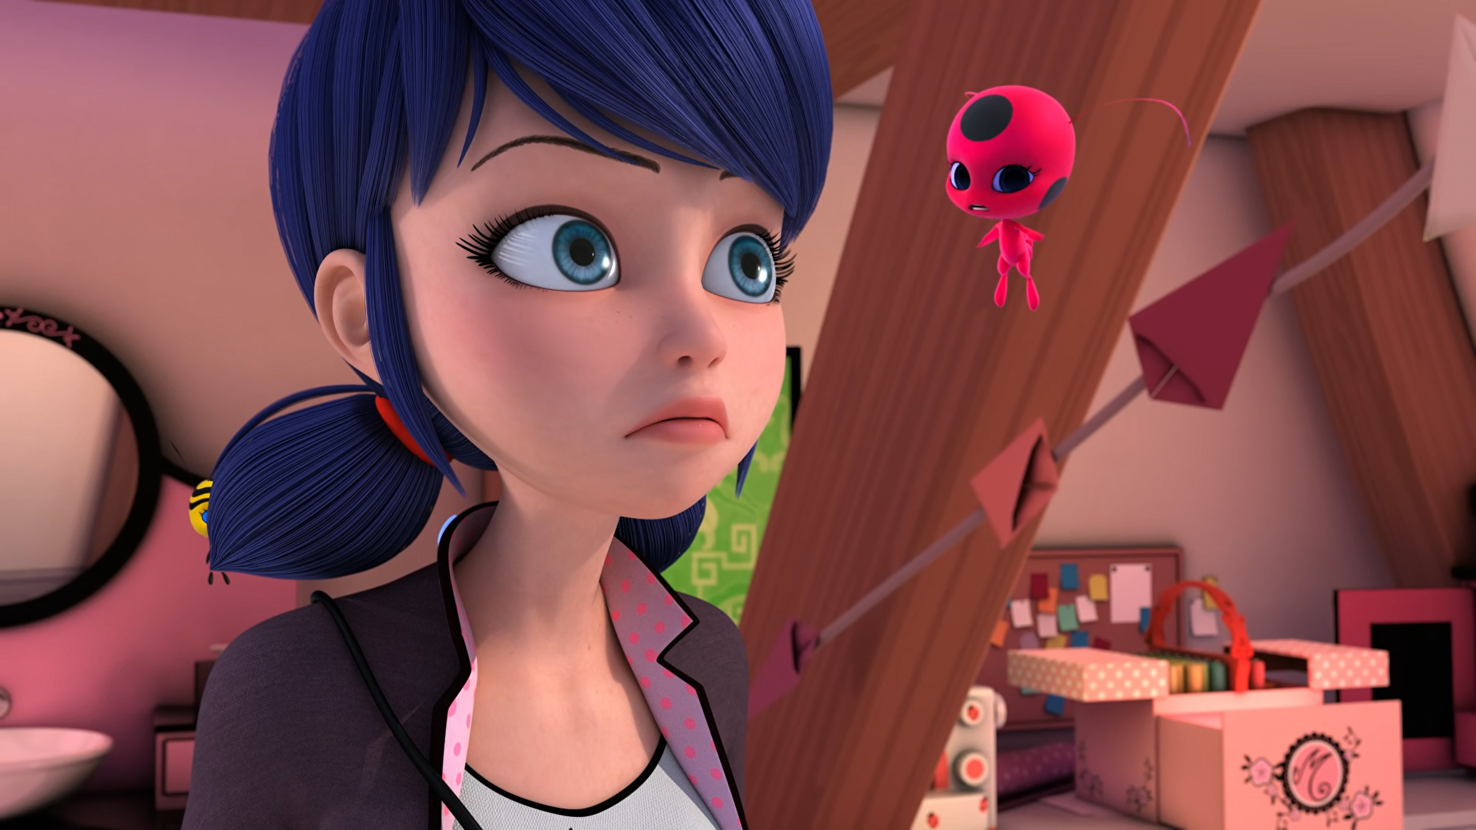
The Celestial Guardian of the ______.
Miraculous
Miracle Box
Kwamis

Slide 12
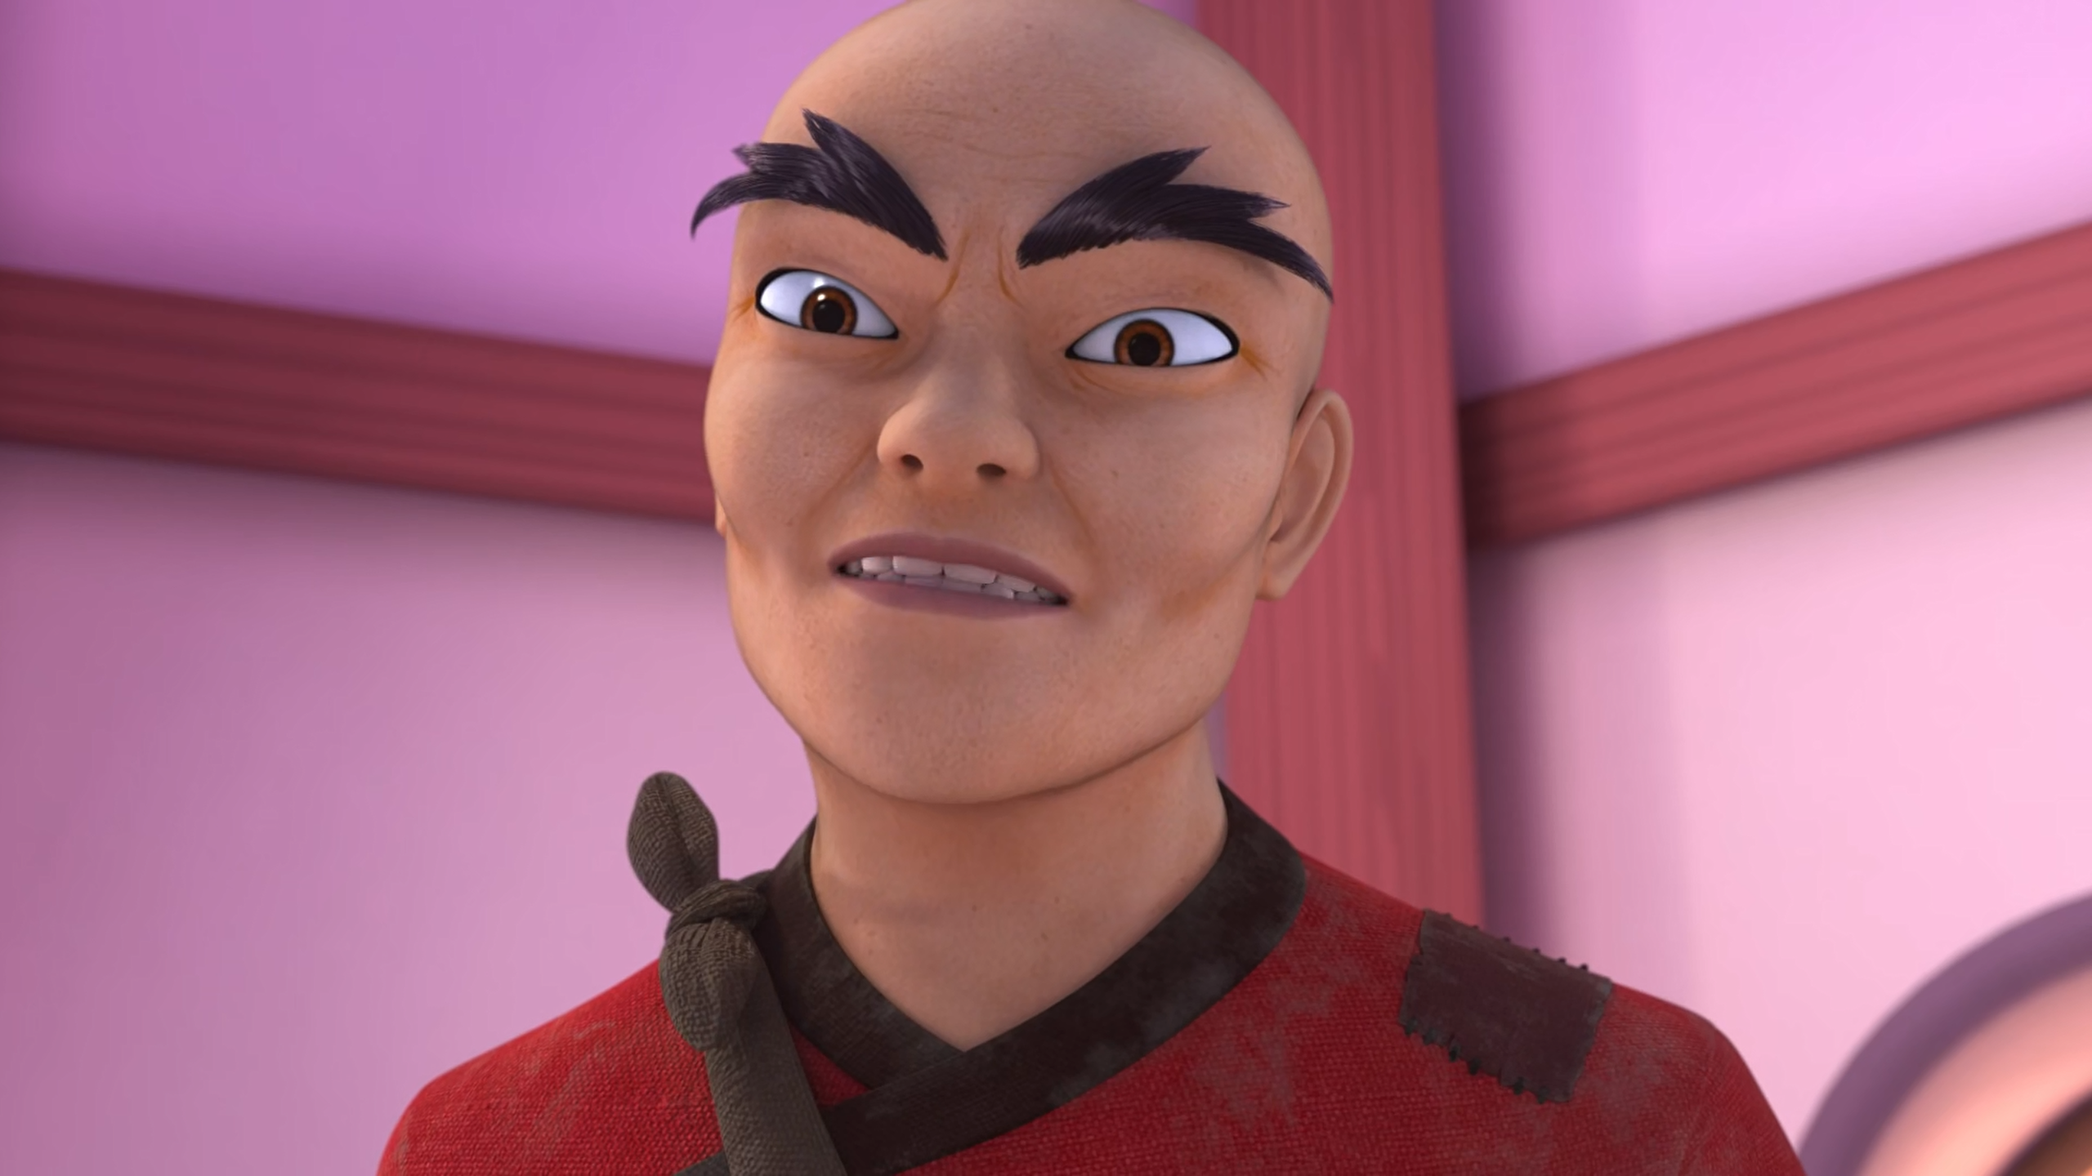
FU?! As in Wang Fu, also known as Whiny ______ Leg?!
Monkey
Pig
Chicken

Slide 13
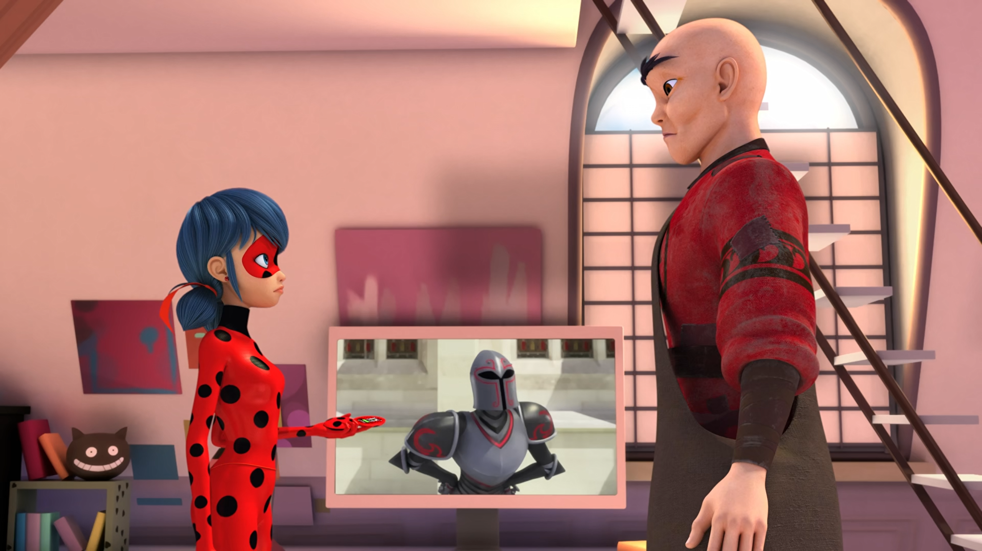
You don't have to send ______ to communicate with each other?
doves
WeChat
SMS

Slide 14
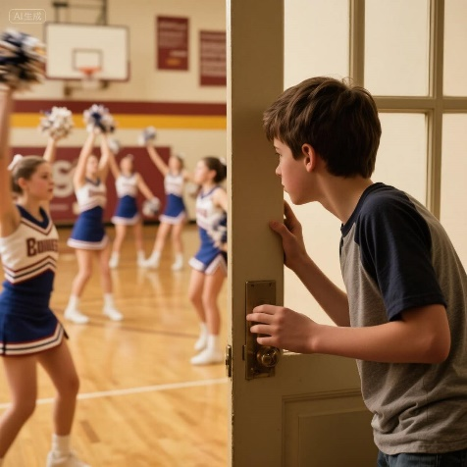

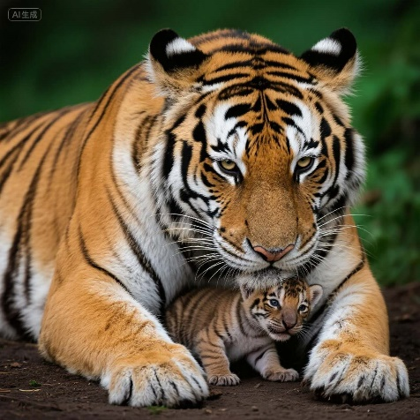
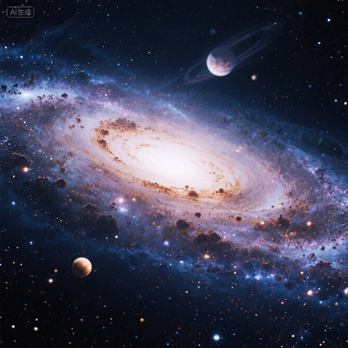
Matching Exercise
protect | cosmic | peeping | compass

Slide 15
Matching Exercise
peeping | compass | protect | cosmic

Slide 16
TRUE OR FALSE
1. The Kwami's want to see Master Fu.
2. Bark is watching a movie.
3. Marinette gets on a train.
4. Marianne's nickname is Whiny Chicken Leg.
5. Cat Noir gives Su-Han his Miraculous.

Slide 17
TRUE OR FALSE
1. The Kwami's want to see Master Fu. | TRUE
2. Bark is watching a movie. | TRUE
3. Marinette gets on a train. | FALSE
4. Marianne's nickname is Whiny Chicken Leg. | FALSE
5. Cat Noir gives Su-Han his Miraculous. | FALSE

