Slide 1
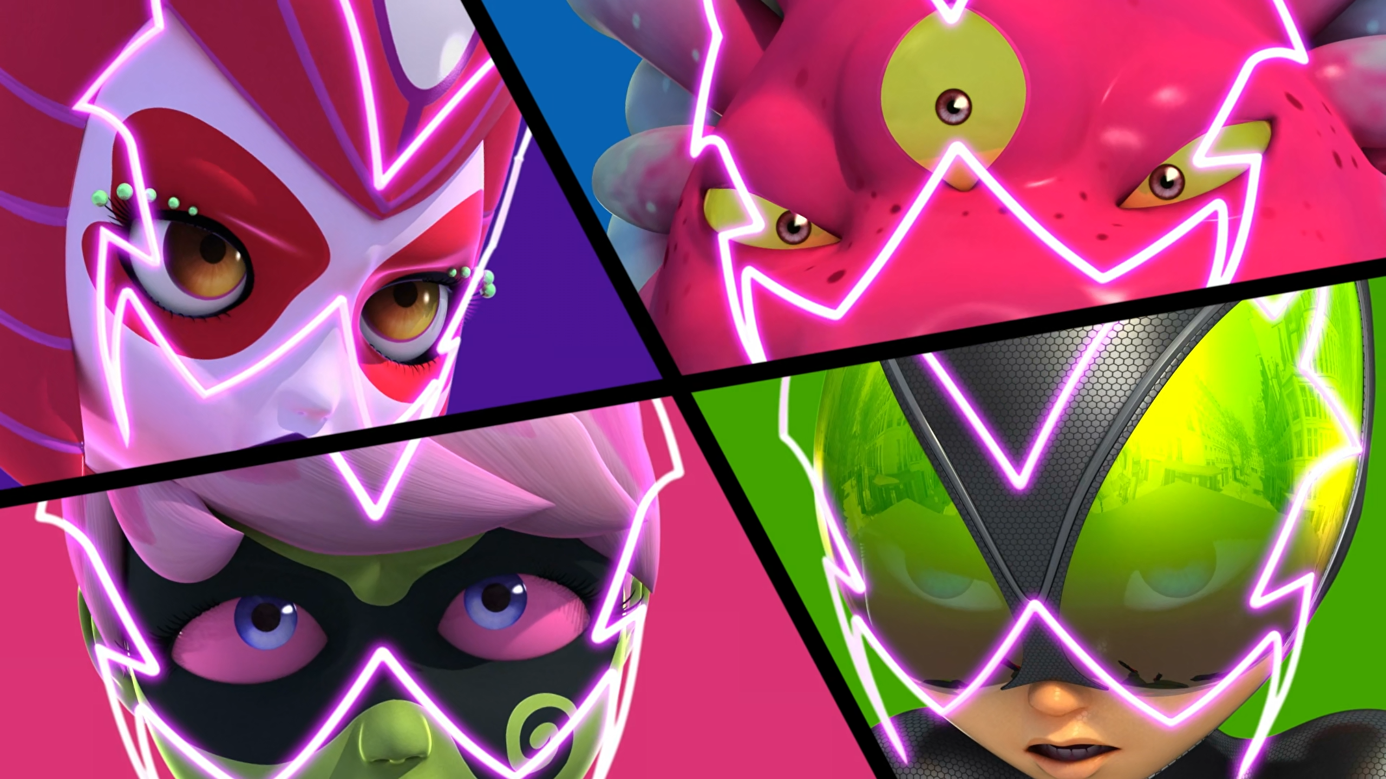
MIRACULOUS LADYBUG: GANG OF SECRETS. PART 2

Slide 2
VOCABULARY
alienate - 使疏远 - eɪliəneɪt
bunch - 束 - bʌnʧ
catastrophe - 灾难 - kəˈtæstrəfi
channel energy - 通道能量 - ʧænᵊl ˈɛnəʤi
pounce - 猛扑 - paʊns
side effects - 副作用 - saɪd ɪˈfɛkts
upgrade - 升级 - ʌpˈɡreɪd
vanish - 消失 - vænɪʃ
whisker away - 拂去胡须 - wɪskər əˈweɪ

Slide 3
1. eɪliəneɪt
2. 升级
3. 消失

Slide 4
1. eɪliəneɪt - alienate
2. 升级 - upgrade
3. 消失 - vanish

Slide 5
GANG OF SECRETS. PART 2
Cat Noir: Hey there, m'lady. Somebody is having a super villain party and didn't invite us.
Ladybug: They're looking for Marinette Dupain-Cheng, one of their classmates.
Cat Noir: Haven't we already saved her a bunch of times? Funny you'd think everybody would like her.

Slide 6
Ladybug: I trust you completely Alya. And I need you! I.. need Rena Rouge!
Shadow Moth: That's.. impossible!
Ladybug: Wow. No one has ever done that... you're amazing!
Alya: It's 'cause you're an amazing friend, Ladybug.
Ladybug and Alya: Pound it.

Slide 7
Marinette: No, not this time. I have no choice. All this is bigger than us, Alya. Way too big.
Alya: If it's too big, two of us can handle it better than one.
Marinette: If I tell you, things will never be the same between us again. It'll mess up everything, maybe even destroy it.
Alya: Marinette, I'm your very best friend.
Marinette: And I… I'm Ladybug.

Slide 8
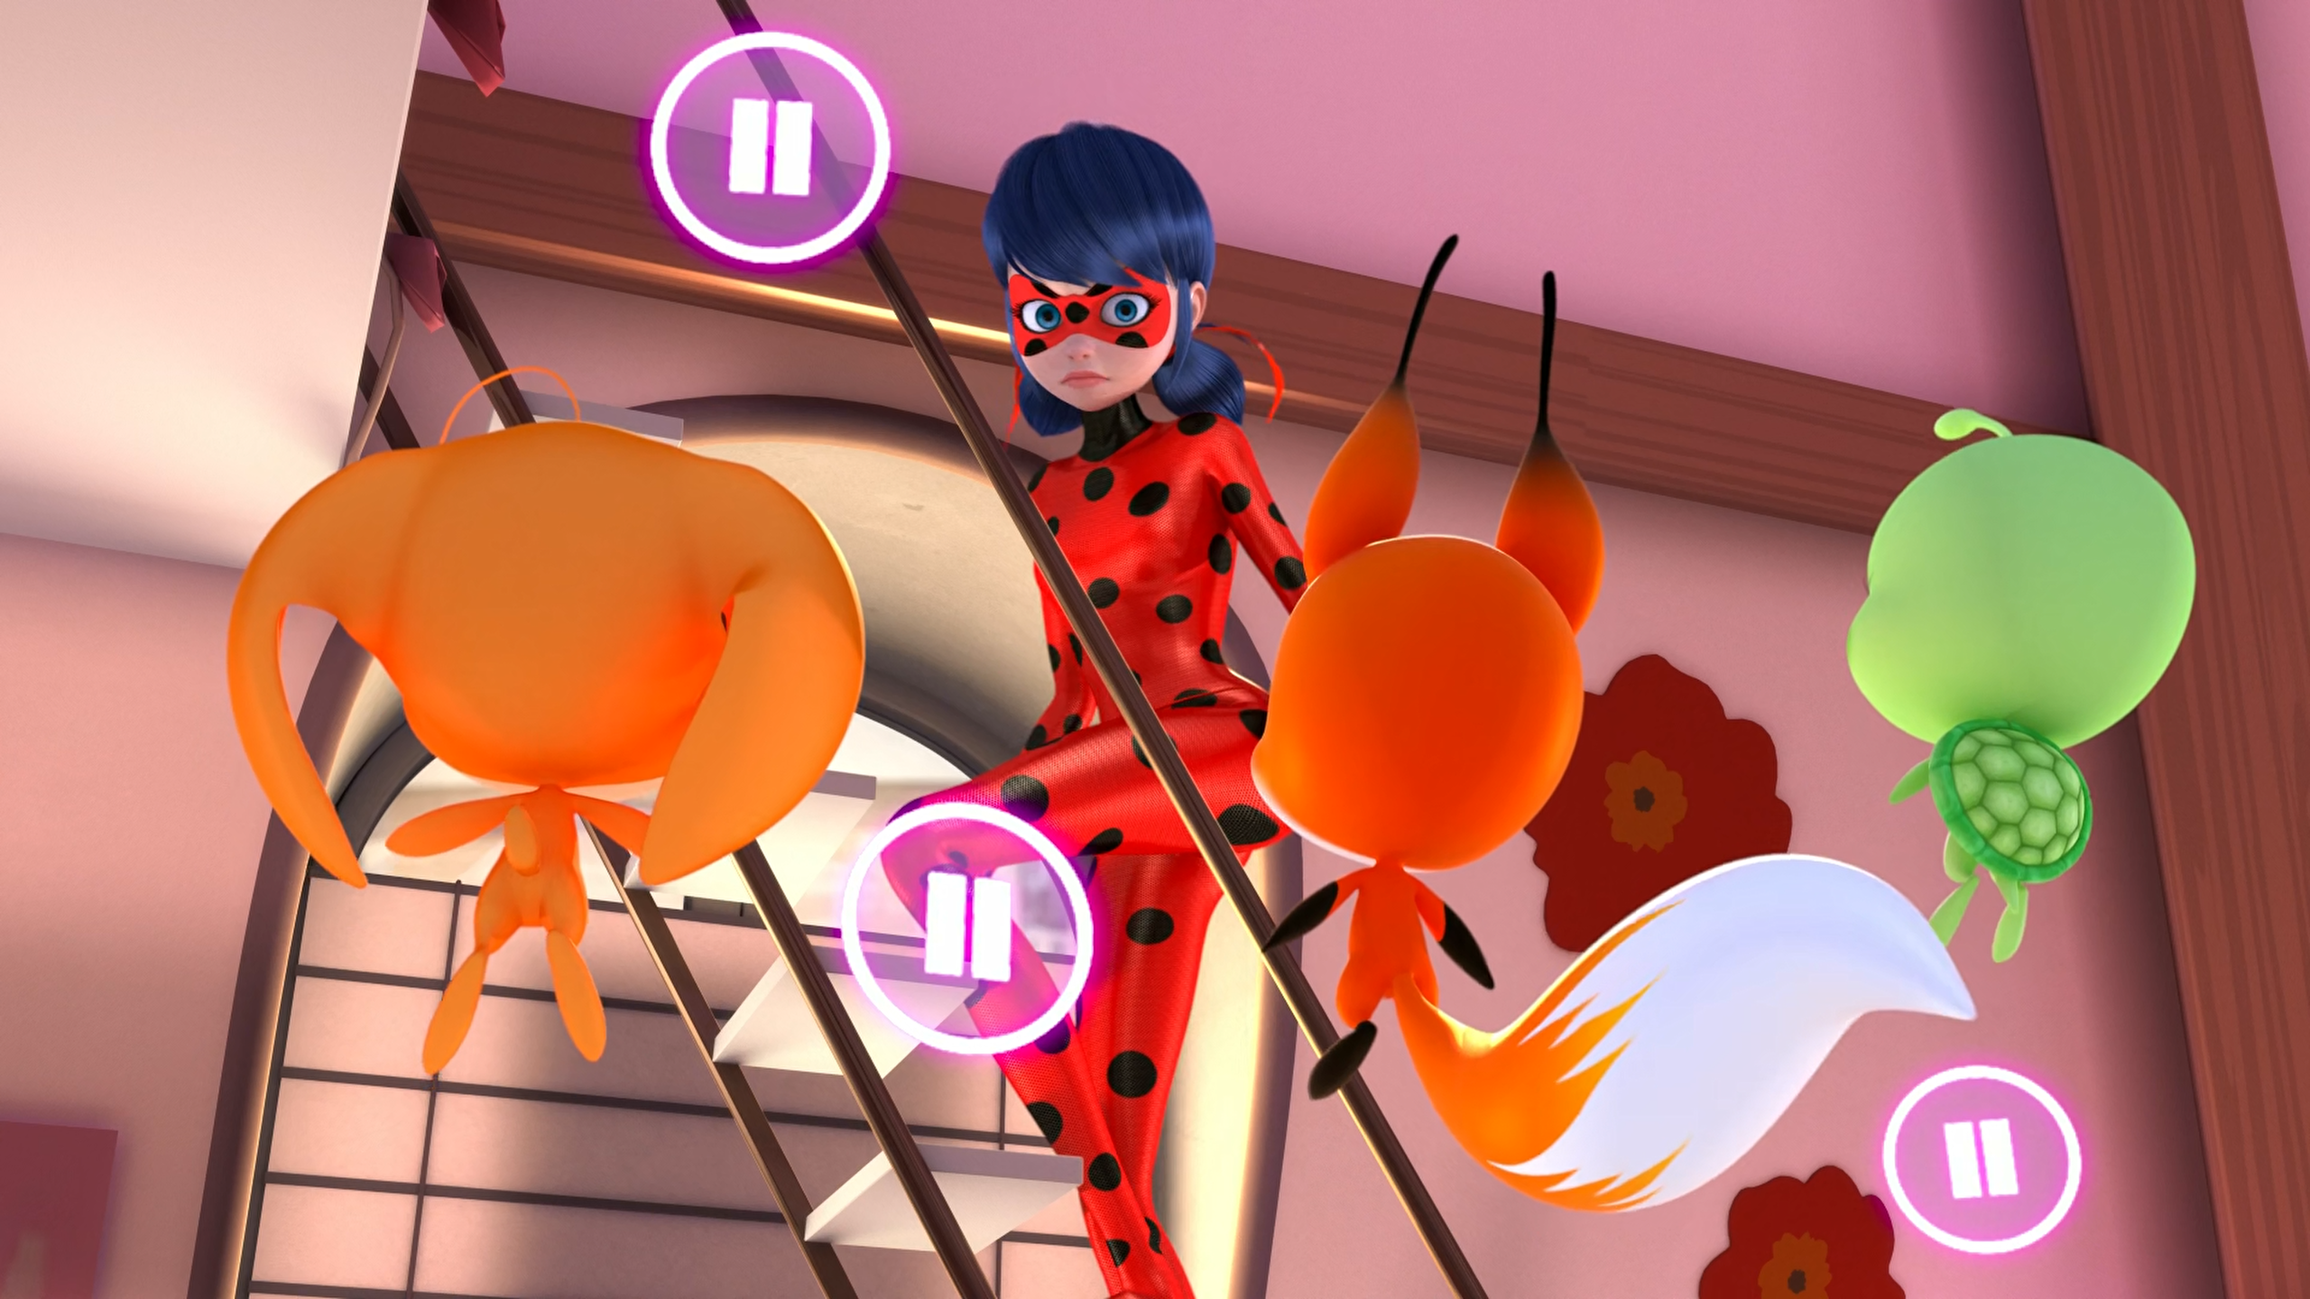

Doesn't it often set off some kind of ______?
cataclysm
calamity
catastrophe

Slide 9
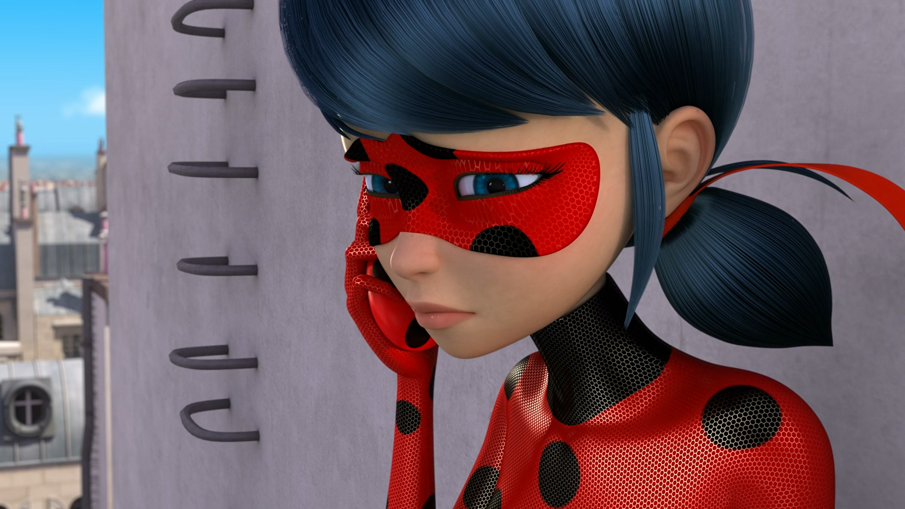
Well apparently, she's managed to ______ all her friends at once.
alienate
anger
annoy

Slide 10
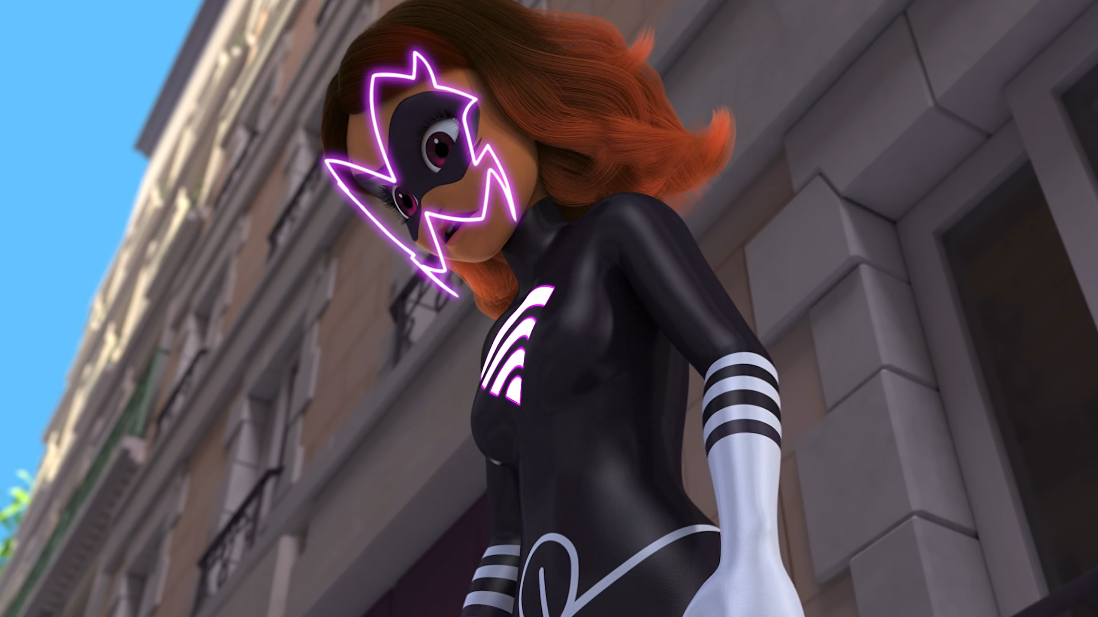
I trust you completely Alya and
I need you! I need ______!
Cat Noir
Rena Rogue
Wi-Fi

Slide 11
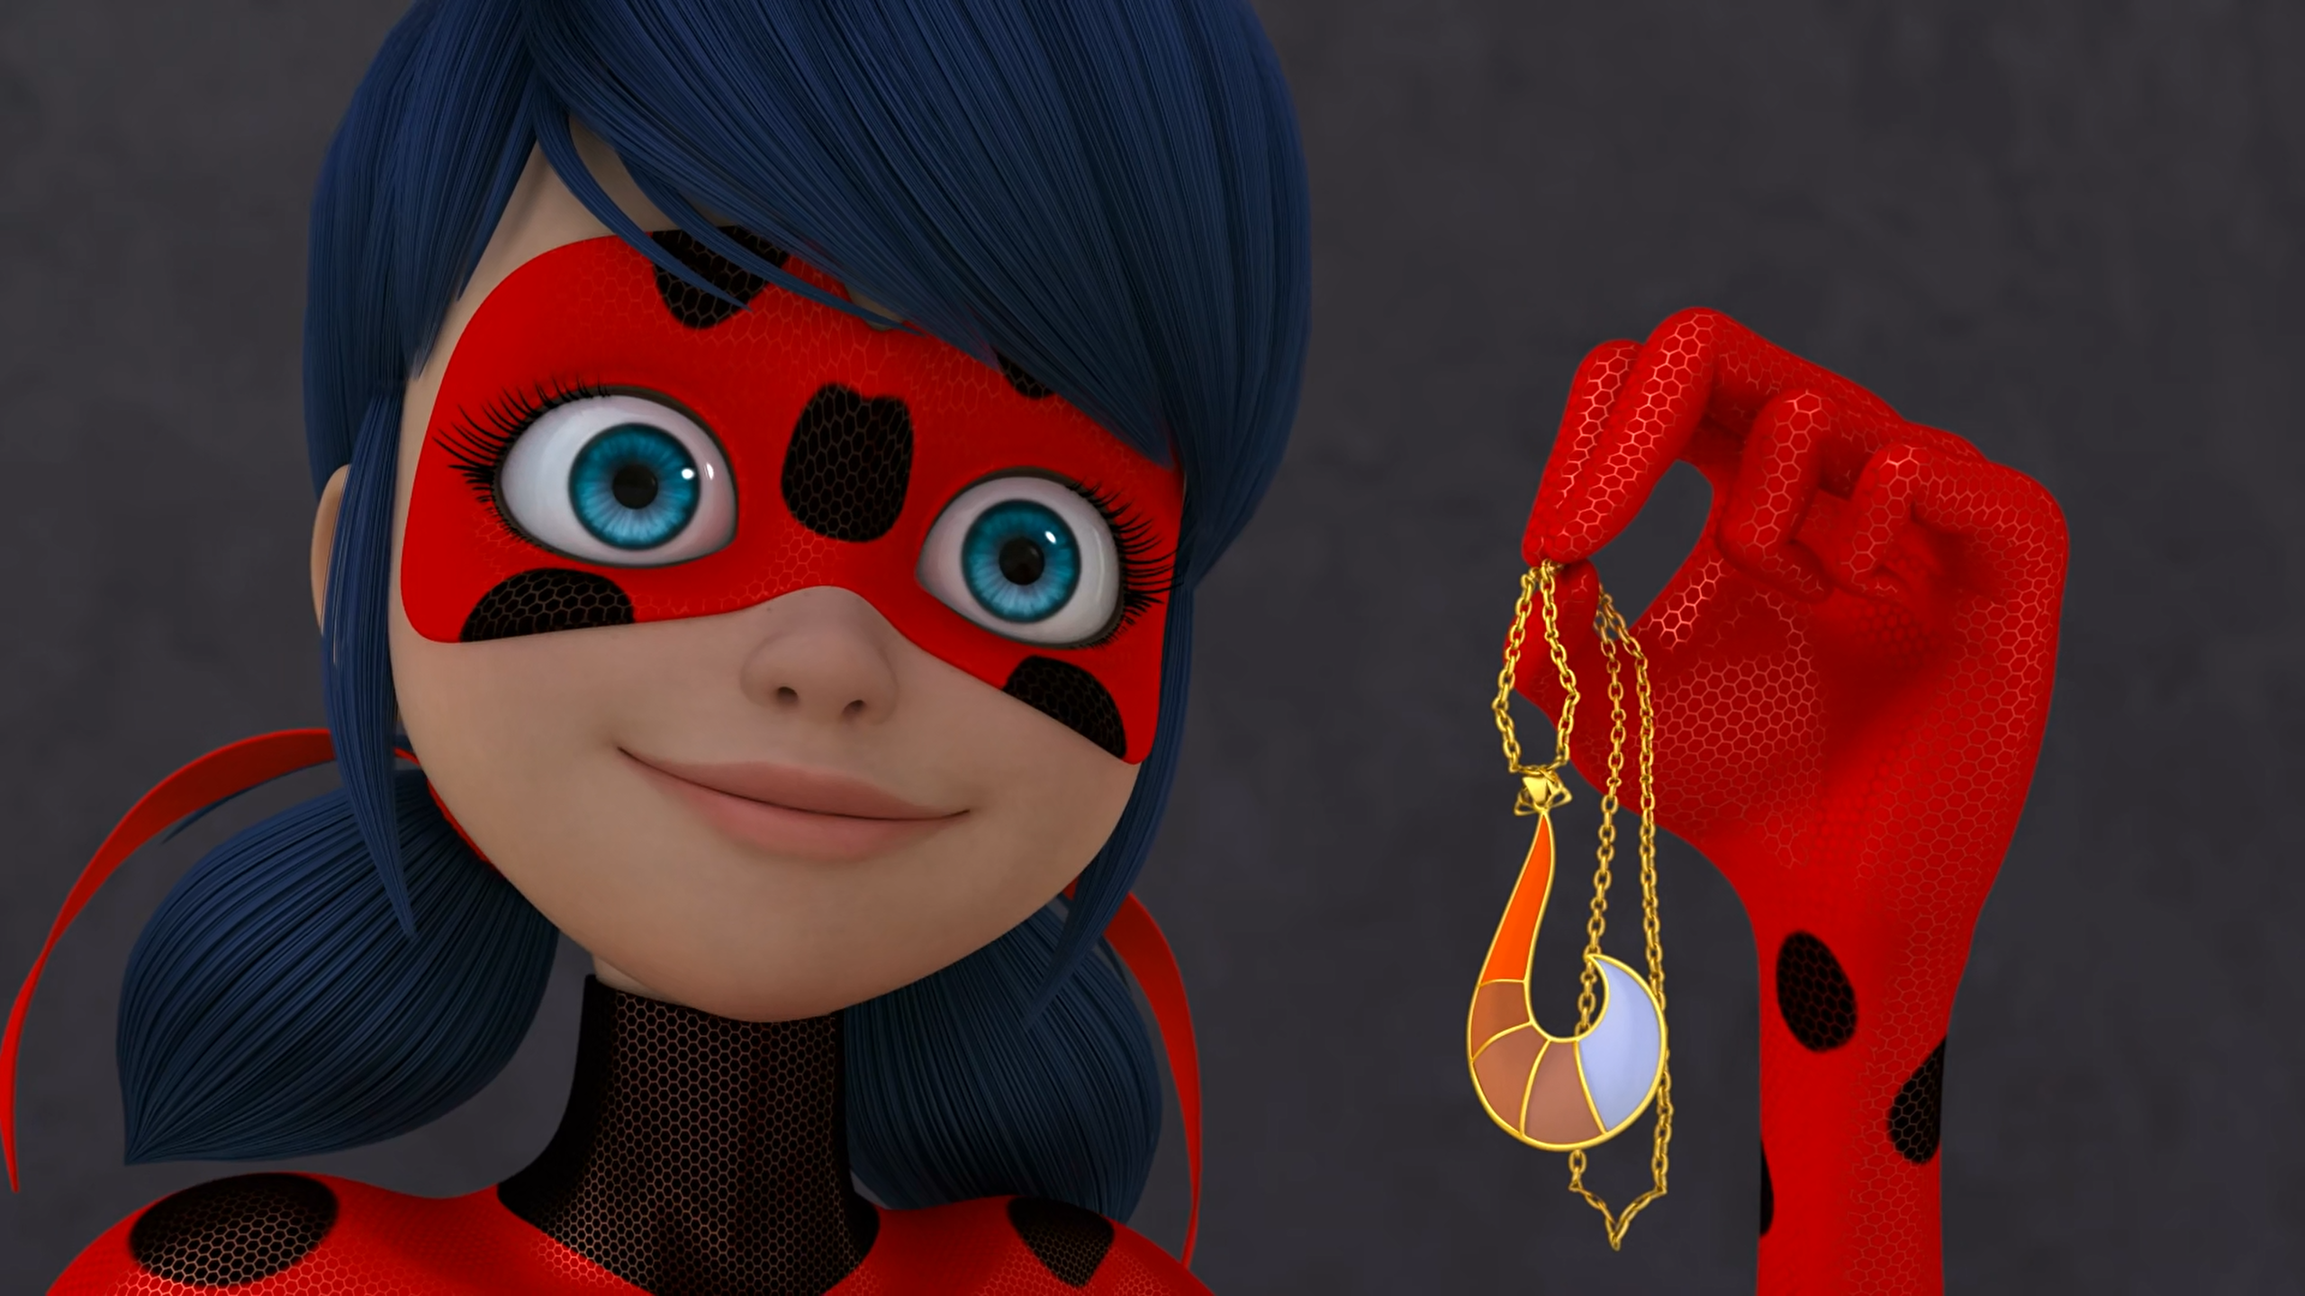
There have been a few upgrades since I became ______.
Aquabug
guardian
pregnant

Slide 12
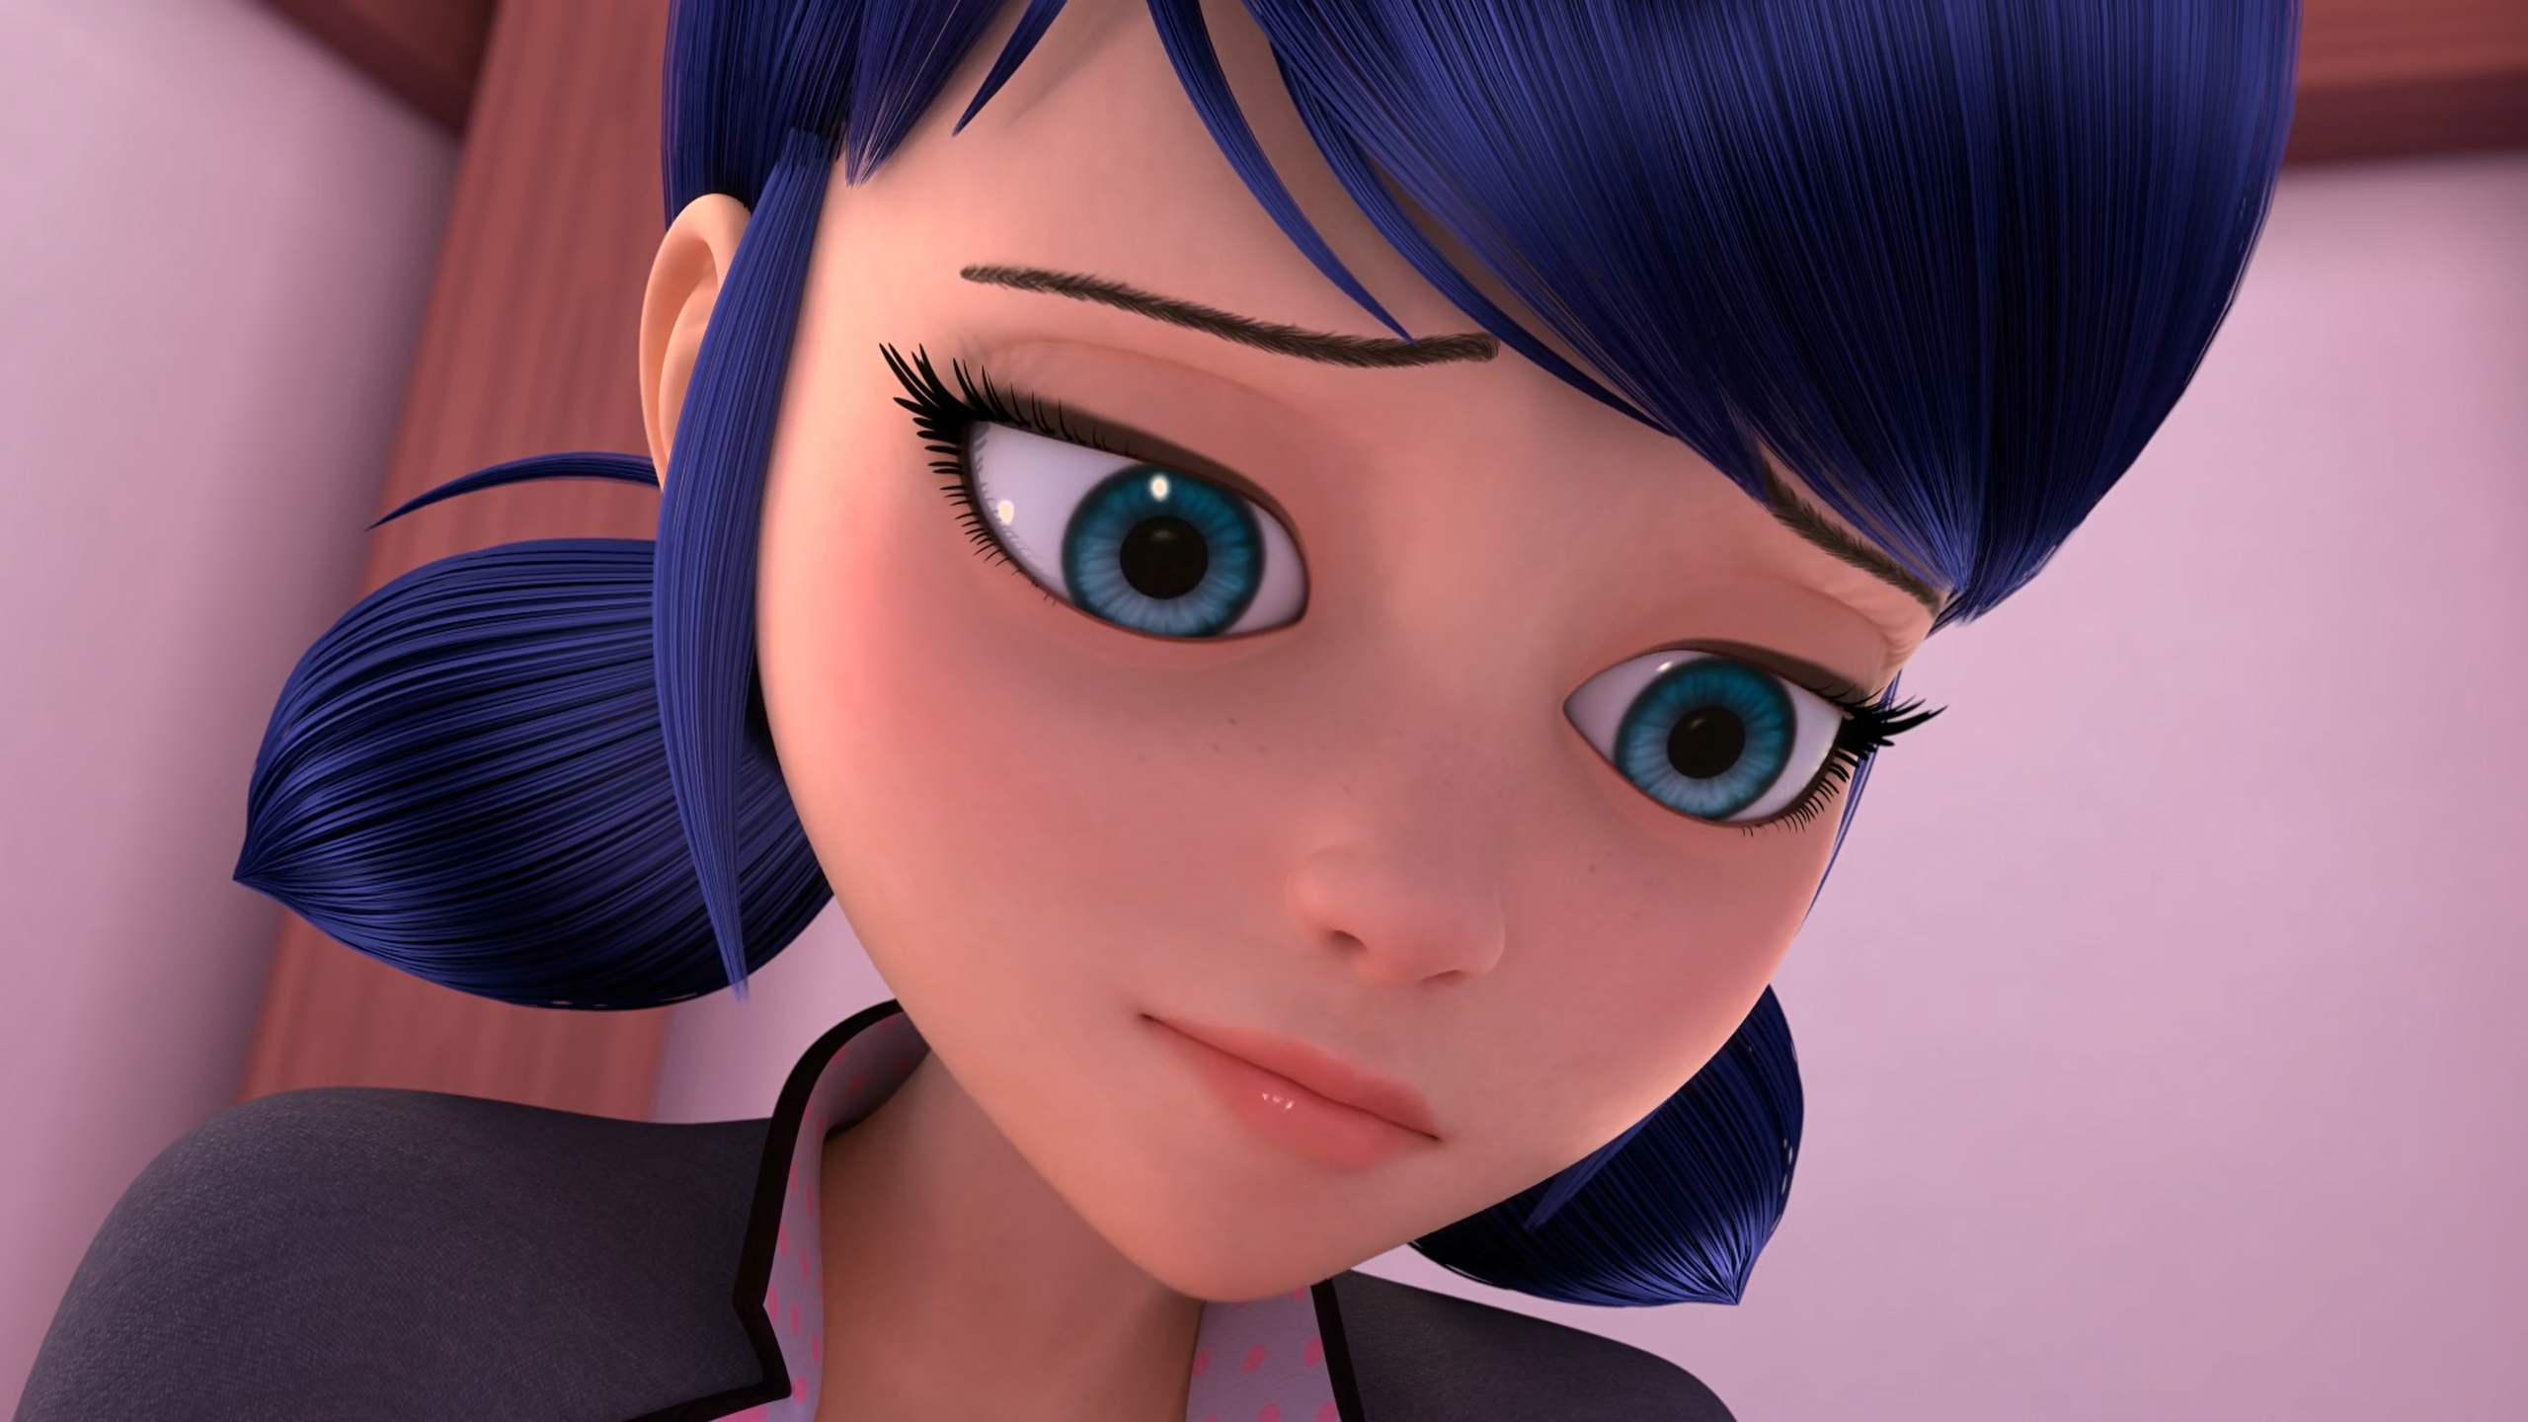
Love is too difficult. I think I'm gonna stick to ______.
WeChat
Tikki
friendship

Slide 13
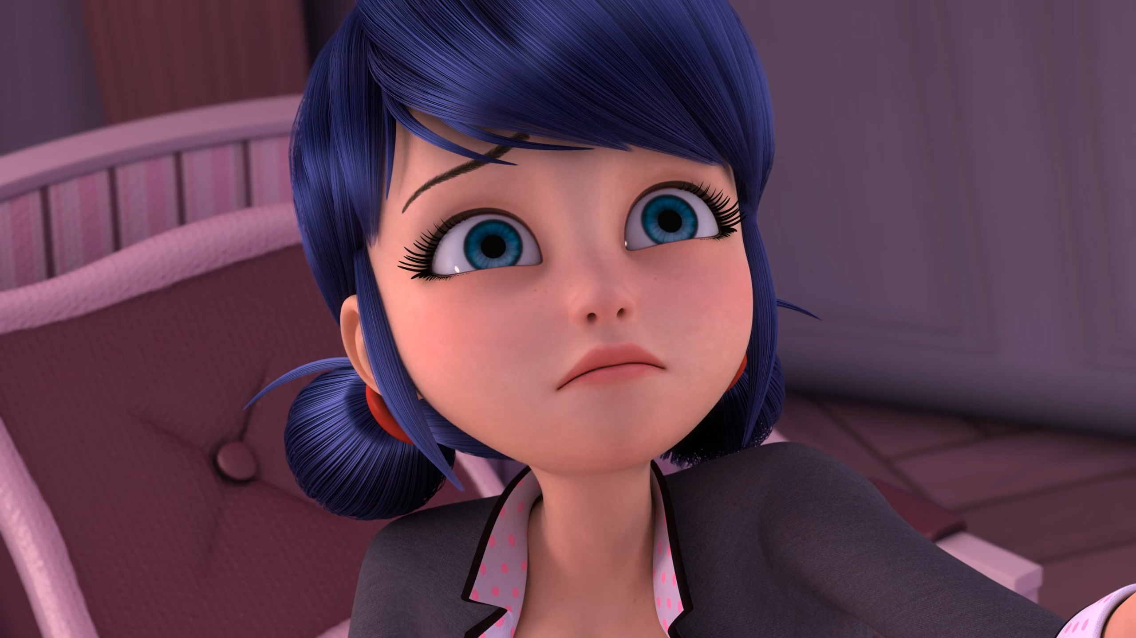
You know why I broke up with ______? Not because I don't like him.
Luka
Trump
Adrien

Slide 14
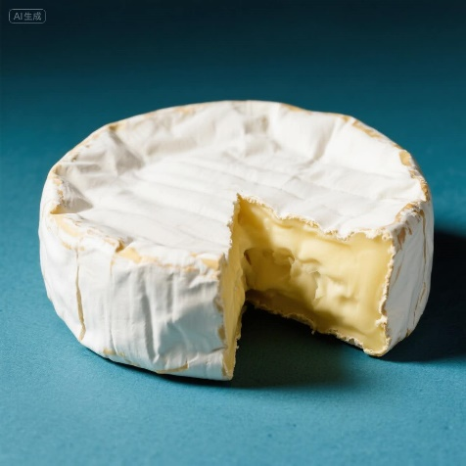
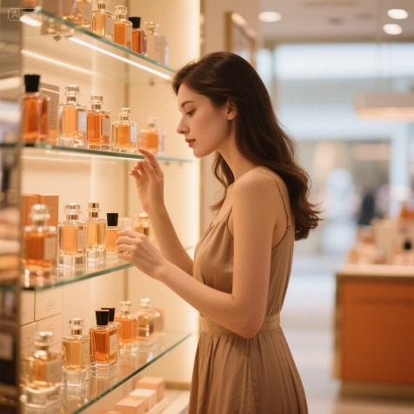

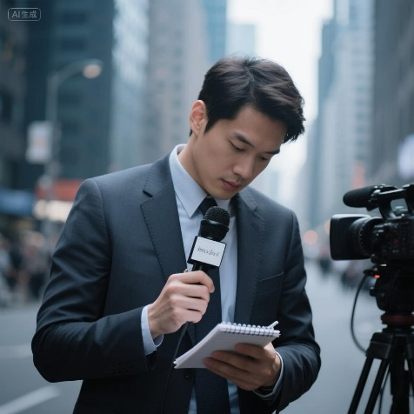
Matching Exercise
secret | camembert | journalist | fragrance

Slide 15
Matching Exercise
camembert | fragrance | secret | journalist

Slide 16
TRUE OR FALSE
1. Trixx sets off a catastrophe.
2. Cat Noir finds Shadow Moth.
3. Reflekta has the akuma.
4. Marinette apologises to the girls.
5. Marinette tells Alya that she's Ladybug.

Slide 17
TRUE OR FALSE
1. Trixx sets off a catastrophe. | TRUE
2. Cat Noir finds Shadow Moth. | FALSE
3. Reflekta has the akuma. | FALSE
4. Marinette apologises to the girls. | TRUE
5. Marinette tells Alya that she's Ladybug. | TRUE

