Slide 1
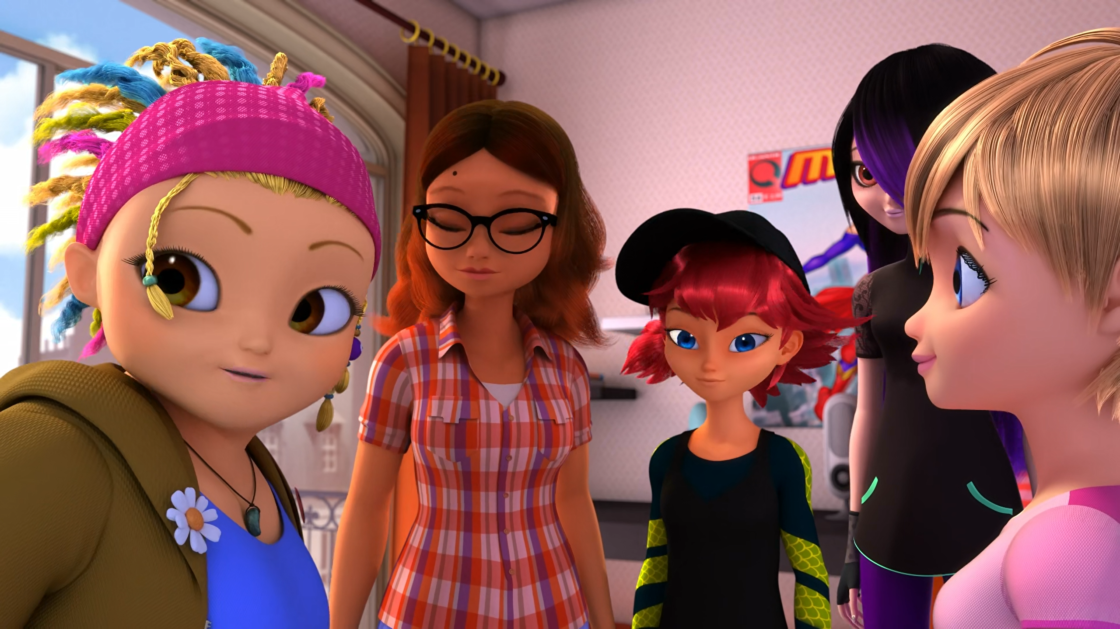
MIRACULOUS LADYBUG: GANG OF SECRETS. PART 1

Slide 2
VOCABULARY
confide - 倾诉 - kənˈfaɪd
double life - 双重人格的生活 - dʌbᵊl laɪf
eternal - 永恒的 - ɪˈtɜːnᵊl
gang - 帮派 - ɡæŋ
intervention - 干预 - ɪntəˈvɛnʃᵊn
patrol - 巡逻 - pəˈtrəʊl
smoothie - 果汁 - smuːði
tribe - 部落 - traɪb

Slide 3
1. kənˈfaɪd
2. 帮派
3. 果汁

Slide 4
1. kənˈfaɪd - confide
2. 帮派 - ɡang
3. 果汁 - smoothie

Slide 5
GANG OF SECRETS. PART 1
Cat Noir: I know nothing about your private life, but I do know what heartbreak sounds and feels like, and…
Ladybug: Heartbreak? Me? That is not it at all, everything's fine. In fact, I feel like swimming, let's go to the pool!
Cat Noir: You know, if you ever want to talk about anything, I'm here for you.

Slide 6
Marinette: What are you doing here?
Alya: We're just checkin' in on you, girl.
Rose: Aw, it looks just like a real house, look how the roof comes off to show the inside!
Marinette: No! No, don't touch that! Move away!
Rose: Sorry, Marinette!
Marinette: Will you please leave my room?!

Slide 7
Princess Fragrance: I will force her to reveal what she's been hiding from us.
Timebreaker: And I'll turn back time to return everything to the way it was.
Reflekta: We'll comfort her and she'll be our friend again.
Lady Wifi: And if Ladybug and Cat Noir try to stand in our way, Horrificator will keep them busy!

Slide 8
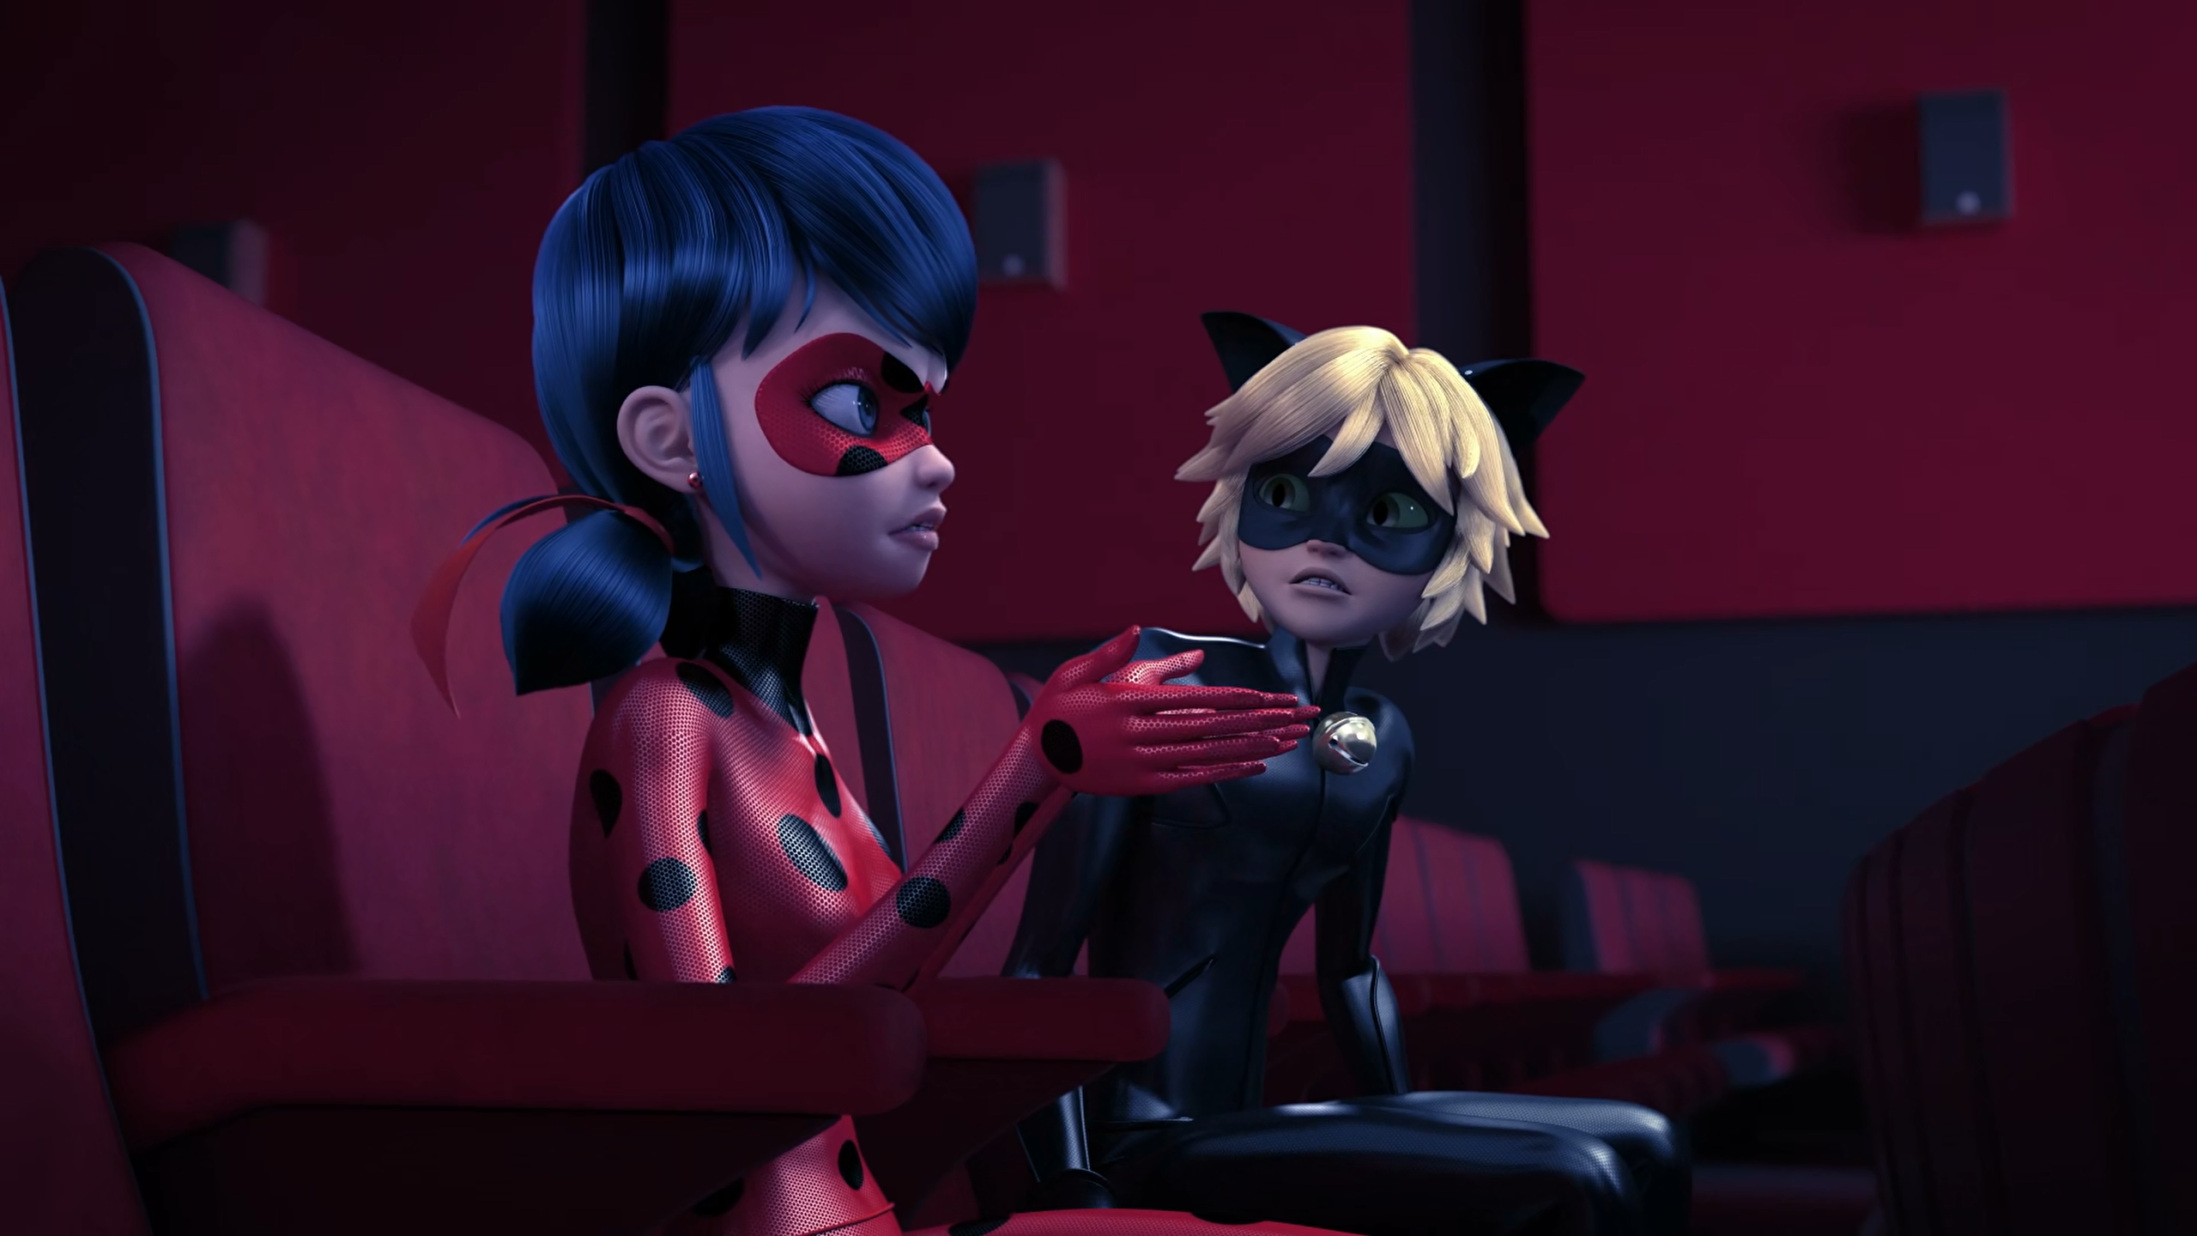

Romantic comedies are ______ anyway, and you know why?
stupid
silly
lame

Slide 9
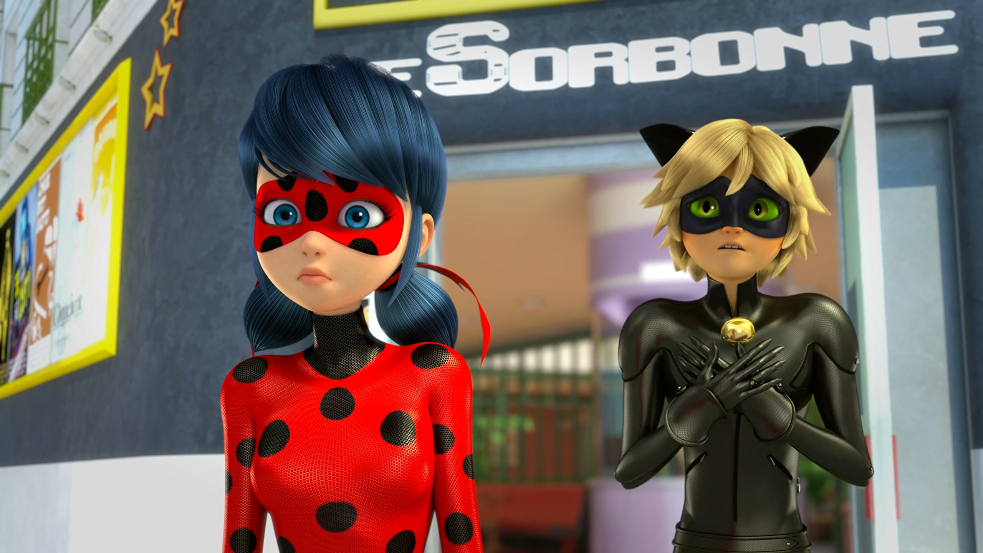
I do know what ______ sounds and feels like.
heartbreak
heartache
heart attack

Slide 10
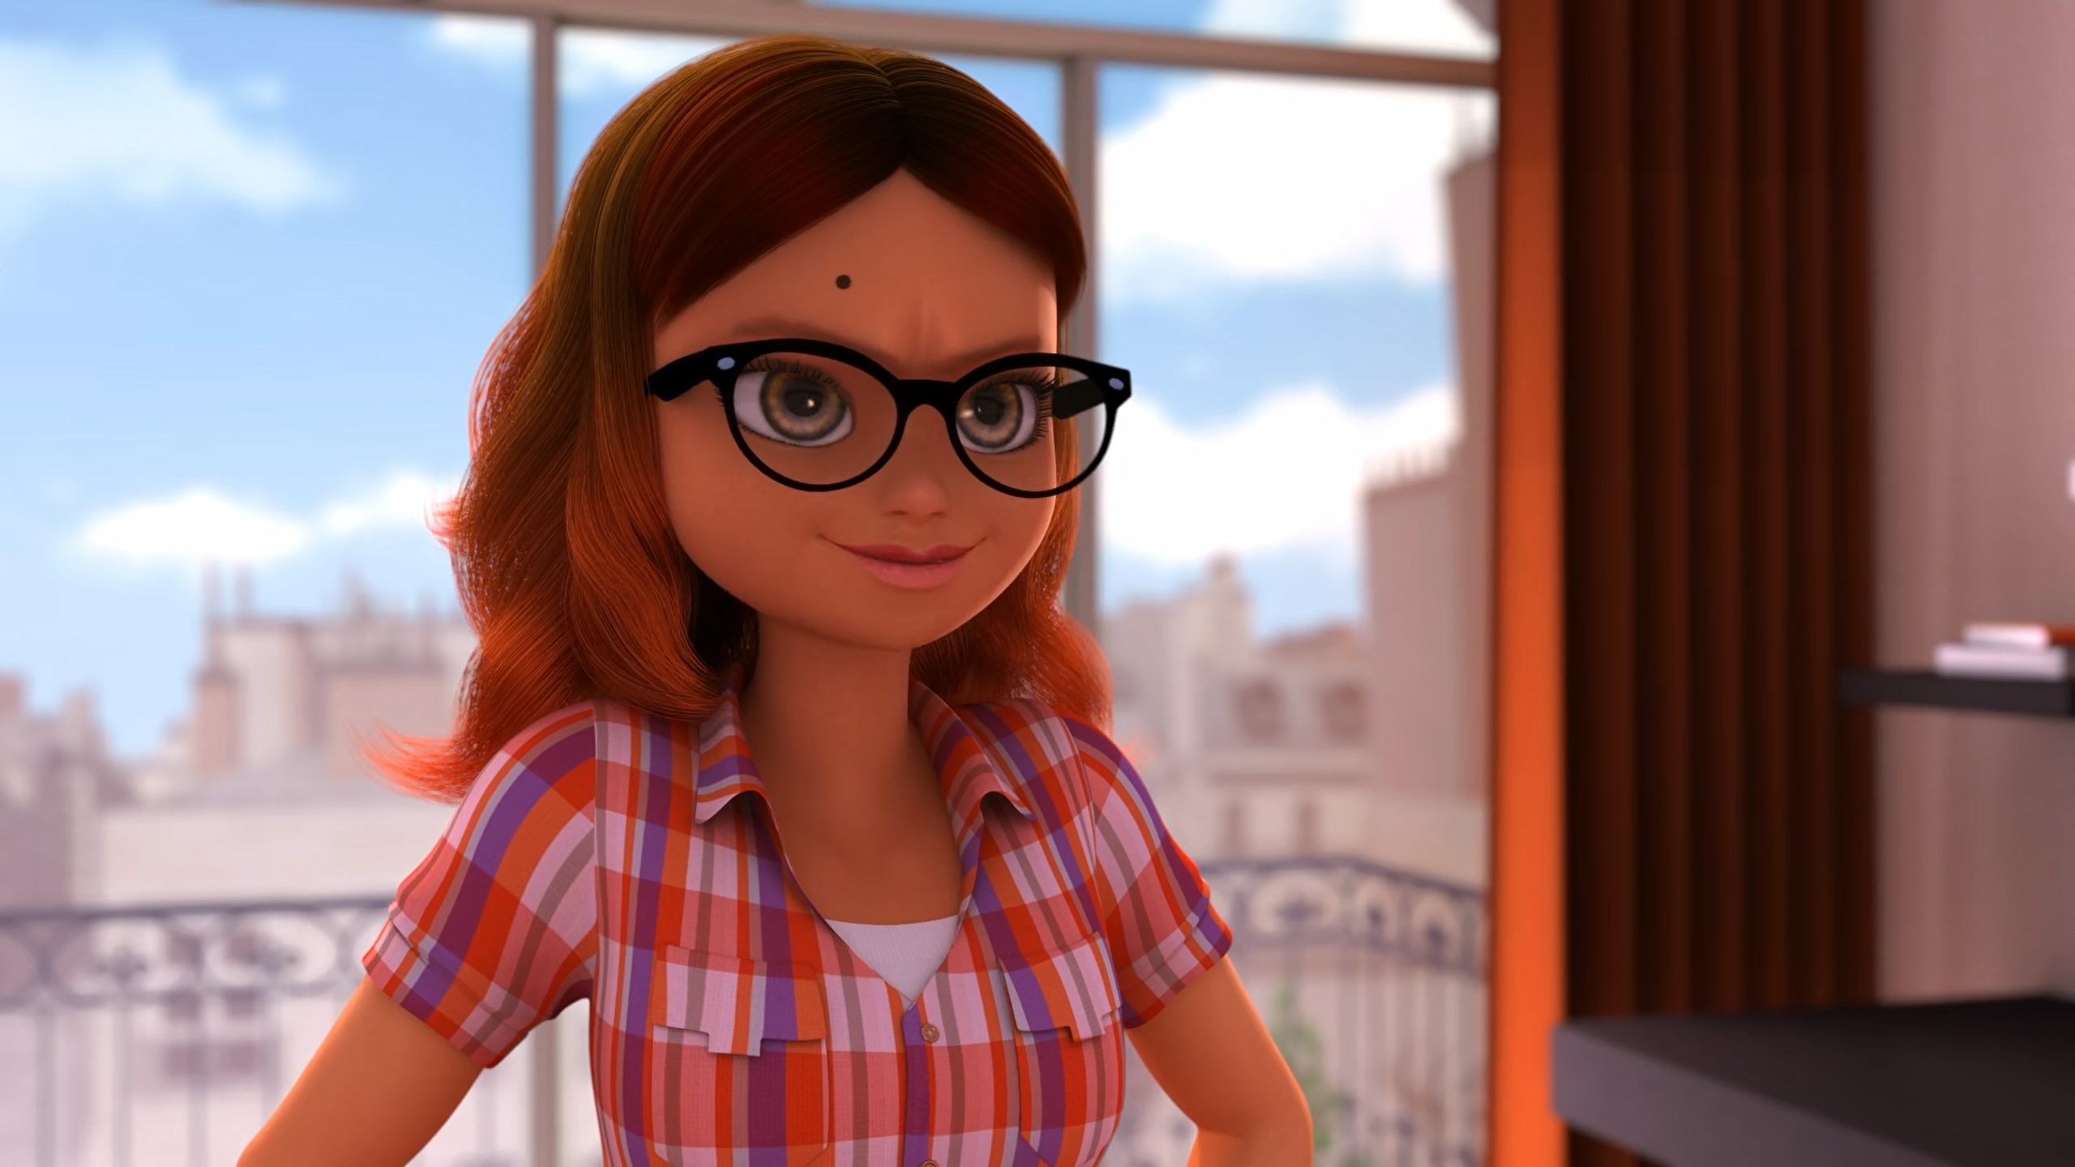
What Marinette needs is a friendly ______!
invention
intervention
interview

Slide 11
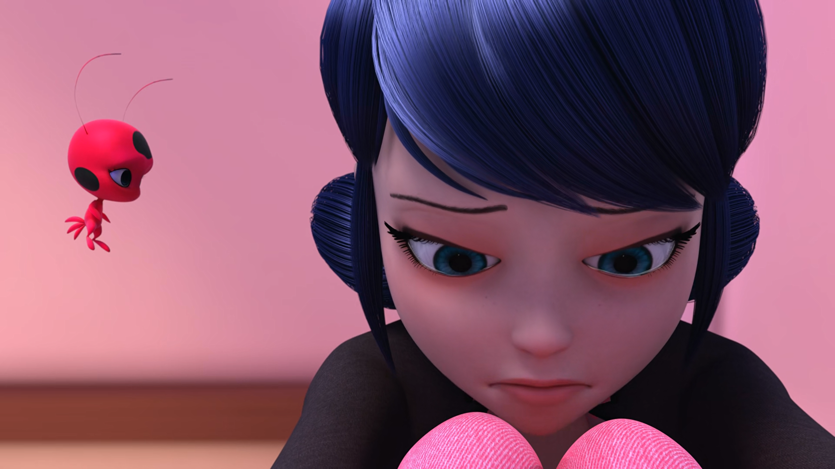
I'm ______ to be a big liar to everyone, forever.
cursed
doomed
going

Slide 12
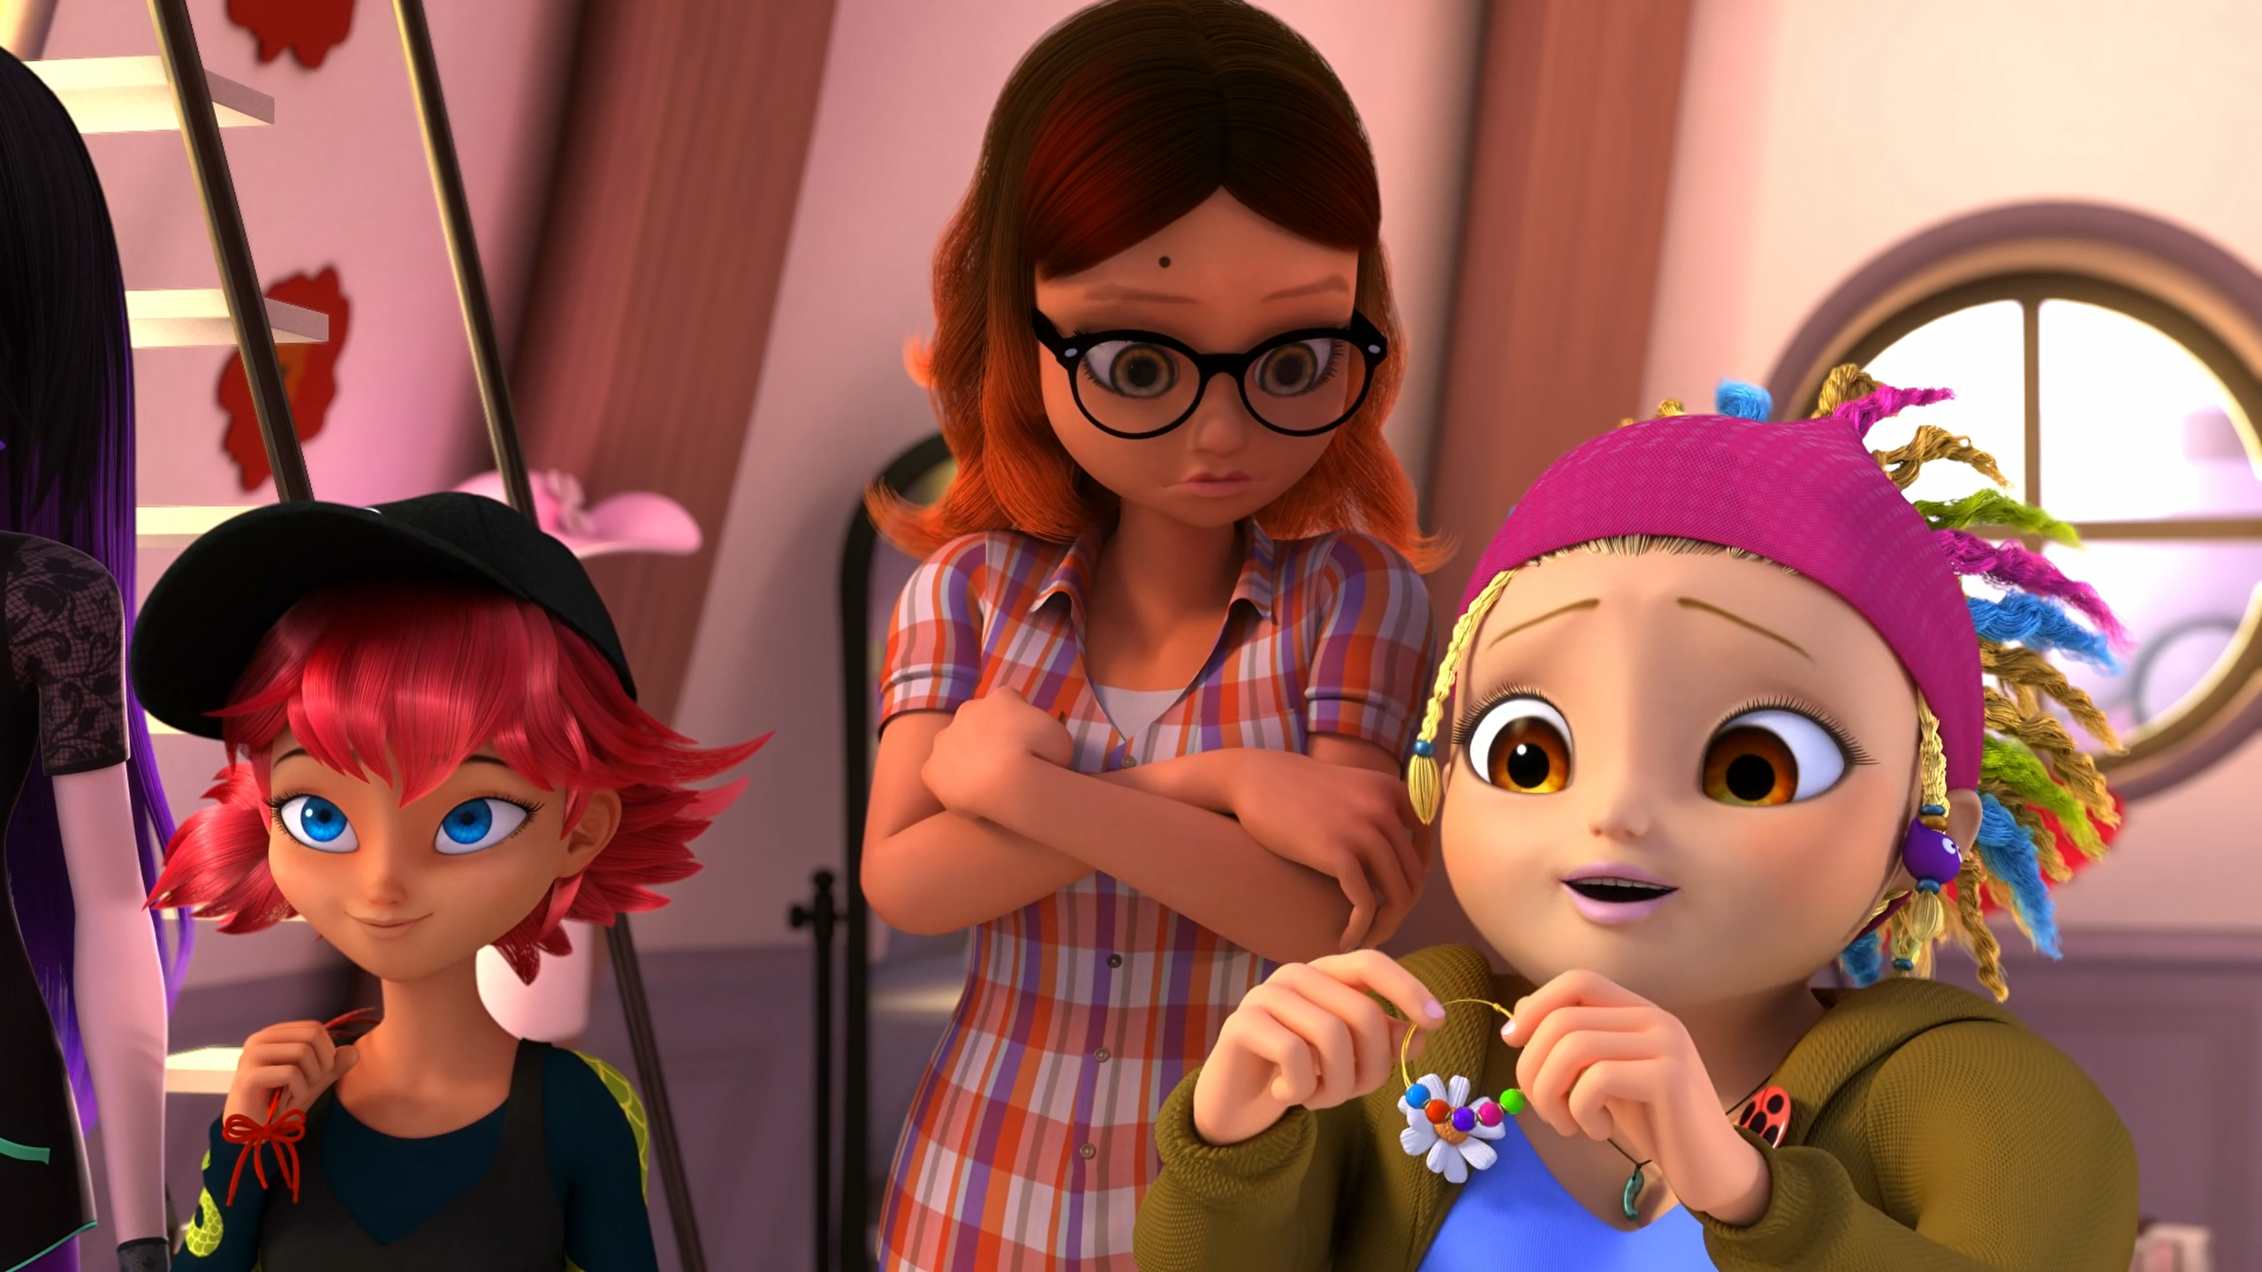
Each of us told our secrets to this ______.
ring
necklace
bracelet

Slide 13
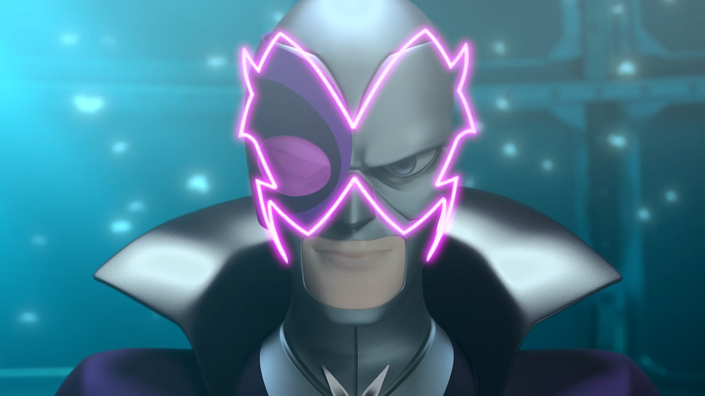
I am Shadow Moth. Your friend won't reveal her ______ to you?
secrets
password
WeChat

Slide 14
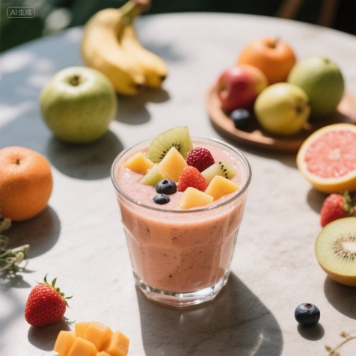

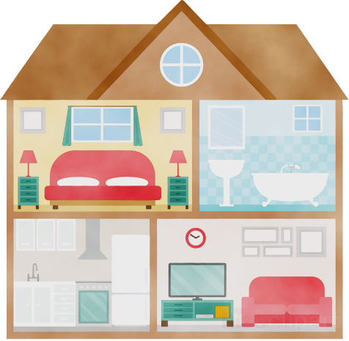
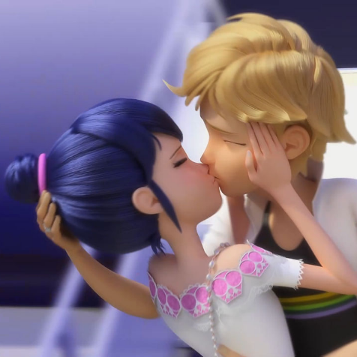
Matching Exercise
doll house | kissy-kissy | fashion | smoothie

Slide 15
Matching Exercise
smoothie | fashion | doll house | kissy-kissy

Slide 16
TRUE OR FALSE
1. Ladybug loves the movie.
2. Ladybug goes swimming.
3. Alya heard Marinette crying in the toilet.
4. The girls make a bracelet.
5. Juleka breaks the doll house.

Slide 17
TRUE OR FALSE
1. Ladybug loves the movie. | FALSE
2. Ladybug goes swimming. | TRUE
3. Alya heard Marinette crying in the toilet. | TRUE
4. The girls make a bracelet. | TRUE
5. Juleka breaks the doll house. | FALSE

