Slide 1
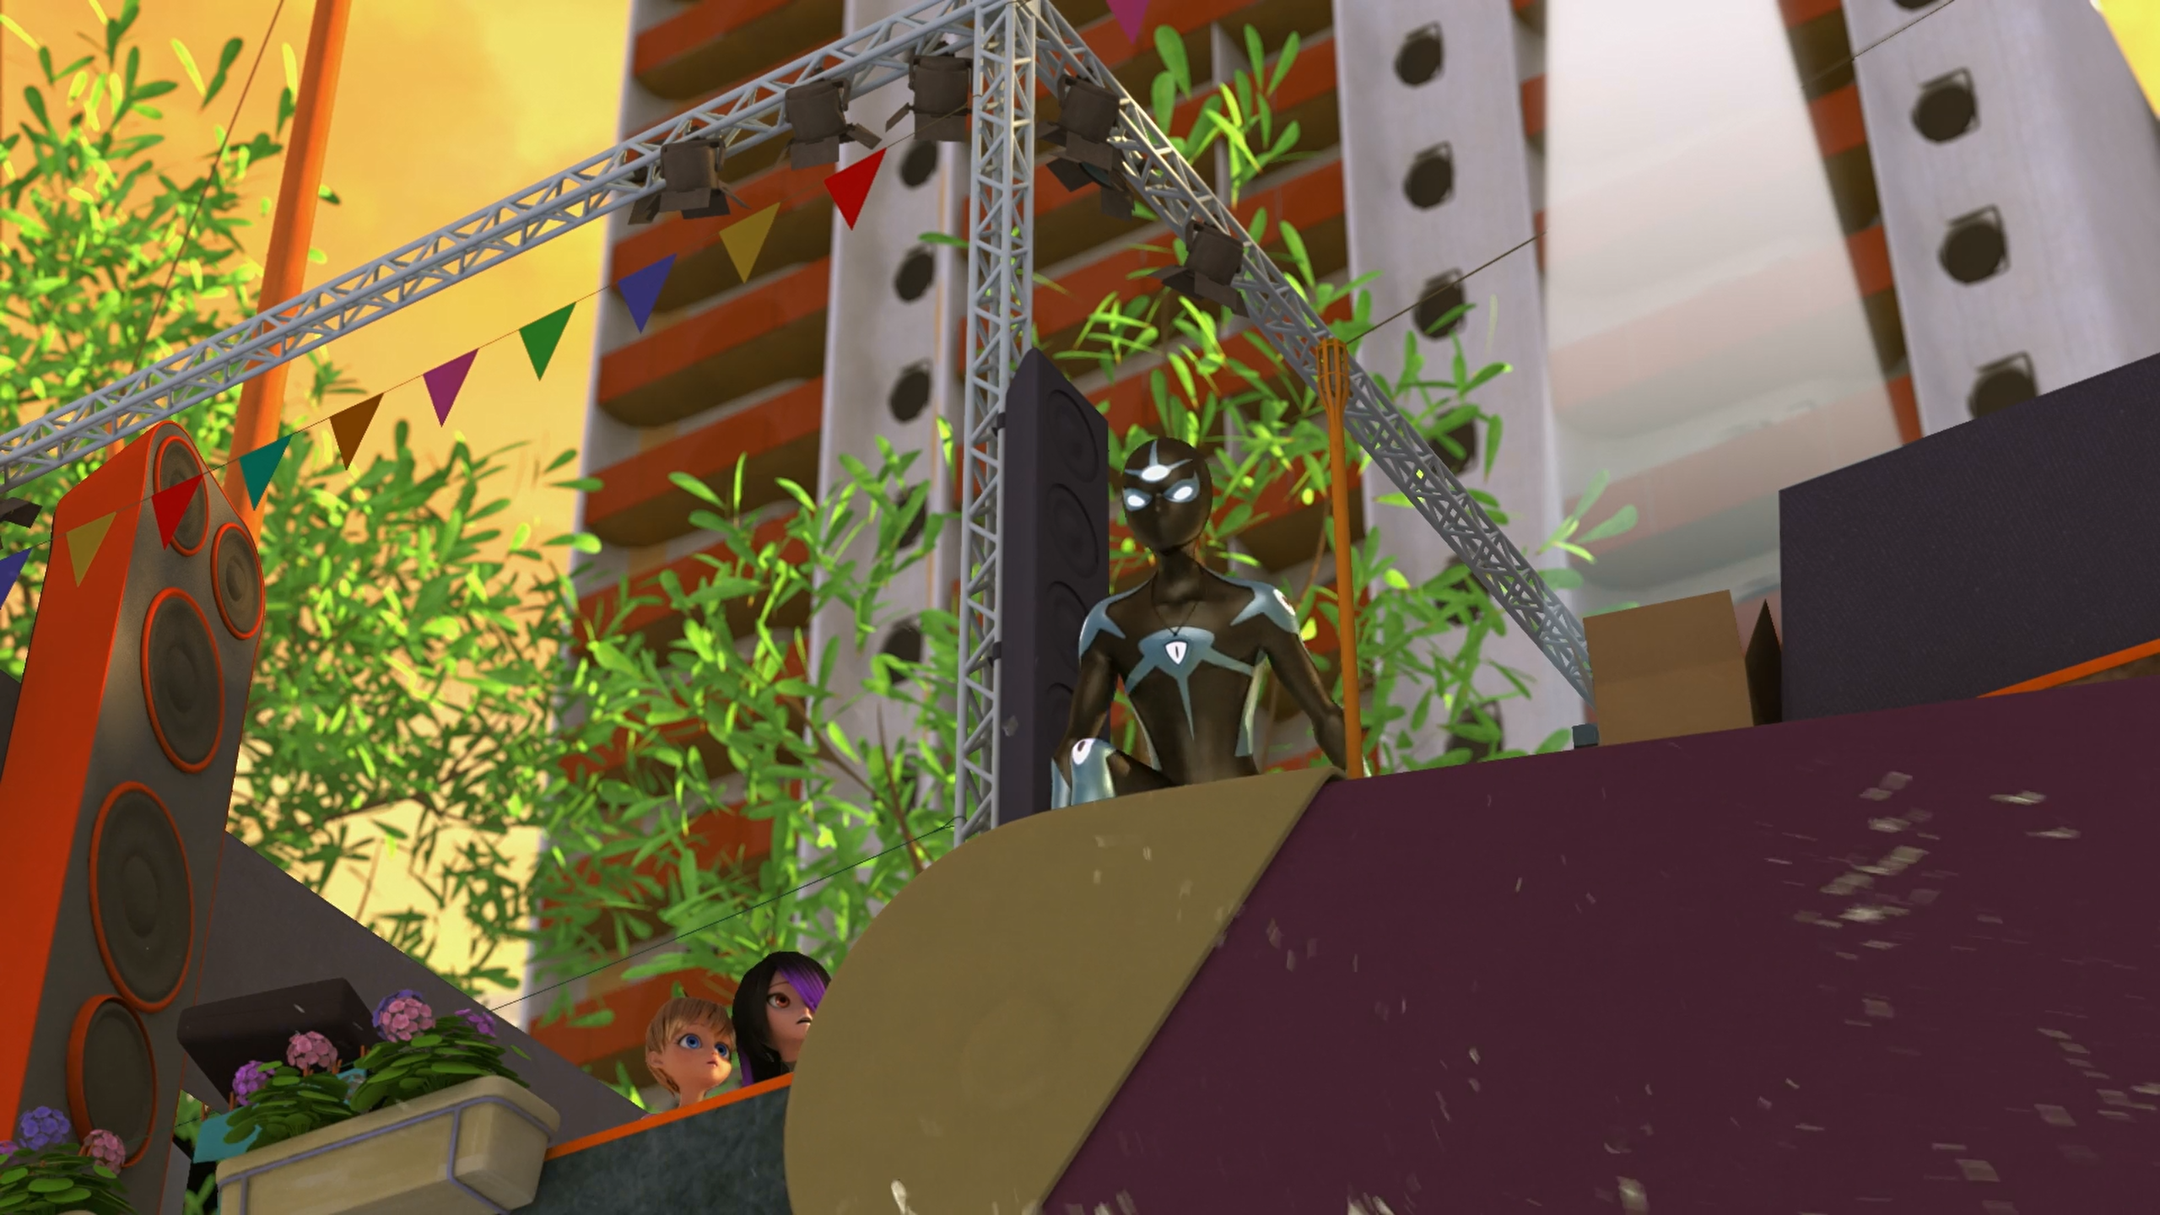
MIRACULOUS LADYBUG: TRUTH. PART 2

Slide 2
VOCABULARY
betray - 背叛 - bɪˈtreɪ
honours - 荣誉 - ɒnəz
liquid - 液体 - lɪkwɪd
miracle - 奇迹 - mɪrəkᵊl
qualities - 品质 - kwɒlətiz
resist - 抵抗 - rɪˈzɪst
run amok - 横行 - rʌn əˈmɒk
sacred - 神圣 - seɪkrɪd
tour - 巡演 - tʊə

Slide 3
1. 液体
2. rʌn əˈmɒk
3. 神圣

Slide 4
1. 液体 - liquid
2. rʌn əˈmɒk - run amok
3. 神圣 - sacred

Slide 5
TRUTH. PART 2
Shadow Moth: Truth, I am Shadow Moth. I'm giving you the power to force people to tell you their most sacred secrets.
Luka: Truth needs to be shared, not taken by force, Shadow Moth!
Marinette: Uh! Shadow Moth? No! Luka, please resist, I am so sorry!

Slide 6
Truth: She must have another secret!
Ladybug: Cat Noir, Hawk Moth's merged his powers with the Peacock to become Shadow Moth. He's created a supervillain and a sentimonster at the same time. I need you out here!
Rose: Marinette doesn't have any secrets because she's the most honest girl in the whole world.

Slide 7
Truth: Are you or are you not my father?!
Jagged Stone: Luka? Yes, I am your father.
Truth: Why would you hide this from me, and why did you abandon me?!
Jagged Stone: I was too lame to take care of a kid. I'm sorry, son, but I spent my whole life on tour. I live in hotels with a crocodile. I could never be the father you'd need me to be.

Slide 8
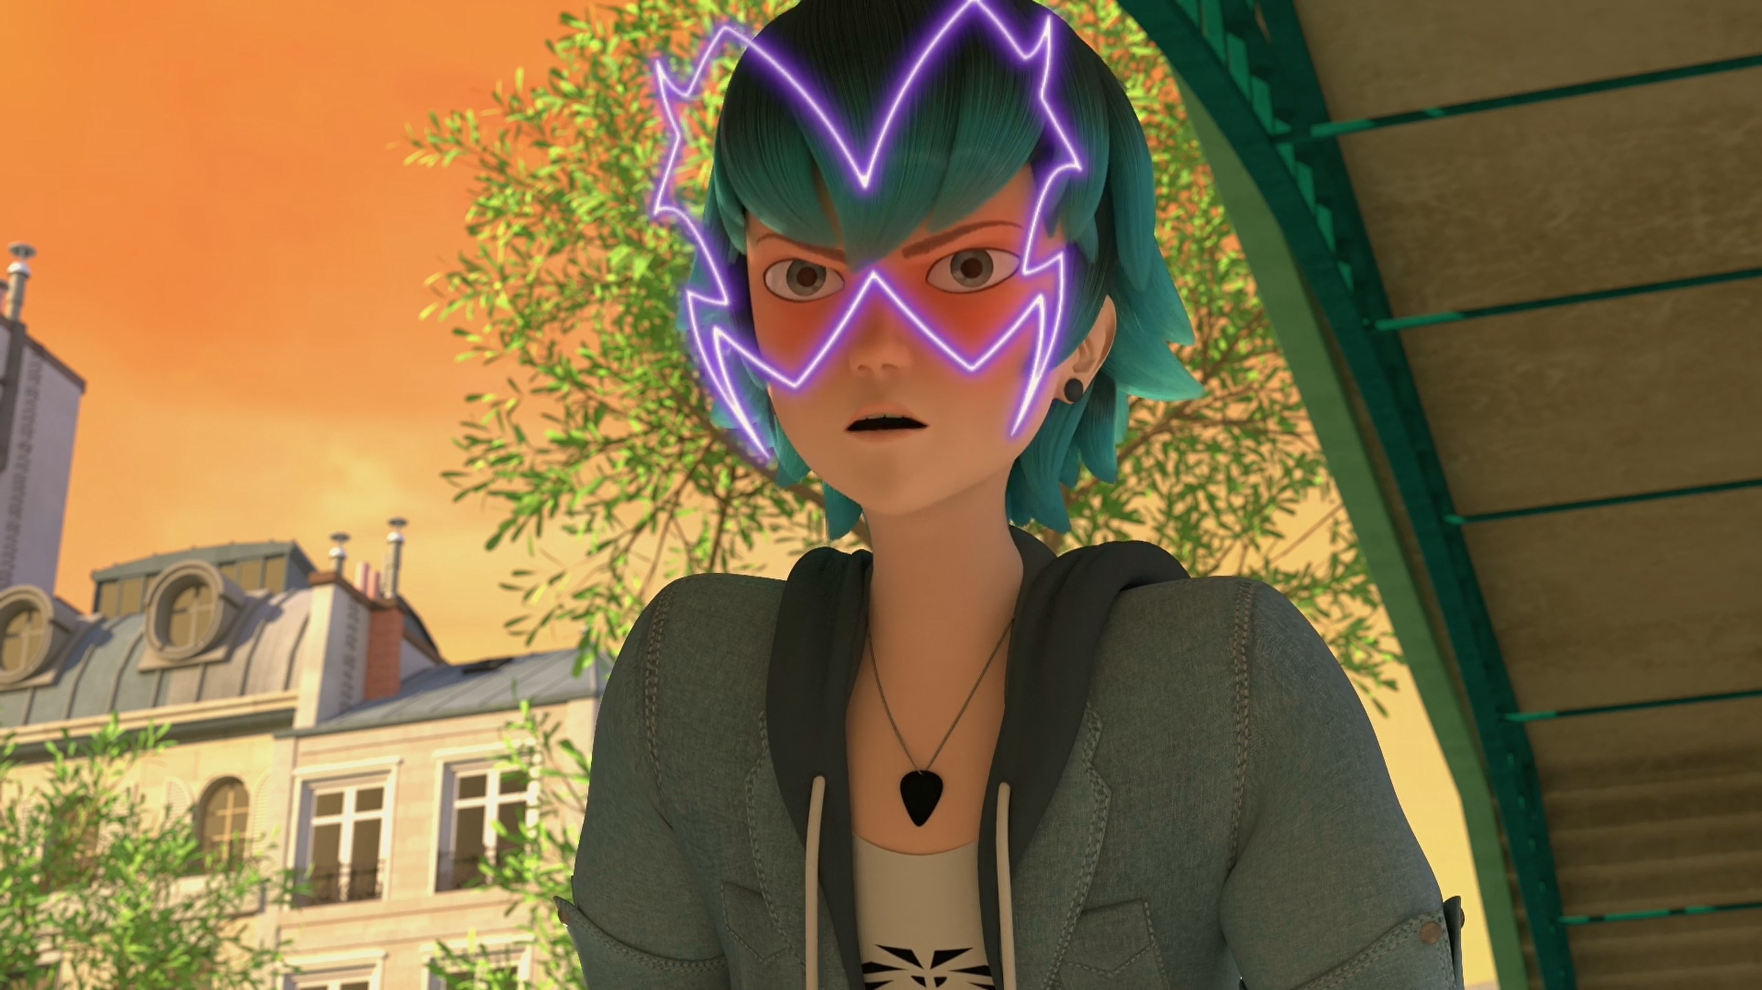

Truth needs to be ______, not taken by force, Shadow Moth!
told
freed
shared

Slide 9
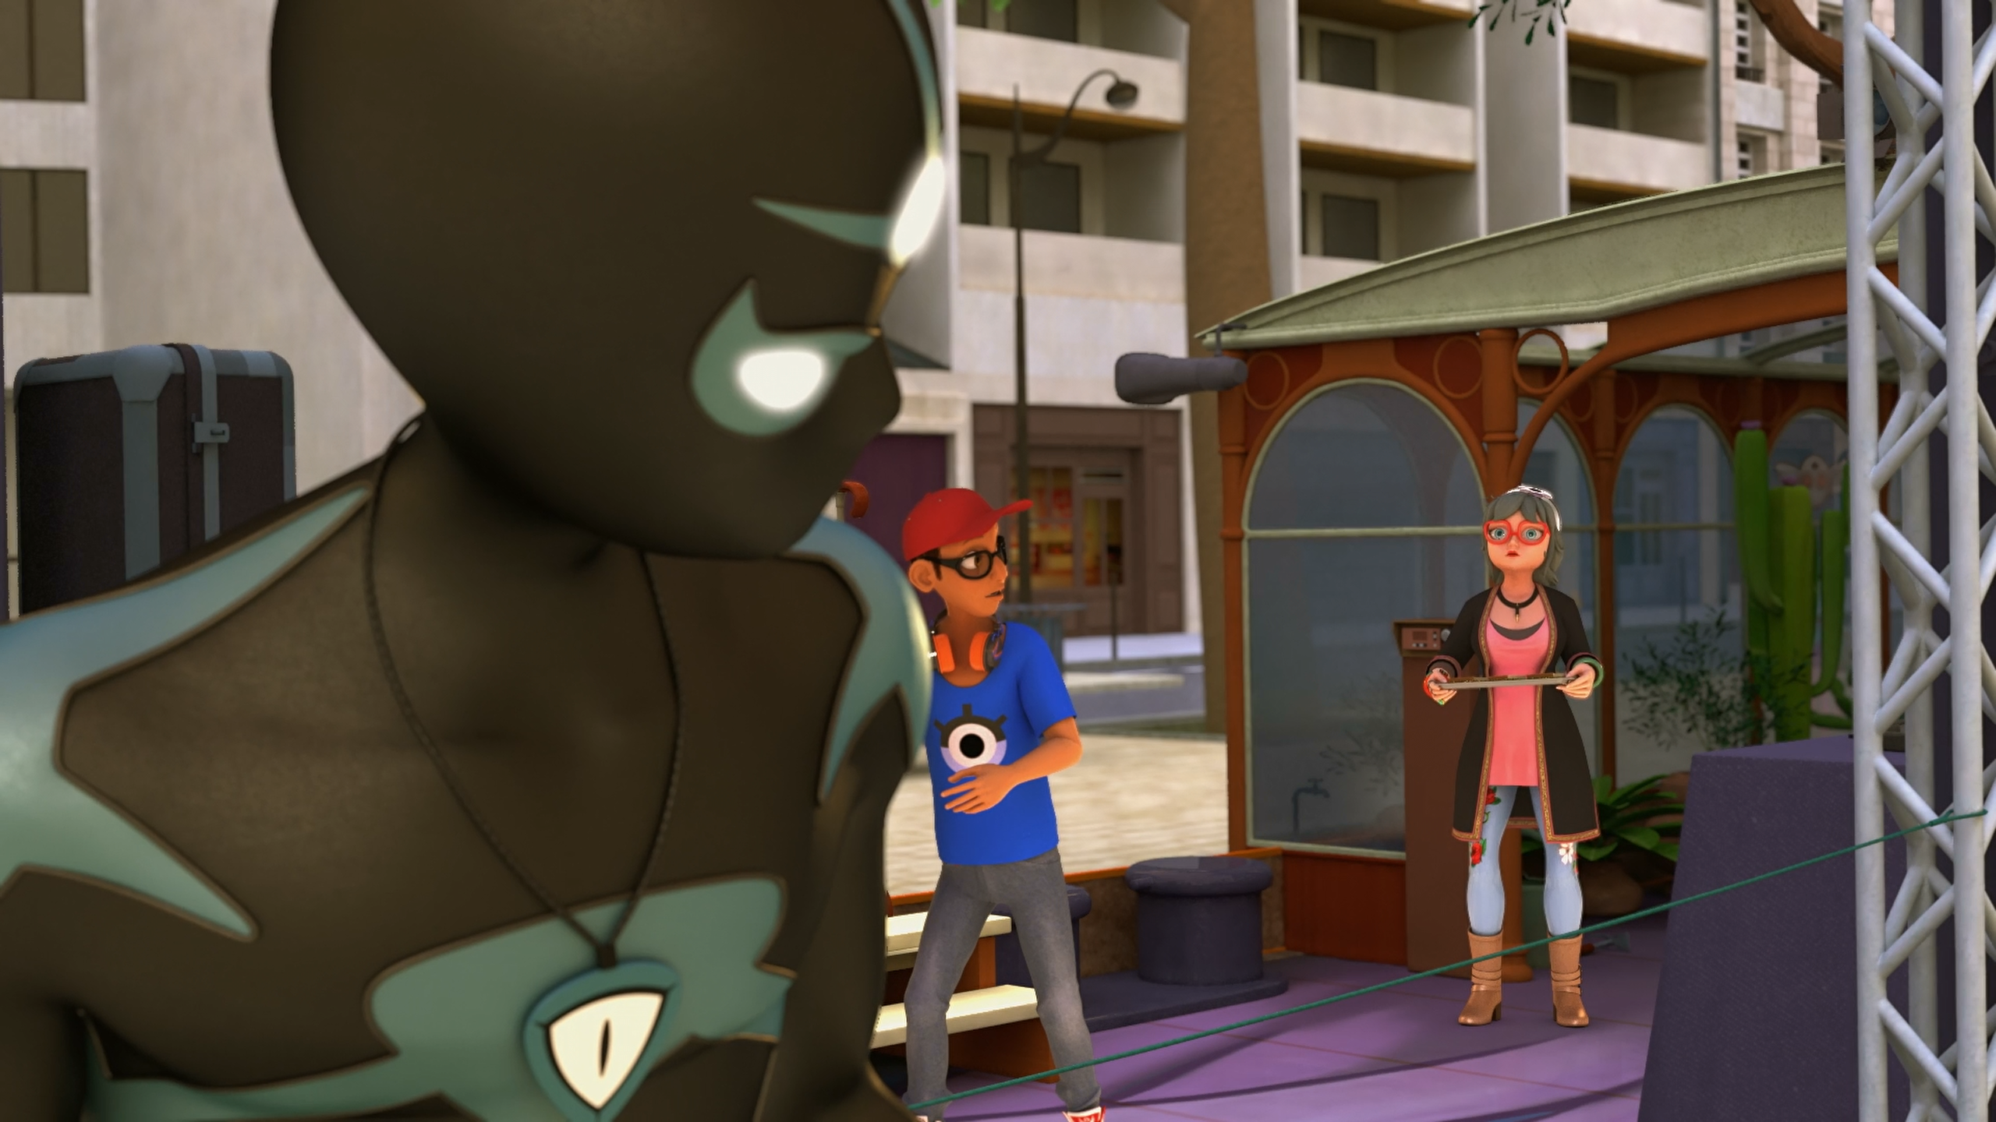
Hey! what are you doing on my ______, pirate?
ship
boat
yacht

Slide 10
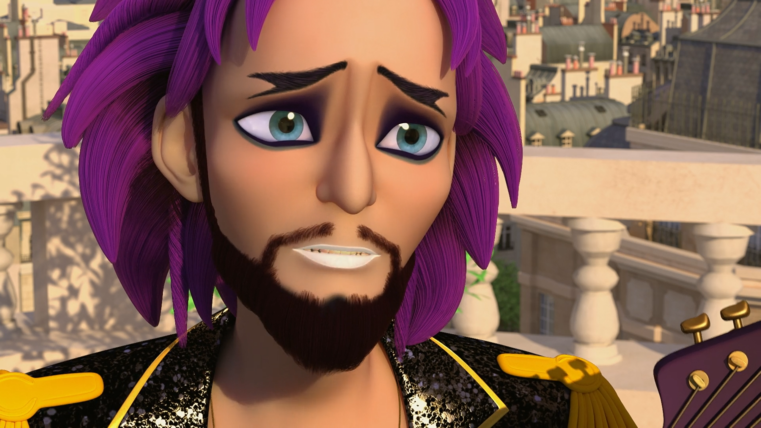
I live in hotels with ______.
my girlfriend
a crocodile
Shadow Moth

Slide 11
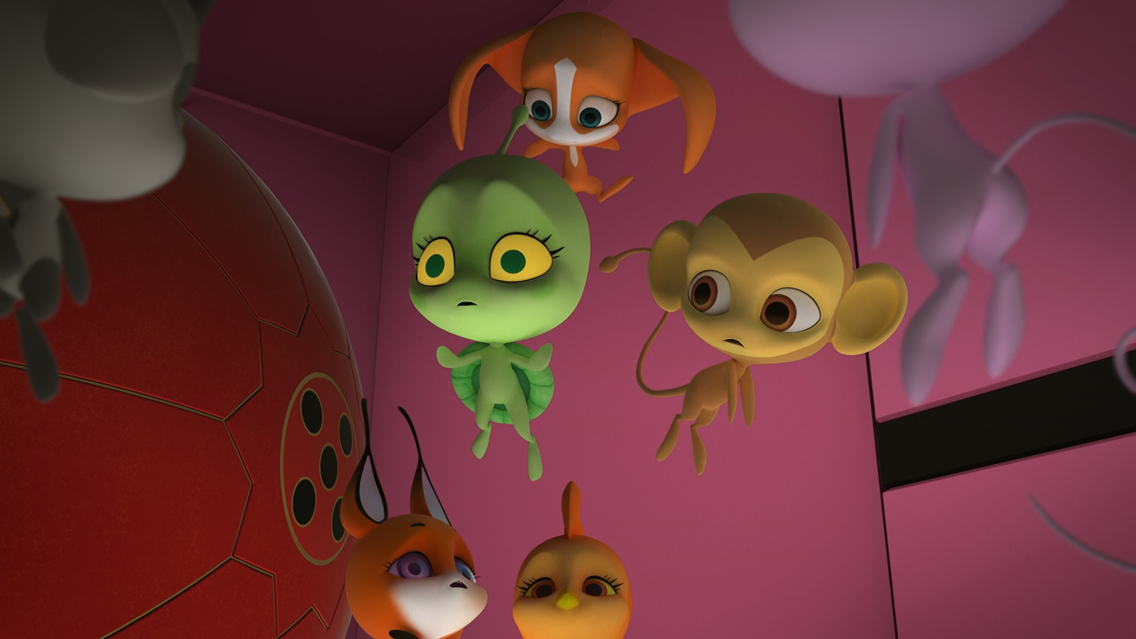
Remember when Plagg sunk ______?
Paris
Atlantis
Dalian

Slide 12
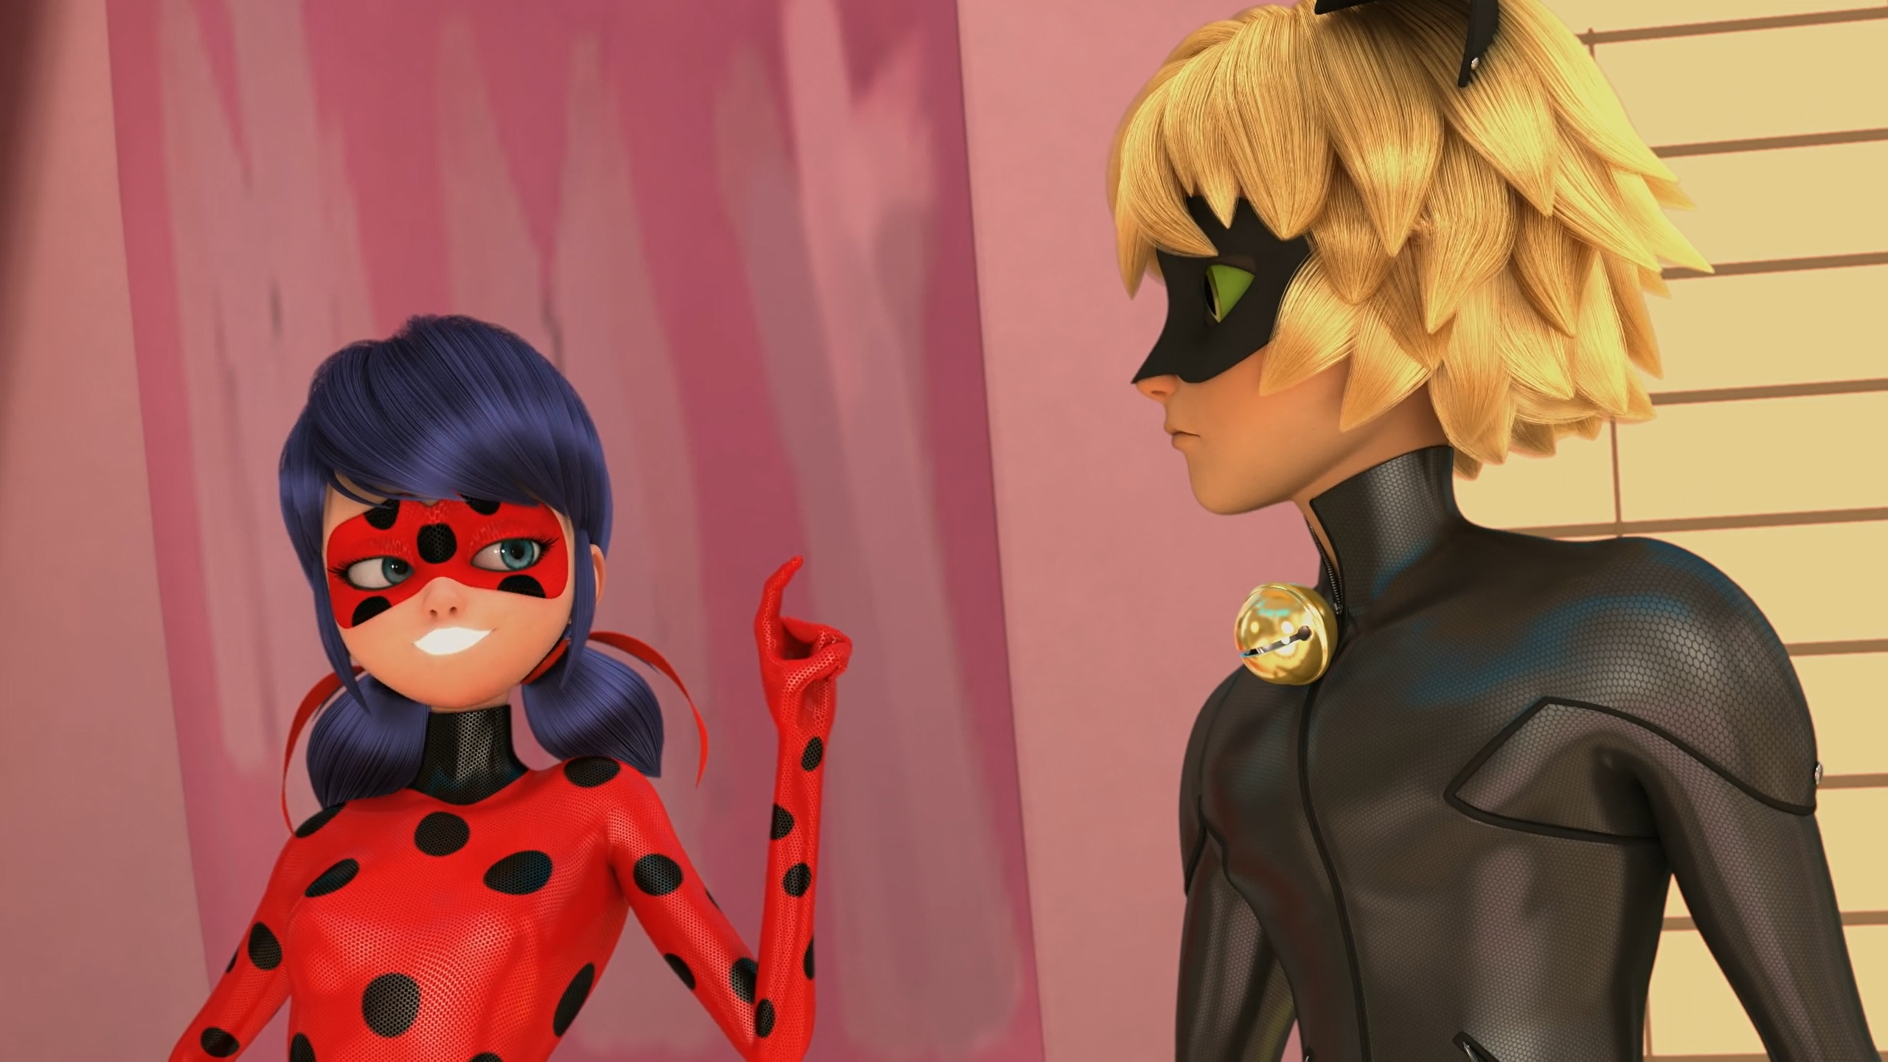
The quality I like most in Cat Noir is his ______.
wisdom
cataclysm
humour

Slide 13
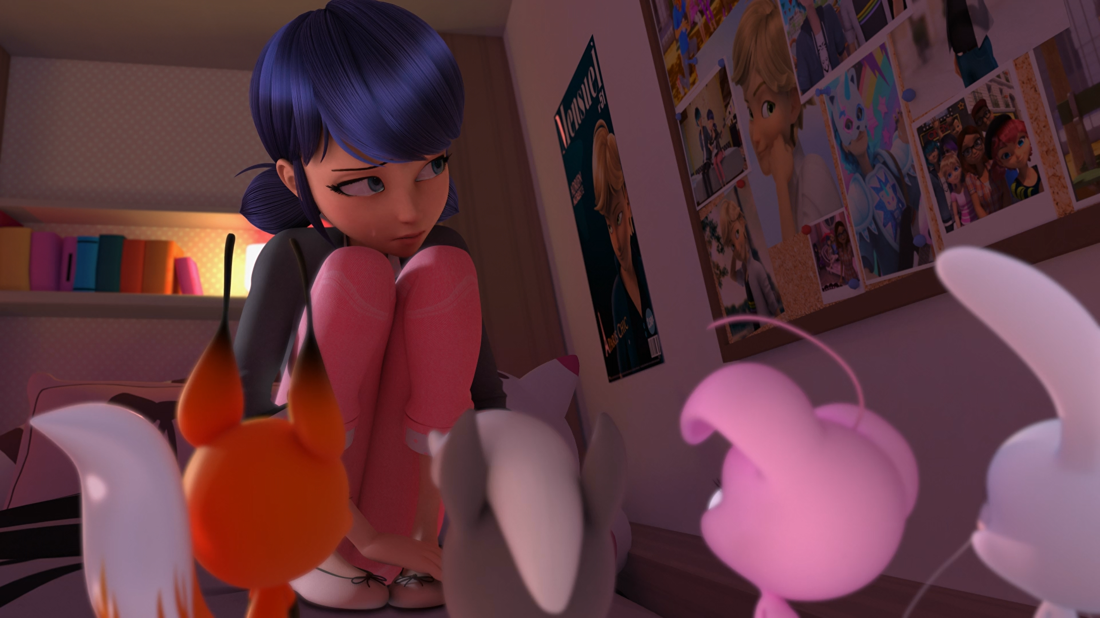
Shadow Moth is a ______ to the people I love.
threat
danger
risk

Slide 14

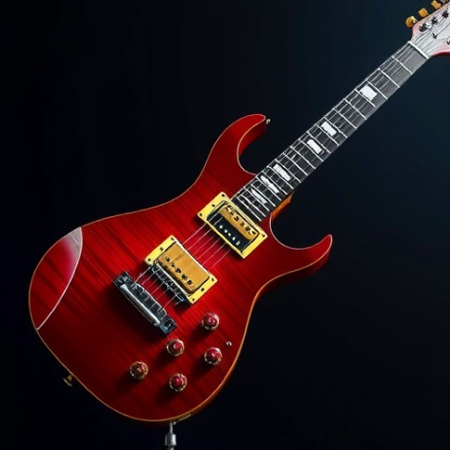
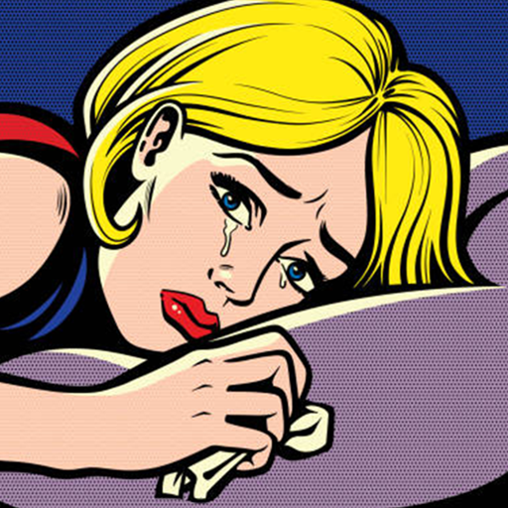
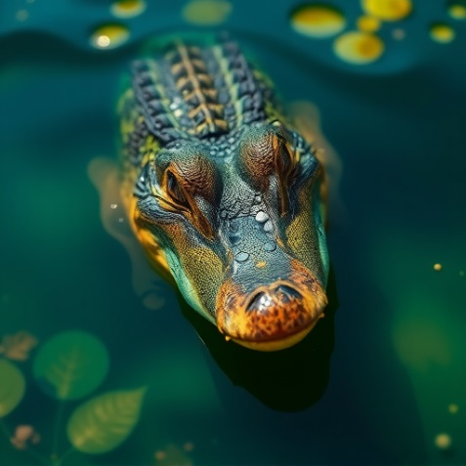
Matching Exercise
crocodile | tears | pirate | guitar

Slide 15
Matching Exercise
pirate | guitar | tears | crocodile

Slide 16
TRUE OR FALSE
1. Rose says Marinette is the most honest girl in the world.
2. Luka's mother is Jagged Stone.
3. Jagged Stone lives in hotels with his crocodile.
4. Marinette likes Cat Noir's charm.
5. Marinette cannot have a boyfriend.

Slide 17
TRUE OR FALSE
1. Rose says Marinette is the most honest girl in the world. | TRUE
2. Luka's mother is Jagged Stone. | FALSE
3. Jagged Stone lives in hotels with his crocodile. | TRUE
4. Marinette likes Cat Noir's charm. | FALSE
5. Marinette cannot have a boyfriend. | TRUE

