Slide 1
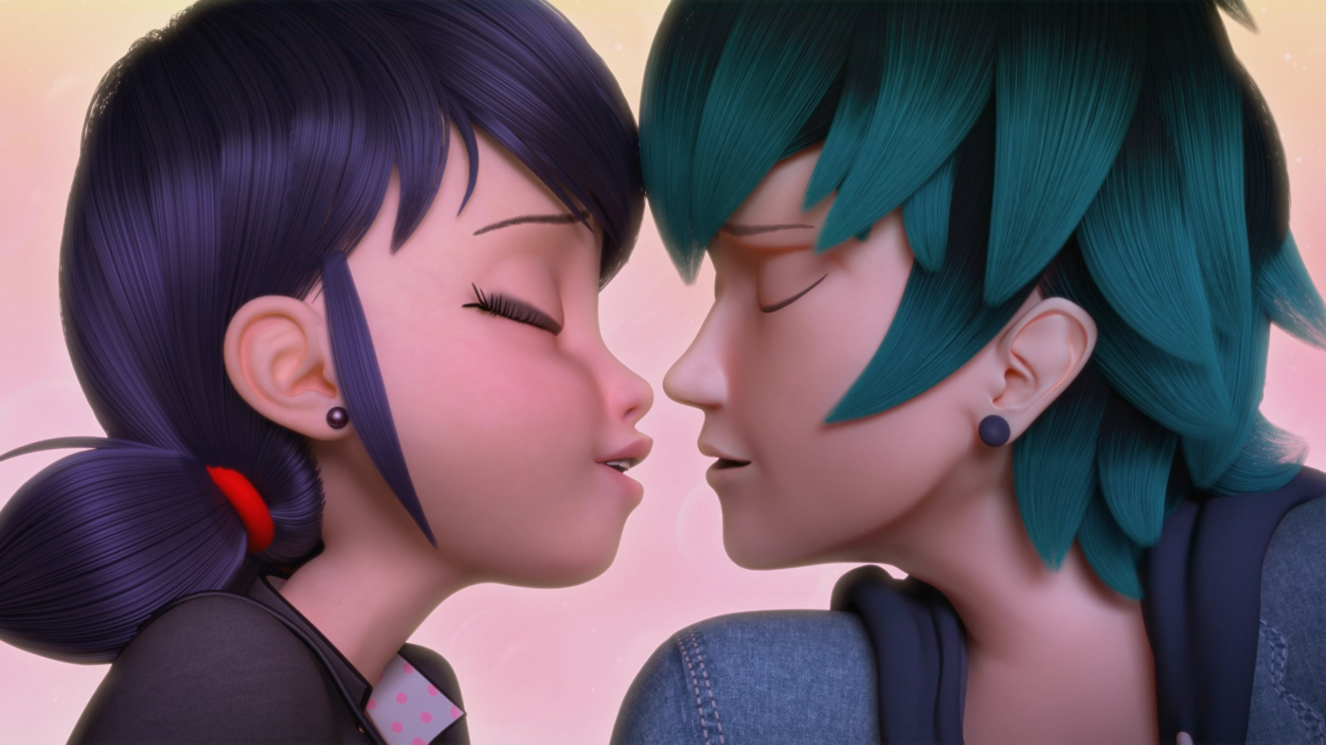
MIRACULOUS LADYBUG: TRUTH. PART 1

Slide 2
VOCABULARY
busted - 破损 - bʌstɪd
chaotic - 混乱 - keɪˈɒtɪk
meteorite - 陨石 - miːtiəraɪt
molten - 熔化的 - məʊltᵊn
napkins - 餐巾纸 - næpkɪnz
parallel world - 平行世界 - pærəlɛl wɜːld
thirsty - 口渴 - θɜːsti
unify - 统一 - juːnɪfaɪ
weird - 奇怪 - wɪəd

Slide 3
1. keɪˈɒtɪk
2. 餐巾纸
3. 口渴

Slide 4
1. keɪˈɒtɪk - chaotic
2. 餐巾纸 - napkins
3. 口渴 - thirsty

Slide 5
TRUTH. PART 1
Luka: So you ready?
Marinette: Ready for what?
Luka: Well... our date.
Sabine: Marinette, Luka is waiting for you!
Marinette: Right! Haha okay. I'll be right there! And remember, be good. Hide, Tikki. Sabine: Wasn't your date with Luka supposed to be yesterday?

Slide 6
Marinette: Is it "you are the popcorn of my life"?
Luka: Nope. It was "the donut of my life".
Marinette: Of course! "The donut", featured on the "Candy Apple" album! His food phase, my favorite! Two points for you.
Luka: I got another one: "I gave up everything..."
Marinette: "... but my dreams!"

Slide 7
Marinette: I'm sorry about earlier. There were mosquitoes on the boat, I thought we needed some insect repellent but the drug store was closed so I had to.
Luka: Shh, listen, the song of the water. If you listen carefully at this very spot under the bridge, you'll hear a melody. You know,
I never knew my father and my mom would never bring herself to tell me.

Slide 8
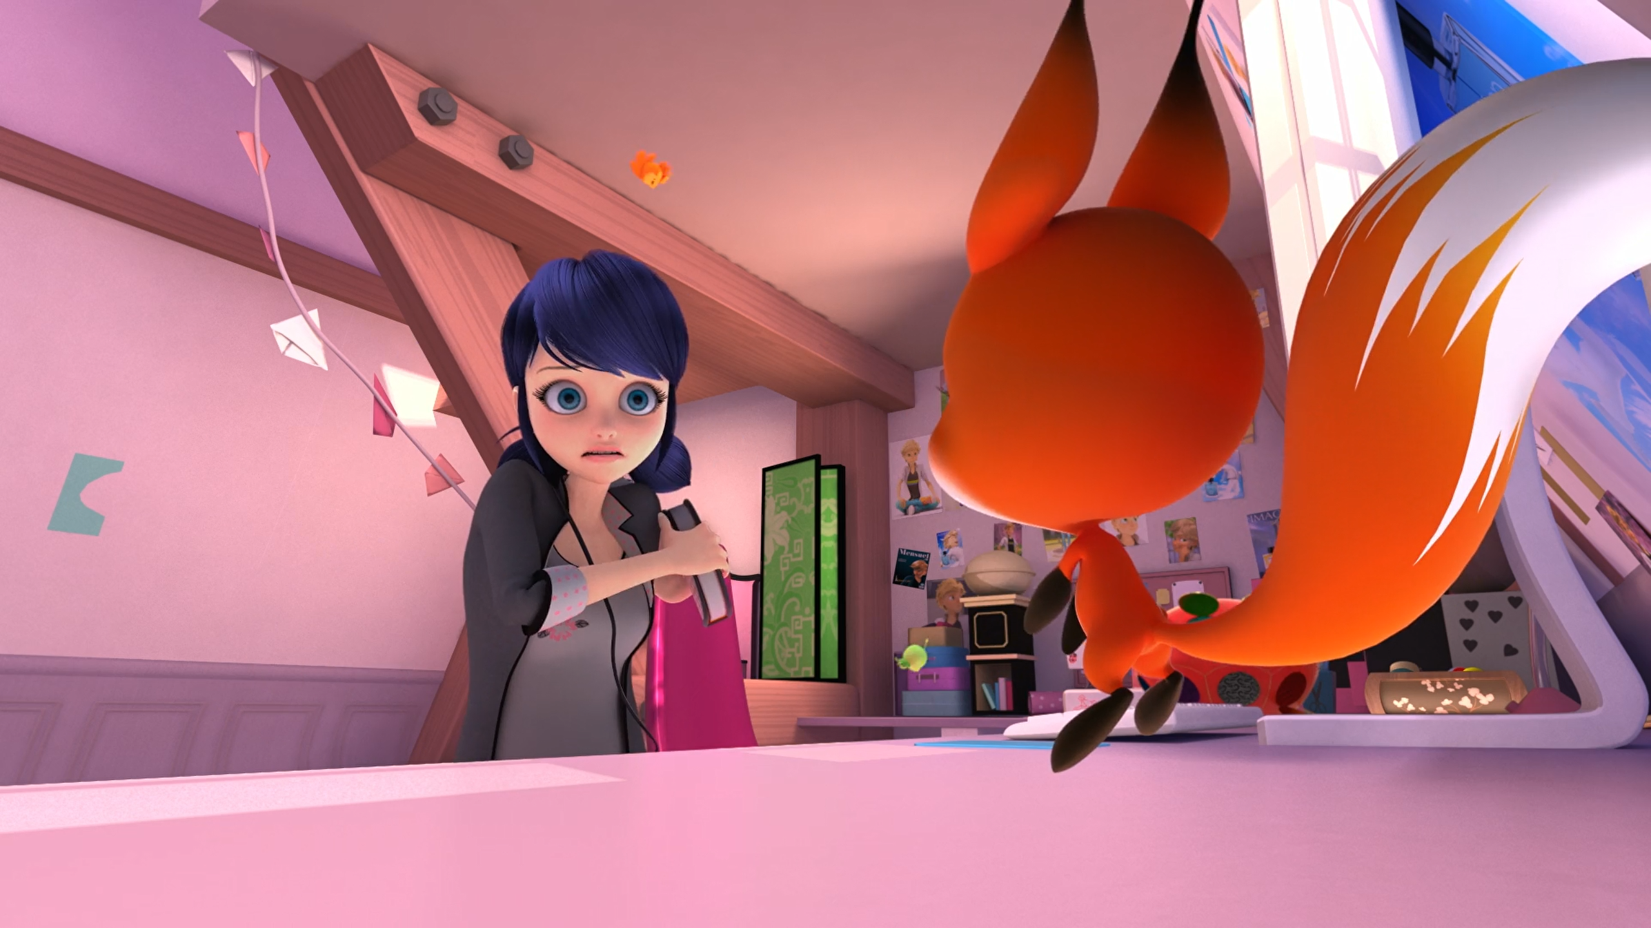

That's my secret ______!
journal
notebook
diary

Slide 9
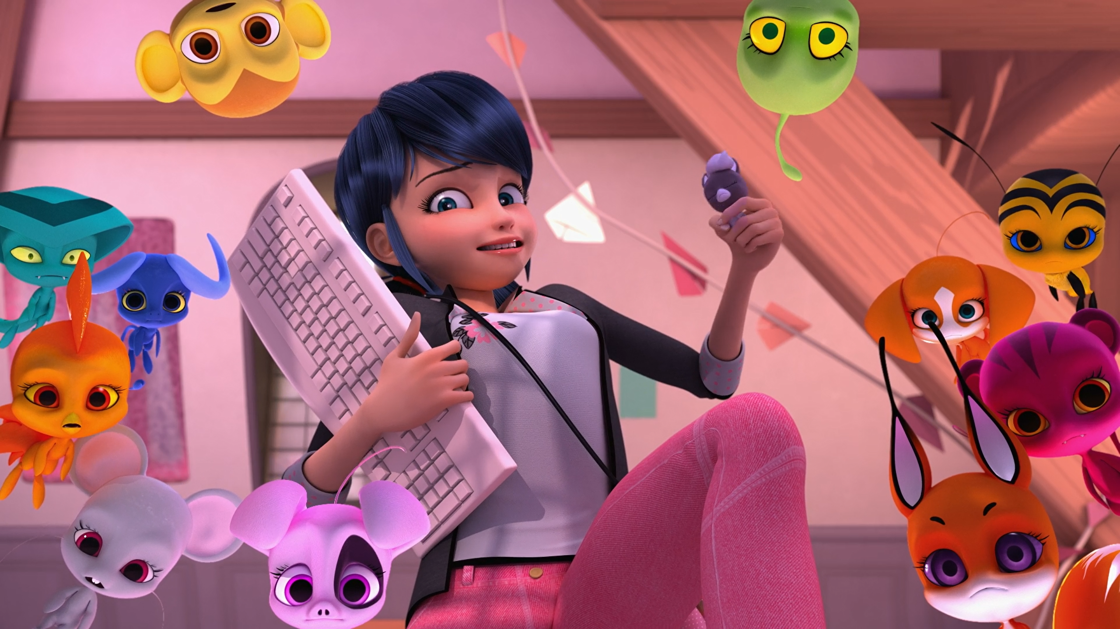
Oh, Alya! What do you think of my new ______? Pretty cute, right?
squishies
kwamis
toys

Slide 10
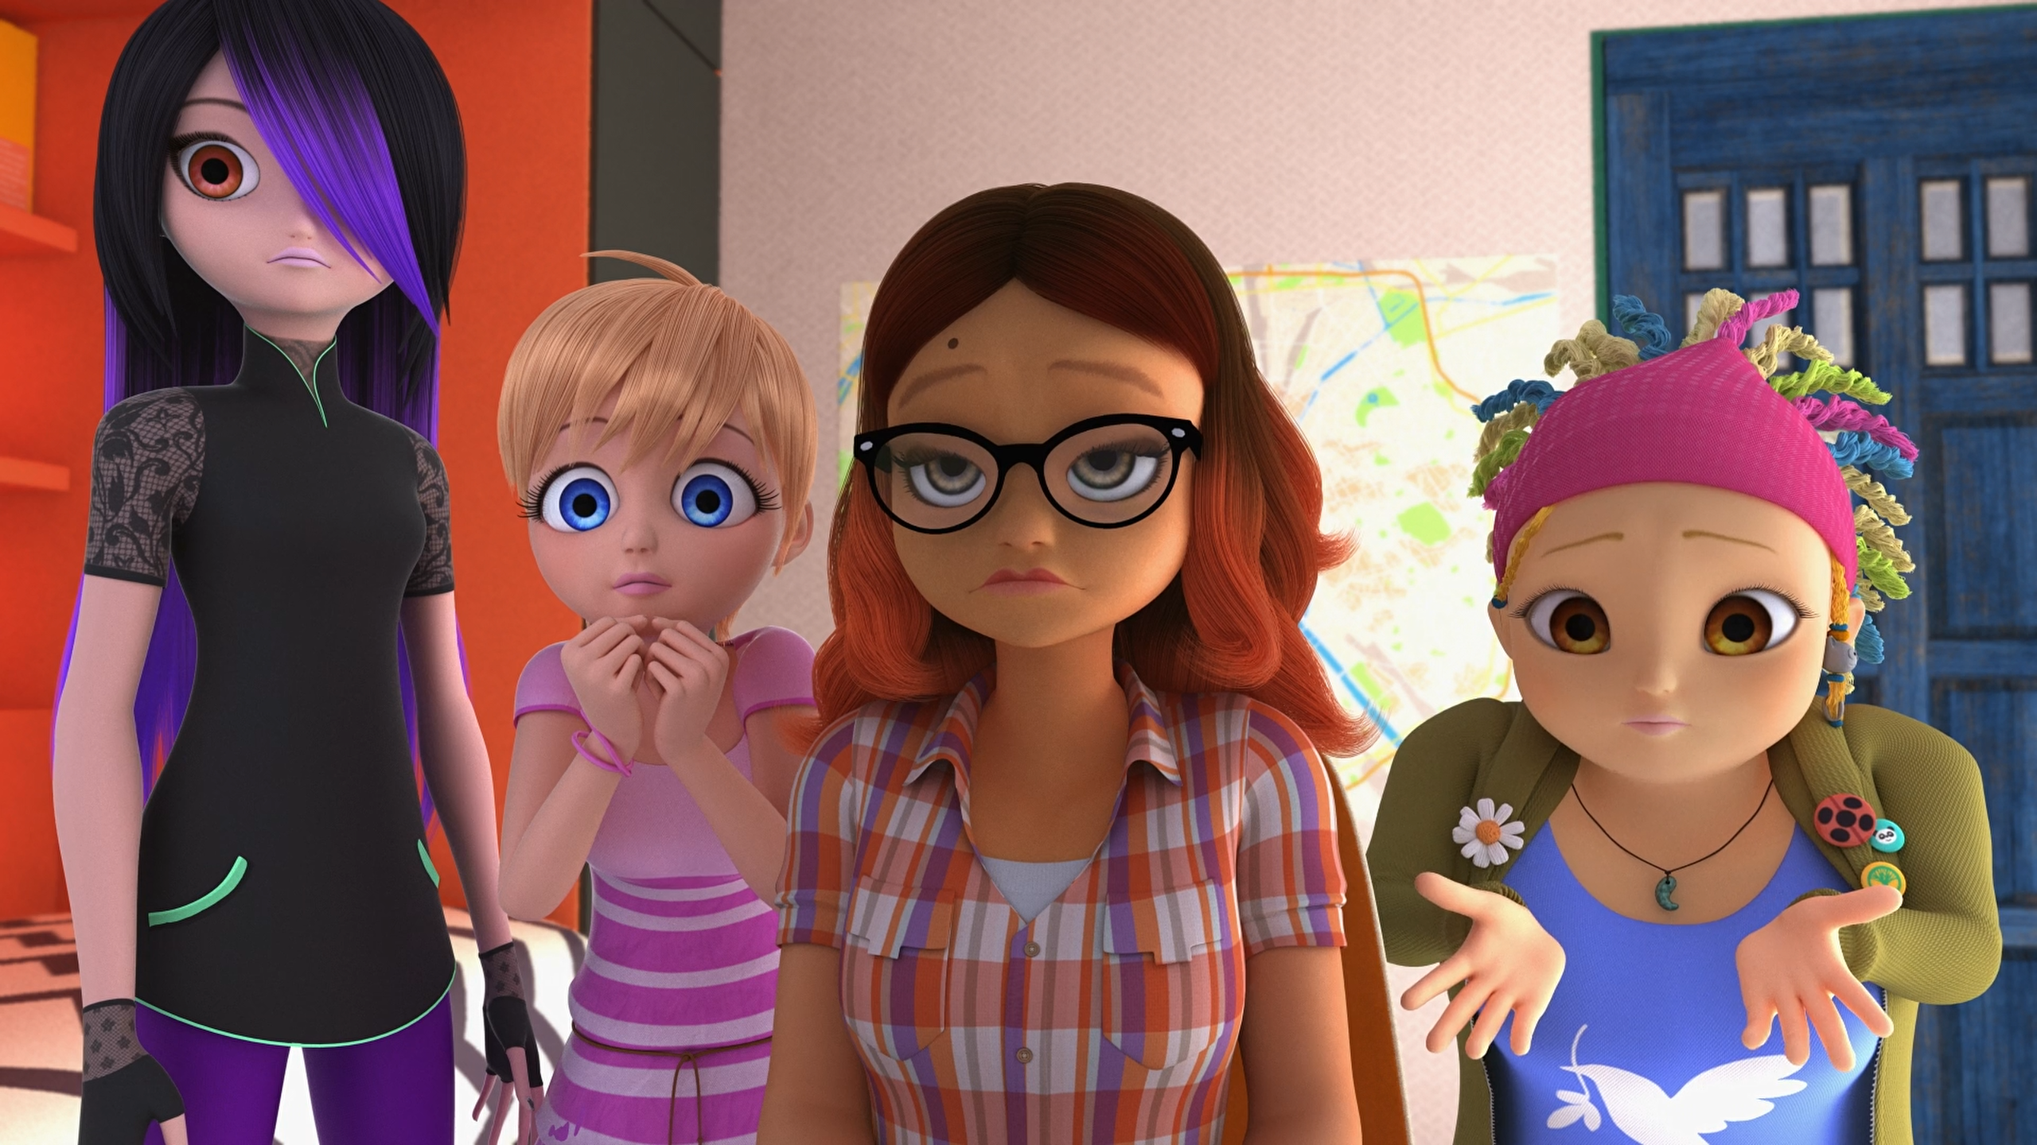
You should get some ______, you look overwhelmed.
coffee
fresh air
medicine

Slide 11
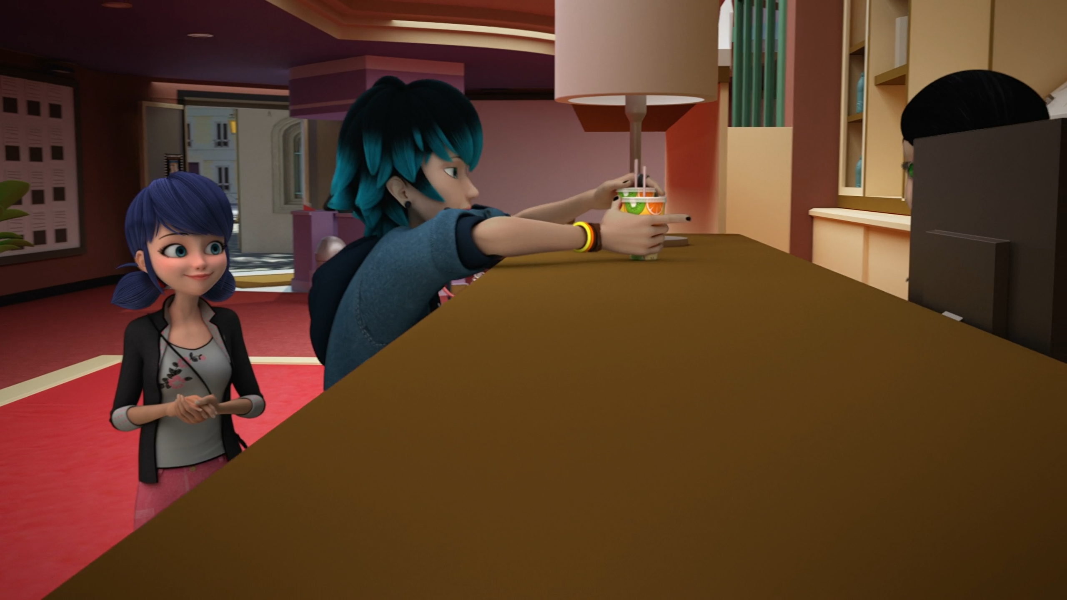
Two ______ please. Thank you.
cokes
orange juices
milkshakes

Slide 12
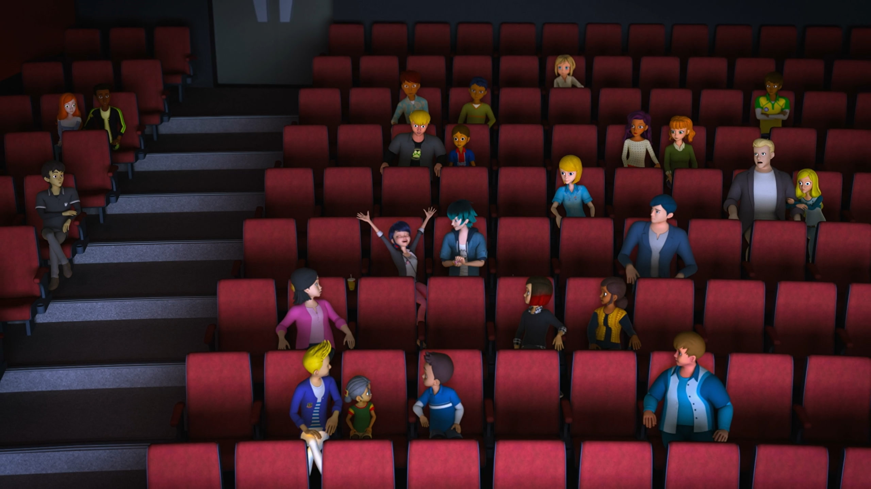
Under the ______, by the sea, kiss me!
stars
bridge
moonlight

Slide 13
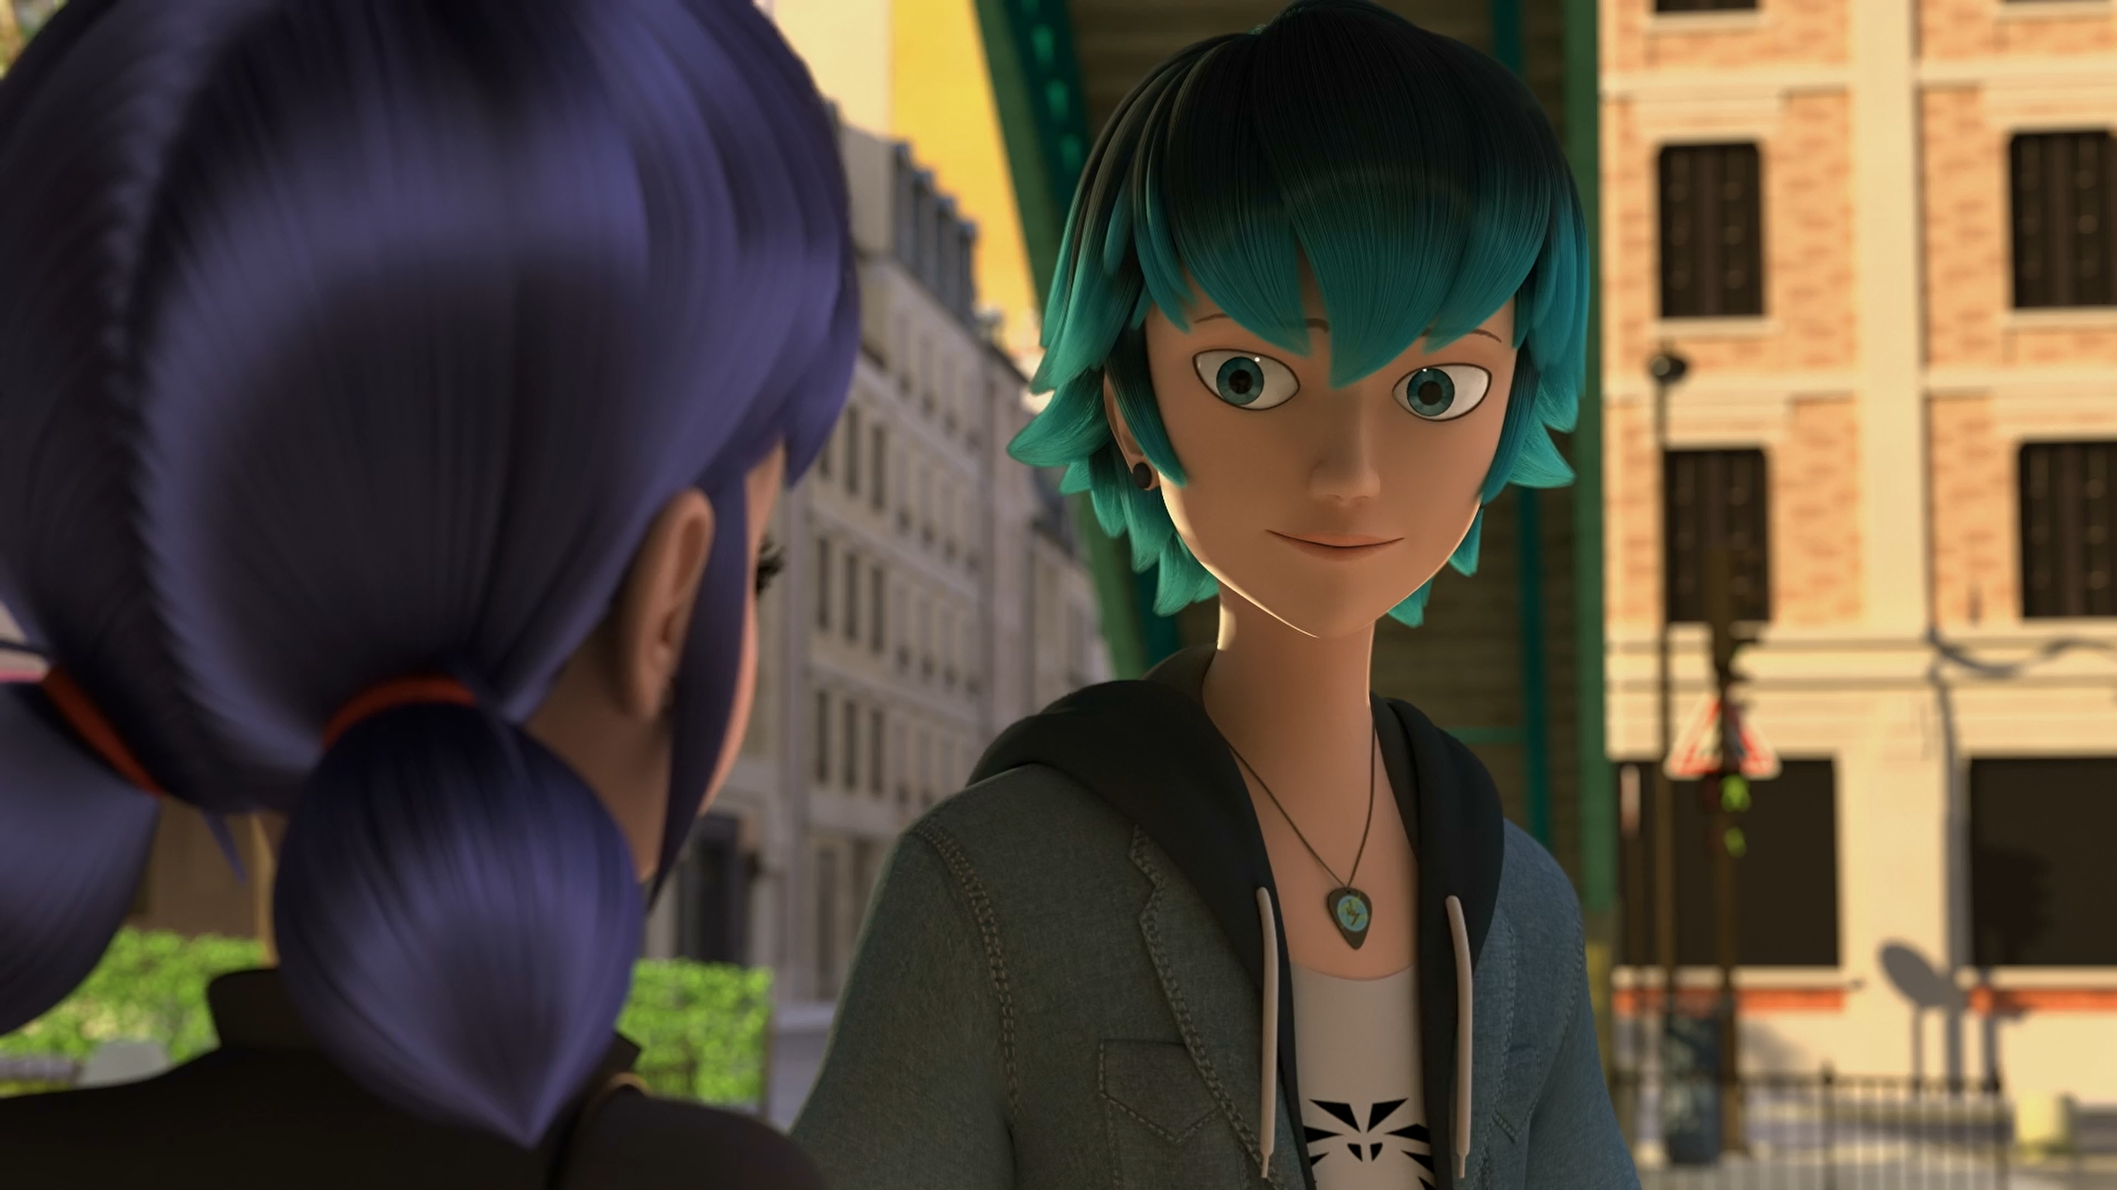
What about you, Marinette? Where do you go when you ______?
disappear
cat
kitten

Slide 14
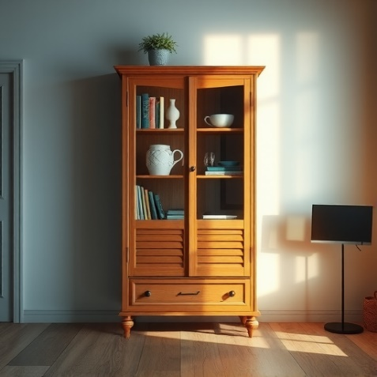
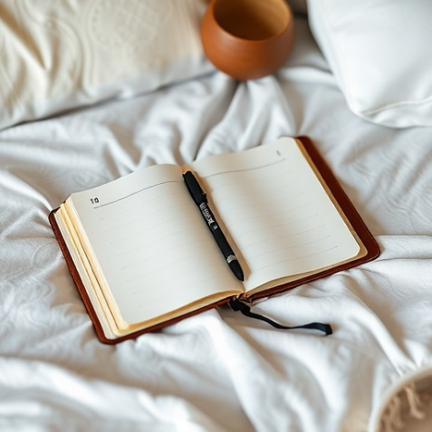
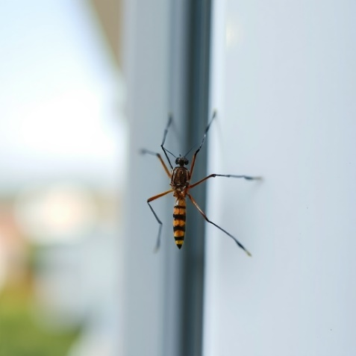
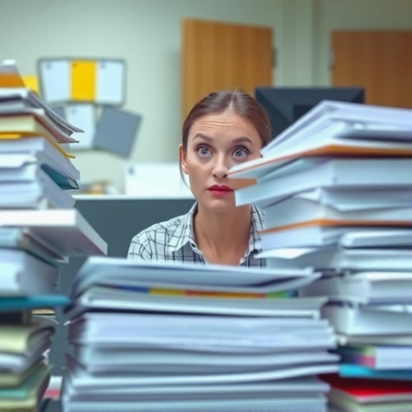
Matching Exercise
overwhelm | cabinet | diary | mosquito

Slide 15
Matching Exercise
cabinet | diary | mosquito | overwhelm

Slide 16
TRUE OR FALSE
1. Kwami's must have a holder to go out in the human world.
2. Kwami's cannot be recorded in photos or videos.
3. Marinette had a date with Adrien yesterday.
4. Luka buys two milkshakes.
5. Marinette gives Luka a gift.

Slide 17
TRUE OR FALSE
1. Kwami's must have a holder to go out in the human world. | TRUE
2. Kwami's cannot be recorded in photos or videos. | TRUE
3. Marinette had a date with Adrien yesterday. | FALSE
4. Luka buys two milkshakes. | FALSE
5. Marinette gives Luka a gift. | TRUE

