Slide 1
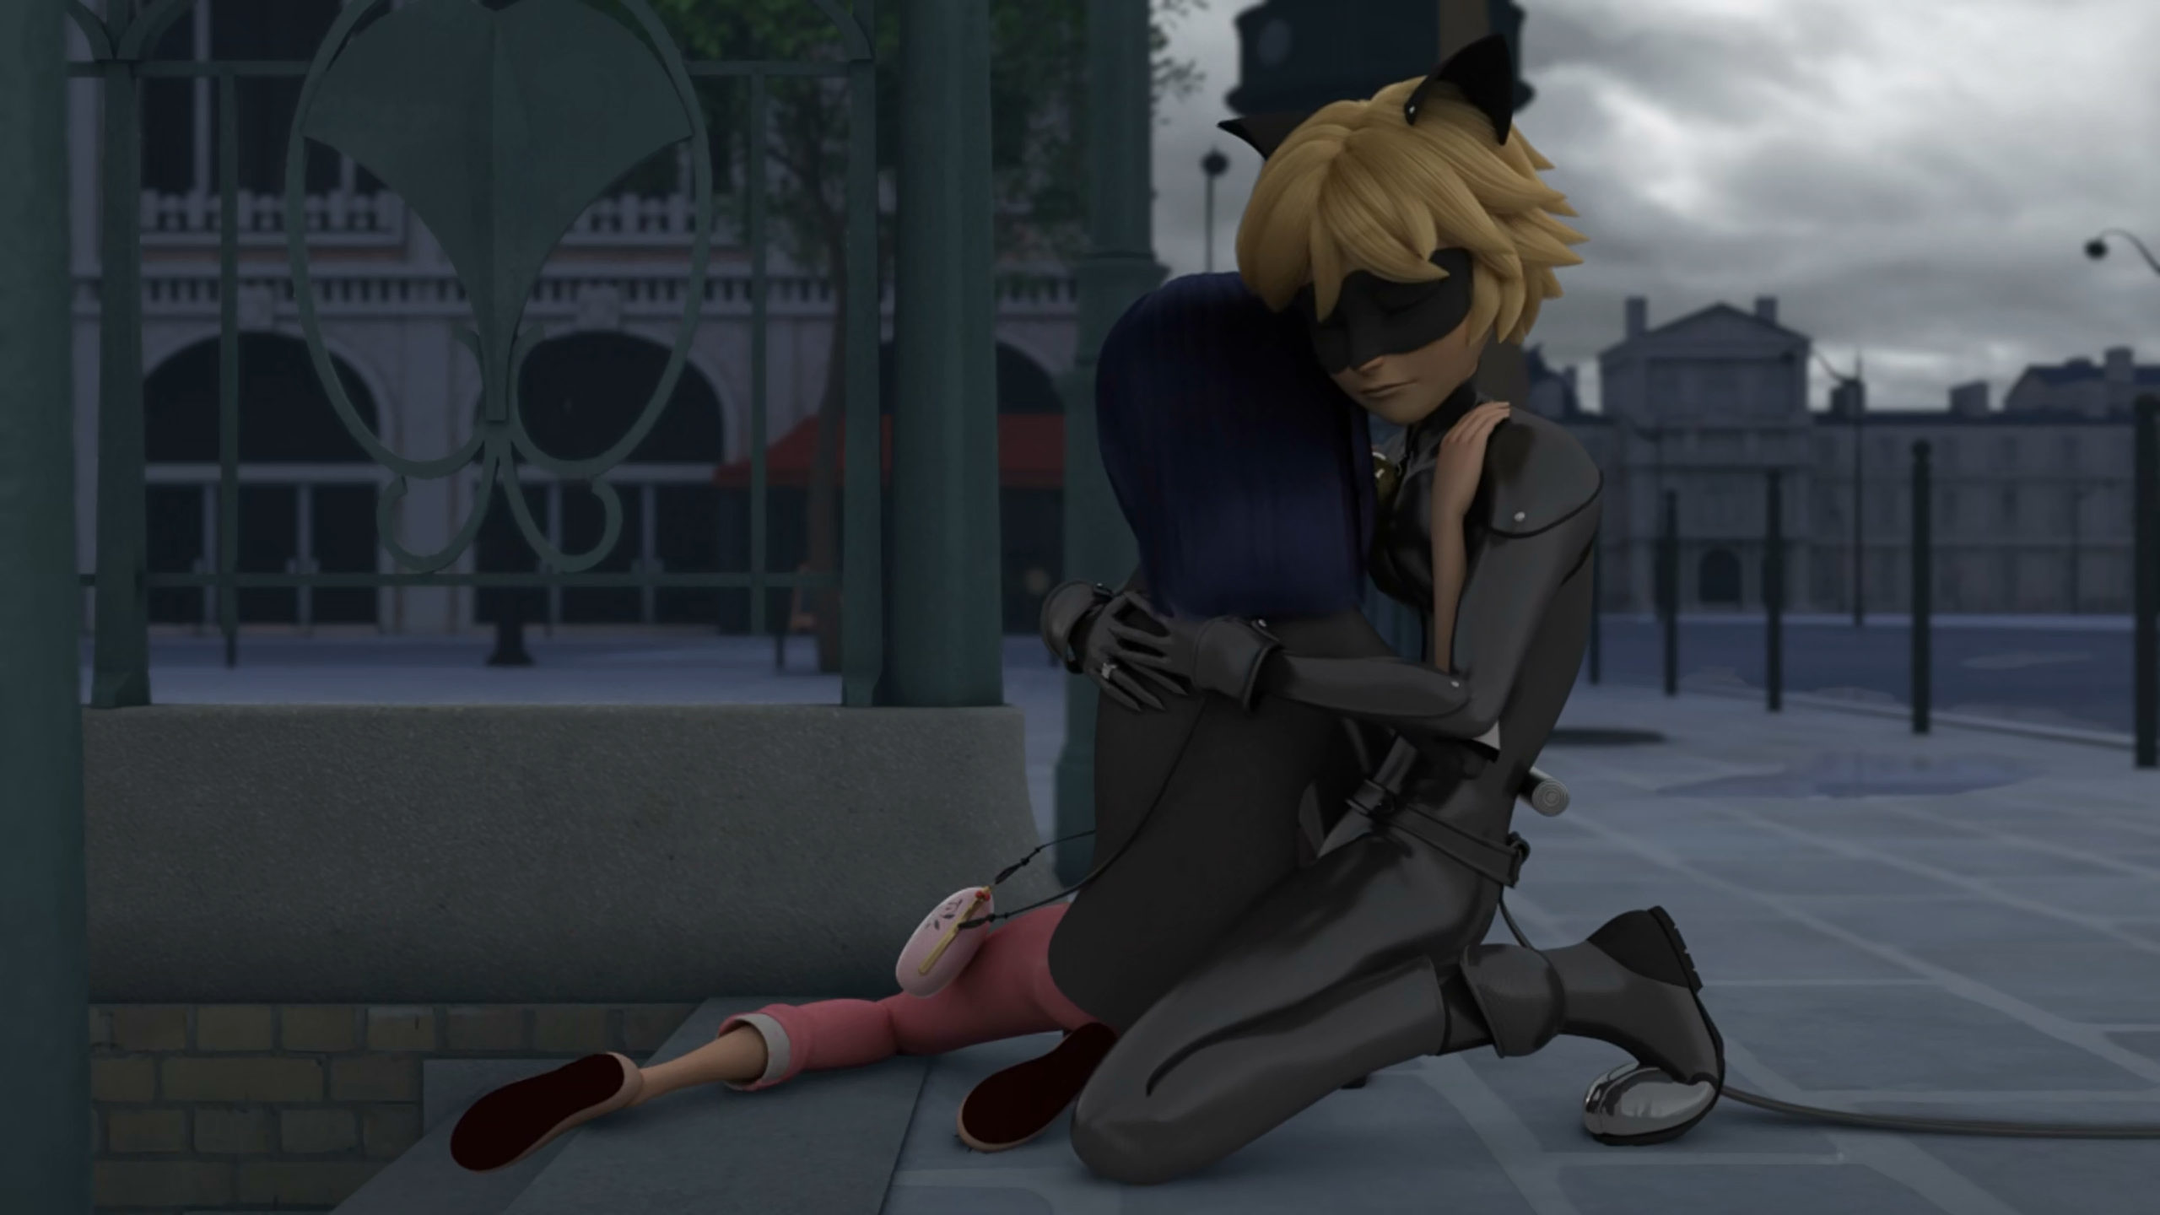
MIRACULOUS LADYBUG: CAT BLANC. PART 2

Slide 2
VOCABULARY
exchange - 交换 - ɪksˈʧeɪnʤ
infinite - 无限 - ɪnfɪnət
masterpiece - 杰作 - mɑːstəpiːs
merge - 合并 - mɜːʤ
obey - 服从 - əʊˈbeɪ
resist - 抵抗 - rɪˈzɪst
strike - 打击 - straɪk
trigger - 触发 - trɪɡə
utter - 说出 - ʌtə

Slide 3
1. 交换
2. 服从
3. trɪɡə

Slide 4
1. 交换 - exchange
2. 服从 - obey
3. trɪɡə - trigger

Slide 5
CAT BLANC. PART 2
Marinette: I thought our identities were supposed to remain a secret!
Cat Noir: Everything will be okay, I promise.
Hawk Moth: Nathalie? Nathalie!
Nathalie: It's Adrien. Your son... he's... he's Cat Noir.
Hawk Moth: Cat Noir, my own son? The Miraculous will soon be mine!!

Slide 6
Hawk Moth: We can save your mother using your Miraculous and hers!!
Cat Noir: No! Just stop!
Ladybug: Don't listen to him! You know there'd be a terrible price to pay in exchange!
Hawk Moth: If she really loved you, she'd let you save your mother!!!
Cat Noir: Stop it! Stop it! Stop it!

Slide 7
Cat Noir: Marinette, what happened?
What's wrong?
Ladybug: You're still calling me Marinette. You're not supposed to know who I am. It means that if I use my Miraculous Ladybug
to fix everything now...
Bunnyx: You'll still have this memory of her.
Ladybug: Of course! I'm gonna fix everything, Cat Noir, I promise!

Slide 8
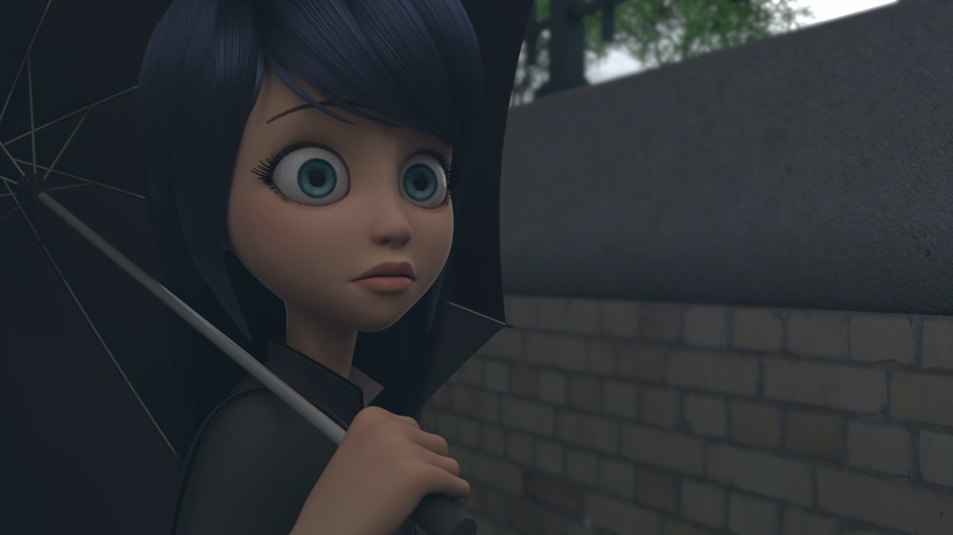

I thought our ______ were supposed to remain a secret!
names
powers
identities

Slide 9
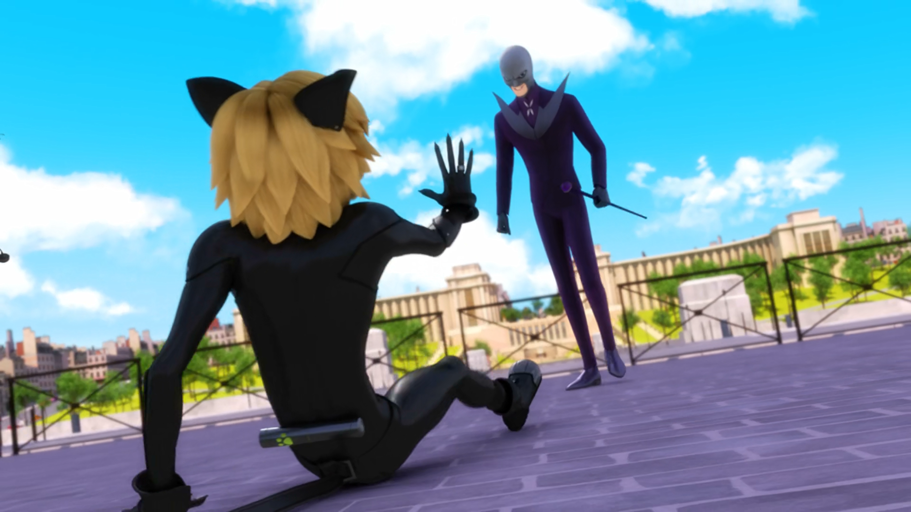

We can save your ______ using your Miraculous and hers!
mother
grandma
mum

Slide 10
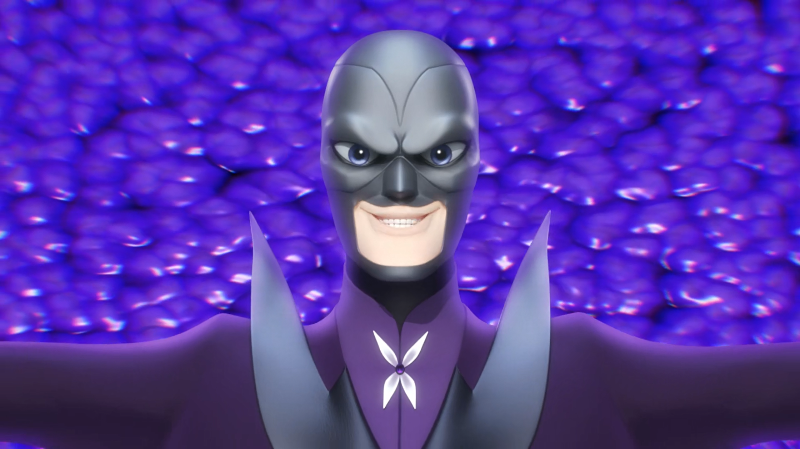
Cat ______, I'm giving you the infinite power of destruction!
Black
Blanc
Back

Slide 11
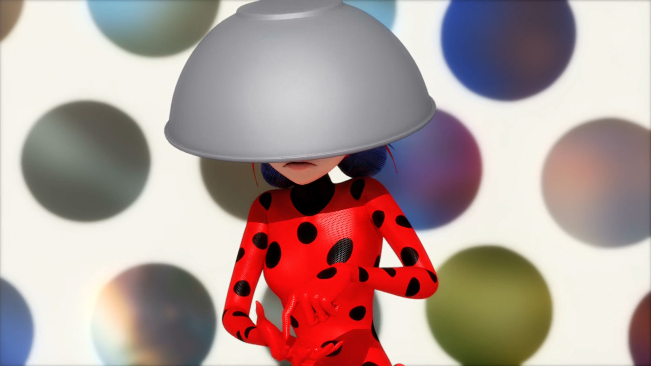
I must not throw my ______ here and now.
rubber
eraser
lucky charm

Slide 12
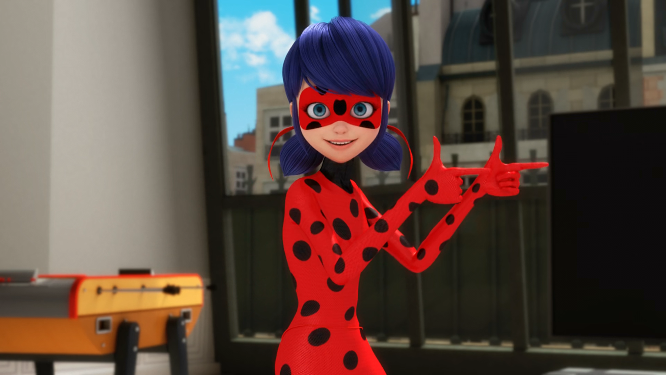
I brought you a gift from your fan club in ______!
DLU
Paris
Brazil

Slide 13
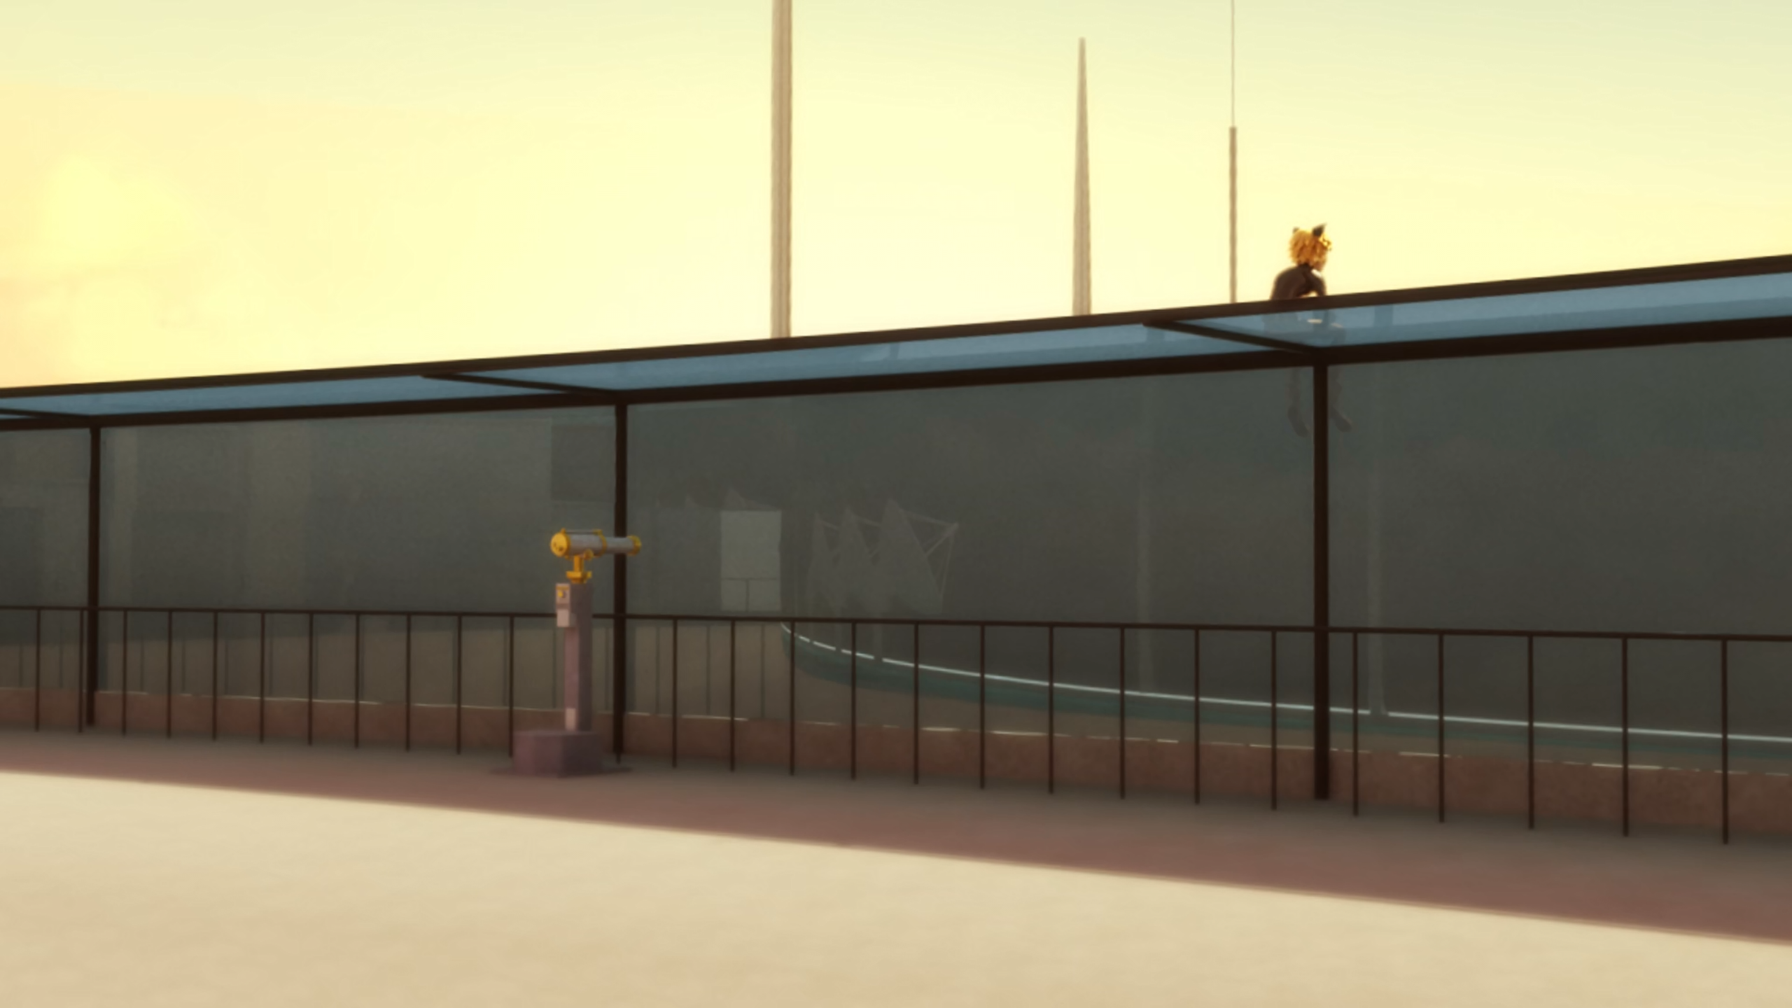
Little ______ on a roof, all alone without his lady...
kitty
cat
kitten

Slide 14


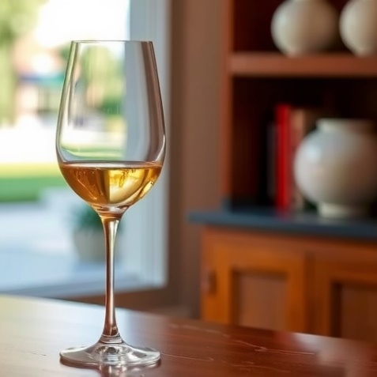
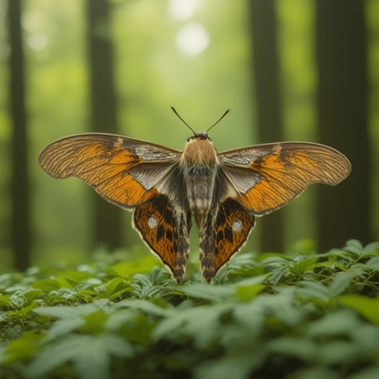
Matching Exercise
fragile | despair | moth | eraser

Slide 15
Matching Exercise
despair | eraser | fragile | moth

Slide 16
TRUE OR FALSE
1. Nathalie knows Adrien is Cat Noir.
2. Hawk Moth wants to save his wife.
3. Marinette goes back 20 minutes to fix everything.
4. Marinette tells Adrien she has a gift from his Chinese fan club.
5. The gift is a green beret.

Slide 17
TRUE OR FALSE
1. Nathalie knows Adrien is Cat Noir. | TRUE
2. Hawk Moth wants to save his wife. | TRUE
3. Marinette goes back 20 minutes to fix everything. | FALSE
4. Marinette tells Adrien she has a gift from his Chinese fan club. | FALSE
5. The gift is a green beret. | FALSE

