Slide 1
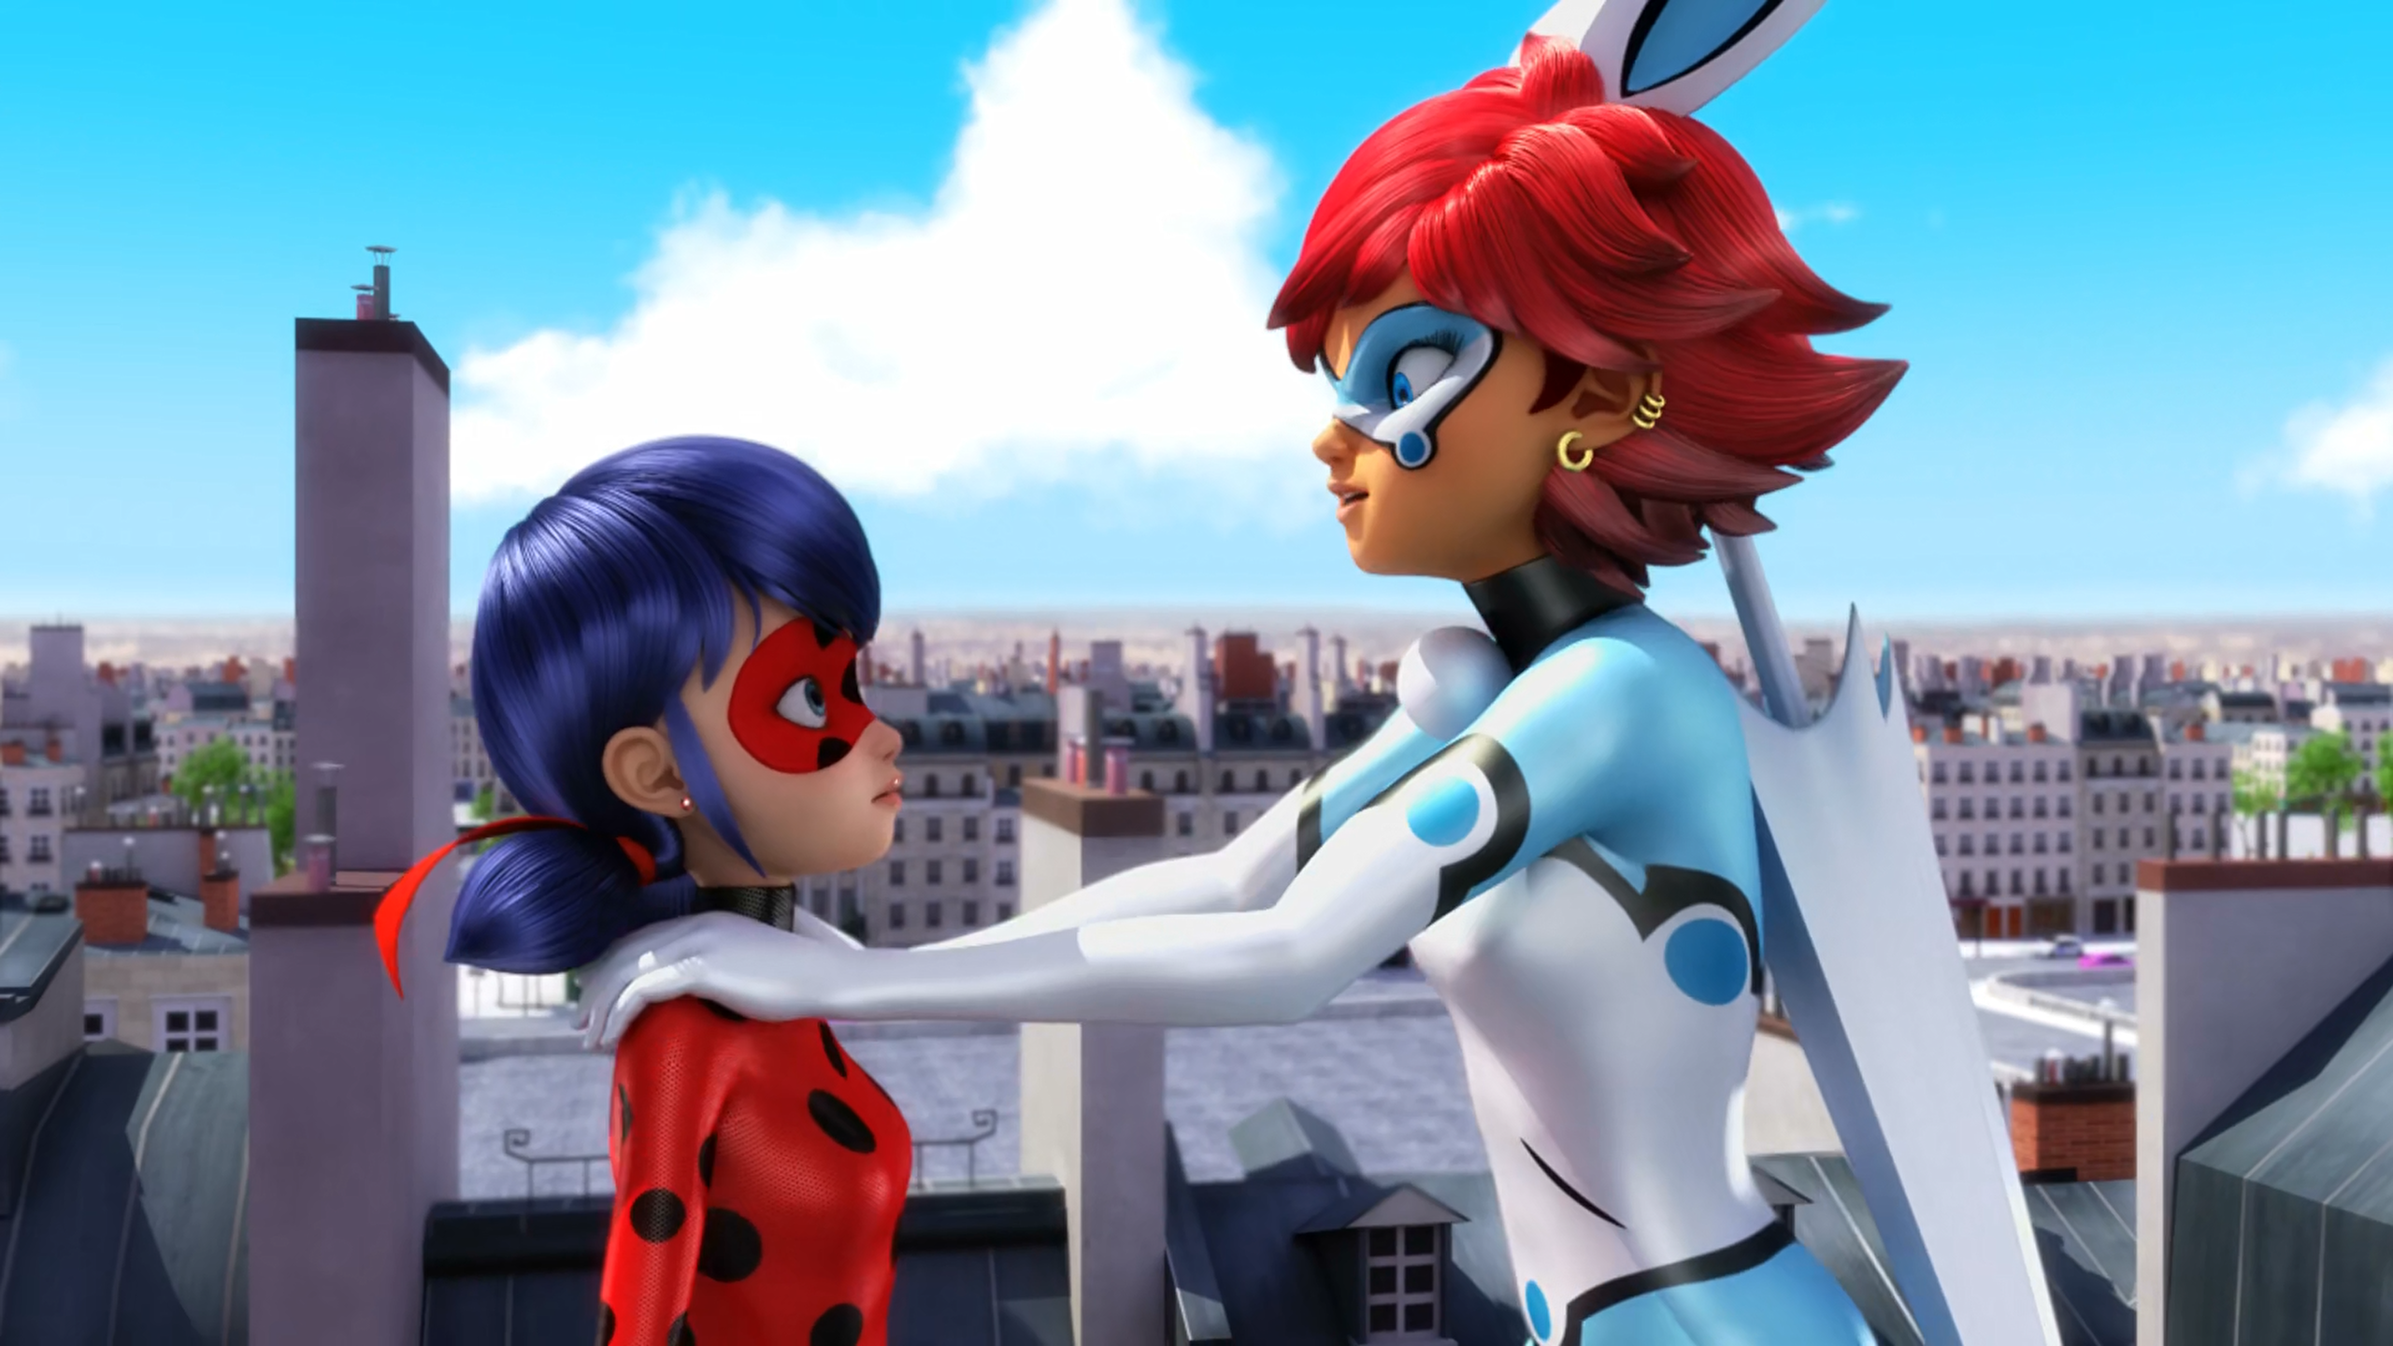
MIRACULOUS LADYBUG: CAT BLANC. PART 1

Slide 2
VOCABULARY
ceremony - 典礼 - sɛrɪməni
event - 活动 - ɪˈvɛnt
interfere - 干扰 - ɪntəˈfɪə
personal - 个人 - pɜːsᵊnᵊl
plush toy - 毛绒玩具 - plʌʃ tɔɪ
rotten - 烂 - rɒtᵊn
skates - 溜冰鞋 - skeɪts
sleepover - 过夜 - sliːpəʊvə
unusual - 不寻常 - ʌnˈjuːʒuəl

Slide 3
1. plʌʃ tɔɪ
2. 溜冰鞋
3. 过夜

Slide 4
1. plʌʃ tɔɪ - plush toy
2. 溜冰鞋 - skates
3. 过夜 - sleepover

Slide 5
CAT BLANC. PART 1
Alya: The only way you'll know is to tell him how you really feel!
Marinette: I know, but...
Rose: That's it, Marinette! No more picnics, sleepovers, or going to the movies with us until you give him that gift! How is Adrien's supposed to know you're thinking of him if you don't give him your gift?

Slide 6
Tikki: Maybe you can give him his present tomorrow at school?
Marinette: No. You heard what Rose said. I can't back out again. Since he's not back yet,
I can go through the window!
Tikki: Oh, no no no! You know it's not a good idea to use your powers for personal reasons.
Marinette: I'll be quick, Tikki, no one will ever know!

Slide 7
Cat Blanc: Now you're breaking more than my heart, Marinette!!!
Ladybug: what?! what did you say?
Cat Blanc: Give me a hug... Marinette!!!!
Ladybug: you're wrong! I'm not Marinette! it's impossible, I never told you anything!
Adrien: Ladybug?
Bunnyx: Oh, no! what have you done, Marinette?!

Slide 8
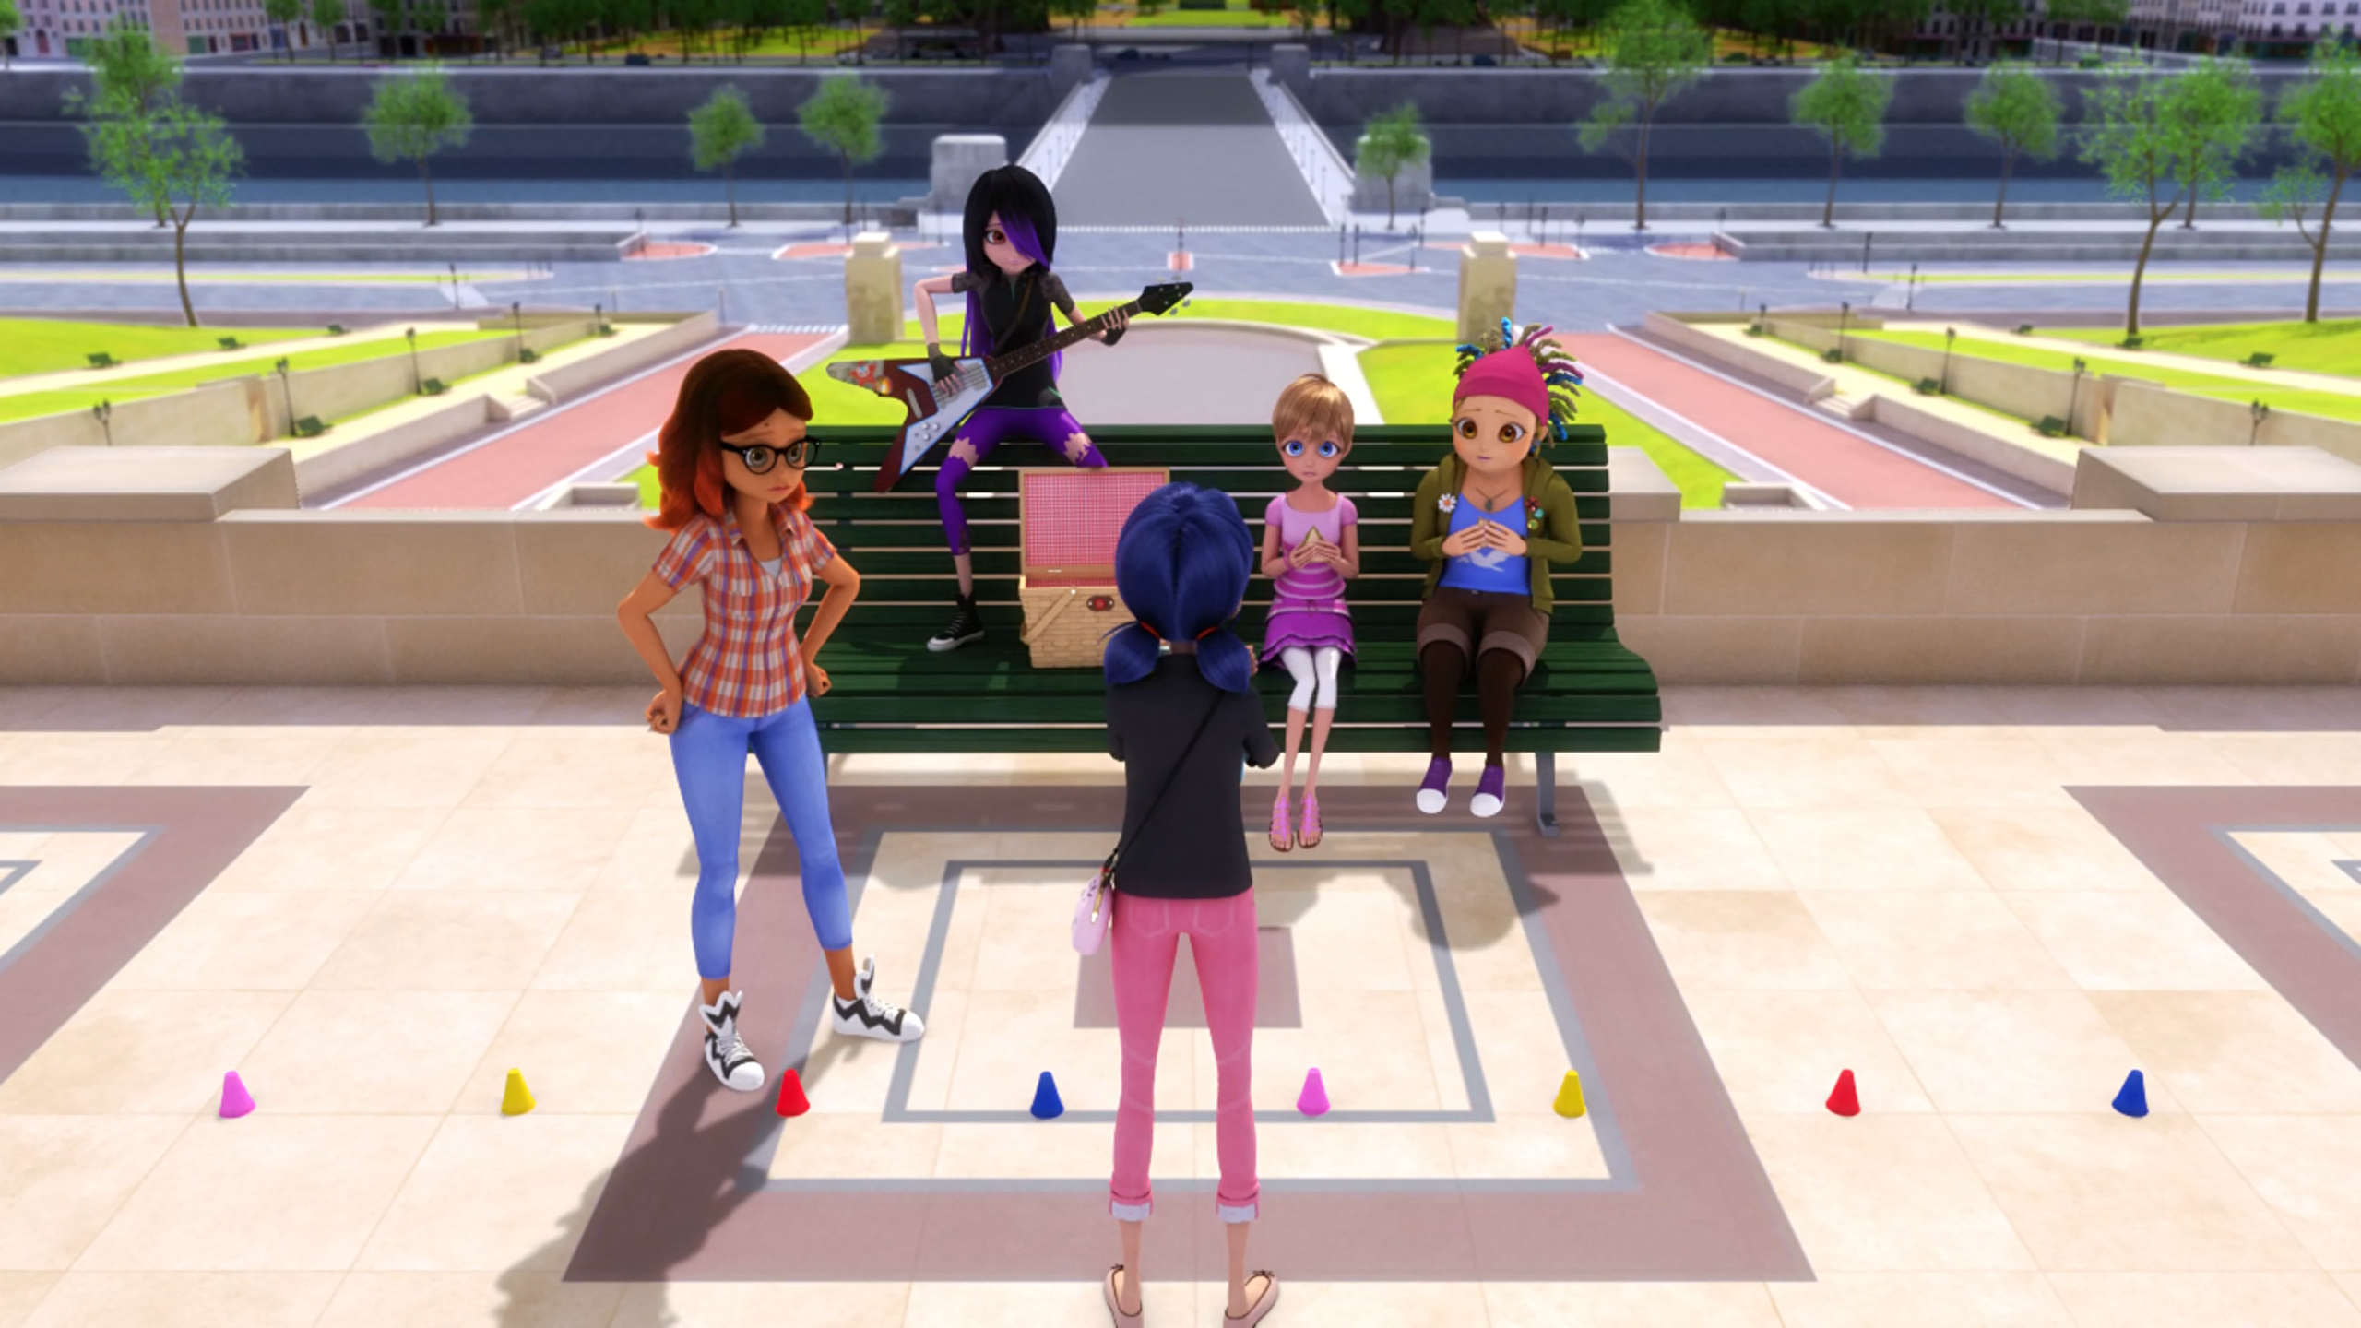

I was thinking, maybe Adrien doesn't like ______?
hats
girls
berets

Slide 9
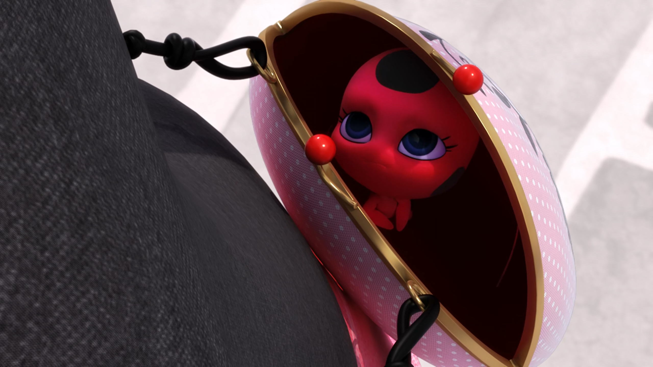
You know it's not a good idea to use your ______ for personal reasons.
powers
gifts
Miraculous

Slide 10
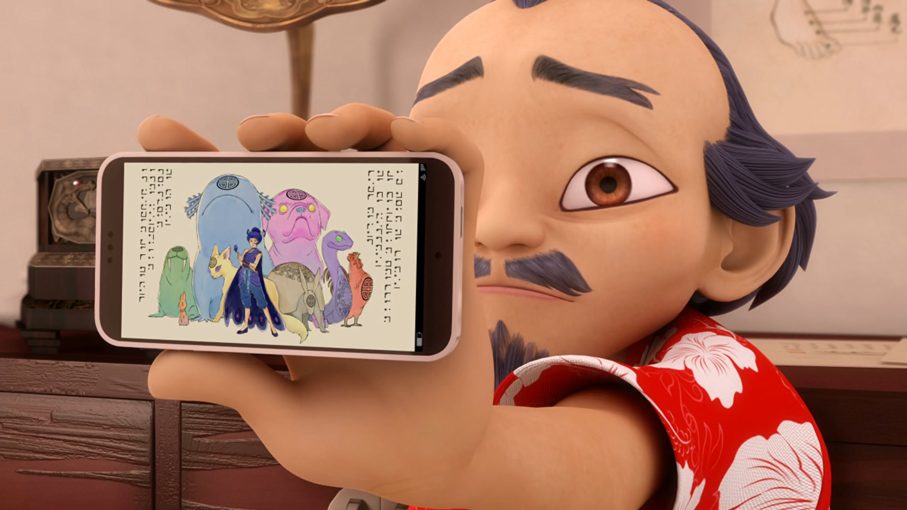
That's not a statue, Marinette. It's a ______!
centimetre
sentimonster
centipede

Slide 11
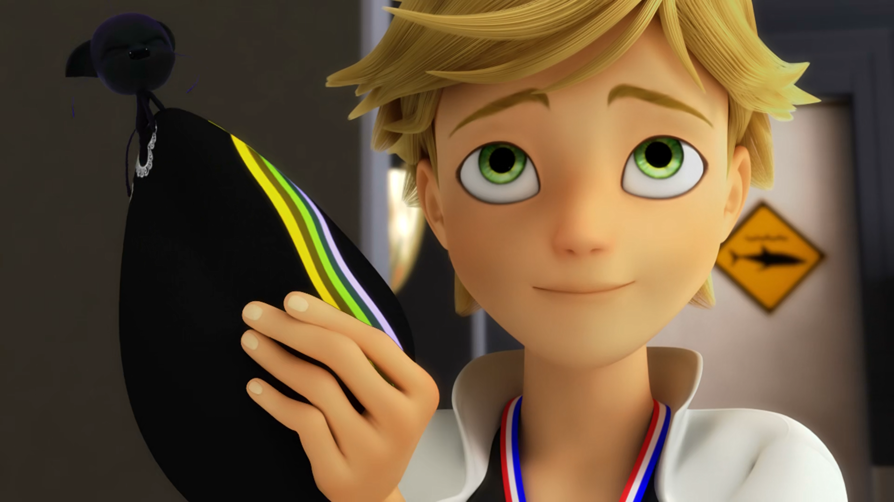
Okay Adrien, this whole thing smells like rotten ______.
socks
cheese
fruit

Slide 12
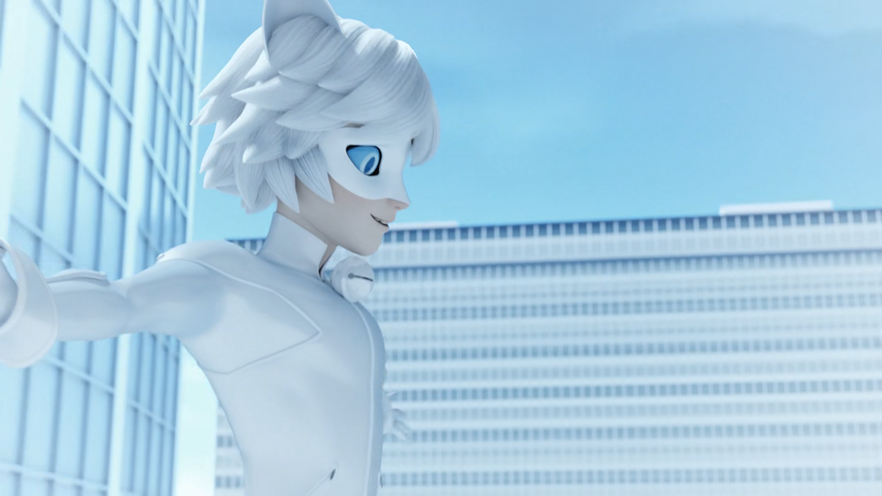
Give me a ______... Marinette!!!!
kiss
cookie
hug

Slide 13
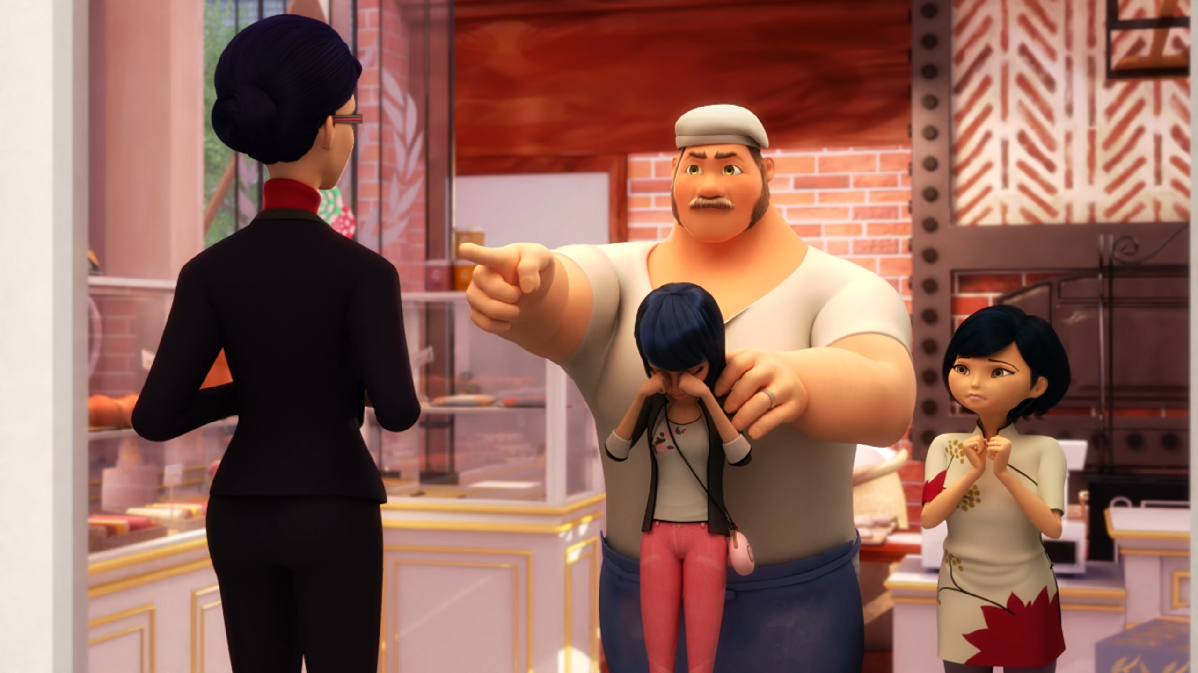
Get out of my ______, now!
bakery
house
shop

Slide 14

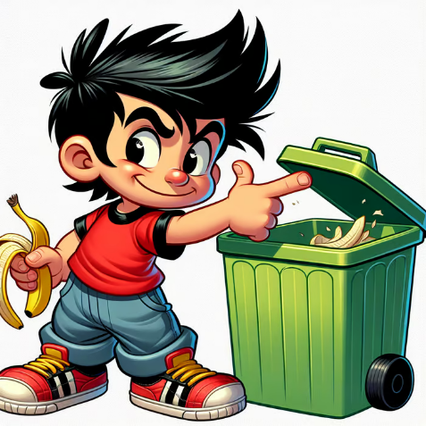
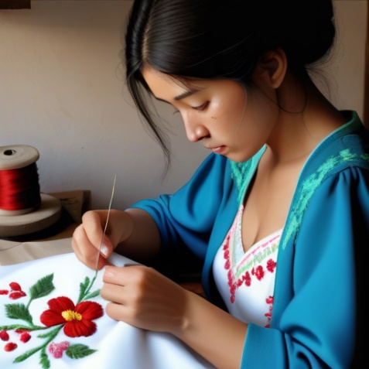
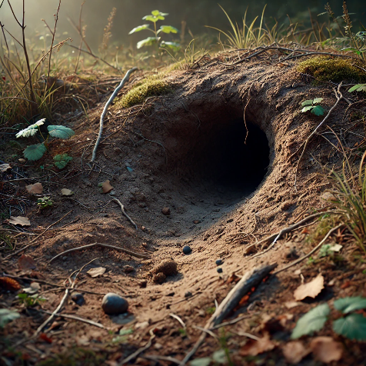
Matching Exercise
burrow | embroidery | mischief | trophy

Slide 15
Matching Exercise
trophy | mischief | embroidery | burrow

Slide 16
TRUE OR FALSE
1. Tikki doesn't warn Marinette about using her powers for personal reasons.
2. Ladybug sleeps in Adrien's bed.
3. Adrien realises Marinette is Ladybug.
4. Marinette causes a disaster in the future.
5. Adrien tells Marinette that he loves her.

Slide 17
TRUE OR FALSE
1. Tikki doesn't warn Marinette about using her powers for personal reasons. | FALSE
2. Ladybug sleeps in Adrien's bed. | FALSE
3. Adrien realises Marinette is Ladybug. | TRUE
4. Marinette causes a disaster in the future. | TRUE
5. Adrien tells Marinette that he loves her. | TRUE

