Slide 1
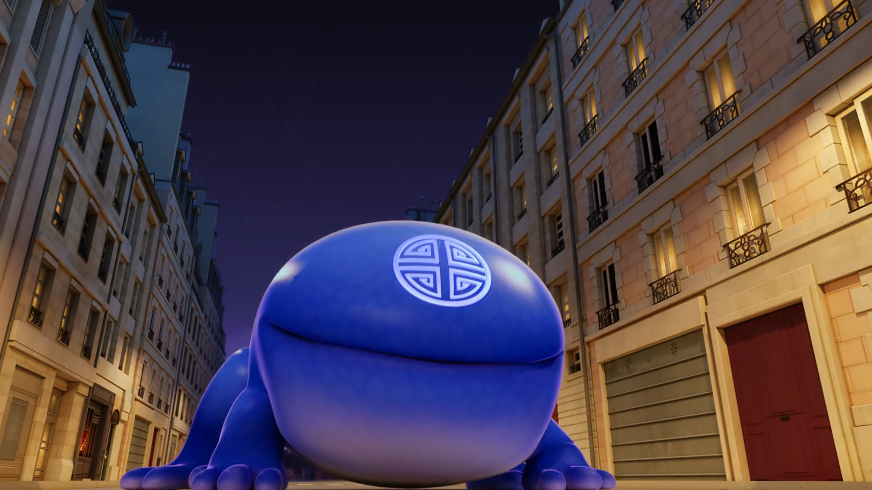
MIRACULOUS LADYBUG: FEAST. PART 2

Slide 2
VOCABULARY
devour - 吞噬 - dɪˈvaʊə
encounter - 遭遇 - ɪnˈkaʊntə
futile - 徒劳的 - fjuːtaɪl
haunting - 困扰的 - hɔːntɪŋ
honour - 荣誉的 - ɒnə
metal - 金属的 - mɛtᵊl
relish - 享受的 - rɛlɪʃ
risk - 风险的 - rɪsk
shortcut - 捷径的 - ʃɔːtkʌt

Slide 3
1. fjuːtaɪl
2. 金属的
3. ʃɔːtkʌt

Slide 4
1. fjuːtaɪl - futile
2. 金属的 - metal
3. ʃɔːtkʌt - shortcut

Slide 5
FEAST. PART 2
Ladybug: Cat Noir? Is that you?
Cat Noir: Of course it is. Who else would you expect by your side?
Ladybug: Isn't that costume of yours a little unsafe?
Cat Noir: Only on the outside. I've got a helmet and pads on under my banana peel, Bugaboo.

Slide 6
Master Fu: Hey! Leave them alone! I'm the one you have been wanting the past one hundred and seventy-two years!
Hawk Moth: The guardian of the Miraculous is this decrepit old man?
Master Fu: Looking for this?
Feast: Yum, yum! Miraculous!
Hawk Moth: You won't have any trouble getting rid of him, Feast!

Slide 7
Ladybug: Whatever he swallows gets sealed here forever.
Cat Noir: In that case, we'd better hurry up and figure out where the Master's staff is hiding.
Master Fu: Farewell, my dear Wayzz. You're the best kwami I could have ever hoped to have by my side all these years.
Wayzz: It's been an honor to be your kwami.

Slide 8
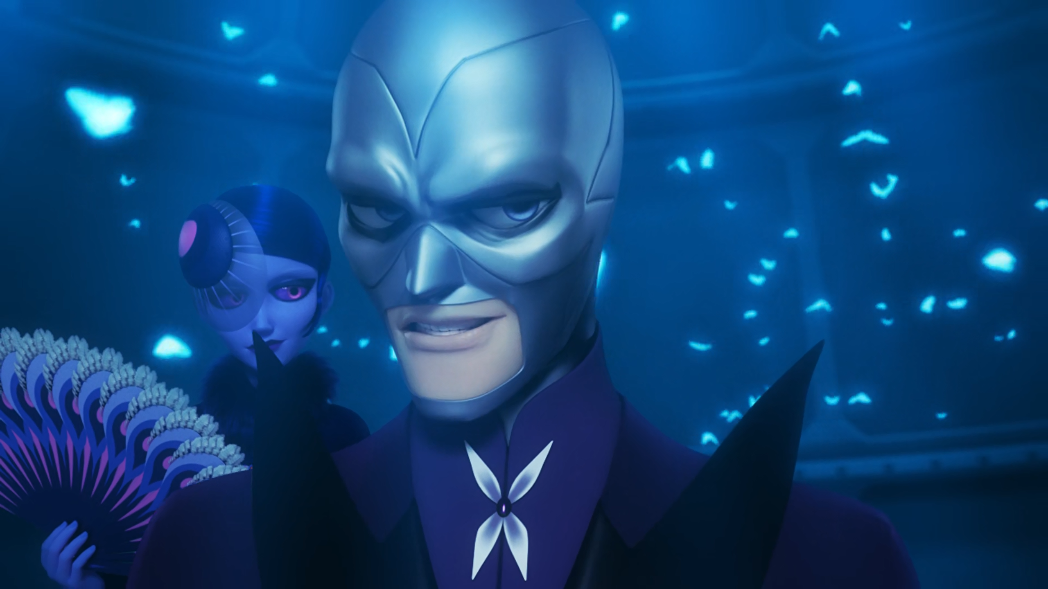

Feast is attracted by the Miraculous's ______.
smell
trail
scent

Slide 9
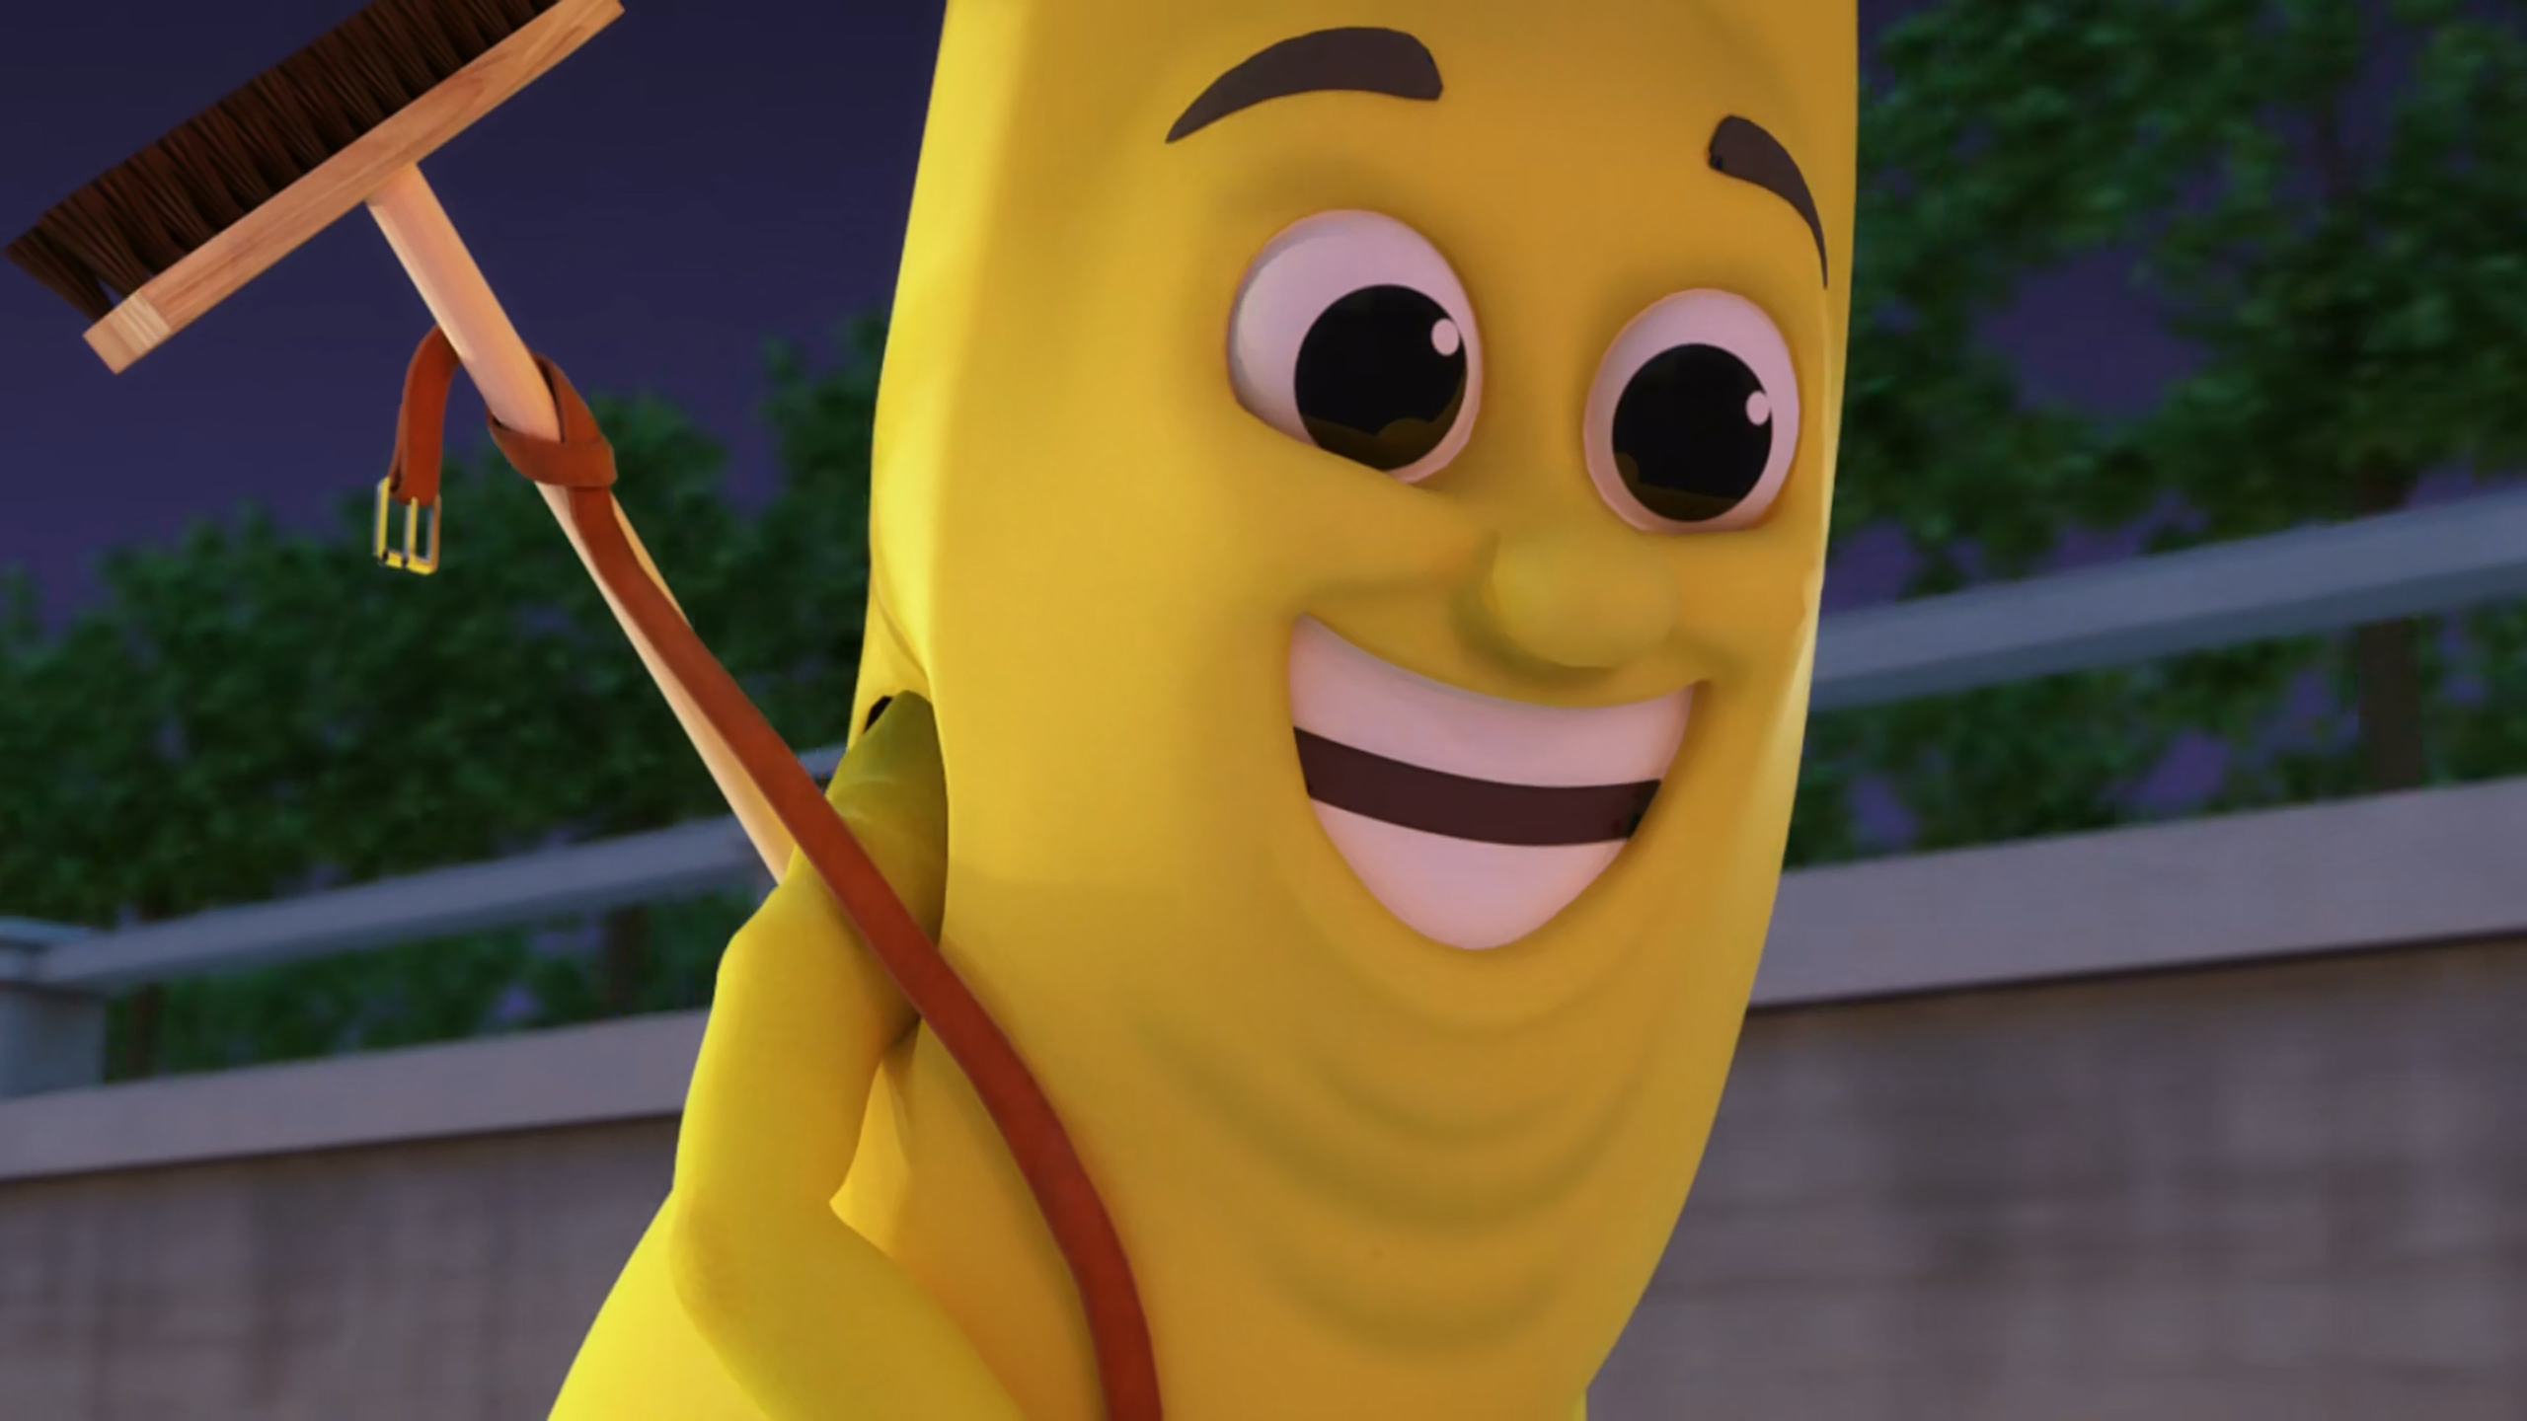
I've got a ______ and pads on under my banana peel, Bugaboo.
helmet
mask
hat

Slide 10
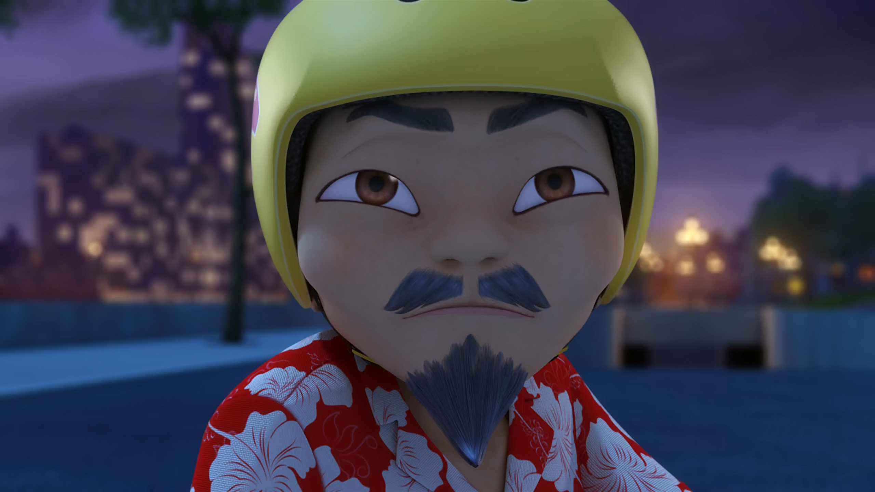
The guardian of the Miraculous is this ______ old man?
feeble
decrepit
weak

Slide 11
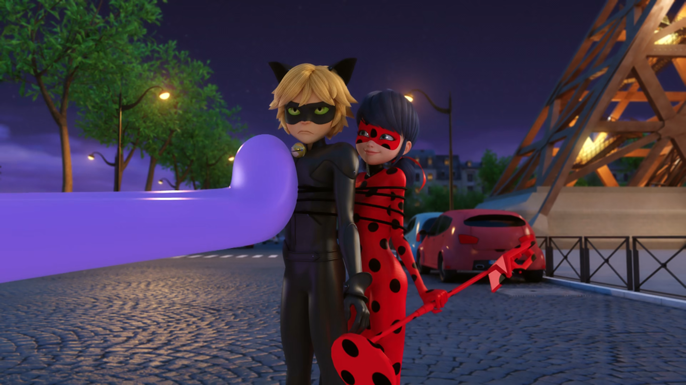
Oh no, not the ______.
mouth
tongue
lips

Slide 12
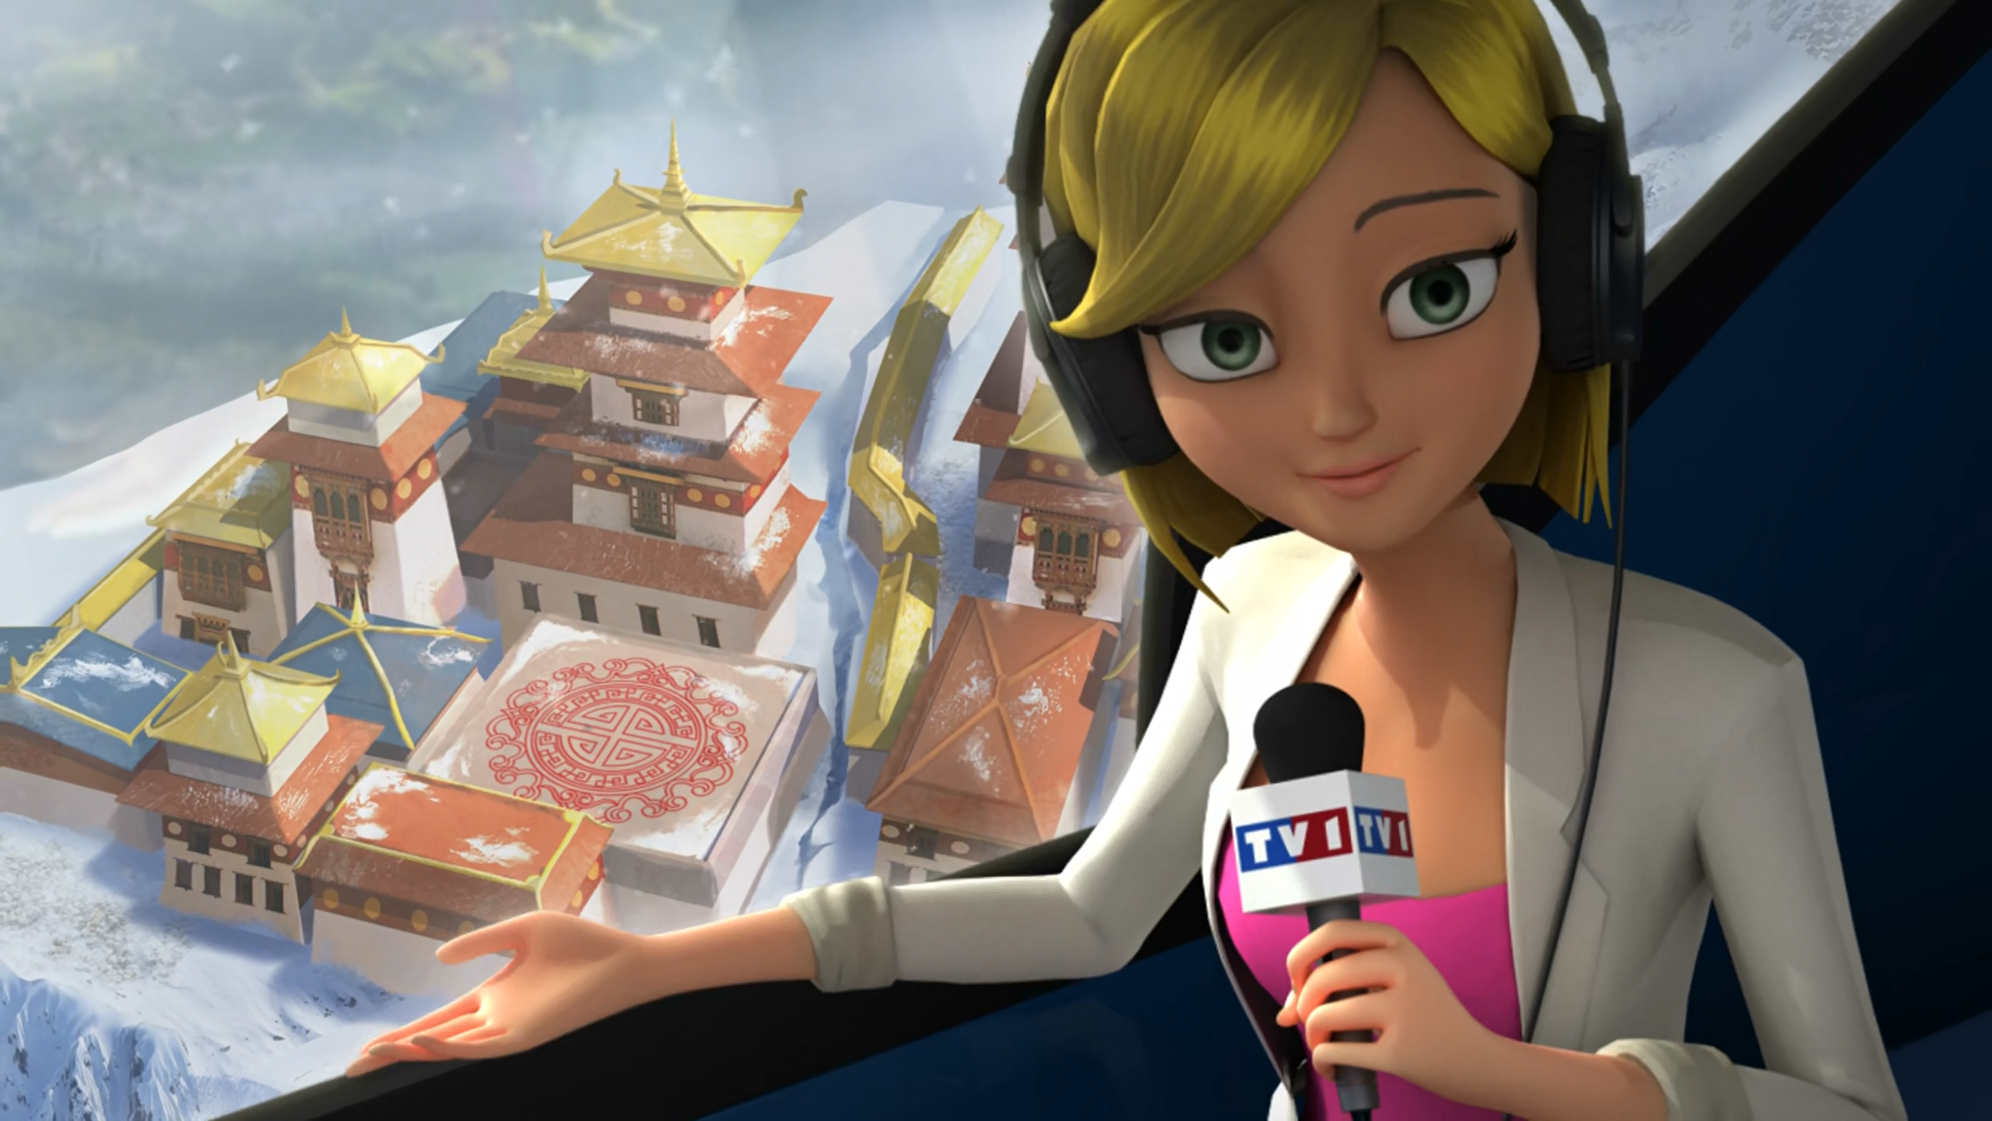
The surprising reappearance of this ______ in the Tibetan mountains.
palace
hotel
temple

Slide 13
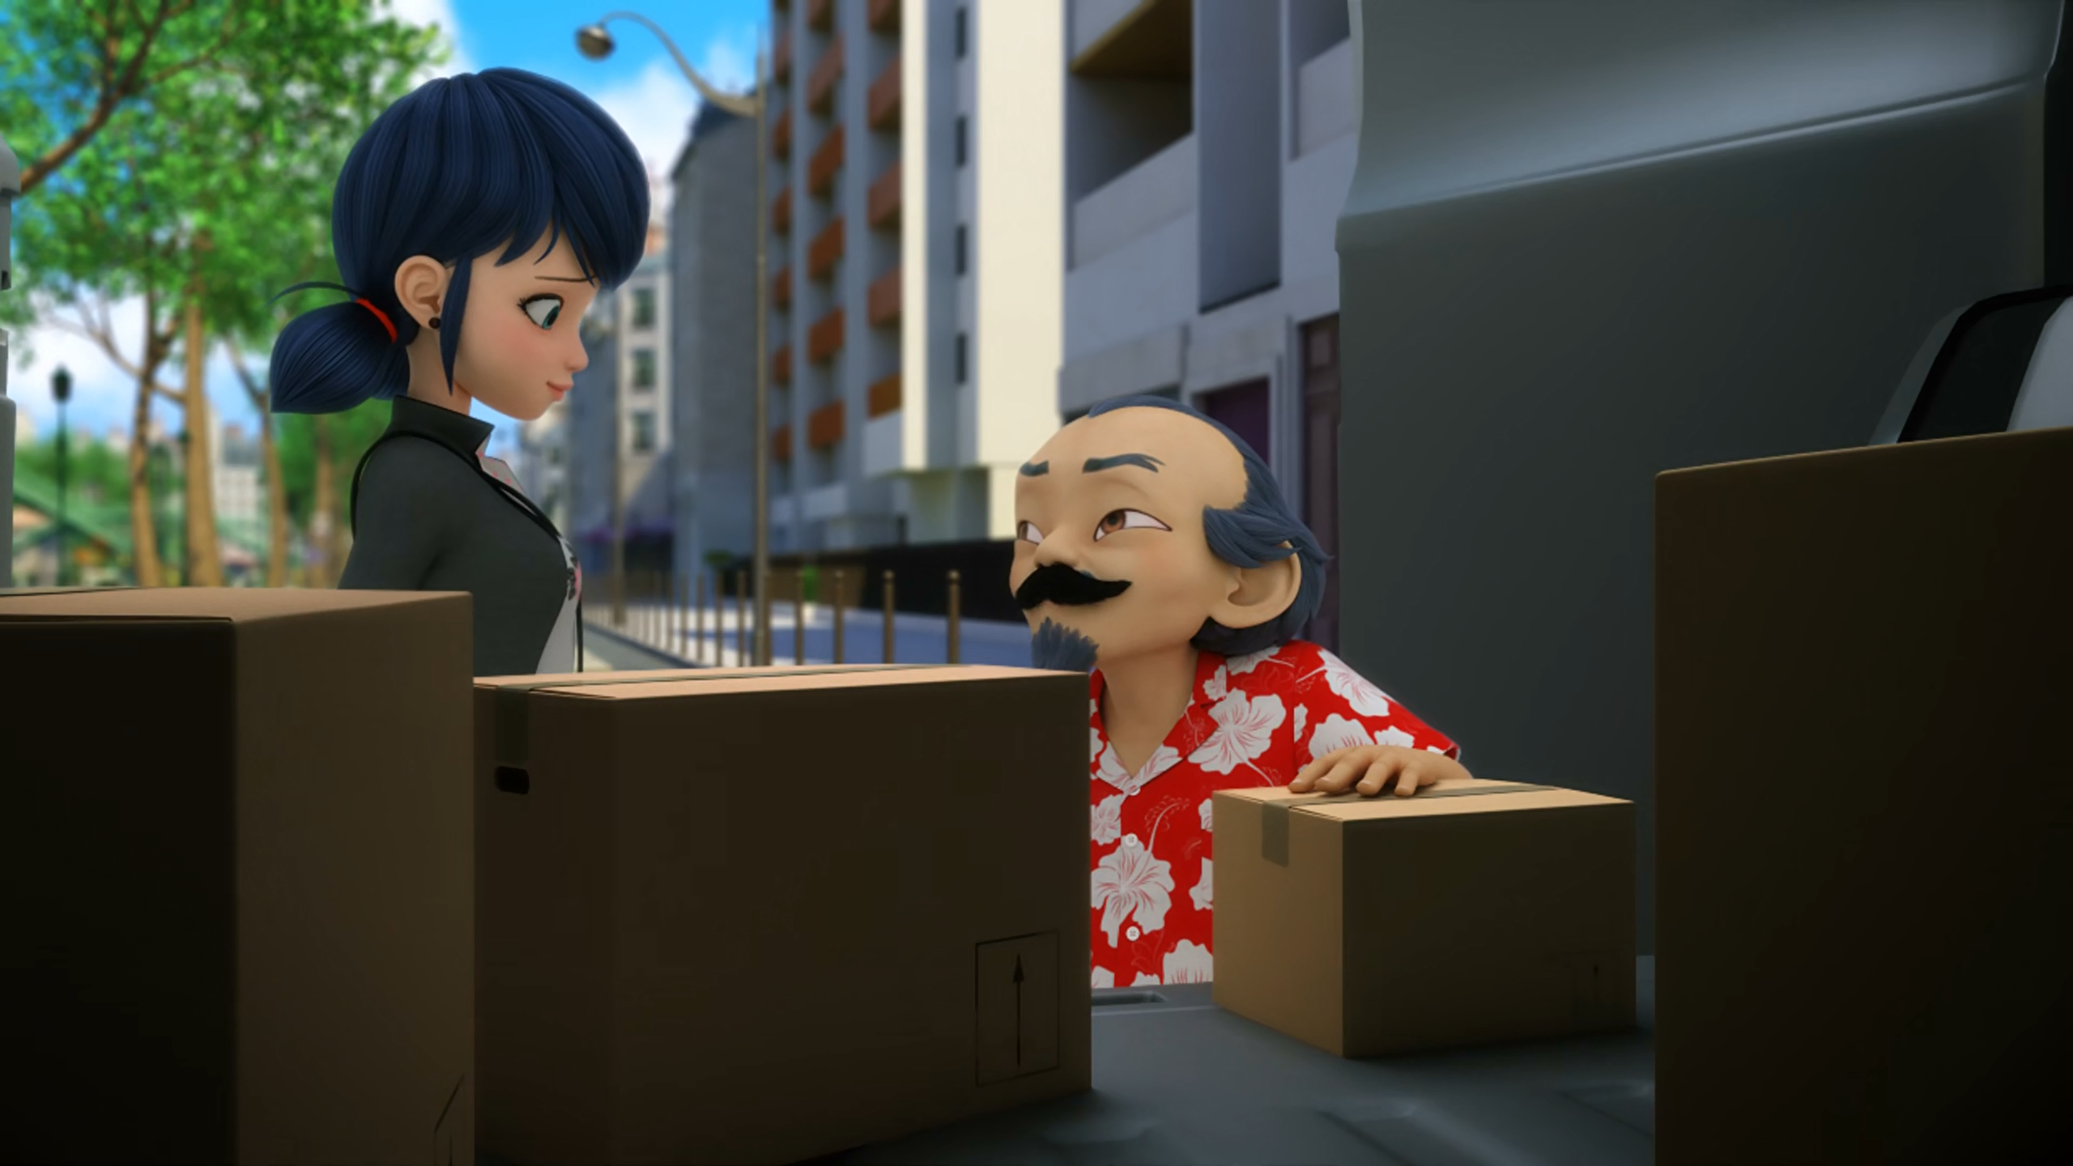
Now that ______ knows who I am, it's too dangerous for me to live here.
Hawk Moth
Alya
Mayura

Slide 14
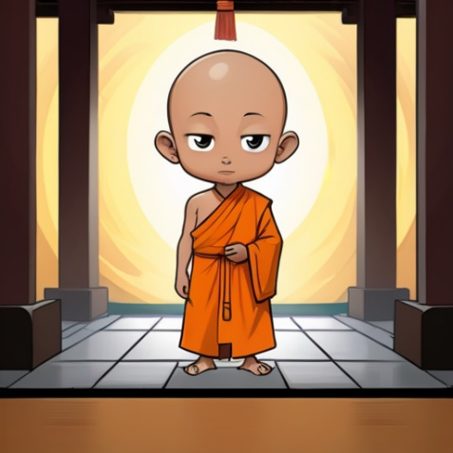
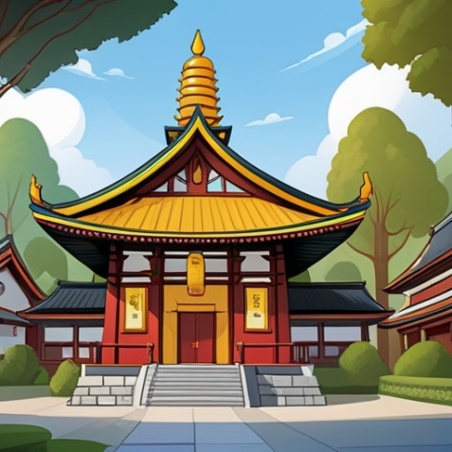

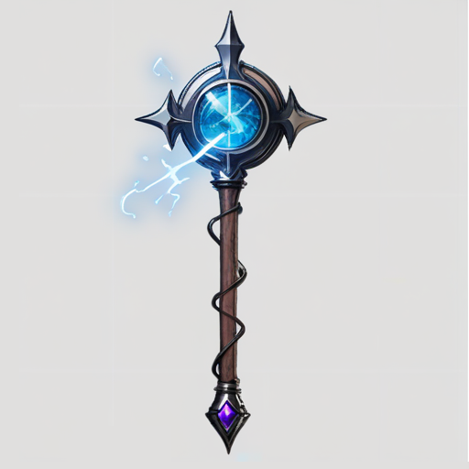
Matching Exercise
temple | staff | monk | triumph

Slide 15
Matching Exercise
monk | temple | triumph | staff

Slide 16
TRUE OR FALSE
1. Wayzz writes Adrien and Marinette a letter.
2. Adrien and Marinette ride a bus.
3. Feast eats ice cream.
4. Ladybug finds Cat Noir's staff with a metal detector.
5. Master Fu is moving house.

Slide 17
TRUE OR FALSE
1. Wayzz writes Adrien and Marinette a letter. | FALSE
2. Adrien and Marinette ride a bus. | FALSE
3. Feast eats ice cream. | TRUE
4. Ladybug finds Cat Noir's staff with a metal detector. | TRUE
5. Master Fu is moving house. | TRUE

