Slide 1
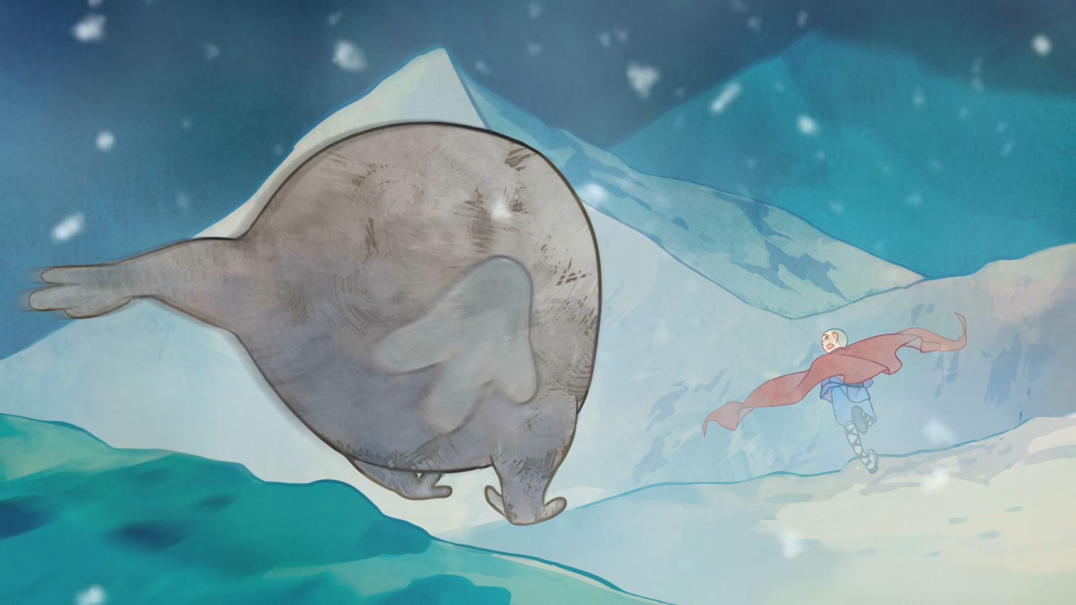
MIRACULOUS LADYBUG: FEAST. PART 1

Slide 2
VOCABULARY
consume - 消耗 - kənˈsjuːm
devour - 狼吞虎咽 - dɪˈvaʊə
duet - 二重奏 - djuˈet
futile - 无用的 - ˈfjuːtaɪl
gawk - 呆呆地看 - ɡɔːk
honour - 荣誉 - ˈɒnə
immune - 免疫的 - ɪˈmjuːn
inhabitant - 居民 - ɪnˈhæbɪtənt
scent - 气味 - sent

Slide 3
1. kənˈsjuːm
2. ɡɔːk
3. ɪnˈhæbɪtənt

Slide 4
1. kənˈsjuːm - consume
2. ɡɔːk - gawk
3. ɪnˈhæbɪtənt - inhabitant

Slide 5
FEAST. PART 1
Alix: Huh, looks like the symbol on the Tibetan statue my old man found.
Adrien: Nathalie, are you okay?
Nathalie: It's nothing, Adrien. Just a dizzy spell.
Adrien: Maybe we should head home now.
Alix: According to my old man, the statue is almost two hundred years old!

Slide 6
Master Fu: You and Cat Noir will give me your Miraculous back and I'll leave Paris with the Miracle Box.
Marinette: But what if it catches up with you this time?
Master Fu: That will be my fate. It's all my fault, after all.
Marinette: I won't let you leave on your own!

Slide 7
Plagg: Why the long face?
Adrien: My mom used to have dizzy spells, just like Nathalie. My father said those weren't serious either.
Plagg: How about a duet?
Adrien: You play the piano?
Plagg: My talents go way beyond sniffing out cheese, young man.

Slide 8
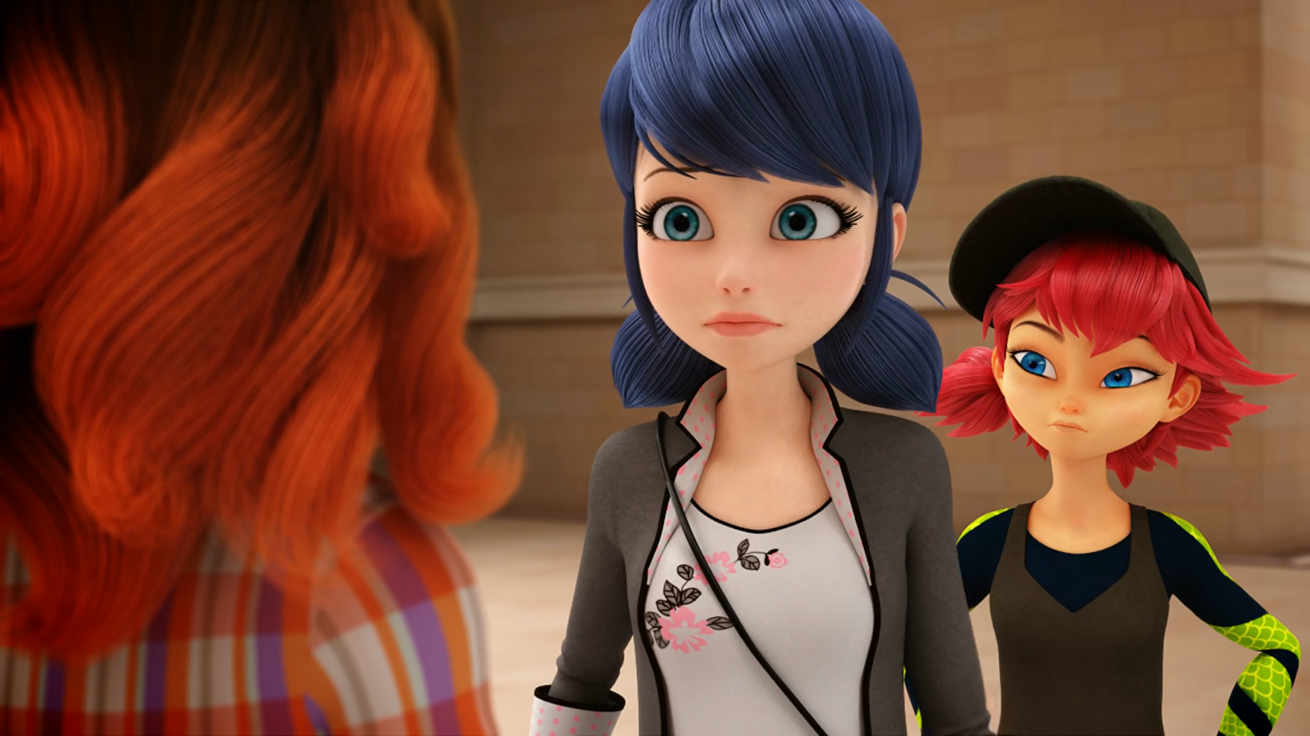
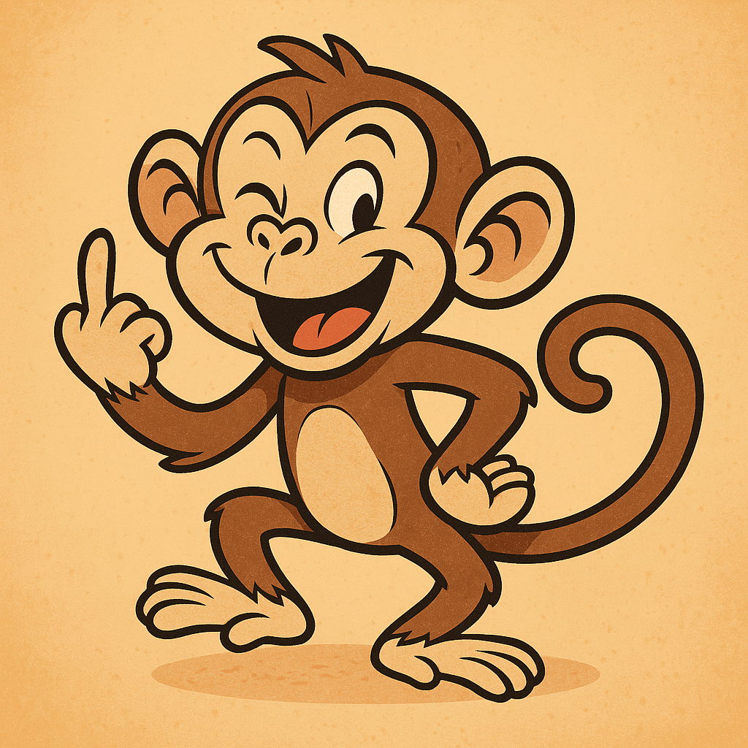
You told me you're gonna stop ______ Ladybug.
searching
following
researching

Slide 9
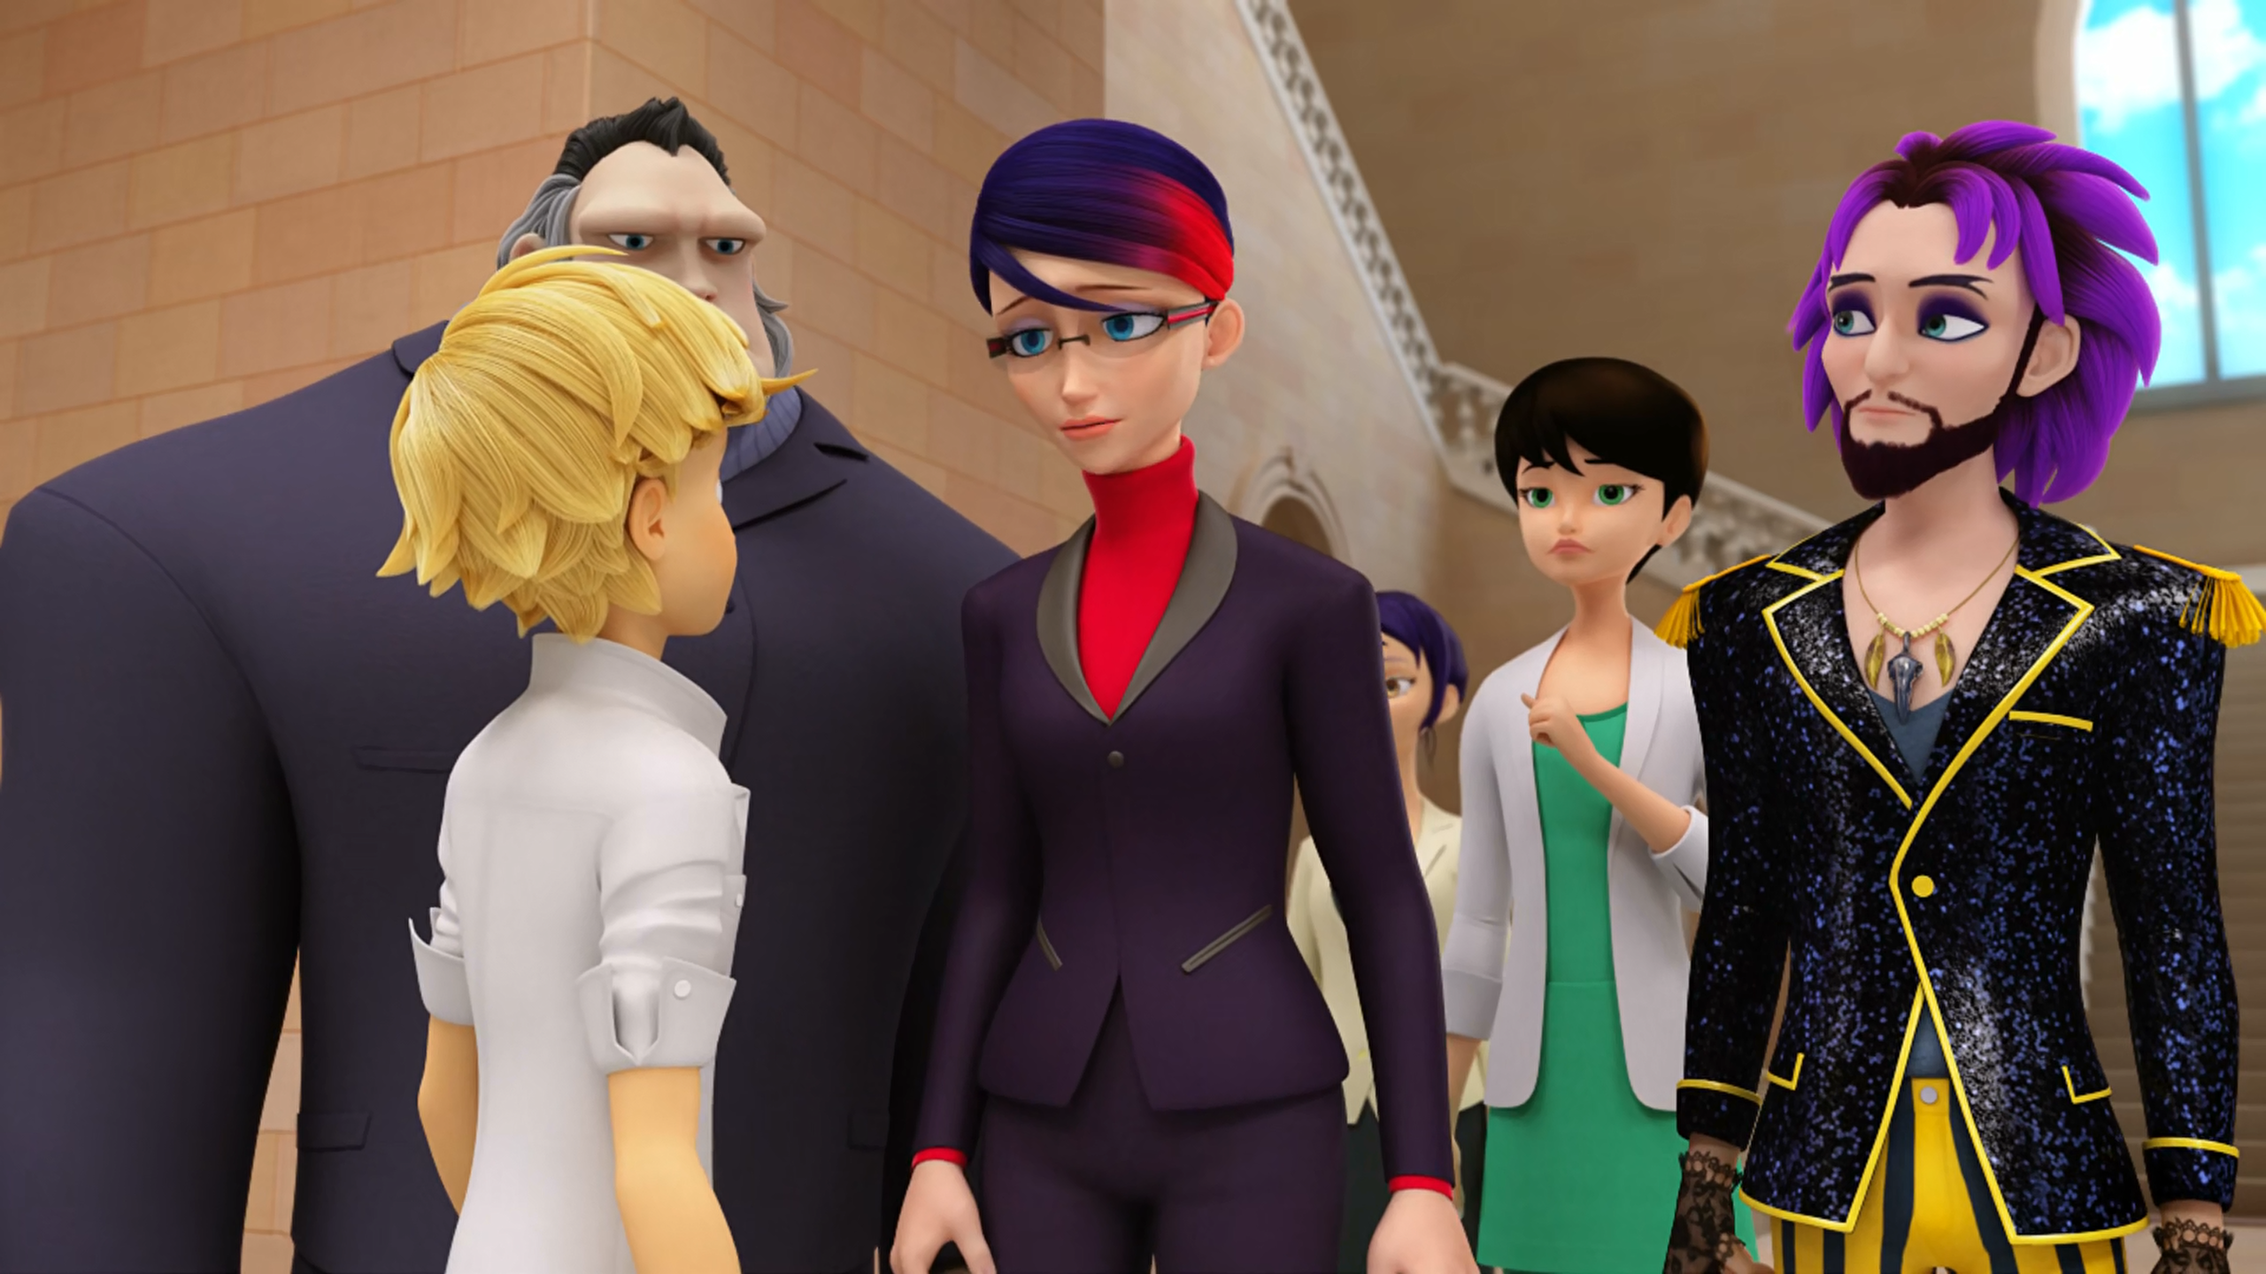
It's nothing, Adrien. Just a ______ spell.
dizzy
magic
hypnotic

Slide 10
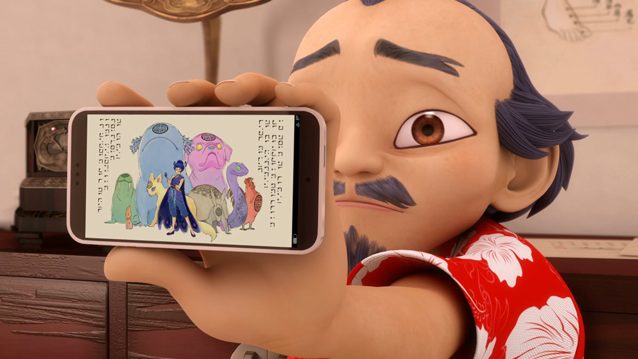
That's not a statue, Marinette. It's a ______!
centimetre
sentimonster
centipede

Slide 11
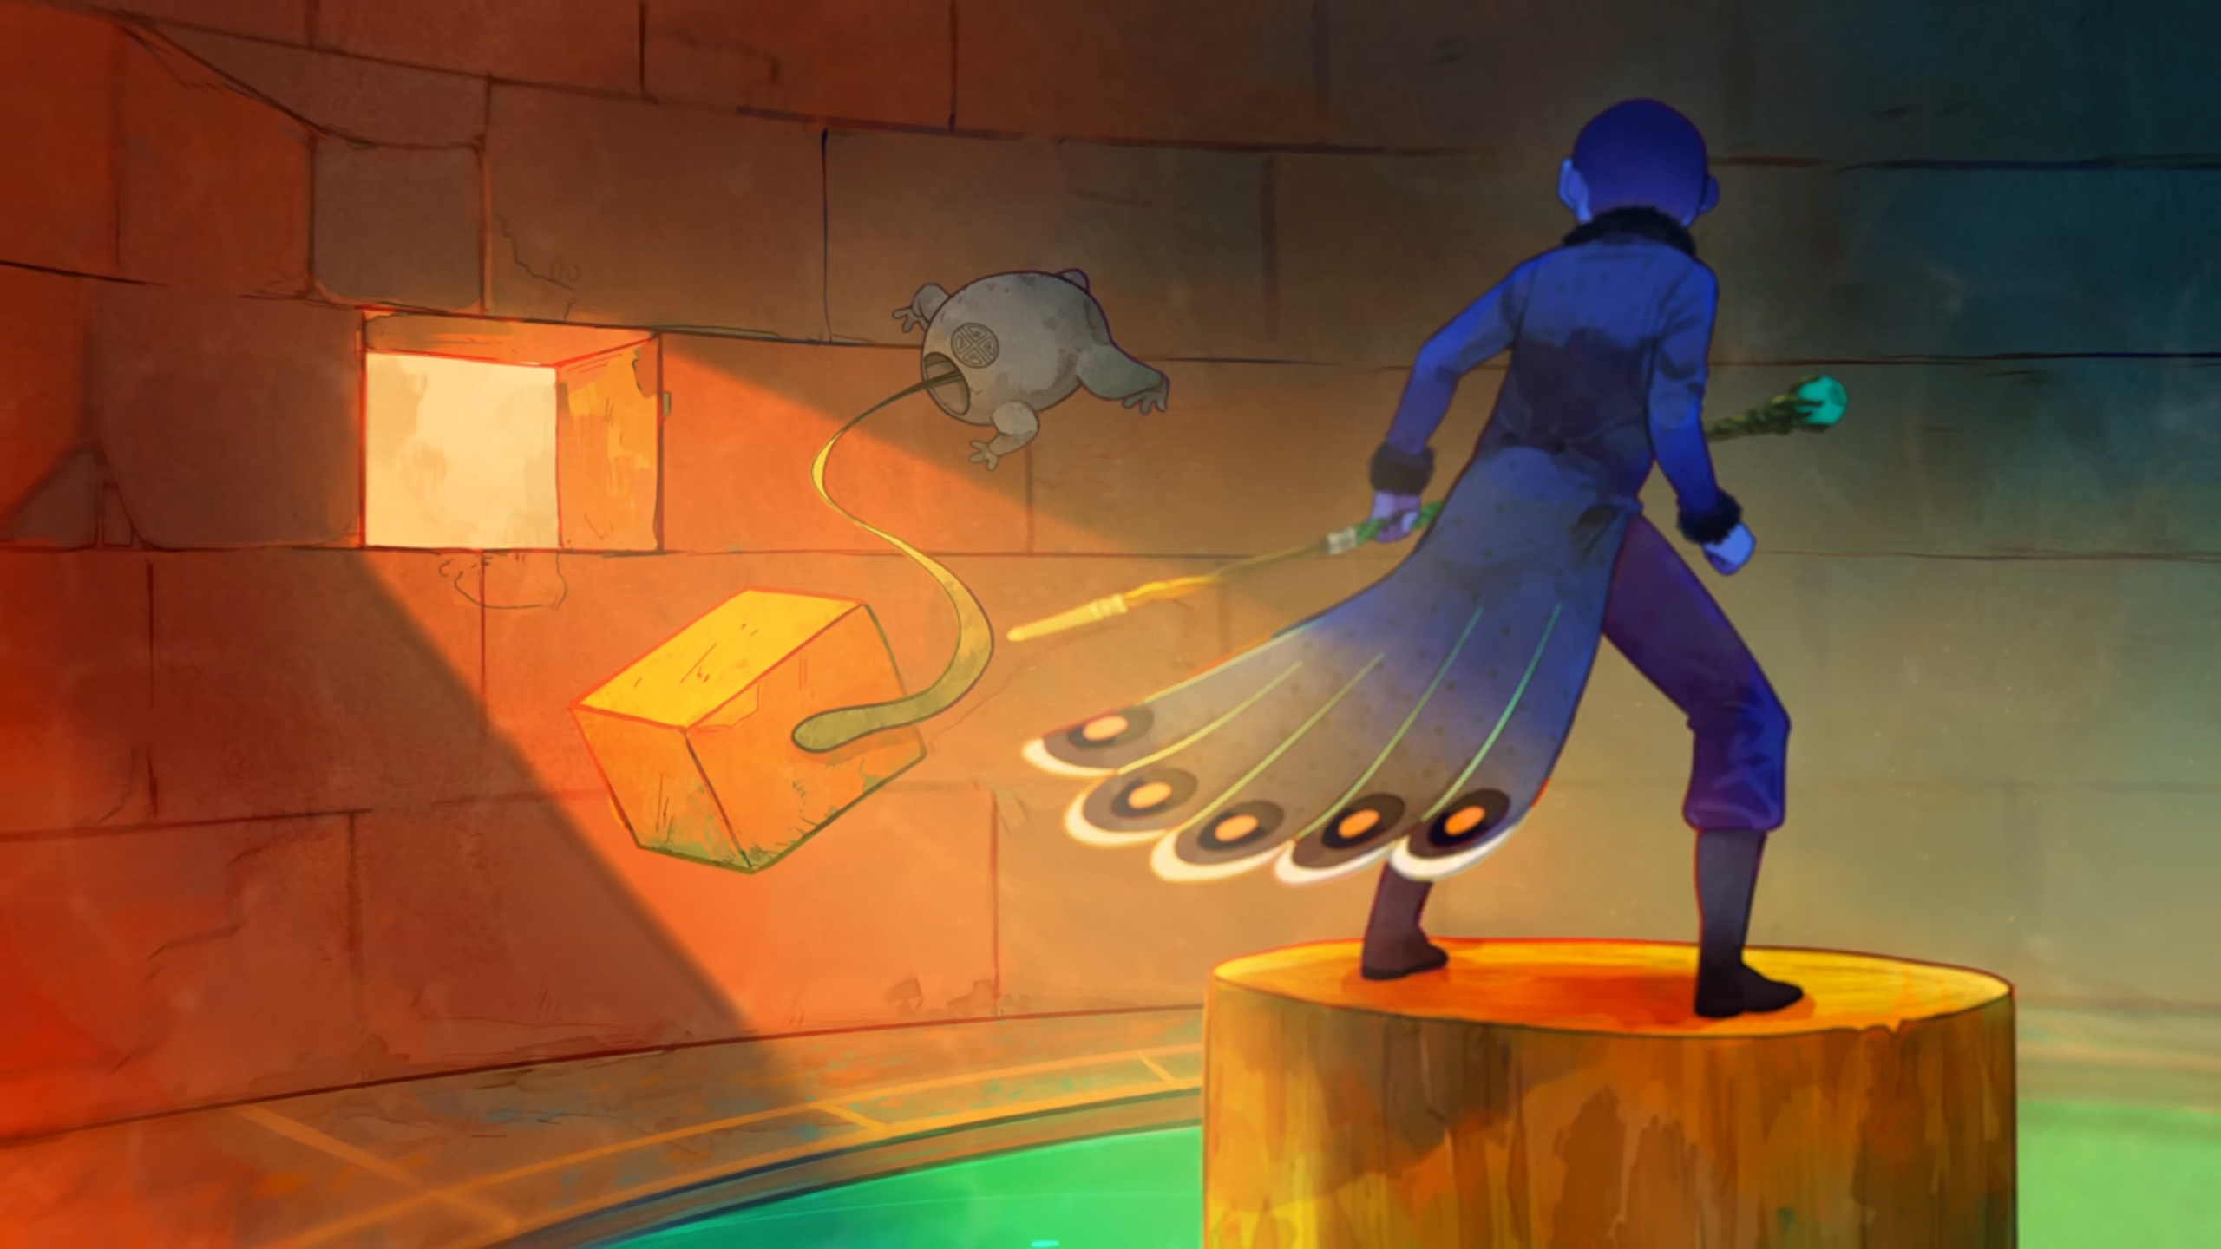
All I wanted was a nice little ______.
colleague
companion
comrade

Slide 12
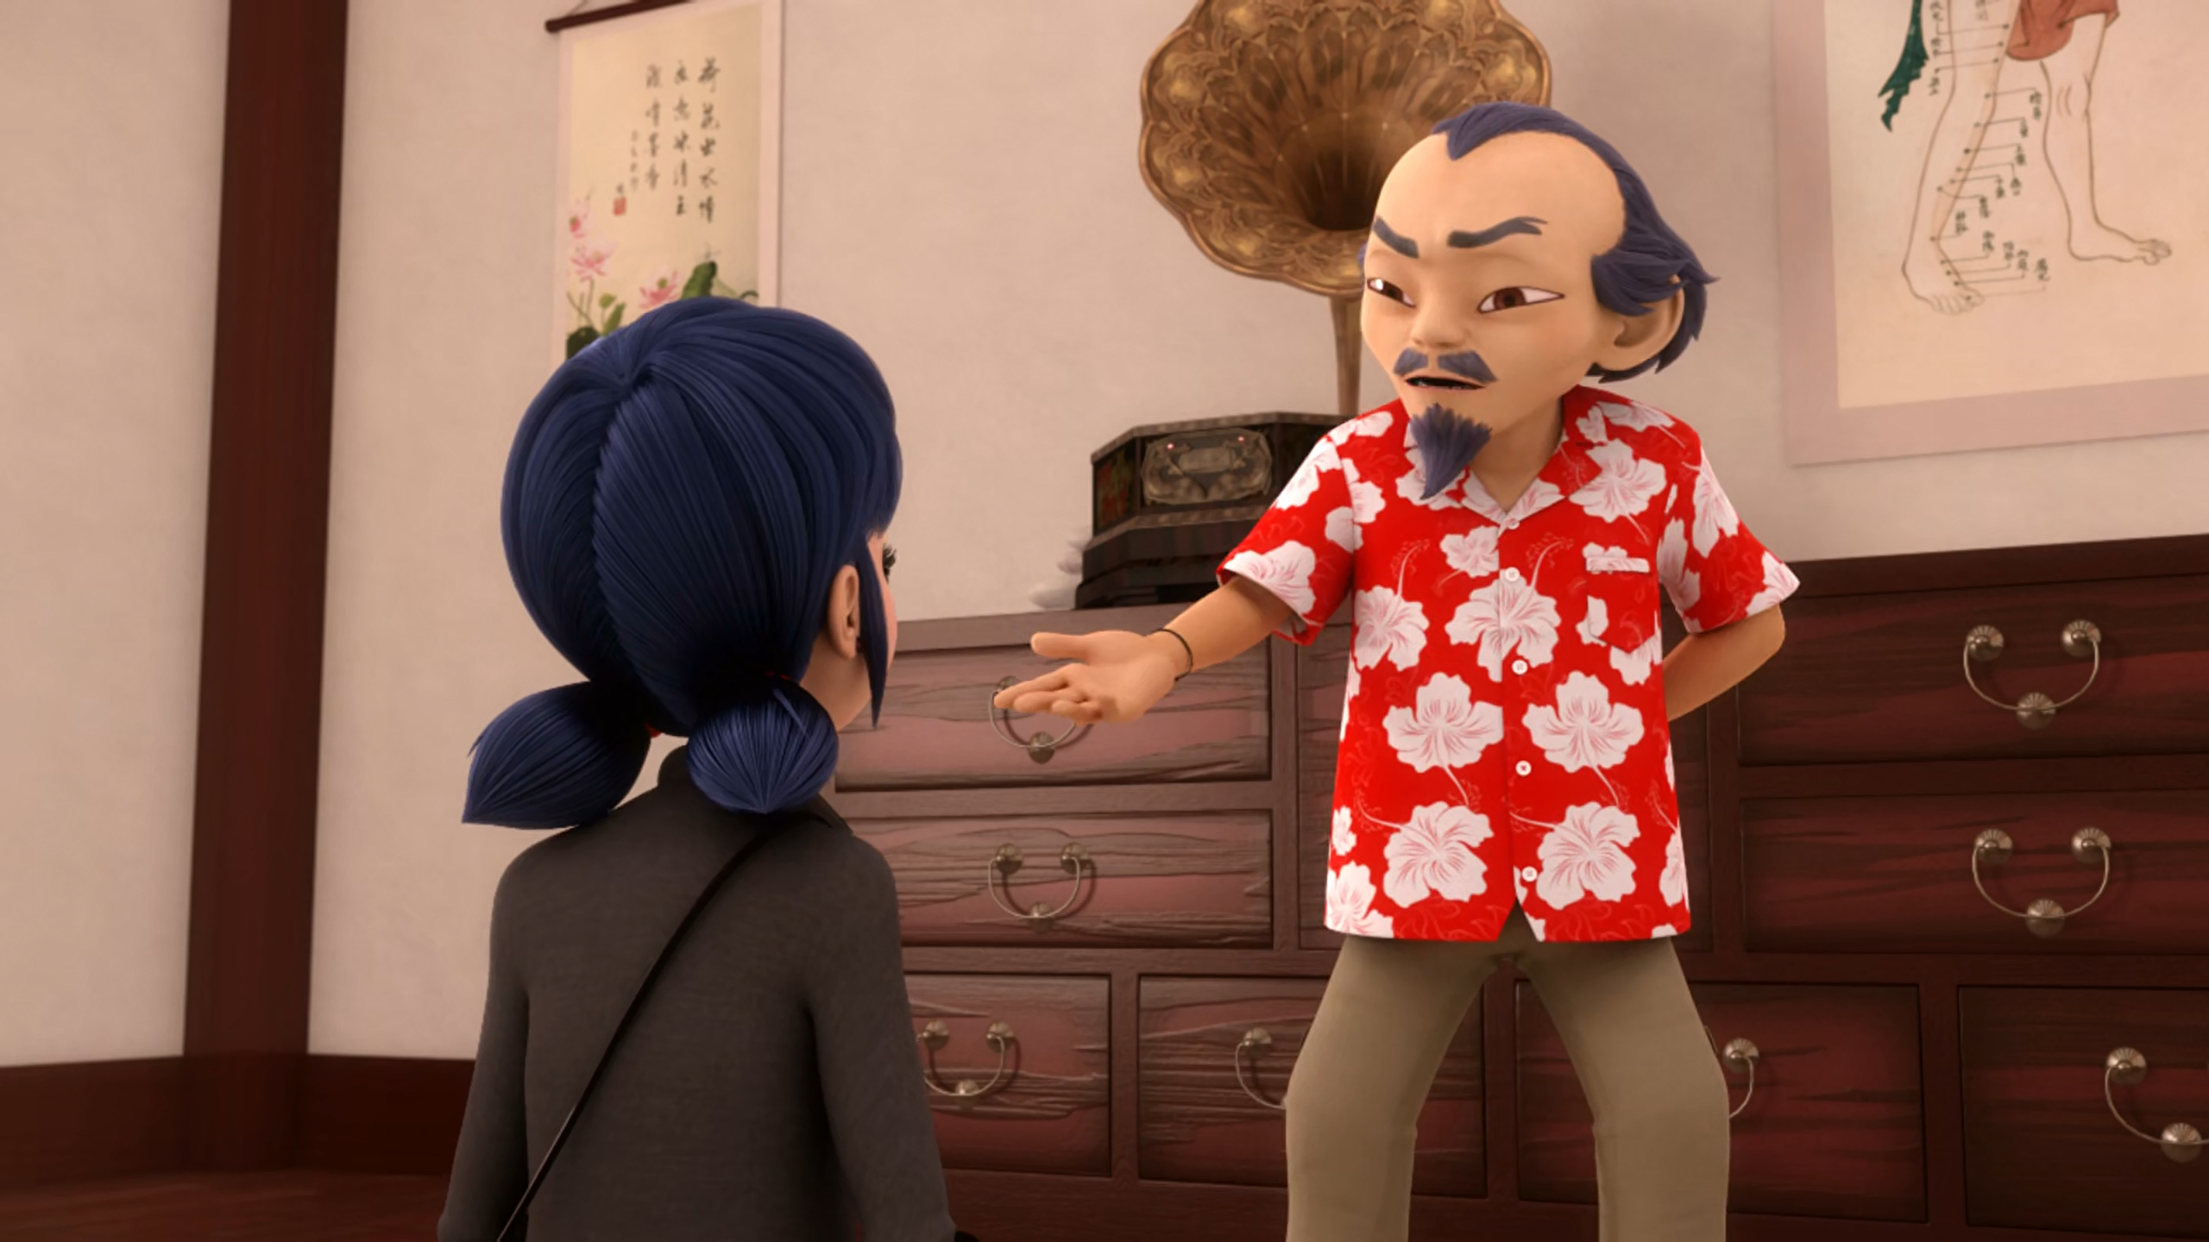
You and Cat Noir will give me your Miraculous back and I'll leave ______.
Paris
DLU
France

Slide 13
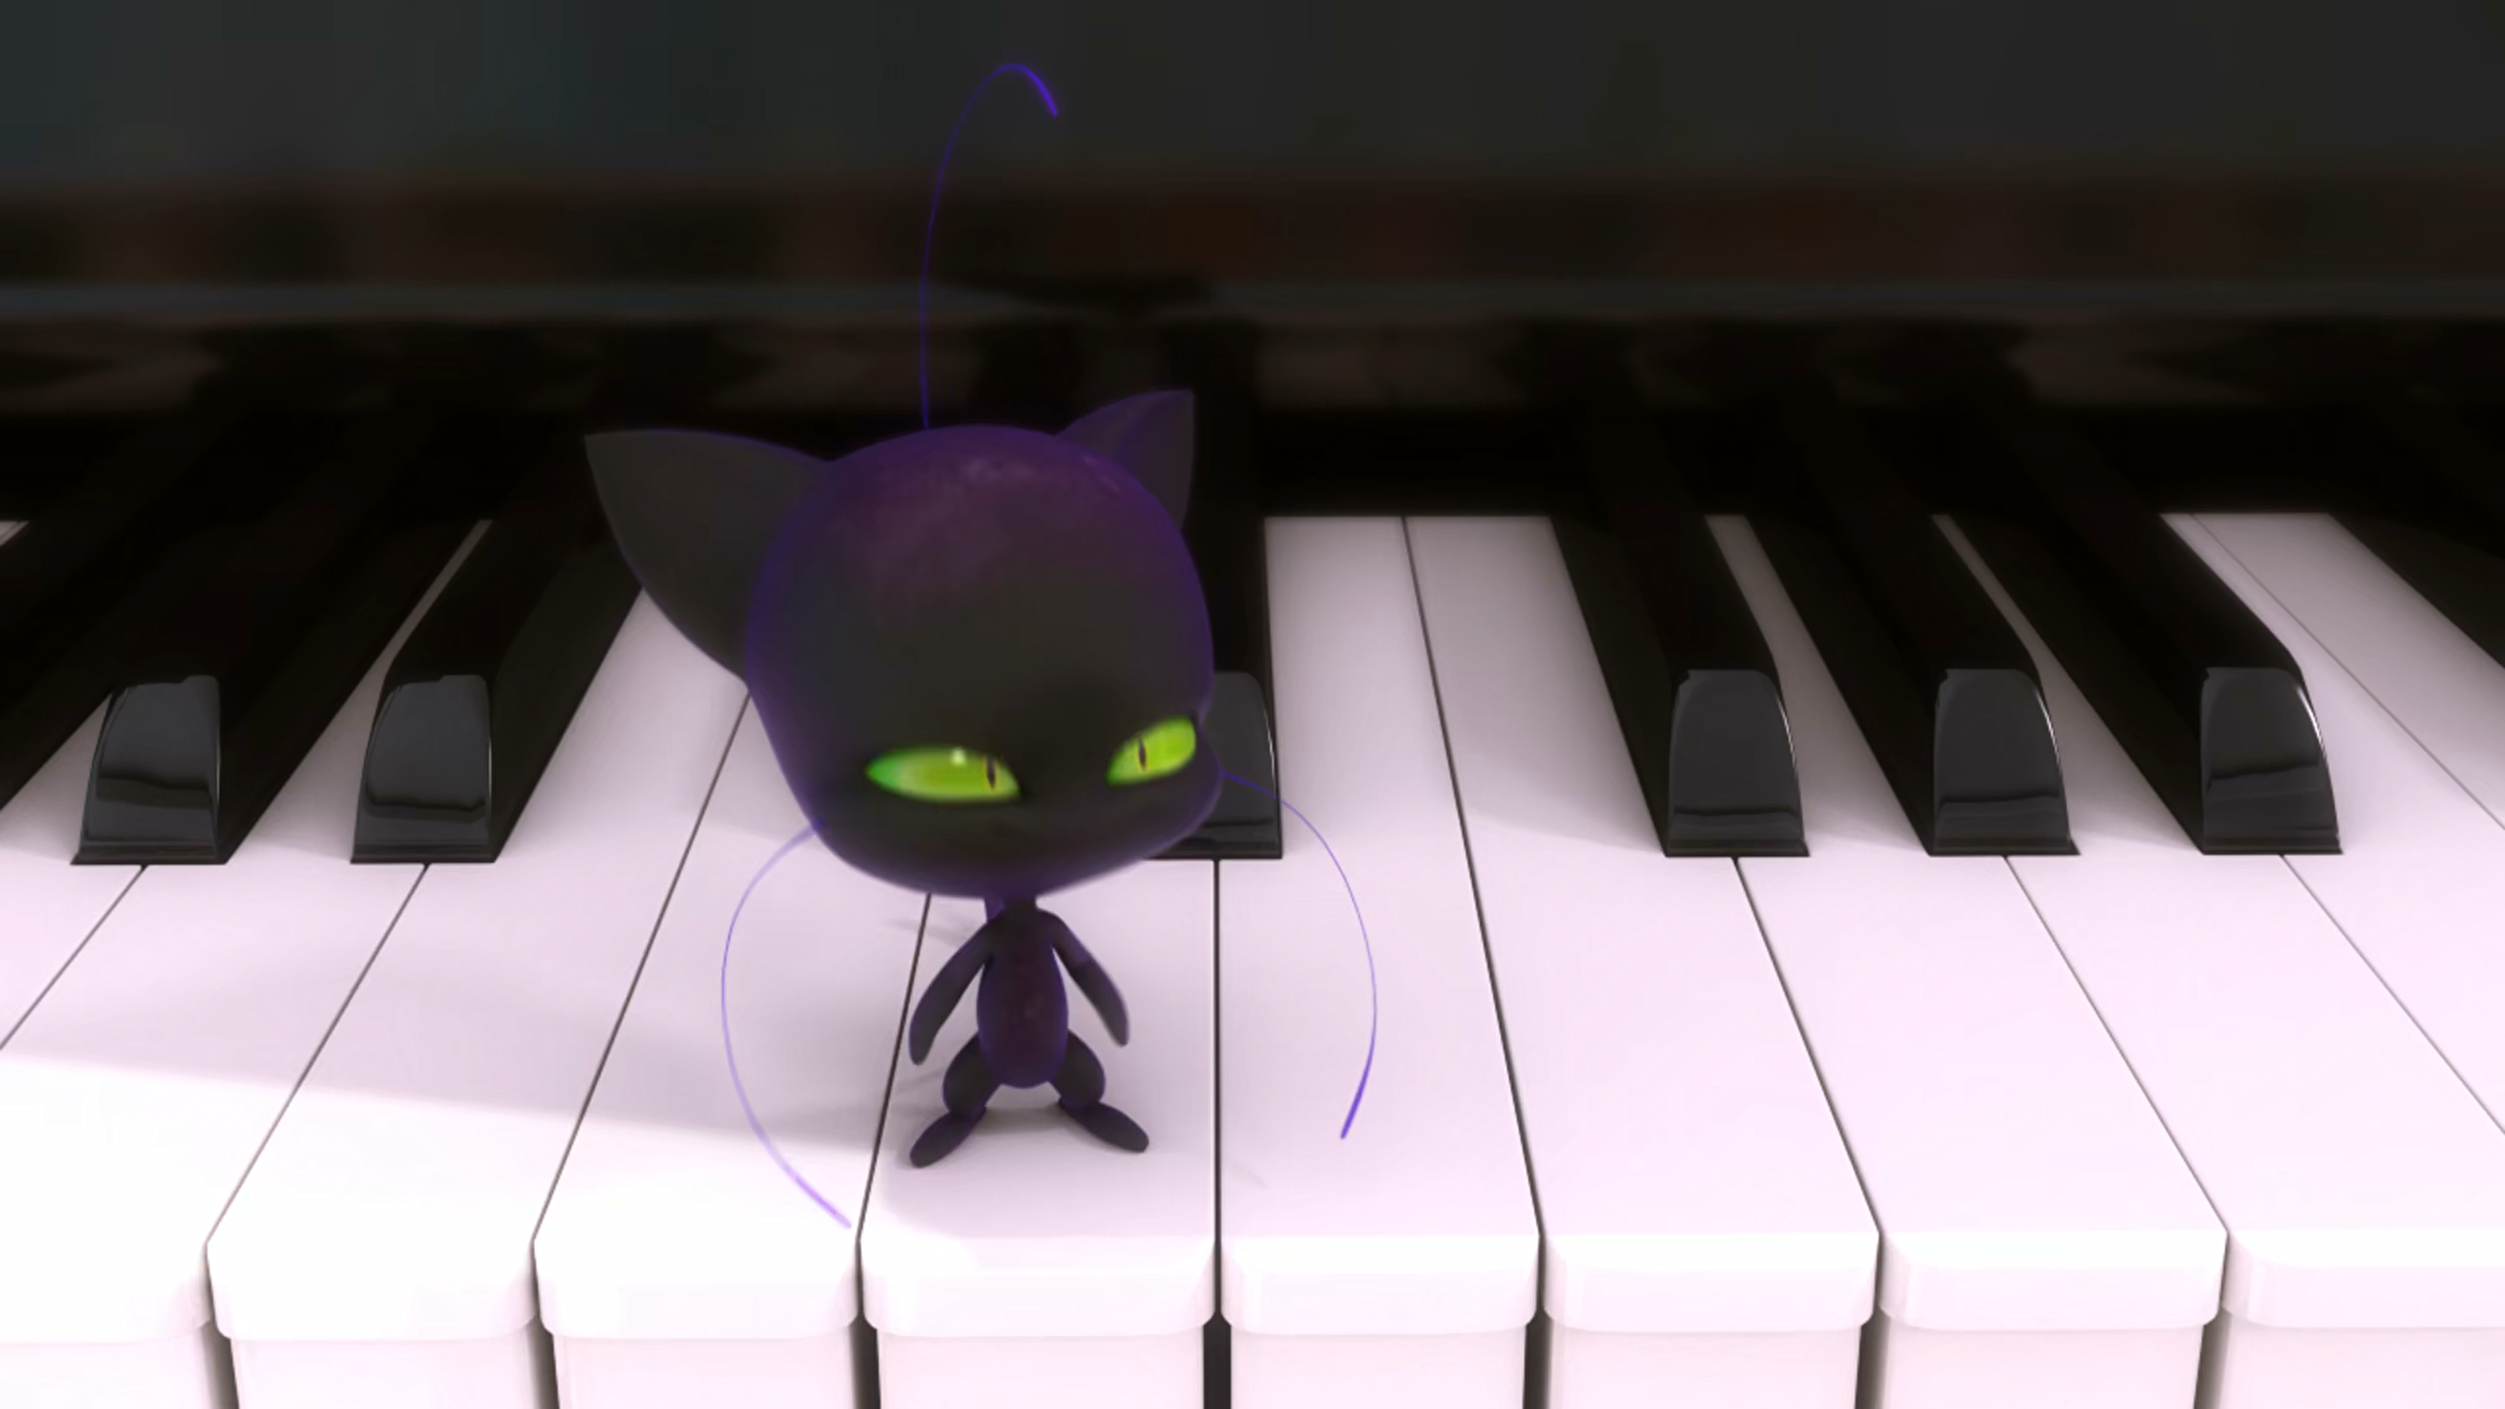
My talents go way beyond ______
out cheese, young man.
sniffing
searching
smelling

Slide 14
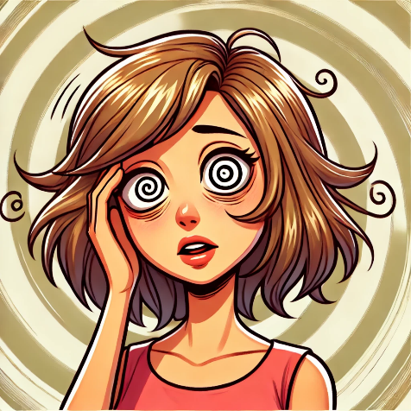

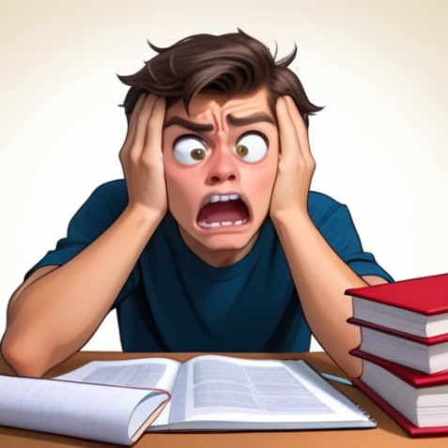

Matching Exercise
jewels | frustrated | dizzy | emblem

Slide 15
Matching Exercise
dizzy | emblem | frustrated | jewels

Slide 16
TRUE OR FALSE
1. The students are at The Louvre museum.
2. The Ladybug is from ancient Greece.
3. Alya shows Master Fu her blog.
4. Master Fu always wanted to be a guardian.
5. Plagg can play the piano.

Slide 17
TRUE OR FALSE
1. The students are at The Louvre museum. | TRUE
2. The Ladybug is from ancient Greece. | FALSE
3. Alya shows Master Fu her blog. | FALSE
4. Master Fu always wanted to be a guardian. | FALSE
5. Plagg can play the piano. | TRUE

