Slide 1
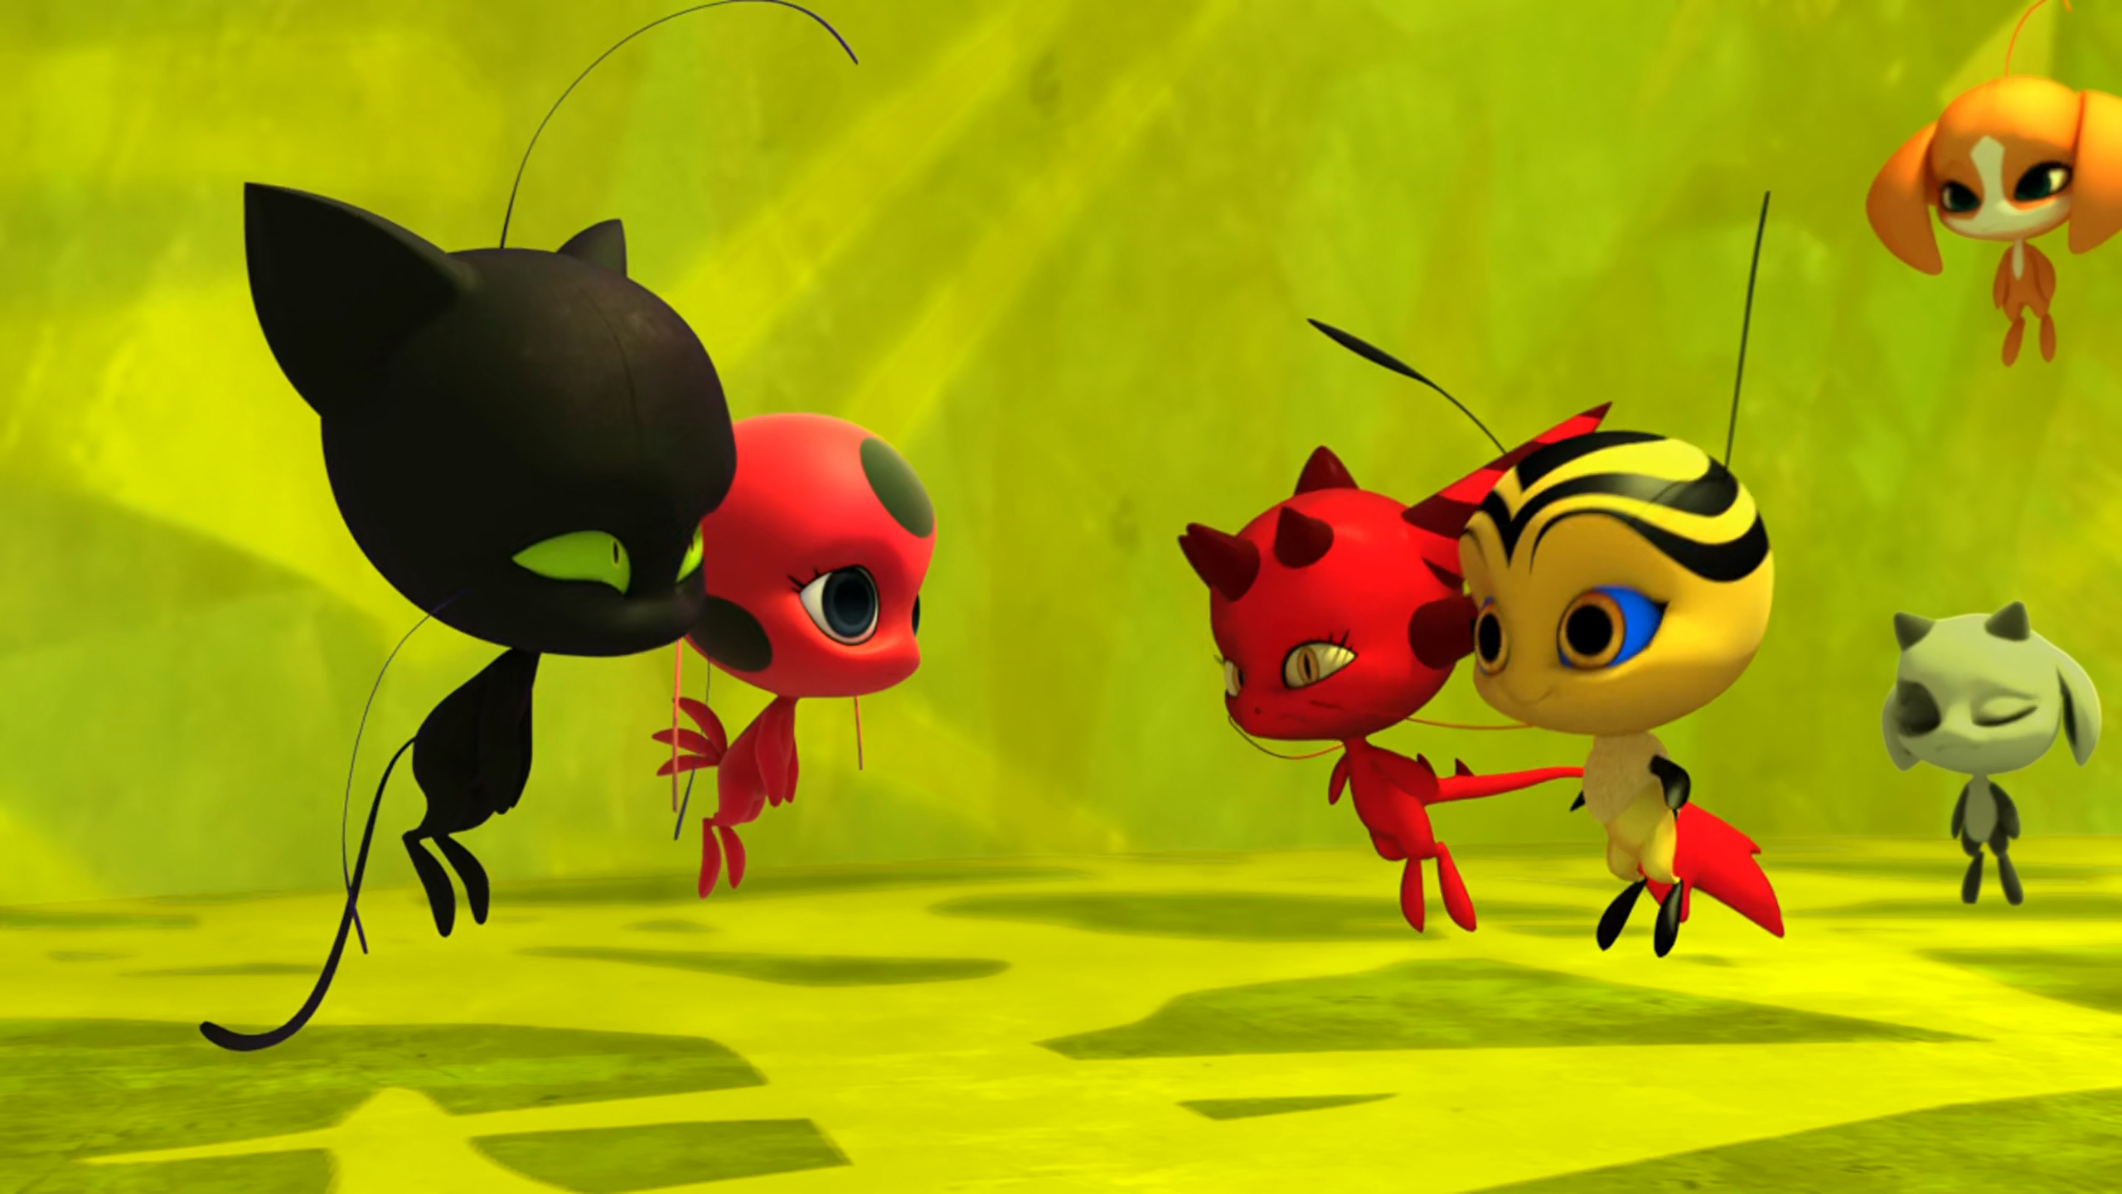
MIRACULOUS LADYBUG: KWAMIBUSTER. PART 2

Slide 2
VOCABULARY
aware - 意识到 - əˈweə
claim - 声称 - kleɪm
consequence - 后果 - kɒnsɪkwəns
convince - 说服 - kənˈvɪns
doom - 厄运 - duːm
mysterious - 神秘 - mɪˈstɪəriəs
owner - 主人 - əʊnə
squeak - 吱吱声 - skwiːk
testify - 作证 - tɛstɪfaɪ

Slide 3
1. kɒnsɪkwəns
2. 神秘
3. 主人

Slide 4
1. kɒnsɪkwəns - consequence
2. 神秘 - mysterious
3. 主人 - owner

Slide 5
KWAMIBUSTER. PART 2
Master Fu: Marinette Dupain-Cheng, you have to pick a Miraculous, only this time, you won't be giving it to someone else. You'll wear it yourself, until you get Tikki back. You can't do that! Merging Miraculous would give you way too much power! It could make you lose your mind!

Slide 6
Kwamibuster: True or false: Cat Noir has disguised himself as Mr. Banana!
Adrien: Uh... Stay peachy?
Kwamibuster: Stay put!
Hawk Moth: Soon, we'll discover Cat Noir's true identity and his Miraculous will be mine at last!
Multimouse: Charge!!!
Kwamis: Ahh!

Slide 7
Marinette: Cat Noir wouldn't imagine in a million years that I'm Ladybug. And now
I know that he's not a student, he thought it was an elementary school.
Tikki: Marinette, if you had been forced to give up being Ladybug because of me? I would have never forgiven myself.
Marinette: We all make mistakes, Tikki,
but I know you're a friend I can truly rely on.

Slide 8
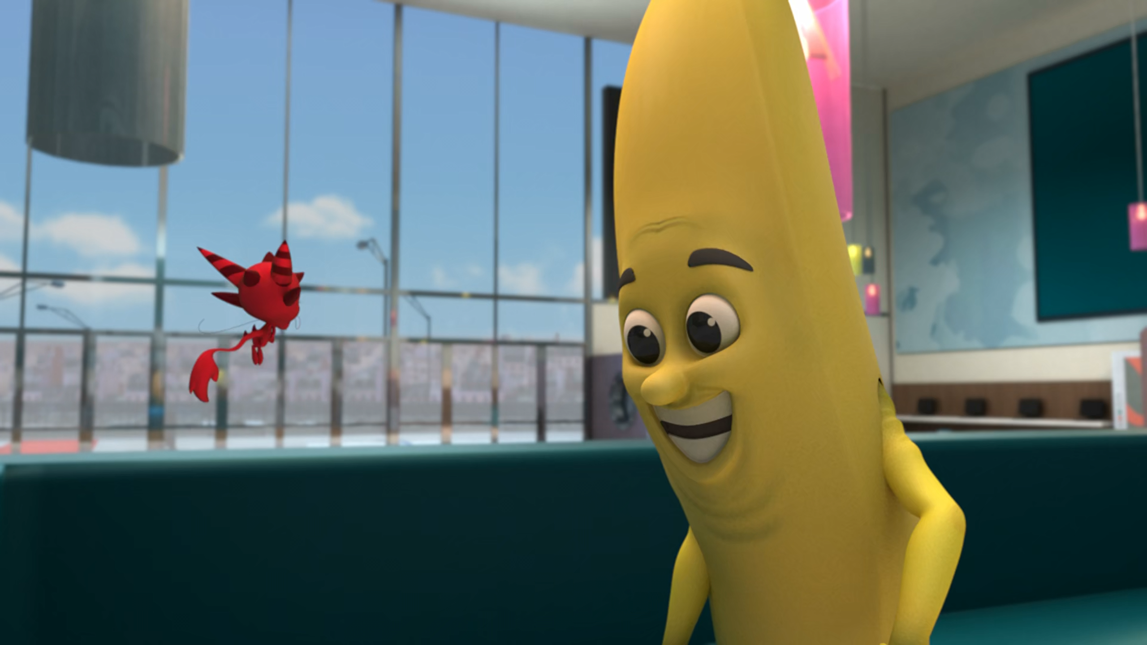

Oh yeah! Ladybug said you should meet her on the ______.
bus
balcony
roof

Slide 9
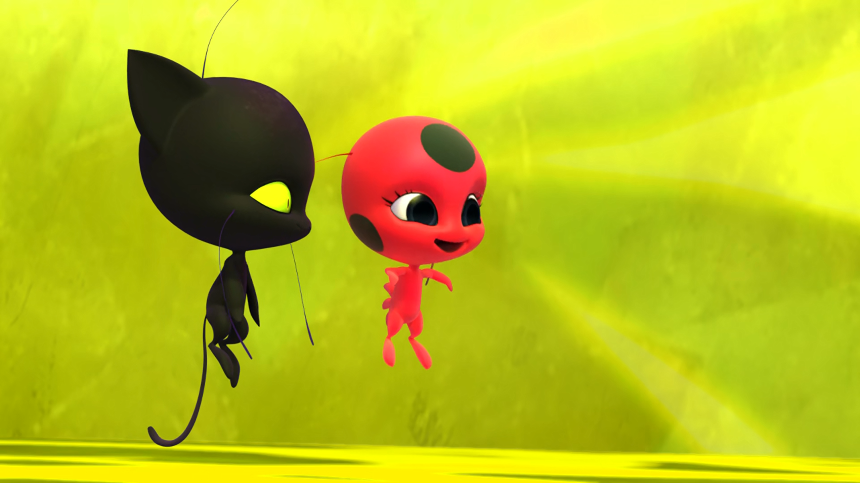
I'd never ______ you, Tikki.
abandon
kill
forget

Slide 10
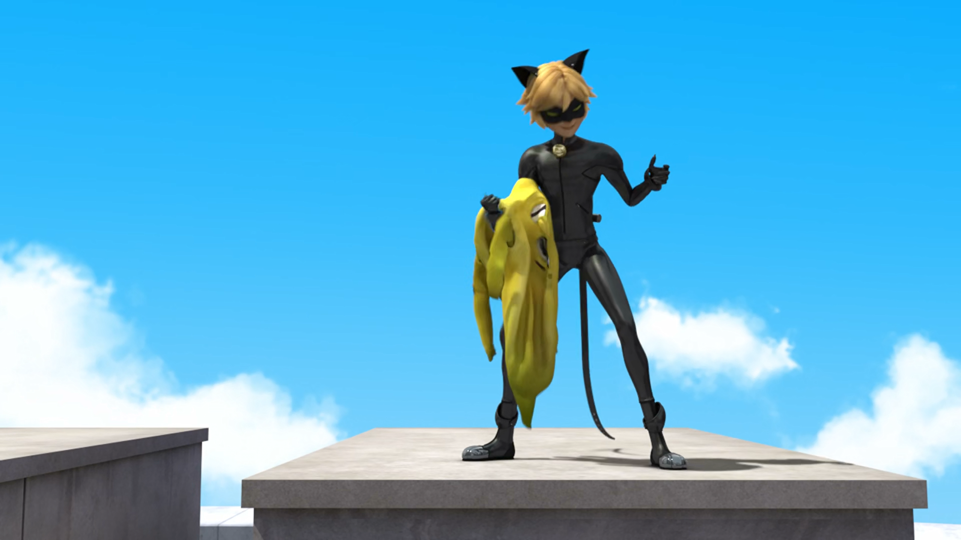
Being Cat Noir is much more appealing than being a ______.
melon
banana
apple

Slide 11
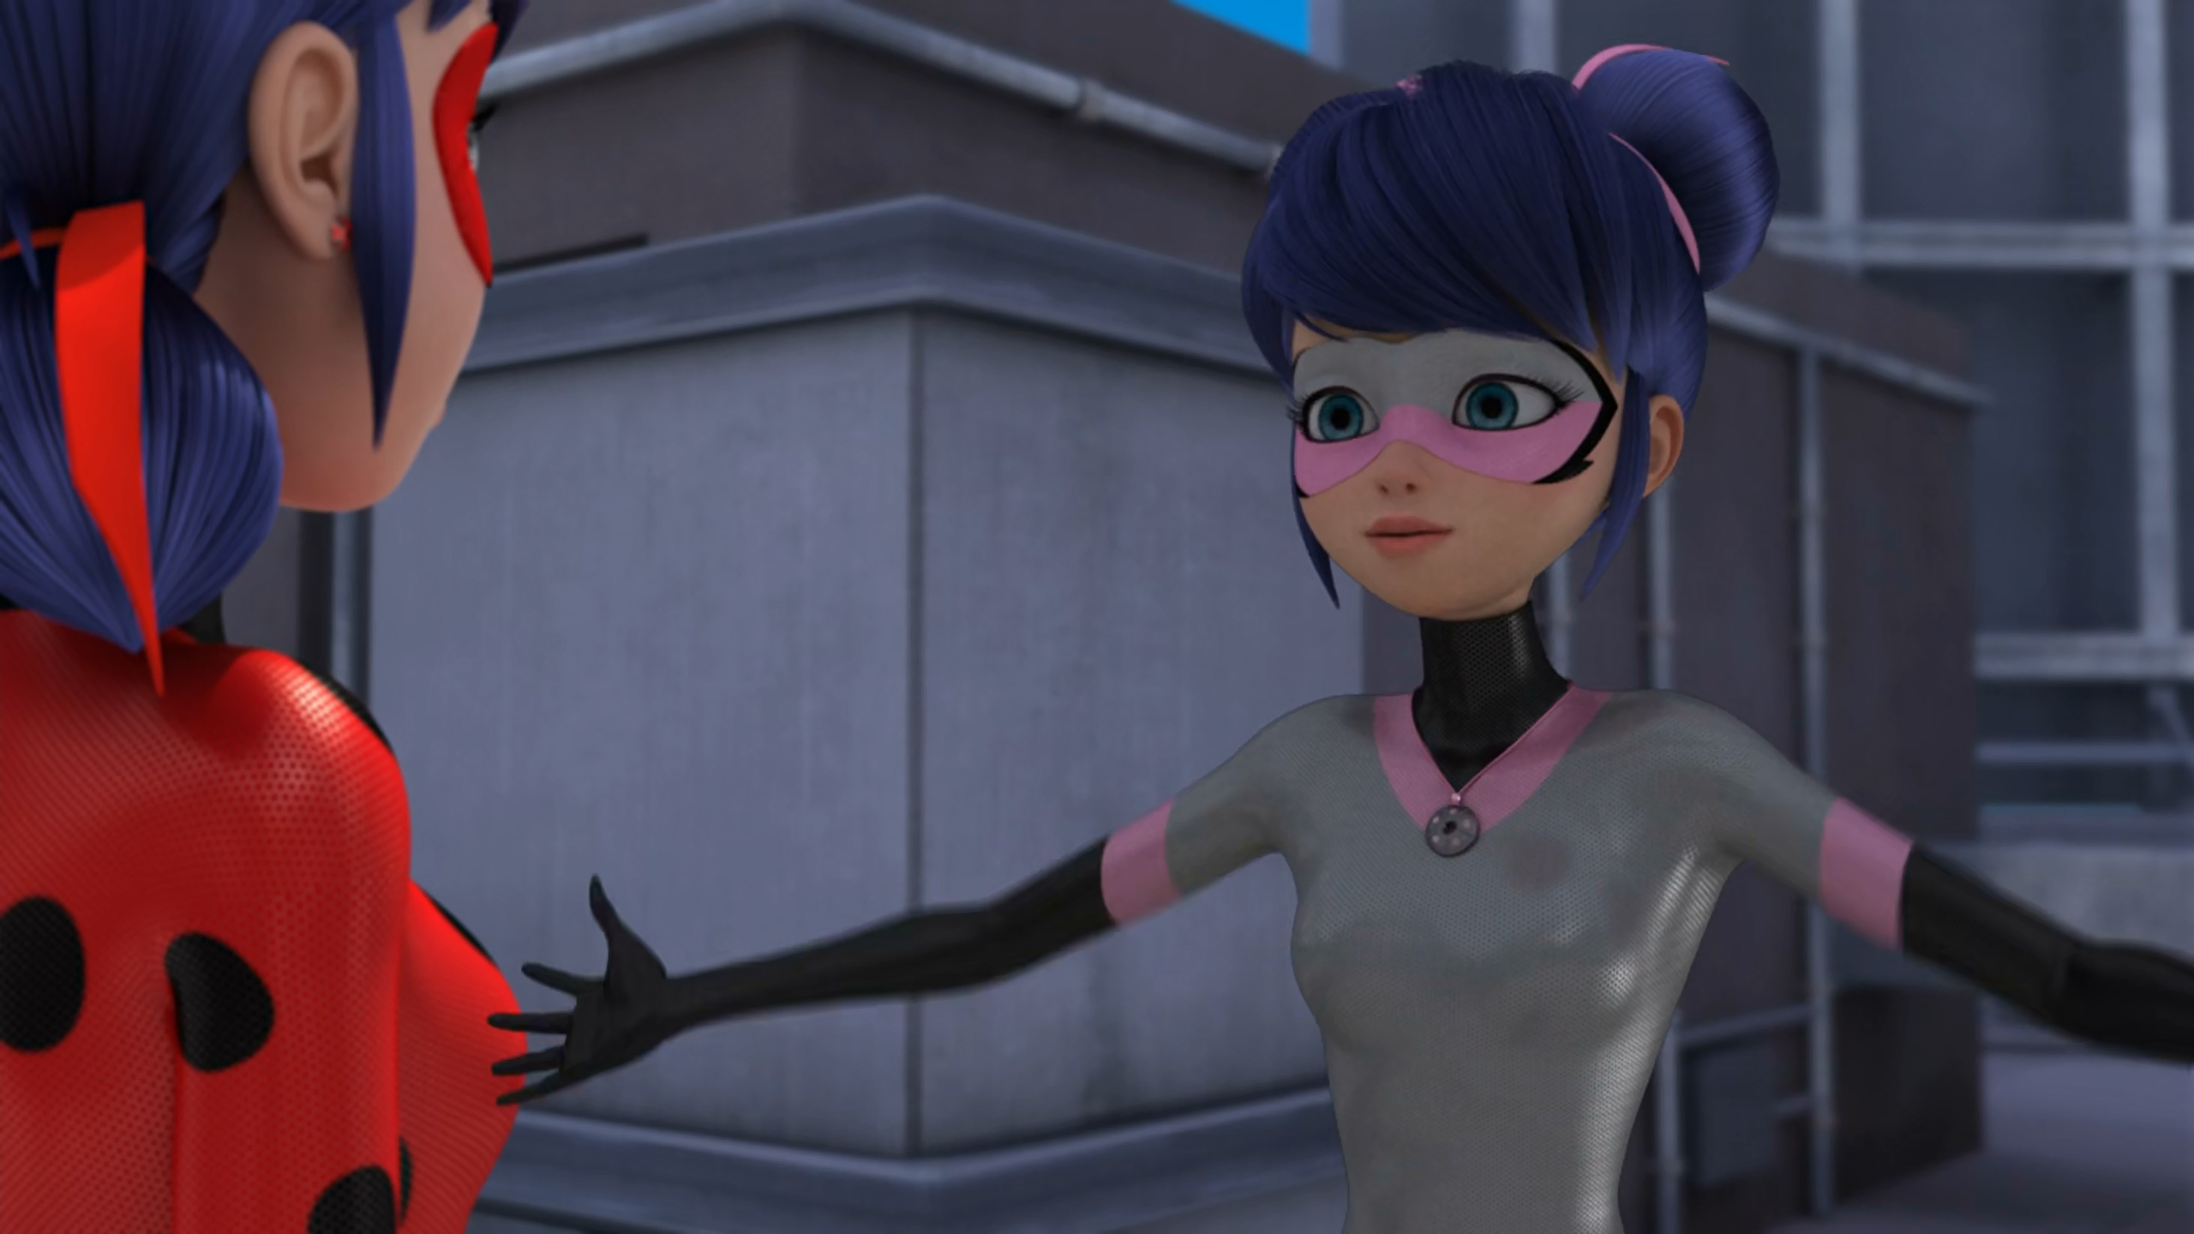
We came, we saw, we kicked her ______.
butt
hat
cap

Slide 12
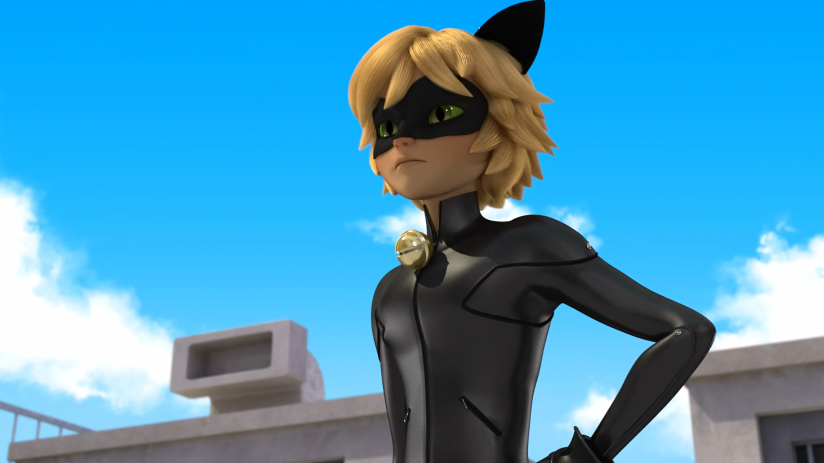
Ladybug, wait! I wanted to apologize for ______.
Plagg
being late
my Kwami

Slide 13
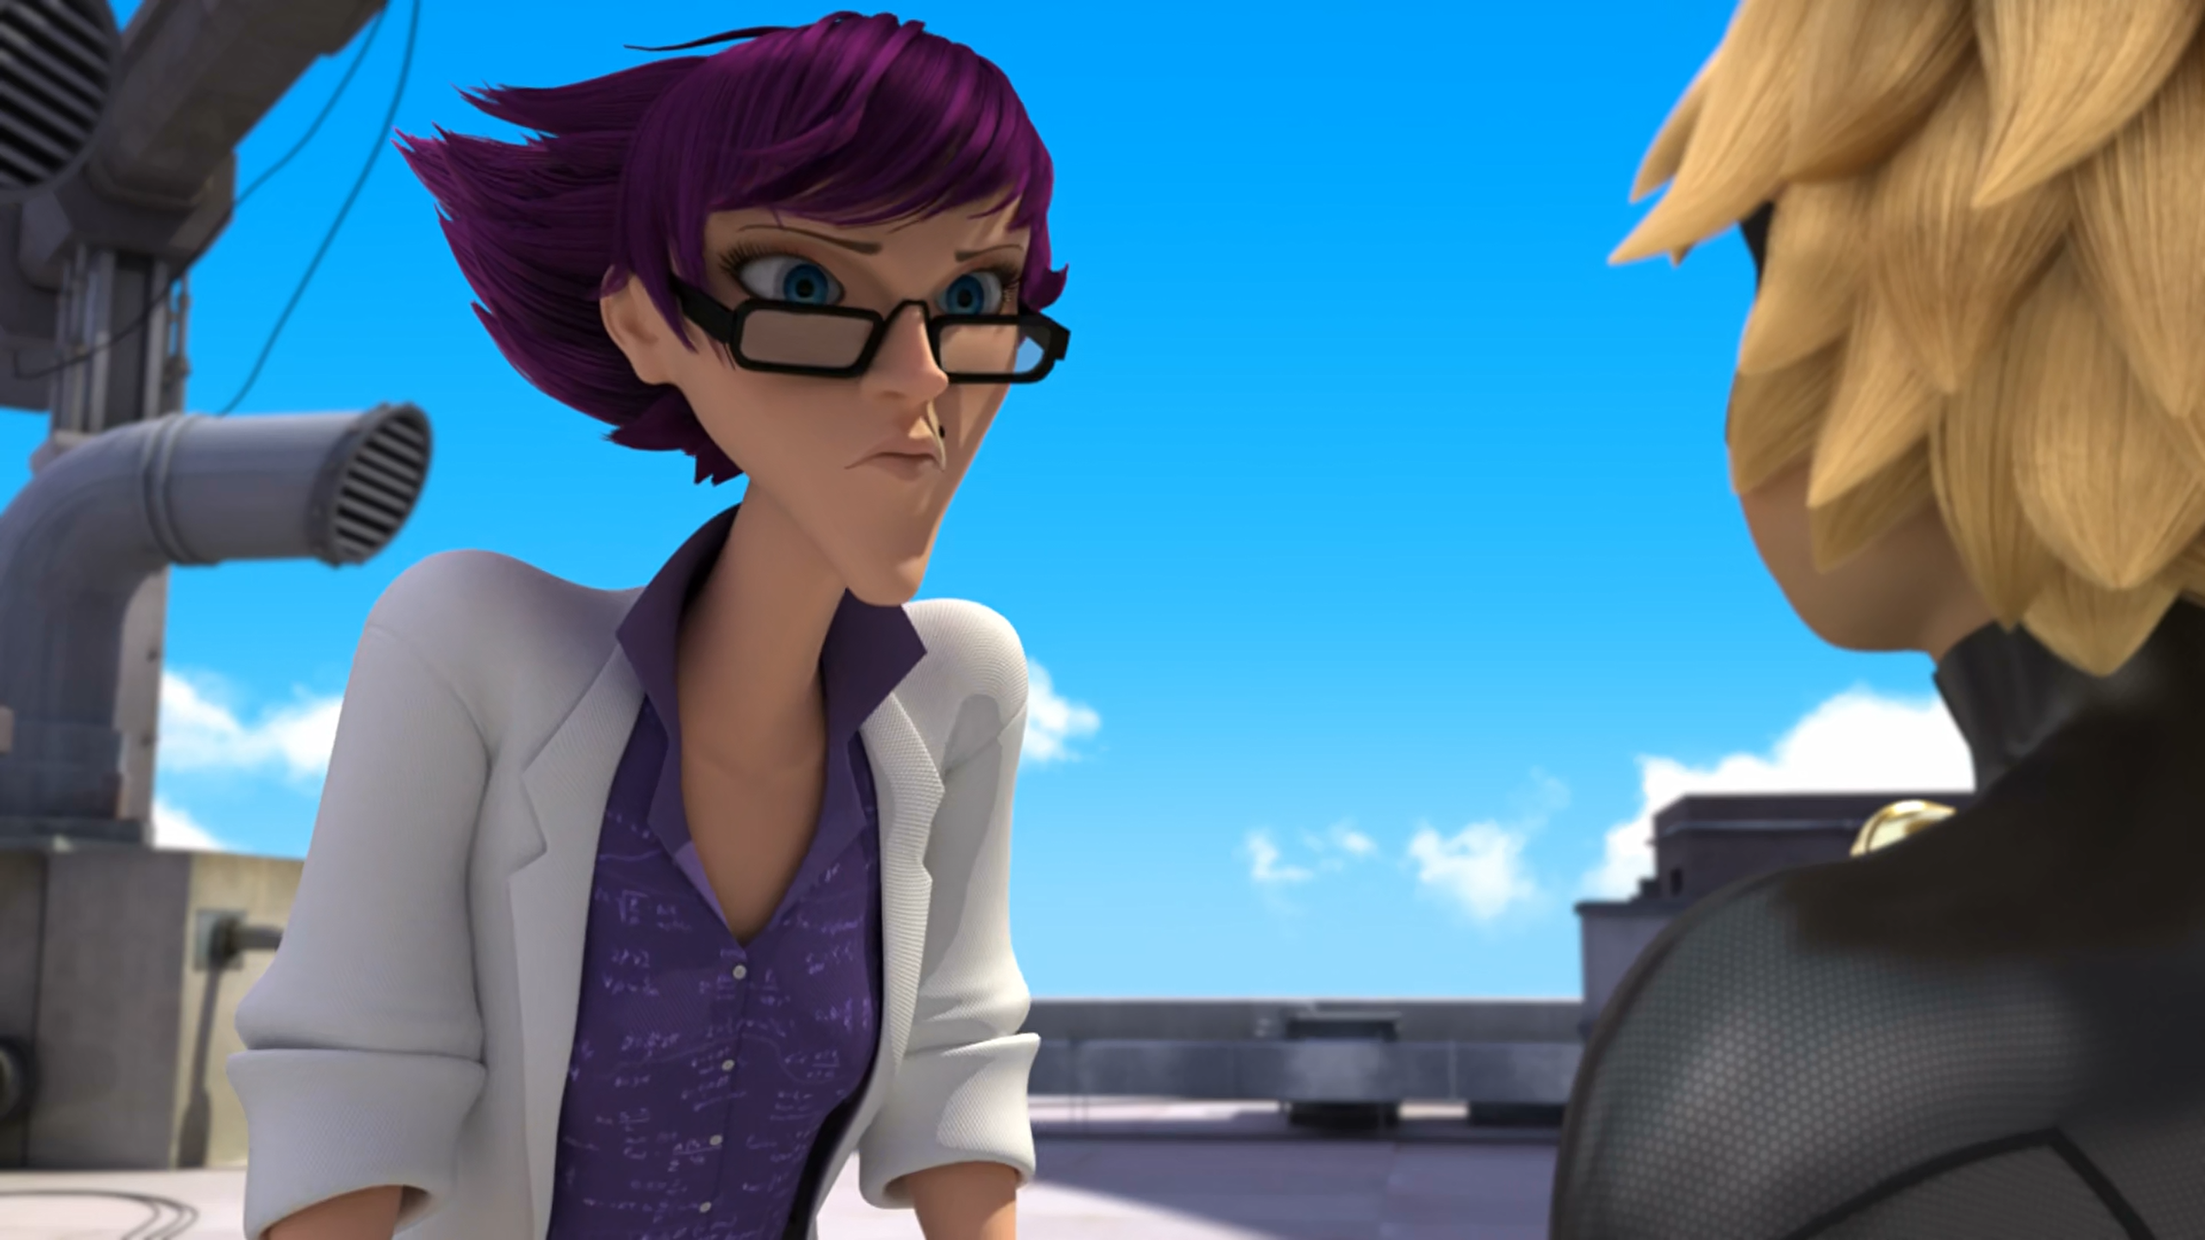
______, would you be willing to testify?
Mister Cat
Adrien
Cat Noir

Slide 14

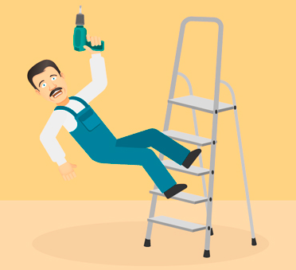
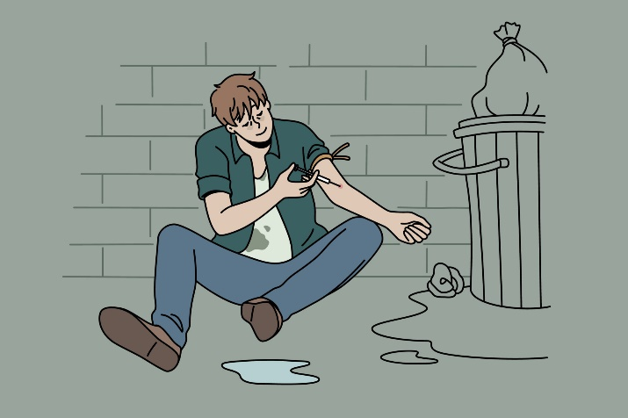
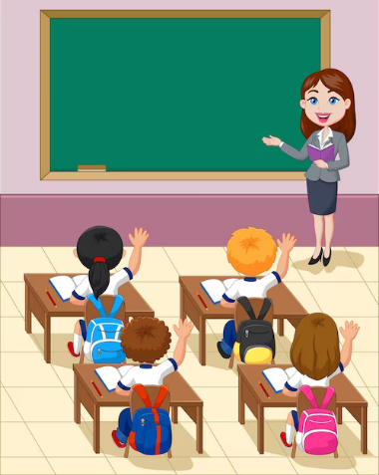
Matching Exercise
fall | clumsy | elementary | addiction

Slide 15
Matching Exercise
clumsy | fall | addiction | elementary

Slide 16
TRUE OR FALSE
1. Kwamibuster captures Plagg.
2. Cat Noir is disguised as Mr. Banana.
3. Marinette only takes two Miraculous.
4. Multimouse allows herself to be captured.
5. Cat Noir agrees to testify for Miss Mendelev.

Slide 17
TRUE OR FALSE
1. Kwamibuster captures Plagg. | TRUE
2. Cat Noir is disguised as Mr. Banana. | TRUE
3. Marinette only takes two Miraculous. | FALSE
4. Multimouse allows herself to be captured. | TRUE
5. Cat Noir agrees to testify for Miss Mendelev. | FALSE

