Slide 1
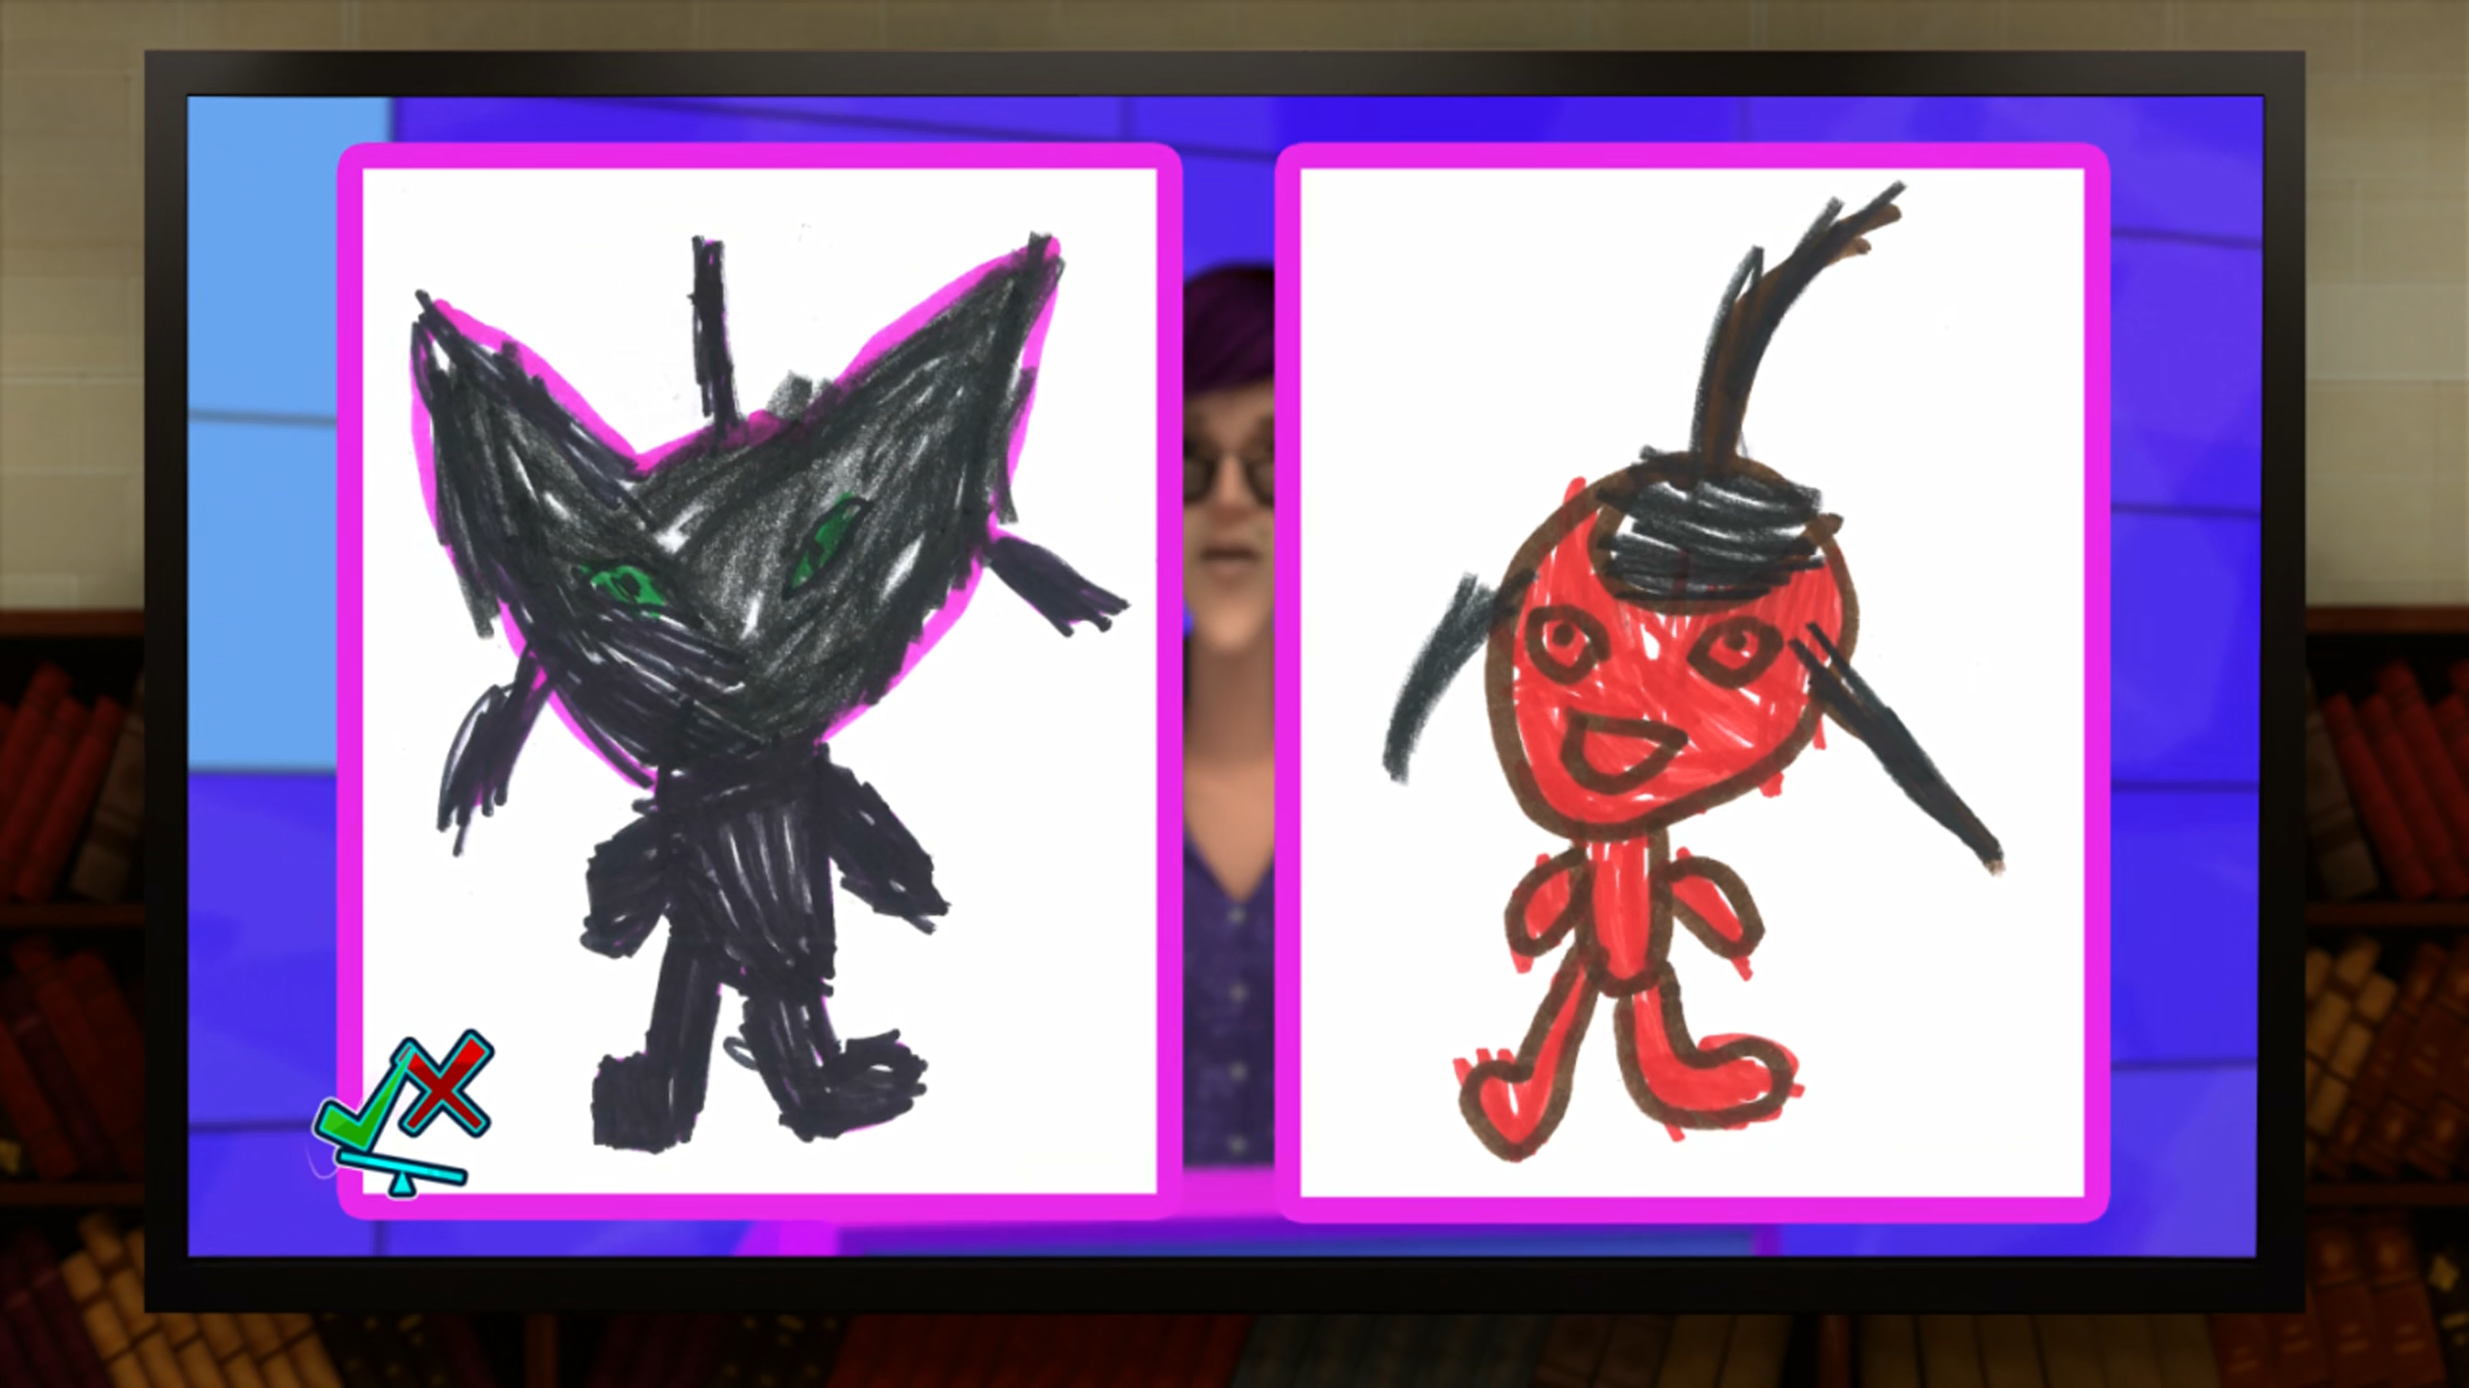
MIRACULOUS LADYBUG: KWAMIBUSTER. PART 1

Slide 2
VOCABULARY
commission - 委托 - kəˈmɪʃən
discovery - 发现 - dɪˈskʌvəri
gooey - 黏糊糊的 - ɡui
interdimensional - 多维的 - ɪnˈtɜrdɪˈmɛnʃənəl
irresistible - 不可抗拒的 - ˌɪrɪˈzɪstəbəl
luscious - 甜美的 - lʌʃɪs
matter - 物质 - mætər
predictable - 可预测的 - prɪˈdɪktəbəl
utmost - 极致的 - ʌtˌmoʊst

Slide 3
1. 发现
2. ɡui
3. 可预测的

Slide 4
1. 发现 - discovery
2. ɡui - gooey
3. 可预测的 - predictable

Slide 5
KWAMIBUSTER. PART 1
Plagg: Sorry, Sugarcube, but I can't resist such irresistible beauty! Here it sits everyday beckoning me with its gooey lusciousness. And every time I eat it, it just pops right back up the very next day!
Tikki: Don't you think it's strange that this gross, stinky thing just reappears in the same spot day after day?

Slide 6
Plagg: Chill out, Sugarcube. Don't forget that nobody can capture or record us.
Tikki: I know that, but we were actually seen by a human. And at school, too! That could jeopardize our owners' secret identities.
Plagg: Aaw, okay, I promise you I won't eat any more magic cheese ever again and really what's the worst that could happen anyway.

Slide 7
Olga Mendeleiev: What are you about to witness is proof of the existence of interdimensional creatures with incredible powers who can move through matter and seem to be attracted to aged cheese.
I discovered the first of these creatures soon after school began in September, I started observing it closely. Then, I discovered a second one.

Slide 8
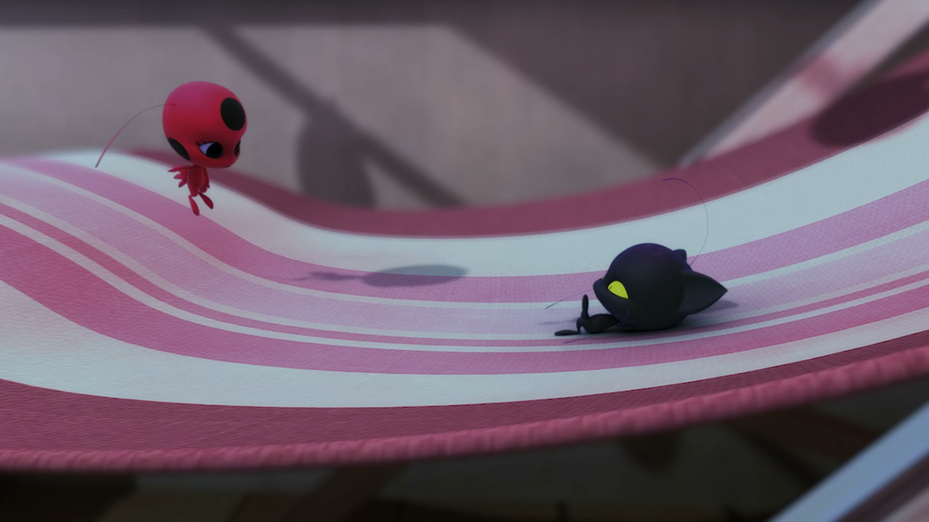

Chill out, ______. Don't forget that nobody can capture or record us.
sexy
honey
sugarcube

Slide 9
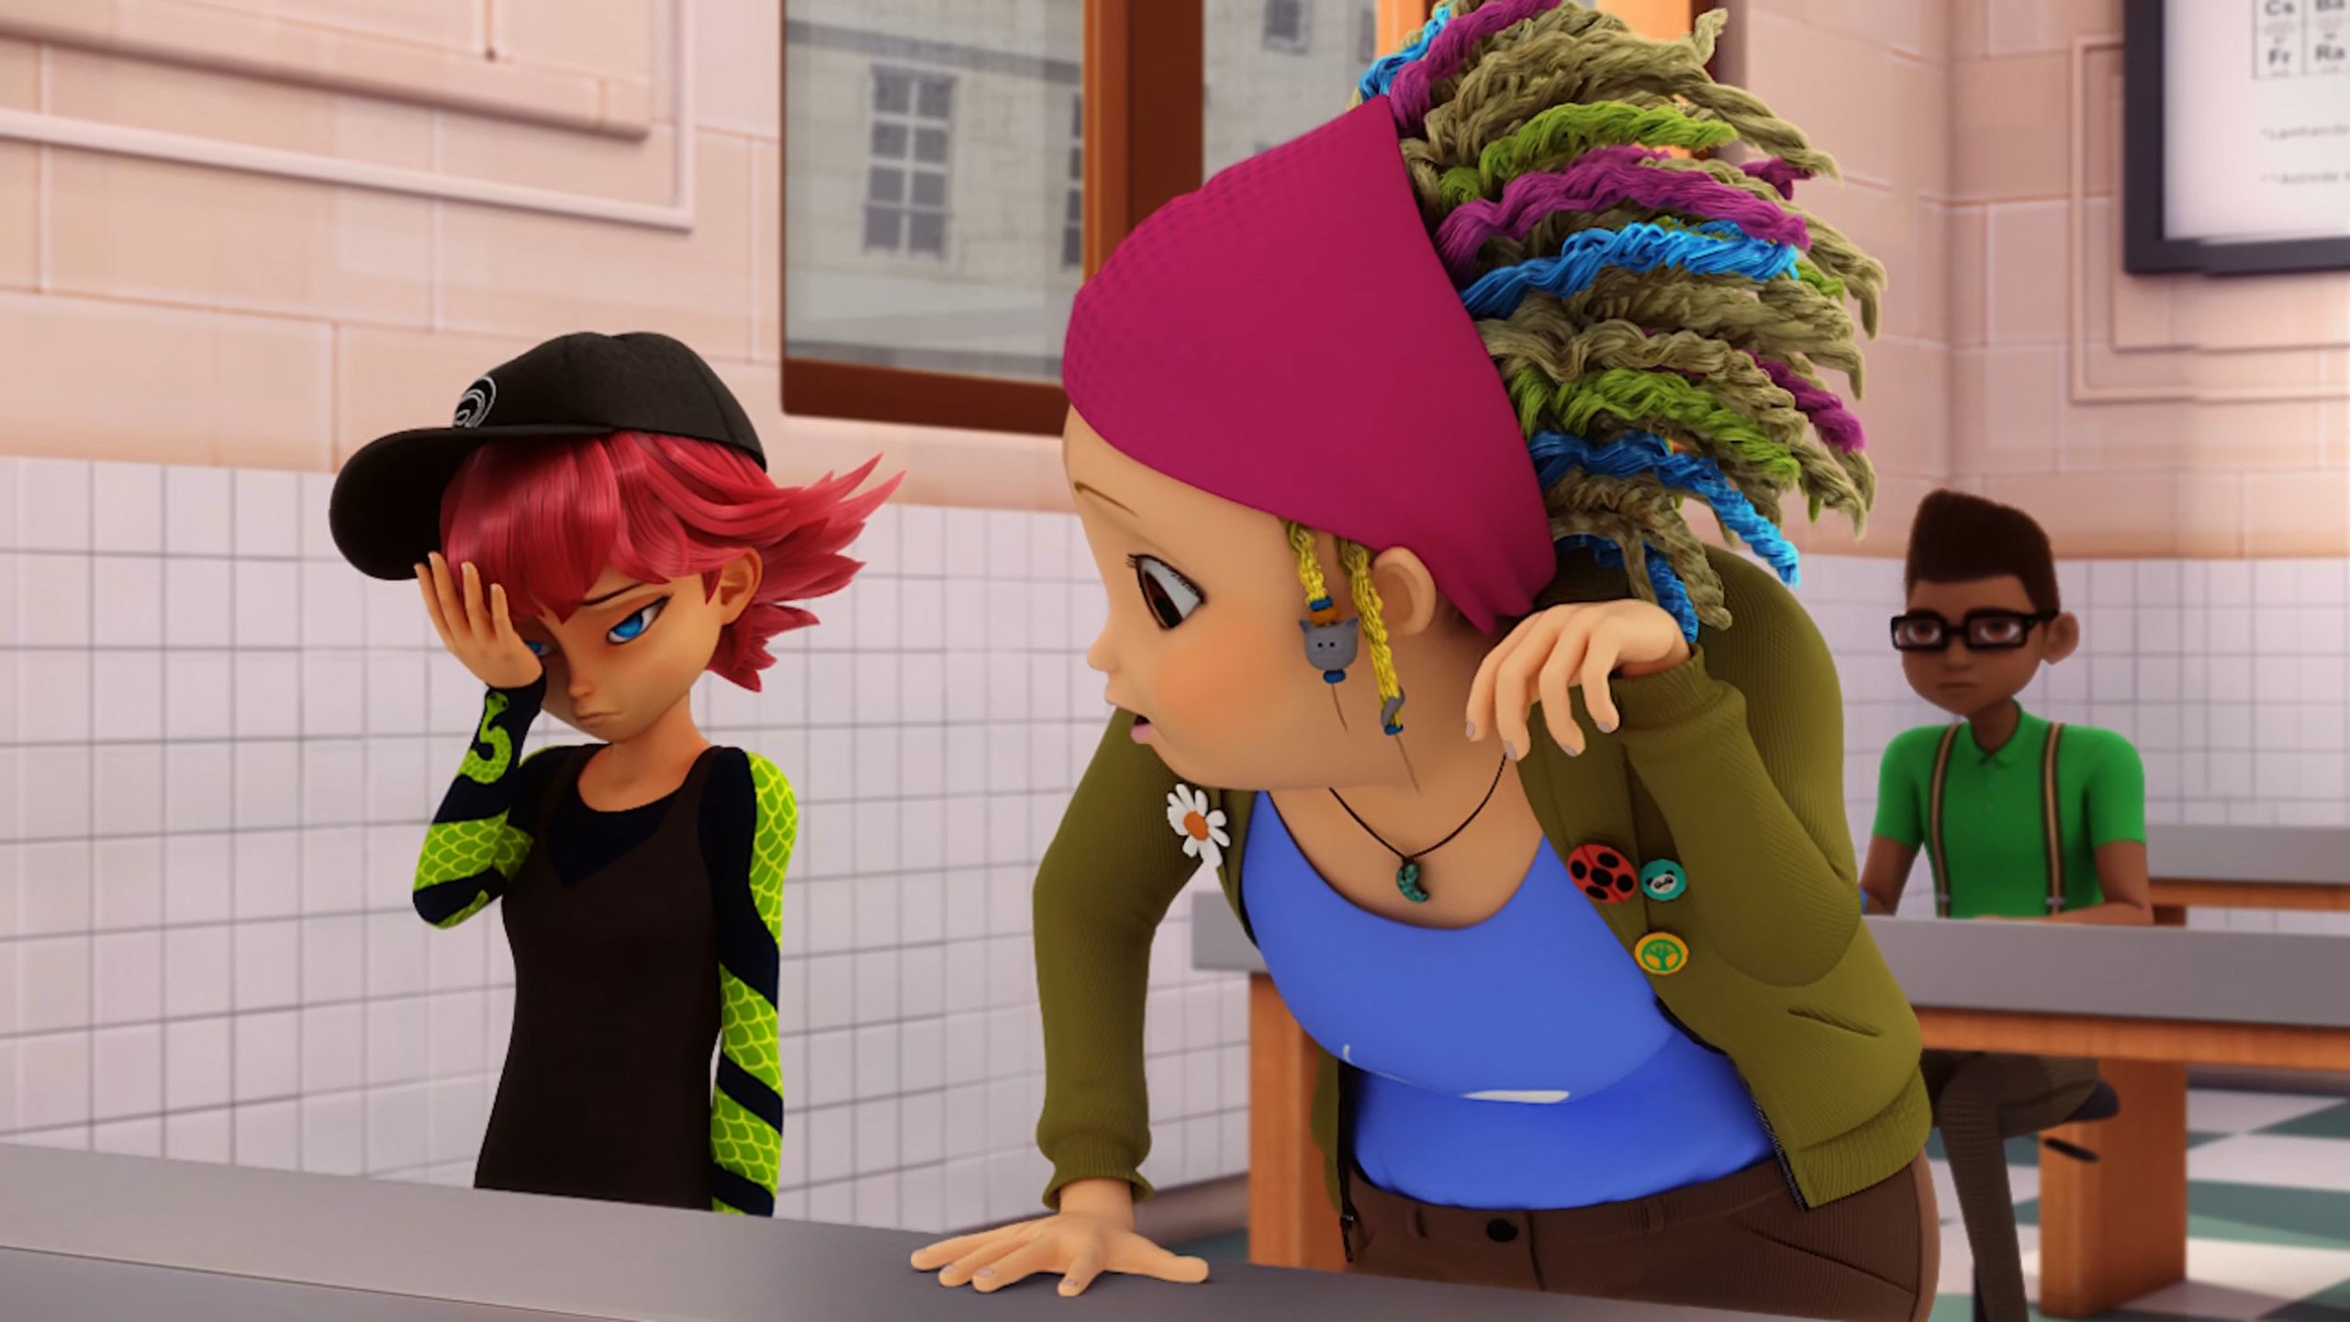
Ugh, my ______ is one of the guests, too...
brother
sister
pig

Slide 10
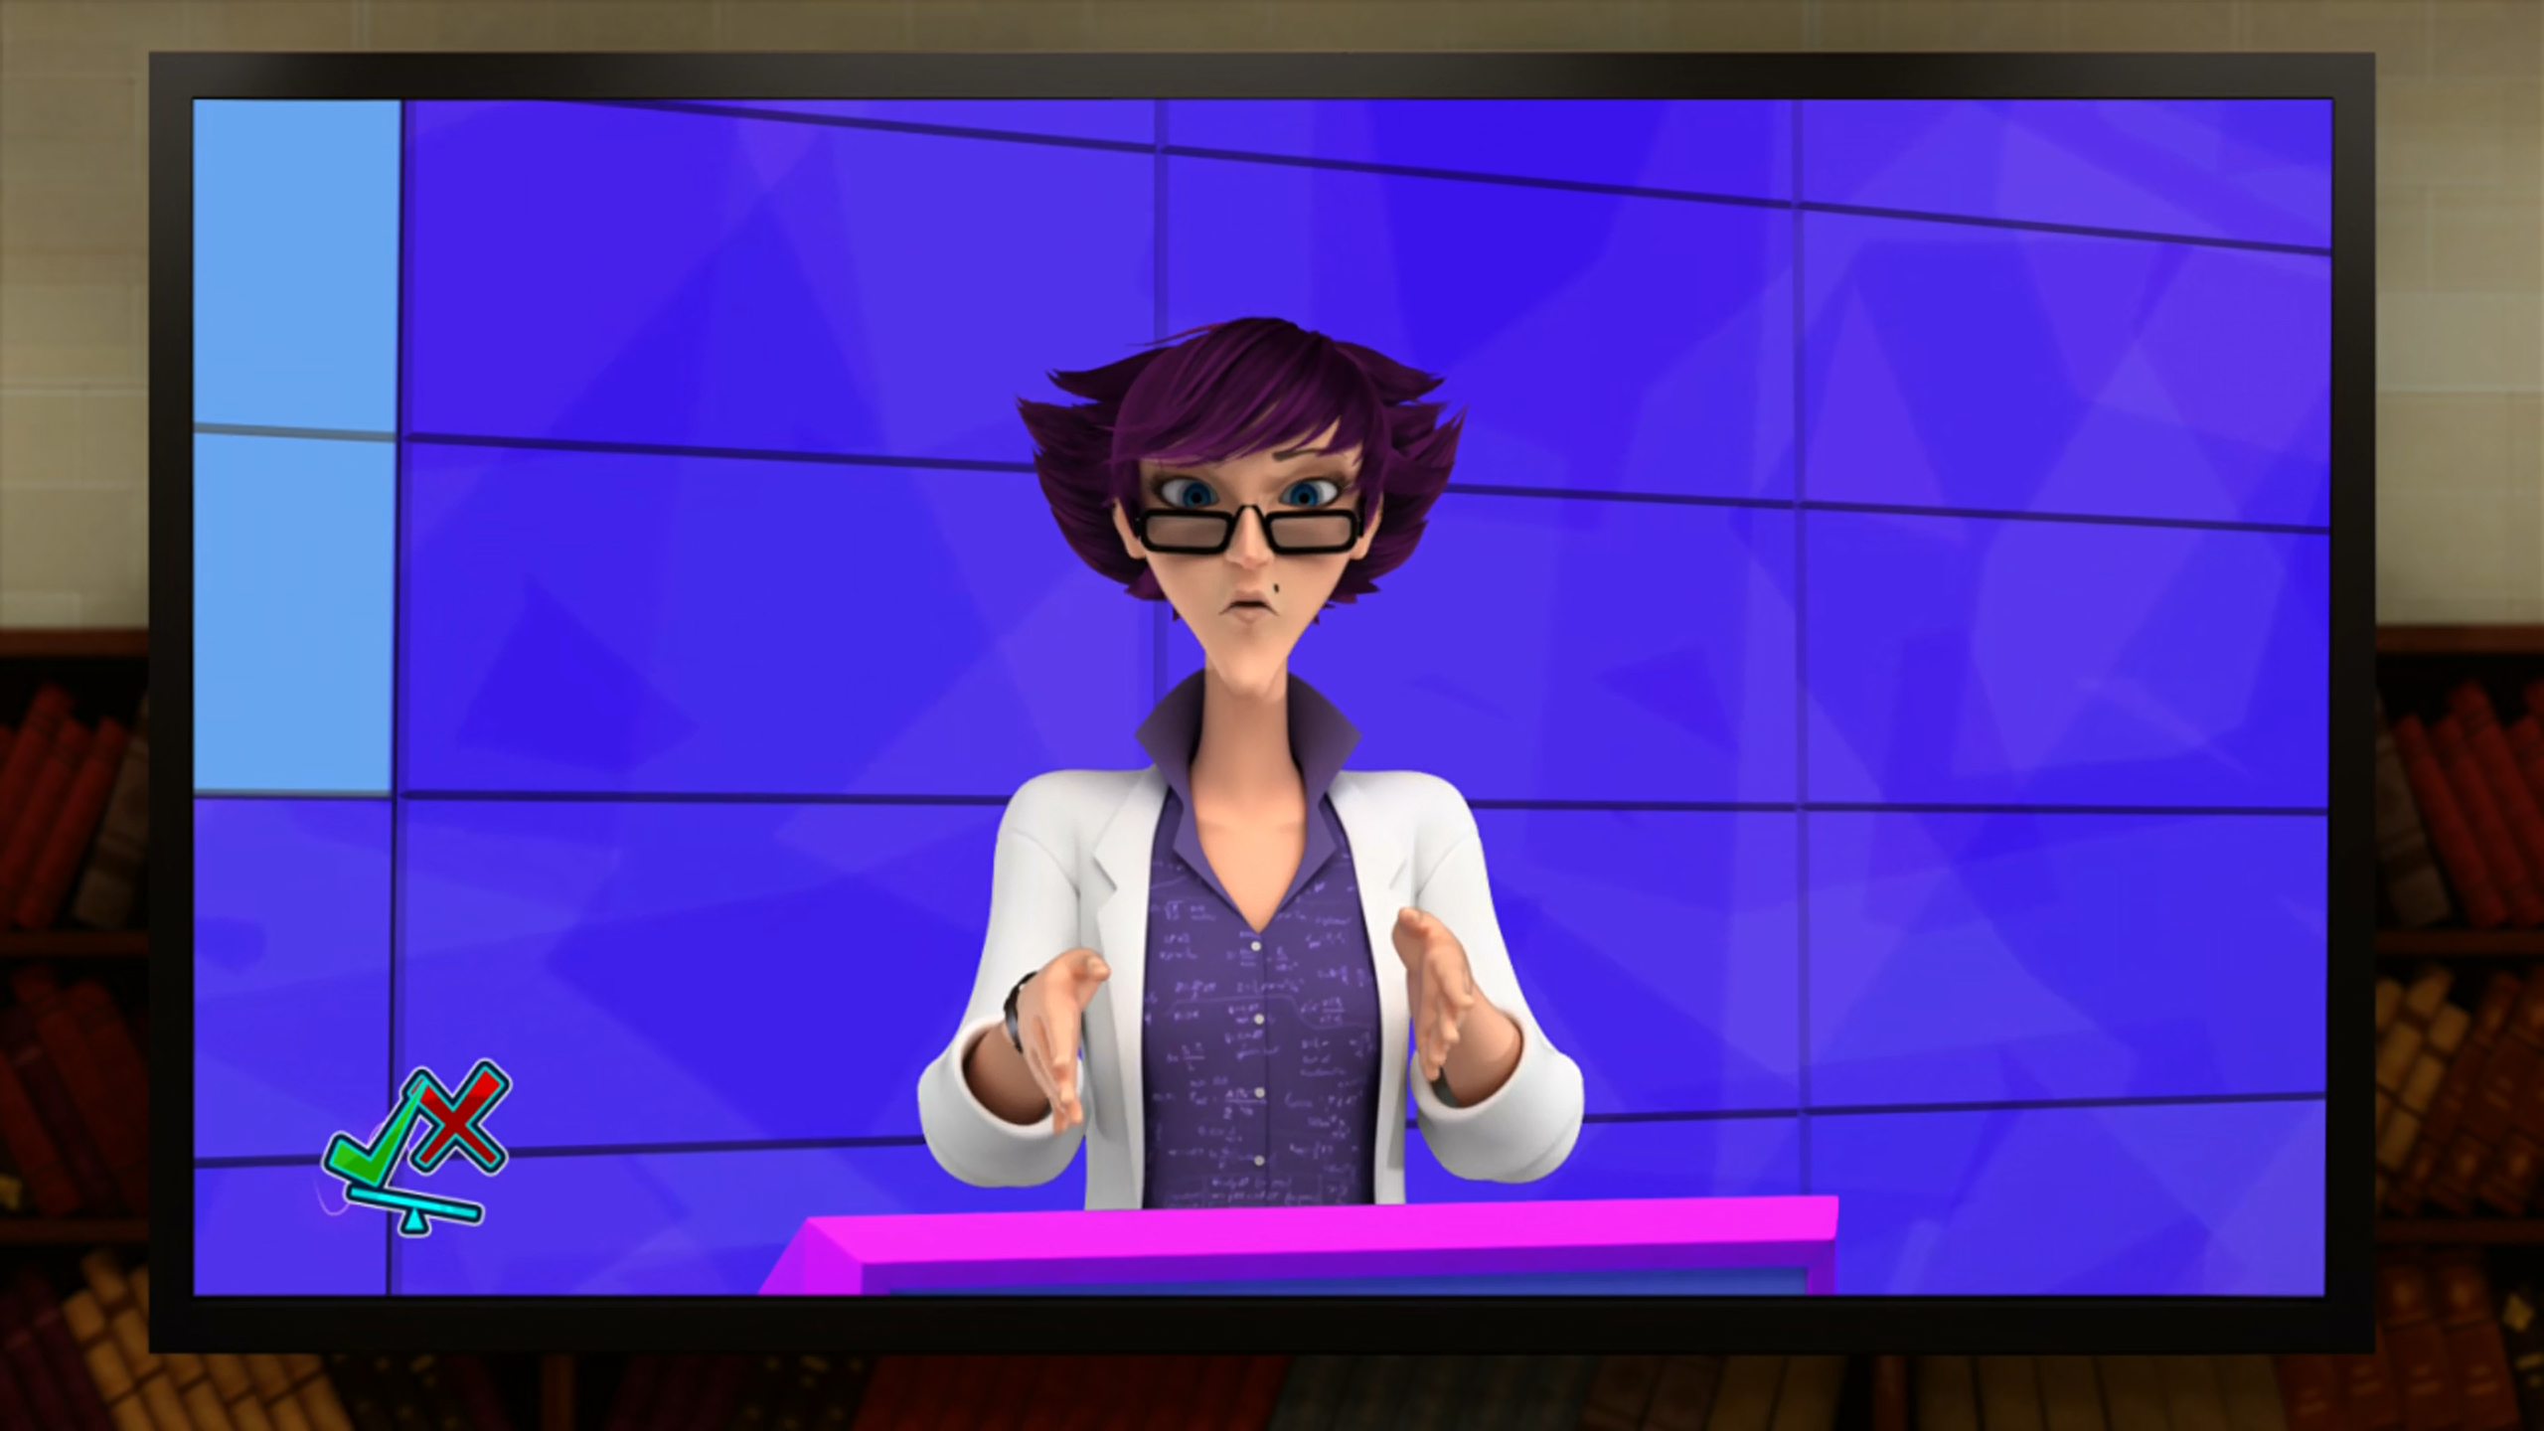
interdimensional ______ with incredible powers.
aliens
creatures
kwamis

Slide 11
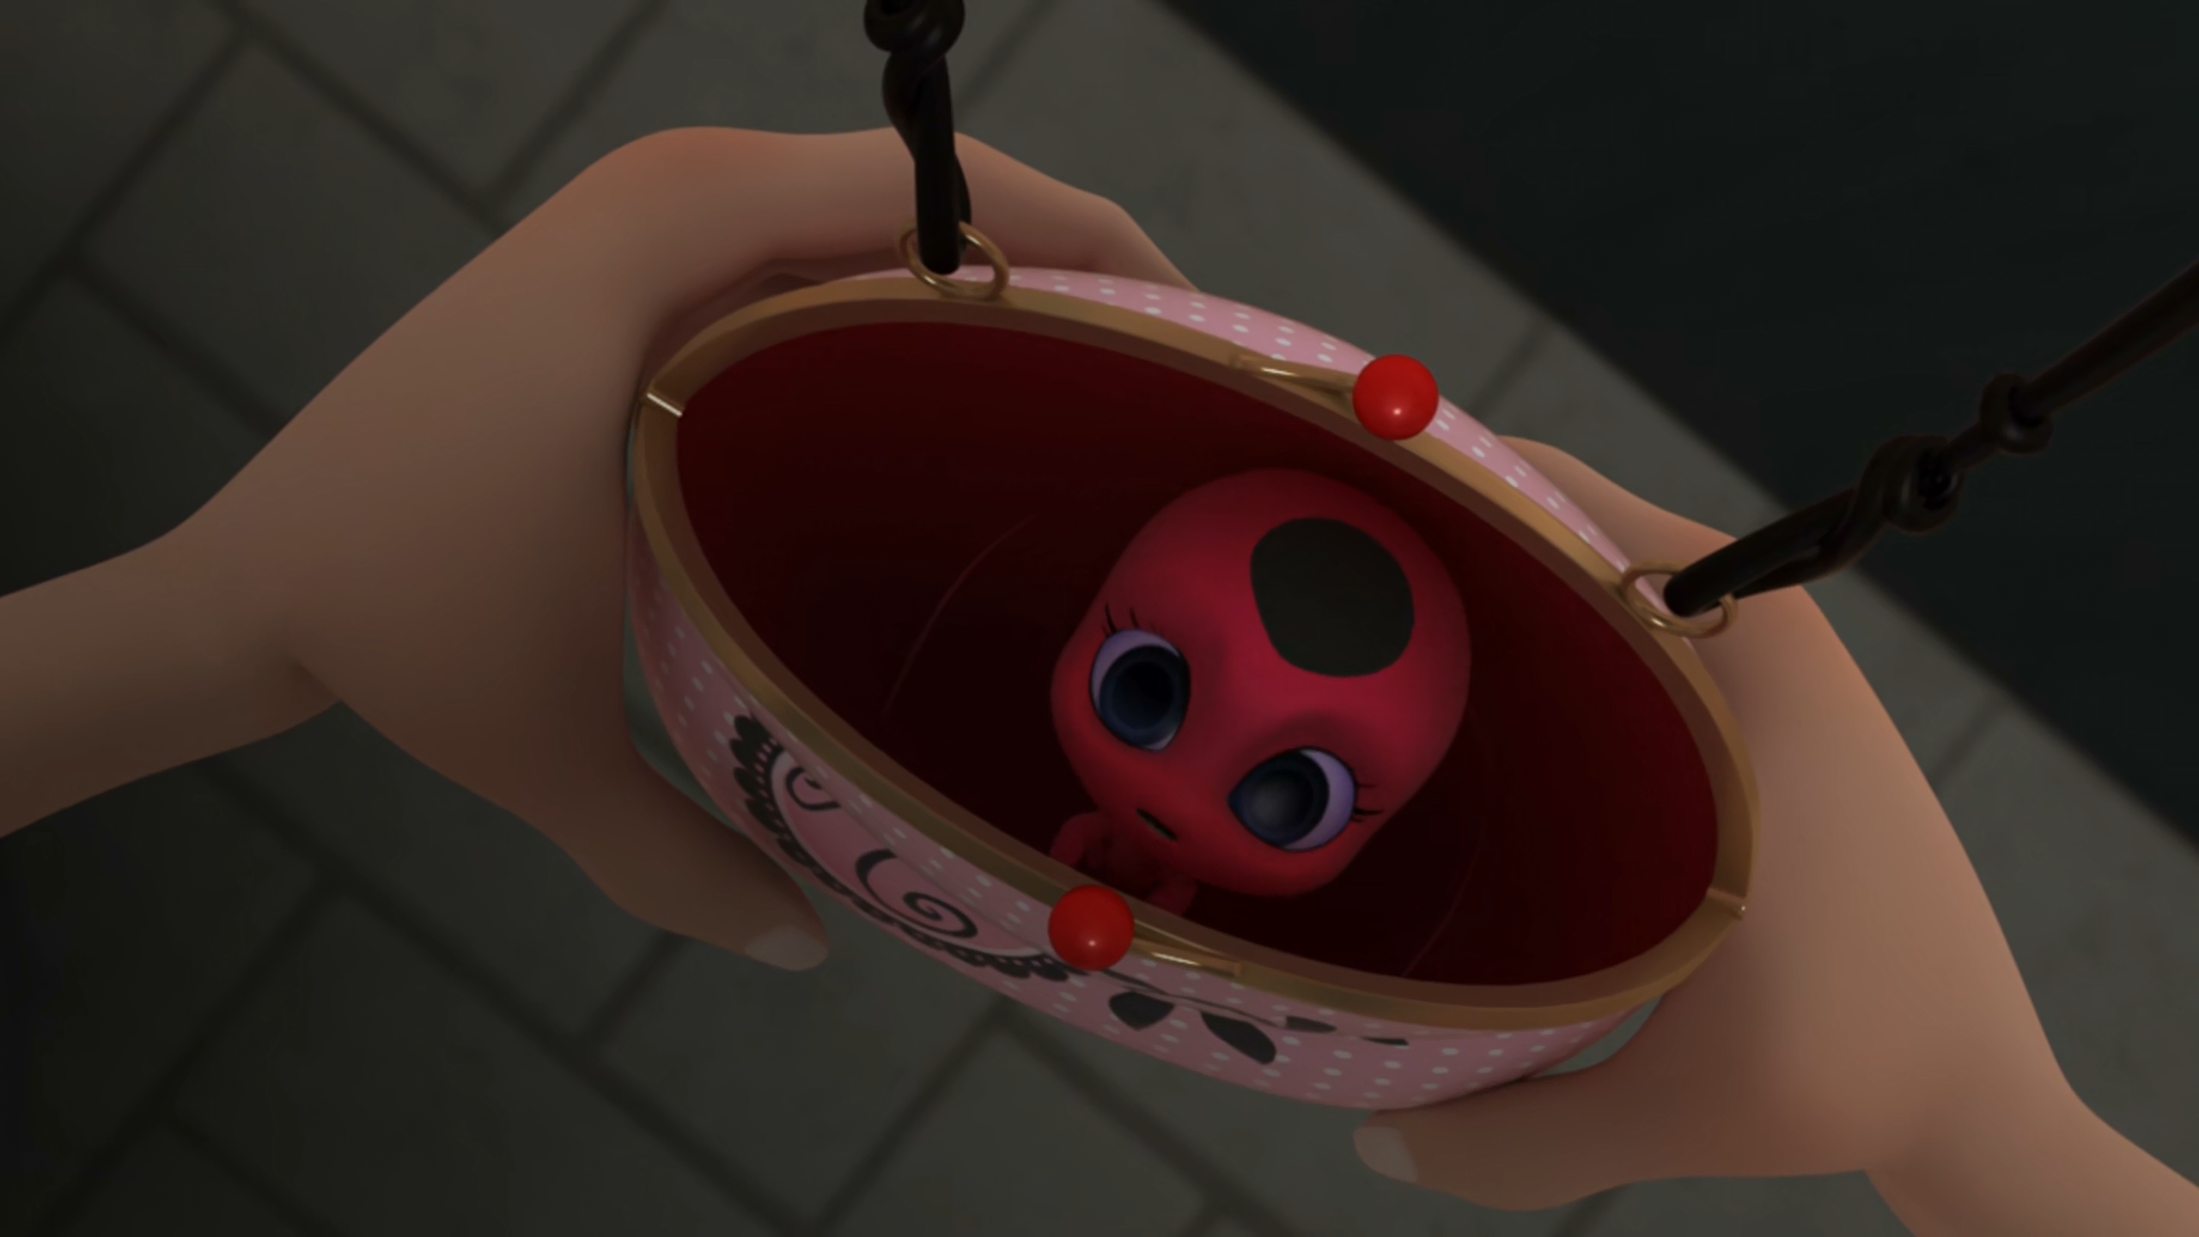
Plagg promised he wouldn't eat any of that magic ______ anymore.
chocolate
cheese
croissants

Slide 12
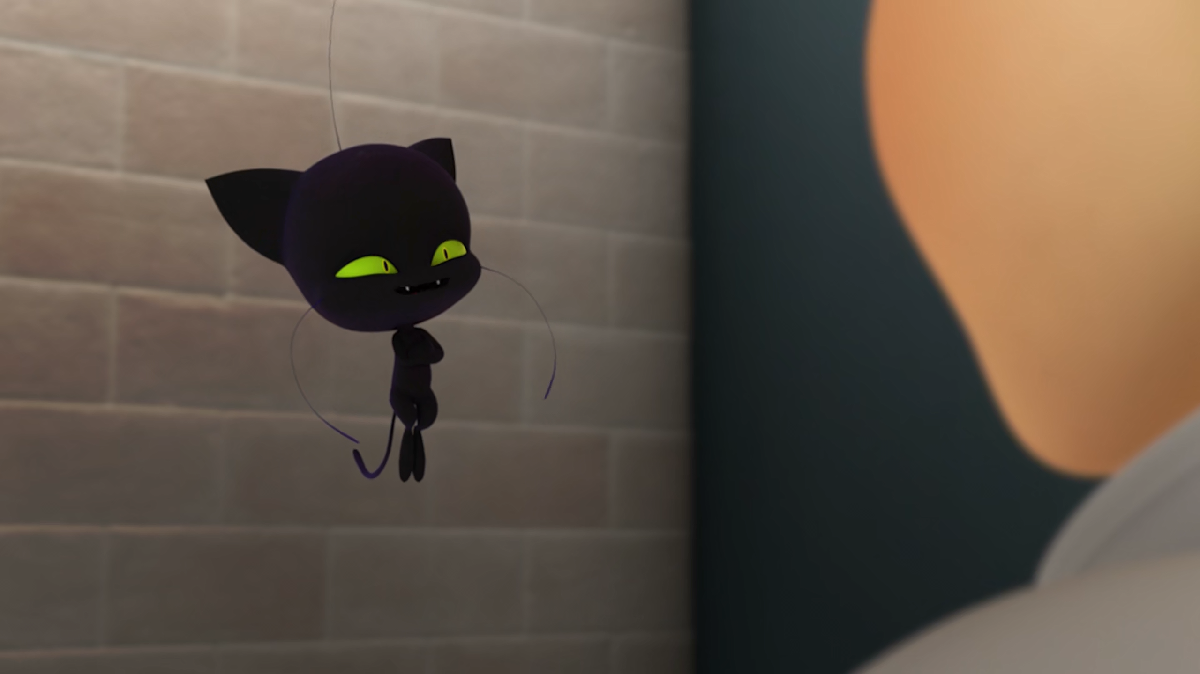
Puh-lease, it's ______ to capture a kwami.
possible
not possible
impossible

Slide 13
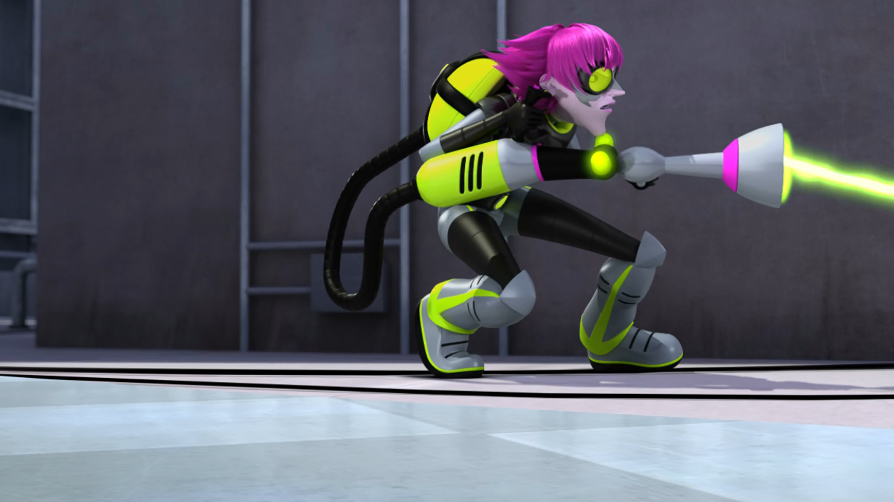
Back off, kids, I'm a ______!
scientist
teacher
supervillian

Slide 14
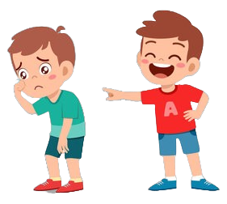
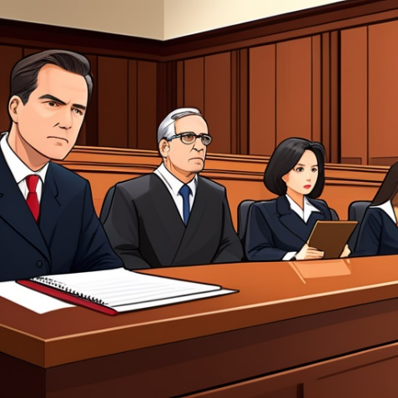
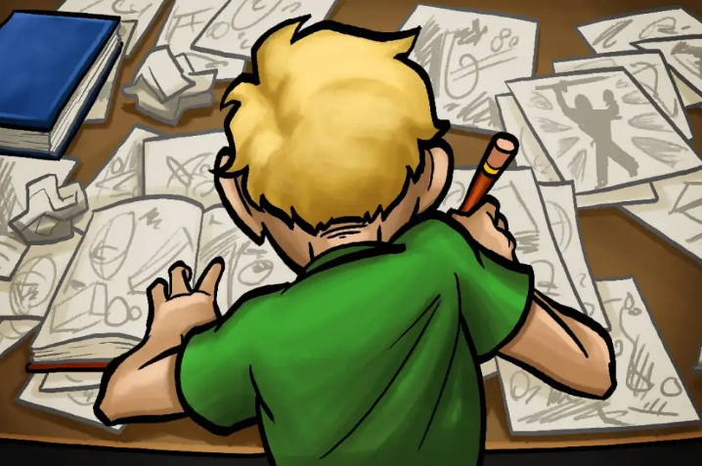
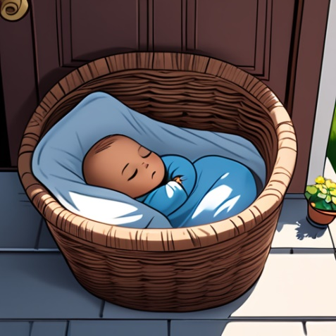
Matching Exercise
abandon | ridicule | jury | sketch

Slide 15
Matching Exercise
ridicule | jury | sketch | abandon

Slide 16
TRUE OR FALSE
1. Plagg goes to the science lab to eat magic cheese.
2. Miss Mendeleiev gets Plagg and Tikki on film.
3. Miss Mendeleiev appears on a TV show.
4. Adrien thinks Marinette could be Ladybug.
5. Kwamibuster puts the game show host in a fridge.

Slide 17
TRUE OR FALSE
1. Plagg goes to the science lab to eat magic cheese. | TRUE
2. Miss Mendeleiev gets Plagg and Tikki on film. | FALSE
3. Miss Mendeleiev appears on a TV show. | TRUE
4. Adrien thinks Marinette could be Ladybug. | TRUE
5. Kwamibuster puts the game show host in a fridge. | FALSE

