Slide 1
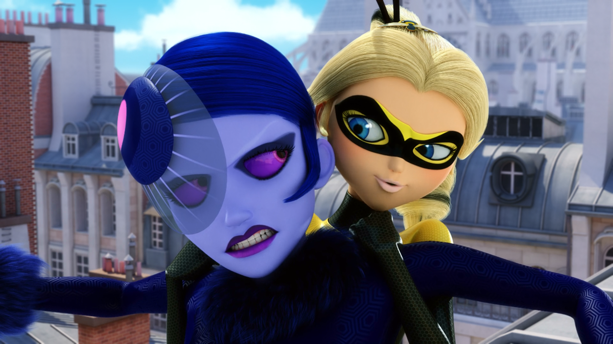
MIRACULOUS LADYBUG: MIRACULER. PART 2

Slide 2
VOCABULARY
boundless - 无边无际 - baʊndləs
copycat - 模仿者 - kɒpɪkæt
despicable - 卑鄙无耻 - dɛspɪkəbᵊl
heal - 治愈 - hiːl
incompetent - 无能 - ɪnˈkɒmpɪtᵊnt
phrase - 短语 - freɪz
swipe - 滑动 - swaɪp
wuss - 懦夫 - wʌs

Slide 3
1. 治愈
2. freɪz
3. swaɪp

Slide 4
1. 治愈 - heal
2. freɪz - phrase
3. swaɪp - swipe

Slide 5
MIRACULER. PART 2
Cat Noir: Plagg, claws in.
Plagg: So, that's what it feels like to get Cataclysmed. I promise I'll never call the dinosaurs a bunch of wusses ever again.
Adrien: Plagg, grab some Camembert in my jacket. We'll rest for a while 'til Ladybug comes back.

Slide 6
Chloé: Not like this! You are so far off the mark! I don't wanna be Ladybug, there's only one Ladybug, and she isn't me. I am…
Cat Noir: Queen Bee.
Chloé: Ugh! About time, too!
Hawk Moth: Right on time!
Cat Noir: Hey!
Chloé: Who are you?
Mayura: I am Mayura.

Slide 7
Queen Bee: Buzz off.
Chloé: I understand. But I'm sure that you'll need me again, Ladybug. I know that I'll be Queen Bee again someday. I will always be Queen Bee.
Ladybug: Thank you, Chloé. Let's go.
Cat Noir: Ladies.
Sabrina: I guess you'll never wanna play with me again now.

Slide 8
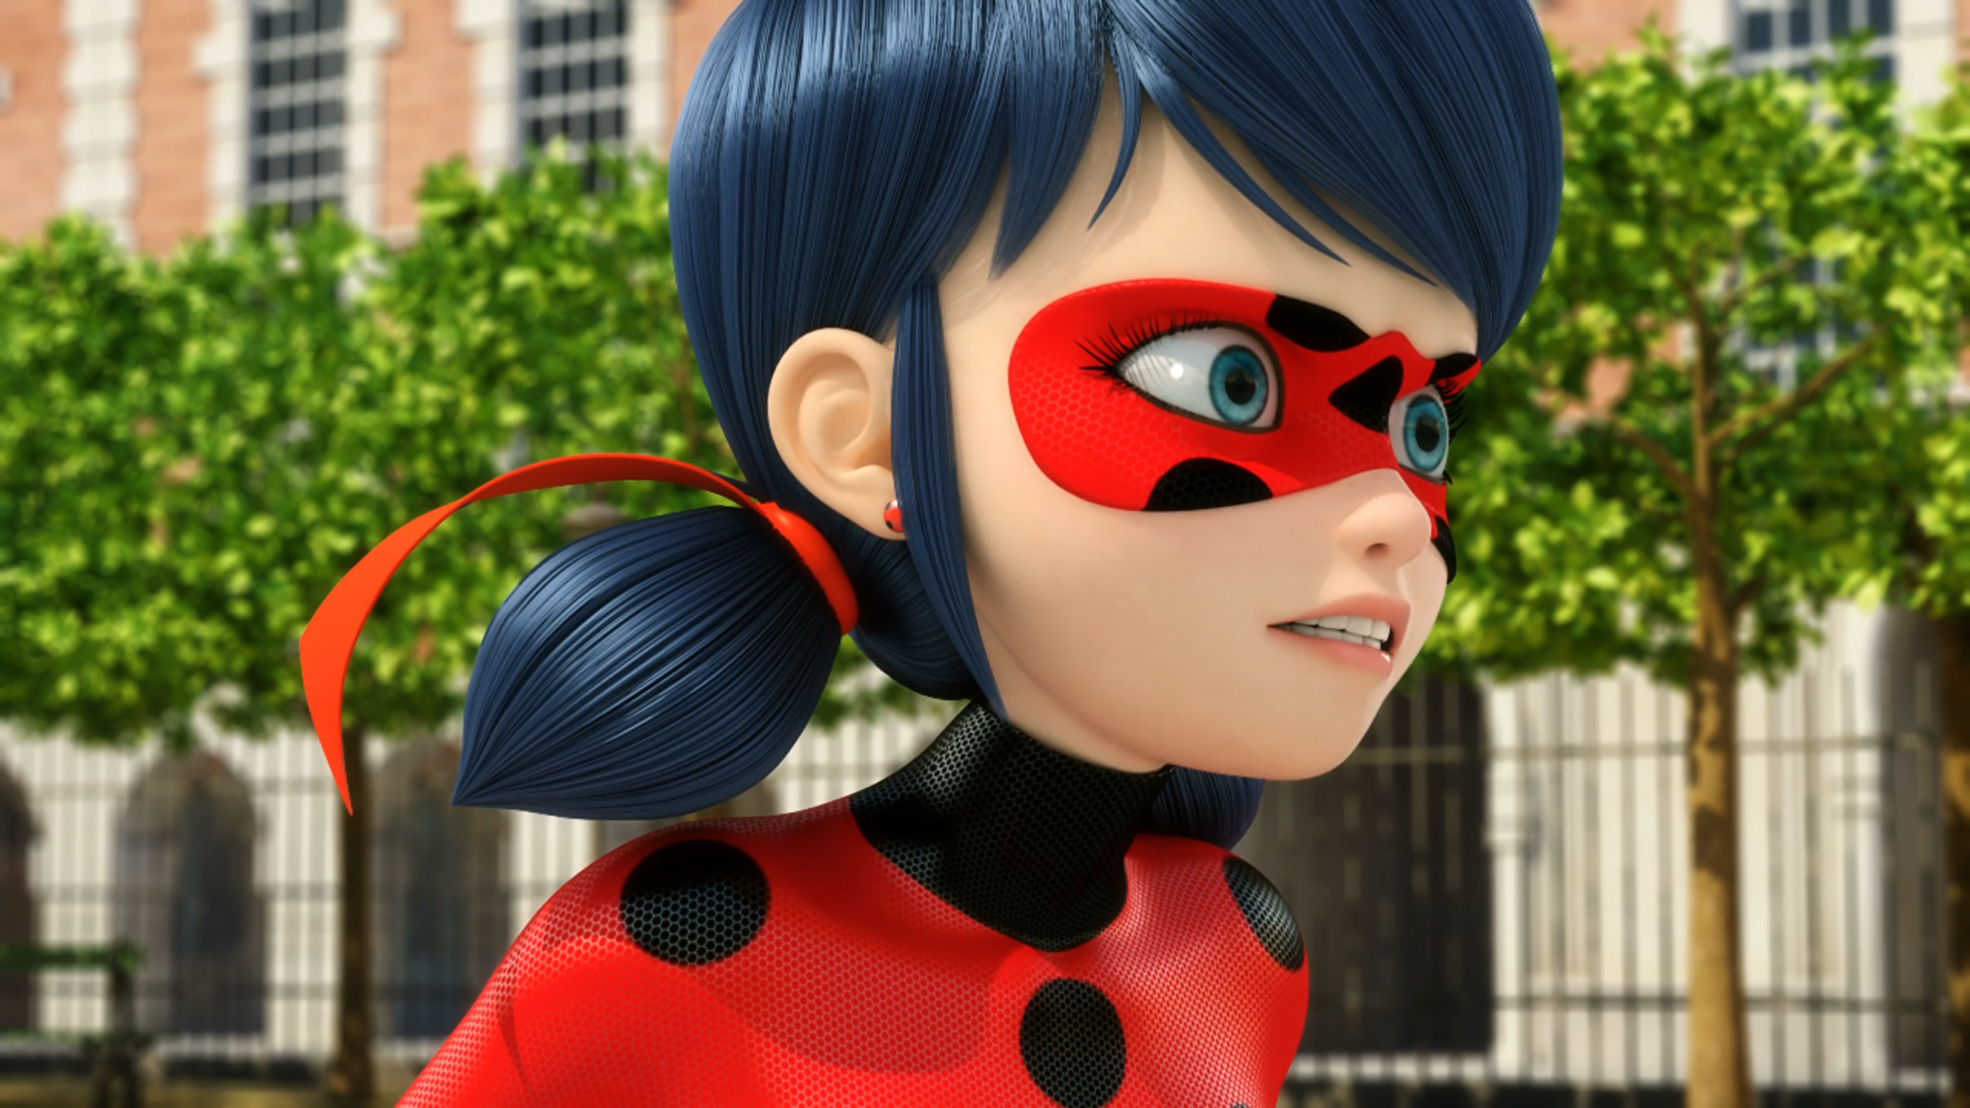
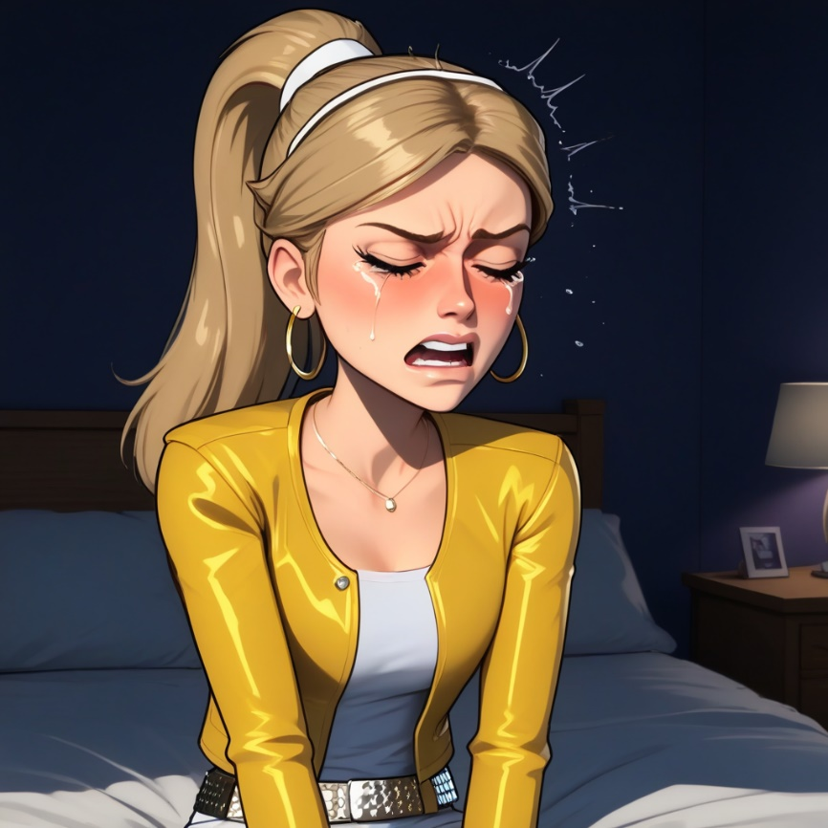
I don't even talk like that! Stop ______ me!
mocking
copying
mimicking

Slide 9
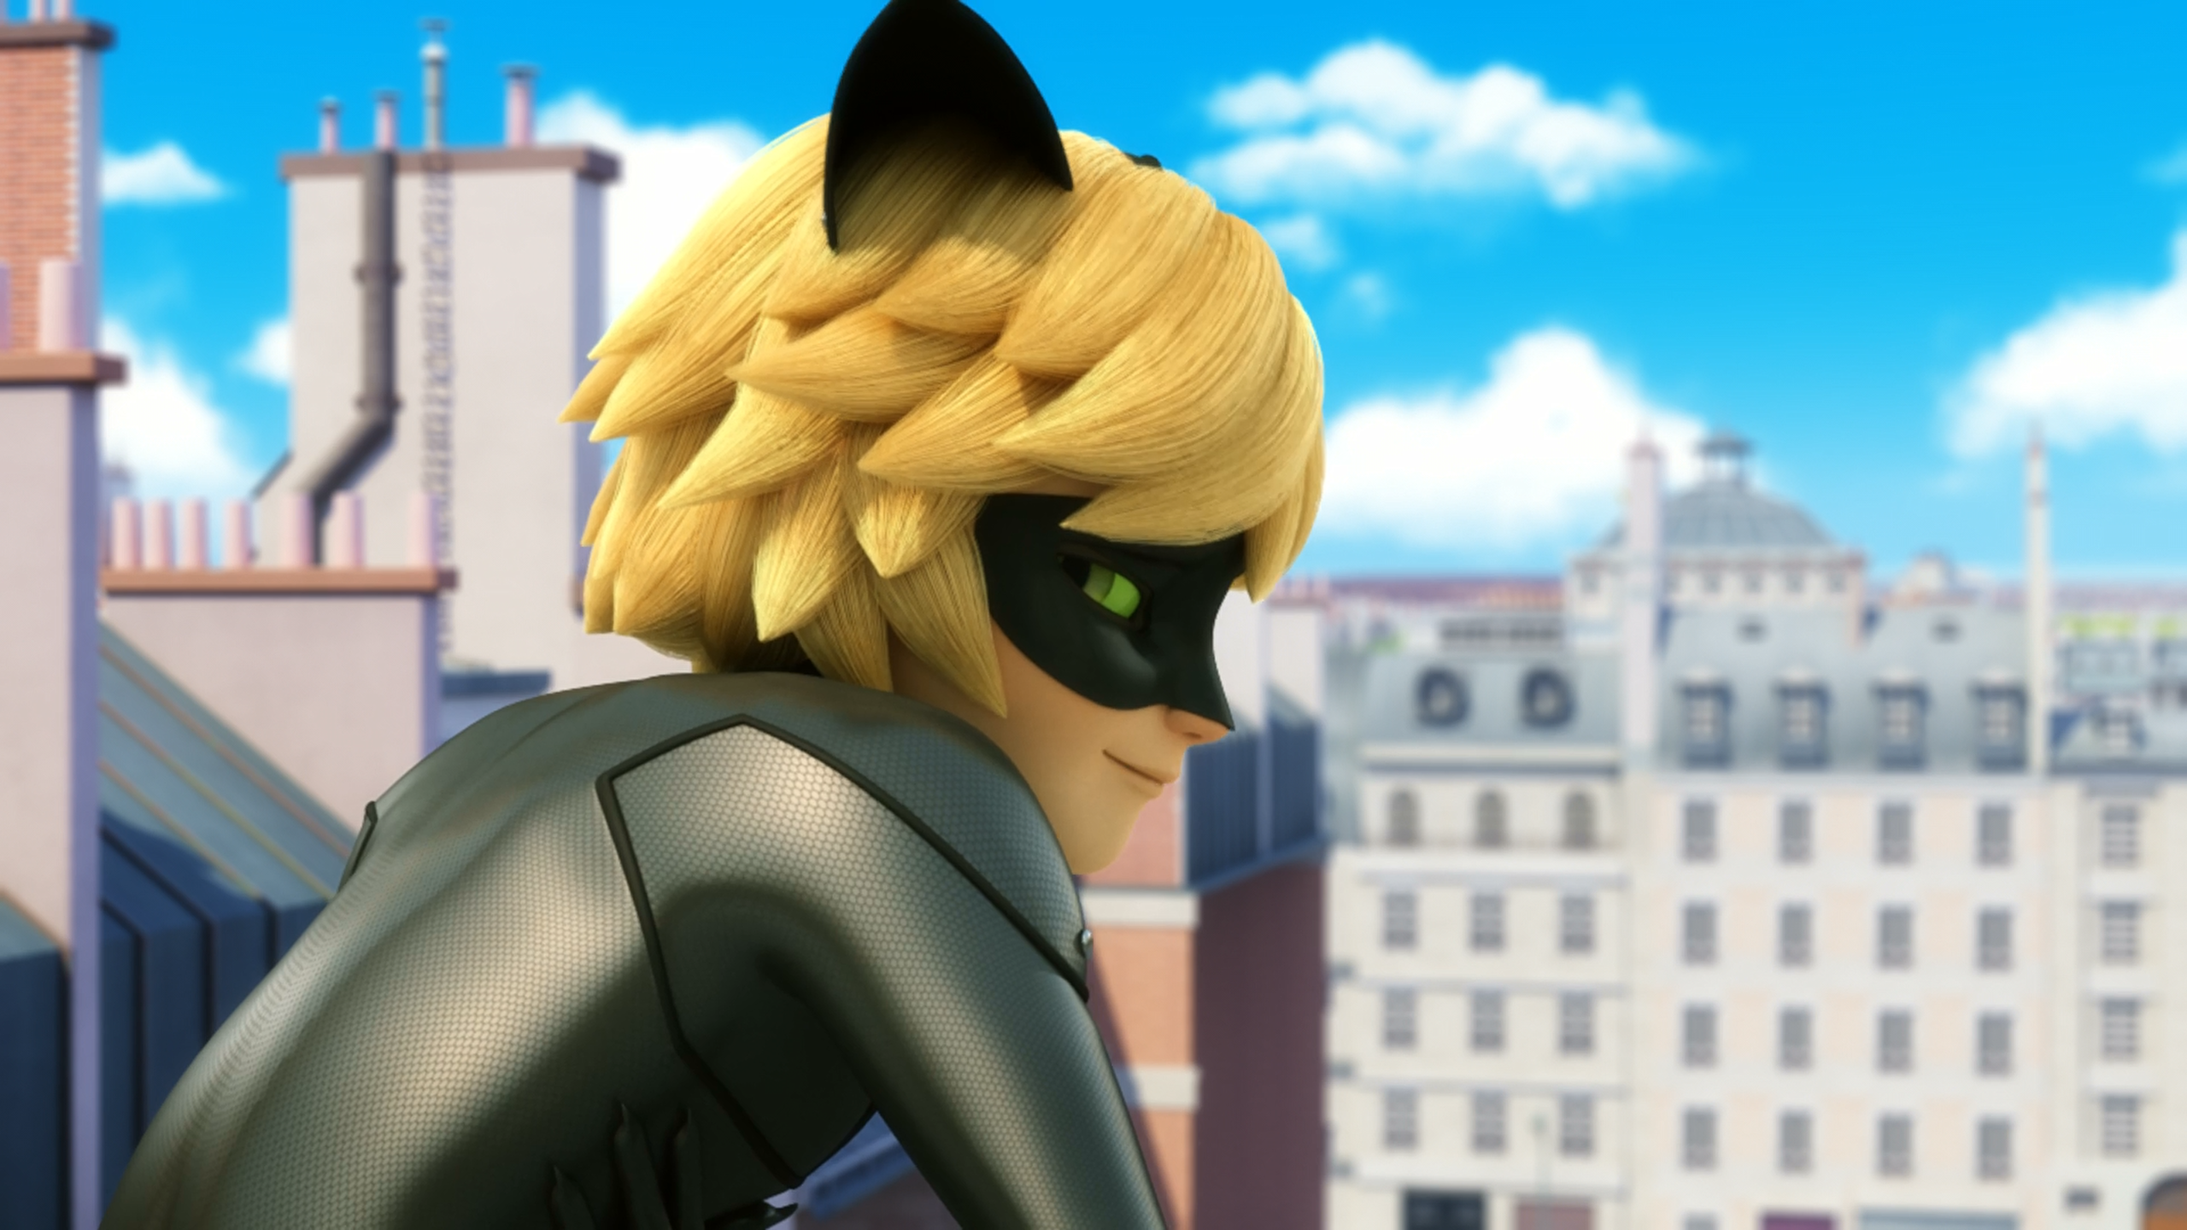
Oh, it's nothing. I just got Cataclysmed in the ______.
ribs
butt
face

Slide 10
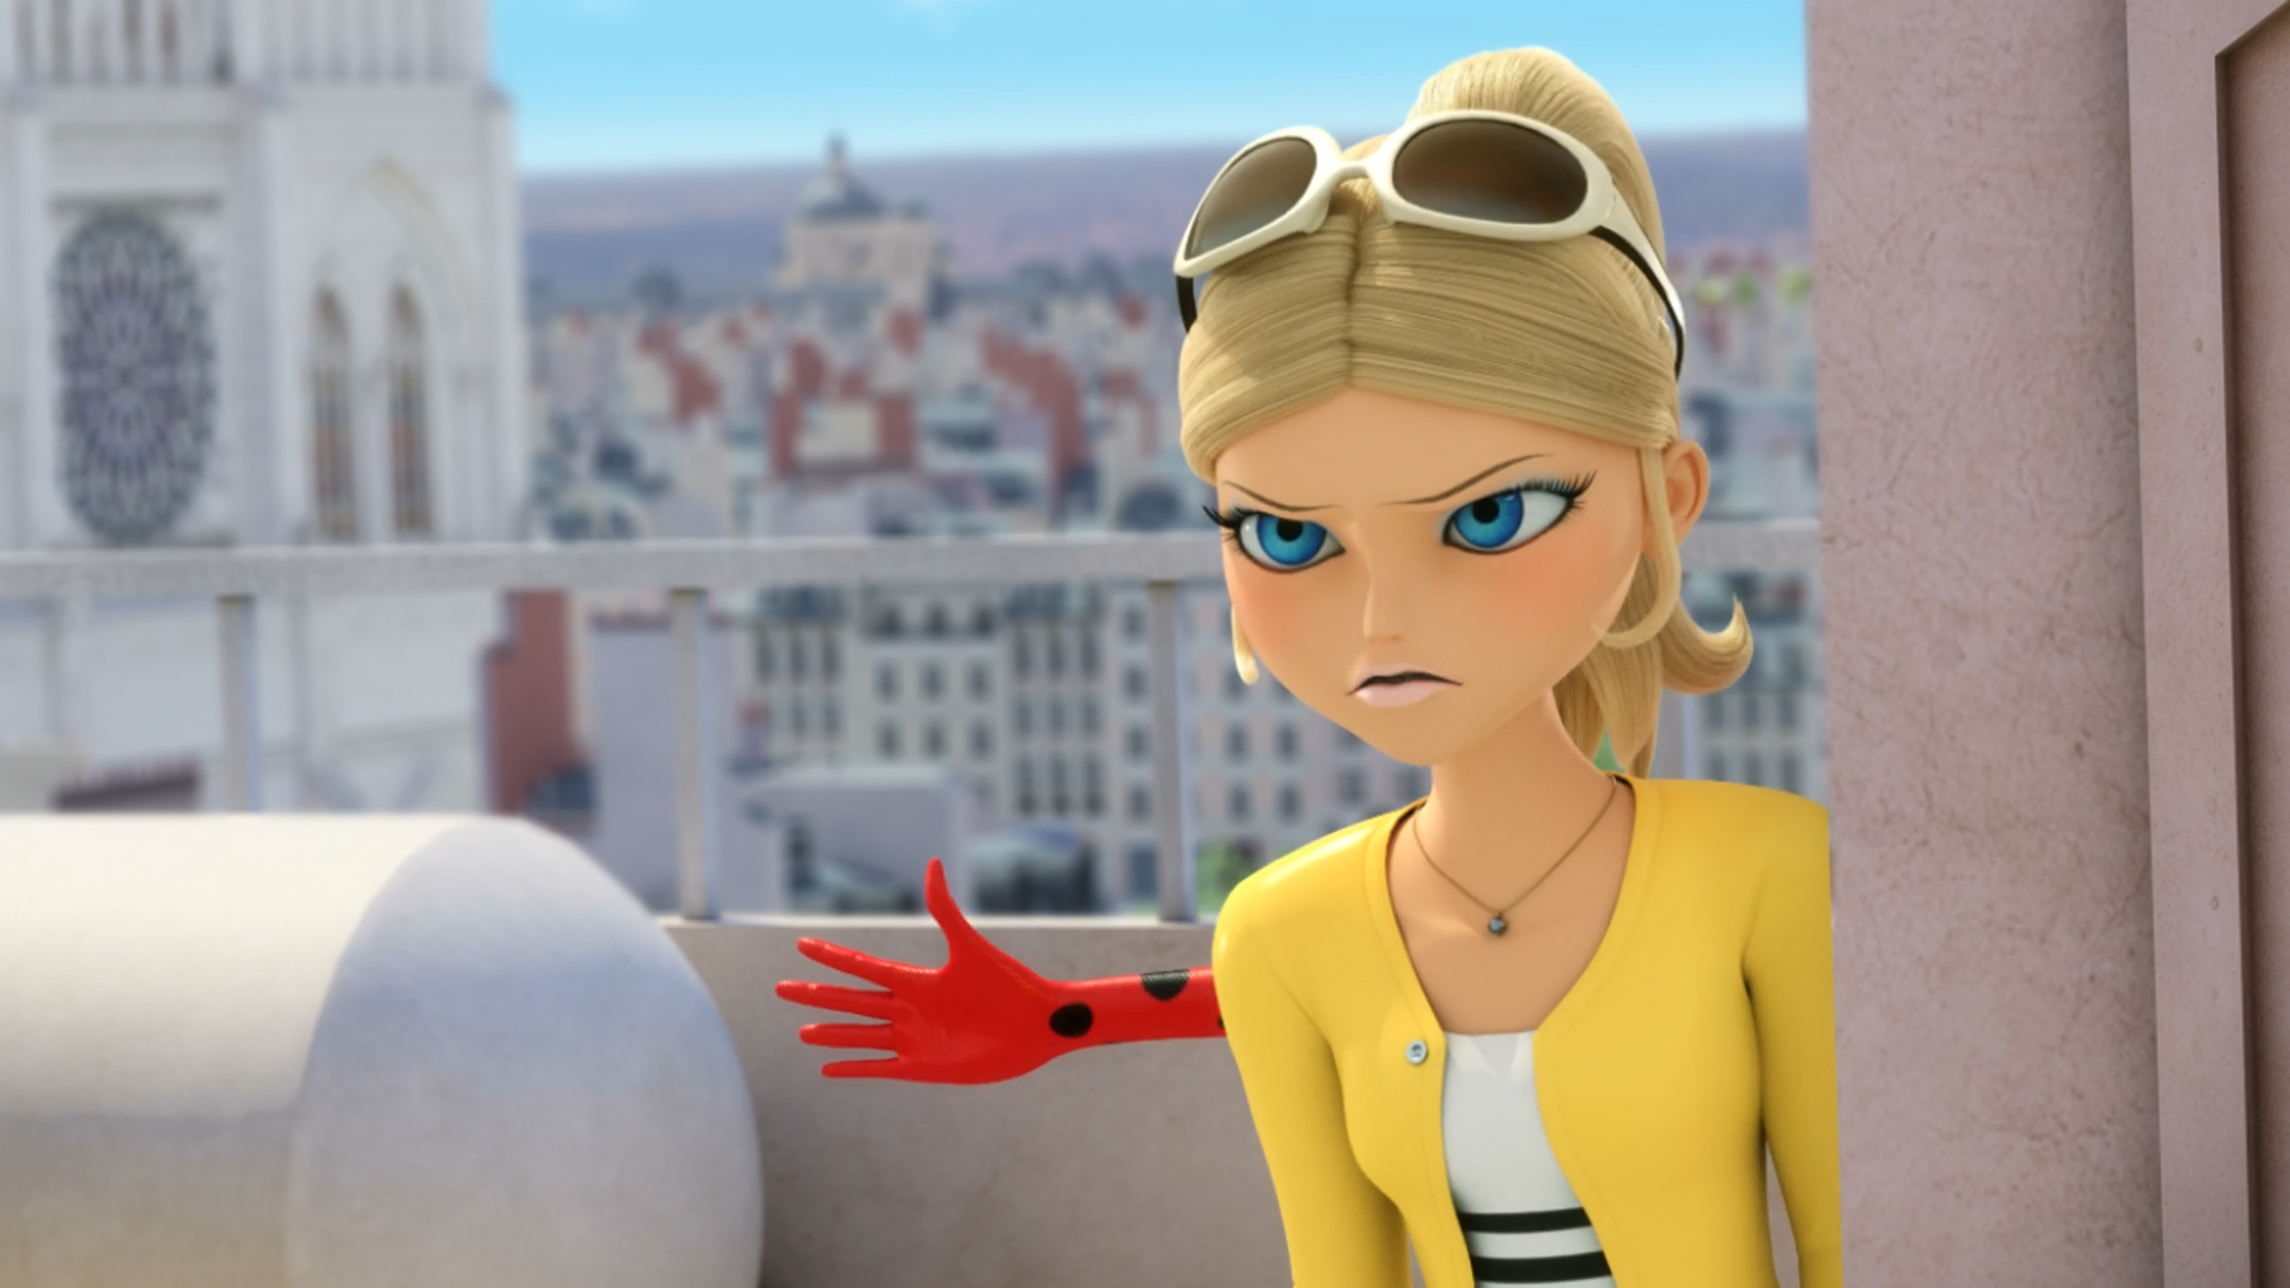
I could've helped you. I'd have ______ those two by now.
killed
floored
defeated

Slide 11
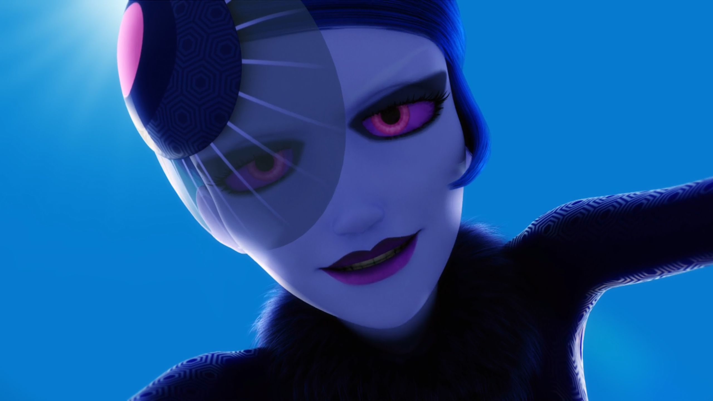
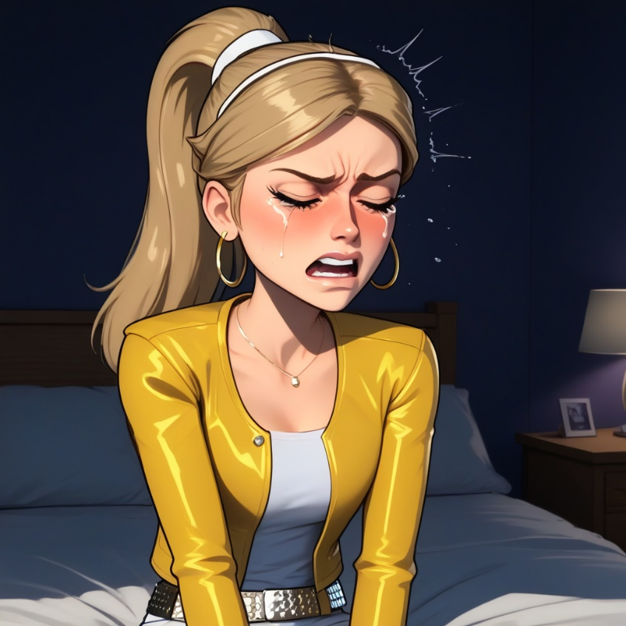
Do you enjoy being Ladybug's ______?
slave
servant
sidekick

Slide 12
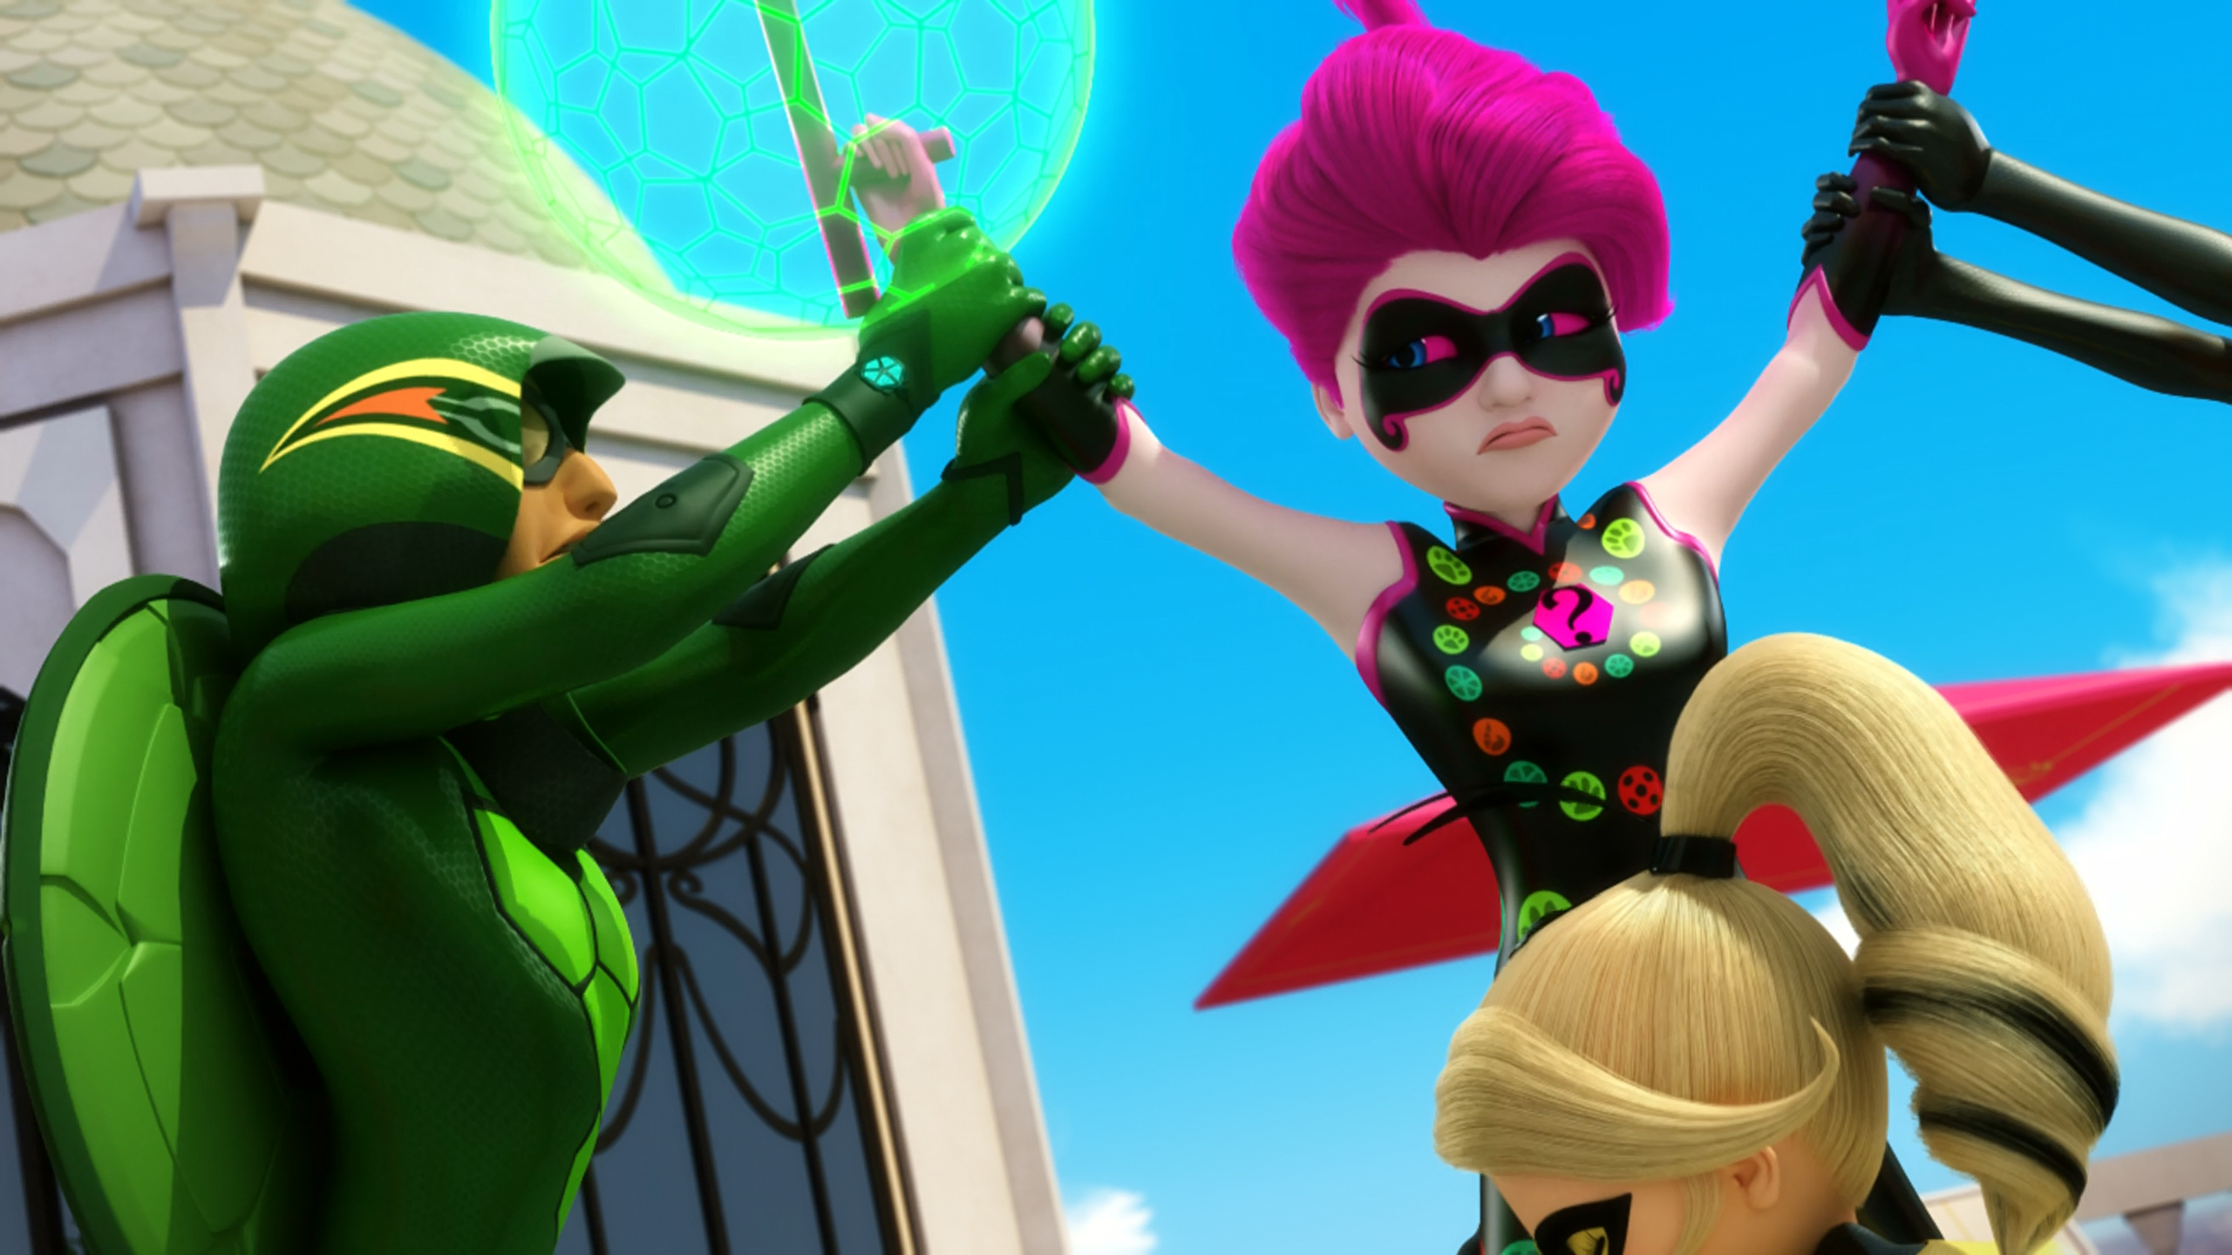
Well, you were wrong. ______ is my friend, not Miraculer.
Cat Noir
Ladybug
Sabrina

Slide 13
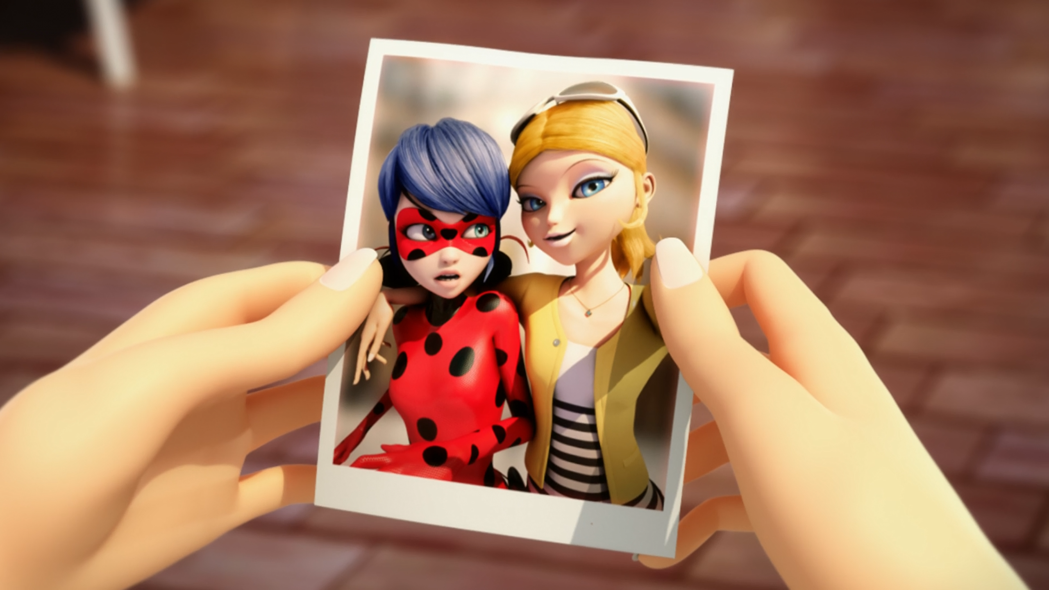
Of course I will. I just don't wanna be ______ anymore.
Ladybug
Queen Bee
Chloé

Slide 14
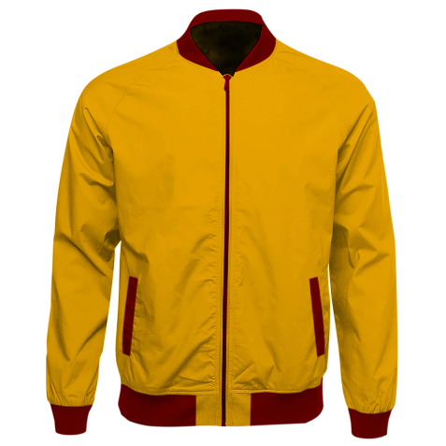
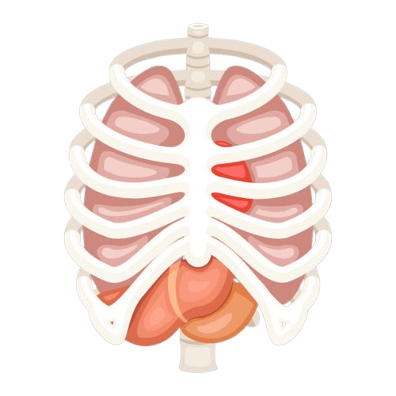
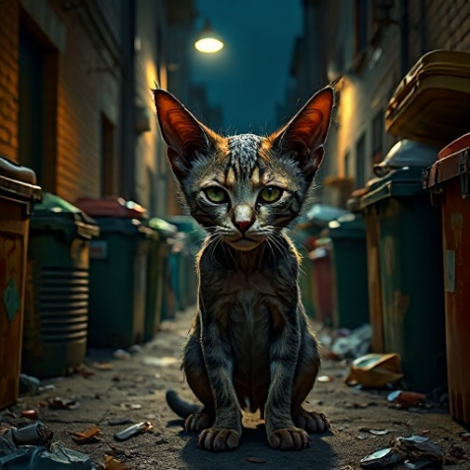
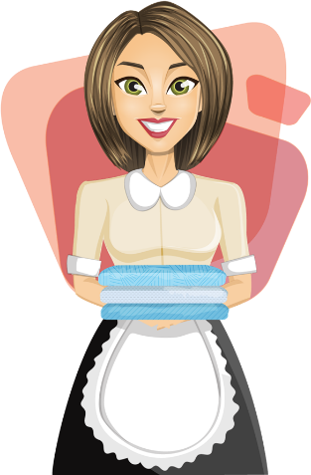
Matching Exercise
mangy | servant | jacket | ribs

Slide 15
Matching Exercise
jacket | ribs | mangy | servant

Slide 16
TRUE OR FALSE
1. Miraculer's first lucky charm is a pig.
2. Cat Noir cataclysms Miraculer in the ribs.
3. Mayura steals the Queen Bee Miraculous.
4. Marinette tickles Miraculer.
5. Chloé tears her Ladybug photo.

Slide 17
TRUE OR FALSE
1. Miraculer's first lucky charm is a pig. | FALSE
2. Cat Noir cataclysms Miraculer in the ribs. | FALSE
3. Mayura steals the Queen Bee Miraculous. | TRUE
4. Marinette tickles Miraculer. | TRUE
5. Chloé tears her Ladybug photo. | TRUE

