Slide 1
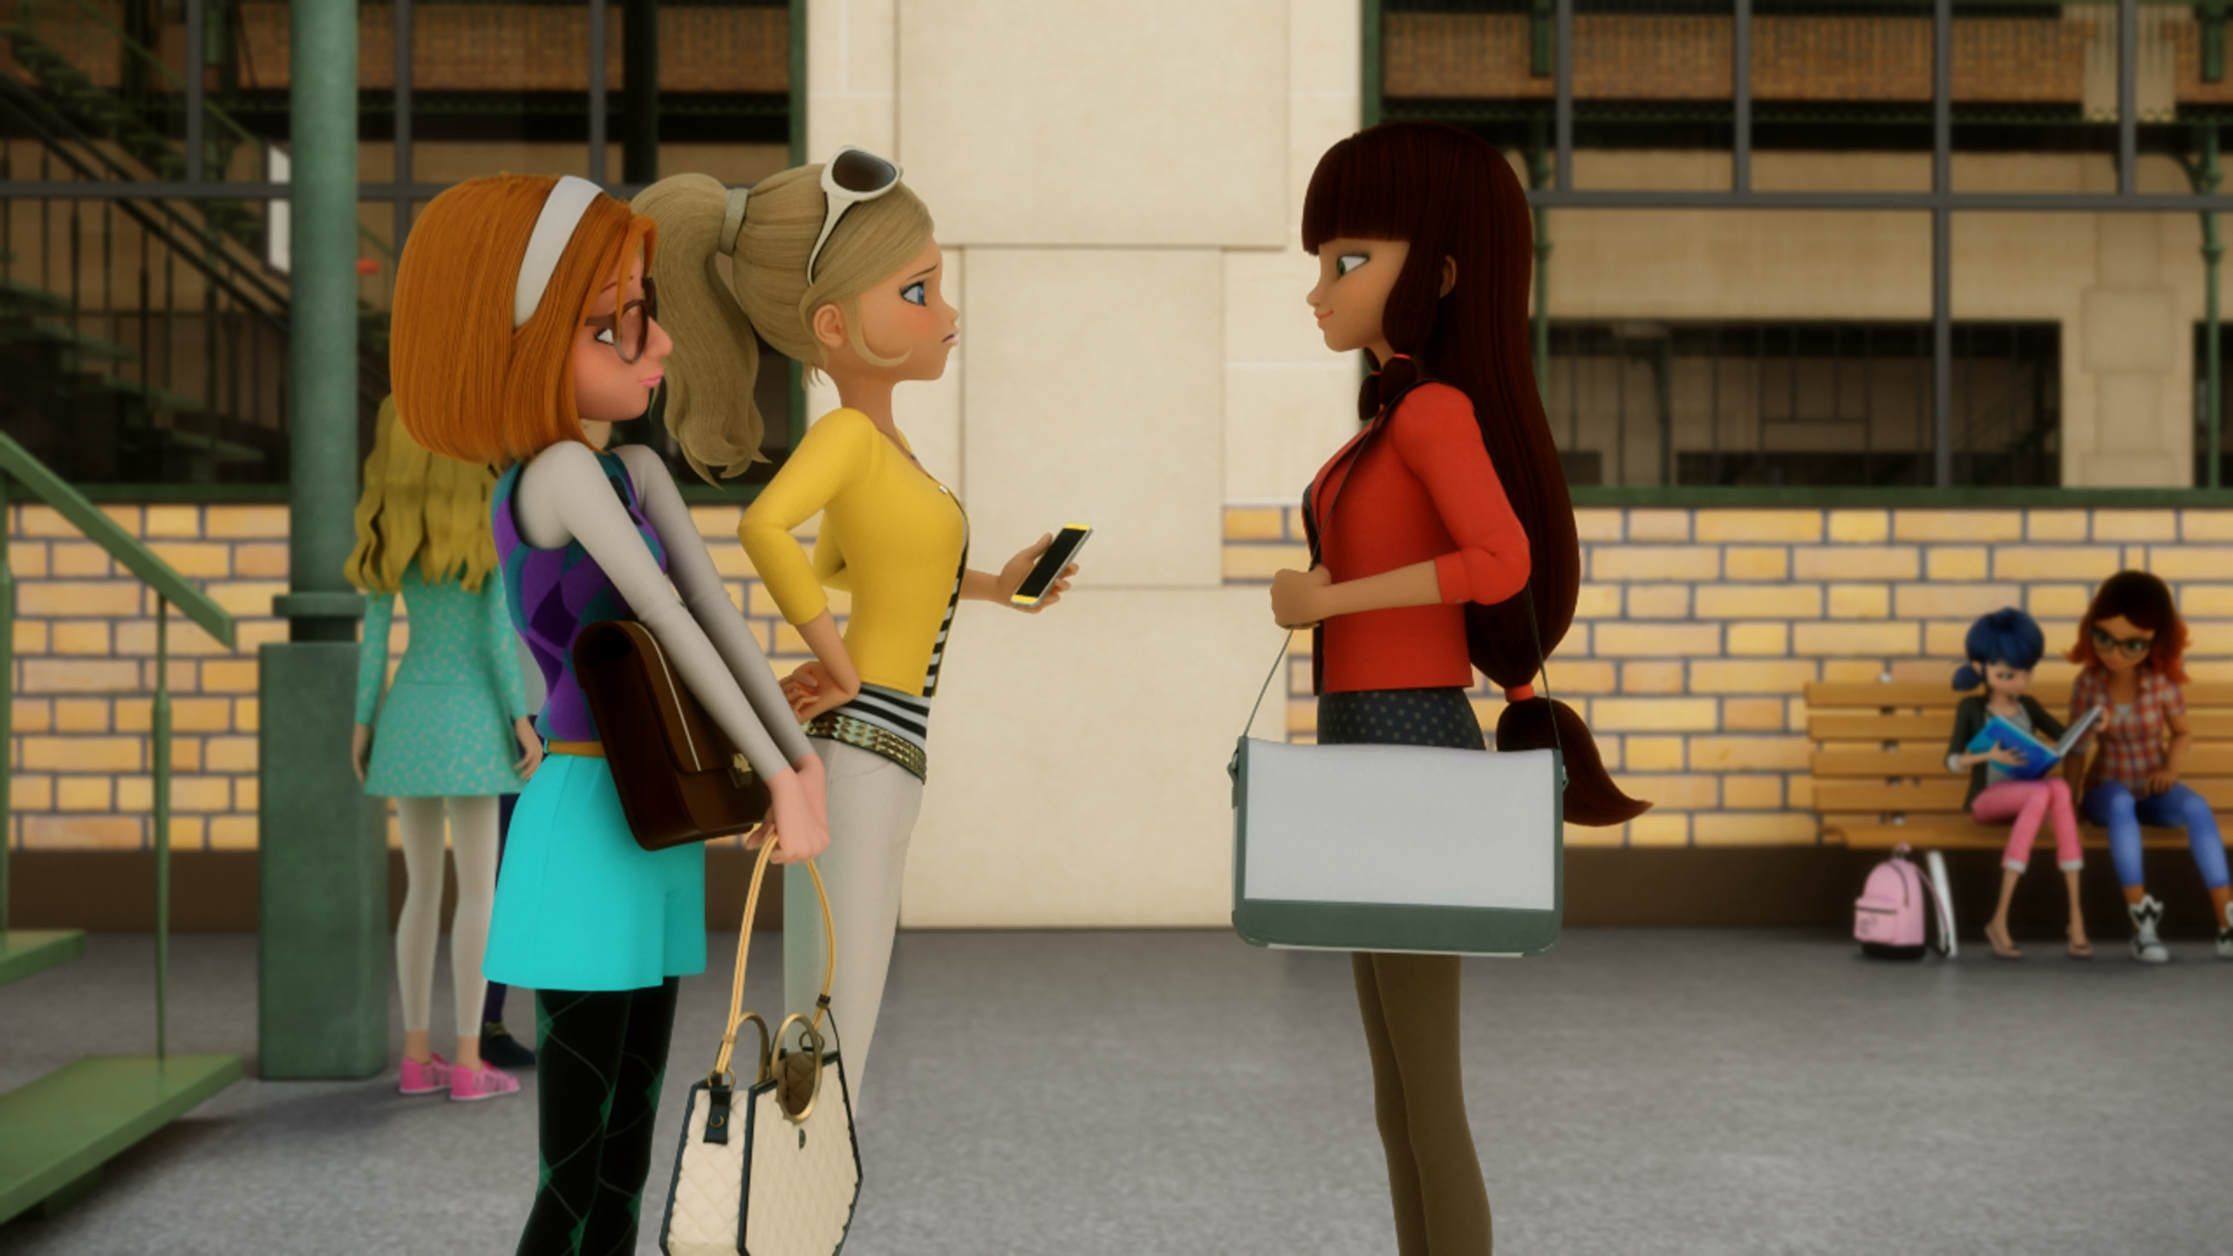
MIRACULOUS LADYBUG: MIRACULER. PART 1

Slide 2
VOCABULARY
ally - 盟友 - ælaɪ
command - 指挥 - kəˈmɑːnd
empower - 赋予权力 - ɪmˈpaʊə
enhance - 增强 - ɪnˈhɑːns
fearsome - 可怕 - ˈfɪəsəm
hone - 磨练 - həʊn
impression - 印象 - ɪmˈprɛʃᵊn
summon - 召唤 - sʌmən

Slide 3
1. kəˈmɑːnd
2. ɪnˈhɑːns
3. ɪmˈprɛʃᵊn

Slide 4
1. kəˈmɑːnd - command
2. ɪnˈhɑːns - enhance
3. ɪmˈprɛʃᵊn - impression

Slide 5
MIRACULER. PART 1
Nadja: ...with the help of their sidekicks: Rena Rouge and Carapace...
Chloé: What about Queen Bee? Ugh!
Sabrina: That's really not cool.
Chloé: Oh, you so don't get it. Ladybug only calls on me when she has serious villains to contend with.
Sabrina: Uhh, yeah! Of course.

Slide 6
Ladybug: You know how dangerous it is to use Chloé. Everybody knows that she was Queen Bee, everyone including Hawk Moth. He can use it to trap us. That's why our identities must remain a secret.
Cat Noir: And the best kept secrets are the ones you don't share, yeah-yeah, I know.
I don't think Chloé knows that her time as Queen Bee is over, though.

Slide 7
Chloé: I could see Ladybug whenever I feel like it, okay, so mind your own business Dupain-Cheng.
Tikki: You really got to talk to Chloé.
Marinette: But I just did. It's pointless, obviously.
Tikki: No! Marinette talked to Chloé! You know the only person Chloé listens to is Ladybug.

Slide 8
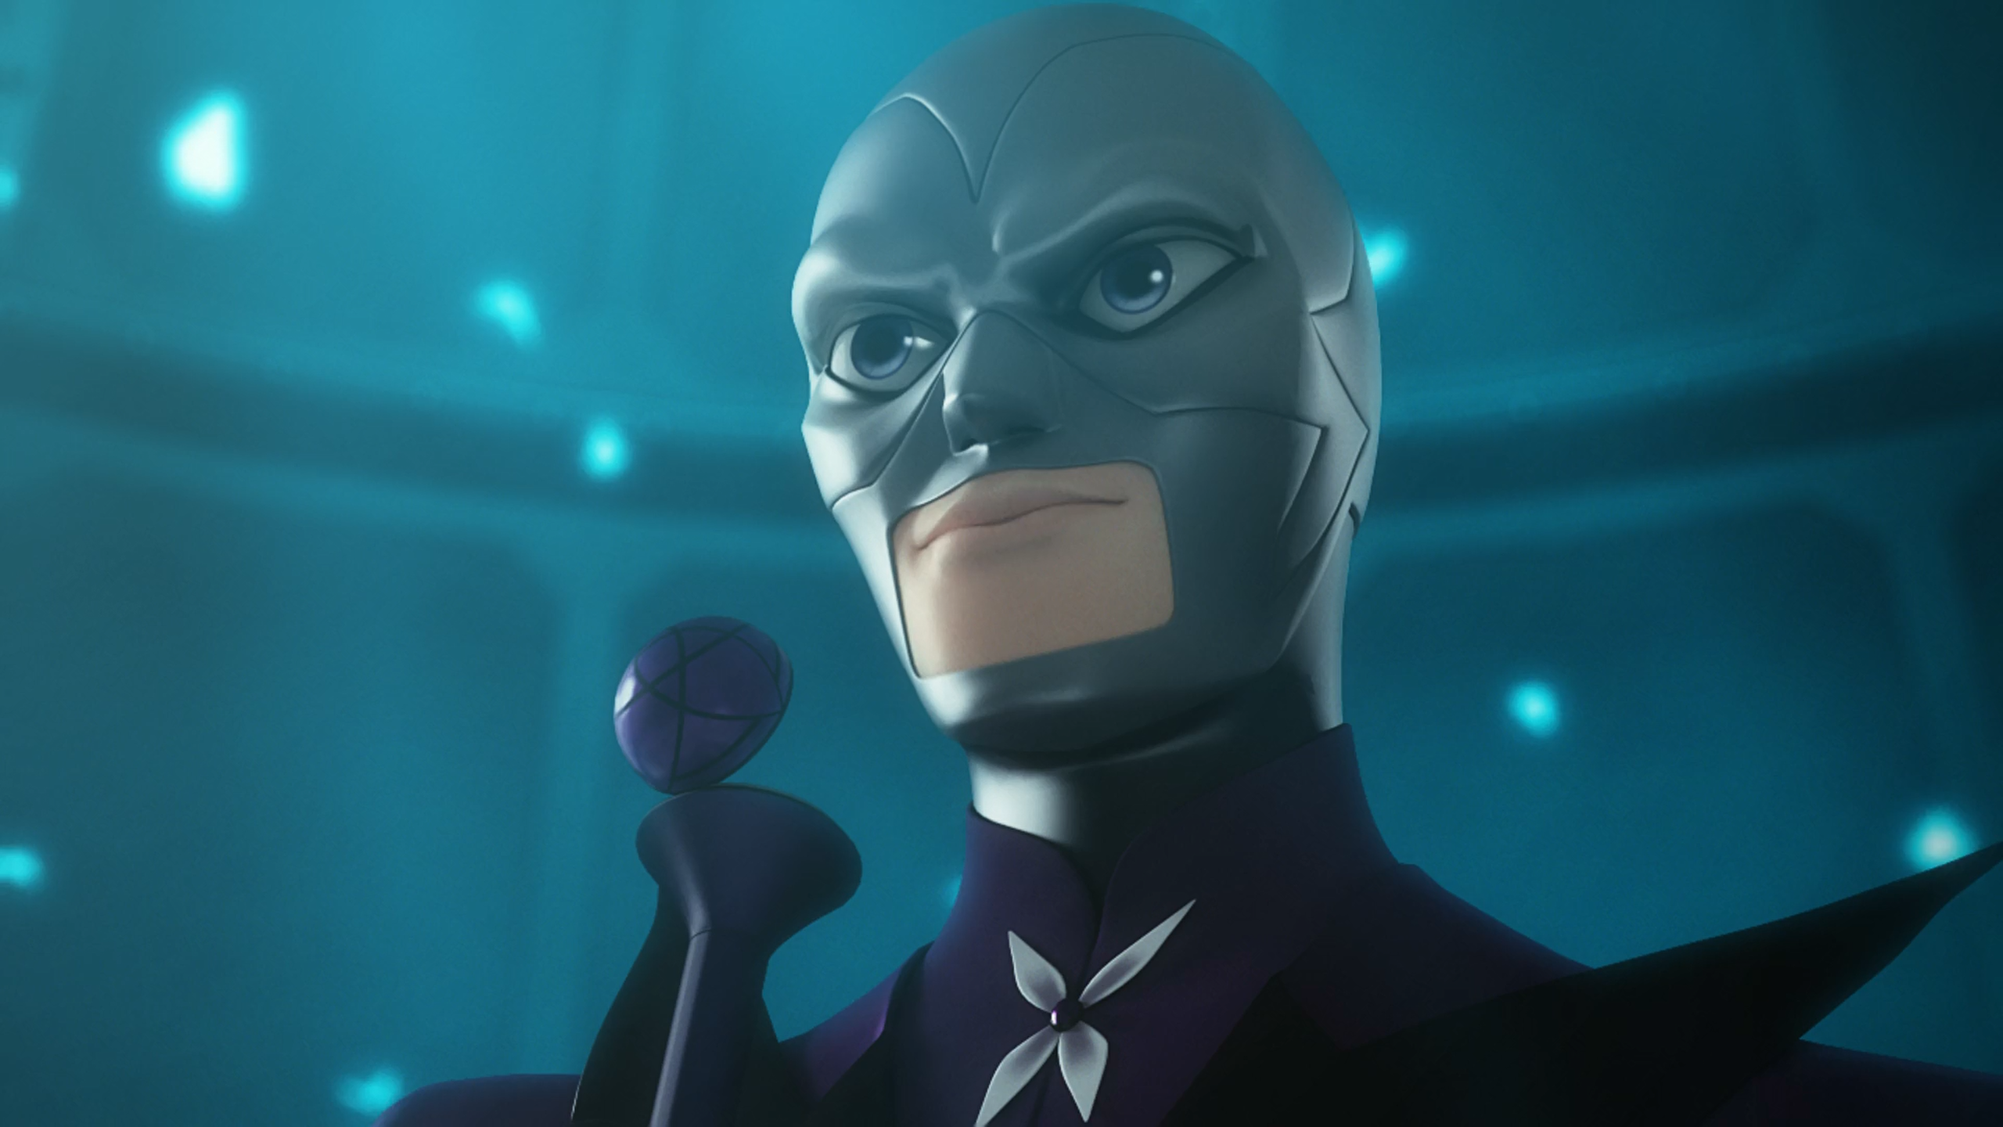
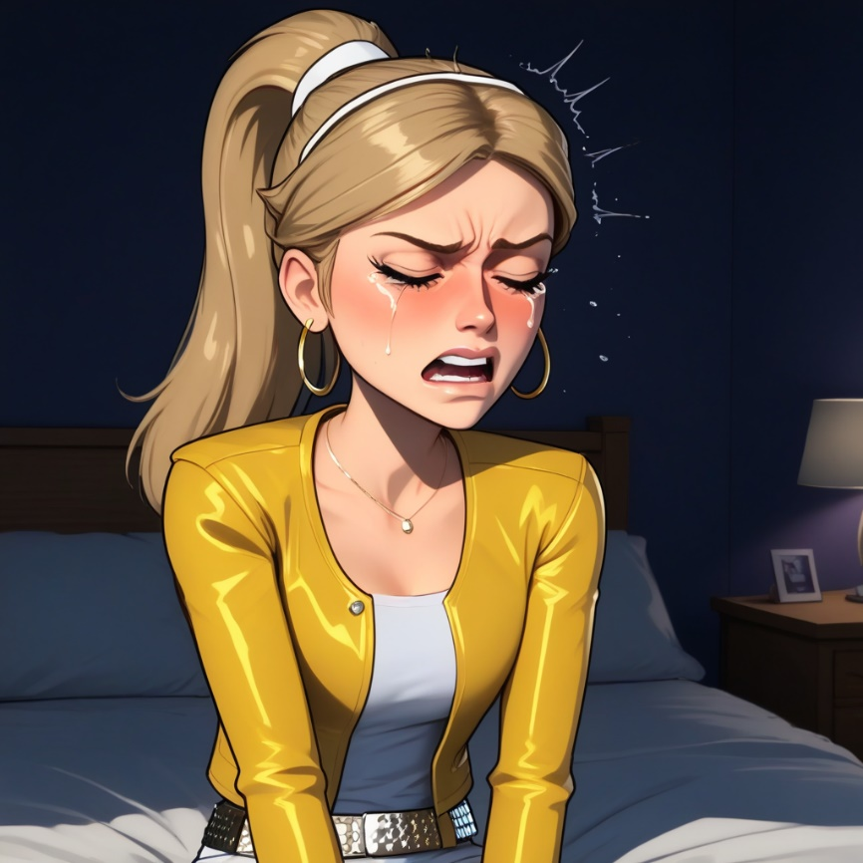
Be ready in case Ladybug goes and hands her the ______ Miraculous.
Wasp
Ladybug
Bee

Slide 9
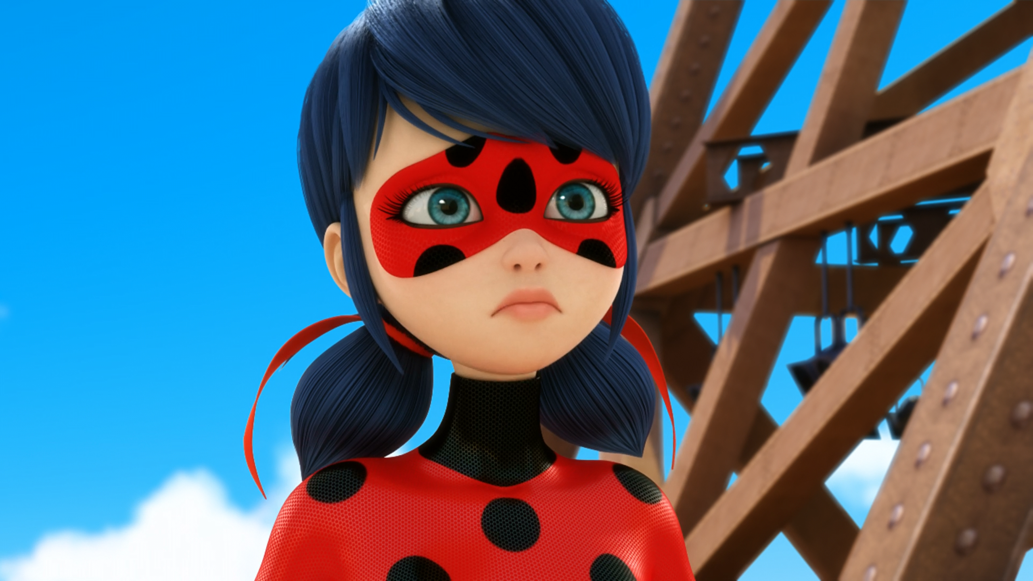
You know how dangerous it is to use ______.
Chloé
Cataclysm
Carapace

Slide 10
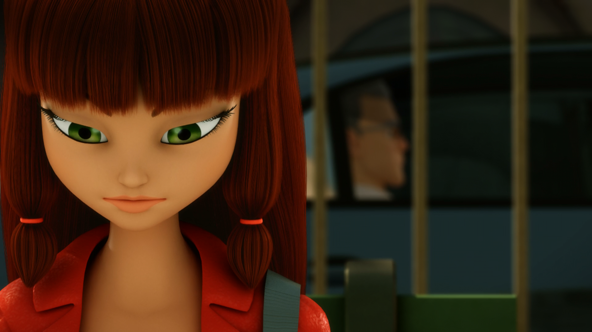
Your son deserves better than that friend of his ______.
Marinette
Nino
Alya

Slide 11
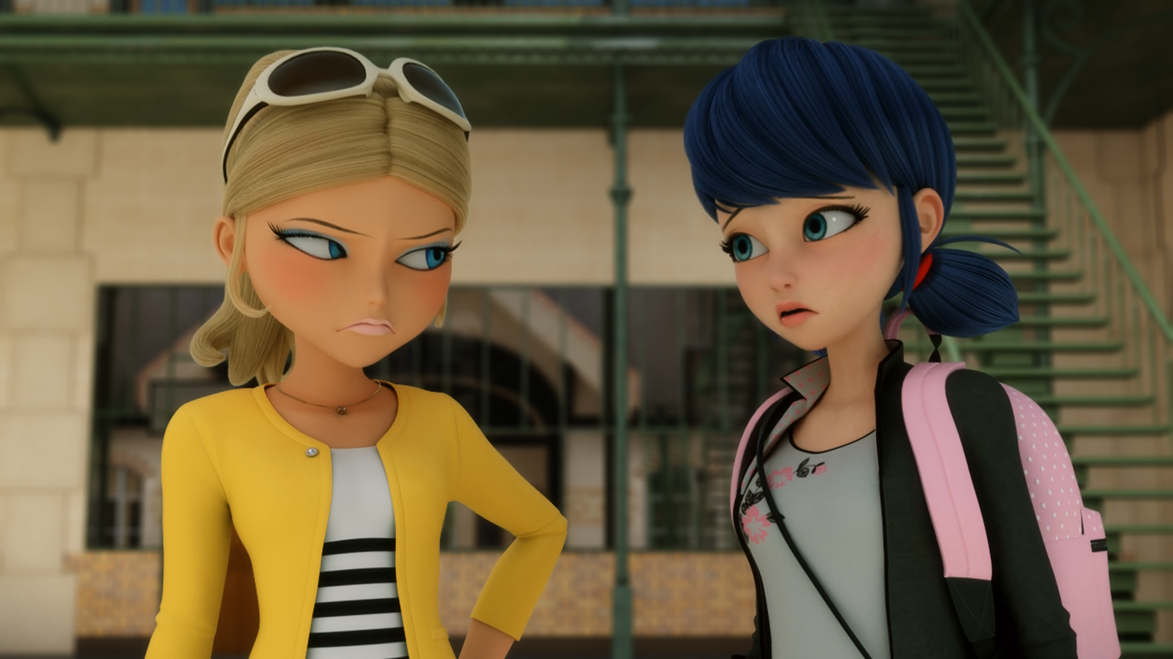
I don't know what ______ told you, but you should watch out for her.
Nino
Lila
Sabrina

Slide 12
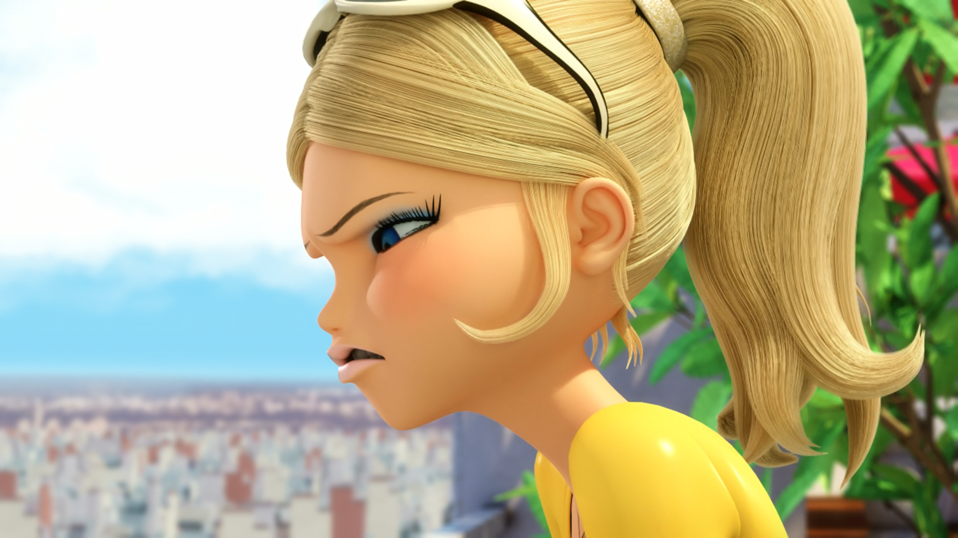
That smart aleck idiot at school took me for a ______!
fool
sucker
ride

Slide 13
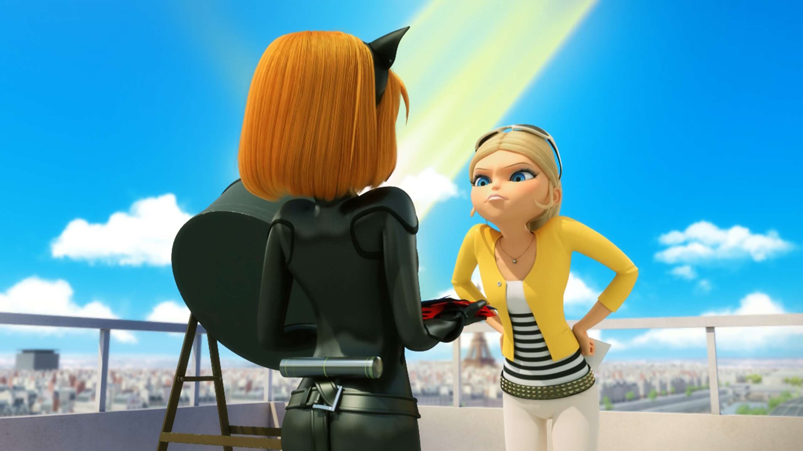
You're a nobody! I'm a ______, okay? I'm Queen Bee!
superheroine
bitch
hero

Slide 14
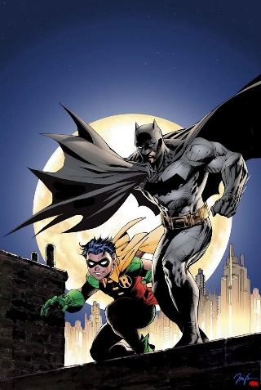


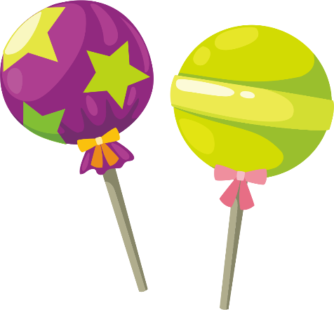
Matching Exercise
rubber | lollipop | sidekick | fetch

Slide 15
Matching Exercise
sidekick | fetch | rubber | lollipop

Slide 16
TRUE OR FALSE
1. Rena Rouge and Carapace are sidekicks.
2. Hawk Moth doesn't know that Chloé is Queen Bee.
3. The students have a science test in the afternoon.
4. Adrien warns Chloé about Lila.
5. Chloé is akumatized.

Slide 17
TRUE OR FALSE
1. Rena Rouge and Carapace are sidekicks. | TRUE
2. Hawk Moth doesn't know that Chloé is Queen Bee. | FALSE
3. The students have a science test in the afternoon. | TRUE
4. Adrien warns Chloé about Lila. | FALSE
5. Chloé is akumatized. | FALSE

