Slide 1
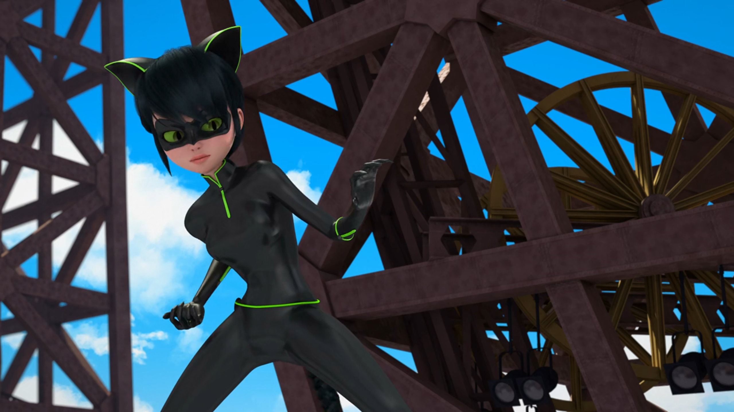
MIRACULOUS LADYBUG: REFLEKDOLL. PART 2

Slide 2
VOCABULARY
beam - 光束 - biːm
capable - 能力 - keɪpəbᵊl
convoluted - 复杂的 - kɒnvəluːtɪd
mastery - 精通 - mɑːstᵊri
mix-up - 混合 - mɪksˌʌp
opponent - 对手 - əˈpəʊnənt
reach - 到达 - riːʧ
reflect - 反射 - rɪˈflɛkt
shield - 屏蔽 - ʃiːld

Slide 3
1. mɑːstᵊri
2. 对手
3. ʃiːld

Slide 4
1. mɑːstᵊri - mastery
2. 对手 - opponent
3. ʃiːld - shield

Slide 5
REFLEKDOLL. PART 2
Mister Bug: If I could just get my hands on a mirror, I'd be able to reflect her own beam back at her!
Lady Noire: That's not how it works! The Lucky Charm doesn't just give you what you want.
Mister Bug: We'll see about that. Watch and learn! Lucky Charm! A mirror!

Slide 6
Mister Bug: Why don't you try helping me instead of making fun of me!?
Lady Noire: Apparently, Bugaboy doesn't have a sense of humor.
Mister Bug: Sounds like you're wearing the clown costume now!
Lady Noire: You bet! I'm the cunning, funny, and ultra-charming Lady Noire!

Slide 7
Marinette: Girls!
Alya: Are you okay?
Marinette: I'm so sorry, Juleka, I should've realized how important the shoot was for you. Do you want to give another try?
Juleka: Yeah, totally! Awesome.
Marinette: Do you still have anytime left, Adrien?
Adrien: It's important.

Slide 8
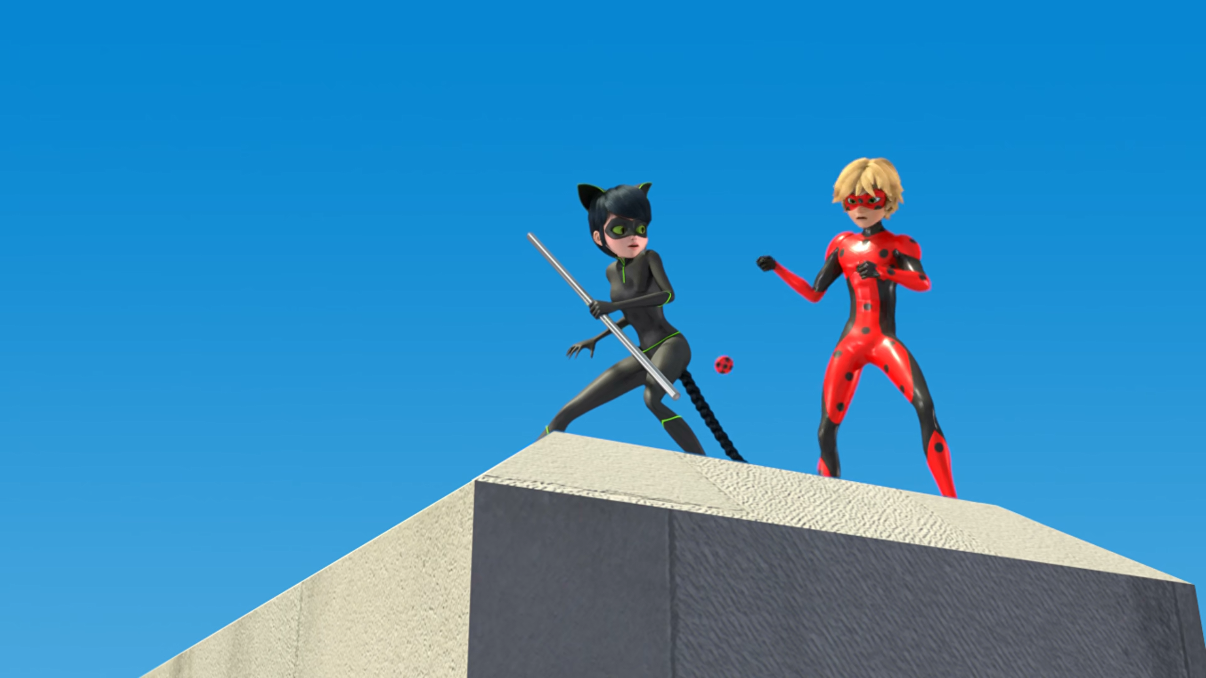

Stay focused, Mister Bug. Use the
______ as a shield!
staff
mirror
yo-yo

Slide 9
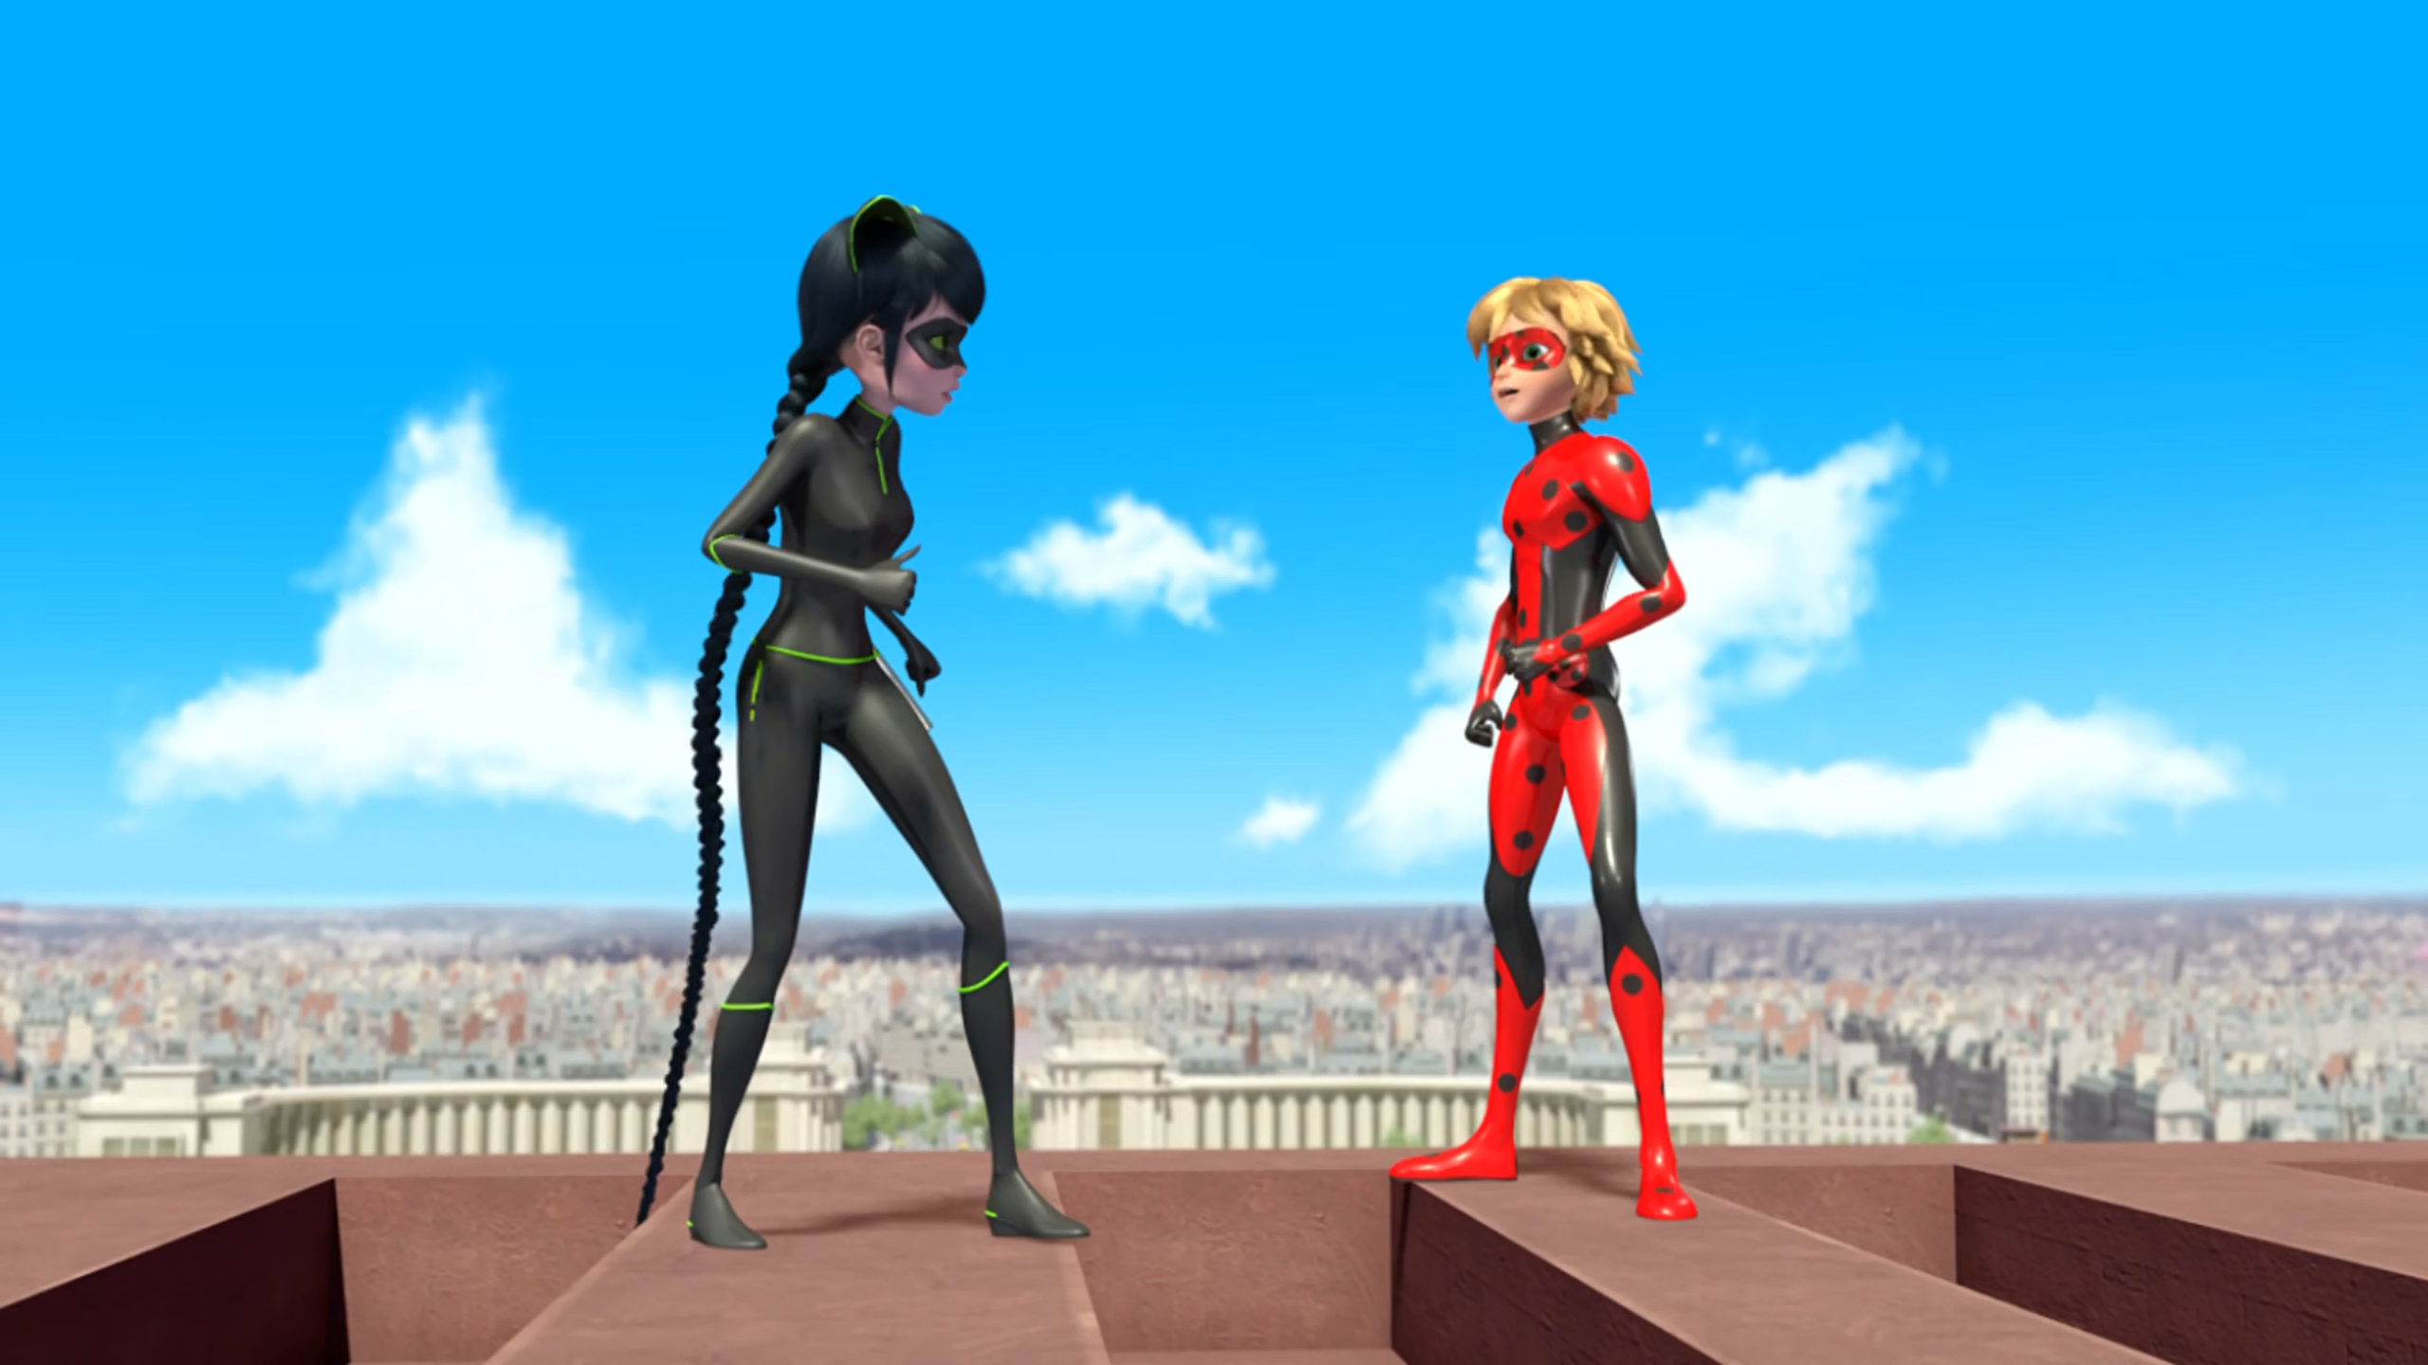
If I could just get my hands on a ______.
mirror
miraculous
pig

Slide 10
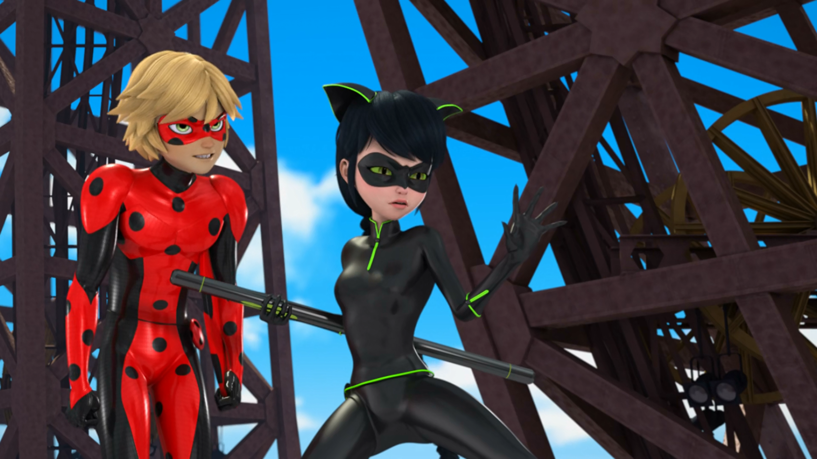
Why don't you try ______ me instead of making fun of me!?
kissing
helping
loving

Slide 11
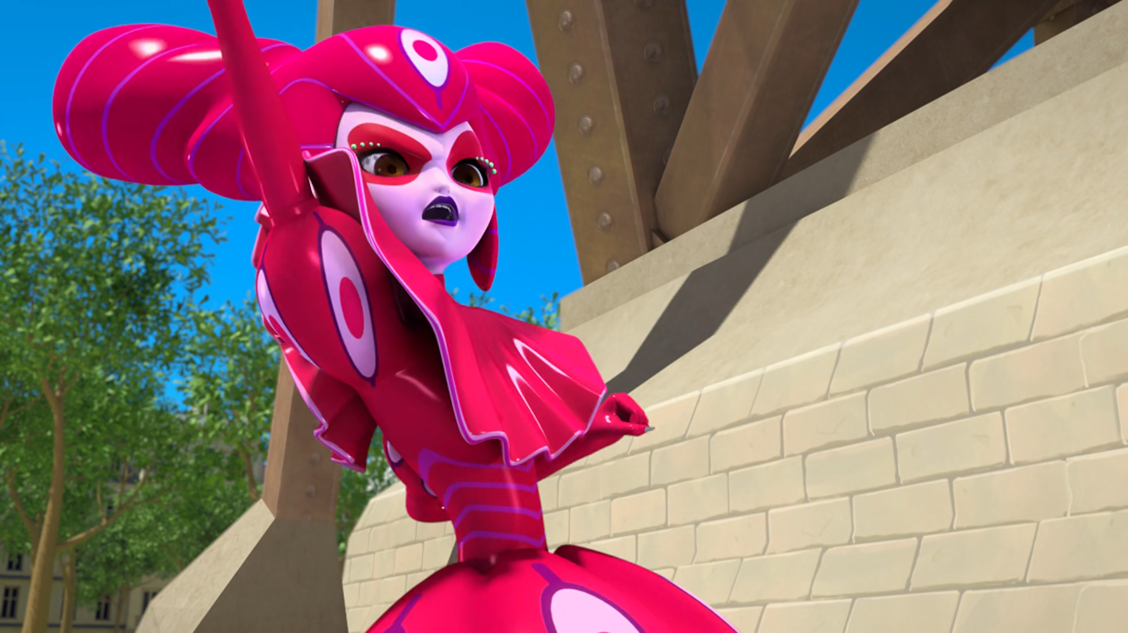
These ______ look ridiculous on you.
clothes
costumes
masks

Slide 12
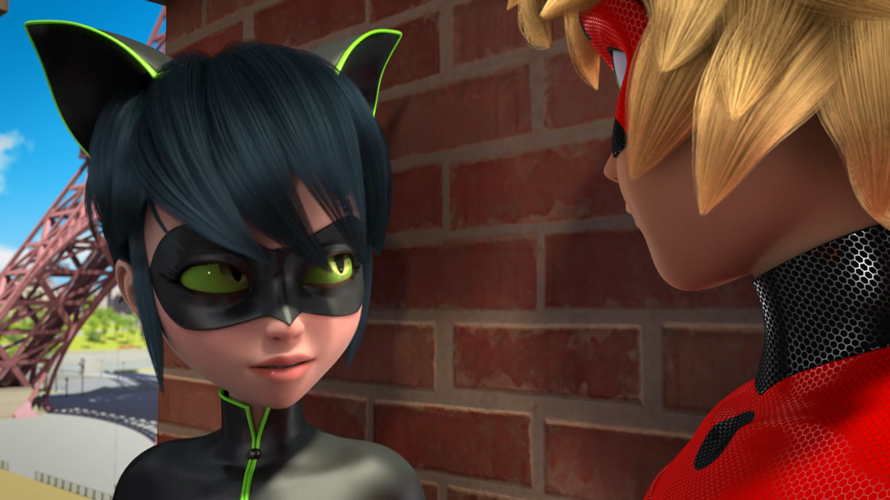
Reflekta was controlling the ______ from inside its eye.
robot
giant
doll

Slide 13
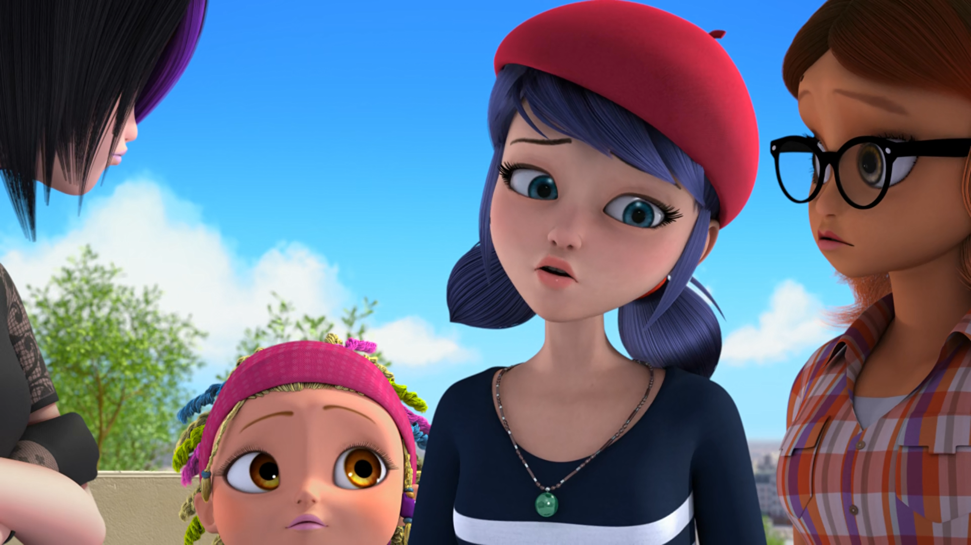
Juleka, I should've realized how important the ______ was for you.
shoot
dance
party

Slide 14
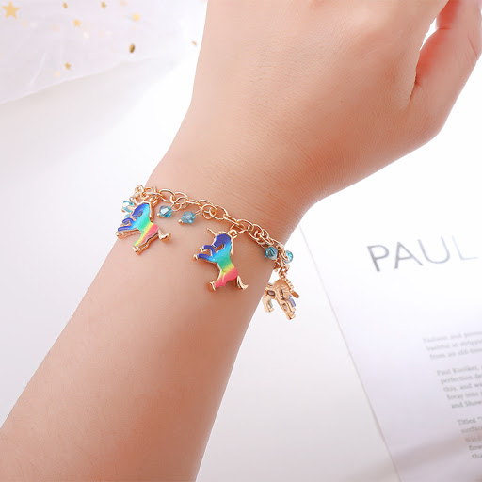
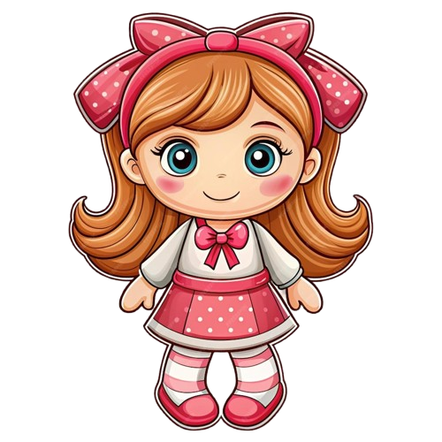
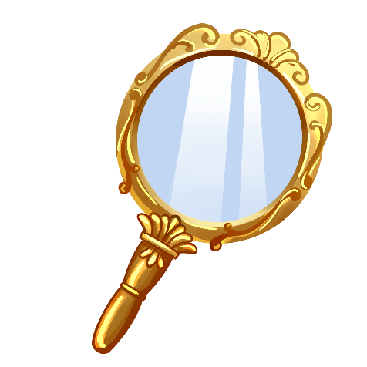
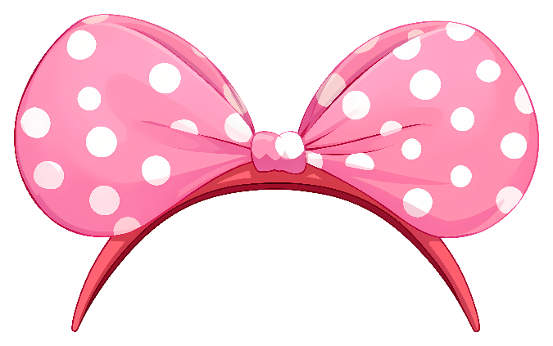
Matching Exercise
mirror | bracelet | hair clip | doll

Slide 15
Matching Exercise
bracelet | hair clip | doll | mirror

Slide 16
TRUE OR FALSE
1. Mister Bug uses the yo-yo as a shield.
2. The akuma is in the doll's bracelet.
3. The lucky charm is a screwdriver.
4. Lady Noire says her costume is heavy.
5. Jureka has her photoshoot.

Slide 17
TRUE OR FALSE
1. Mister Bug uses the yo-yo as a shield. | TRUE
2. The akuma is in the doll's bracelet. | TRUE
3. The lucky charm is a screwdriver. | FALSE
4. Lady Noire says her costume is heavy. | FALSE
5. Jureka has her photoshoot. | TRUE

