Slide 1
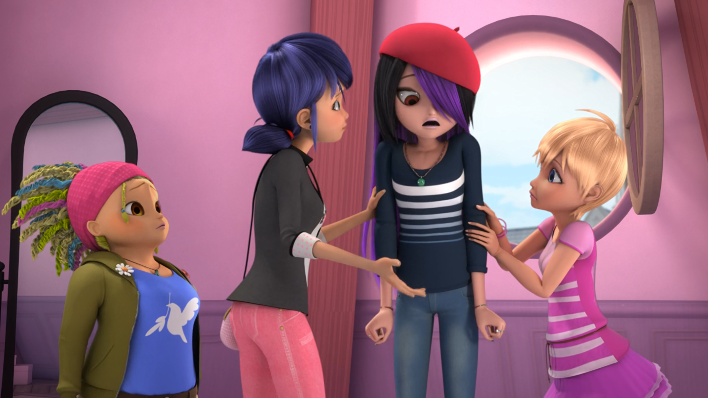
MIRACULOUS LADYBUG: REFLEKDOLL. PART 1

Slide 2
VOCABULARY
dimension - 维度 - dɪˈmɛnʃᵊn
entirely - 完全 - ɪnˈtaɪəli
focus - 焦点 - fəʊkəs
limelight - 聚光灯 - laɪmlaɪt
require - 需要 - rɪˈkwaɪə
taker - 接受者 - teɪkə
technical - 技术 - tɛknɪkᵊl
wonder - 奇迹 - wʌndə

Slide 3
1. 焦点
2. laɪmlaɪt
3. 技术

Slide 4
1. 焦点 - focus
2. laɪmlaɪt - limelight
3. 技术 - technical

Slide 5
REFLEKDOLL. PART 1
Luka: Don't you wanna be a model anymore?
Juleka: Yeah, but... no one's ever going to pick me.
Luka: Have you tried talking to Marinette?
Juleka: I don't want to bother her with that.
Luka: You're really pretty, Jule. I'm sure Marinette would love to have you as her model.

Slide 6
Alya: How about a little smile for the camera, Juleka?
Juleka: Uh, I don't think this is such a good idea, you guys, I...
Marinette: Is something wrong?
Juleka: I'm just not feeling that…
Marinette: You know, it was really cool of you to agree to be my model, but I can tell you're not feeling that comfortable about it at all.

Slide 7
Juleka: I... I'd rather not come.
Marinette: Wha...? Why not?
Juleka: Nothing! I...
Rose: I'll stay with you.
Juleka: No, don't worry. Please go. Just tired, and need to study, and...
Marinette: Are you sure?
Alya: Girls! We've only got thirty minutes left!
Marinette: Make yourself at home.

Slide 8
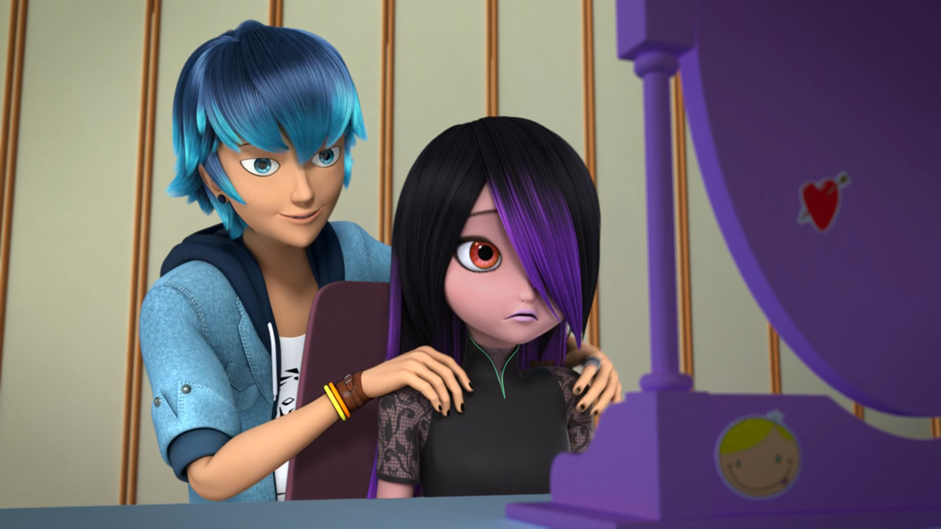

I'm sure Marinette would love to have you as her ______.
teacher
friend
model

Slide 9
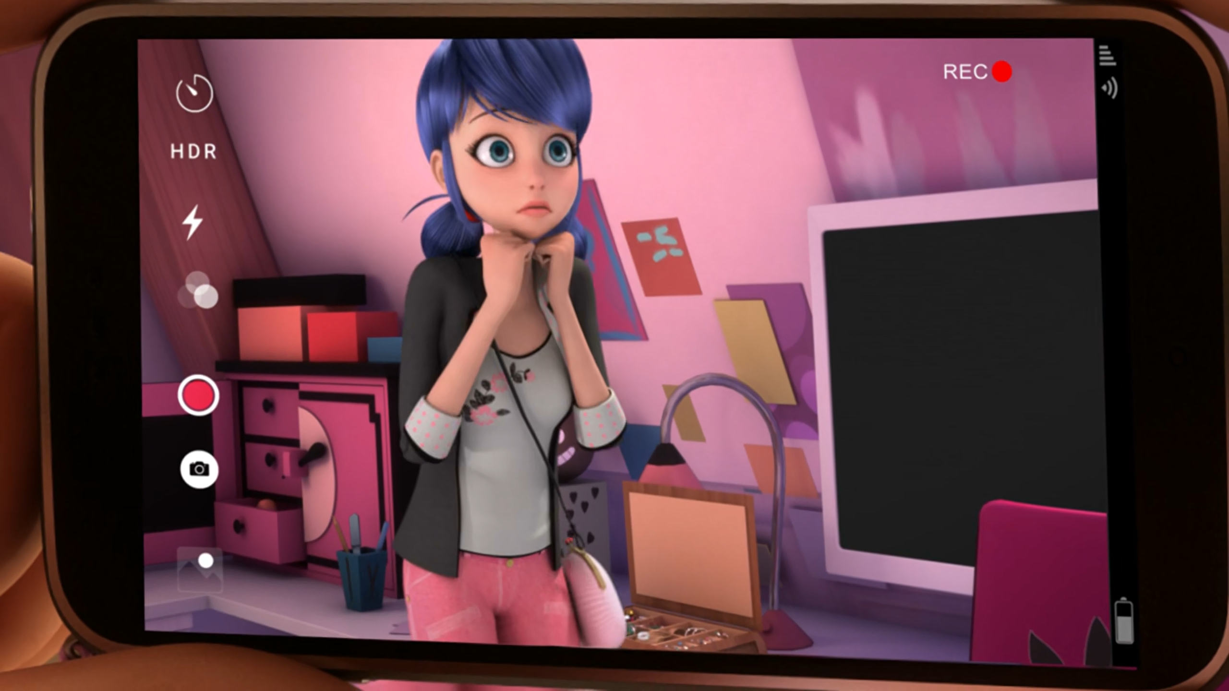
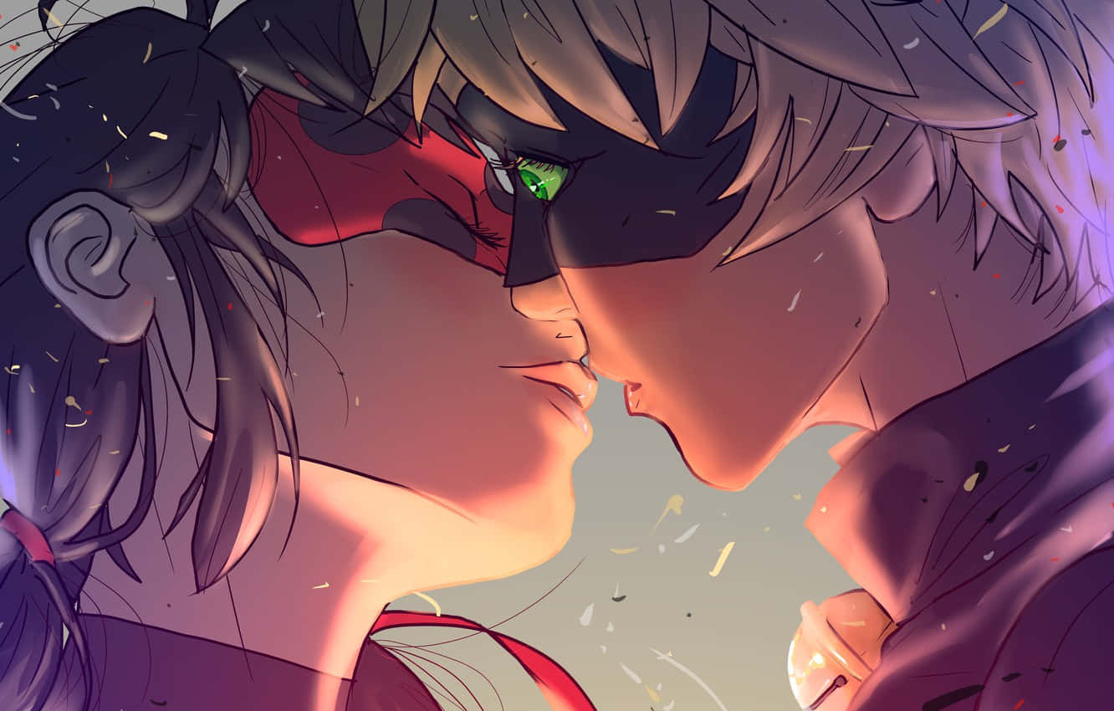
Psst! This is totally your chance to ask him to the ______!
movies
hotel
toilet

Slide 10
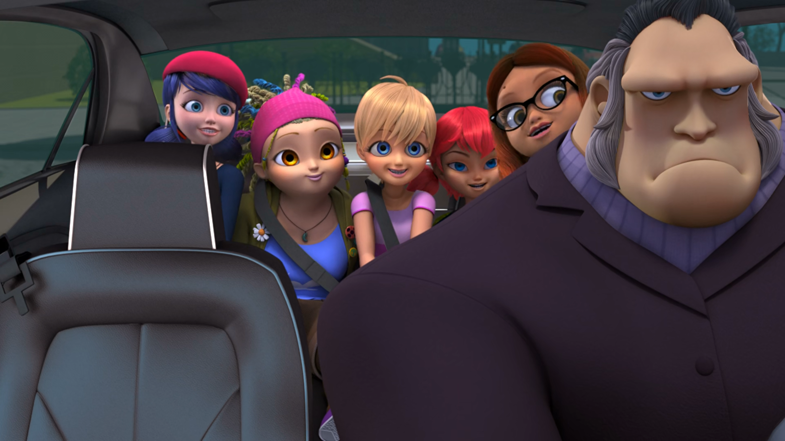
To the ______, please! sunglasses here she made!
Louvre
Eiffel Tower
DLU

Slide 11
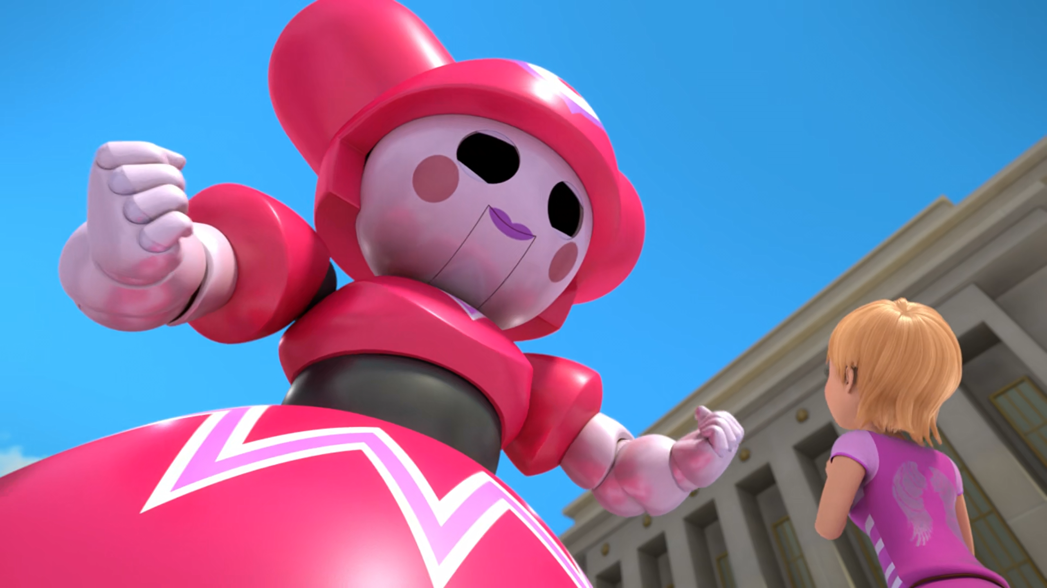
I'm sorry, ______! I should've stayed with you!
Julia
Juleka
Julie

Slide 12
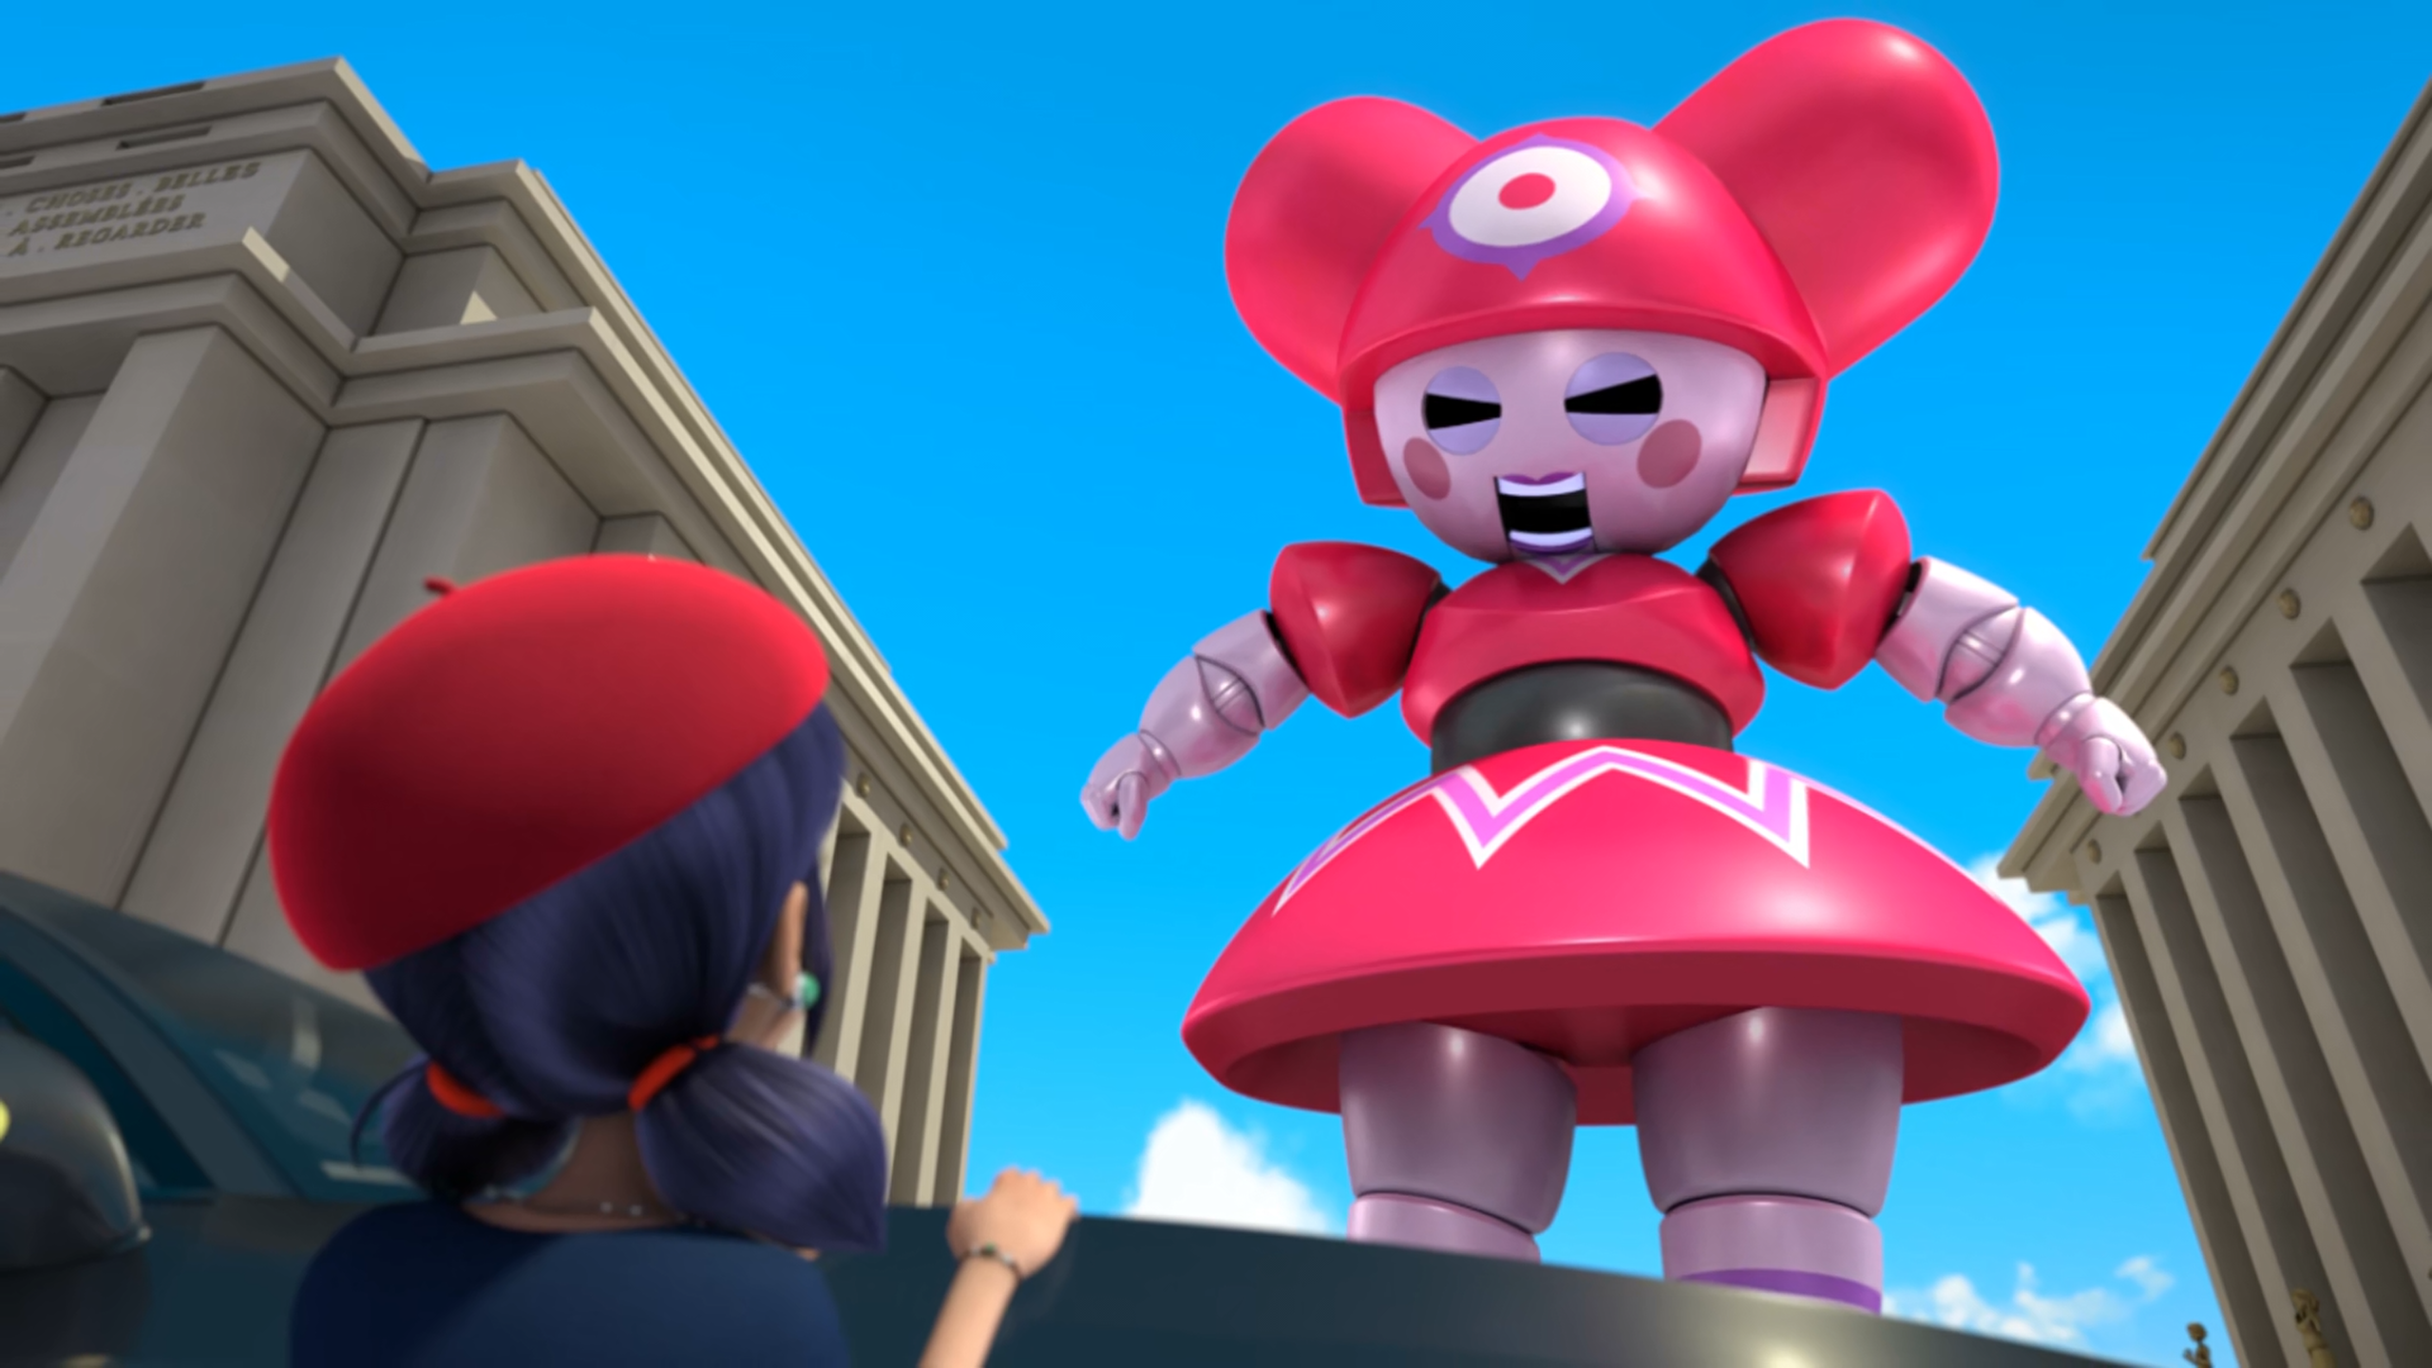
Marinette! You stole my ______.
boyfriend
pig
limelight

Slide 13
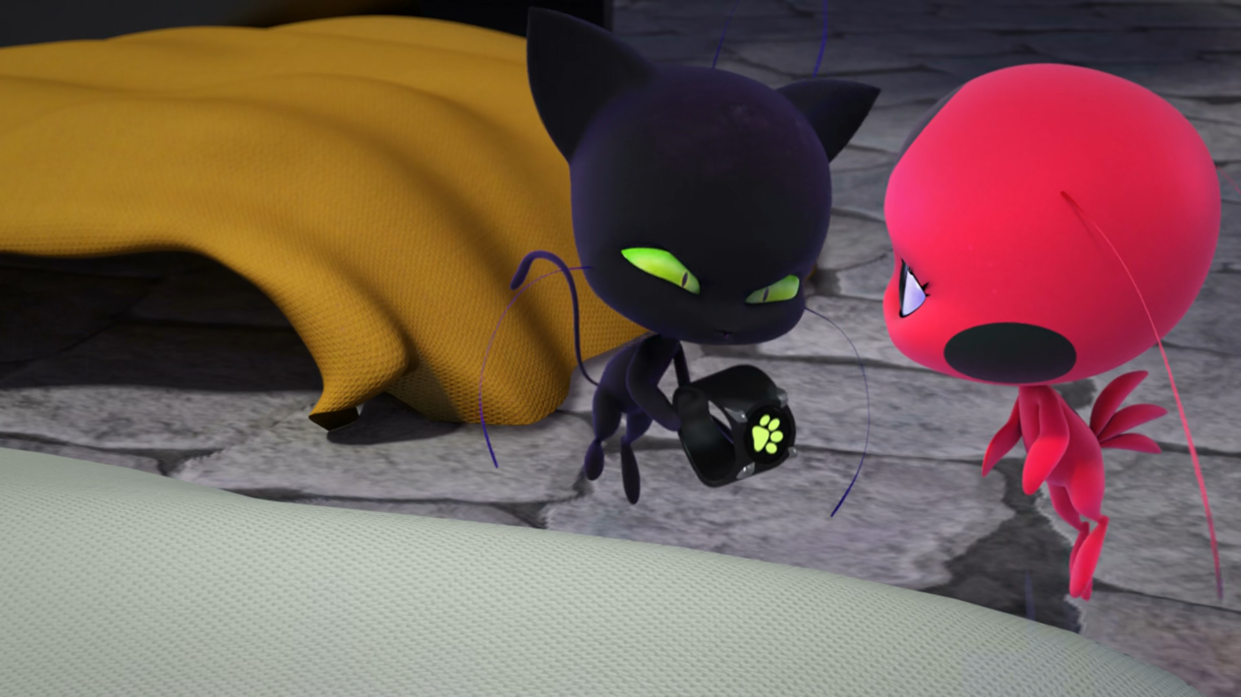
Stay focused, ______, everything will be all right!
sugarcube
sexy
sweetheart

Slide 14
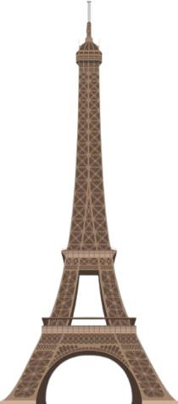
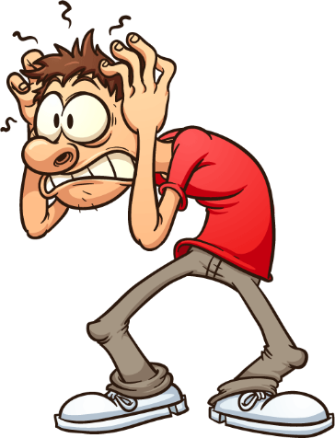
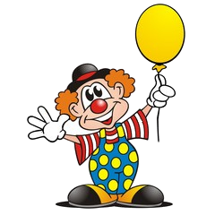
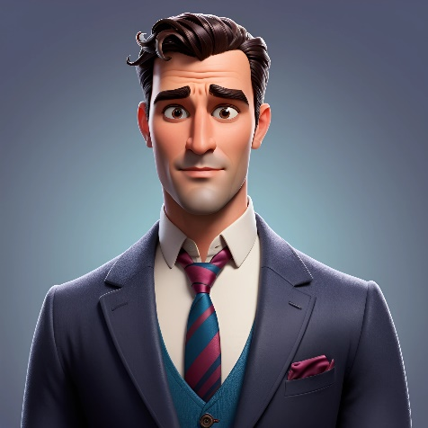
Matching Exercise
clown | Eiffel Tower | anxiety | suit

Slide 15
Matching Exercise
anxiety | clown | suit | Eiffel Tower

Slide 16
TRUE OR FALSE
1. Cat Noir says Ladybug doesn't have a sense of humour.
2. Juleka wants to be a model.
3. Alya and Adrien wear matching suits.
4. Juleka has anxiety.
5. Plagg transforms Marinette.

Slide 17
TRUE OR FALSE
1. Cat Noir says Ladybug doesn't have a sense of humour. | TRUE
2. Juleka wants to be a model. | TRUE
3. Alya and Adrien wear matching suits. | FALSE
4. Juleka has anxiety. | TRUE
5. Plagg transforms Marinette. | TRUE

