Slide 1
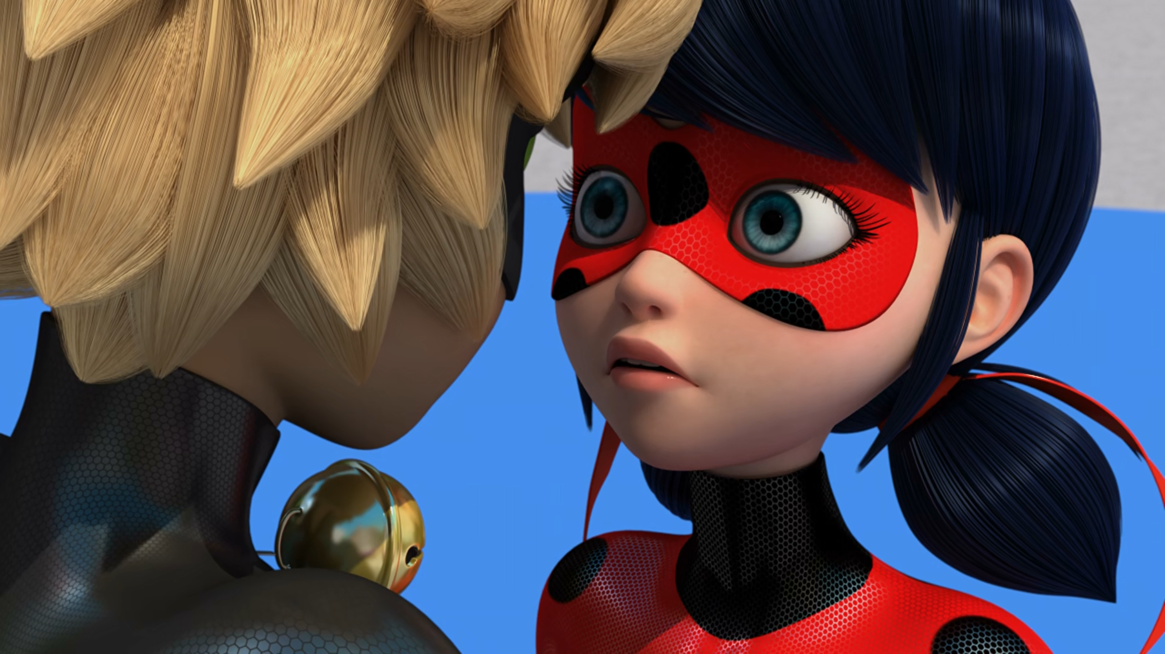
MIRACULOUS LADYBUG: OBLIVIO. PART 2

Slide 2
VOCABULARY
agility - 敏捷 - əˈʤɪləti
battery - 电池 - bætᵊri
closet - 柜子 - klɒzɪt
downfall - 垮台 - daʊnfɔːl
erase - 擦除 - ɪˈreɪz
footage - 影片 - fʊtɪʤ
storage - 存储 - stɔːrɪʤ
struggle - 挣扎 - strʌɡᵊl
tag - 标签 - tæɡ

Slide 3
1. 电池
2. 柜子
3. tæɡ

Slide 4
1. 电池 - battery
2. 柜子 - closet
3. tæɡ - tag

Slide 5
OBLIVIO. PART 2
Nadja: Looks like Ladybug and Cat Noir are struggling today.
Ladybug: And stop calling us a couple!
Adrien: We don't exactly look lovey-dovey in this footage.
Marinette: Probably just a regular fight like all couples have.

Slide 6
Ladybug: How am I gonna find the solution?
Adrien: Don't worry, you always have the right idea at the right time, you got this!
Ladybug: Mm hm. Hoo. It's time for action!
Adrien: Marinette, I want to fight beside you. If we're a couple, then we'll be stronger together.
Ladybug: But you don't have your kwami or your superpowers.

Slide 7
Ladybug: Stop! It'll trigger it if you say it out loud.
Cat Noir: And it says it can only be used once?
Ladybug: What does your power do, exactly?
Cat Noir: Apparently, I can destroy anything
I touch.
Ladybug: Then stay away from me, if you don't mind.
Cat Noir: That's not gonna be easy, Ma— Lady.

Slide 8
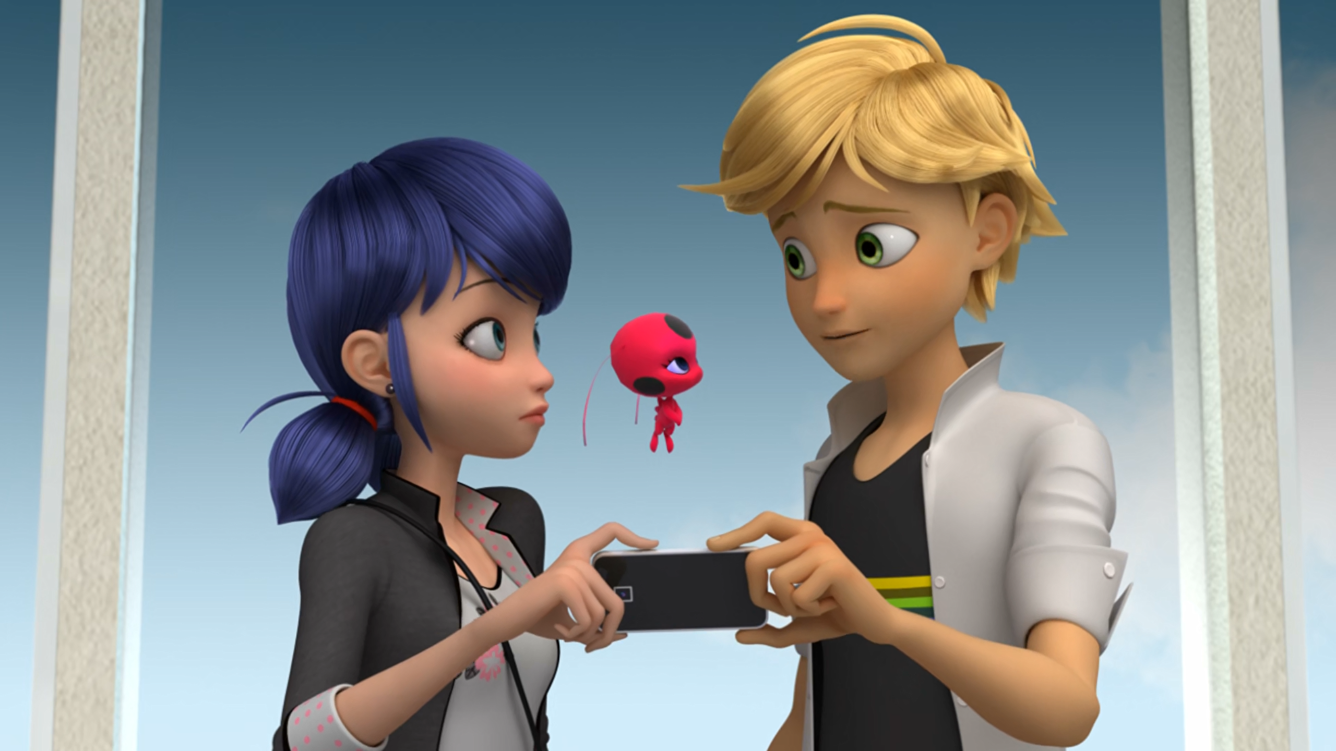
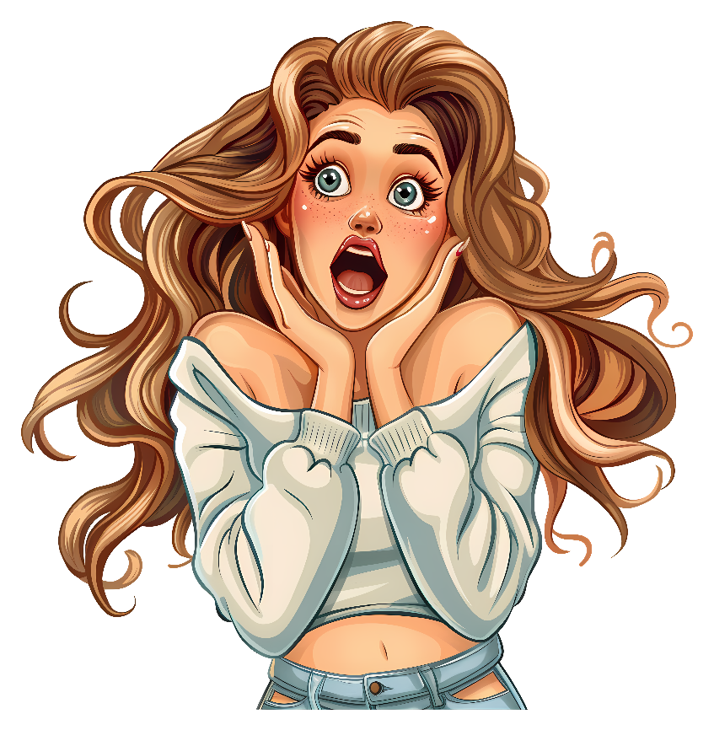
We don't exactly look lovey-dovey in this ______.
video
clip
footage

Slide 9
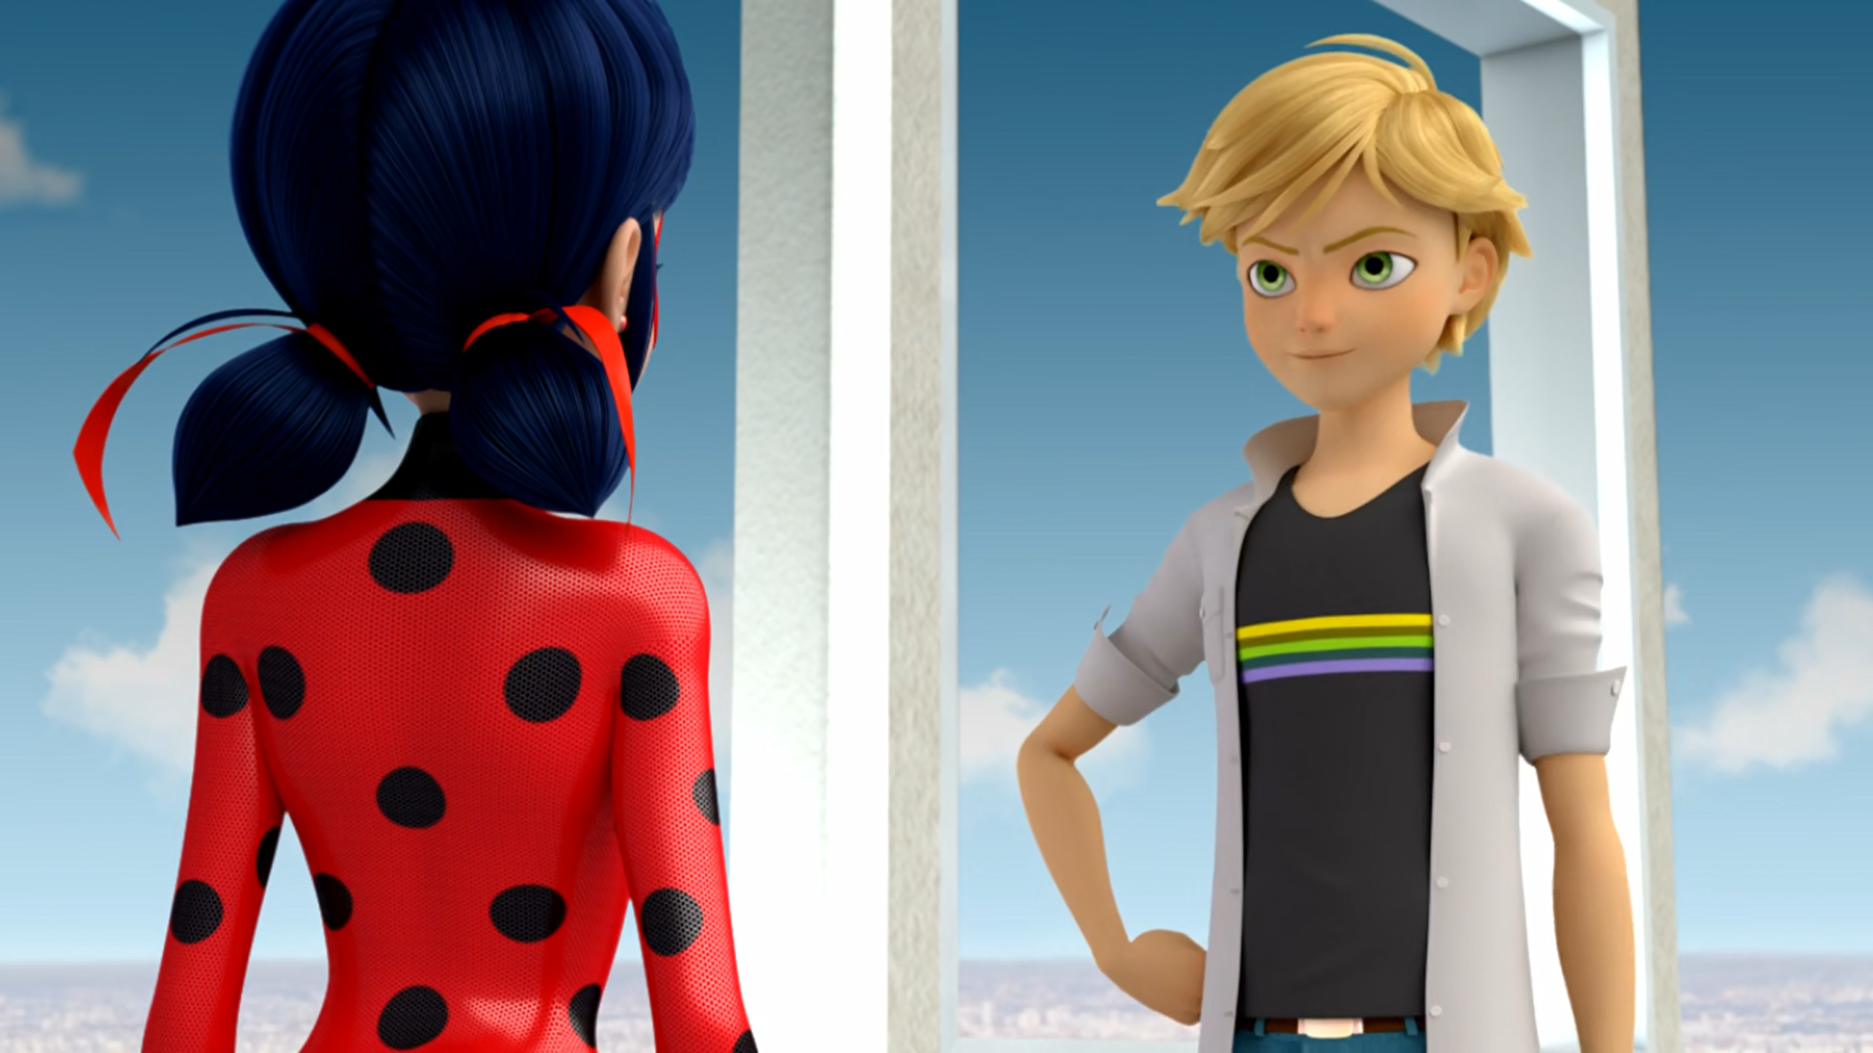
You've already proven that you are one, with or without a ______.
costume
yo-yo
kwami

Slide 10
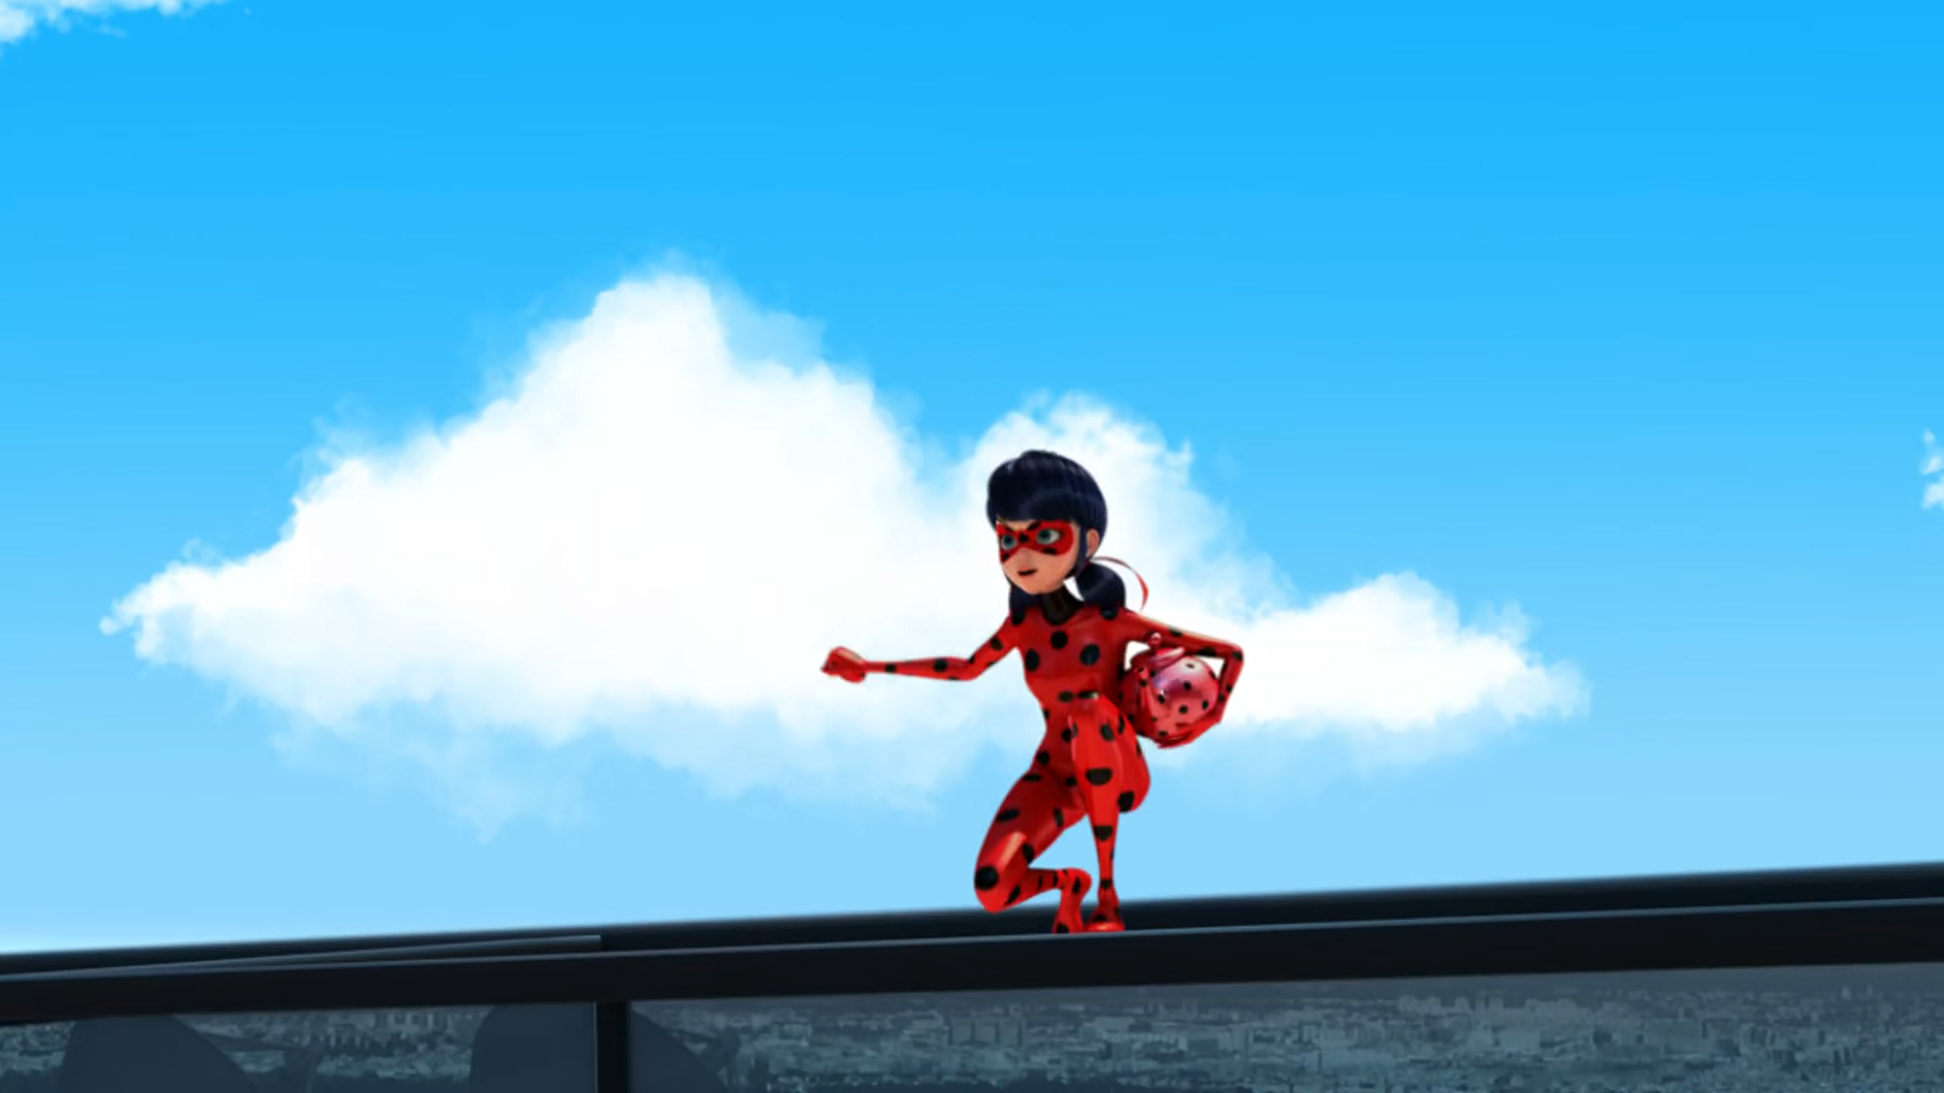
Whoo hoo! Ha ha! Super ______ is super awesome!
powers
agility
strength

Slide 11
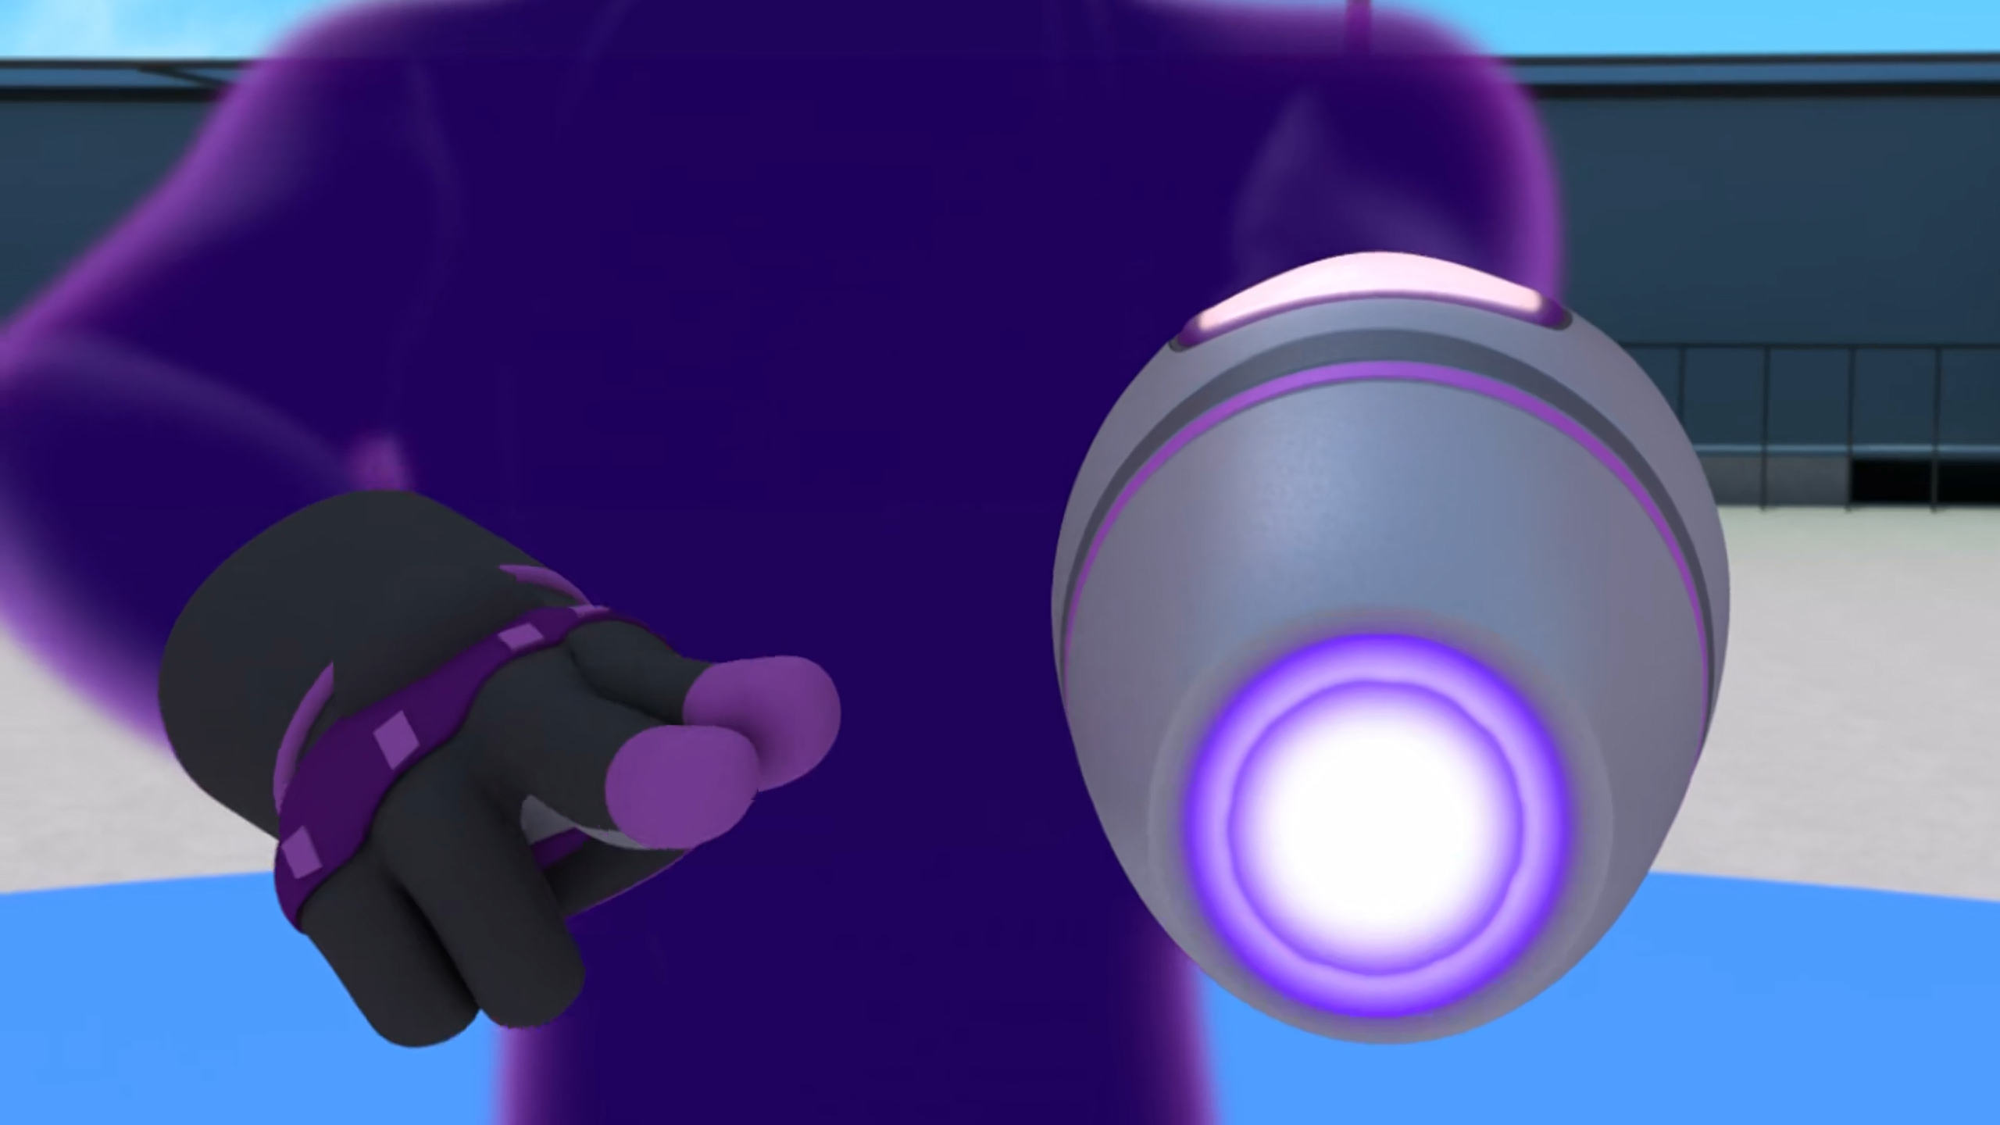
Of course! His left ______ is different from the rest of his body!
arm
hand
wrist

Slide 12
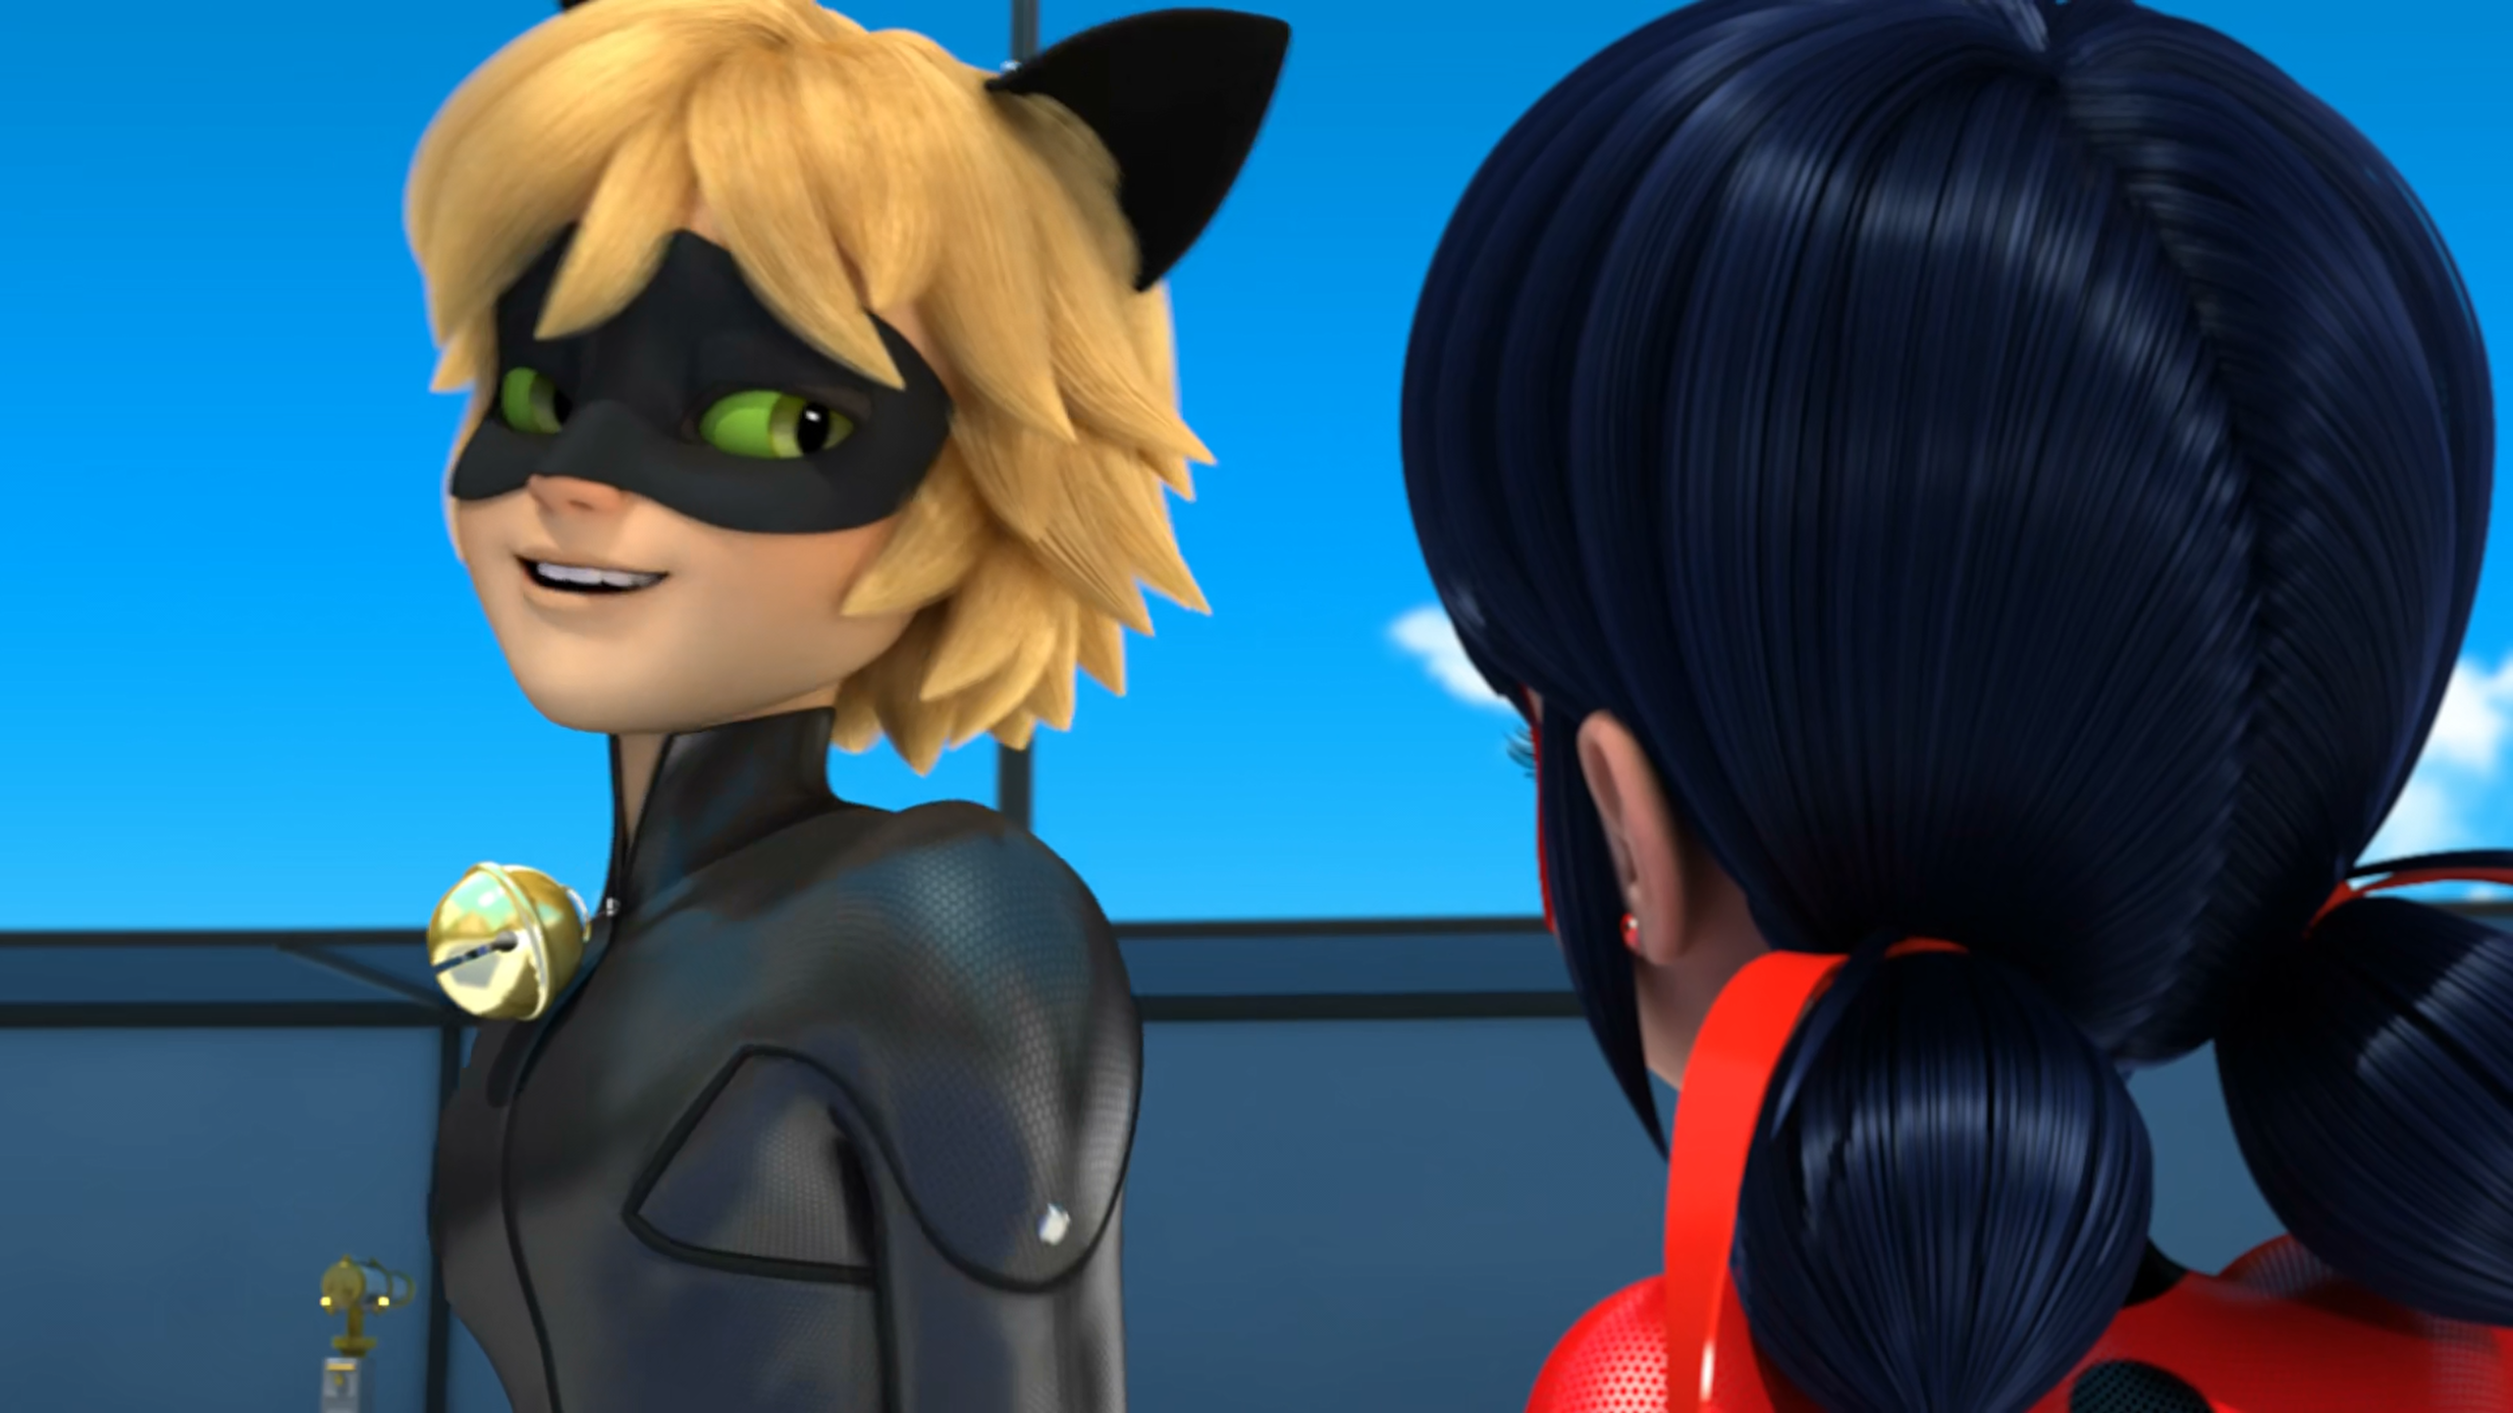
We're ______ for each other m'Lady.
made
hot
meant

Slide 13
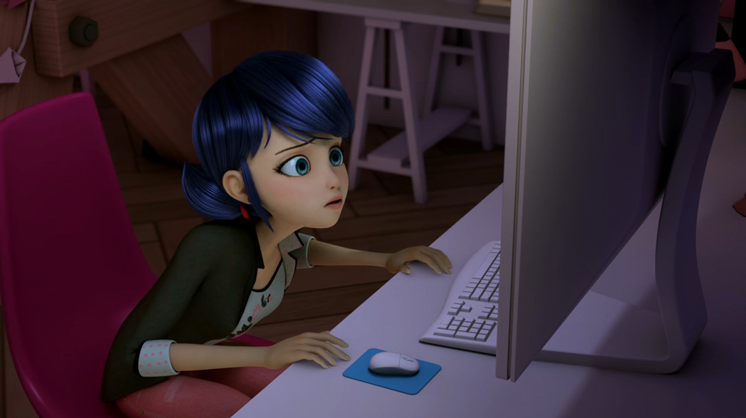
I actually kissed ______! How could this have happened?
Cat Noir
Nino
Chloé

Slide 14
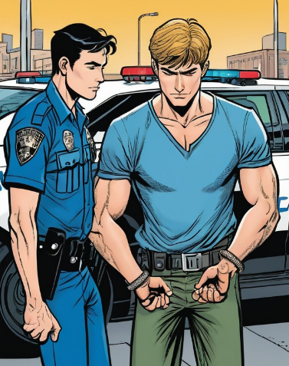
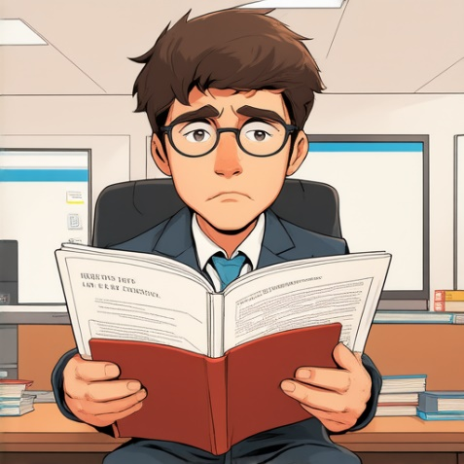
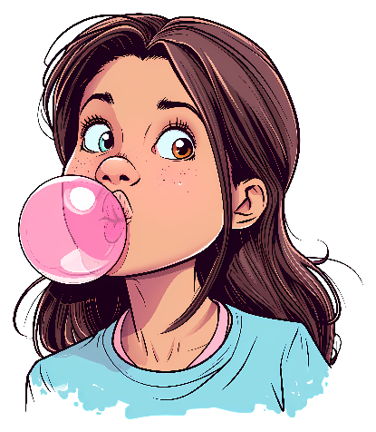
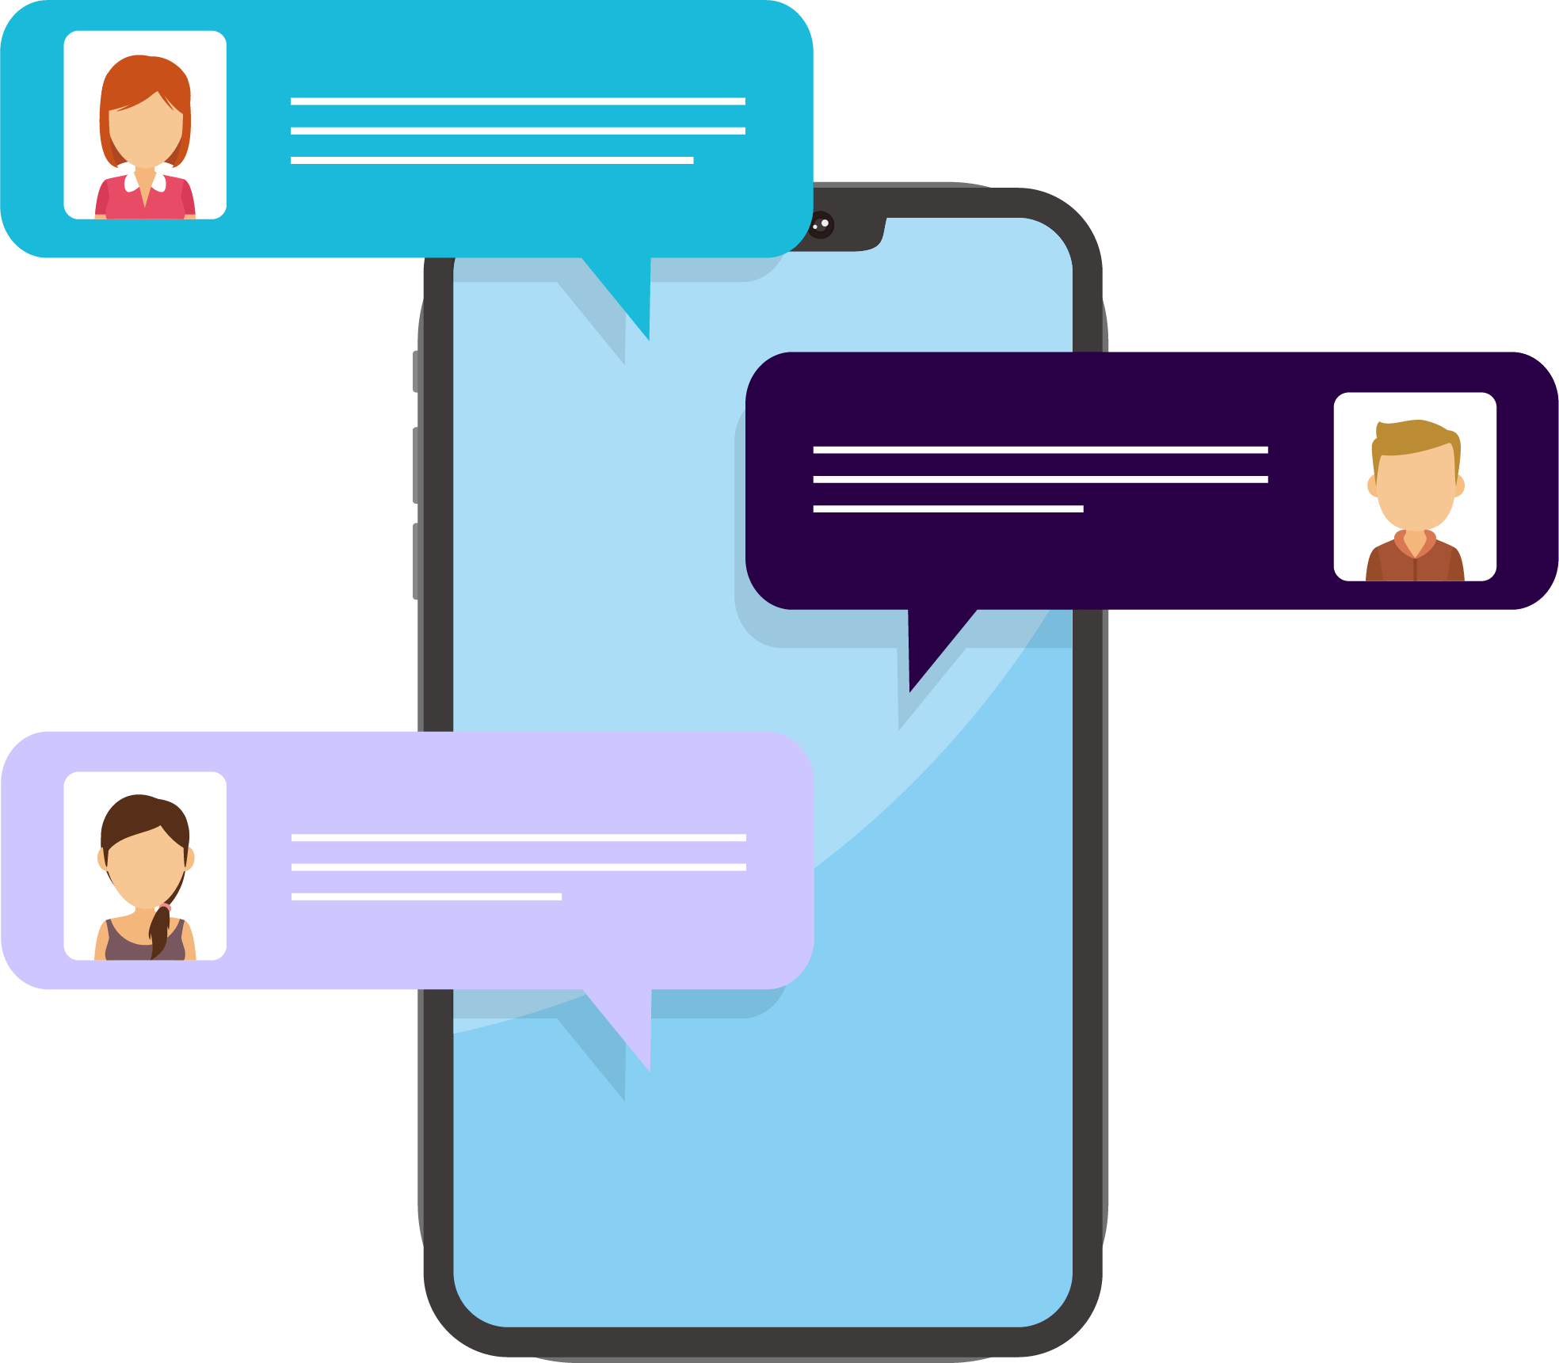
Matching Exercise
bubble | message | caught | user guide

Slide 15
Matching Exercise
message | caught | user guide | bubble

Slide 16
TRUE OR FALSE
1. Ladybug drew a cat on the wall in the elevator.
2. Marinette phones Master Fu.
3. Adrien makes a costume out of cardboard.
4. Cat Noir kisses Ladybug.
5. Alya and Nino were punished for playing Super Mario.

Slide 17
TRUE OR FALSE
1. Ladybug drew a cat on the wall in the elevator. | FALSE
2. Marinette phones Master Fu. | TRUE
3. Adrien makes a costume out of cardboard. | TRUE
4. Cat Noir kisses Ladybug. | TRUE
5. Alya and Nino were punished for playing Super Mario. | FALSE

