Slide 1
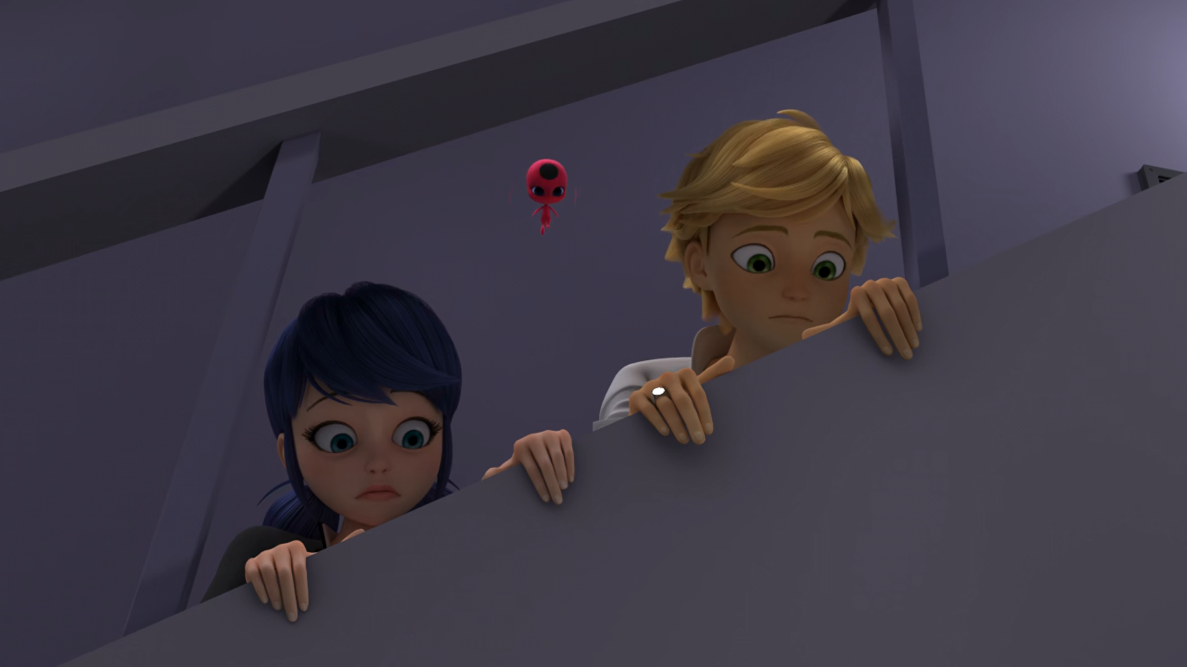
MIRACULOUS LADYBUG: OBLIVIO. PART 1

Slide 2
VOCABULARY
amnesia - 失忆 - æmˈniːziə
block - 阻塞 - blɒk
convinced - 确信 - kənˈvɪnst
exceptional - 异常 - ɪkˈsɛpʃᵊnᵊl
flush - 潮红 - flʌʃ
psychological - 心理 - saɪkᵊlˈɒʤɪkᵊl
relieved - 松了一口气 - rɪˈliːvd
retrace - 回溯 - rɪˈtreɪs
signal - 信号 - sɪɡnᵊl

Slide 3
1. æmˈniːziə
2. ɪkˈsɛpʃᵊnᵊl
3. 松了一口气

Slide 4
1. æmˈniːziə - amnesia
2. ɪkˈsɛpʃᵊnᵊl - exceptional
3. 松了一口气 - relieved

Slide 5
OBLIVIO. PART 1
Adrien: Okay everyone we're gonna keep our cool here. We've all lost our memories and we don't know why.
Marinette: What is it this time? We can't stay here.
Adrien: Couldn't agree more.
Tikki: Perhaps we should help them?

Slide 6
Adrien: Not to mention the two strange creatures who magically appeared when our costumes disappeared.
Plagg: Uh, excuse me, but the creatures are hungry. Would you mind opening up your shirt to see what smells so good?
Adrien: Camembert?
Plagg: It's the most beautiful thing I've ever seen...

Slide 7
Marinette: If my own mother doesn't know that I'm Ladybug, then nobody must know.
Adrien: What about us? Do you think… we know?
Marinette: Hm. I feel like we're more than just a superhero team.
Adrien: Do you think we're…
Marinette: Looks like it.

Slide 8
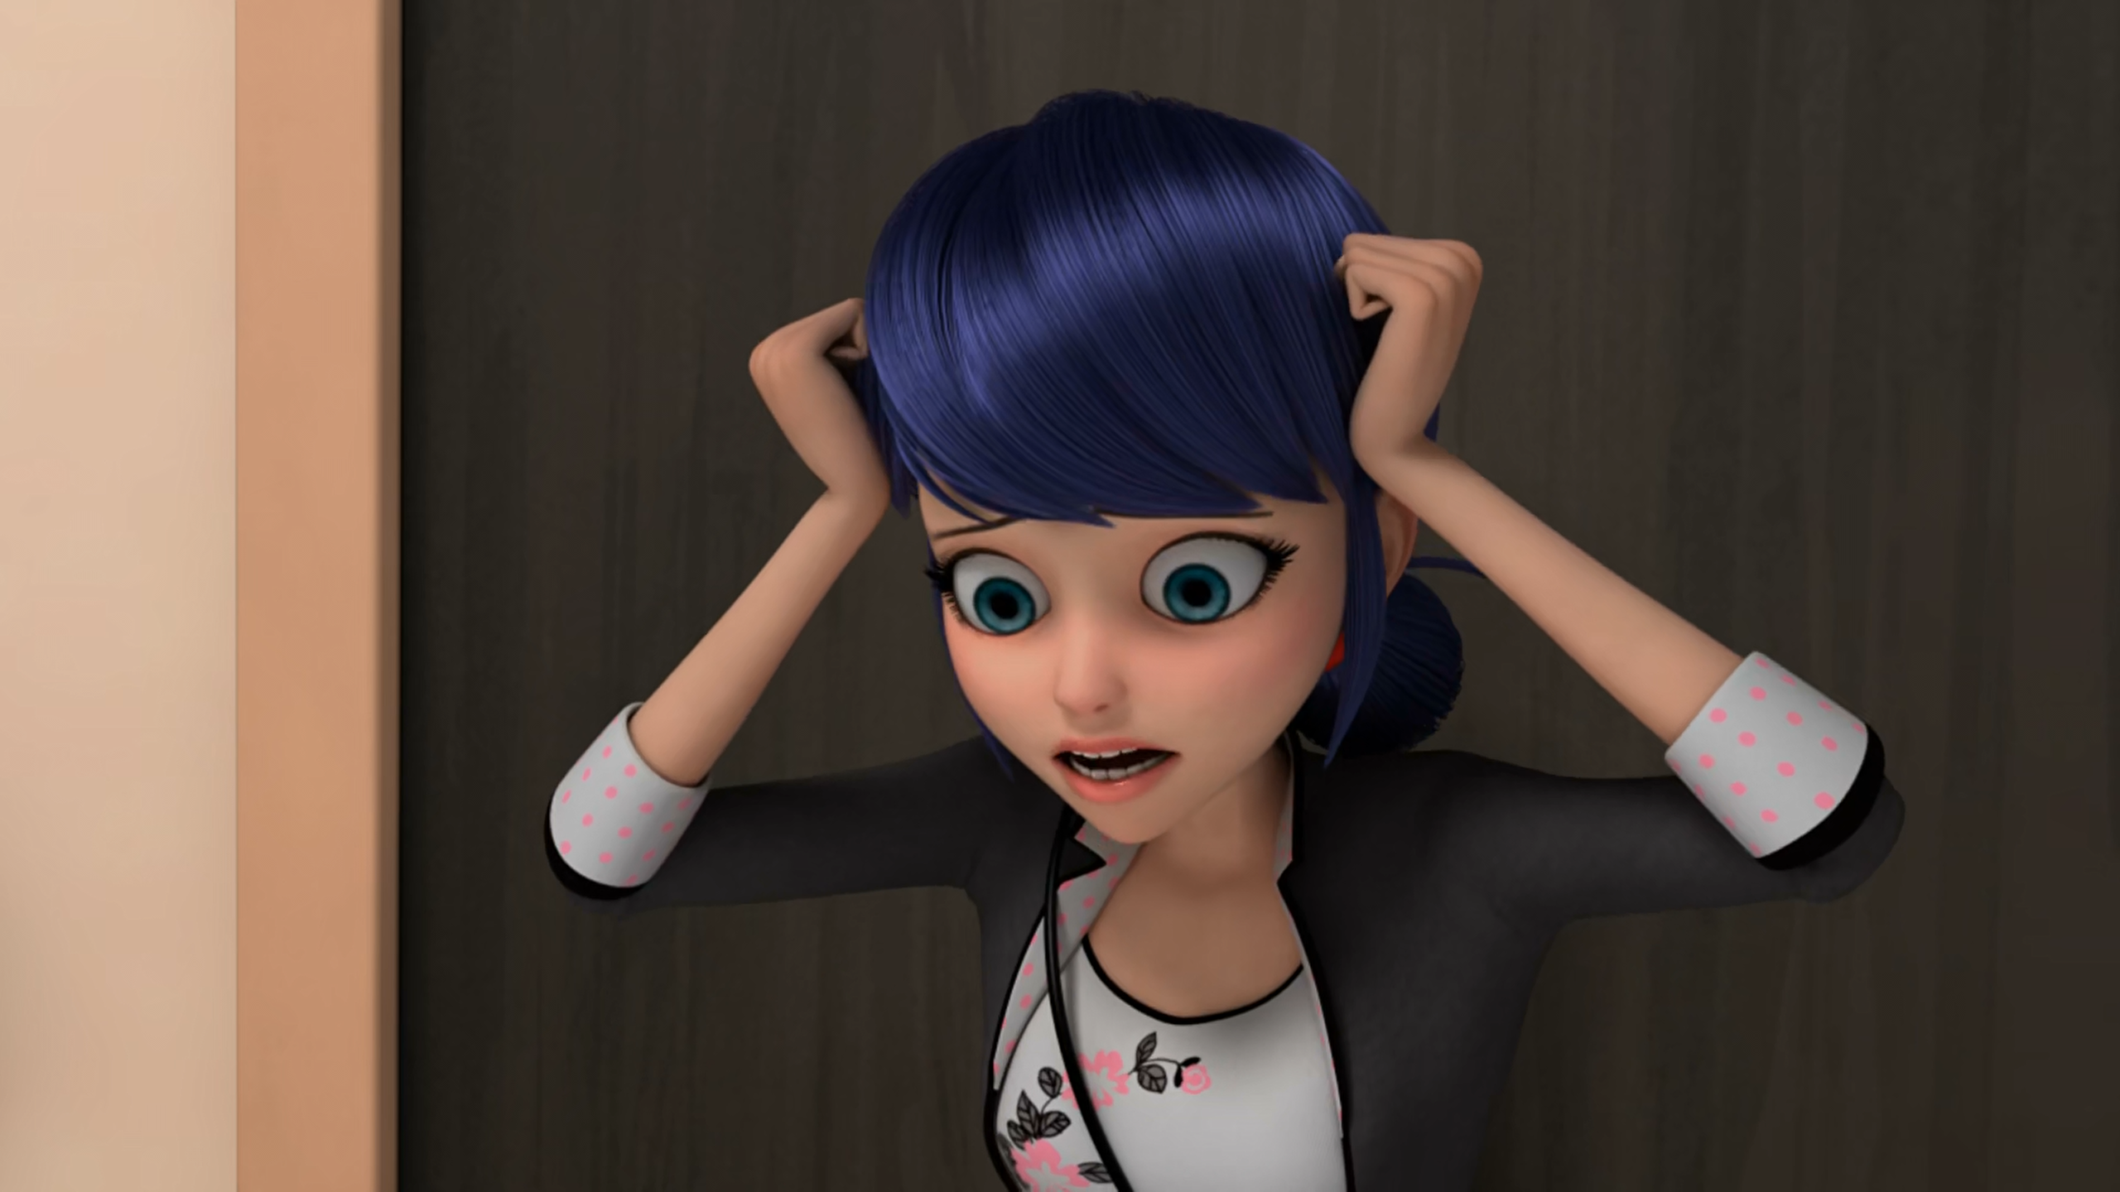

Okay. We’re stuck in the building with ______.
Alya
Adrien
amnesia

Slide 9
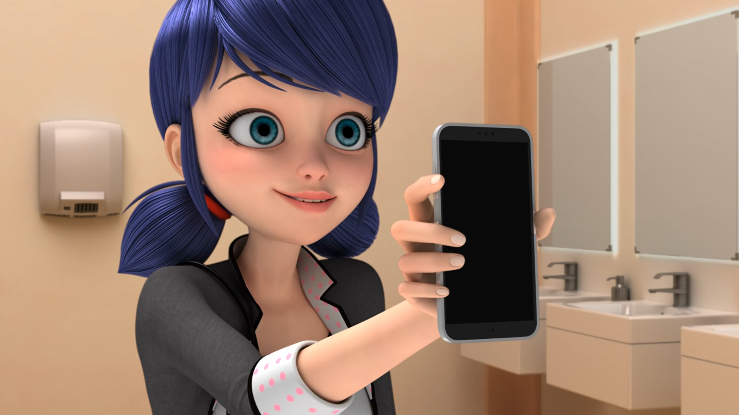
We still got our ______!
phones
brains
internet

Slide 10
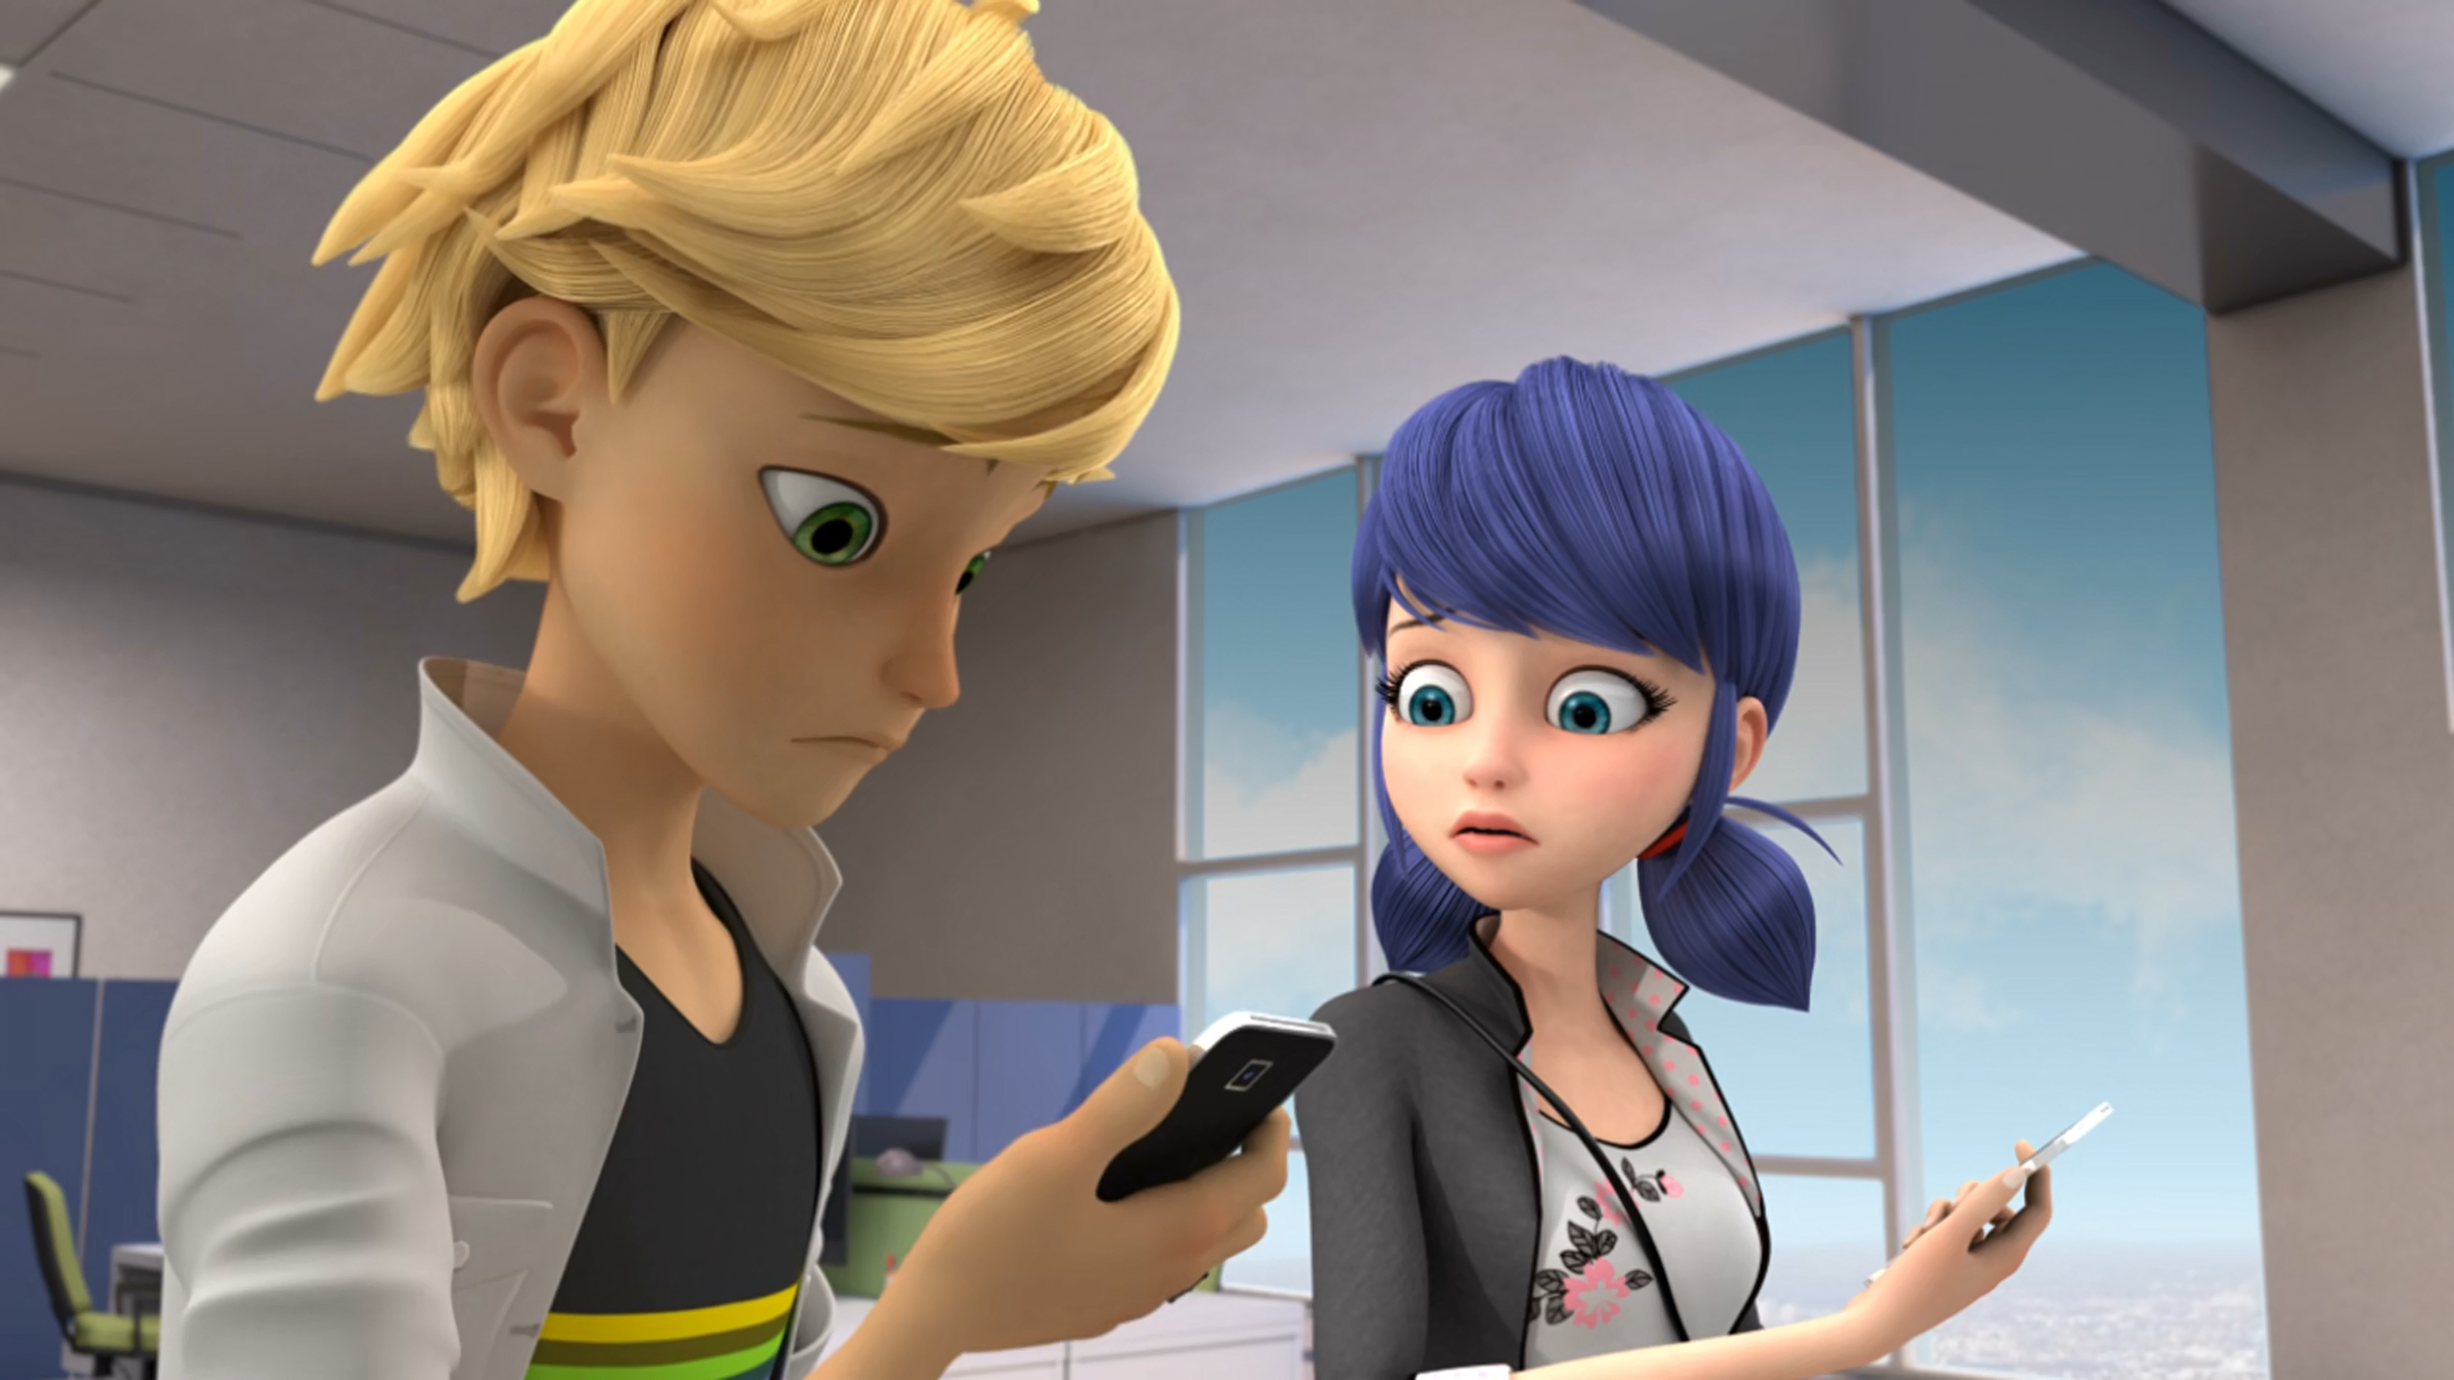
To leave a message, please call my ______.
grandma
secretary
pig

Slide 11
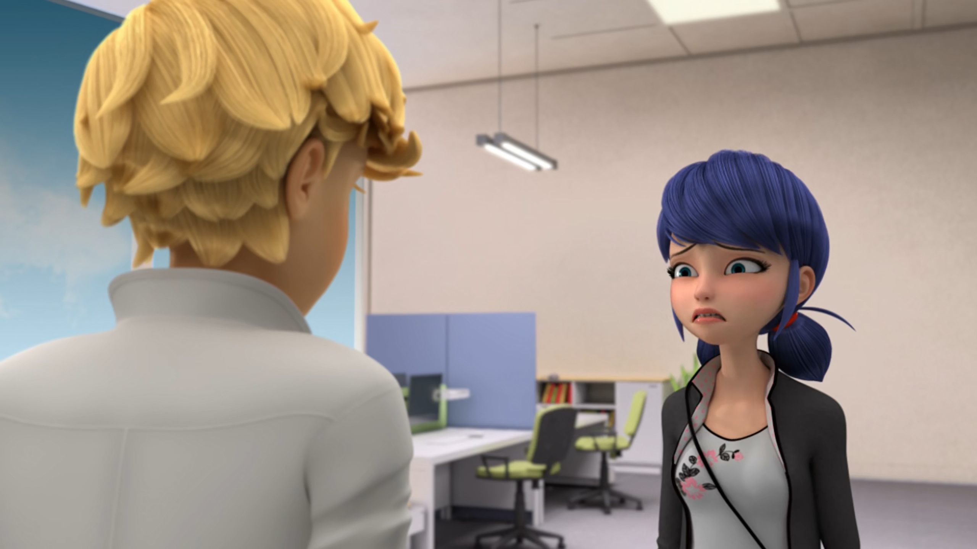
We're supposed to be defeating it with ______ we no longer have!
technology
superpowers
cunning

Slide 12
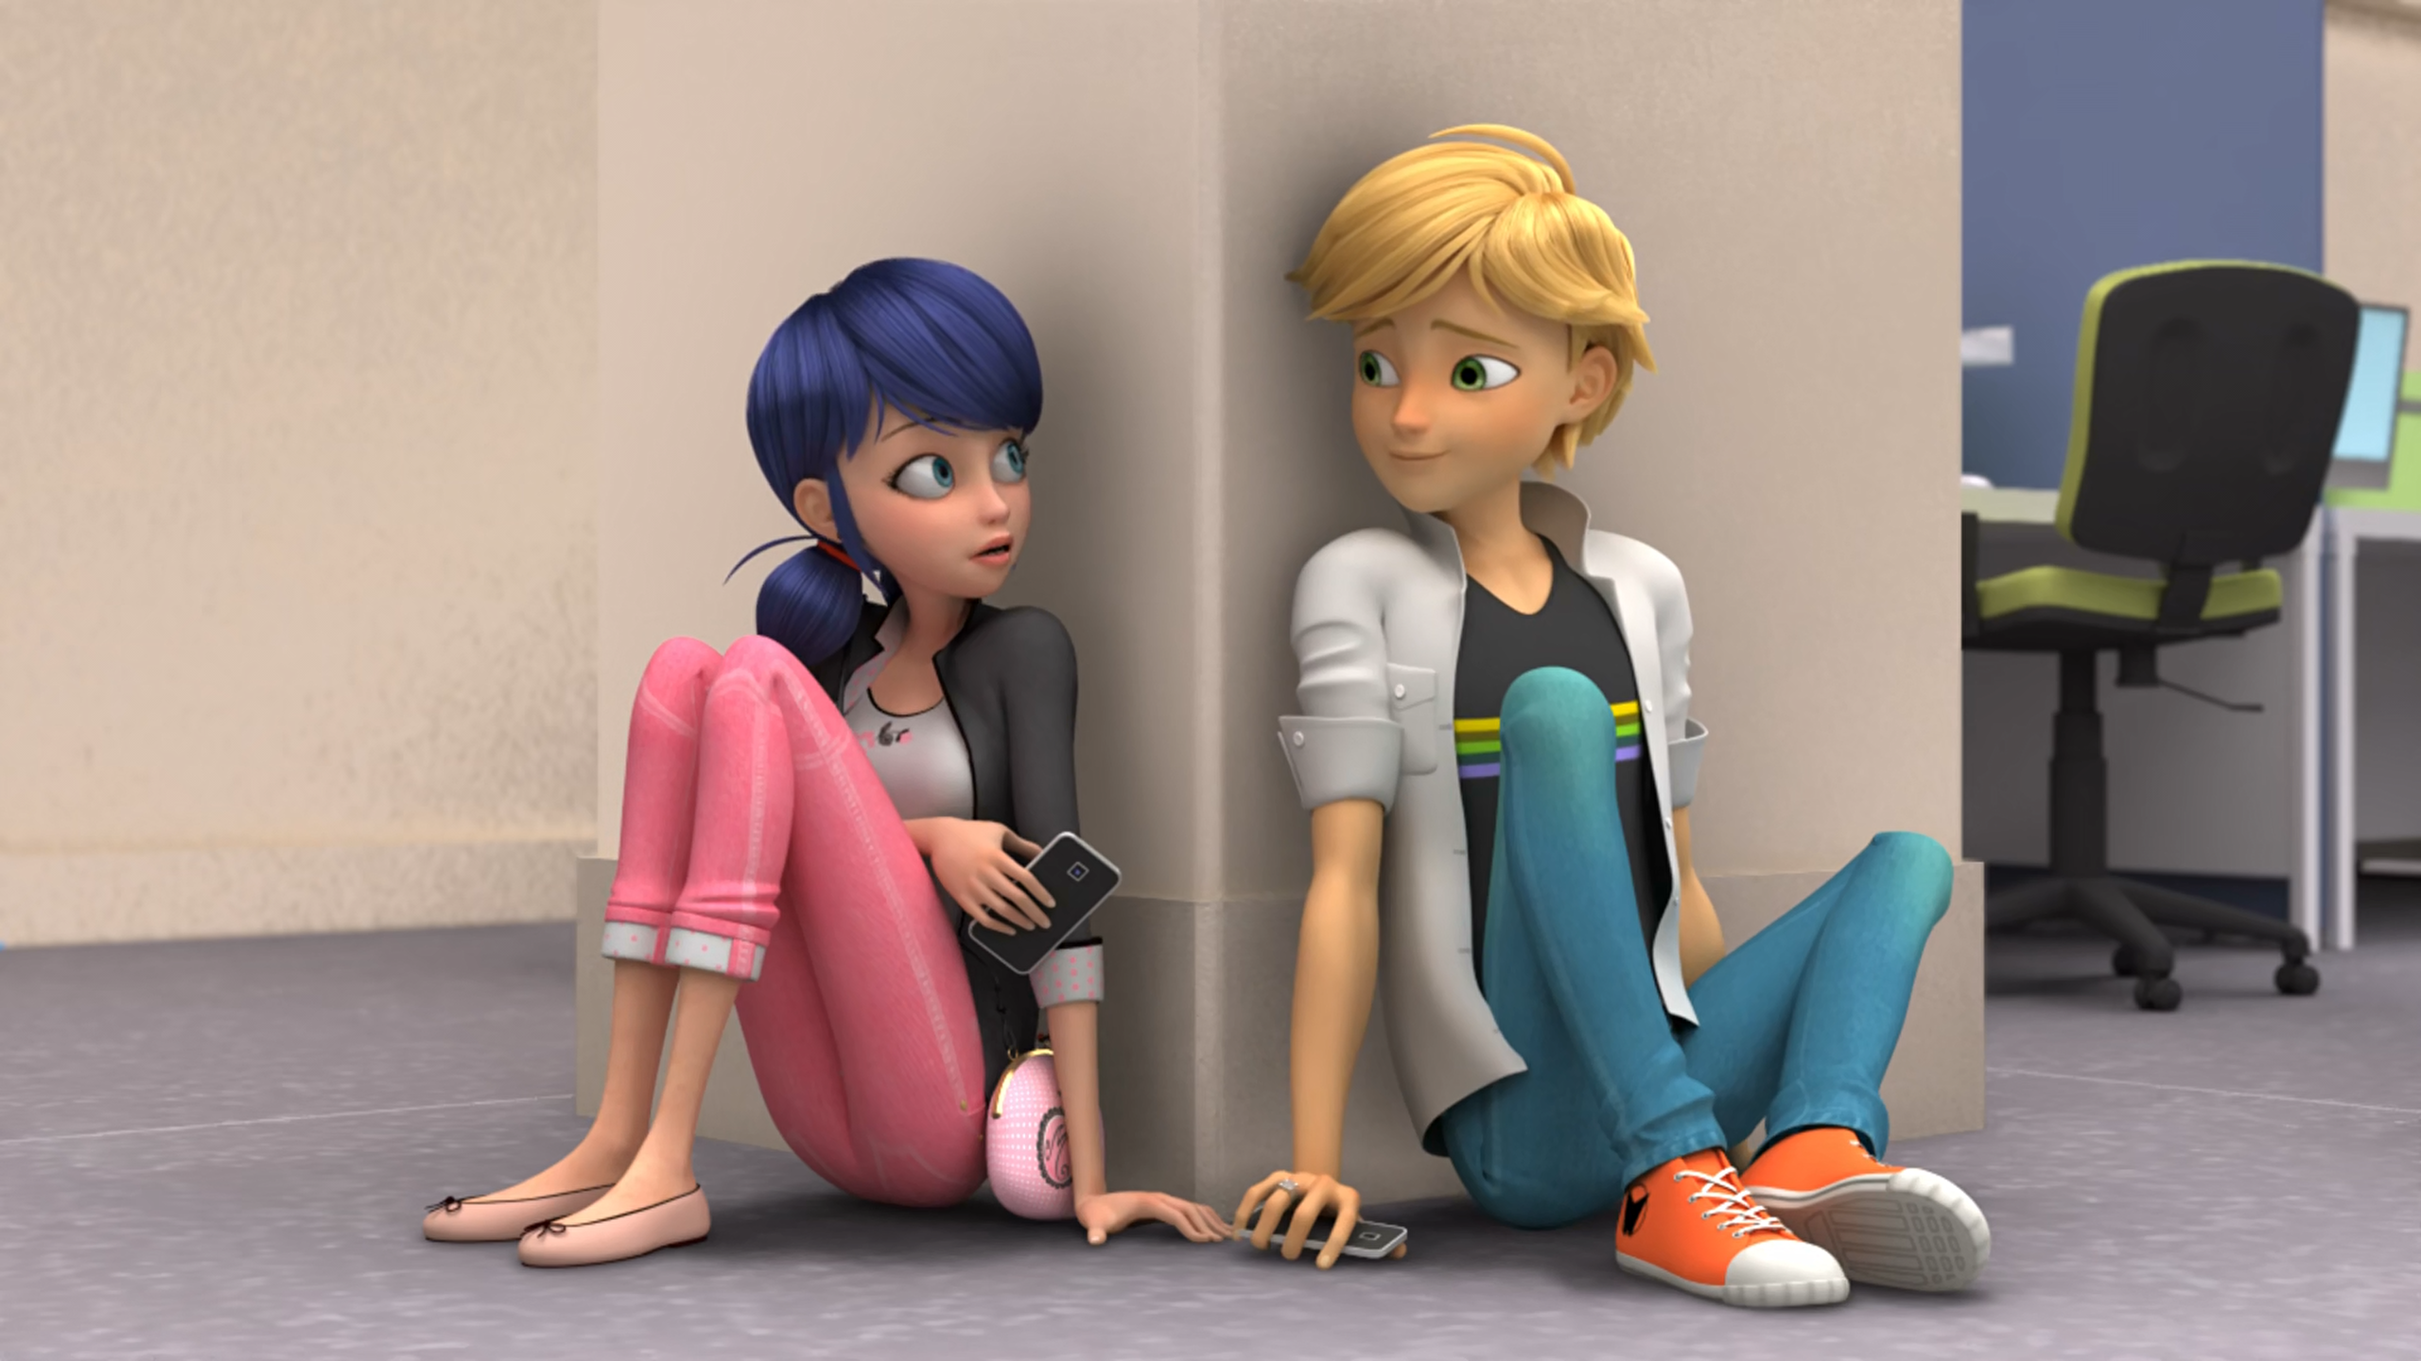
I couldn't hide my ______ from the girl I love.
e-mail
phone
identity

Slide 13
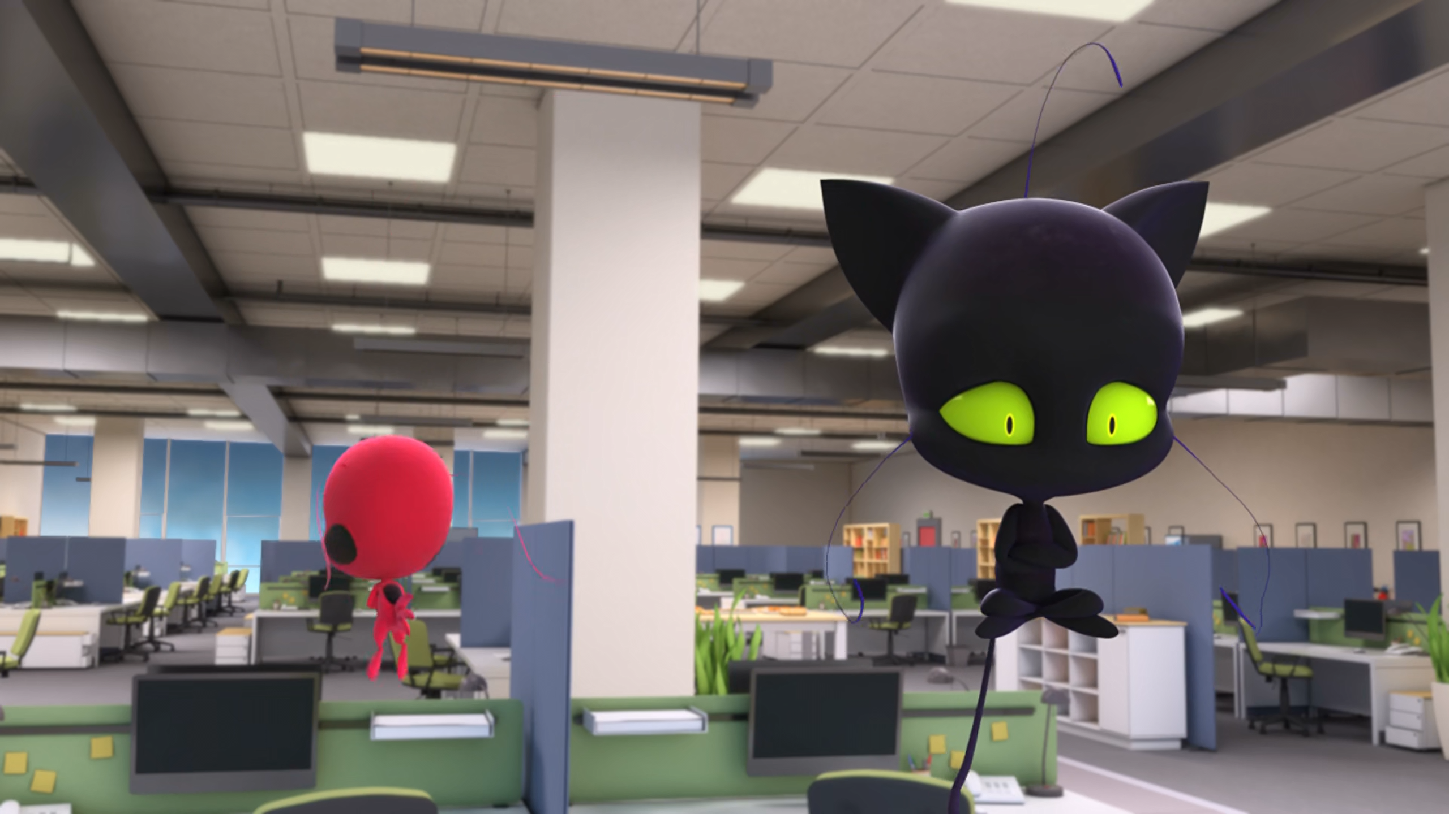
You're a selfish being, and a total ______!
coward
idiot
bitch

Slide 14
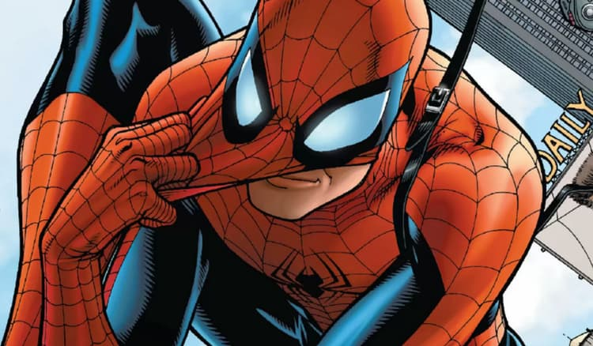
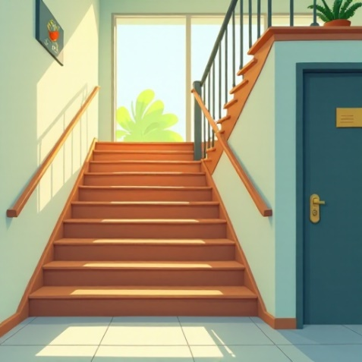
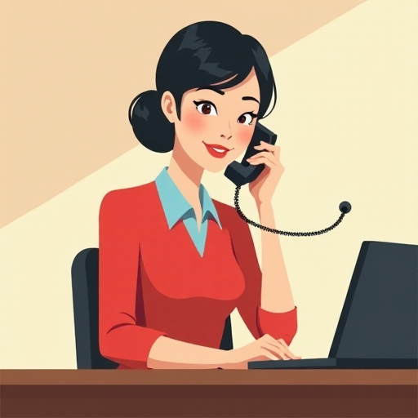
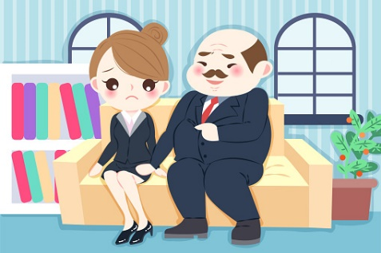
Matching Exercise
secretary | harassment | identity | stairs

Slide 15
Matching Exercise
identity | stairs | secretary | harassment

Slide 16
TRUE OR FALSE
1. Tikki is hungry.
2. Plagg eats KFC.
3. Adrien's dad answers the phone.
4. Tikki calls Plagg a coward.
5. Adrien's phone battery dies.

Slide 17
TRUE OR FALSE
1. Tikki is hungry. | TRUE
2. Plagg eats KFC. | FALSE
3. Adrien's dad answers the phone. | FALSE
4. Tikki calls Plagg a coward. | TRUE
5. Adrien's phone battery dies. | TRUE

