Slide 1
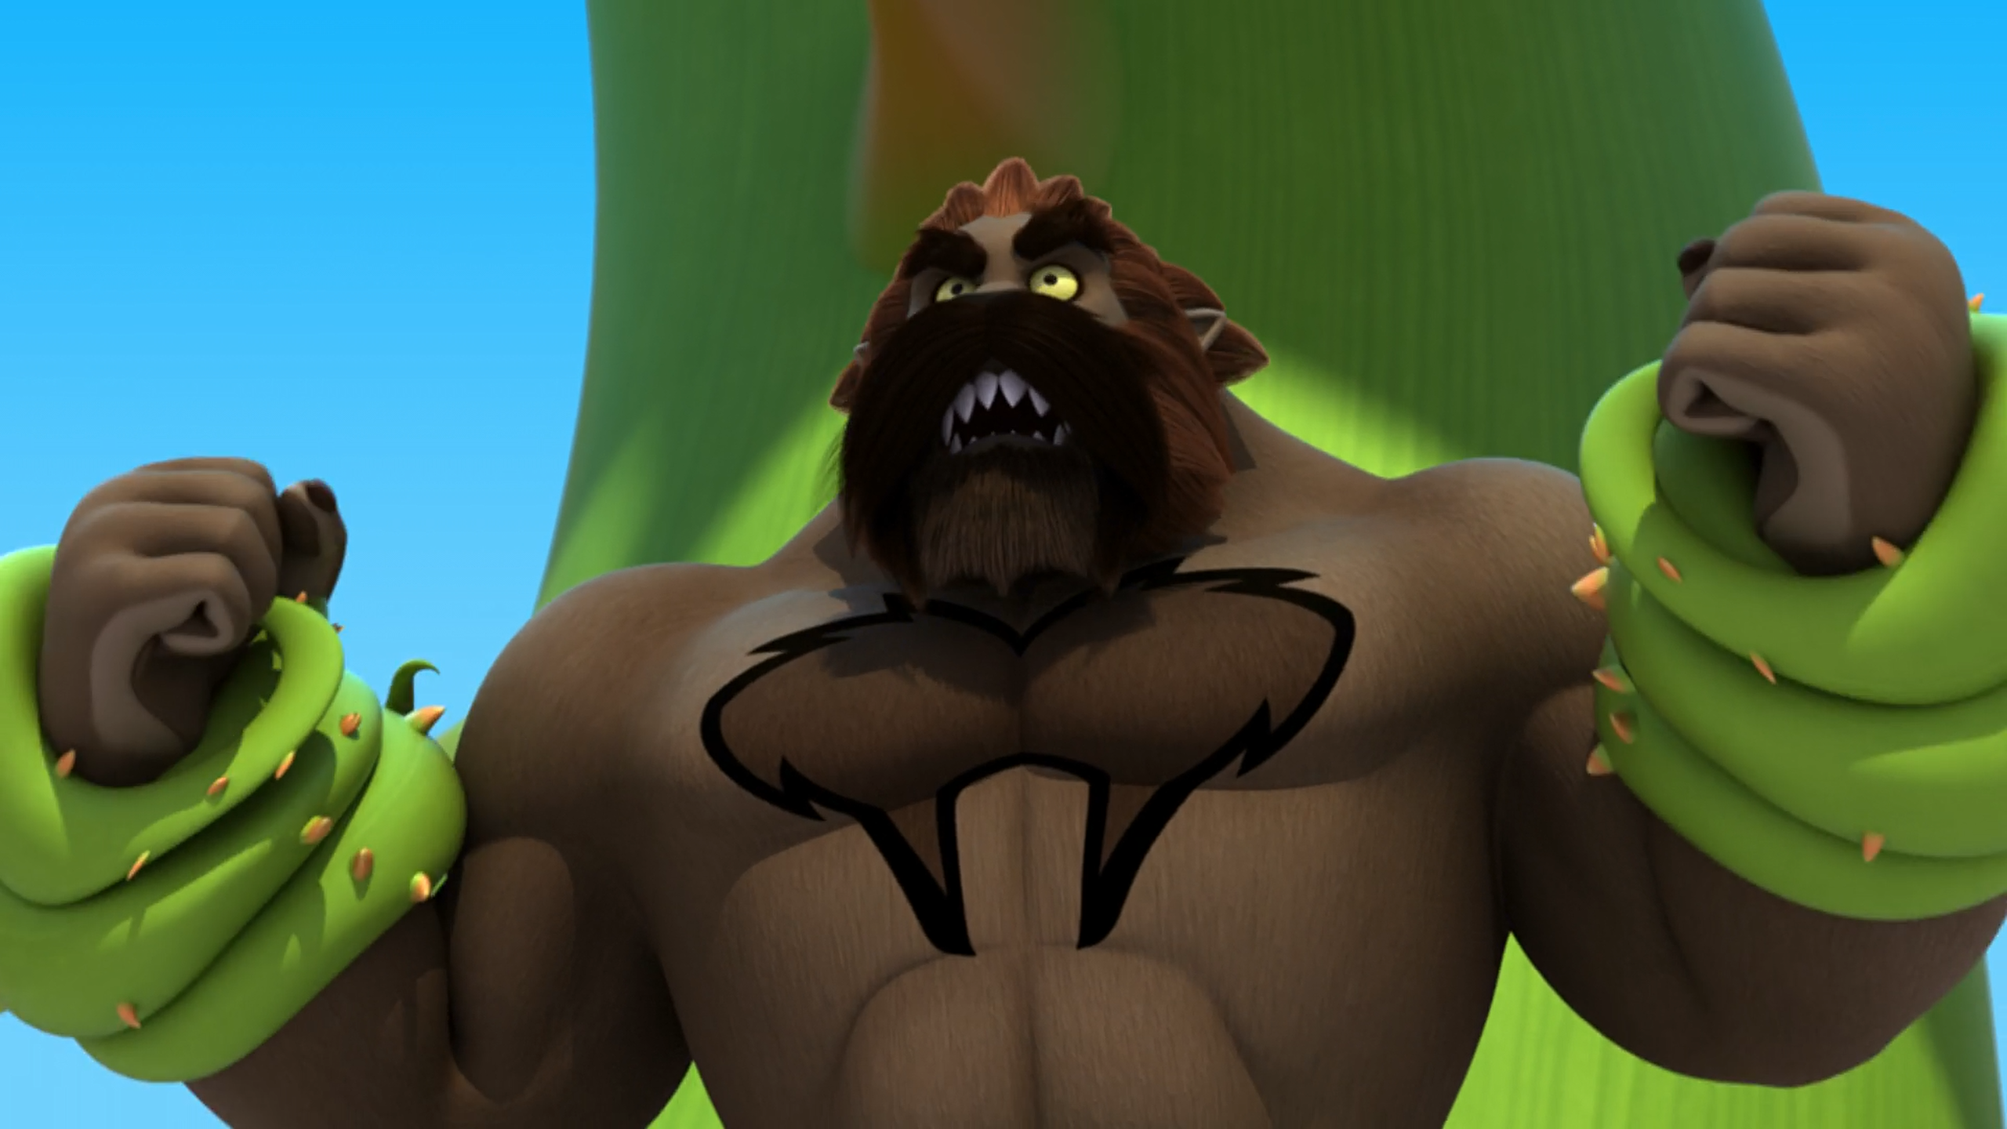
MIRACULOUS LADYBUG: WEREDAD. PART 2

Slide 2
VOCABULARY
damsel - 少女 - dæmzᵊl
disappointment - 失望 - dɪsəˈpɔɪntmənt
distress - 苦恼 - dɪˈstrɛs
feast - 盛宴 - fiːst
flaw - 缺陷 - flɔː
forbid - 禁止 - fəˈbɪd
hardship - 困难 - hɑːdʃɪp
tenacity - 韧性 - təˈnæsəti
worthy - 值得 - wɜːði

Slide 3
1. 失望
2. 盛宴
3. wɜːði

Slide 4
1. 失望 - dɪsəˈpɔɪntmənt
2. 盛宴 - feast
3. wɜːði - worthy

Slide 5
WEREDAD. PART 2
Cat Noir: I trust her. She always shows up at the right time.
Sabine: You really love her, huh?
Cat Noir: Yes, but, Marinette's seems like an awesome girl, too. Don't worry. I'll save her.
Sabine: I have faith in you, Cat Noir. You're a good person. Never apologize for your feelings.

Slide 6
Weredad: How dare you come back after what you've done to Marinette?
Cat Noir: I will always be here to save her.
Weredad: She's safe from you and all the boys who want to break her heart.
Cat Noir: I didn't mean to break her heart, sir, I swear.
Weredad: Then I swear that I'm about to crush your bones!

Slide 7
Tom: Marinette!
Marinette: Dad, I can't breathe!
Tom: Oh, sorry. I was so scared. You were so heartbroken because of that …
Marinette: Dad, stop! Cat Noir has every right to be in love with Ladybug. She's very lucky to have you. And just because you and
I aren't in love with each other doesn't mean that we can't be friends.

Slide 8
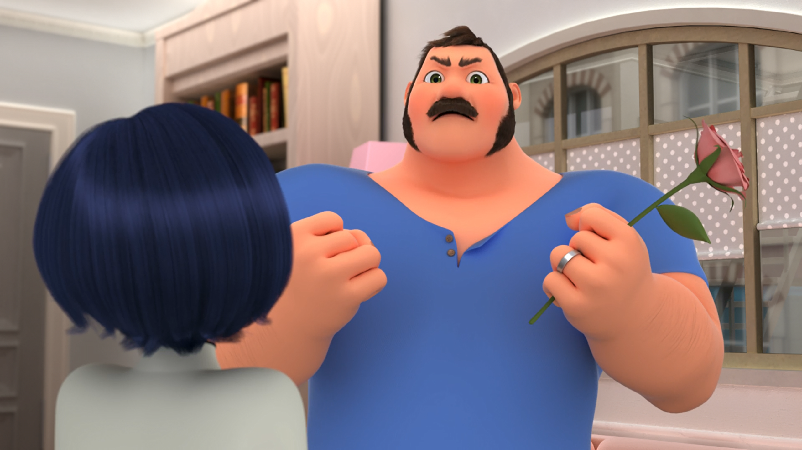

I won't let anyone break my ______ heart again!
doctor's
grandma's
daughter's

Slide 9
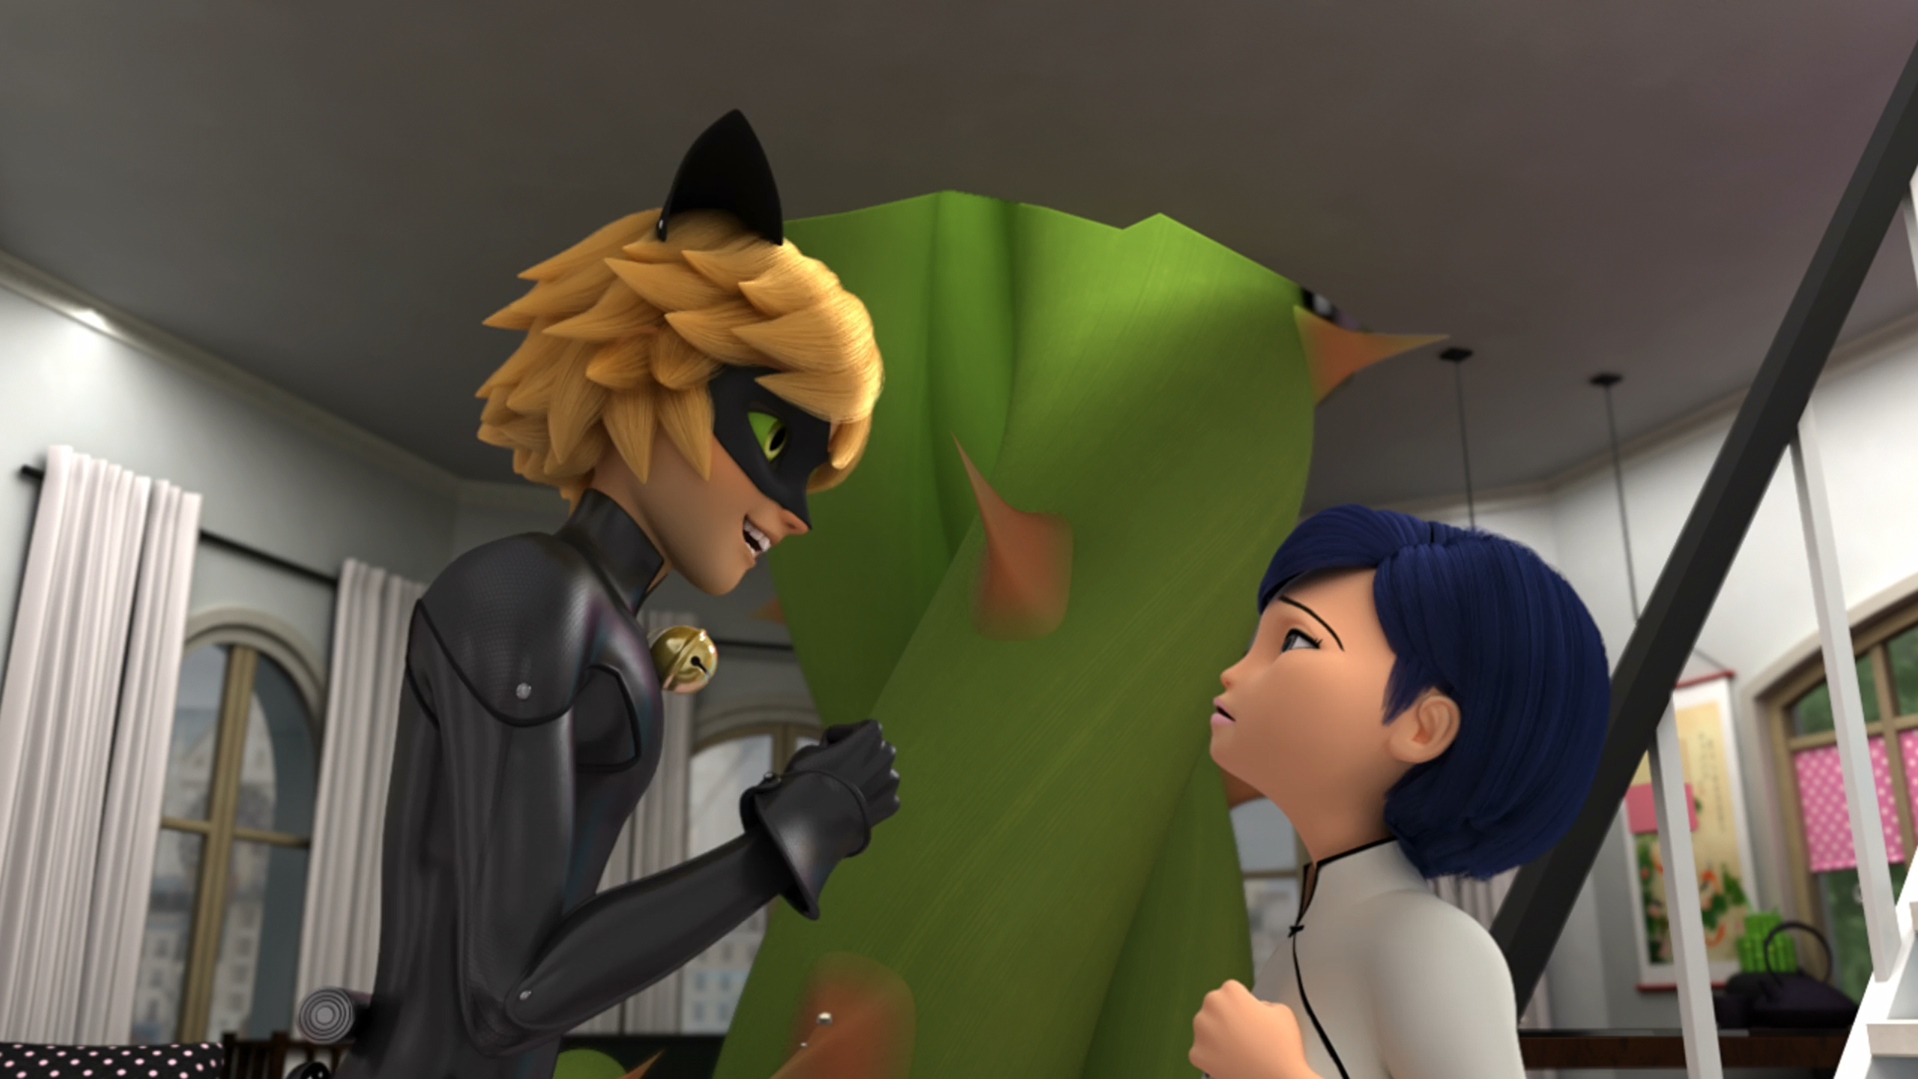
I'll bring your husband back to his ______ and get Marinette out of this.
senses
census
sensitivity

Slide 10
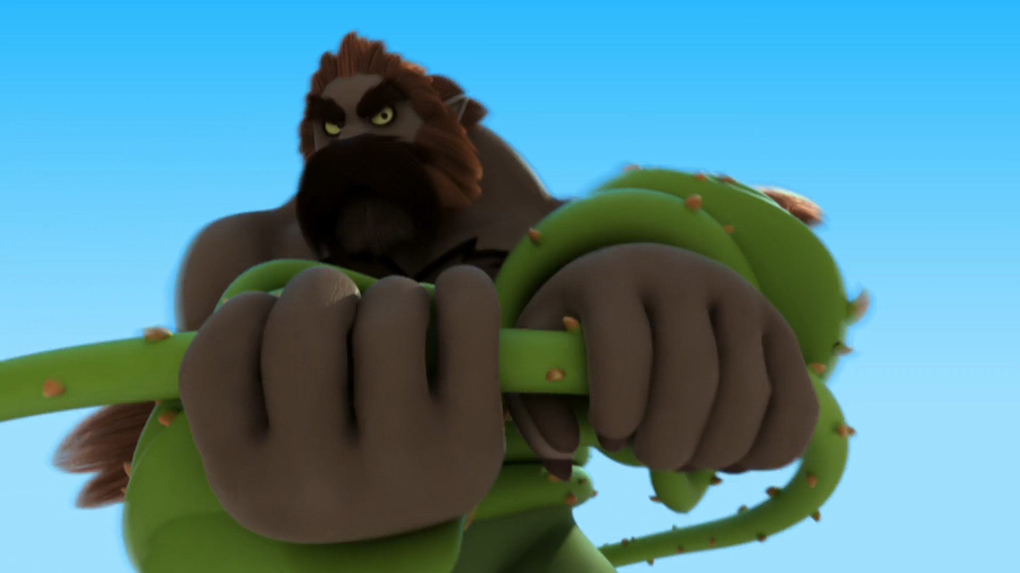
Then I swear that I'm about to crush your ______!
back
bones
body

Slide 11
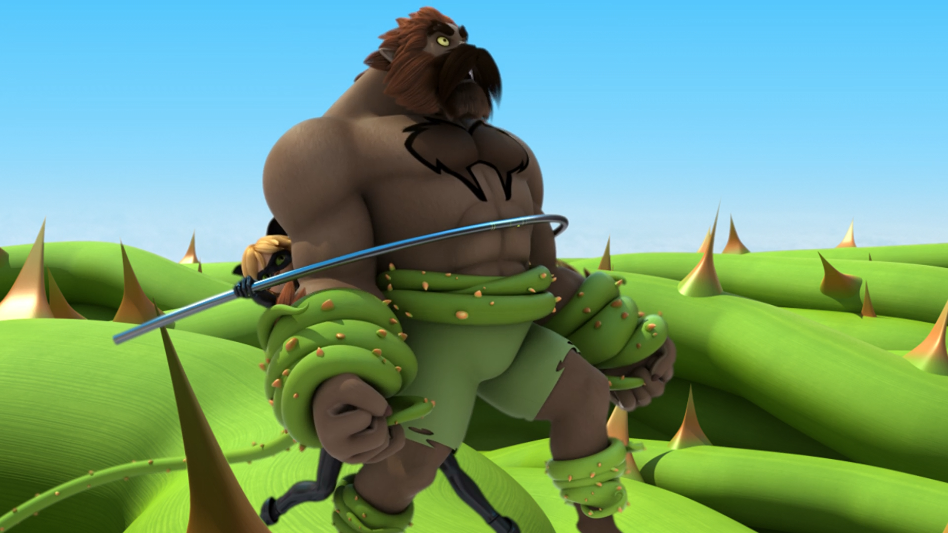
Nothing hurts more than ______.
homework
isolation
DLU

Slide 12
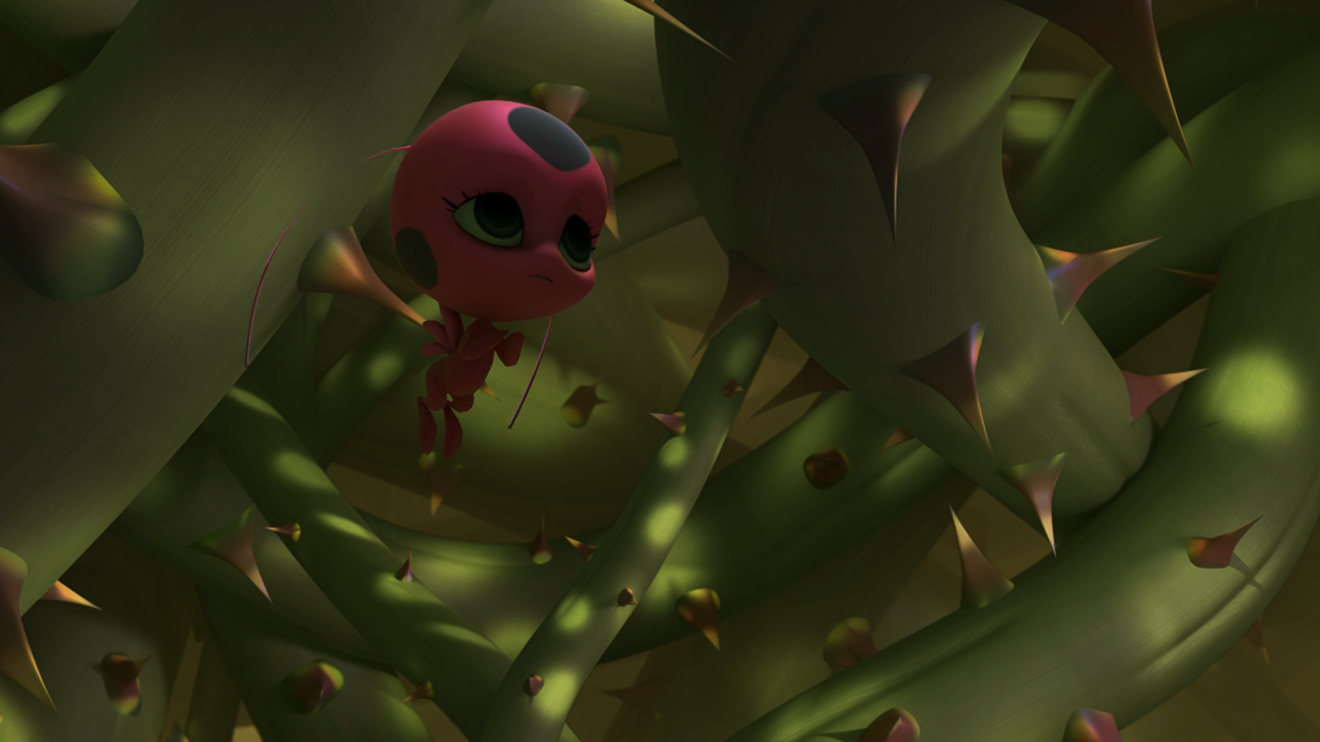
This is a magic ______, Marinette.
tree
forest
prison

Slide 13
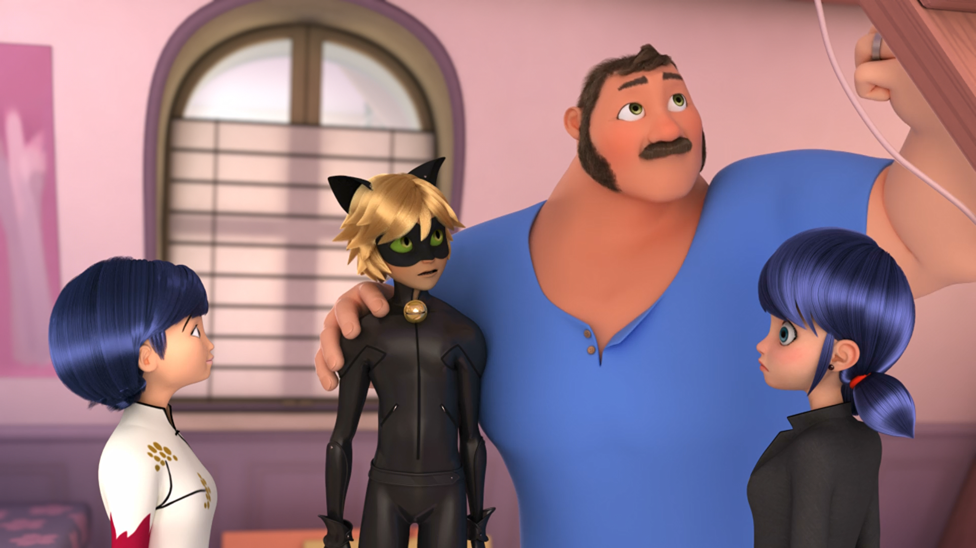
Your courage and ______ match those of the greatest pastry chefs.
tenacity
ferocity
generosity

Slide 14
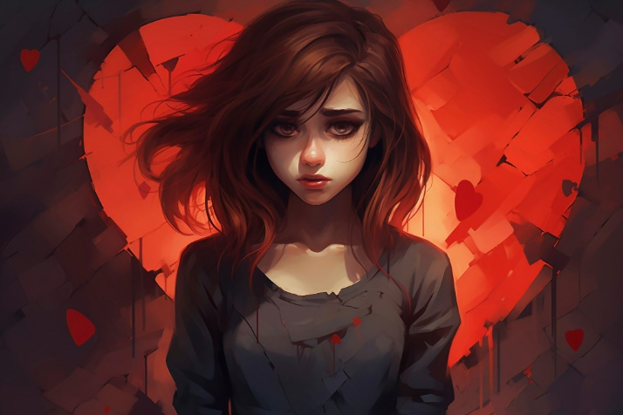
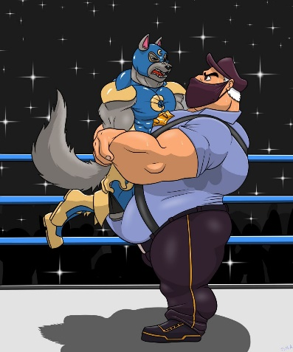
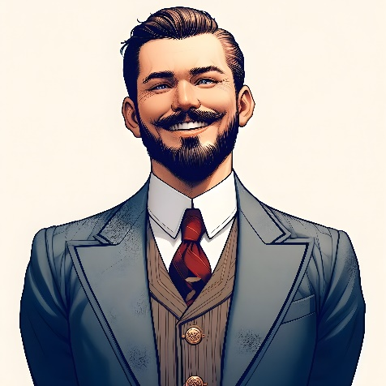
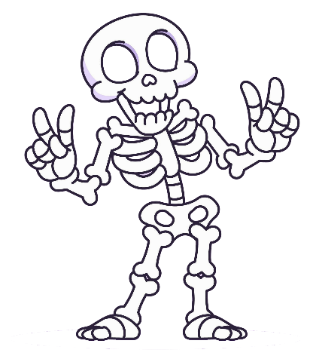
Matching Exercise
bones | charming | crush | heartache

Slide 15
Matching Exercise
heartache | crush | charming | bones

Slide 16
TRUE OR FALSE
1. In return for power, Tom will bring Hawk Moth Cat Noir pâté.
2. Weredad forbids Cat Noir from rescuing Marinette.
3. Maths homework is what hurts Cat Noir the most.
4. Marinette and Tikki are trapped in a magic cave.
5. Tom will teach Cat Noir how to bake.

Slide 17
TRUE OR FALSE
1. In return for power, Tom will bring Hawk Moth Cat Noir pâté. | TRUE
2. Weredad forbids Cat Noir from rescuing Marinette. | TRUE
3. Maths homework is what hurts Cat Noir the most. | FALSE
4. Marinette and Tikki are trapped in a magic cave. | FALSE
5. Tom will teach Cat Noir how to bake. | TRUE

