Slide 1
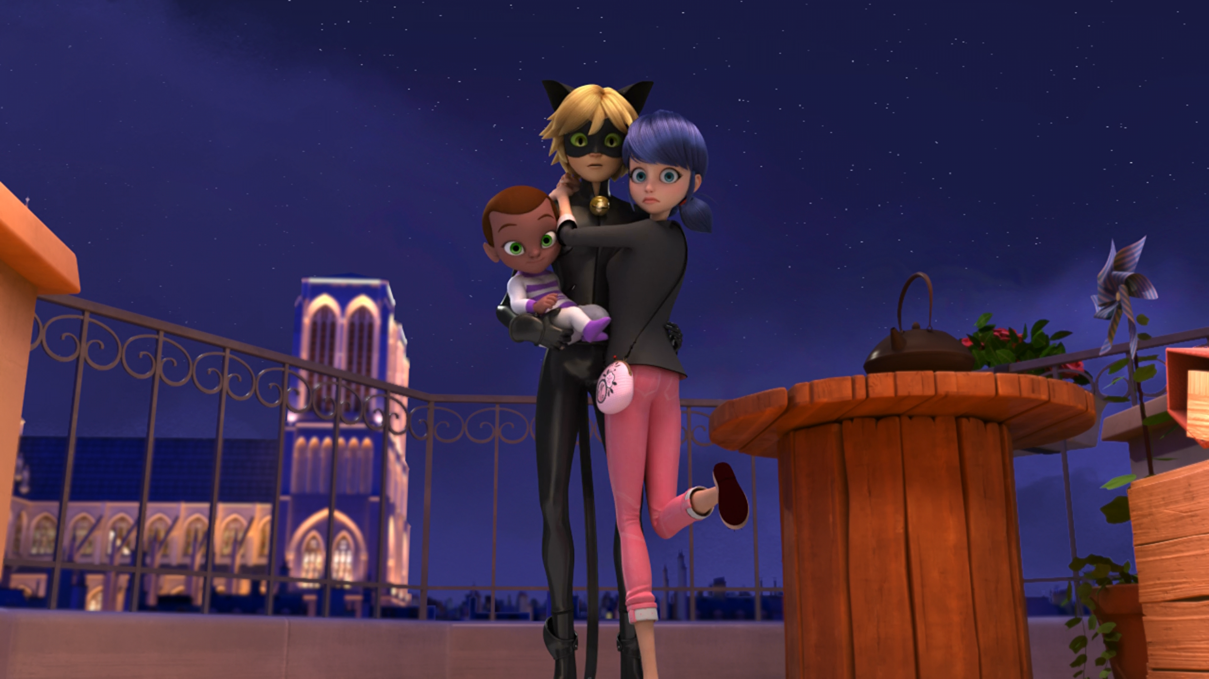
MIRACULOUS LADYBUG: WEREDAD. PART 1

Slide 2
VOCABULARY
craving - 渴望 - kreɪvɪŋ
crispy - 酥脆 - krɪspi
obvious - 明显 - ɒbviəs
pastries - 糕点 - peɪstriz
plastic - 塑料 - plæstɪk
platter - 盘子 - plætə
protect - 保护 - prəˈtɛkt
verse - 诗句 - vɜːs

Slide 3
1. krɪspi
2. 塑料
3. 保护

Slide 4
1. krɪspi - crispy
2. 塑料 - plastic
3. 保护 - protect

Slide 5
WEREDAD. PART 1
Cat Noir: Wow, my heart is just like that yo-yo-wrapped baby's wrist. Taken prisoner by m'Lady forever.
Ladybug: Ah, Adrien's lips.
Cat Noir: Admit it, for a second there, you almost fell for my poetic verse.
Ladybug: I never fall for your poetry, but I do find your foolishness incredibly powerful.

Slide 6
Marinette: This is a total disaster!
Tikki: You shouldn't have lied about your feelings, Marinette.
Marinette: But Tikki, he was about to figure out that I'm Ladybug!
Tikki: And now everyone thinks that you're in love with him.
Tom: Our daughter's boyfriend is coming for lunch tomorrow!

Slide 7
Plagg: Before you know it, we'll be enjoying some warm and crispy bread to go with every piece of cheese. Our life is about to change!
Adrien: Stop it, Plagg. You know I'm in love with Ladybug.
Plagg: So? I don't see the problem in keeping two pots simmering on the stove.
Adrien: I have to be honest with Marinette.

Slide 8
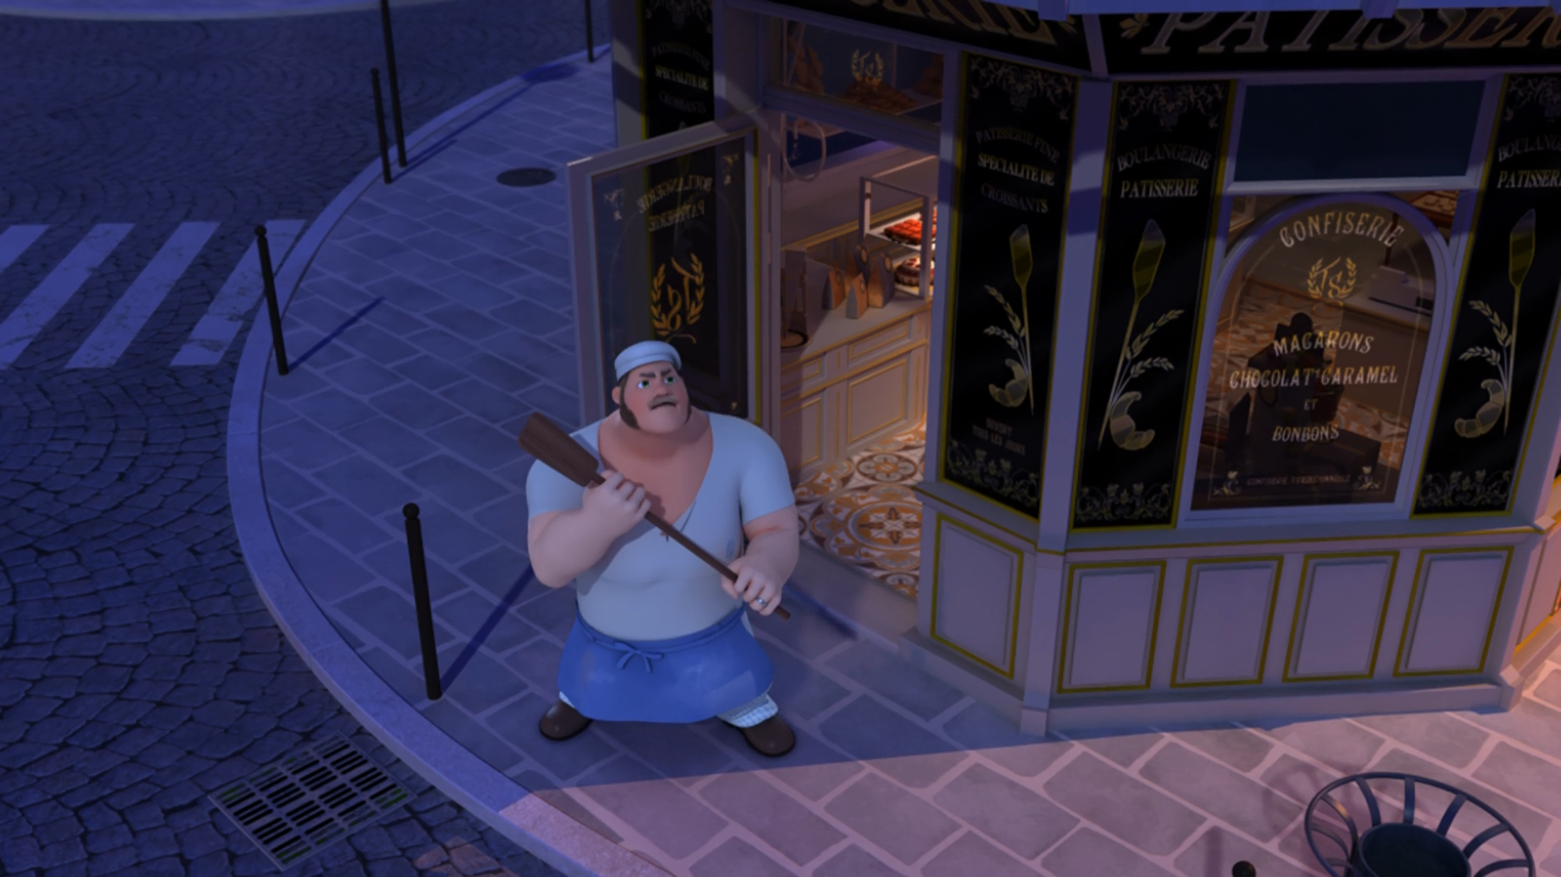
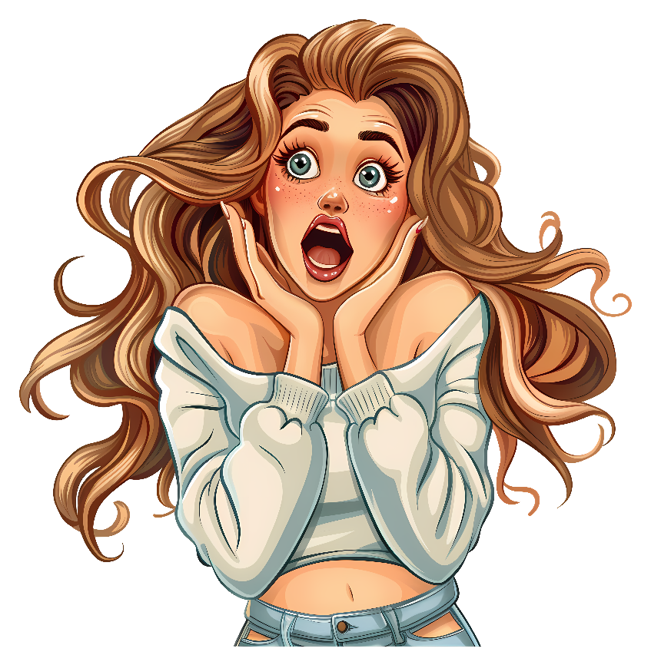
I'll protect my ______ if it's the last thing I do.
babies
cakes
pastries

Slide 9
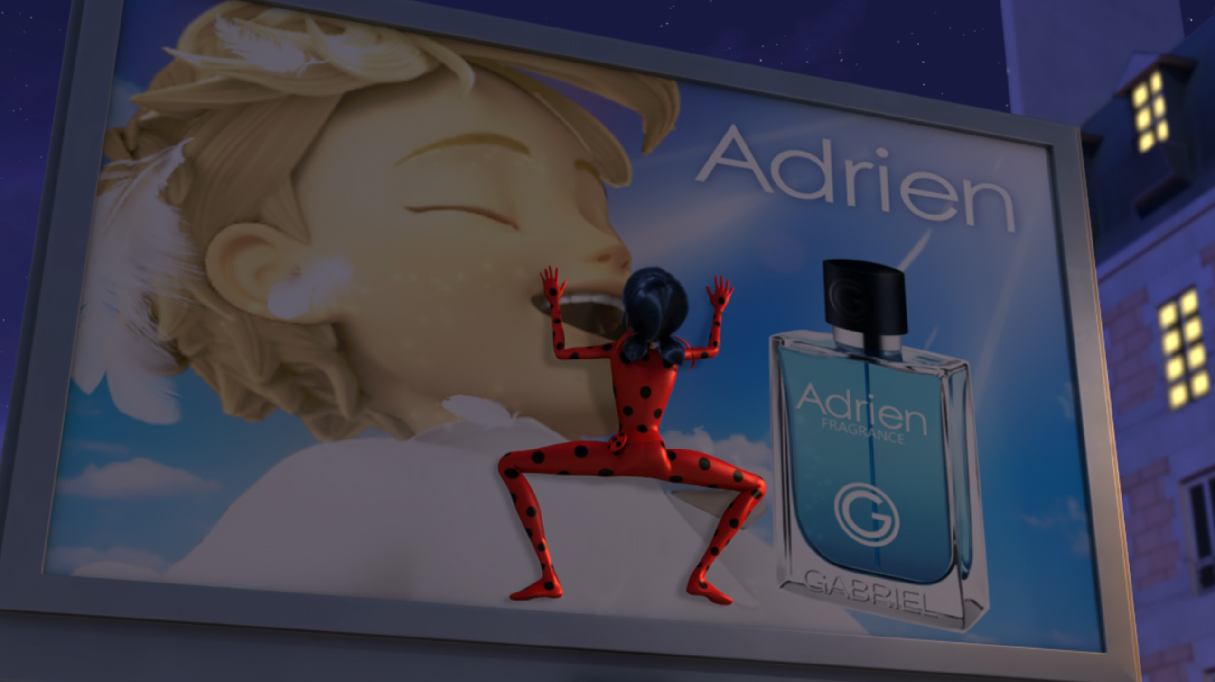
Ah, Adrien's ______.
lips
eyes
mouth

Slide 10
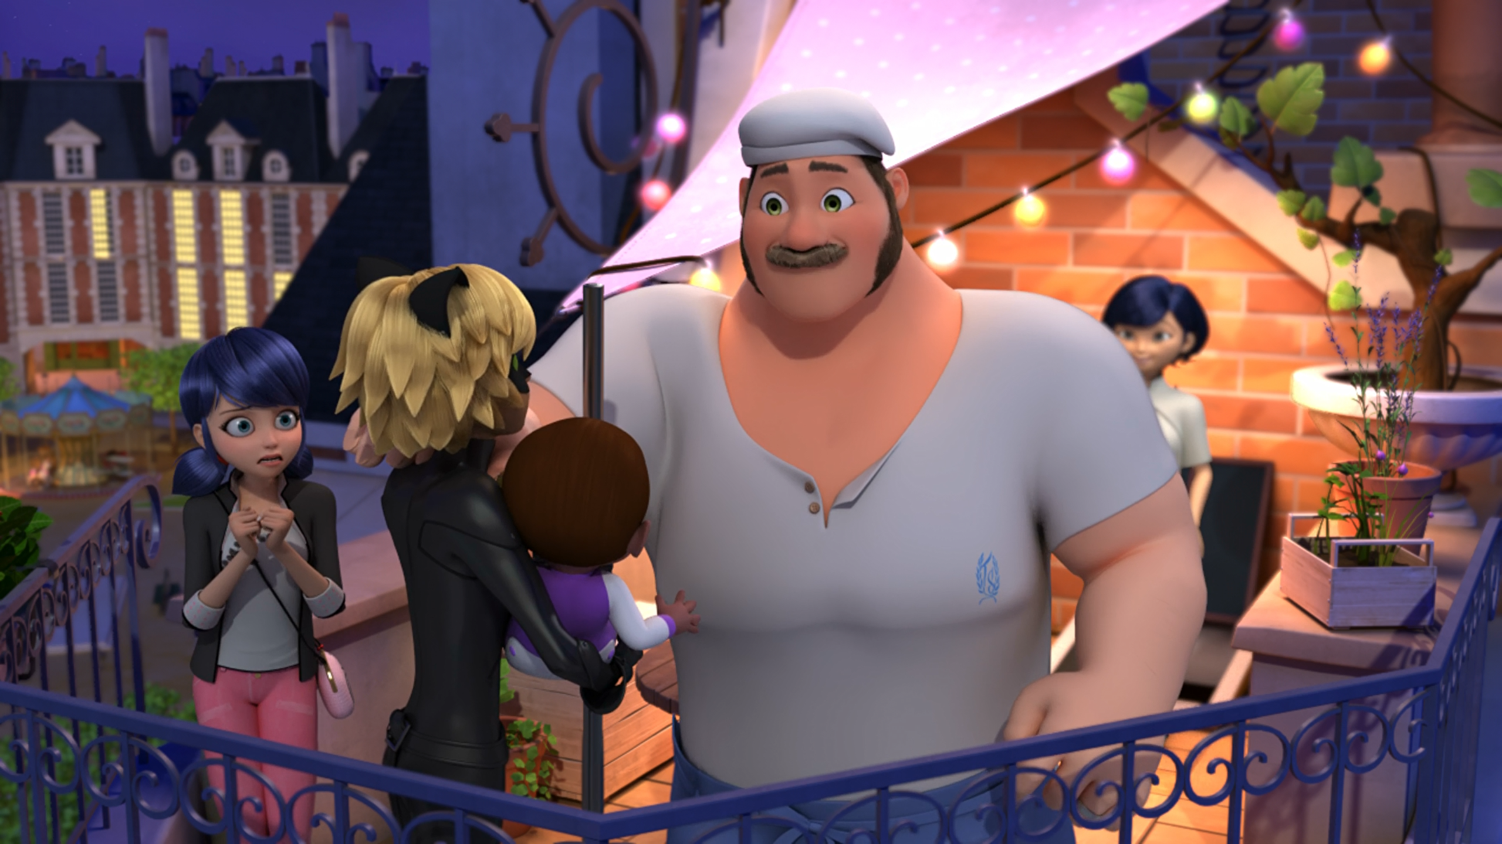
Why don’t you come have Sunday ______ with us tomorrow?
dinner
brunch
lunch

Slide 11
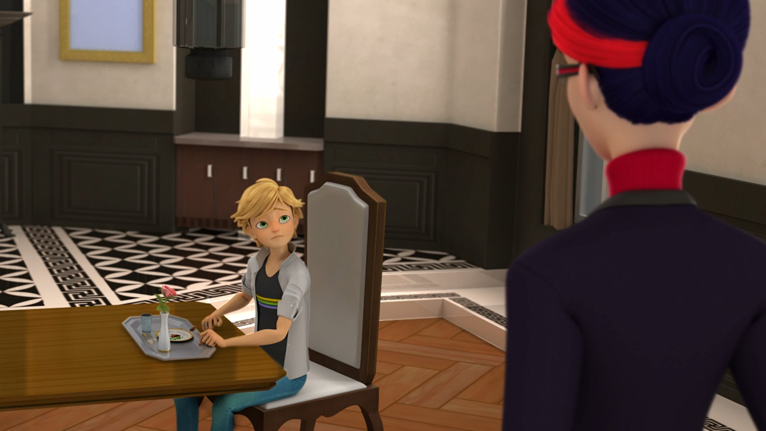
Is my ______ too busy to have lunch with me again?
girlfriend
father
grandma

Slide 12
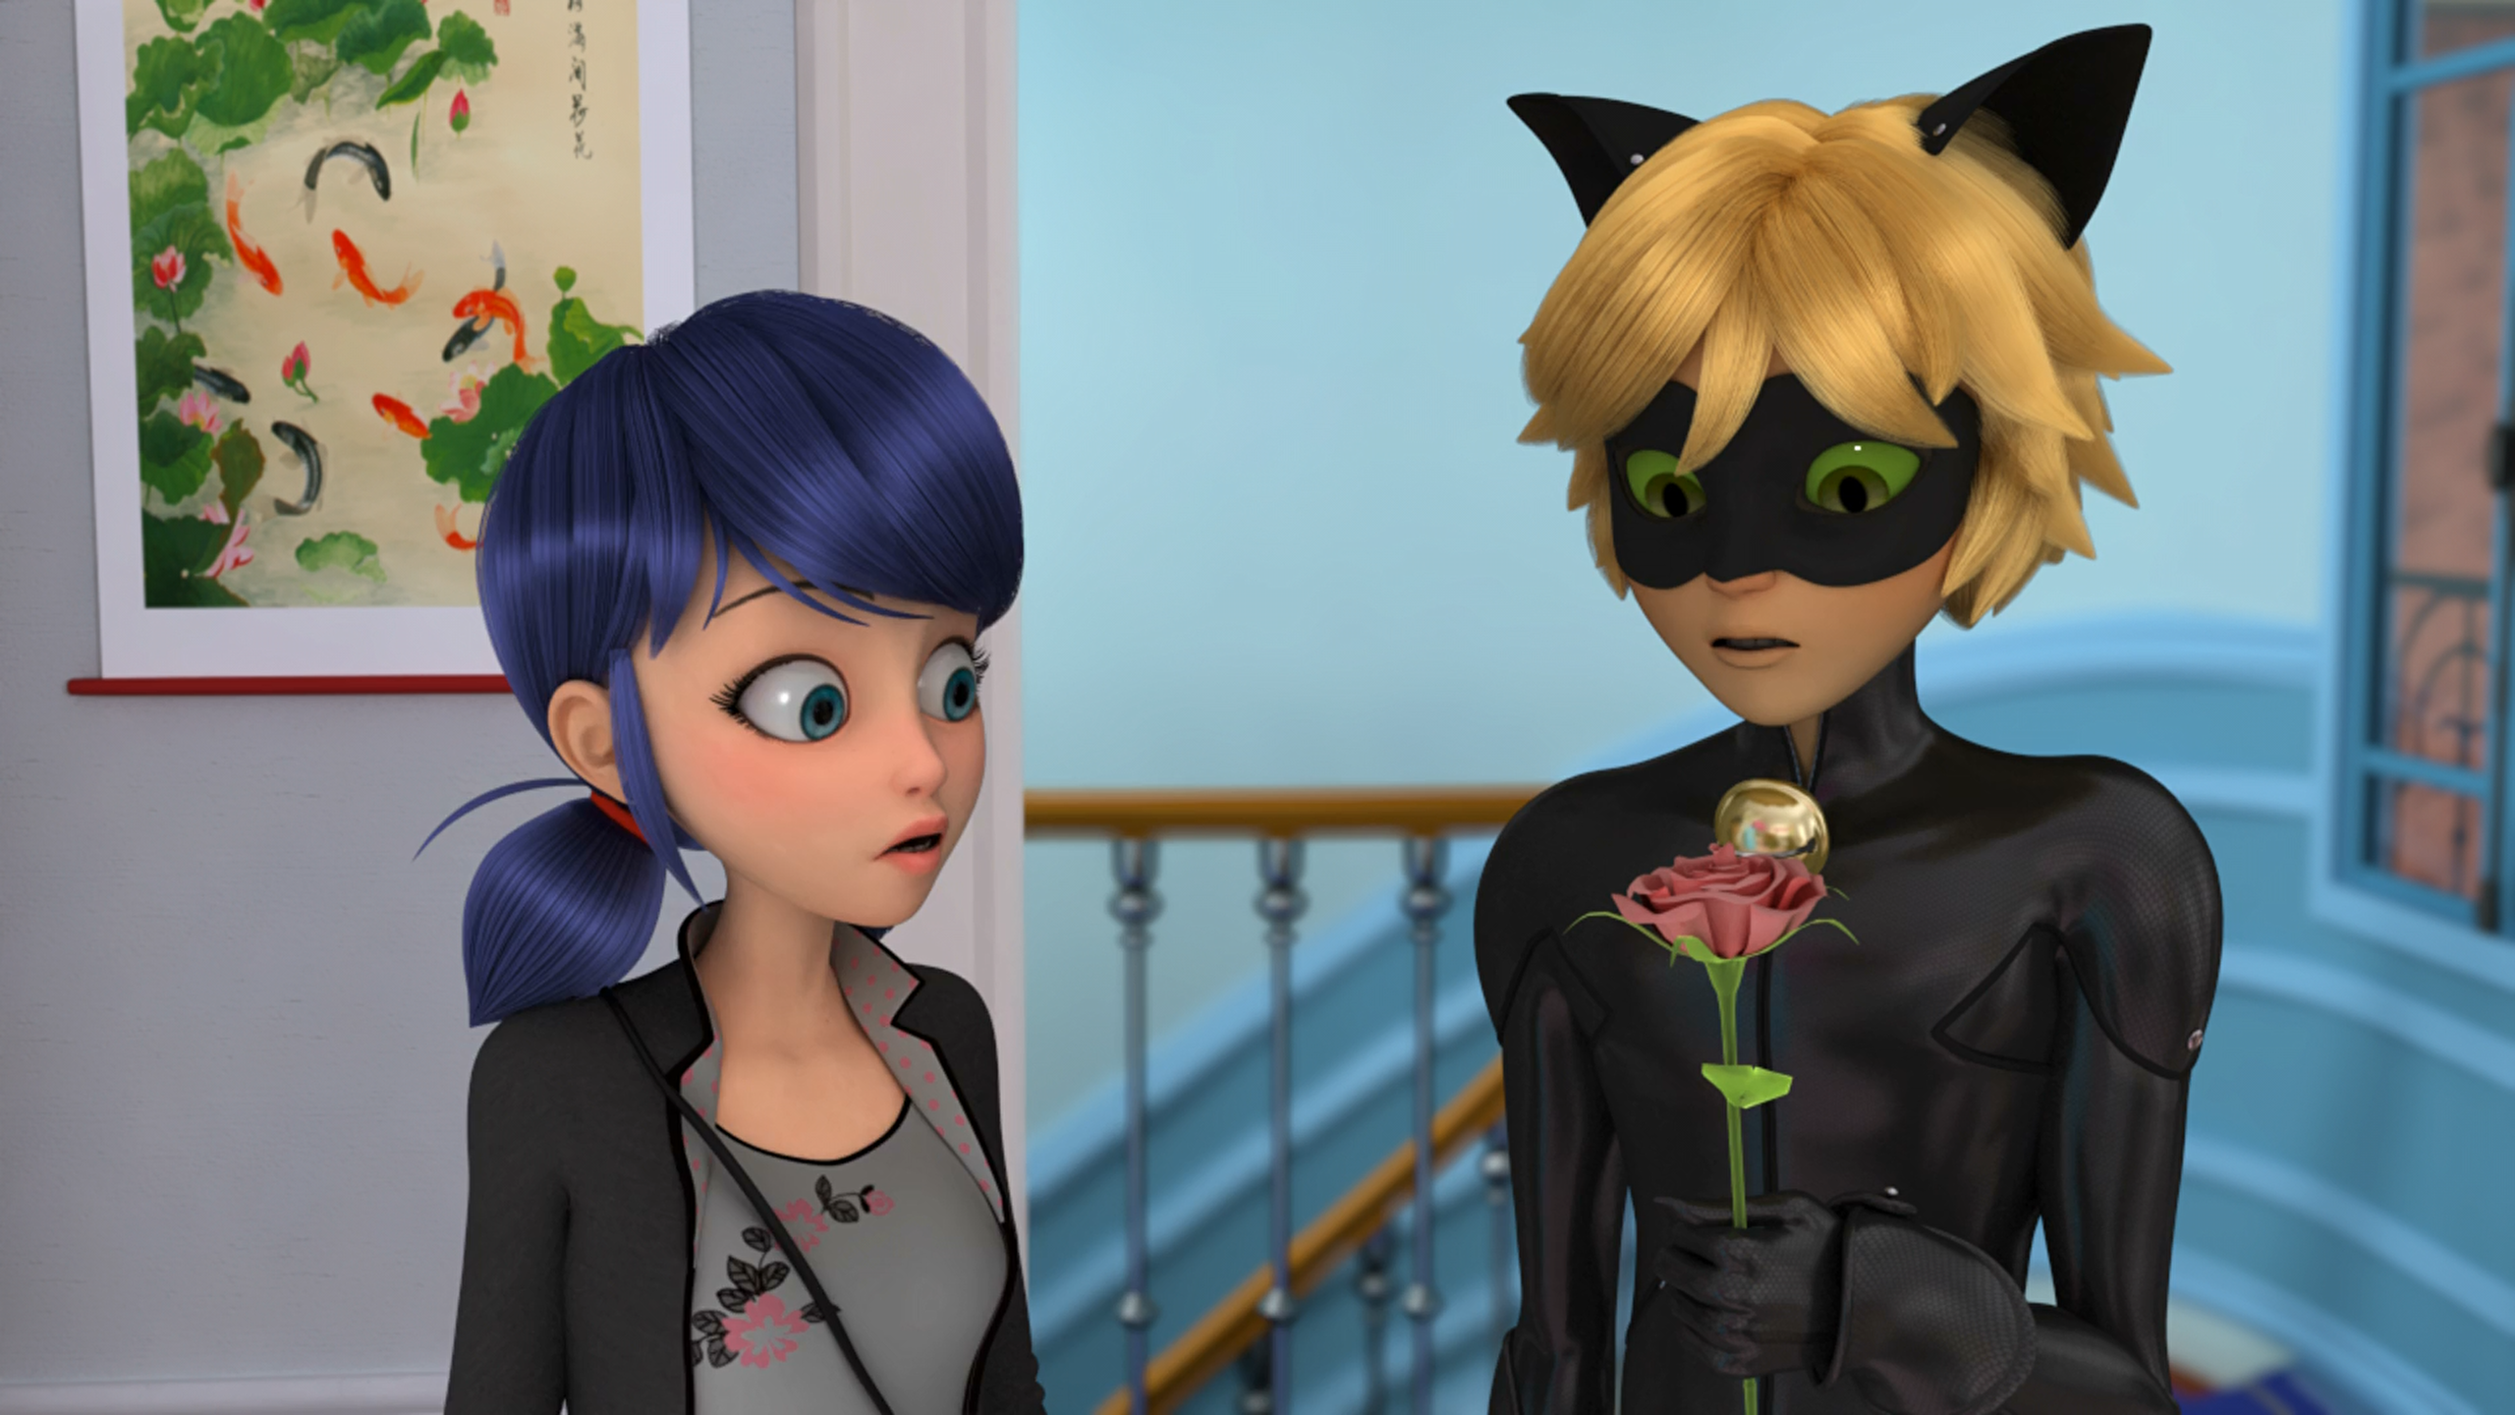
Oh, he brought a pink ______ for Marinette, she loves pink!
daisy
tulip
rose

Slide 13
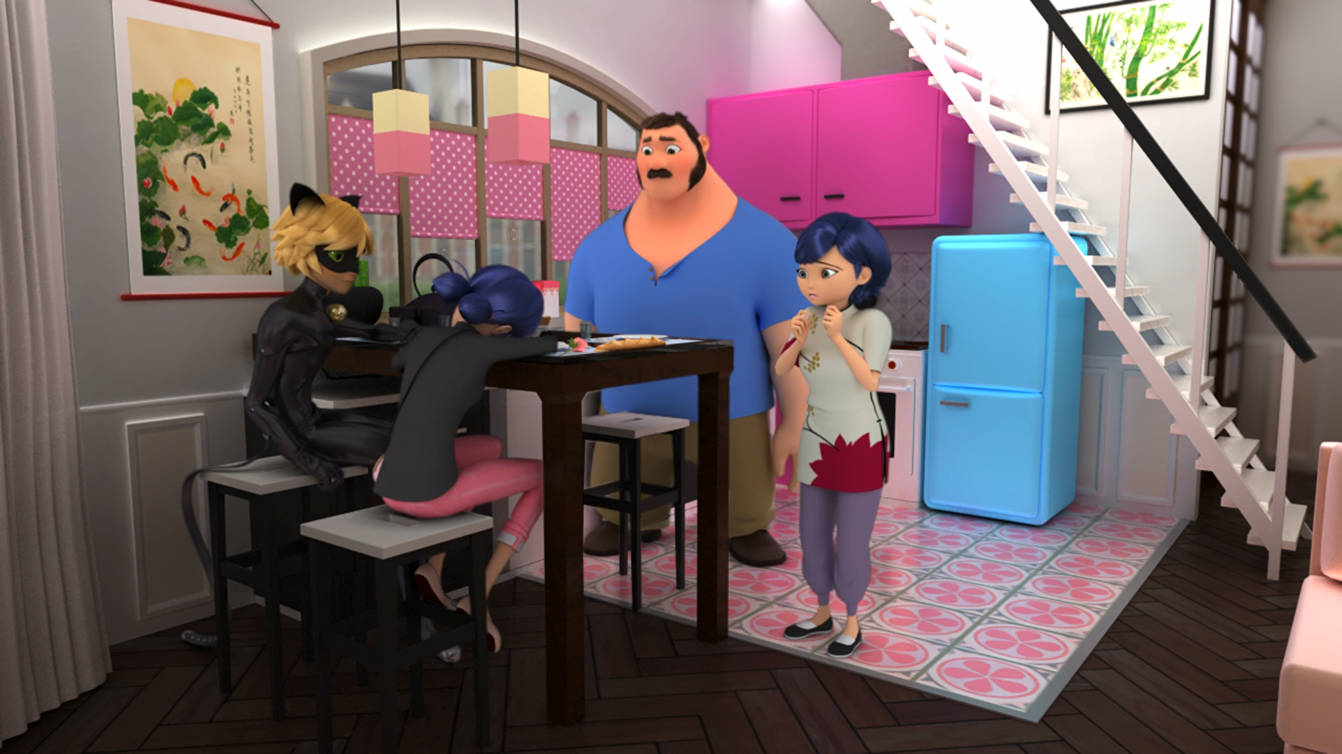
No one will ever love me! I'll end up all alone with my ______.
hamster
phone
grandma

Slide 14
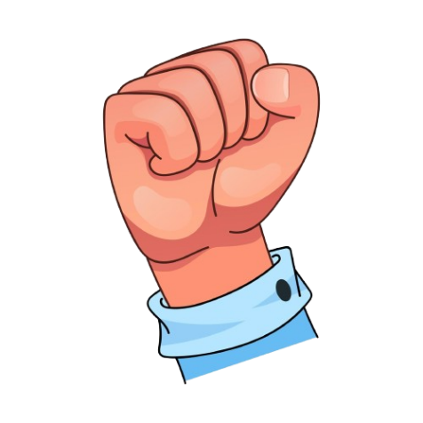
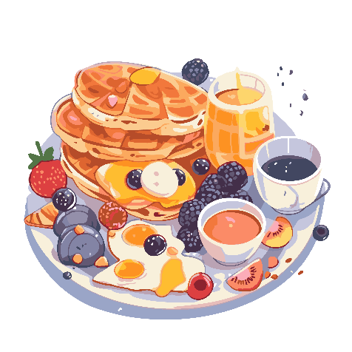


Matching Exercise
brunch | lips | pacifier | wrist

Slide 15
Matching Exercise
wrist | brunch | lips | pacifier

Slide 16
TRUE OR FALSE
1. The giant baby eats Marinette's donut.
2. Tom thinks Marinette is in love with Cat Noir.
3. Tom invites Cat Noir to brunch.
4. Adrien has lunch with his father.
5. Cat Noir confesses his love for Sabine.

Slide 17
TRUE OR FALSE
1. The giant baby eats Marinette's donut. | FALSE
2. Tom thinks Marinette is in love with Cat Noir. | TRUE
3. Tom invites Cat Noir to brunch. | TRUE
4. Adrien has lunch with his father. | FALSE
5. Cat Noir confesses his love for Sabine. | FALSE

