Slide 1
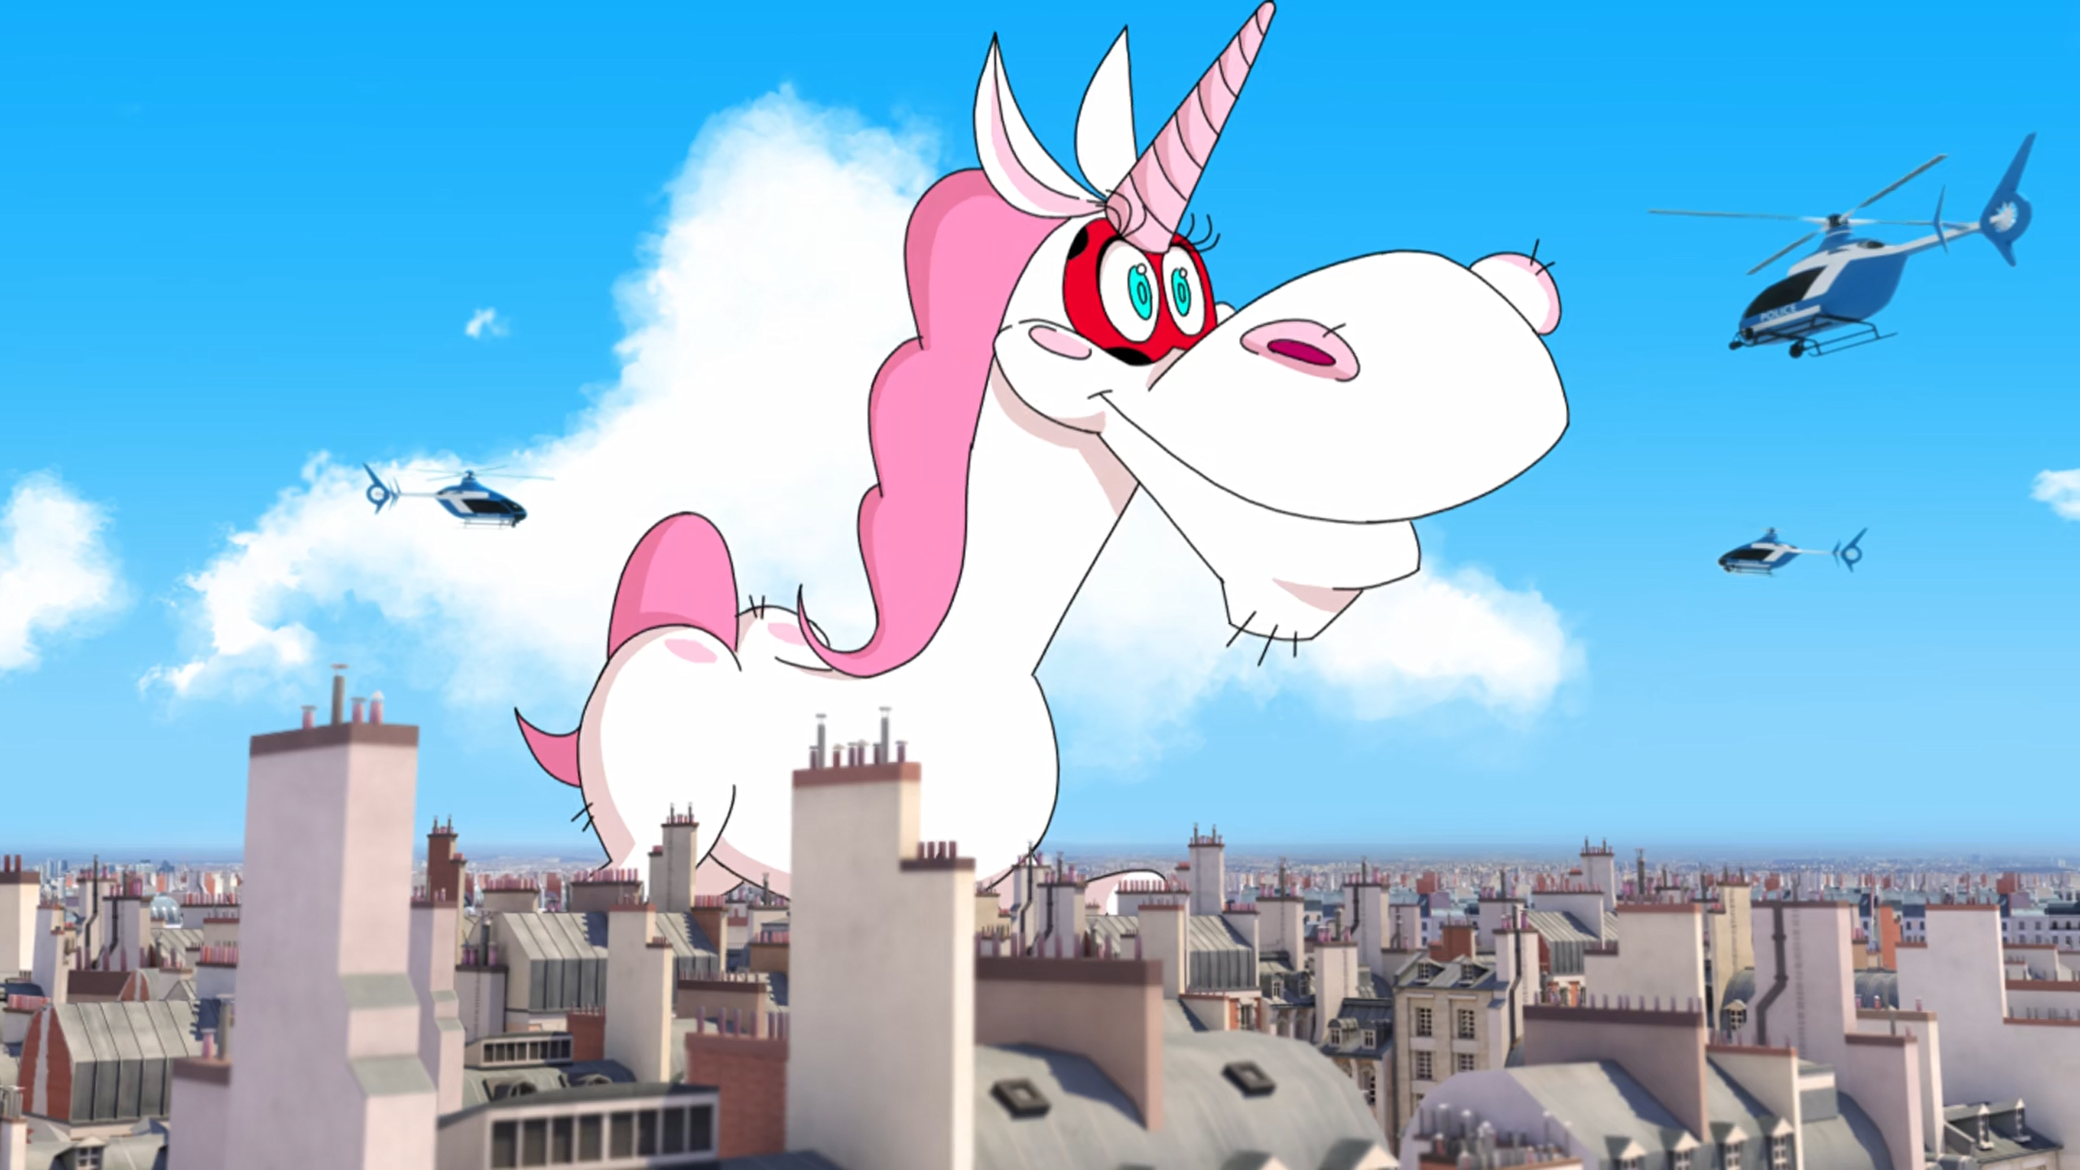
MIRACULOUS LADYBUG: ANIMAESTRO. PART 2

Slide 2
VOCABULARY
constructive - 建设性的 - kənˈstrʌktɪv
end credits - 片尾 - ɛnd ˈkrɛdɪts
exist - 存在 - ɪɡˈzɪst
limitless - 无限 - lɪmɪtləs
mercy - 怜悯 - mɜːsi
occasion - 场合 - əˈkeɪʒᵊn
pause - 暂停 - pɔːz
refined - 精致 - rɪˈfaɪnd
tragedy - 悲剧 - træʤədi

Slide 3
1. lɪmɪtləs
2. 场合
3. 暂停

Slide 4
1. lɪmɪtləs - limitless
2. 场合 - occasion
3. 暂停 - pause

Slide 5
ANIMAESTRO. PART 2
Mrs. Tsurugi: Now I understand why Kagami speaks so much about you. Your father has raised you to be a refined young man! Marinette: The plan is a total disaster!
Adrien and Kagami are even closer now than they were before.
Chloé: You ruined everything, Dupain-Cheng. What was it with that macaroon, anyway?

Slide 6
Ladybug: What's with that trailer too? I am not scared of cats, at all.
Animaestro: You haven't even seen the movie and you're already slamming it?
Cat Noir: He does have a point, you know.
Ladybug: I wasn't slamming it. It's called constructive criticism!
Cat Noir: Nice work, M'lady.

Slide 7
Marinette: But... I-I... Uh... But...
Thomas: Sorry, I guess you don't know who
I am either
Marinette: Of course do. You're Thomas Astruc the movie director! Oh thank you, thank you, thank you, thank you, thank you!
Thomas: She recognized me. Somebody actually recognized me! This is the best day of my life!

Slide 8
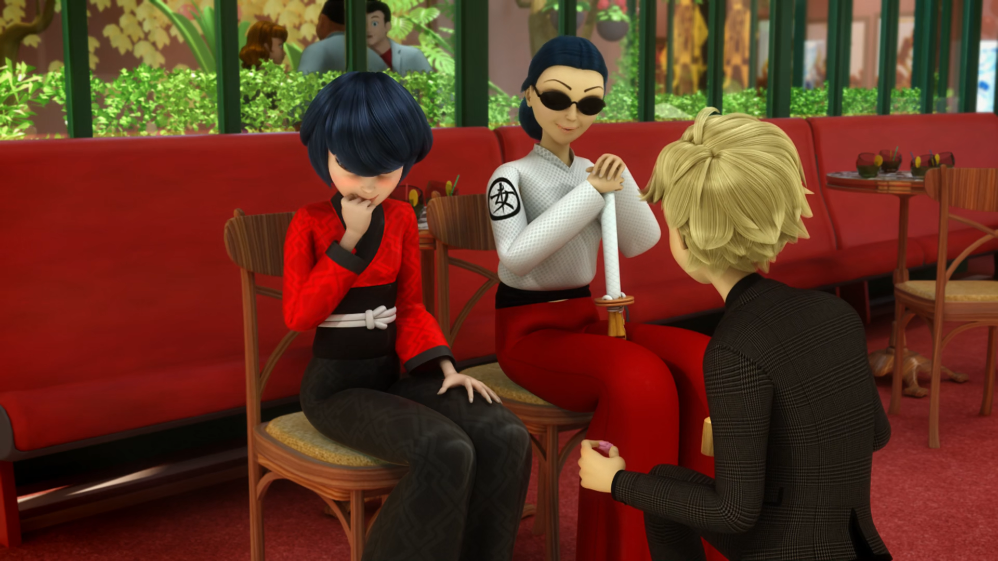

Your father has raised you to be a ______ young man!
fine
fined
refined

Slide 9
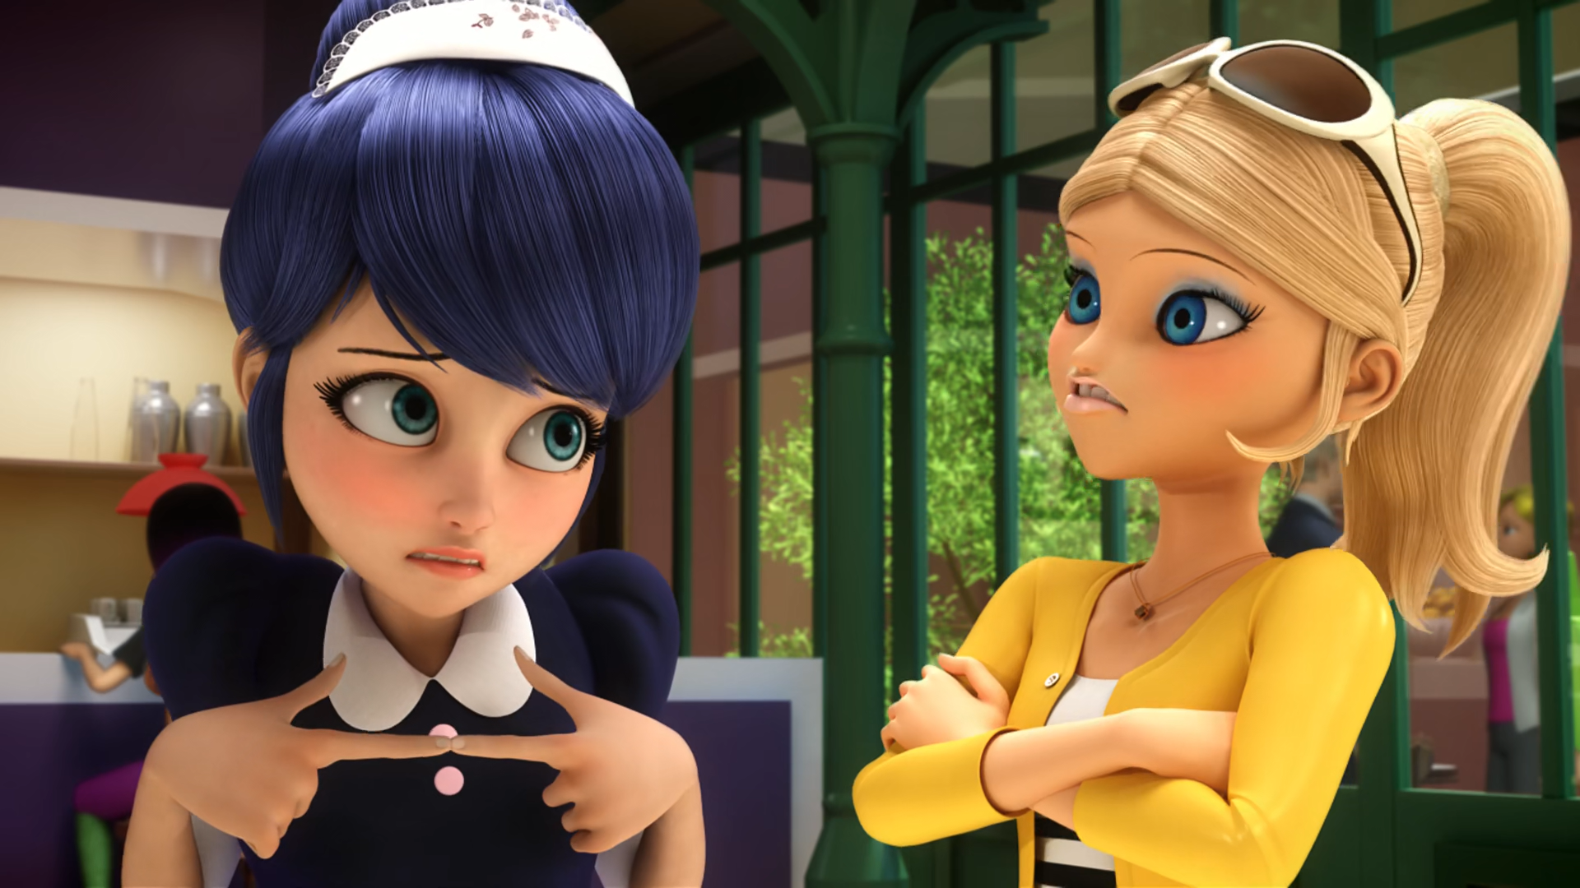
It was a special ______ macaroon.
passion fruit
chocolate
banana

Slide 10
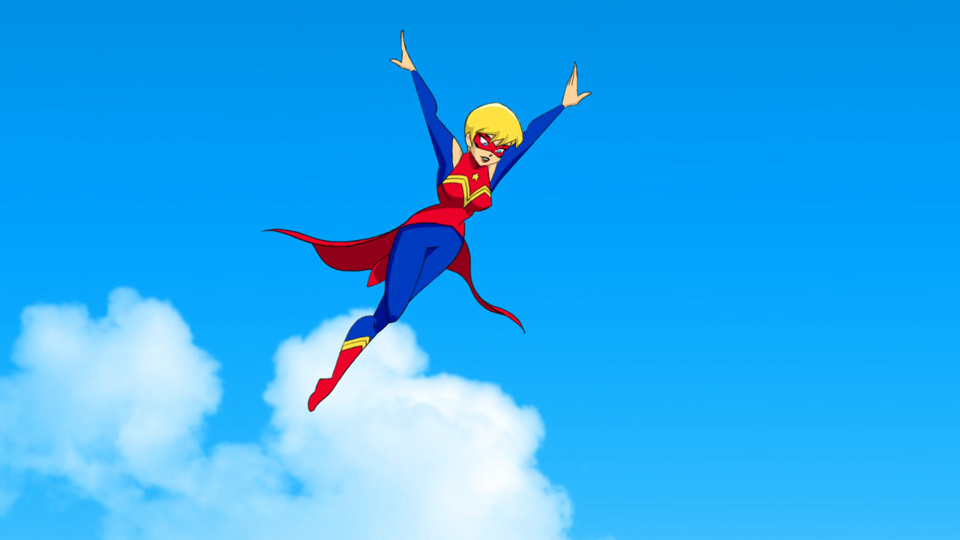
Fear the power of ______!
DLU
cartoons
anime

Slide 11
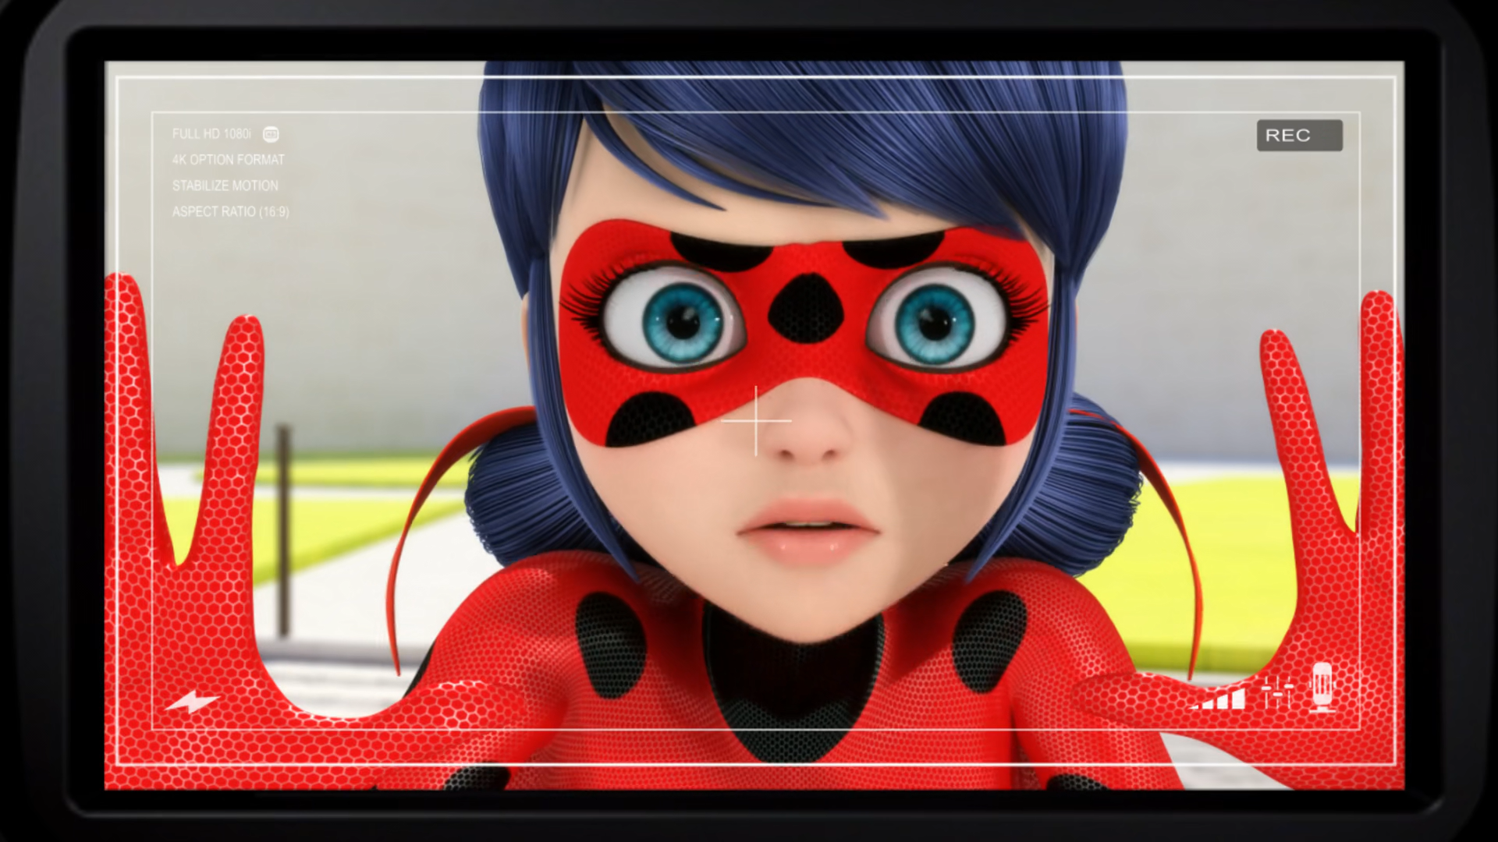
Wherever you are, close your ______!
mouths
eyes
laptops

Slide 12
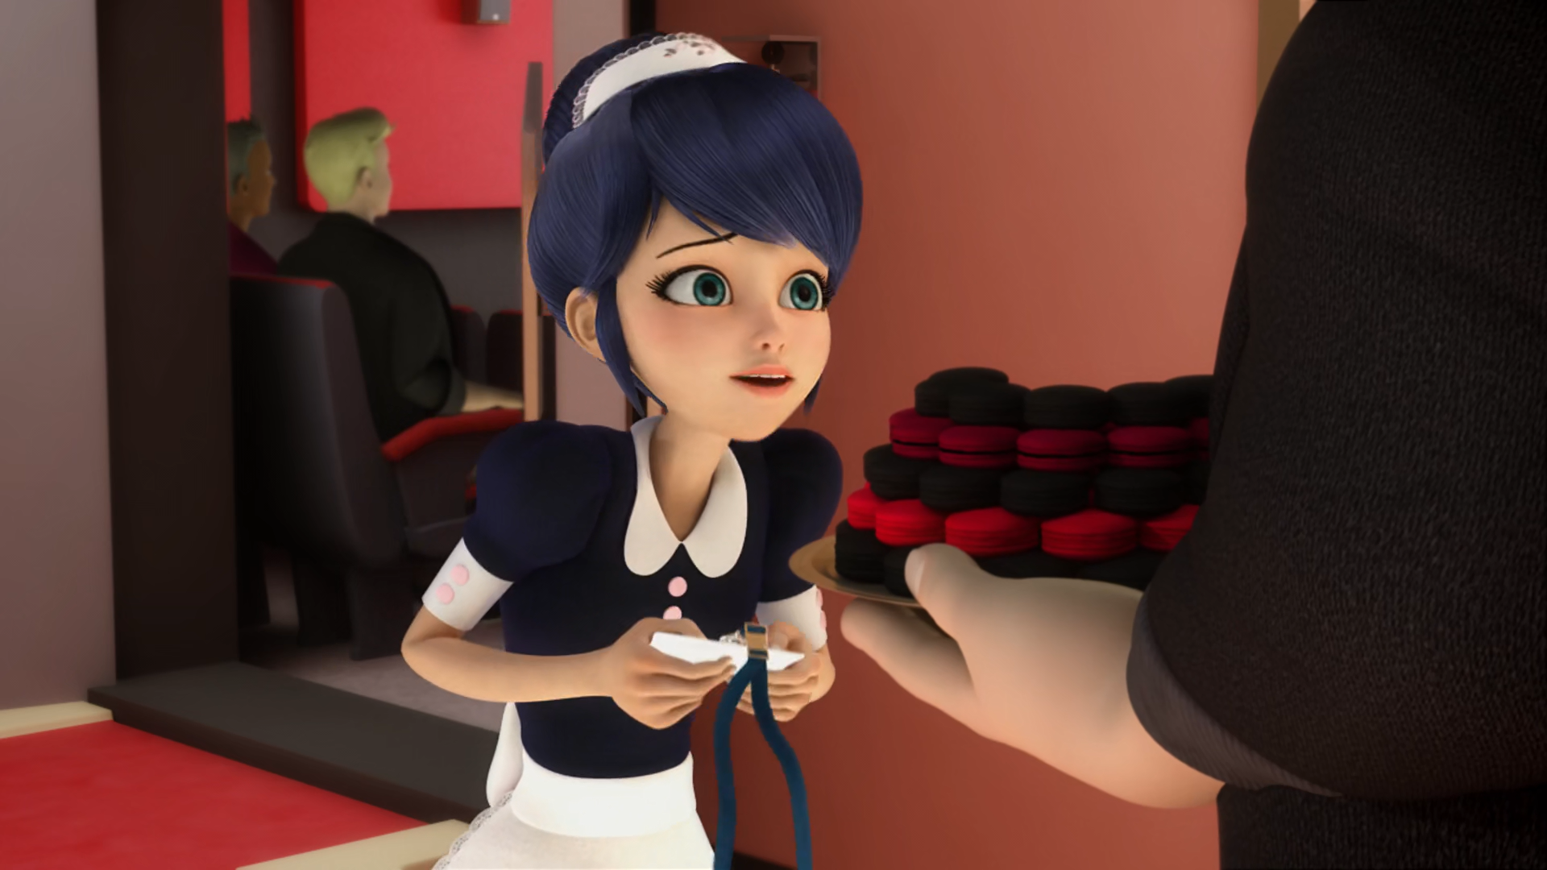
You're Thomas Astruc the ______ director!
music
film
movie

Slide 13
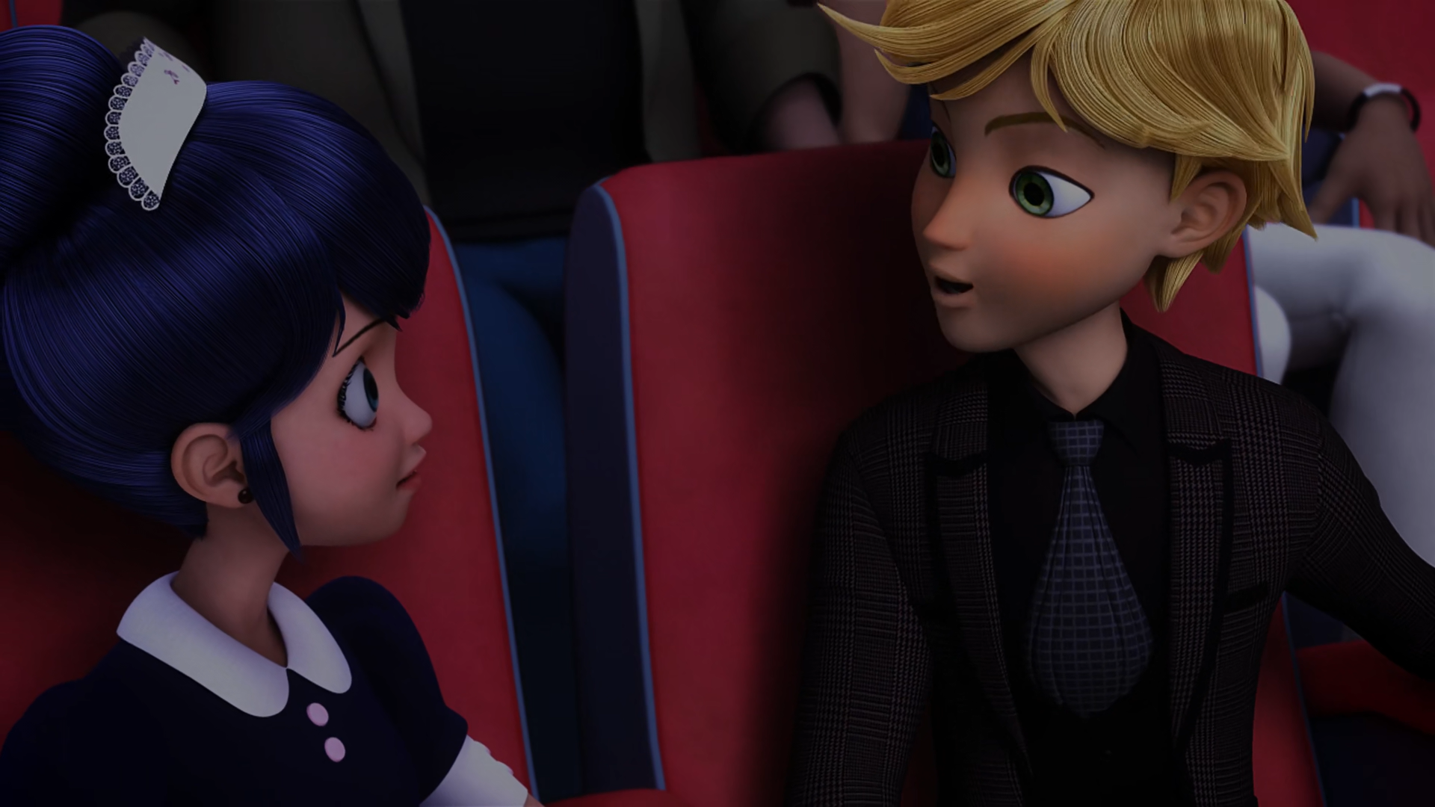
I'm really sorry I didn't get to taste your ______.
macaroon
kisses
cookies

Slide 14

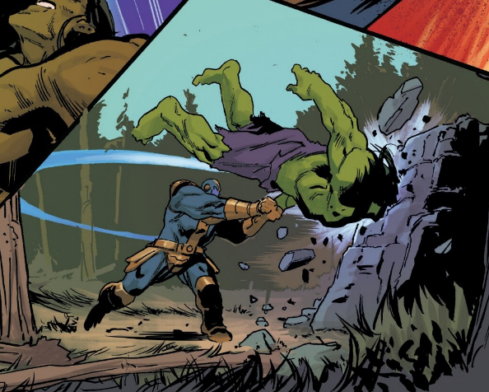
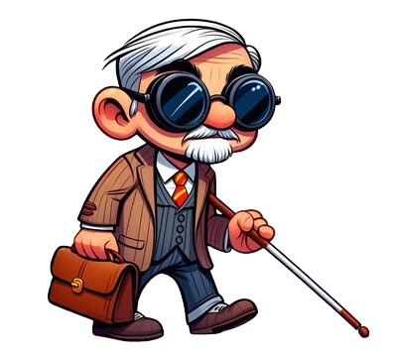
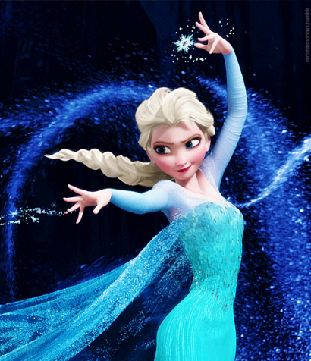
Matching Exercise
blind | passion fruit | freeze | slam

Slide 15
Matching Exercise
passion fruit | slam | blind | freeze

Slide 16
TRUE OR FALSE
1. Chloé knows Marinette has a crush on Adrien.
2. Marinette made a durian macaroon for Adrien.
3. Animaestro transforms into a dinosaur.
4. Animaestro transforms into Captain Marvel.
5. Adrien eats Marinette's macaroon.

Slide 17
TRUE OR FALSE
1. Chloé knows Marinette has a crush on Adrien. | TRUE
2. Marinette made a durian macaroon for Adrien. | FALSE
3. Animaestro transforms into a dinosaur. | TRUE
4. Animaestro transforms into Captain Marvel. | TRUE
5. Adrien eats Marinette's macaroon. | FALSE

