Slide 1
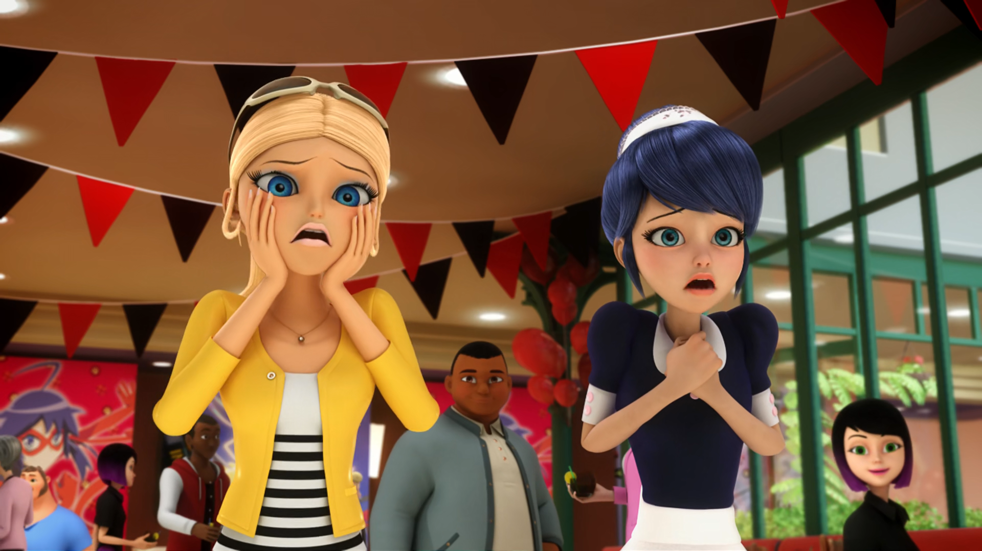
MIRACULOUS LADYBUG: ANIMAESTRO. PART 1

Slide 2
VOCABULARY
almond - 杏仁 - ɑːmənd
destiny - 命运 - dɛstɪni
illustrious - 杰出 - ɪˈlʌstriəs
klutz - 笨手笨脚 - klʌts
premiere - 首映 - prɛmieə
server - 服务器 - sɜːvə
slightest - 最轻微 - slaɪtɪst
trust - 相信 - trʌst

Slide 3
1. ɑːmənd
2. 命运
3. 相信

Slide 4
1. ɑːmənd - almond
2. 命运 - destiny
3. 相信 - trust

Slide 5
ANIMAESTRO. PART 1
Trailer: She's scared of cats, but powerless without this feline.
Marinette: Huh? That is so not true. I'm not scared of cats.
Thomas: The real Cat Noir and Ladybug won't be able to make it to tonight's premiere, but
I hope that they'll love my movie as much as we love them.

Slide 6
Jagged: Woah. Hey Marinette! Now she can draw! She does it all herself. Just check out these groovy sunglasses here she made!
Thomas: Well, that's impressive.
Jagged: She even designed my album cover!
Marinette: Er, thanks. Er, macaroons?
Tom: Phew. So far so good.
Sabine: Uh-oh. She's seen him.

Slide 7
Thomas: But I'm not a waiter. I'm the movie director.
Chloé: Oh, really? So you're the one responsible for this movie?
Thomas: Yes, yes! Exactly! That's me!
Chloé: Then you were the one who left Queen Bee out of the trailer. You're lame, utterly lame. And what were you thinking hiring Dupain-Cheng as a waitress?

Slide 8
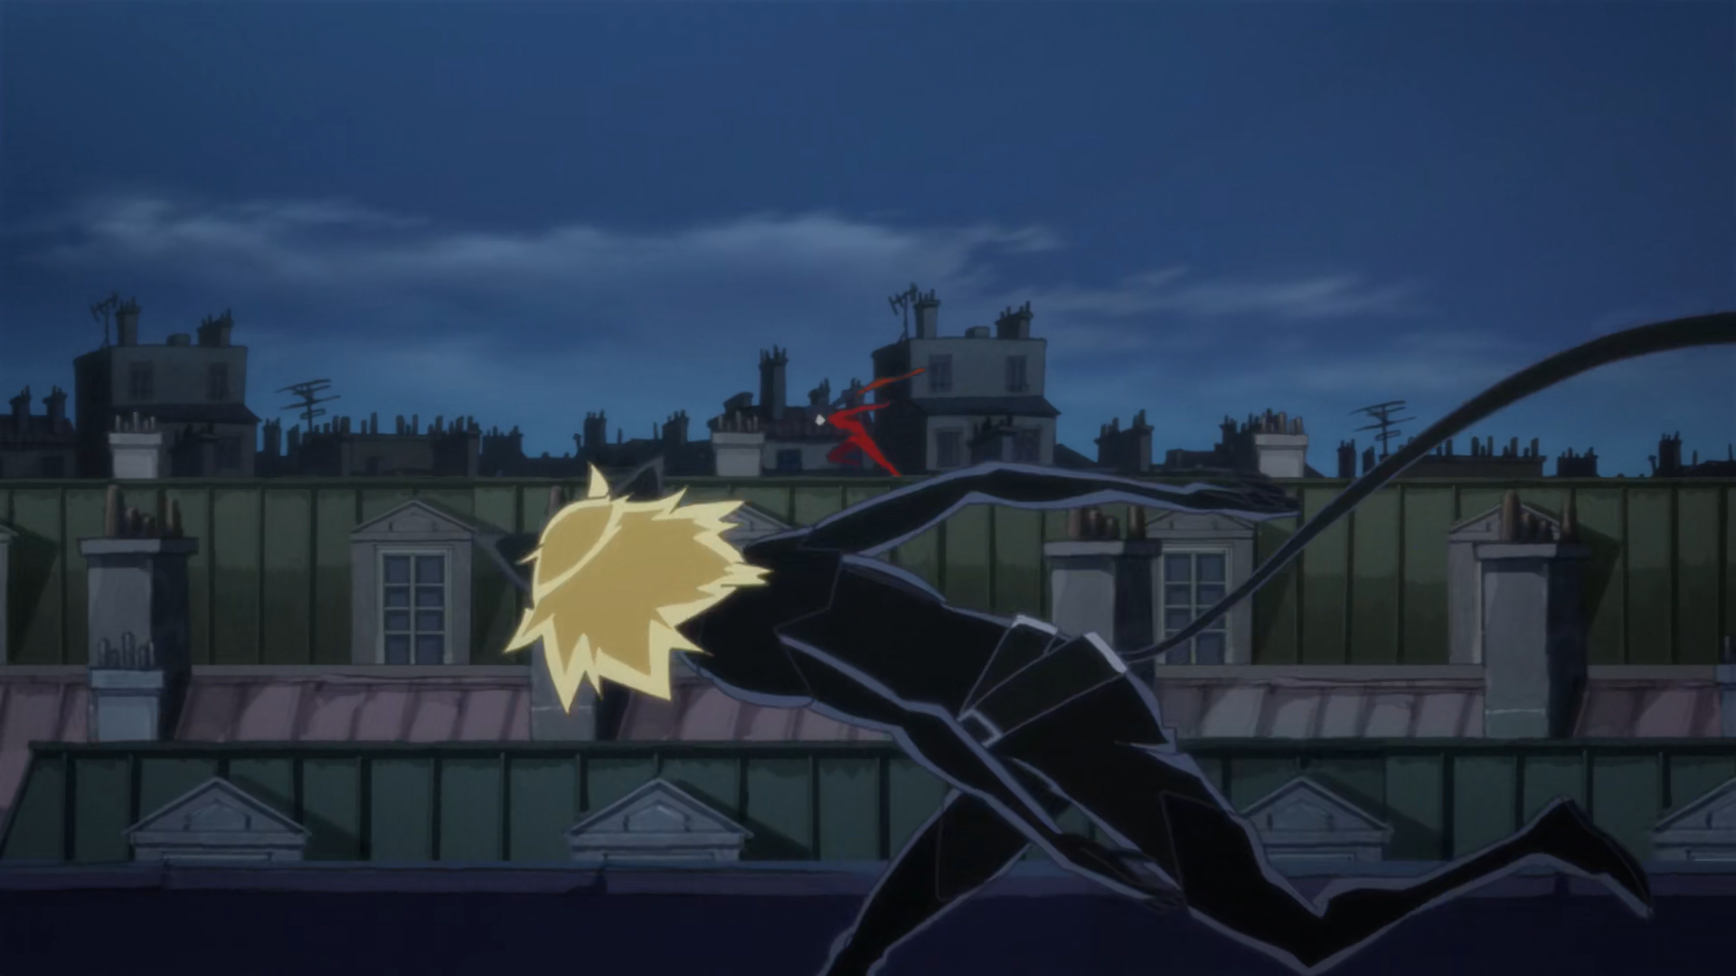
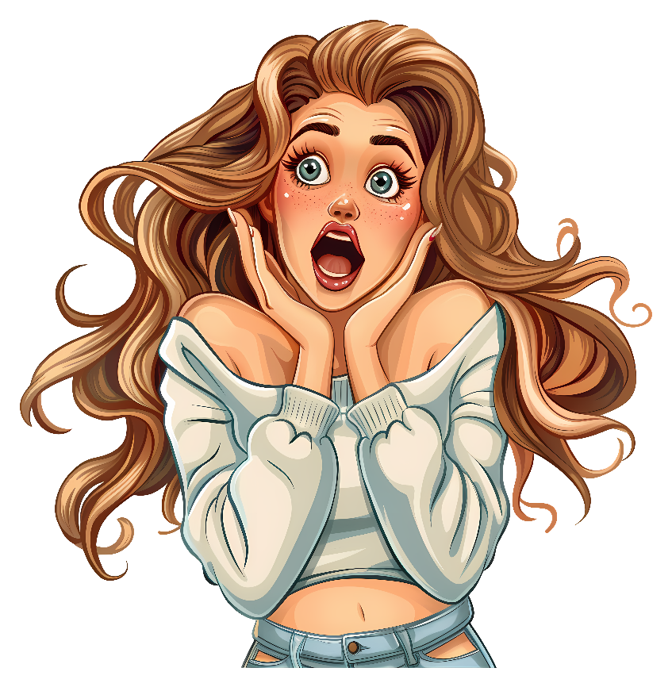
She's ______ of cats, but powerless without this feline.
scared
terrified
afraid

Slide 9
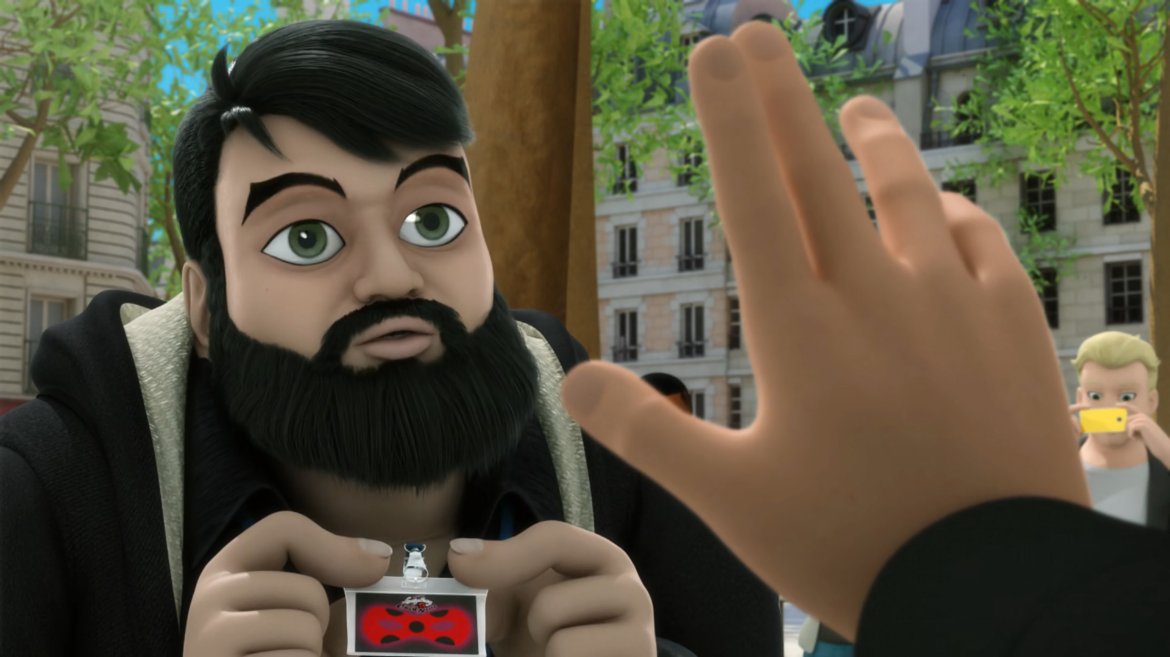
Huh? Excuse me? I'm Thomas Astruc, the movie ______.
director
actor
studio

Slide 10
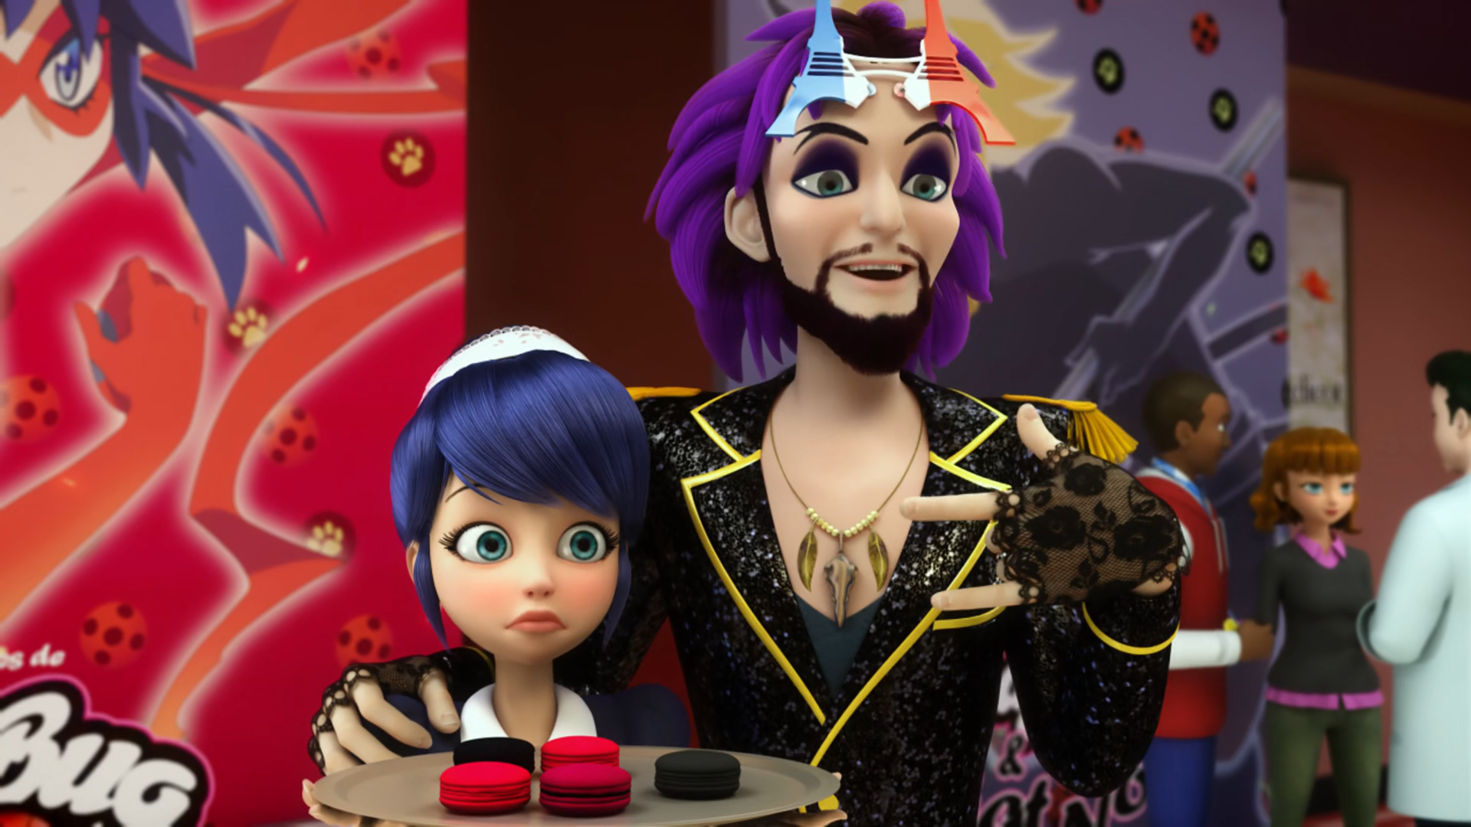
Just check out these ______ sunglasses here she made!
cool
groovy
sexy

Slide 11
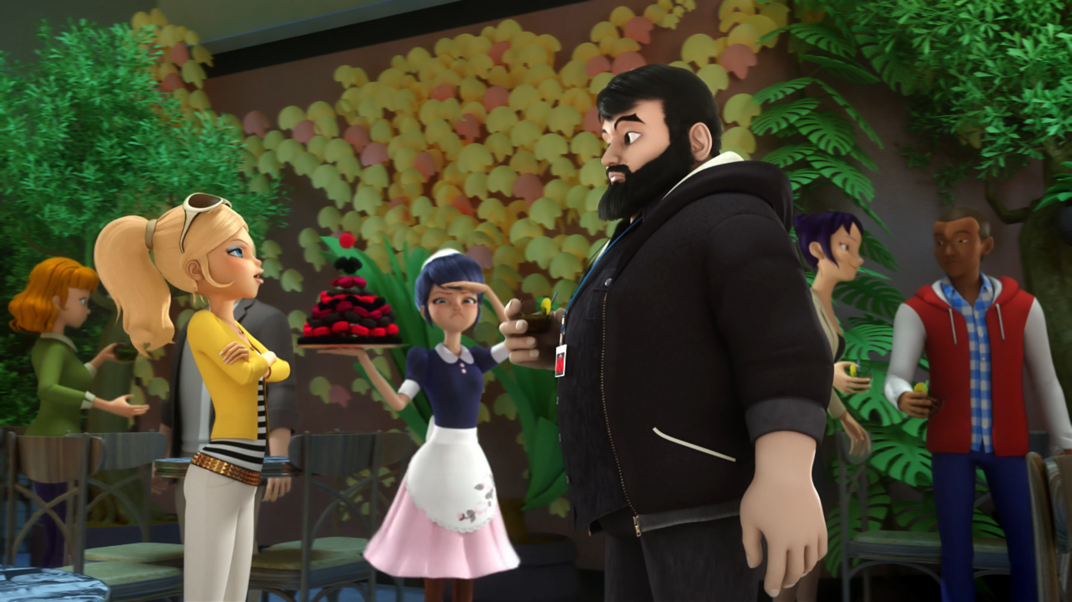
Go fetch me a chocolate ______, but make sure it's dark chocolate.
cookie
macaroon
cake

Slide 12
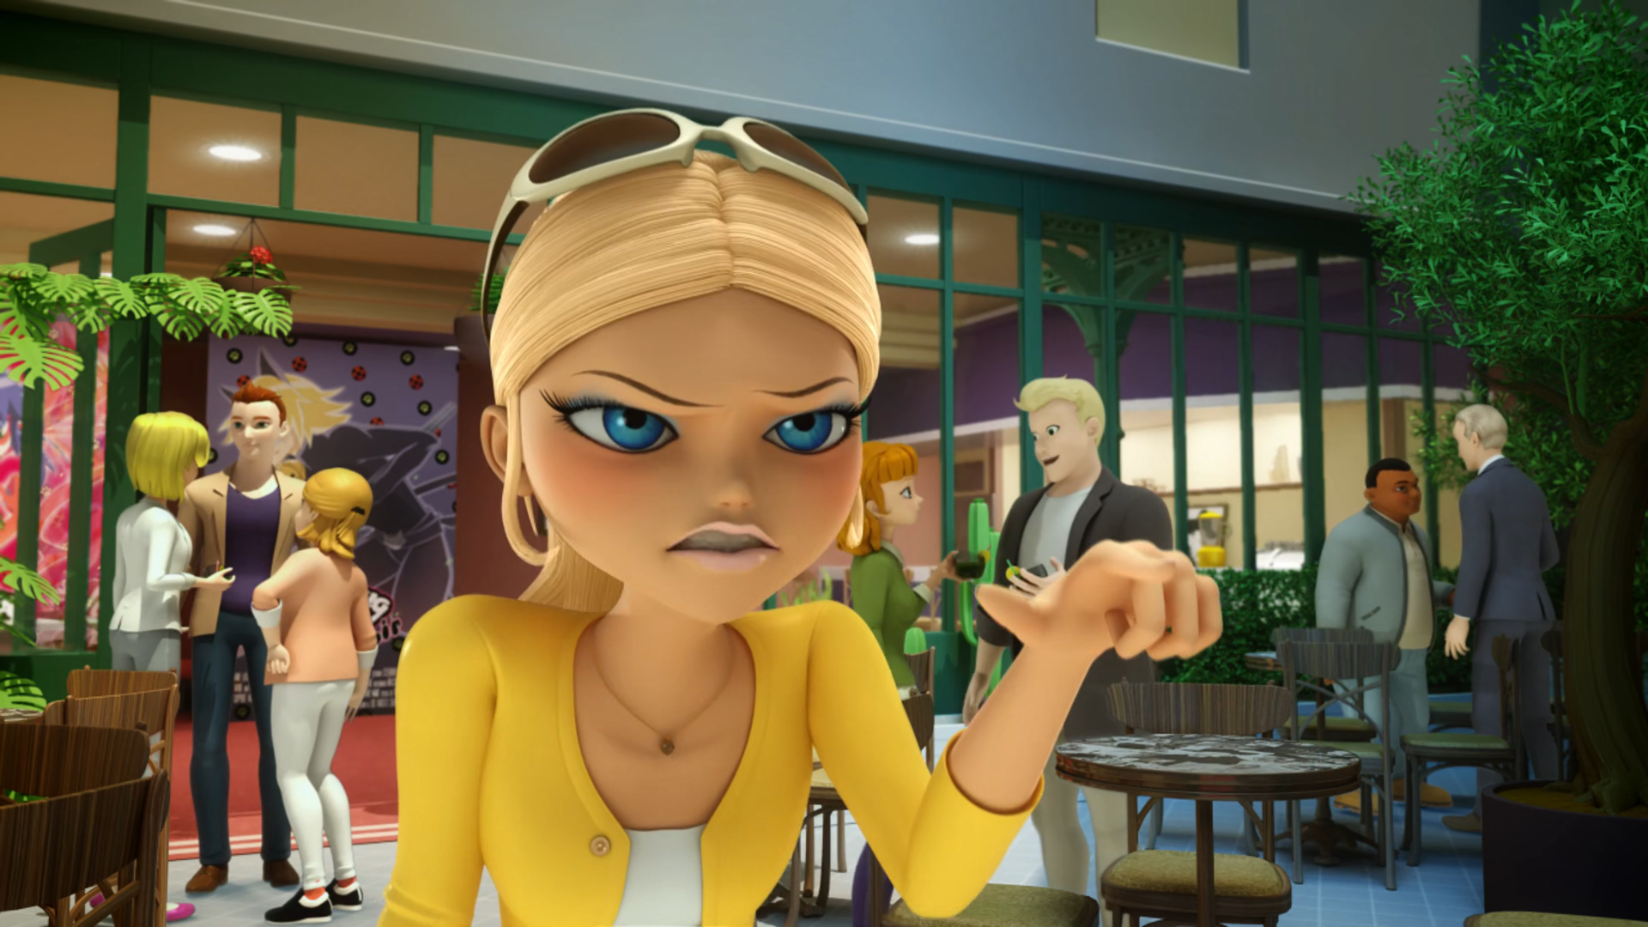
Then you were the one who left Queen Bee out of the ______.
movie
book
trailer

Slide 13
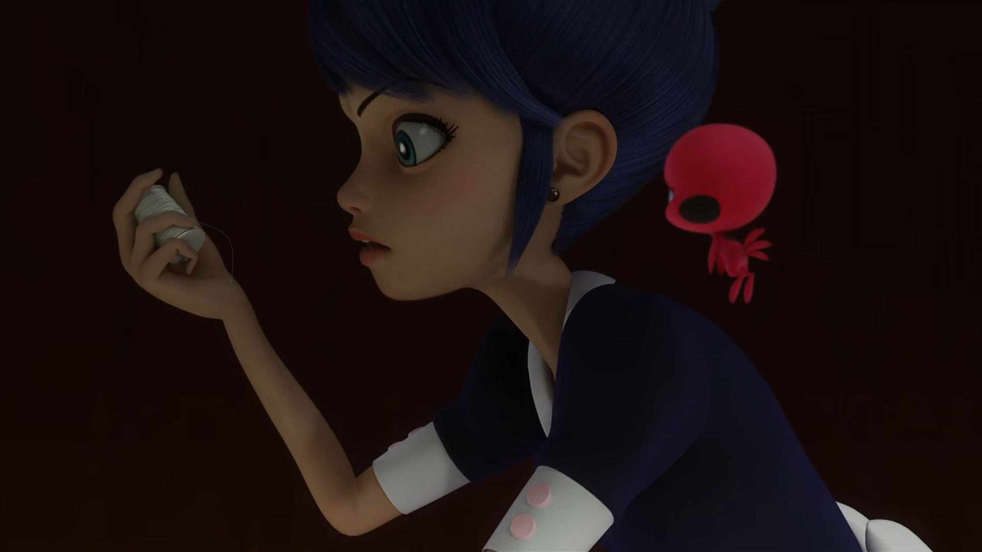
I'm just stopping ______ from kidnapping Adrien.
Kagami
Origami
Tsunami

Slide 14
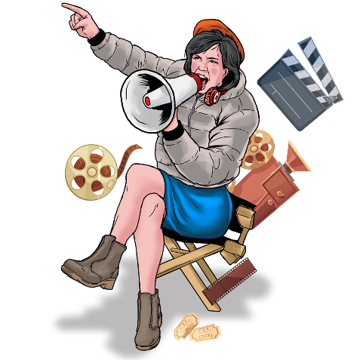
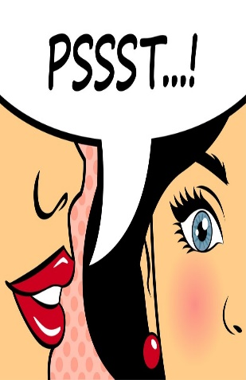
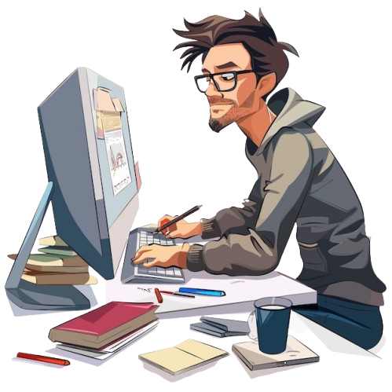
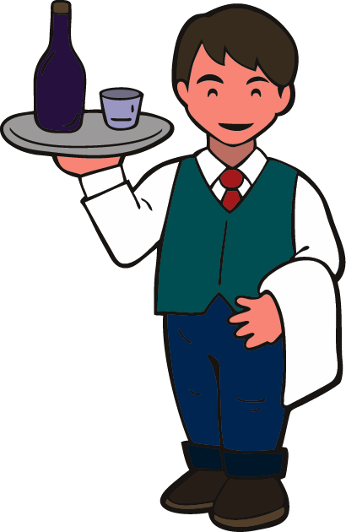
Matching Exercise
animator | waiter | director | secret

Slide 15
Matching Exercise
director | secret | animator | waiter

Slide 16
TRUE OR FALSE
1. Marinette is scared of cats.
2. Jagged Stone will attend the movie premiere.
3. Chloé will serve at the premier.
4. Marinette made Jagged Stone's sunglasses.
5. Kagami scolds Chloé.

Slide 17
TRUE OR FALSE
1. Marinette is scared of cats. | FALSE
2. Jagged Stone will attend the movie premiere. | TRUE
3. Chloé will serve at the premiere. | FALSE
4. Marinette made Jagged Stone's sunglasses. | TRUE
5. Kagami scolds Chloé. | TRUE

